Slide 1
Age-Friendly Health Systems & Age-Friendly Health Community Overview McCook, Nebraska
November 2024

Slide 2
Objectives
Explore the three roles of Age-Friendly Health Communities. Gain an understanding how the three areas work together for the good of the elderly patient.
Learn the implementation process and goals of community-wide implementation of Age-Friendly Health Communities.
Gain first had insight from participating community- McCook, Nebraska.

Slide 3
Age-Friendly Health System Partners
Age-Friendly Health Systems is an initiative of The John A. Hartford Foundation and the Institute for Healthcare Improvement (IHI) in partnership with the American Hospital Association (AHA) and the Catholic Health Association of the United States (CHA).

Slide 4
Goals of an Age-Friendly Health System
The Aim of the Age-Friendly Health System is to:
Guide by an essential set of evidence-based practices (4Ms)
Cause no harms
Align with What Matters to the older adult and their family

Slide 5
The 4Ms of Age-Friendly

Slide 6
Age-Friendly Health System, Now What?
“What’s Next?”
Understanding of Age-Friendly need and use in a community setting, but unsure how to move forward.
Areas of concern:
Implementation Process
Goals and Outcomes
Community Resources
Roles in the Community
Lack of Resources/People
Who to Involve and How

Slide 7
Age-Friendly Health System into Age-Friendly Health Communities
Through working with various hospitals, clinics, nursing homes, IHI, AHA, and various other entities, NHA found the goals of the Community implementation of Age-Friendly need to be:
Clear to Understand
Have framework, but be able to customize based on community
Clear goals
No extra work to the community or businesses participating
Be able to identify resources in a community

Slide 8
Age-Friendly Health Communities

Slide 9
Nebraska Age-Friendly Health Communities
What is an Age-Friendly Health Community?
The concept of Nebraska age friendly health communities is built on the principles of coordination and communication between the health partners involved in all aspects of the elderly patient. By using evidences-based practice, streamlined processes, and opportunity identification, Health Communities better the holistic care provided to the elderly population and help drive change to lead to a more inclusive and complete community.
Who is involved?
The Age-Friendly Health Community is made of three main partners: Age-Friendly Health Systems, Age-Friendly Health Partners and Age-Friendly Community Partners.
What is the goal of Age-Friendly Health Communities?
By coordinating the referral process, resource list, and communication structure, the goal is to increase the overall health care for elderly patients in that community setting and identifying areas of opportunity.
What are expected outcomes?
By implementing a streamlined approach, facilities and communities can expect to have a streamlined referral process, increased health outcomes from elder adults, and a more involved community.
How to join?
To being the process, contact NHA

Slide 10
Age-Friendly Health Community & Partners
Age-Friendly Health System
Consists of hospitals, nursing homes, primary care clinics
Age-Friendly Health Partners
Consists of dental offices, vision clinics, home health, etc. (any health provider not able to be AFHS)
Age-Friendly Community Partners
Consists of community businesses, programs, and groups
Implements 4M’s in the facility with hands on patient care
Refers patients to needed resources within the community (community partners and health partners)
Using 4M’s and coordinating care, health systems can improve patient outcomes and reduce facility burden
Learns about the 4M’s and implements one of the 4M’s in the facility with hands on patient care
Refers patients to needed resources and health services within the community (health systems and health partners)
Becomes a more involved health plan of the elderly patients
Learns about the 4M’s
Refers patients to needed resources and health services within the community (health systems and health partners)
Actively engages the health teams in a community to fully implement patient-centered care in a community

Slide 11
Group
Who is in the Group
Requirements for Group
Outcomes
Age-Friendly Health System
Hospitals
Nursing Homes
Clinics
Must complete AF process
Each community needs at least one of each (if possible)
Attend quarterly meetings
Track/trend data
Consistent patient care with implementation of 4M’s
Decrease errors
Increase patient outcomes
Age-Friendly Health Partners
Dental Clinic
Dialysis Centers
Health Departments
Vision Centers
Pharmacy
Home Health
Must go through AF process training
Implements a minimum of one M
Attend quarterly meetings
Track/trend data
Consistent screening of patients
More involvement in patient care
Better patient outcomes
Age-Friendly Community Partners
Senior Centers
Agency on Aging
Local Stores
Churches
Must go through AF process training
Attend quarterly meetings
Track/trend data
Understands 4M’s
Improvement in community resource for the elderly
Involvement in healthcare within community

Slide 12
How to Become a Health Community?
Set up Age-Friendly groups
Age-Friendly Health Systems
Age-Friendly Health Partners
Age-Friendly Community Partners
Identify elderly resources in your area
Use community partners, health department, and other community groups to identify resources
Use the resource template or your own
Give community access to the resource list (online, public access points)
Referral process
Implement a standardized process
Use the referral template or your own template/process
Set goals and outcomes
Consider both health care related and non-healthcare outcomes and metrics
Set quarterly community health meetings and team
Follow up and make changes/implementations based on the data and feedback from the elderly population

Slide 13
Why Age-Friendly Health Community
Increased communication among community members and health care team members.
Community involvement in health care.
Identification of community resources and/or lack of resource areas.
There is evidence of a strong association between higher continuity of care and reduced mortality rate, complication risks and health service utilization among DM and/or HT (BMC Family Practice, 2021).
Improving continuity of care in general practice is associated with positive outcomes for patients, GPs and the wider health system, such as fewer hospital admissions and higher patient satisfaction (health.org.uk, 2023).

Slide 14
References and Resources
Health Equity Toolkit (Nebraska Hospital Association)
Age-Friendly Links (Nebraska Hospital Association)
Institute for Healthcare Improvement
American Hospital Association
Monthly State Calls by NHA
Monthly Cohort Education by IHI and AHA

Slide 15
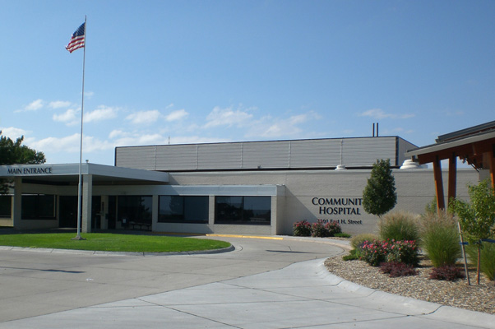
Age-Friendly Health Community Partner
Charlotte Marks from Community Hospital in McCook, Nebraska.
Charlotte has been the lead for the community since the start in January of 2024.
McCook’s AFHC group consists of 5 to 8 members.

Slide 16
Age-Friendly Health Community Partner Questions
Can you please give a brief overview of the implementation process from your point of view?
How did you decide to initially include in your core group and who is in it?
What has been the biggest surprise/ learning point since your community has started?
What has been your biggest challenge?
What advice do you have for communities looking to start this program?
What outcomes have you seen so far?
What are the next steps for McCook?

Slide 17
Questions?
Matt Lentz RN, MSN
Quality Consultant
Nebraska Hospital Association
3255 Salt Creek Circle, Suite 100 | Lincoln, NE 68504
(402) 382-8025 (cell)
mlentz@nebraskahospitals.org

