Slide 1
Module G
Patient Safety
Carla Snyder, MT(ASCP)SBB, MHA, CPHQ
Emily Barr, OTD, MBA, OTR/L, BCG
Notes:
Emily and Carla

Slide 2
Objectives
Describe the impact of “To Err is Human” on the modern patient safety movement, including federal and state regulations and the PSO program
Discuss the role of organizational culture and safety culture in quality and patient safety improvement
Discuss the role of leadership in building a culture of safety
Define safety culture in terms of levels, categories, and key components
Explain how and why to conduct a safety culture assessment
Identify four types of interventions that support safety culture
Discuss how knowledge of human factors leads us to use systems thinking and high reliability principles
Describe the hierarchy of the strength of interventions
Discuss pre-work assignment and provide contextual support for patient safety for residency participants
Identify strategies and resources to improve patient safety and quality in healthcare organizations
Notes:
Emily

Slide 3
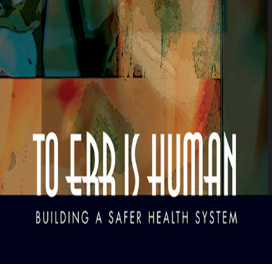
Institute of Medicine Report, “To Err is Human” 1999¹
Helped begin the Patient Safety Movement and prompted the passage of important legislation
Outlined 4 strategies for improvement
Establish national focus and enhance knowledge base about safety
Encourage health care providers to participate in voluntary reporting systems
Raise expectations for improvements in safety
Improve culture and systems in health care organizations for safer healthcare delivery
PCAST Report Update
Notes:
Emily
Brought the public’s attention to the problem of preventable medical error in the U.S. healthcare system
The key areas of the strategy relate to
improving knowledge about patient safety, (including establishing a national center for pt safety within AHRQ)
establishing voluntary provider reporting, (called for laws to protect confidentiality of reporting)
raising the bar for what we expect, and (and professional societies should be leaders in encouraging and demanding improvements in patient safety)
improving the safety of health care delivery at the front lines. (through development of culture of safety, focus on reliability and systems improvement.)

Slide 4
Federal and State Laws and Regulation
Patient Safety and Quality Improvement Act (PSQIA) of 2005³
Established voluntary reporting system for healthcare providers to enhance data about quality and patient safety issues
Provides Federal privilege and confidentiality protections for Patient Safety Work Product
Authorizes AHRQ to list Patient Safety Organizations
Patient Safety Rule published in 2008 implements PSQIA
Provides the requirements for PSOs to be listed under AHRQ oversight
Describes privilege and confidentiality protections
Establishes framework for HHS to monitor compliance with PSO program, confidentiality provisions, impose penalties, etc.
AHRQ does not provide funding to individual PSOs
Notes:
Emily

Slide 5
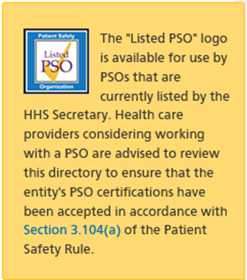
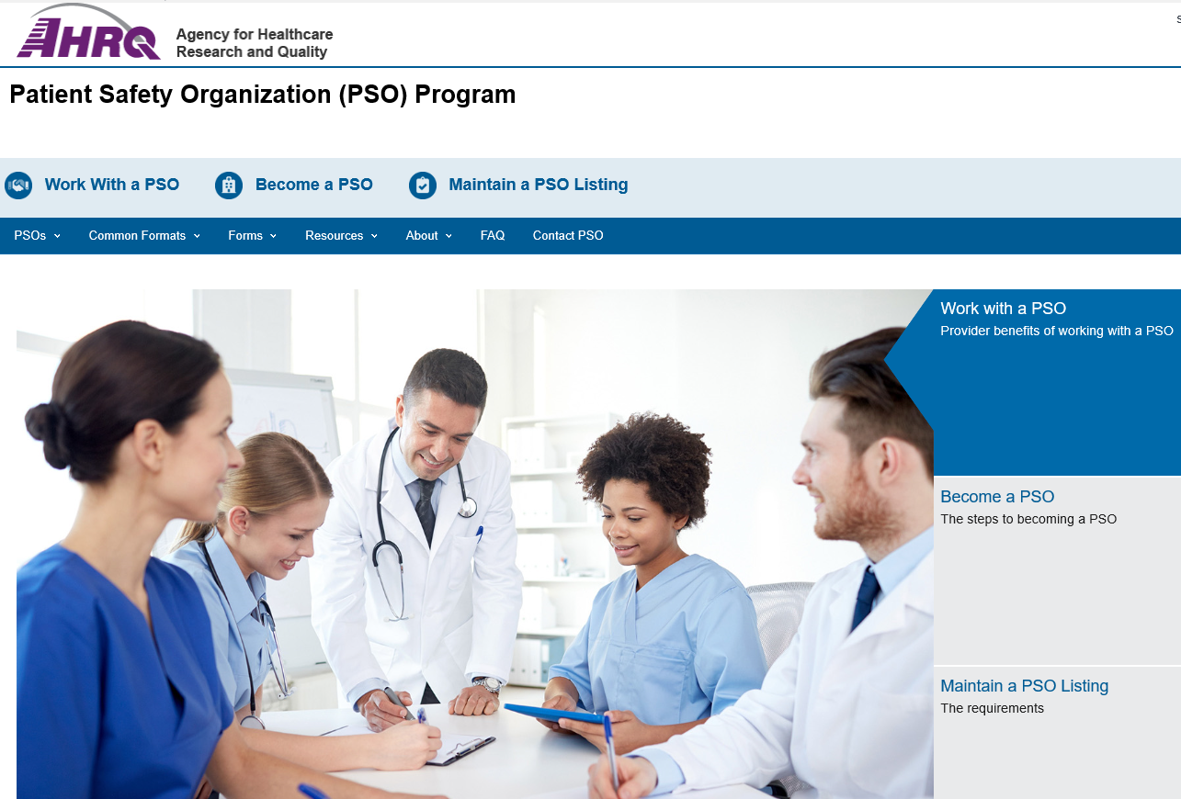
AHRQ PSO Program
https://pso.ahrq.gov/
Notes:
Emily
To be listed with AHRQ, a PSO must meet certification for listing requirements initially and every three years. Excellent information about the AHRQ’s PSO program is freely available on their website, including a list of PSOs across the US which meet the listing requirements of AHRQ. There are currently 103 listed PSOs.

Slide 6
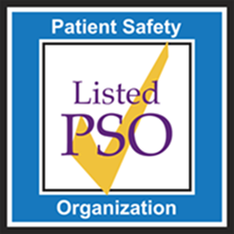
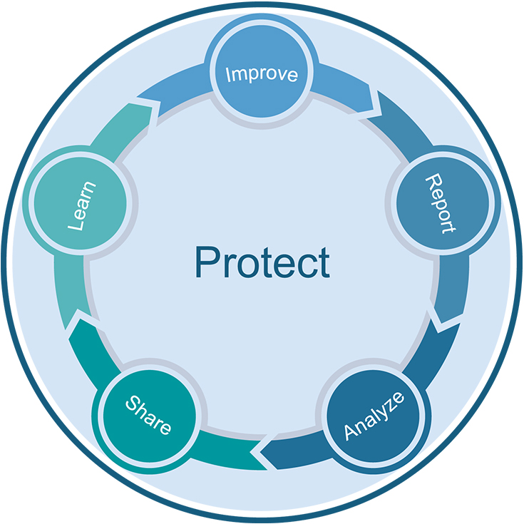
Why work with a PSO
Working with a PSO provides a safe and protected environment in which to report, analyze, and share information about patient safety events so they can be learned from and improvements can be made to reduce the risk of patient harm.
These privilege and confidentiality protections can only be achieved by working with a federally-listed PSO.
Protect – Report – Analyze – Share – Learn – Improve
Notes:
Emily

Slide 7
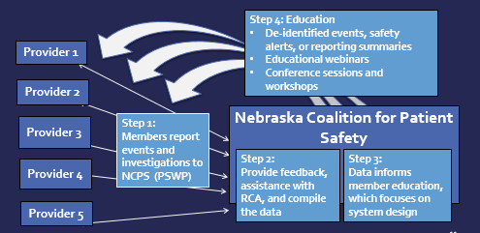
How NCPS Works with Member Organizations
Notes:
Emily
This graphic shows the information flow for NCPS’ PSO:
Providers report patient safety events to NCPS and they become privileged as Patient Safety Work Product.
NCPS provides feedback, assistance with investigations, and aggregates data from the reports.
The data is analyzed and is used to develop shared learning reports, education, and training, which is provided to NCPS members as part of the feedback loop.
These Patient Safety Activities are conducted within the confidential and protected Patient Safety Evaluation Systems of both the providers and PSO.

Slide 8
Nebraska Coalition For Patient Safety PSO
Nebraska’s only federally listed PSO
Complies with state and federal regulations
Meets AHRQ listing requirements and is reviewed every 3 years
Non-profit 501C3
Funded by member fees, sponsor contributions, some grants.
Governed by board of directors with representation from parent organizations, other state professional organizations and consumers
Workforce of 2.5 FTEs – Executive Director, Program Director and Patient Safety Statistician
Located on UNMC campus via a services agreement for facilities, administration, HR, and IT support.
https://www.nepatientsafety.org/
Notes:
Emily

Slide 9





NCPS Founders
Nebraska Coalition for Patient Safety formed in 2006 through collaboration of:
Nebraska Academy of Physician Assistants
Nebraska Hospital Association
Nebraska Medical Association
Nebraska Nurses Association
Nebraska Pharmacists Association
Representatives from these organizations serve on NCPS Board of Directors
Notes:
Emily
As a result of the Nebraska Patient Safety Improvement Act, five Nebraska professional organizations came together to form NCPS in 2006, answering IOM’s call to action for professional organizations to be actively engaged in patient safety improvement.

Slide 10
NCPS Goals
Provide protection for reporting
Event investigations that meet the definition of Patient Safety Work Product are made privileged and
confidential when reported to a PSO.
Learn from reported events
Learning from event review and data aggregation informs the development of feedback, training, and
education.
Share learning
As an integral component of the patient safety learning system, products such as de-identified events,
patient safety alerts, and reporting summaries are provided to members.
Offer resources
Members receive feedback on events, root cause analysis support, information about evidence-based
best practices, and patient safety culture development.
Provide education and training
Offerings include quarterly member education, annual RCA training, and conference sessions specific to
patient safety.
Notes:
Emily

Slide 11
Check-in For Relevance
How many of you were aware of state regulations protecting quality and patient safety improvement information? Where could you look to find that information? Who could help?
How many of you know whether or not you are working with a PSO? What are the benefits? What questions do you have about working with a PSO?
What other questions do you have? What additional information do you need?
Notes:
Emily

Slide 12
Organizational Culture
Shared assumptions learned by a group as they solve problems that originate in external and internal environments
Norms and behaviors that are taught by leaders (designated and situational) that define how to think and feel about those problems
(Schein, 2010)
Notes:
Carla
We’re now going to talk about the roles of organizational culture and safety culture in quality and patient safety improvement

Slide 13
Safety Culture
Shared values, norms, and behaviors related to patient safety among members of an organization (Weaver et al., 2013)
These values, norms, and behaviors reflect
Relative importance of patient safety as compared to other organizational goals such as productivity (Zohar, 1980)
Your organization’s willingness to learn from experience (Wiegmann, 2002)
Notes:
Carla

Slide 14
Four Beliefs Present In a Strong Safety Culture
Our processes are designed to prevent failure
We are committed to detect and learn from error
We have a just culture that disciplines based on risk taking
People who work in teams make fewer errors
(IOM, 2004)
Notes:
Carla

Slide 15
Safety Culture: A specific type of organizational culture
Organizational Culture
Allows us to make sense of our environment
Reflects common language… is heard and observed
Leaders create/teach culture by how they
Share information
Reward, provide feedback
Hold people accountable
Safety Culture
A cross cutting contextual factor that moderates effectiveness of patient safety interventions (Weaver et al., 2013)
Notes:
Carla
A safety culture is a certain type of organizational culture. This culture impacts your total organizational culture.
1. Schein, E.H. Organizational Leadership and Culture 4th ed. San Francisco: John Wiley & Sons; 2010.
2. Weaver SJ, Lubomski LH, Wilson RF, Pfoh ER, Martinez KA, Dy SM. Promoting a culture of safety as a patient safety strategy: A systematic review. Ann Int Med. 2013;158:369-374.

Slide 16
Role of Leadership
Joint Commission Sentinel Event Alert # 57: The essential role of leadership in developing a safety culture
Leadership’s first priority is to be accountable for effective care while protecting the safety of patients, employees, and visitors.
Leadership commitment to creating and maintaining a culture of safety is just as critical as the resources devoted to financial stability, system integration, and productivity.
Maintaining a safety culture requires leaders to consistently and visibly support and promote everyday safety measures.
Leaders must understand that systemic flaws exist and each step in a care process has the potential for failure simply because humans make mistakes.
https://www.jointcommission.org/resources/patient-safety-topics/sentinel-event/sentinel-event-alert-newsletters/sentinel-event-alert-57-the-essential-role-of-leadership-in-developing-a-safety-culture/
Notes:
Carla
Whether your organization is Joint Commission accredited or not, this is a good list for the actions leadership need to take in order to develop a safety culture
Needed Leader Actions:
first priority is ensuring effective care while protecting patients, employees, and visitors
allocating resources so a culture of safety is created/maintained; equally as important as resources needed for financial stability, system integration, ad productivity.
consistently and visibly support and promote everyday safety measures
this last bullet point is the basis of a Just Culture

Slide 17
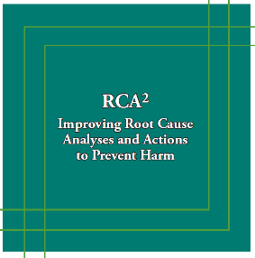
Leadership Involvement in the RCA² Process
Understand and actively support the process
Ensure the RCA team has the resources it needs – time, training, tools - to carry out the process
Approve and review action plans for effectiveness
Understand what a thorough RCA² report should include
Act when RCA reviews are not effective and credible
Annually review the RCA process
NPSF/IHI. RCA2: Improving root cause analyses and actions to prevent harm. Boston: 2015
IHI RCA2 guide: http://www.ihi.org/resources/Pages/Tools/RCA2-Improving-Root-Cause-Analyses-and-Actions-to-Prevent-Harm.aspx
Notes:
Carla
In addition to support for the overall quality and patient safety programs, leaders need to understand and support event investigations and fostering a just and fair culture. The IHI guide for RCA2 is publicly available and is a great resource.
The IHI RCA squared guide outlines leadership responsibilities specifically related to RCAs and we have those summarized here for you..
No matter what size organization you are working in, whether you are in a small rural health clinic, a critical access hospital with 15 beds, or a large healthcare system, these leadership responsibilities with regard to the RCA process will not change.

Slide 18
Check-in For Relevance
Does your organization have a quality/risk management plan?
Who is ultimately accountable for the quality of care and safety of patients at your organization?
How does leadership demonstrate commitment to patient safety?
How is leadership and the board informed of how you are doing with quality improvement and patient safety? What metrics are reported to the board? How often and by whom?
What success stories can you share? What challenges are you facing?
Notes:
Carla

Slide 19

Organizational Culture
Three levels of organizational culture…
“the way we do things around here”
Observable behavior
Values
(Schein, 2010)
Underlying assumptions
https://www.continuitysa.com/beware-iceberg-business-continuity-important-not-outsource/
Notes:
Carla
The foundation of organizational culture is our underlying assumptions. These unconscious assumptions dictate our beliefs and values
What we say is important to us, our values, is the second level of organizational culture.
What you expect is that our observed behaviors—the third level-- would be consistent with what we say our beliefs and values are.
As we all know, an organization’s true culture is found after you’ve worked there for a while and discover “the way we do things around here”

Slide 20
Why is it important to recognize the three levels of culture?
A gap often exists between our observed behaviors and our values/beliefs! (Schein, 2010)
Example: We know we should get at least 7 hours of sleep every night, yet we stay up late or get up early to catch up on work or have time to self and don’t regularly get the needed nightly 7 hours.
Teachable, learnable tools and strategies can bridge this gap
Notes:
Carla
In the work Edgar Schein did on organizational culture, he found that too often our values reflect the behaviors we would like to see, NOT what we actually see.

Slide 21
Three Levels of Culture
Behaviors
Beliefs & Values
Underlying Assumptions
Behavior consistent with Belief:
50% agree, “Staff feel free to question decisions or actions of those with more authority.”*
Communication Openness Belief:
79% agree, “Staff will freely speak up if they see something that may negatively affect patient care.”*
Assumption: Safety is a system property. Thus, we should voice our concerns about patient safety.
“…in many organizations, values reflect desired behavior but are not reflected in observed behavior.” (Schein, 2010, pp. 24, 27)
*50th percentile response from 630 hospitals reporting to AHRQ 2018 National Database
Notes:
Carla
Here is an example that we often see in HSOPS results.
An underlying assumption among your staff is that safety is a system property and that fallible human beings work within that system.
If so, then they will value teamwork as a safety net and likely state that they support one another.
Another example of this gap is evidenced with data from the HSOPS National Database which indicates that on average, 86% of HSOPS respondents agree, “People support one another in this unit.” However, if we were to observe a unit, we might find that nurses and therapists who experience a sudden increase in their workload try to work faster as individuals and cut corners rather than call for a huddle to adjust the plan or ask for task assistance or debrief to learn from what happened. Data from the HSOPS National Database indicates that on average , 69% of HSOPS respondents agree, “When one area in this unit gets really busy, others help out.” This concept that a gap often exists between beliefs and behaviors is very useful when interpreting HSOPS results.

Slide 22


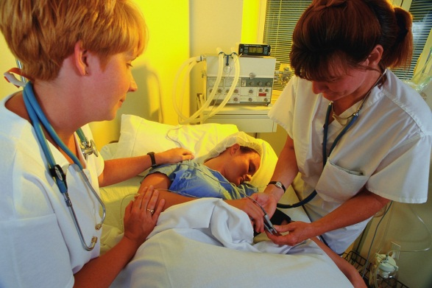

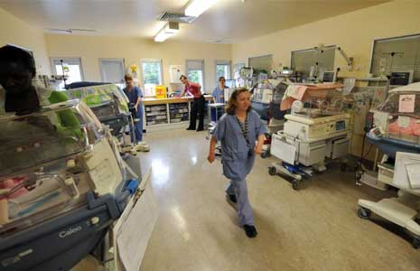
Four Categories of Organizational Culture (Schein, 2010)
Macroculture
Organizational Culture
Professional Subcultures
Unit/Dep’t. Microcultures
Notes:
Carla
Who drives your culture? Your most immediate supervisor. That leader either sets out to engineer, create or develop a culture of safety, or the culture runs them. HSOPS (9 of 12) measure culture at department level and 3 measure the organization as a whole.
Edgar Schein defined four overarching categories of culture:
Macroculture
Organizational Culture
Subculture…which reflects the varying culture of different professions
Microculture
Our national culture arises out of values or beliefs
Our organizational cultures are primarily shaped by shared practices or behaviors…what we do…
Each organizational culture is shaped by the professional subcultures of its personnel…physicians, surgeons, nurses, allied health, managers, and administrators all have different cultures based on their unique beliefs and behaviors.
Culture varies among departments and units and even shifts within units.
Your organizational culture is really a patchwork quilt made up of unit and department microcultures.

Slide 23
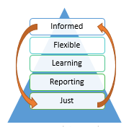
Five Components of Safety Culture (Reason, 1997)
Informed – safe, highly reliable organization
Flexible – the organization changes processes and systems to improve; team communications are optimized; there is psychological safety to speak up about safety related information
Learning – information from reports is used to understand risk in the organization and how systems and processes can be improved (includes RCAs)
Reporting – staff feel safe to freely report errors and unsafe situations; they understand how the information is used
Just –there is a fair, transparent, consistent system of managing events, demonstrating a shared accountability between system design and behavioral choices
Reason, J. Managing the Risks of Organizational Accidents. Hampshire, England: Ashgate Publishing Limited; 1997.
Notes:
Carla
Based on James Reason’s work, we can think about safety culture as being made up of four key components.. which are interactive and dynamic
A Just Culture is foundational component of a robust culture of safety. We’ll talk more in depth a little later about Just Culture. For now consider that just culture focuses is on system design and safe choices.
People then feel safe to report events – they know they will be treated in a just and fair manner and they understand how the information is used – that it will be used for learning and improvement– and they trust that system.
Learning - information from reports is used as a window to understand risk in the system. Conducting Root Cause Analysis is one of the methods an organization uses to learn–
Flexible behaviors make an organization adaptable and resilient – the organization changes processes and systems to improve; - this includes RCA action plans
As these components of safety culture are strengthened, the organization moves toward a safe, informed, highly reliable organization. An informed culture is needed to achieve high reliability. High reliability organizations are “mindful” ….they are….
preoccupied with failure
sensitive to how each team member affects a process
allows those who are most knowledgeable about a process to make decisions, and
resists the temptation to blame individuals for errors within complex processes

Slide 24
Check-in For Relevance
Have you heard of Just Culture? Do you have any experience with this concept?
What kind of event reporting system do you have? How are event reports used?
Have you been involved in a Root Cause Analysis? How did it go?
Why is it important to learn from events? Why is it important to share the learning with staff?
Notes:
Carla

Slide 25
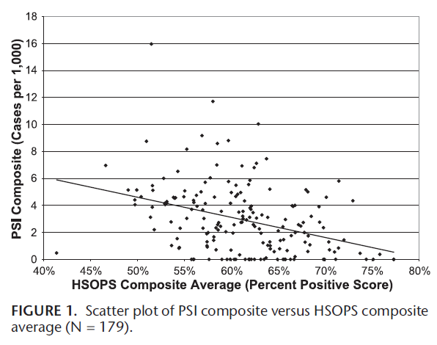
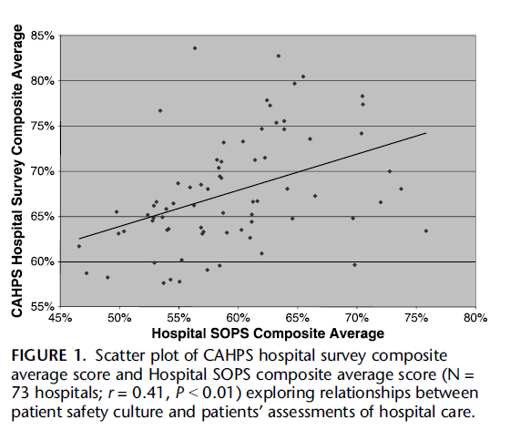
Safety Culture As An Indication of Patient Safety & Patient Experience
Mardon RE, 2010
Sorra, J. 2012
Higher composite HSOPS scores are associated with fewer adverse events; Joint Commission’s Sentinel Event Database indicates that leadership’s failure to create an effective safety culture is a contributing factor to adverse events
“….behaviors and attitudes [of hospital employees] can directly affect the pain, discomfort, health, and recovery of patients.”
Notes:
Emily
There is evidence which shows that HSOPS scores reflect patient safety and patient experience.
On the left is a graph of the incidence of patient harm events and HSOPS composite scores. You can see as the composite score for HSOPS goes up, the # of adverse events goes down. This work was published in 2010 by Mardon RE, Khanna K, Sorra J, Dyer N, Famolaro T. Exploring relationships between hospital patient safety culture and adverse events. J Patient Saf 2010;6: 226-232
Joint Commission’s Sentinel Event data base also shows a greater number of adverse events in organizations with weak safety culture. Joint Commission reference available at: https://www.jointcommission.org/sea_issue_57/
On the right is a graph that plots the relationship between patient safety culture composite scores and patients’ assessment of hospital care. This work was published in 2012 by Sorra J, Khanna K, Dyer N, Mardon R, Famolaro T. Exploring relationships between patient safety culture and patients’ assessments of hospital care. J Patient Saf 2012;8: 131-139.
You can see the higher the culture of safety composite scores, the higher the patients’ ratings of the hospital on CAPHS.

Slide 26
Plan to Assess Safety Culture
Leaders should ensure your organization
Establishes a baseline measure of safety culture using the Agency for Healthcare Research and Quality (AHRQ) Hospital Survey on Patient Safety Culture (HSOPS)
Analyzes and shares results from the survey at the unit and job title level with front-line workers
Develops and implements action plans to address areas of weakness at organizational and unit-level
Re-assess safety culture every 18 – 24 months
(Joint Commission, 2017)
Notes:
Emily
The HSOPS was developed by AHRQ to provide healthcare organizations with a valid tool to measure safety culture. AHRQ supports a national comparative database of HSOPS results that allows benchmarking of results by hospital size, type of unit and profession.

Slide 27
Resources to Assess Safety Culture
Leaders should ensure your organization
AHRQ Hospital Survey on Patient Safety Culture (HSOPS) Toolkit available at:
https://www.ahrq.gov/sops/quality-patient-safety/patientsafetyculture/hospital/index.html
AHRQ National Comparative Database of HSOPS results for Benchmarking available at:
https://www.ahrq.gov/sops/quality-patient-safety/patientsafetyculture/hospital/hosp-reports.html
630 hospitals; 382,834 respondents in 2018 database
Notes:
Emily

Slide 28
Additional Surveys AHRQ has Developed
Practice Setting Specific
Medical Office
Nursing Home
Community Pharmacy
Ambulatory Surgery Center
Supplemental Item Sets
Hospital Health Information Technology Patient Safety
Hospital Value and Efficiency
Hospital Workplace Safety
Medical Office Diagnostic Safety
Medical Office Value and Efficiency
Nursing Home Workplace Safety
Notes:
Emily

Slide 29
Goals of Safety Culture Assessment
Identify areas of culture in need of improvement
Identify impairments in organizational learning
Create road map for improvement of infrastructure that supports all safety and quality initiatives
Increase awareness of patient safety concepts
Evaluate effectiveness of patient safety interventions over time
Conduct internal and external benchmarking
Meet regulatory requirements
Identify gaps between observed behaviors and values/beliefs within subcultures and microcultures
(Schein, 2010; Jones et al., 2008; Nieva & Sorra, 2003)
Notes:
Emily

Slide 30
How to Conduct SOPS
Leaders should ensure your organization
AHRQ resources to help you conduct the survey directly in your organization: https://www.ahrq.gov/sops/surveys/index.html
Use a vendor to help you conduct the survey
Through NCPS because:
Uses principles of survey research to
Ensure adequate response rate > 50%
Accurately determine response rate
Ensure confidentiality of respondents
Correctly code reverse-worded survey items
Customizes survey demographics to ensure accurate assessment at level of Work Area (microcultures) and Job Title (subcultures)
Provides a report to assist in understanding results and implementing strong action plans for improvement based on evidence-based interventions
Notes:
Emily

Slide 31
Check-in For Relevance
Has your organization conducted SOPS? Do you have access to the results? What did you find?
What resources are available to you to conduct SOPS?
Share your experience and thoughts. What challenges do you face?
Notes:
Emily

Slide 32
Interventions Which Support a Culture of Safety
Just Culture
Event Reporting
Learning
Team Strategies and Tools to Enhance Performance and Patient Safety (TeamSTEPPS®)
Notes:
Emily
Here are 4 key interventions which support/forward a culture of safety

Slide 33
Just Culture
Algorithm-based decision-making to manage behavior: human error, at-risk, reckless
Shared accountability: employees accountable for their behavior; management accountable for systems
Human
Error
At-Risk
Behavior
Reckless
Behavior
Choice that increases risk where risk is not recognized or believed to be justified
Inadvertently doing other than what was intended: a slip, lapse, mistake
Choice to consciously disregard a substantial and unjustifiable risk
Console
Coach
Punish
Notes:
Emily
When we talk about just culture we are really talking about a system of workplace justice. One that is transparent, consistent, and fair.
It holds the organization (leaders) accountable for the systems it puts into place and the employees for making safe choices within those systems.
The management of the behaviors within the system must be consistent and objective (as possible).
It uses tools, such as the just culture algorithm and structured methods of event investigation to support the consistent approach across the organization.

Slide 34
Event Reporting
organization
“The reporting of safety events can be facilitated through a well-developed error reporting system that is easy to use and can track improvement in reducing both errors and near misses. Hospital leaders can promote reporting by providing sufficient feedback and engaging those who take the time to report errors.” (Campione et al., 2018, p. 29)
Formal Reporting of adverse events with standardized taxonomies (e.g. NCC-MERP A – I Error Severity Taxonomy; medication errors by type and phase of origin; assisted and unassisted falls)
Near misses and non-harmful errors are frequently reported, valued, and learned from
Informal Reporting – Safety Briefings and Leadership WalkRounds to leverage frontline expertise
(Institute for Healthcare Improvement, Singer et al., 2013)
Successful Reporting Systems
Nonpunitive
Confidential
Independent
Expert analysis
Timely
Systems-oriented
Responsive
(Leape, 2002)
Notes:
Emily
3 studies which looked at Event Reporting to see its possible impact on a culture of patient safety.
The upper left quote is from a 2018 study by Campione and Famolare where their goal was to gain knowledge about best practices to improve hospital-wide patient safety culture. They used HSOP’s results to find and then interview the 6 top performing hospitals so to identify common themes and best practices used by them.
For culture improvement they found 3 common actions:
- Goal setting and strong action planning for quality improvement
- Implementation of well-known patient safety initiatives and programs
- Rigorous survey administration methods
Common Best Practices included:
- Implementation of routine culture measurement with a wide dissemination of
results
- Strong action planning for improvement that includes leadership support and involvement from all staff levels
- Multifaceted patient safety programs and education
Singer’s study was done at an East coast-based VAMC, which are typically more hierarchical, and was piloting a program to engage senior leaders with the work-systems challenges faced by frontline workers and ensuring follow-up and accountability for systemic change.
Lucian Leape wrote a Health Policy Report for the New England Journal of Medicine in 2002 which focused on the inadequacy of the then current error reporting requirements/systems and advocating for a National Voluntary Reporting system. In that piece he noted these characteristics of a successful reporting system.

Slide 35
Learning Interventions
organization
Team-based meetings (briefs, huddles, debriefs)
Process Mapping (Colligan et al., 2010)
Individual Root Cause Analysis (Institute for Healthcare Improvement)
Aggregate Root Cause Analysis (Neilly et al., 2003)
Failure Modes and Effect Analysis (VA National Center for Patient Safety)
Safety Briefings and Leadership WalkRounds (Institute for Healthcare Improvement)
Leveraging Frontline Expertise (Singer et al., 2013)
Close the loop with reporting… provide feedback to frontline
Notes:
Emily
“Ultimately, the willingness of workers to report depends on their belief that the organization will analyze reported information and then implement appropriate change—organizational practices support a learning culture.” (Reason, 1997)

Slide 36
Leveraging Frontline Expertise
The Leveraging Frontline Expertise (LFLE) Cycle
The foundation of all safety culture interventions
Information Gathering
Prioritization
Follow-Up
Feedback Communication
Leaders engage the frontline to learn from and with them about system problems
Leaders hold frontline accountable for implementing and sustaining mutually agreed upon change
(Singer et al., 2013)
Notes:
Emily
Learning from the frontline is the foundation of patient safety culture. Open communication between frontline and leadership.
Add Deming philosophy – those who are doing the work know best how the work is done.

Slide 37
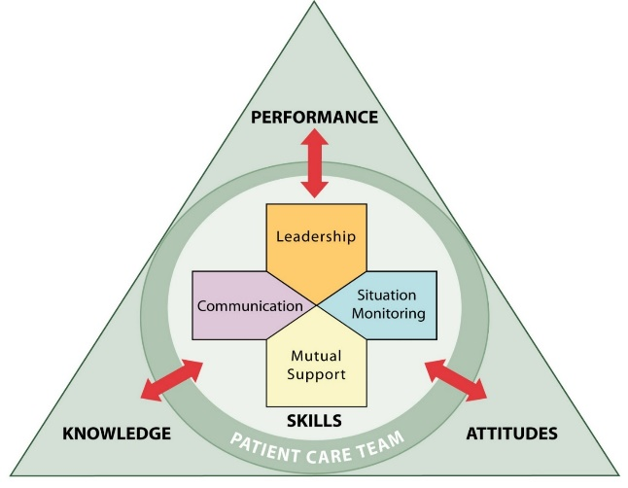
TeamSTEPPS® (Team Strategies and Tools to Enhance Performance and Patient Safety)
Evidence-based team training program
Developed by the Department of Defense and the Agency for Healthcare Research and Quality
Builds on 30 years of research on teams and team performance in high-risk areas in which poor performance may lead to serious consequences or death (e.g. aviation, the military, nuclear power, and healthcare)
TeamSTEPPS® support the flexible culture - The knowledge, skills, attitudes, language and coordinating mechanisms inherent in teamwork create the flexibility team members need to manage complexity and learn from experience. (Jones, et. Al, 2008)
Notes:
Emily
TeamSTEPPS is designed to optimize team performance across the healthcare delivery system by focusing on specific skills supporting team performance that empowers ‘experts on the spot’ to ensure all have a shared mental model.
Provides healthcare teams the capacity for resilience to adapt to ever-changing environments and needs – deference to expertise, regardless of title.

Slide 38
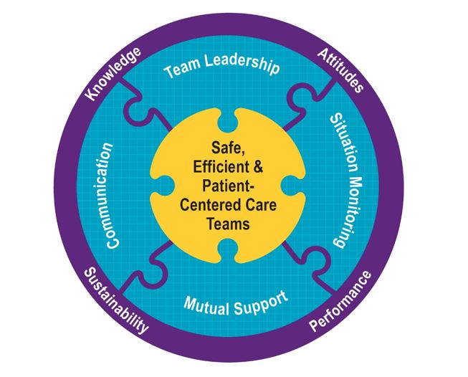
TeamSTEPPS®
Adopting team behaviors positively impacts all components of safety culture because teamwork supports learning. (Jones et al., 2013)
http://teamstepps.ahrq.gov
Notes:
Emily

Slide 39
Safety Culture Summary
Safety culture is the learned, shared beliefs and behaviors that reflect willingness to learn
Why is it important to devote resources to safety culture?
Improving safety culture increases likelihood of success of all other patient safety interventions
Safety culture is associated with adverse events and patient satisfaction
Use sound survey research methods to ensure your assessments of safety culture are valid
“If I had an hour to solve a problem I'd spend 55 minutes thinking about the problem and 5 minutes thinking about solutions.” ― Albert Einstein
Notes:
Emily

Slide 40
Safety Culture Summary
Implement evidence-based interventions within each key component of safety culture
Just culture
Effective reporting systems that capture near misses
Root cause analysis, Leveraging Frontline Expertise
Team training, implementation, and sustainment
Keep in mind the end goal…to understand and use what the frontline knows about the system to plan, implement, and sustain change
Notes:
Emily
Finally, remember we can often identify whether an item within a dimension is asking about a belief/value or a behavior/practice. We want to look for gaps between beliefs and behaviors within dimensions. We will identify evidence-based practices that can bridge those gaps and “engineer a culture of safety.”

Slide 41
Check-in For Relevance
Do the four components of a safety culture make sense?
What can you tell me about the culture of your organization (whether or not you have conducted a SOPS)?
Just and fair?
Reporting?
Learning?
Flexible?
What opportunities for improvement have you identified so far? What resources do you need?
Notes:
Emily

Slide 42
High Reliability, Systems Thinking and Human Factors
High reliability - consistent performance at high levels of safety over long periods of time
Used in high-risk organizations that manage extreme hazards in complex situation with success
Healthcare is a high-risk industry that can use High Reliability Organization (HRO) principles
Systems thinking and human factors engineering are inherent in HROs
Notes:
Carla
Commercial aviation, nuclear power and military aircraft carriers are examples of HROs
A classic example is that of the military aircraft carrier: despite significant production pressures (aircrafts take off and land every 48–60 seconds), constantly changing conditions, and hierarchical organizational structure, all personnel consistently prioritize safety and have both the authority and the responsibility to make real-time operational adjustments to maintain safe operations as the top priority https://psnet.ahrq.gov/primers/primer/31/high-reliability

Slide 43
HRO Principles
Preoccupation with Failure
Reluctance to Simplify
Sensitivity to Operations
Deference to Expertise
Commitment to Resilience
Notes:
Carla

Slide 44
Preoccupation with Failure
Everyone is alert and on the lookout for potential failures.
New threats arise unexpectedly and often.
The absence of errors or accidents does not lead to complacency.
Near misses are seen as opportunities to learn about systems issues and potential improvements, rather than as evidence of safety.
People feel safe to report small problems, so they won’t become big ones.
Notes:
Carla
How does this fit into what we’ve learning about a just culture and reporting culture?

Slide 45
Reluctance to Simplify
People resist looking for a simple answer or excuse for a problem.
People understand that the systems they work in are complex and dynamic.
Problems are analyzed for underlying explanations, rather than surface ones.
Curiosity and questioning of the status quo is encouraged.
Notes:
Carla
How does this fit into a learning culture? How does it fit into a just culture? How abut a flexible/team culture?

Slide 46
Sensitivity to Operations
There is “situational awareness” – people have an understanding of what is going on around them and how the current state may threaten safety.
People understand the “big picture” – the context of their work in relation to the unit, process flow or organization.
Resources are available for unexpected situations, changes in workload, etc.
AHRQ Patient Safety Network, 2019
Notes:
Carla
How does this fit into a flexible culture?

Slide 47
Deference to Operations
People closest to the work are the most knowledgeable about the work.
In a crisis or emergency, the person with greatest knowledge of the situation might not be the person with the highest status and seniority.
If something unexpected occurs, the most highly qualified people, regardless of rank, make the decision.
The organizational culture is such that all staff members are comfortable speaking up about potential safety problems.
AHRQ Patient Safety Network, 2019
Notes:
Carla
How does this fit into a flexible culture? A just culture?

Slide 48
Commitment to Resilience
People understand that system failures are often unpredictable.
People prepare for and practice assessing and responding to challenging situations.
Teams are cultivated through team training in skills such as situation assessment and cross monitoring so that potential safety threats can be identified and responded to quickly.
Events and potential threats are learned from to improve systems and processes so future problems and harm can be prevented.
AHRQ Patient Safety Network, 2019
Notes:
Carla
How does this fit into flexible culture? Learning culture?

Slide 49
Roadmap to HRO
Requirements to achieve high reliability:
Leadership commitment
Development of a culture of safety
Robust and ongoing improvement
Notes:
Carla
Looks simple, but we know that it isn’t. It starts with leadership commitment (or at the very least, support)! It is like any other performance improvement project in this way – measure, assess, action planning - continuous improvement. PDCA applied to patient safety.

Slide 50
Human Factors and Systems Thinking
The proposition is this: framed by the right systems of learning, the right systems of justice, we can design systems, and help humans make choices in those systems, to produce better outcomes at the individual, local, and societal level.
David Marx, Founder of Outcome Engenuity
Notes:
Carla

Slide 51
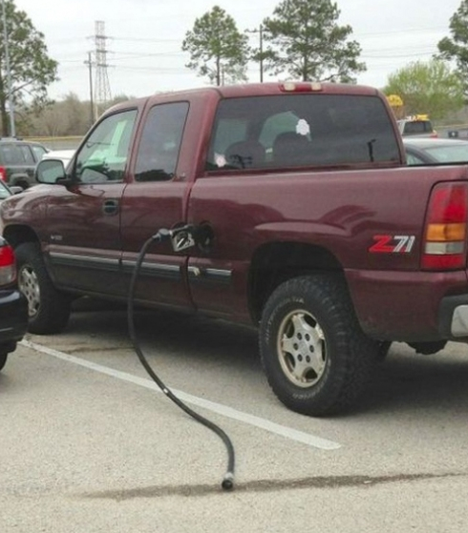
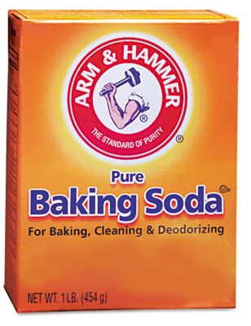
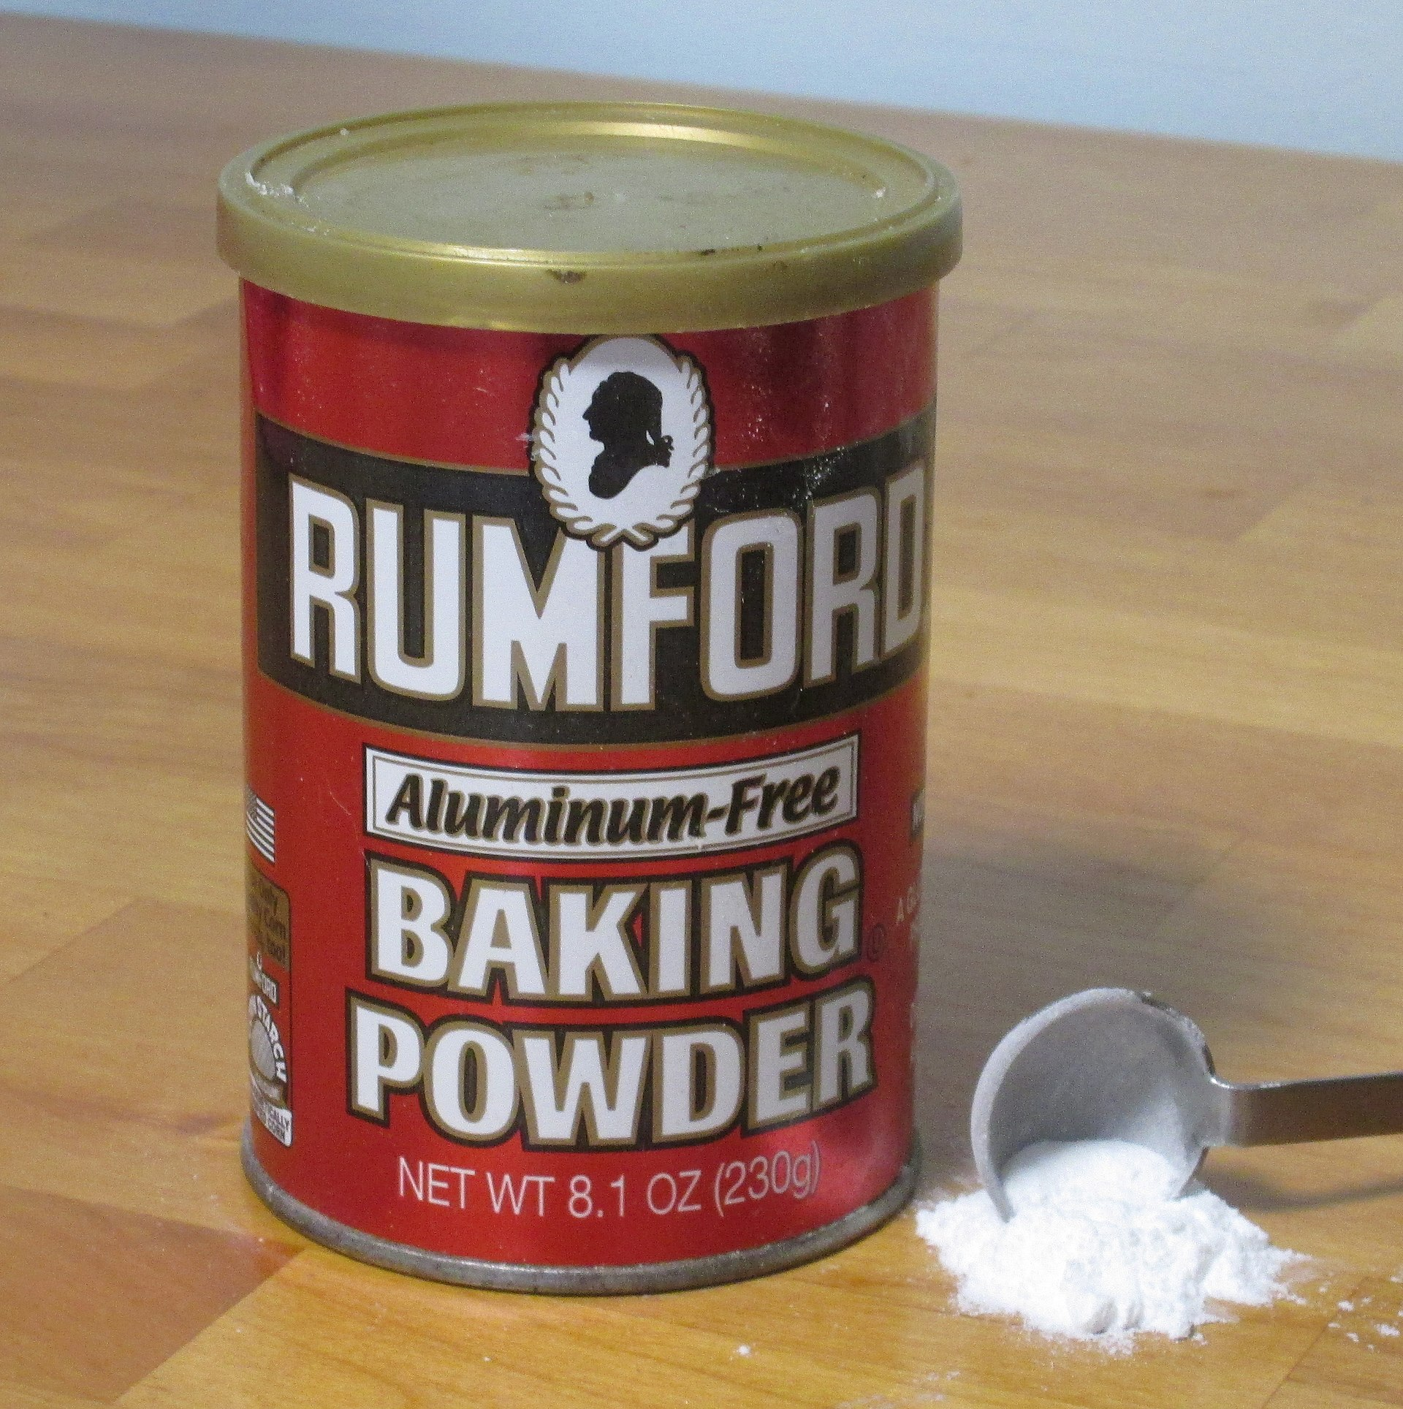
To Err is Human
This Photo by Unknown Author is licensed under CC BY-SA
Notes:
Carla
We are fallible human beings which we means we will make mistakes; we don’t have the intention to cause harm and yet we experience mental slips, lapses and mistakes. Attempts to keep human errors from happening should be built into systems to guard against human errors.
This slide depict common human errors and how systems have been built to mistake proof them:
Forgetting to remove the gas nozzle from your gas tank when you pump your own gas. (this has led gas stations to utilize detachable gas pump lines)
Packaging of leavening agents to help mistake proof choosing the wrong one when baking (baking soda in a cardboard, square box; baking powder in a metal, cylindrical canister)
Where are we one human error away from an outcome we cannot tolerate? Let’s find those weak spots and if we can…fix them before the bad outcomes.

Slide 52


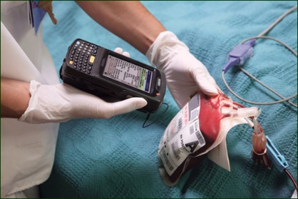
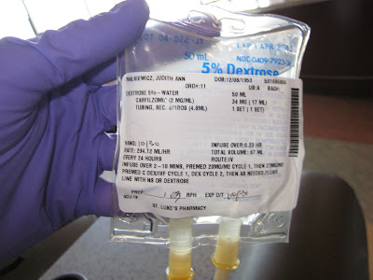
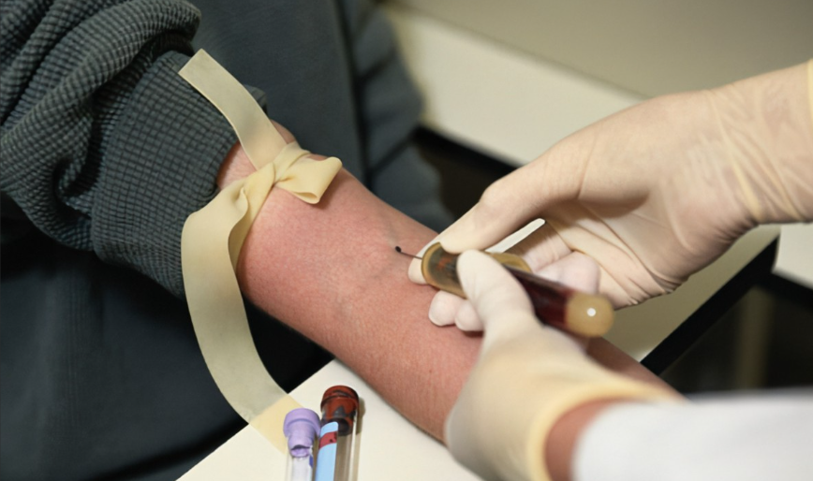

To Drift is Human
Notes:
Carla
It is human nature to drift away from strict procedural compliance and to develop unsafe habits for which we fail to see the risk.
Human behavior runs counter to safety because the rewards for risk taking (e.g., saved time) are often immediate and positive, while possible adverse outcomes (e.g., patient harm) are often delayed and remote. As a result, even the most educated and careful individuals will learn to master dangerous shortcuts, particularly when faced with an unanticipated system problem (e.g., technology glitches, time urgency).
Over time, the risk associated with these behaviors fades and the entire culture becomes tolerant to these risks. Individuals are not choosing to put patients in harm’s way; instead, they feel they are still acting safely. In fact, the more experienced you are at what you do, the less likely you are to recognize that you are in a risky situation when engaging in at-risk behavior. As a result, even the most educated and careful individuals will learn to master dangerous shortcuts, particularly when faced with an unanticipated system problem (e.g., technology glitches, time urgency).
Here are 2 examples of potential drift. What is your personal tolerance for exceeding a posted speed limit (by 5 or 10 or 15 miles/hr ? Failing to utilize barcoded patient ID bands though it is a recognized patient safety tool). We have received reports of patient harm in blood administration, medication administration, blood sample acquisition, and radiology procedures because though present the barcode technology was not used.

Slide 53

The P.I.D.A. Model
Decision-Making
Sight
Standard interpretation
(heuristics, mission focused)
Unconscious,
Automatic
Conscious,
Thoughtful
Sound
Smell
The
“Risk Monitor”
(background process, harm focused)
Taste
Touch
Level of Mental Effort
Low
High
Perception
Interpretation
Decision-Making
Action
Notes:
Carla
One of the useful concepts to understand how a person decides how to respond is the P.I.D.A. Model (Perception, Interpretation, Decision, Action).
Perception is how our 5 physical senses perceive what is going on around us.
Interpretation is how we interpret the signals. The Standard Interpretation is the fast thinking our brain does. These are the mental “short cuts” based on previous experiences and training which allow us to make decisions without having to think really hard so we can react expediently. Within each of us there is an internal “Risk Monitor” which subconsciously “checks” the interpretation we’ve just made for any potential “harm” we may have overlooked.
Decision-Making is based on our interpretation

Slide 54
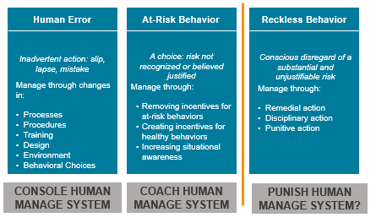
Three Core Human Behaviors
Notes:
Carla
Reference Just Culture Algorithms

Slide 55
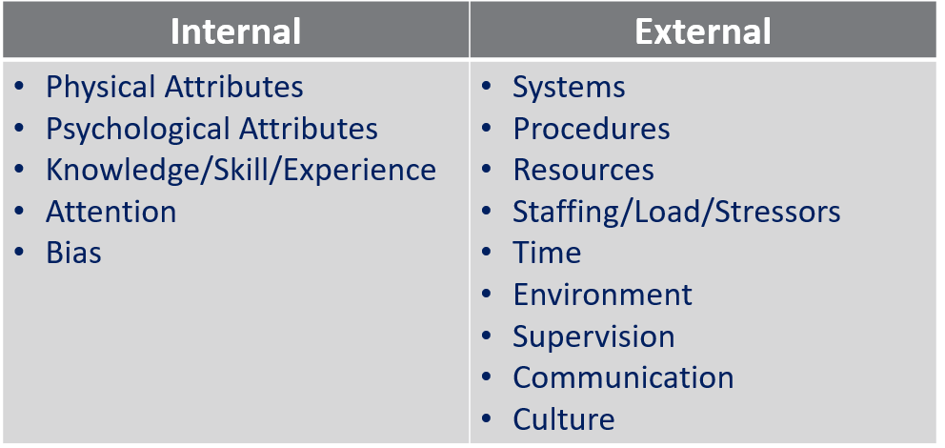
Human Performance Shaping Factors
Outcome Engenuity, 2018
Notes:
Carla

Slide 56
Systems Thinking
What is a “System”?
An organized, purposeful structure that consists of interrelated and interdependent elements (components, entities, factors, members, parts) that continually influence one another (directly or indirectly) to maintain their activity and the existence of the system, to achieve the goal of the system.
A set of detailed methods, procedures and routines created to carry out a specific activity, perform a duty, or solve a problem.
http://www.businessdictionary.com/definition/system.html
Notes:
Carla

Slide 57
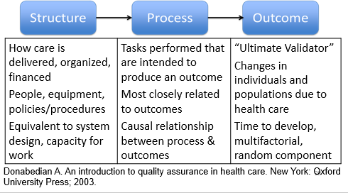
Outcomes Produced Through the Design and Operation of Structures and Processes
Notes:
Carla

Slide 58
Human Factors Engineering (Systems + Humans)
A discipline that strives to design systems that optimize safety and minimize risk of error in complex environments, by focusing on how systems work in actual practice - with fallible human beings interacting with tools, technology, systems and the environment.
Specific activities are examined in terms of component tasks for the physical and skill demands, mental workload, team dynamics, and environmental conditions and device design needed for optimal performance of the work.
https://psnet.ahrq.gov/primers/primer/20/Human-Factors-Engineering
Notes:
Carla

Slide 59
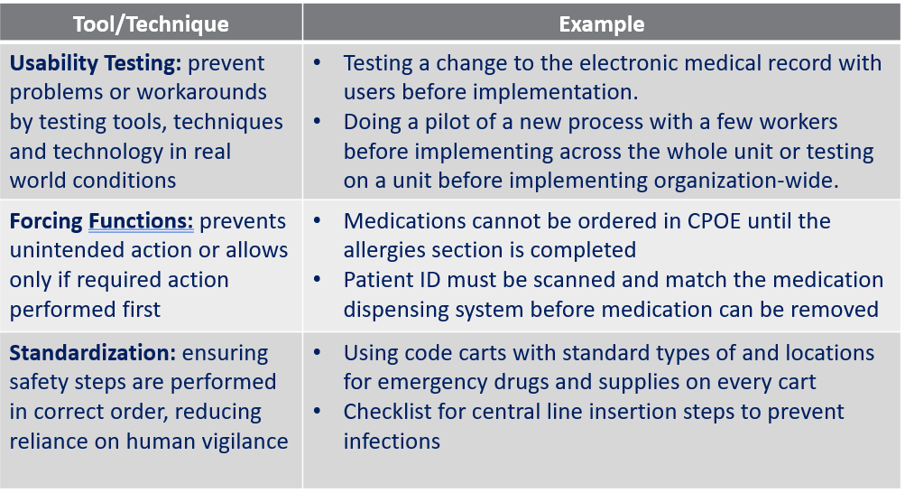
Human Factors Engineering in System Design
.
https://psnet.ahrq.gov/primers/primer/20/Human-Factors-Engineering
Notes:
Carla

Slide 60
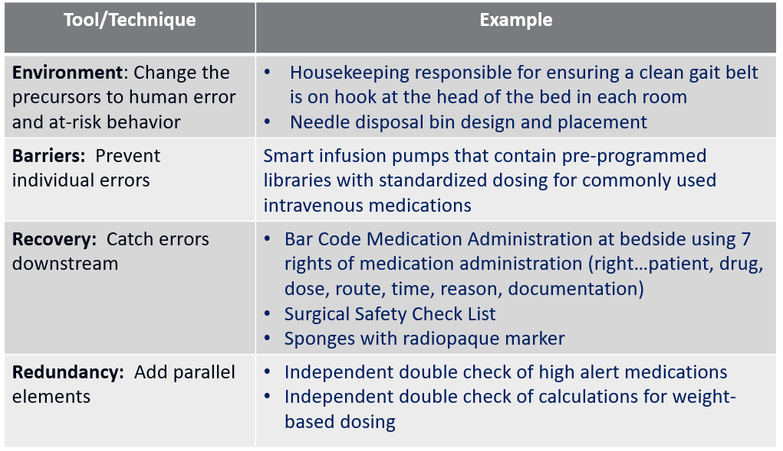
Human Factors Engineering in System Design
.
Notes:
Carla

Slide 61
How Can You Learn How Your Systems are Operating?
Team-based meetings (briefs, huddles, debriefs)
Process Mapping (Colligan et al., 2010)
Individual Root Cause Analysis (Institute for Healthcare Improvement)
Aggregate Root Cause Analysis (Neilly et al., 2003)
Failure Modes and Effect Analysis (VA National Center for Patient Safety)
Safety Briefings and Leadership WalkRounds (Institute for Healthcare Improvement)
Leveraging Frontline Expertise (Singer et al., 2013)
Notes:
Carla
A learning culture takes action based on information about its systems and is driven to improve through constant feedback about the successes and failures of its processes.
The foundation of a learning culture is information systems…reporting. Workers will report if they believe that the organization will analyze the reported information and implement change.
Root cause analysis, individual and aggregate, FMEA, Safety Briefings, and Leadership WalkRounds are the tools that organizations use to learn from their experience.

Slide 62
Looking for System Causes
Outcome
Human Error
Why?
Why?
Behavioral Choice
Why?
Mechanical Failure
Why?
Notes:
Carla
A root cause analysis is one method of learning about how systems are operating, after an event.
We start with the undesirable outcome on the right side of the page.
Then we build the diagram from right to left – identifying causal factors and linking the causal chain. We look for causes for every human error, behavioral choice and mechanical failure. We keep asking why until we have an underlying system cause that we can address, or the cause is out of our control.
This helps you see how the proximal causes (middle column) and the preceding causes or contributing factors (left column) line up to produce the outcome. How the holes in the Swiss cheese line up.

Slide 63
Check-in For Relevance
How does knowledge of the four components of a safety culture help an organization work toward becoming a high reliability organization?
Why is knowledge of how systems and humans interact important to improving patient safety?
Are humans ever a component of a system?
Is human error a choice?
How can we help humans make safe choices?
Notes:
Carla

Slide 64
Hierarchy of Interventions
Interventions for improvement vary in effectiveness and sustainability
Stronger interventions:
Are aimed at eliminating or mitigating root causes of undesired outcomes
Are aimed at improving systems and processes
Take human factors engineering into consideration
Include input from front line experts
May need to be made incrementally, especially if they are large scale system design improvements
Notes:
Carla

Slide 65
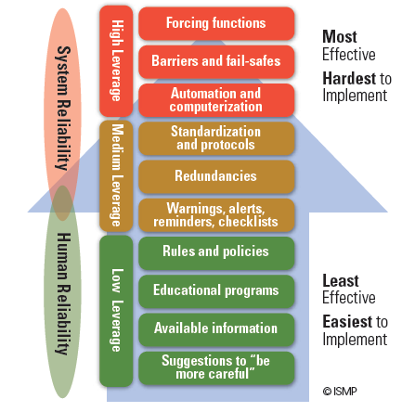
Hierarchy of Effectiveness of Risk Reduction Strategies
Notes:
Carla
How can we support humans in making safe choices?

Slide 66
Hierarchy of Interventions
STRONG | Example
Institutional (large facility-wide investment) | Implementing unit-based pharmacists
IT Structure (change in software/interface) | Usability evaluation, forcing functions (e.g. to prevent wt-based dosing errors in CPOE)
Architectural/ Environmental (change in physical environment) | Signage, relocating equipment (e.g. gait belt on hook next to bed)
Standardize Equipment | Surgical instrument trays, IV pumps
Leadership Involvement | Clinical champions assigned to relevant interventions
Simplify processes | Revise criteria for admission to Observation unit
Commonwealth of Massachusetts, 2012; Hibbert et al., 2018; Hettinger et al., 2013
Notes:
Carla
Strong: actions that do not depend on staff to remember to do the right thing; they are built into the system; .the action may not totally eliminate the vulnerability but provide very strong controls. Performance shaping factors are changed. Forcing functions, hard stops.
Examples: Engineering controls (forcing functions) Edits on electronic medical record that won’t let you exit until a field is filled, IV tubing that will not allow you to connect certain types of piggy backs, tangible involvement/action by leadership in support of resident and staff safety, and leadership checks in with staff during rounds on how a new process is going, and follows up if issues are identified
Strongest may include: Physical plant changes—e.g., moving a grab bar, Simplfication of the process—remove unnecessary steps or steps that no longer make sense
Standardize equipment or process to reduce variation and/or conducting usability testing before purchasing new devices—will it really do what you need?

Slide 67
Hierarchy of Interventions
Moderate | Example
Policy/Procedure change or implementation | Patients at high risk for falls not to be left alone while toileting
Audit/Feedback | Appropriate fall risk interventions in place according to policy
Redundancy | Have an additional person assist
Enhanced documentation/ forms | Making hourly rounding and measures easier to document.
Checklists/Cognitive Aids | Fall Risk Signage with picture of required assist device (i.e., walker)
Standardize communication tools | Shift report form with specific space for fall risk and interventions
Training with practice and competency assessment | Falls skills fair. Personnel file documentation of skills competence
Commonwealth of Massachusetts, 2012; Hibbert et al., 2018; Hettinger et al., 2013
Notes:
Carla
Intermediate: actions are somewhat dependent on staff remembering to do the right thing, but they provide tools to help staff to remember or to promote clear communication
Examples: Redundancy—everyone entering room looks for “x”, elimination of /reduction of distractions, checklists, cognitive aids, elimination of look-alikes and sound-a-likes, read back—verbal orders, software enhancements/modifications, increase staffing; decrease workload, and enhanced documentation/communication
Cognitive aids, checklists, procedures that are pervasive – standard and in wide use

Slide 68
Hierarchy of Interventions
Weak | Example
Counseling / Discipline | Discussion with individual employee and note in personnel file
Discussions in meetings | General mention in monthly staff meeting (*daily safety huddle reminders might be more helpful)
Notifications (email, communication book) | Notice to “do better.” Decreased opportunity for it to be personalized or have questions answered.
Warnings | Punitive discussion and file note
Double-checks | Double checks of medication dosage prior to administration
Training without practice or competency assessment | Float staff expected to “see one, do one”
Commonwealth of Massachusetts, 2012; Hibbert et al., 2018; Hettinger et al., 2013
Notes:
Carla
Weaker: actions that depend on staff to remember their training or remember what is written in the policy
Examples: Double checks (risk for human error), posters or signs on the new equipment, new procedure, policy, memo, training alone and additional study/analysis.

Slide 69




Priority Payoff Matrix
Payoff/ Benefit
(strength of intervention)
HIGH
LOW
 | EASY/INEXPENSIVE | DIFFICULT/EXPENSIVE
Rank your proposed actions on this matrix to help with selection and timing
Use sticky notes with action items on them
Works well with a team
Could you use this tool with your core team in a small organization?
Ease/Cost of Implementation
Adapted from GE Medical Systems
Notes:
Carla
The Priority/Payoff matrix is a tool that can help you select action items to implement – where to start. Where will you get the biggest bang for the buck??
Vertical axis is benefit – horizontal axis is difficulty or cost.
This is a simple tool to use and works well with a team (or even to use individually). Draw out the matrix on a white board - use sticky notes with action items on them and place them in the quadrants.
Could you use a tool like this in your organization with a small team to help build an action plan?
Examples of each category:
High payoff/Easy implementation : (discontinue stocking two strengths of a certain medication to avoid wrong dose)
High payoff/difficult implementation: (Architectural changes, EMR implementation, )
Low payoff/difficult implementation: (why go here?)
Low payoff/easy implementation: (these will probably be weak interventions – poster, email reminder, memo)

Slide 70
Check-in For Relevance
How does knowledge of human factors and systems help us create strong action plans for improvement?
Are strong actions more difficult to implement?
Are weaker actions easier to implement?
When are weaker actions appropriate to use?
Which type of actions to you use most often in your action plans?
Could the hierarchy and priority matrix help you create stronger action plans?
Notes:
Carla

Slide 71
Homework Assignment
Homework with mentor
How does the mentor’s organization tie patient safety culture to organizational culture and make it a priority?
What patient safety metrics does the mentor’s organization track? How are they reported to the Board of directors? What education is the Board given about patient safety?
How does the mentor’s organization use the SOPS results? What interventions are they implementing to improve their culture of safety?
How does the mentor encourage reporting? How are near misses reported? When is an RCA done at the mentor’s organization and how do they conduct it? Suggestions and lessons learned?
Notes:
Emily

Slide 72
Patient Safety Resources
Nebraska Coalition for Patient Safety
Agency for Healthcare Research and Quality
Institute for Healthcare Improvement
Institute for Safe Medication Practices https://www.ismp.org/
ThinkReliability
Outcome Engenuity https://outcome-eng.com/just-culture-the-foundation-of-an-effective-safety-culture/
https://www.nepatientsafety.org/
https://www.ahrq.gov/
http://www.ihi.org/Pages/default.aspx
https://www.thinkreliability.com/
Notes:
Emily
NCPS – on our website you’ll find posting available to members and non-members; the webinars that we collaborate with NHA are available to anyone. The monthly deidentified event topics are a members only offering. Also working to strengthen our Events Calendar so not only NCPS hosted offerings are listed there but also patient safety webinars from our collaborative partners (AQIPS, NMA, NHA, NPIQIC, etc.). We will research specific topics for members through the McGoogan Medical Science Library at UNMC.
AHRQ – a wide variety of resources are available on this website; they often report on research they have funded or exemplars they have worked with; also, there are “tool kits” for various patient safety and quality improvement initiatives that can be adapted to your practice setting. Encourage you to sign up for the PSNET newsletter
IHI – a variety of tools for patient safety; unfortunately, often find what I want to see requires a fee. Encourage you to sign up for their newsletter
ISMP – Medication errors continue to be our #1 reported incident. This website has great information about Medication Safety Best Practices and a host of resources which you can access without a paid membership.
ThinkReliability – offer Root Cause Analysis training, although NCPS also offers this training
Outcome Engenuity – Just Culture training, NCPS also offers this training (in a train the trainer format)

Slide 73
Check-in For Relevance
Have you identified opportunities to improve your patient safety program?
What are your next steps to improve your program and culture?
What resources might you use to help you?
What challenges will you face?
What help do you need?

Slide 74
References
Agency for Healthcare Research and Quality. Patient safety primer: human factors engineering. Patient Safety Network. January 2019. Available at: https://psnet.ahrq.gov/primers/primer/20/Human-Factors-Engineering
Agency for Healthcare Research and Quality. Patient safety primer: High reliability. Patient Safety Network. January 2019. Available at: https://psnet.ahrq.gov/primers/primer/31/high-reliability
Alliger GM, Tannenbaum SI, Bennett W, et al. A meta-analysis of the relations among training criteria. Pers Psychol 1997;50:341–58.
Battles et al. (2006). Sensemaking of patient safety risks and hazards. HSR, 41(4 Pt 2), 1555-1575.
Campione J, Famolaro T. Promising practices for improving hospital patient safety culture. Jt Comm J Qual Patient Saf. 2018;44(1):23-32.
Chassin MR, Loeb JM. The ongoing quality improvement journey: next stop, high reliability. Health Affairs. 2011; 559-568. Project HOPE— The People-to-People Health Foundation, Inc. Available at: https://doi.org/10.1377/hlthaff.2011.0076

Slide 75
References
Colligan L, Anderson JE, Potts HWW, Berman J. Does the process map influence the outcome of quality improvement work? A comparison of a sequential flow diagram and a hierarchical task analysis diagram. BMC Health Serv Res. 2010; 10: 7. Available at: http://www.ncbi.nlm.nih.gov/pmc/articles/PMC2822834/pdf/1472-6963-10-7.pdf
Grossman R, Salas E. The transfer of training: what really matters. Int J Train Dev 2011;15:103–20.
Institute of Medicine. Patient safety: Achieving a new standard of care. Washington, DC: The National Academies Press; 2004.
Institute for Healthcare Improvement. Conduct Safety Briefings. Available at: http://www.ihi.org/resources/Pages/Tools/SafetyBriefings.aspx
Institute for Healthcare Improvement. Leadership WalkRounds. Available at: http://www.ihi.org/resources/Pages/Tools/PatientSafetyLeadershipWalkRounds.aspx
InstituteRCA2: Improving Root Cause Analyses and Actions to Prevent Harm for Healthcare Improvement. Available at: http://www.ihi.org/resources/Pages/Tools/RCA2-Improving-Root-Cause-Analyses-and-Actions-to-Prevent-Harm.aspx
Joint Commission. The essential role of leadership in developing a safety culture. Sentinel Event Alert. Issue 57. March 1, 2017. Available at: https://www.jointcommission.org/sea_issue_57/

Slide 76
References
Jones, Skinner, Xu, Sun, Mueller. (2008). The AHRQ Hospital Survey on Patient Safety Culture: a tool to plan and evaluate patient safety programs. Advances in Patient Safety: New Directions and Alternative Approaches http://www.ncbi.nlm.nih.gov/books/NBK43699/
Kirkpatrick DL, Kirkpatrick JD. Evaluating training programs: the four levels, 3rd edn. San Francisco: Berrett-Koehler Publishers, Inc., 2006.
Leape, L.L. (2002) Reporting adverse events. The New England Journal of Medicine, 347, 1633-1638 Institute for Healthcare Improvement.
Liberati EG, Peerally MF, Dixon-Woods M. Learning from high risk industries may not be straightforward: a qualitative study of the hierarchy of risk controls approach in healthcare, International Journal for Quality in Health Care, Volume 30, Issue 1, 1 February 2018, Pages 39–43, https://doi.org/10.1093/intqhc/mzx163
Mardon RE, Khanna K, Sorra J, Dyer N, Famolaro T. Exploring relationships between hospital patient safety culture and adverse events. J Patient Saf 2010;6: 226-232.
Marx D. Patient Safety and the “Just Culture”: A Primer for Health Care Executives. New York, NY: Columbia University; 2001. Available at: http://psnet.ahrq.gov/resource.aspx?resourceID=1582

Slide 77
References
Neily J, Ogrinc G, Mills P, et al. Using aggregate root cause analysis to improve patient safety. Jt Comm J Qual Saf. 2003;29:434-9.
Nieva VF, Sorra J. Safety culture assessment: A tool for improving patient safety in healthcare organizations. Qual Saf Health Care 2003; 12(Suppl II): ii17-ii23.
Outcome Engenuity. Engineering better outcomes through just culture. Available at: https://www.outcome-eng.com/just-culture-training/
Outcome Engenuity. Just Culture Train the Trainer Course Slides. 2018. Outcome Engenuity, LLC.
Outcome Engenuity. Root Cause Analysis Certification Course Workbook. 2018. Outcome Engenuity, LLC.
Reason, J. (1997). Managing the Risks of Organizational Accidents. Hampshire, England: Ashgate Publishing Limited.
Schein, E.H. Organizational Leadership and Culture 4th ed. San Francisco: John Wiley & Sons; 2010.
Singer SJ, Rivard PE, Hayes JE, Shokeen P, Gaba D, Rosen A. Improving patient care through leadership engagement with frontline staff: A Department of Veterans Affairs case study. The Joint Commission Journal on Quality and Patient Safety. 2013;39:349-360.

Slide 78
References
Sorra J, Khanna K, Dyer N, Mardon R, Famolaro T. Exploring relationships between patient safety culture and patients’ assessments of hospital care. J Patient Saf 2012;8: 131-139.
VA National Center for Patient Safety. Healthcare Failure Mode and Effect Analysis (HFMEA). Available at: https://www.patientsafety.va.gov/professionals/onthejob/hfmea.asp
Wiegmann. A synthesis of safety culture and safety climate research; 2002. http://www.humanfactors.uiuc.edu/Reports&PapersPDFs/TechReport/02-03.pdf
Weaver SJ, Lubomski LH, Wilson RF, Pfoh ER, Martinez KA, Dy SM. Promoting a culture of safety as a patient safety strategy: A systematic review. Ann Int Med. 2013;158:369-374.

Slide 79
References for NCPS/PSO Section
Institute of Medicine. To Err Is Human: Building a Safer Health System. Washington, DC: The National Academies Press, 2000
Nebraska Department of Health and Human Services. Statutes Relating To Patient Safety Improvement Act. December 1, 2008. http://dhhs.ne.gov/publichealth/Documents/Patient%20Safety%20Improvement%20Act.pdf
U.S. Department of Health and Human Services. Patient Safety and Quality Improvement Act of 2005 and Rule. https://www.hhs.gov/hipaa/for-professionals/patient-safety/statute-and-rule/index.html
Agency for Healthcare Research and Quality. Patient Safety Organization (PSO) Program. Federally-Listed PSOs. https://www.pso.ahrq.gov/listed
National Patient Safety Foundation. Free from Harm: Accelerating Patient Safety Improvement Fifteen Years after To Err Is Human. Boston, MA: National Patient Safety Foundation; 2015. Available at: http://www.npsf.org/free-from-harm.
2013 Annual Hospital-Acquired Condition Rate and Estimates of Cost Savings and Deaths Averted From 2010 to 2013. Rockville, MD: Agency for Healthcare Research and Quality; October 2015. 2015. AHRQ Publication No. 16-0006-EF. http://www.ahrq.gov/professionals/quality-patient-safety/pfp/index.html.
Makary MA, Daniel M. Medical error-the third leading cause of death in the US. BMJ 2016;353:i2139 doi: 10.1136/bmj.i2139

Slide 80

Nebraska Coalition for Patient Safety
Thank you!
Emily Barr, OTD, MBA, OTR/L, BCG
Executive Director
embarr@unmc.edu
Carla Snyder, MHA, MT(ASCP) SBB, CPHQ
Patient Safety Program Director
carlasnyder@unmc.edu

