Slide 1
Optimizing Health Care Supply Chain for Resilience
Partnering with CHC & HealthTrust to Build Resilient Supply Chains for Nebraska Hospitals
October 23, 2025

Slide 2
AGENDA
Setting the Stage: Getting to know CHC & HealthTrust | 3
Market Forces Shaping Healthcare Supply Chain | 6
Why Supply Chain Resiliency Matters | 8
Moving Toward Supply Chain Resiliency | 9
Delivering Impact Through Partnerships and Collaboration | 10
Closing & Discussion | 15

Slide 3







About the Speaker
Jon Pruitt
SVP, CHC Supply Trust
Community Hospital Corporation
Education
M.S. in Healthcare Administration, Texas Woman’s University
B.B.A. in Finance, Stephen F. Austin State University
Experience
Currently leads CHC Supply Trust’s efforts to strengthen and streamline supply chain performance across CHC hospitals
Brings 30+ years of leadership experience in healthcare supply chain and support services
Former VP of Supply Chain Integration for Tenet Healthcare - USPI, driving $15M+ in savings across 100+ outpatient facilities
Previous leadership roles with VHA/Provista (Vizient), Texas Purchasing Coalition, LifeCare Hospitals, and Broadlane
Let’s Connect!
Outside the Office:

Slide 4
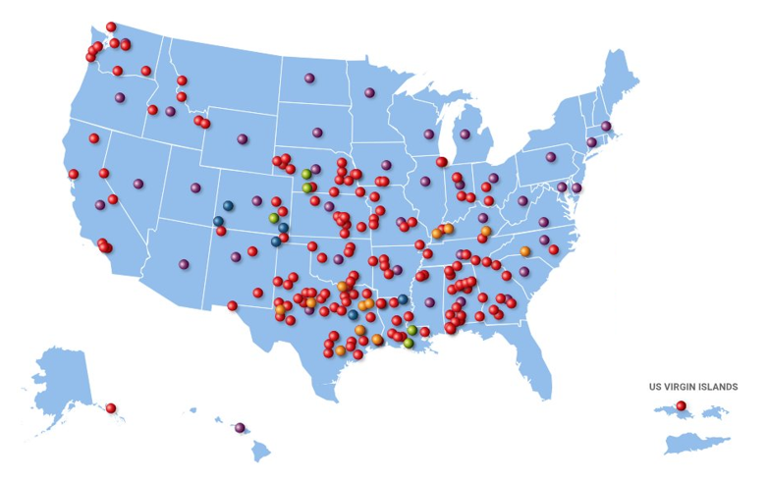




Who is CHC Supply Trust?
Supply Chain Service Provider
The supply chain management arm of Community Hospital Corporation – a company that has owned, managed and consulted with community hospitals for 25+ years.
We are a service provider that supports your hospital to maximize supply chain efficiency and savings.
Former hospital employees who understand the pressures and challenges.
Maximized supply chain savings for 160+ hospitals across the country.
Endorsed partner of the Nebraska Hospital Association

Slide 5

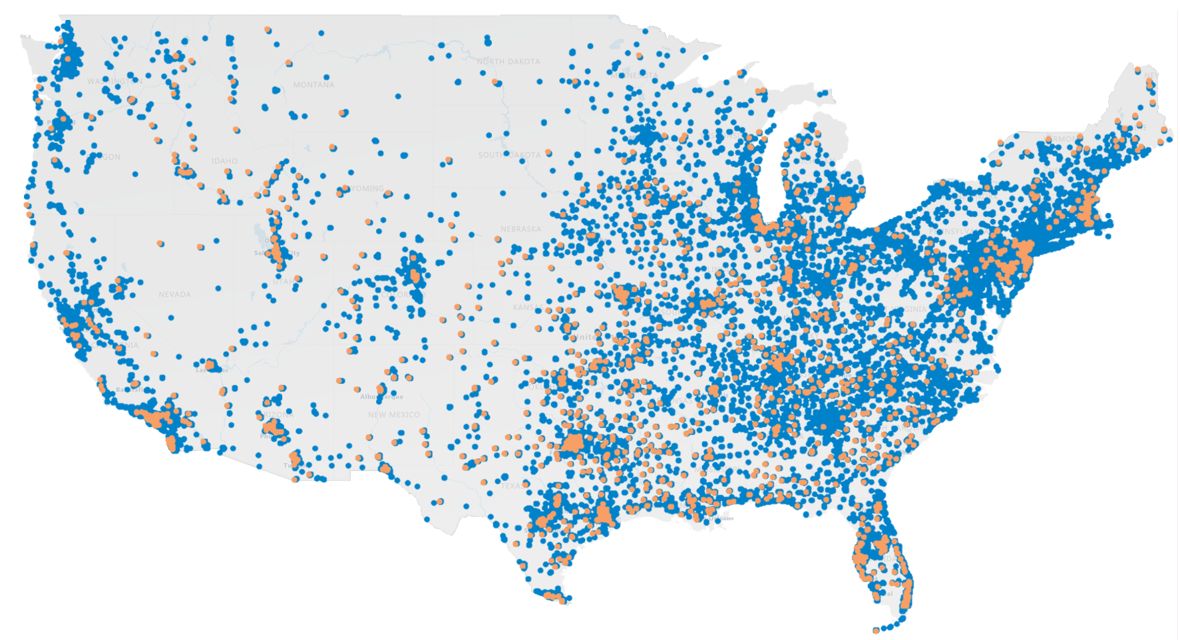


62%
Who is HealthTrust Performance Group?
OF HPG’s MEMBERS ARE NOT-
FOR-PROFIT HEALTH SYSTEMS
Established in 1999
Owned and Operated by 7 healthcare systems, including general partner HCA Healthcare
HEALTHTRUST 1,800 Acute care members
ADVANTAGETRUST 64,000 Non-acute members $57B
Annual Spend
Schaumburg, IL AdvantageTrust 64,000 members
Nashville, TN HEALTHTRUST 1,800 members
Ashville, NC Healthplus
Springfield, MO ROi
Republic, MO Clinical Packaging
Solutions
Frisco, TX Valify Solutions Group
Sunrise, FL HealthTrust Workforce Solutions
Alaska
Hawaii
Birmingham, UK HealthTrust
Europe
Shanghai, China HealthTrust
China
Acute care members (HealthTrust)
Non-acute members (AdvantageTrust)

Slide 6
Market Forces Shaping Healthcare Supply Chain Resiliency
Resiliency today means maintaining continuity, visibility, and efficiency even when market conditions shift.
Economic & Cost Volatility | Supplier Fragility & Consolidation | Workforce Shortages & Aging Workforce | Global & Environmental Disruptions | Evolving Care & Technology Models
Inflation, tariffs, and geopolitical impacts tightening hospital margins and increasing financial risk | Shrinking supplier base and single-source manufacturing heighten vulnerability to shortages | Persistent labor shortages and an aging workforce are straining logistics, distribution, and materials mgmt | Pandemics, weather, conflict, and cyberattacks expose gaps in visibility | Shift to ambulatory and outpatient care, digital integration challenges require agile, tech-enabled supply chains
External pressures are redefining what resiliency means for hospitals today - not just the ability to recover from disruptions, but the capacity to adapt, anticipate, and sustain performance under pressure.

Slide 7
Preparing for Disruption
From Market Forces to Actionable Preparedness
Resilience
Resilient hospitals plan for disruption, integrate clinically, and leverage data and partnerships to transform disruption into readiness.
Resilience
Shift from reactive recovery to proactive readiness by planning, technology, and partnerships.
Clinical Preparedness
Integrate clinicians into planning to ensure viable substitutes, forecast needs, and validate conservation strategies.
Data, Analytics, and Partnerships
Leverage AI and predictive analytics to anticipate shortages. Partnerships with GPOs, distributors, and tech providers enhance visibility and enable proactive mitigation.
Have A Plan
Develop a disruption playbook with core supply lists, validated substitutes, and alternate suppliers. Conduct drills and stress tests regularly. Re-evaluate and improve inventory management processes to ensure flexibility and visibility.
Disruption is Historical and Persistent
Disruptions are inevitable – pandemics and disasters expose vulnerabilities in sourcing, logistics, and visibility.

Slide 8

Why Supply Chain Resiliency Matters
“
A high-performing supply chain function can boost resilience, enhance care, increase satisfaction among physicians, reduce supply spend by up to 10%, and better position health systems to achieve their growth ambitions.
- McKinsey & Company, Optimizing Health-System Supply Chain Performance (2022)
”

Slide 9
Evolving Toward a More Resilient Supply Chain
Building resiliency through connected, agile, and diversified supply chain operations.
Redundancy
Backup plans and multi-source strategies that ensure continuity of supply and reduce dependency on single points of failure.
Redundancy
Visibility
Real-time insight into demand, inventory, suppliers, and logistics – enabling proactive decision-making and faster response to disruption.
Visibility
Stability
Standardized processes, governance, and contract discipline that maintain continuity, even in disruption.
Stability
Supply Chain Resiliency
Agility
The ability to quickly pivot sourcing, contracts, or delivery models as market or clinical needs shift.
Agility
Collaboration
Collaboration
Strong coordination across hospitals, suppliers, and clinical teams to align priorities, share intelligence, and reduce redundancy.

Slide 10



Applying Resiliency Principles in Practice
How partnership drives shared outcomes across hospital supply chains.
Shared Outcomes
Focus: Tailored Support & Implementation
Focus: Scale, Analytics, and Clinical Integration
Hands-on engagement with rural and community hospitals
Measurable financial improvement and cost savings
National leverage for pricing stability and supplier assurance
Leads implementation, conversion, and compliance execution
Improved visibility, assurance, and sourcing flexibility
Expansive portfolio to mitigate risk and improve access
Delivers visibility into spend, utilization, and savings performance
Long-term stability through collaborative decision-making
Predictive analytics and AI to identify risks and savings
Aligns on measurable outcomes through data and analytics
Data-driven alignment between local execution and national scale
Integrates clinicians and supply chain through value analysis

Slide 11




Examples of Partnerships Built for Resiliency
Advancing Visibility, Agility, and Collaboration Across Nebraska Hospitals
Challenge: Smaller hospital faced limited purchasing leverage and higher pricing under a national GPO.
Solution: Transitioned to a supply chain model centered on right-sizing contracts, optimizing OR supply processes, and leveraging benchmark data.
💡 Impact: Realized $532K in first-year savings and achieved ongoing 18% annual supply cost reduction, strengthening stability and efficiency.
Challenges: Existing bundled contract limited flexibility and hindered cost transparency.
Solution: Adopted a customized supply chain approach emphasizing contract flexibility, category strategy, and perioperative optimization.
💡 Impact: Reduced implant spend by 25% ($1.7M) and improved supply chain agility through data-driven decision-making.
Challenges: Rising supply costs and fragmented purchasing limited visibility and negotiation power.
Solution: Strengthened supplier partnerships, standardized pricing, and improved contract governance through analytics and cross-department collaboration.
💡 Impact: Achieved $1.8M in verified savings and enhanced financial resilience with consistent year-over-year cost control.

Slide 12
Using Data and AI to Strengthen Supply Chain Resilience
Reinforcing the core components of a resilient supply chain through data and technology partnerships.
Visibility
Agility
Collaboration
Redundancy
Stability
Unified dashboards and real-time analytics improve transparency across spend, utilization, and supplier performance.
Predictive insights and scenario modeling help hospitals adapt quickly to market and supply changes.
Shared data and digital workflow tools align clinical, supply chain, and financial teams for faster decision-making.
AI modeling pinpoints single-source risks and informs alternate sourcing strategies.
Continuous measurement of KPIs drives consistent performance and cost control.

Slide 13
Aligning Care Decisions with Supply Chain Intelligence
Driving collaboration between clinicians and the supply chain.
Shared data and governance connect clinical insight with operational execution.
Clinicians
Supply Chain
Evidence-based product evaluation
Input through value analysis committees
Focus on quality and patient outcomes
Standardization for cost and availability
Data analytics to inform choices
Contract alignment with clinical priorities
Through collaborative partnerships, hospitals leverage clinical advisory boards, data-driven product evaluations, and standardized governance to balance quality, cost, and care.

Slide 14
Global Risk Meets Rural Reality
Leveraging collective scale to stabilize costs amid global uncertainty.
The Pressure
The Exposure
Scale Advantage
Tariff fluctuations, raw material shortages, and freight surcharges continue to elevate cost volatility.
Price instability now extends beyond commodities to medical devices, packaging, and capital equipment.
Smaller and rural hospitals feel these pressures first, with limited ability to absorb or negotiate increases.
Limited supplier options amplify vulnerability in rural markets.
Multi-year renewals often lock hospitals into above-market rates.
Dependence on single distributors or manufacturers heightens risk during global disruptions.
National scale through GPO purchasing power.
Data-driven sourcing to flag tariff- and freight-exposed categories.
Diversified suppliers reduce risk and ensure continuity.
Predictive analytics forecast and offset cost impacts.
Through collective scale and shared strategies, hospitals can convert global uncertainty into local stability.

Slide 15

Checklist for Action
Key Takeaways for Nebraska Hospitals
Checklist for Action
Increase visibility into spend and utilization
Diversify sourcing and mitigate supplier risk
Engage clinicians in supply decisions
Apply data and AI to identify and forecast opportunities
Prepare for tariffs and market shifts
Measure outcomes and sustain performance
Resiliency is a shared responsibility - and partnerships like those between hospitals, group purchasing organizations, and data partners can help Nebraska hospitals stay strong no matter the pressure.

Slide 16
Appendix

Slide 17
References
McKinsey & Company. Optimizing Health-System Supply Chain Performance. August 23, 2022. Available at: https://www.mckinsey.com/industries/healthcare/our-insights/optimizing-health-system-supply-chain-performance
McKinsey & Company. Bolstering Health System Supply Chain Resilience to Reduce Risk. July 11, 2023. Available at: https://www.mckinsey.com/industries/healthcare/our-insights/bolstering-health-system-supply-chain-resilience-to-reduce-risk
Community Hospital Corporation (CHC). Faith Regional Health Services: Supply Savings Secure Financial Stability. June 5, 2024. Available at: https://chc.com/supply-savings-secure-financial-stability-faith-regional-health-services/
Deloitte Insights. Health Care Supply Chain Resilience. April 25, 2022. Available at: https://www.deloitte.com/us/en/insights/industry/health-care/healthcare-supply-chain.html
Definitive Healthcare. Strategies for Building Healthcare Supply Chains. Available at: https://www.definitivehc.com/resources/how-to-guides/build-resilient-healthcare-supply-chain
U.S. Chamber Foundation & Healthcare Distribution Alliance. Building Toward Healthcare Supply Chain Resilience: Business Solves Roundtable Report. January 2024. Available at: https://chamber-foundation.files.svdcdn.com/production/documents/23-12438_USCCF_2023_HDA-Report_Digital_2024-01-18-182106_pmjn.pdf

Slide 18
References
Community Hospital Corporation (CHC). Great Plains Health: Need for “À La Carte” Medical Consulting Leads to CHC. May 3, 2018. Available at: https://chc.com/hospital-medical-consulting-need-leads-to-chc/
Community Hospital Corporation (CHC). Small Hospital Realizes Healthcare Supply Chain Savings. April 10, 2023. Available at: https://chc.com/small-hospital-realizes-healthcare-supply-chain-savings/
Trexin. Supply Chain Disruptions in Healthcare. December 17, 2024. Available at: https://www.trexin.com/supply-chain-disruptions-in-healthcare/
American Healthcare Leader. How Data Analytics Is Transforming Healthcare Supply Chains. June 19, 2025. Available at: https://www.americanhealthcareleader.com/2025/how-data-analytics-is-transforming-healthcare-supply-chains/
GHX. How to Use Data and Analytics to Optimize Healthcare Supply Chains. March 18, 2024. Available at: https://www.ghx.com/the-healthcare-hub/supply-chain-analytics-guide/
AHRMM. Building More Resilient Supply Chains. Available at: https://www.ahrmm.org/building-more-resilient-supply-chains
American Hospital Association (AHA). Resilient Strategies for the Hospital Supply Chain: Using Data-Driven Insights to Mitigate Disruptions. Sponsored by McKesson, September 2021. Available at: https://www.aha.org/system/files/media/file/2021/09/McKesson_ResilientStrategies_exedialogue_Sept2021.pdf

Slide 19
THANK YOU
FOR MORE INFORMATION, PLEASE CONTACT
Jon Pruitt
SVP, CHC Supply Trust
jpruitt@chc.com | 972.943.1216

