Slide 1

The Road to Stroke Rehabilitation Certification at Butler County Health
Presented by Tara Palensky, RN & Hannah Wurl, OT

Slide 2

Learning Objectives
The why, where, when, and how behind the initiation of becoming Stroke Rehab Certified.
1.
Describe the team approach by defining the roles of the different disciplines within the Stroke Rehab Committee.
2.
The Program Standards: a brief description of the AHA program requirements to become Stroke Rehab Certified.
3.
4.
Talk about the effective treatment and education strategies implemented to meet certification requirements.
5.
Discuss the continuum of care at BCH from the acute emergency room admission to post-acute stroke rehabilitation.
Notes:
Tara

Slide 3
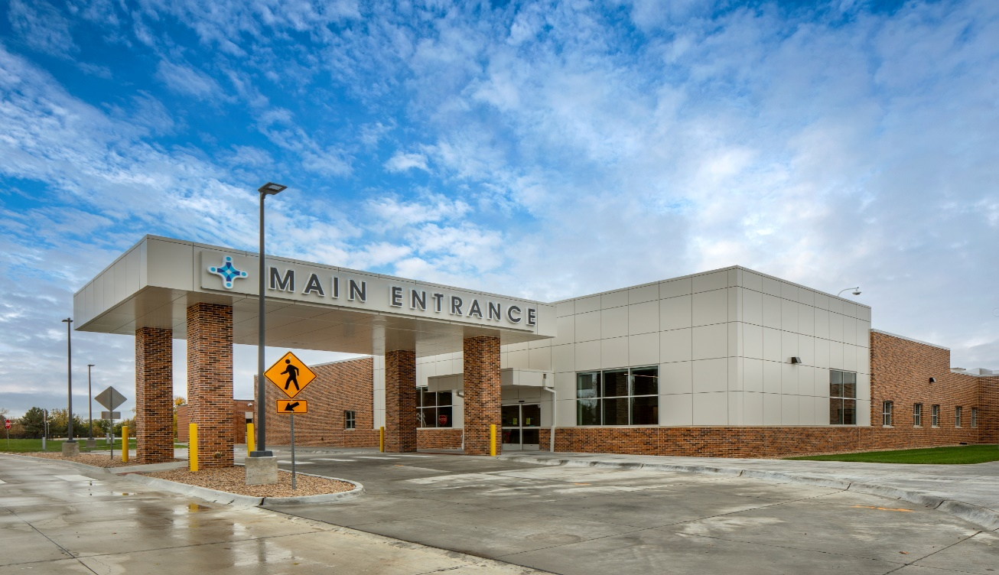
Butler County Health, located in David City, Nebraska
18 Bed Critical Access Hospital
Population of David City: about 3,000. Population of Butler County: about 8,000
Services Provided: Inpatient, Obstetrics, Skilled Nursing (Swing bed), Outpatient Specialty Clinics, and Physical, Occupational, & Speech Therapy
Notes:
Tara: Butler County Health is a county owned, 18 bed critical access hospital offering a variety of services including inpatient, obstetrics, skilled nursing, outpatient specialty clinics and therapy. The hospital is located within David City, the largest town in Butler County with a population of about 3,000 people. Butler County itself is home to over 8,000 people

Slide 4

INCEPTION OF PROGRAM
1
2
3
4
Quality Improvement Committee- Stroke Priority Objective
Data:
Average yearly ER visits - 1450
ER Stroke Diagnosed Patients - 18
Inpatients - 220
Swing bed patients - 89
Skillful Therapy Department
◆ Physical Therapy  Occupational
Therapy
◆ Speech Therapy
Providing Adult and Pediatric therapy within our facility and facilities in the community
Fiscal Year 2025
Therapy Data:
Total patient visits:
PT-9908
OT-2278
ST- 1261
Of total FY 2025 visits……
IP/SB patient visits were:
PT-1,737
OT-830
ST- 162
Notes:
TARA:
Next, Inception of the Program
Butler County Health prioritizes the growth of health care services available to the people of our community. Our goal is to provide top notch quality care close to home without having to travel outside the area. So first-Stroke has been a priority objective for our Quality Improvement Committee for years. The committee has kept stroke care on the top of the list for monthly discussion to ensure we were meeting best practice guidelines and providing the care our patients deserve. In 2024 the opportunity was presented to the QIC Committee to take our stroke care we provide one step further and become post-acute stroke rehab certified. We had been building a strong, successful swing bed program and felt this was a great way to merge our skilled rehab services with our stroke patients who are needing continued care and rehab. On average, we see 1,450 ER patients each year. Last year we treated 18 stroke patients in the ER. Some of these patients were transferred to higher levels of care and others of them stayed within the care of our facility. The patients who continued their care within the facility met with our therapy department to address their individual needs. We currently provide physical, occupational, and speech therapy. These 3 departments not only provide adult services but also pediatric services and stay very busy by traveling to other facilities within the community to provide services. For the 2025 fiscal year, Physical therapy provided 9,908 PT sessions, Occupational therapy provided 2,278 patient sessions, and Speech therapy provided 1,261 patient sessions.

Slide 5
AHA Program Standards
1.0 Program Management 2.0 Personnel Education 3.0 Patient/Caregiver Education & Support 4.0 Care Coordination 5.0 Medical Management 6.0 Quality Improvement
Notes:
Hannah
Listed above are the Program Standards for the American Heart Association’s Post Acute Care Stroke Program.
The standards range cover Managerial Expectations for Program Development → to Education of Supporting Staff, the patient and caregiver → Coordination and Management of Stroke Care within your facility → and finally Quality Improvement Standards

Slide 6
1.0 Program Management
1.0 PROGRAM MANAGEMENT
The Post-Acute Care Stroke program defines its mission, goals, scope and organizational structure. It identifies a stroke program champion(s) and organizes an interprofessional committee which oversees the Post-Acute Stroke program.
INITIATIVES
PAC Stroke Program
Initiatives:
Designate a program champion
Create an interprofessional committee
Form a program charter
Mission
Goals
Scope
Organizational Structure
Designate a program champion
Create an interprofessional committee
Form a program charter
INITIATIVES
Notes:
Hannah
1 – Program Champion: oversees the program coordination, patient advocacy, and quality management of the program
2 – Create and IPC – Meets quarterly, includes members from each discipline – as Tara showed earlier you saw we had members of medical staff, dietary, nursing, pharmacy, etc.
IMPORTANT for developing a holistic and well-rounded program to get input from all members of the IPC.
3 – Form a program charter: includes IPC members and roles, meeting frequency and agenda plans, program goals and expectations, facility demographics, and QI processes

Slide 7
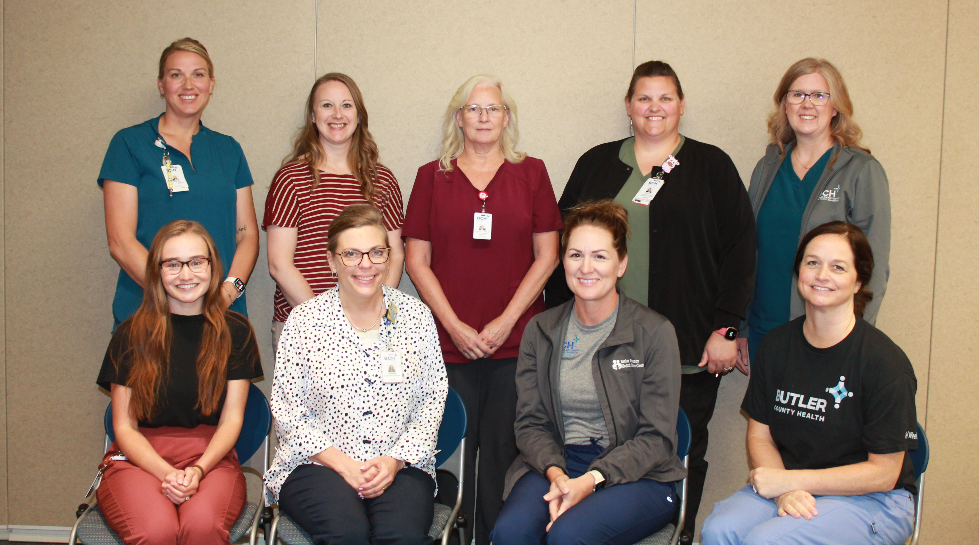
COMMITTEE STRUCTURE
Team Member | Title/Role
Tara Palensky | Quality Improvement, Patient Safety & ER Coordinator/Stroke Rehabilitation Program Champion
Hannah Wurl | Occupational Therapist/Stroke Rehabilitation Program Co-Champion
Don Naiberk | CEO
Dr. Joshua Sypal | Family Medicine Physician
Kristin Hartman | Director of Nursing
Kyle Eller | Physical Therapist
Elaina Eddy | Speech Therapist
Kelli Stara | Social Services
Cortny Augustine | Clinical Education Coordinator & Infectious Disease
Yenni Schroeder | Utilization Review & Risk Management
Amy Jelinek | Pharmacist
Sarah Caldwell | Pharmacist
Linda Bartunek | Nurse Informatics
Sandra Burwell | Dietician
Jenny Polacek | Nursing Administration Assistant
Notes:
Hannah
The Stroke Rehabilitation committee is made up of 15 team members who specialize in many areas of patient care.
When we assembled the team, the goal was to bring knowledge/leadership to the table to ensure well rounded quality patient care.

Slide 8
2.0 Personnel Education
2.0 PERSONNEL EDUCATION
Staff have the education, experience and training for the monitoring and management of stroke patients. The education program should be provided regularly and tailored to all levels of healthcare providers.
Education to be completed annually
Create a facility education policy, review annually
two
Maintain documentation of trained staff
one
three
Initiatives:
Create a facility education policy to be completed annually
Maintain documentation of trained staff
Notes:
Hannah
Facility Education Policy: - developed by the IPC
identifies all staff required to complete stroke education as well as how that information would be delivered (We used relias training as this was already being used for other annual education purposes at our facility)
2) All direct and non-direct care staff who encounter patients will be educated (env services-dietary – etc.) so our policy identified what stroke-specific education would be delivered (our clinical staff was required to complete different training than our non-clinical staff)
3) Having annual training requirement ANNUALLY and at HIRE meant we had to include documentation that was being completed – this was easy for us to just continue to track through our education system which followed the same timeline – Relias.

Slide 9
3.0 Patient/Caregiver Education & Support
3.0 PATIENT/CAREGIVER EDUCATION & SUPPORT
The Post-Acute Stroke program provides the patient and caregiver individualized stroke education and support.
Assessment
Baseline assessment completed
Documented on appropriate patient education
Initiatives:
Baseline assessment completed and documented on appropriate patient education
Patient and caregivers receive education throughout the course of their care
Provide education materials in a variety of formats
Education
Provided to patients and caregivers
Received throughout the course of care
Materials
Appropriate education materials provided
Multiple formats available
Notes:
Hannah
This area helps to determine the best method of education based upon and assessment of the education recipient (Assessment completed/documented before providing education) (Areas such as - educational level of learners - preferred method of receiving education - language - and caregiver’s ability and willingness to provide care is established and documented
Patient and caregivers receive documentation throughout the course of their stay from * admission * to change in status * upon request * at discharge
EDUCATION INCLUDES: stroke risk factors, warning signs, individualized lifestyle coaching, medication management, recognition of emotional changes, importance of follow-up appts
Provide education materials in variety of formats: online, handouts, caregiver education demos, ( AHA has a website with an abundance of information to pull from and they provide certified members with some items as well, you’ll see on the next slide)
Any education provided to the patient does get documented within the patient chart ( from nursing education, therapy home exercise programs or home safety evaluations)

Slide 10
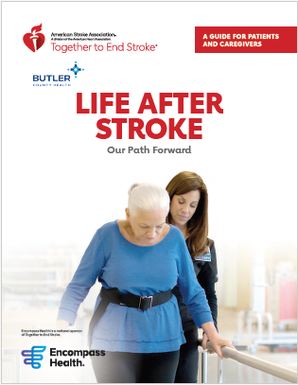
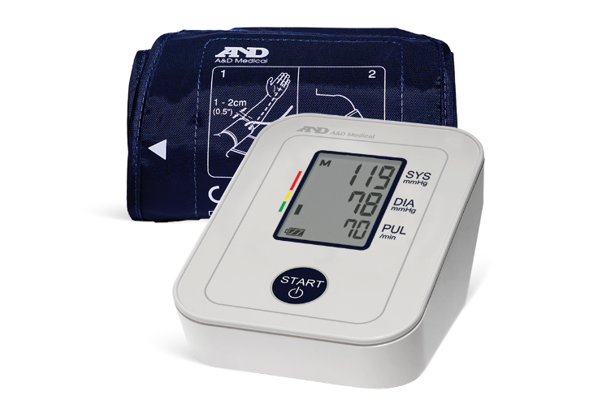

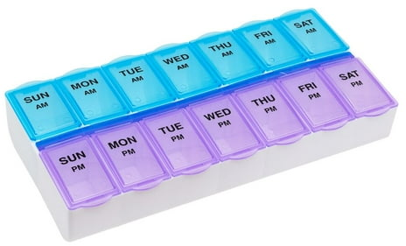
Standard 3.0
PATIENT/CAREGIVER EDUCATION AND SUPPORT
Notes:
Hannah

Slide 11
4.0 Care Coordination
4.0 CARE COORDINATION
The program demonstrates care coordination across the system of care for the stroke patient in three domains: pre-admission, throughout the patient’s admission to the Post-Acute Care facility, and at discharge.
Create a process to facilitate transitions to and from any level of care – including how process is documented
Form a clinical team to meet weekly for care conferences
Developed a referral protocol for the stroke rehabilitation program
Initiatives:
Create a documented process to facilitate transitions to and from any level of care
Form a clinical team group to meet weekly for care conferences
Developed a referral protocol for the stroke rehabilitation program
Construct a discharge checklist
Build and maintain a list of available community resources
Create a follow up communication plan
Create a follow up communication plan
Build and maintain a list of available community resources
Construct a discharge checklist
Notes:
Hannah
Create a documented process to facilitate transitions to and from any level of care (acute, IRF, SNF, LTACH, home health) with specific information about diagnosis, current treatments, ongoing recommendations for care
Form a clinical care group to meet weekly for team conferences: -progress towards goals of the individualized plan of care –discharge planning -assessment of gaps in caregiver readiness and ability to assume the caregiver role ( You will see on the next slide an example of form we use within our EMR)
Referral protocol: a process for providers to place timely referrals to address patient needs and to make sure that the EMR is accessible 24/7 to all members of the team
Discharge checklist: (discussed in our weekly rounding meeting) community resources, referrals to outpatient/HHS, follow up appts, counseling or recommended evaluations, available support groups, provision of DME, medication and nutrition orders and recommendations (all of these things are recommended to be included in our checklist for D/C)
Community Resource checklist – see on the next page – developed by IDT
Follow up communication – recommended follow up with patient and family within 2 business days of dismissal – who is going to do this.

Slide 12
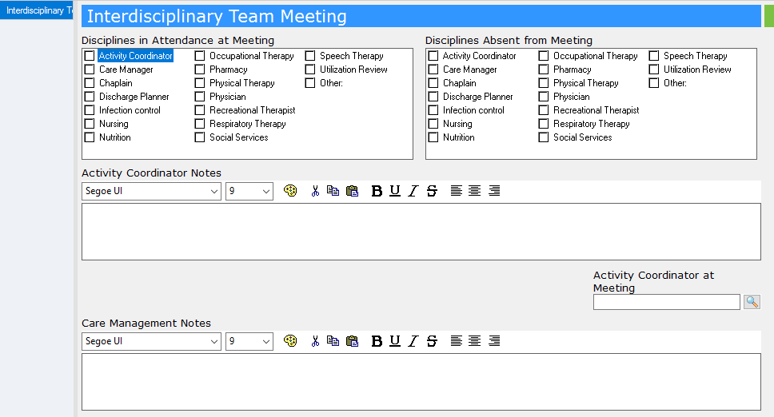
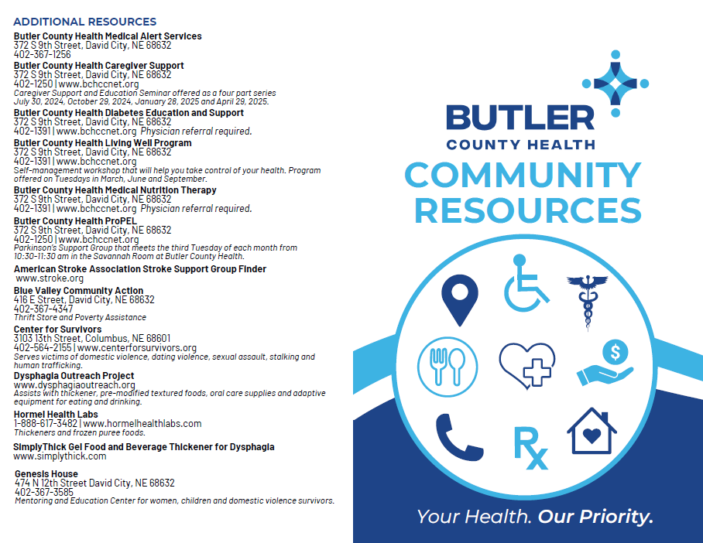
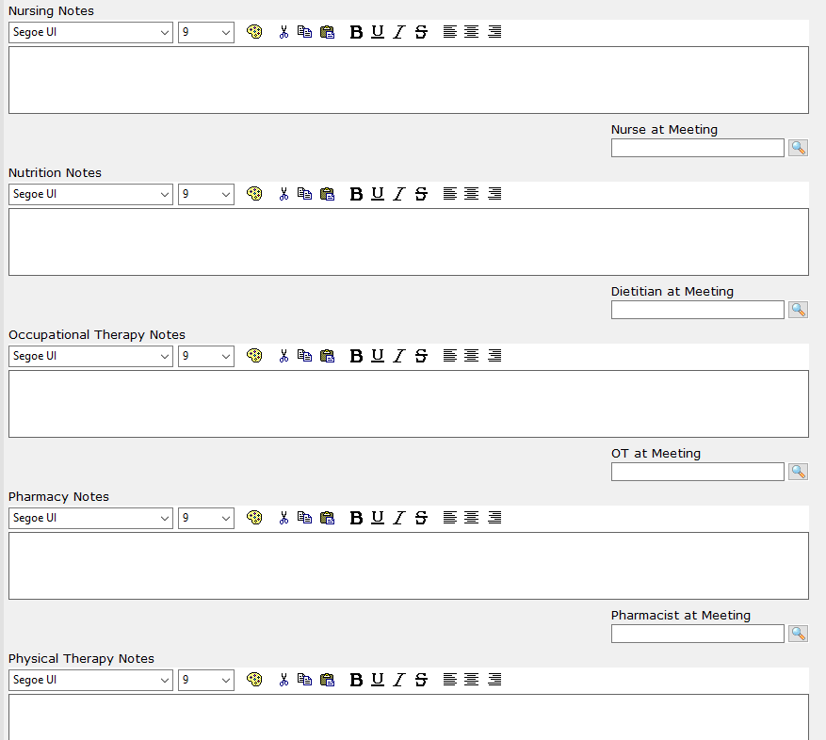
Standard 4.0
CARE COORDINATION
Patient/Caregiver Education and Support
Care Coordination
Standard 3.0-4.0
Notes:
Hannah
Community Resources:
Nutrition Resources
Prescription
DME
Local Clinics
Behavioral Health
Other Additional Resources

Slide 13
5.0 Medical Management
5.0 MEDICAL MANAGEMENT
The Post-Acute Care Stroke program’s ability to provide post-acute care to persons with a stroke diagnosis.
Initiatives:
Establish availability of health care providers
Institute a documented protocol for escalation management
Ensure evidence-based standards are being used for care
Establish availability of health care providers
Institute a documented protocol for escalation management
Ensure evidence-based standards are being used for care
Notes:
Hannah
Establish availability of health care providers > 5 days per week including PT/OT/ST, (Social workers, dietician, behavioral health available for assessment and consultation) , medical staff available 24/7, physician available on-site minimal 3 days per week, neurologist and certified rehab registered nurse are recommended but not required
Screenings and assessments within 24 hours by physician, swallow screen, fall risk assessment, mobility assessment, ADL assessment, skin –integrity screen and
within 72 hours a cognitive screen, SLP formal assessment, and depression screen
Escalation management: include a plan to expedite transfers to acute care prn if status change occured
Ensure evidence-based standards are being used & tracked for skin breakdown/contractures, bowel/bladder management, VTE prophylaxis, pain management, dysphagia, safety in mobility
ORDER SET???

Slide 14
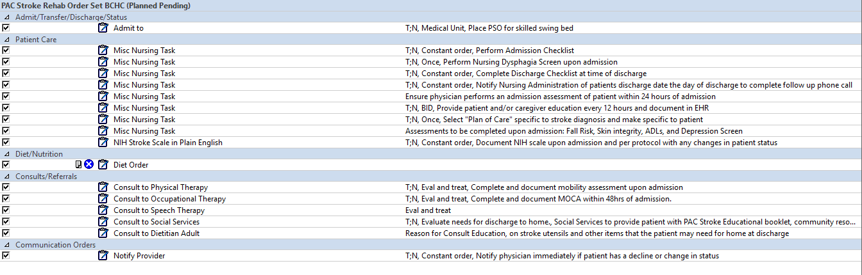
Standard 5.0
MEDICAL MANAGEMENT
Notes:
Hannah
The order set we created within our EMR to ensure we were meeting standards outlined within our policies and created for the PAC Stroke group.

Slide 15
6.0 Quality Improvement
6.0 QUALITY IMPROVEMENT
Ongoing quality improvement measuring the adherence to evidence-based guidelines aimed at improving care and outcomes for stroke patients in the post-acute care setting.
Collect and track regular compliance data
Initiatives:
Collect and track regular compliance data and submit the data in the AHA Quality tracking tool
Identify areas for opportunity for performance improvement
Submit the data in the AHA Quality tracking tool
Identify areas for opportunity for performance improvement
Notes:
Tara
Collect and track regular compliance data on standardized stroke rehab measures and outcomes metrics – then share data quarterly with IPC
Identify areas for opportunity for performance improvement through IPC quarterly meeting minutes then communicate to staff and develop and education plan for PI. Complete follow up assessments to ensure education is effective

Slide 16
CONTINUUM OF CARE at Butler County Health
Tele neurology with Regional Brain Institute through Bryan Health
Daily rounds by tele neurologist via tele video while being treated as an inpatient
Transition to swing bed program as a Post-Acute Stroke Rehab Patient for individualized care
Notes:
Tara

Slide 17






Slide 18
Thank You!

