Slide 1
Promoting Interoperability
Autumn Waldman, BSN, RN
Clinical Informatics at Saunders Medical Center

Slide 2
Objectives
Defining Promoting Interoperability
Defining the Quality Payment Program
Objectives and Measures of the PI Program
Who is required to participate in PI?
Attestation Process

Slide 3
What is Interoperability?
Interoperability: use of technology to exchange and make use of information
makes communicating patient information less burdensome
improves outcomes
It is important because patients receive care from multiple providers working in different healthcare systems.
Helps clinicians deliver safe, effective, patient-centered care
Offers patients and caregivers new ways to access electronic health information to manage and coordinate care

Slide 4
Quality Payment Program (QPP)
The Merit-based Incentive Payment System (MIPS) is one way to participate in the QPP.
The program rewards MIPS eligible clinicians for providing high quality care to their patients.

Slide 5
Who is required to participate?
The program is open to eligible hospitals and critical access hospitals (CAHs) that receive federal funds from Medicare.
Those who are eligible but do not participate are subject to a downward payment adjustment.
Check eligibility status on the QPP website
Notes:
Your performance across the MIPS performance categories, each with a specific weight, will result in a MIPS final score of 0 to 100 points.
Your MIPS final score will determine whether you receive a negative, neutral, or positive MIPS payment adjustment.
Positive payment adjustment 2024 final score above 75
Neutral payment adjustment 2024 final score equal to 75
Negative payment adjustment 2024 final score below 75
Your MIPS payment adjustment is based on your performance during the 2024 performance year and applied to payments for your Medicare Part B-covered professional services beginning on January 1, 2026.

Slide 6
Quality Payment Program (QPP)
Notes:
There are different pathways:
Traditional MIPs: https://qpp.cms.gov/mips/traditional-mips
MIPS Value Pathways (MVPs): https://qpp.cms.gov/mips/mips-value-pathways
APM Performance Pathway (APP): https://qpp.cms.gov/mips/apm-performance-pathway

Slide 7
Traditional MIPS
Notes:
* Available for MVP (MIPS Value Pathways) reporting only
** Available for Traditional MIPS reporting only

Slide 8
APM Performance Pathway

Slide 9
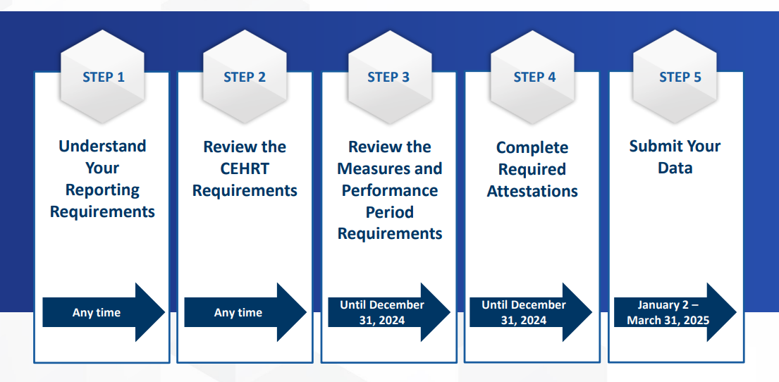
Getting Started (key dates):

Slide 10
Step 1: Reporting Requirements
To be considered a Meaningful User in the program, eligible hospitals and CAHs must:
Attest to the required objectives and their measures for the required EHR reporting period
Update for 2024: 180 continuous days
Satisfy the minimum score requirement
Update for 2024: 75 points
Report on the required number of Electronic Clinical Quality Measures (eCQM)

Slide 11
Reporting Requirements cont.
You qualify for a Promoting Interoperability Performance Category Hardship Exception when you:
Have decertified EHR technology (decertified under the ONC Health IT Certification Program)
Have insufficient internet connectivity
Face extreme and uncontrollable circumstances such as disaster, practice closure, severe financial distress, or vendor issues
Lack control over availability of CEHRT

Slide 12
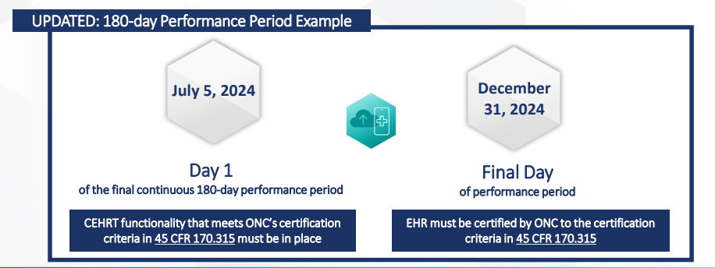
Step 2: Review the CEHRT Requirements
Certified Electronic Health Record Technology (CEHRT)
Notes:
What is CEHRT and why do I have to use CEHRT?
To efficiently capture and share patient data, health care providers need certified electronic health record (EHR) technology (CEHRT) that stores data in a structured format. Structured data allows health care providers to easily retrieve and transfer patient information and use the EHR in ways that can aid patient care.
To meet the CEHRT requirements for 2024 Promoting Interoperability performance category objective and measure reporting, you’ll need to:
Have CEHRT functionality that meets ONC’s certification criteria in 45 CFR 170.315 in place by the first day of your MIPS Promoting Interoperability performance period;
Have your EHR certified by ONC to the certification criteria in 45 CFR 170.315 by the last day of your performance period; and
Provide your EHR’s CMS identification code from the Certified Health IT Product List (CHPL), available on HealthIT.gov, when you submit your data.
If you’re not sure if your EHR is meeting the certification criteria, work with your practice’s technology support team or contact your EHR vendor to verify that your system is on track to meet CEHRT requirements by the last day of your performance period

Slide 13
Step 3: Review the Measures and Performance Period Requirements
Electronic Prescribing
Health Information Exchange (HIE)
Provider to Patient Exchange
Public Health and Clinical Data Exchange

Slide 14
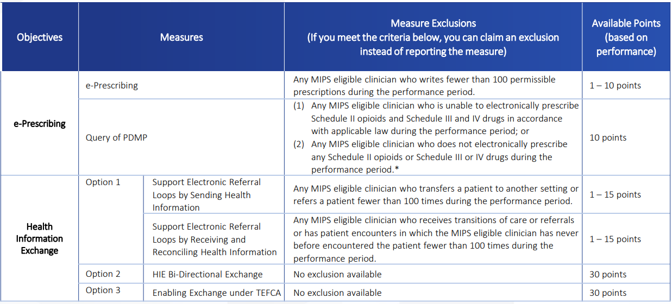
Objectives and Measures: Points
Notes:
The 2024 Promoting Interoperability performance category focuses on the following objectives:
•e-Prescribing
•Health Information Exchange (HIE)
•Provider to Patient Exchange
•Public Health and Clinical Data Exchange
Within these objectives, there are 6 to 7 required measures (dependent upon which measure(s) you choose to report for the HIE objective) in addition to required attestations.
Some of these measures have exclusions; if you qualify, you can claim (submit) the exclusion instead of reporting the measure. See the Appendix for a list of these measures and exclusions.
•You must collect data for all required measures (unless you can claim an exclusion(s)) for the same minimum continuous 180-day period in calendar year (CY) 2024.
•The last 90-day performance period begins on July 5, 2024.
Reminder: For the HIE objective, you have the option to report data for the 2 existing HIE measures and associated exclusions OR the HIE Bi-Directional Exchange measure OR the Enabling Exchange under TEFCA measure

Slide 15
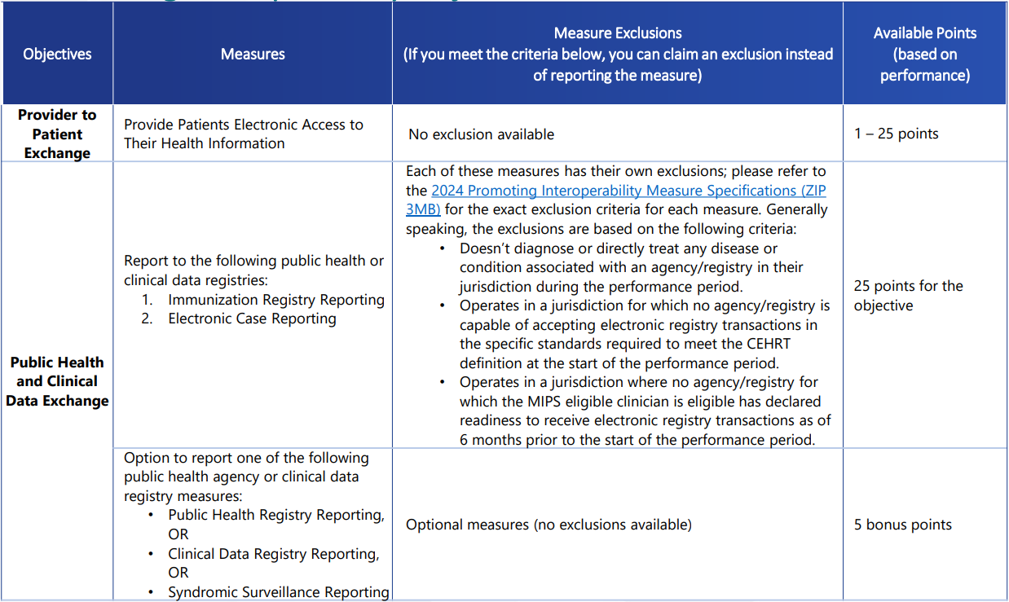
Objectives and Measures: Points
Notes:
For 2024, you can earn a total of 5 bonus points by submitting a “yes” for 1, 2 or 3 of the optional Public Health and Clinical Data Exchange measures listed below:
Public Health Registry Reporting
Clinical Data Registry Reporting
Syndromic Surveillance Reporting
NOTE: Your Promoting Interoperability performance category score can’t exceed 100 achievement points.

Slide 16
Antimicrobial Use and Resistance (AUR) Surveillance Measure
Update: Beginning in CY 2024, CMS finalized changes to the Medicare Promoting Interoperability Program for eligible hospitals and critical access hospitals (CAHs) that include a new AUR Surveillance measure under the Public Health and Clinical Data Exchange Objective.
Notes:
Must attest to being in active engagement with CDC’s NHSN to submit AUR data for the EHR reporting period, or else claim an applicable exclusion.

Slide 17
AUR Surveillance Scoring and Exclusion Criteria

Slide 18
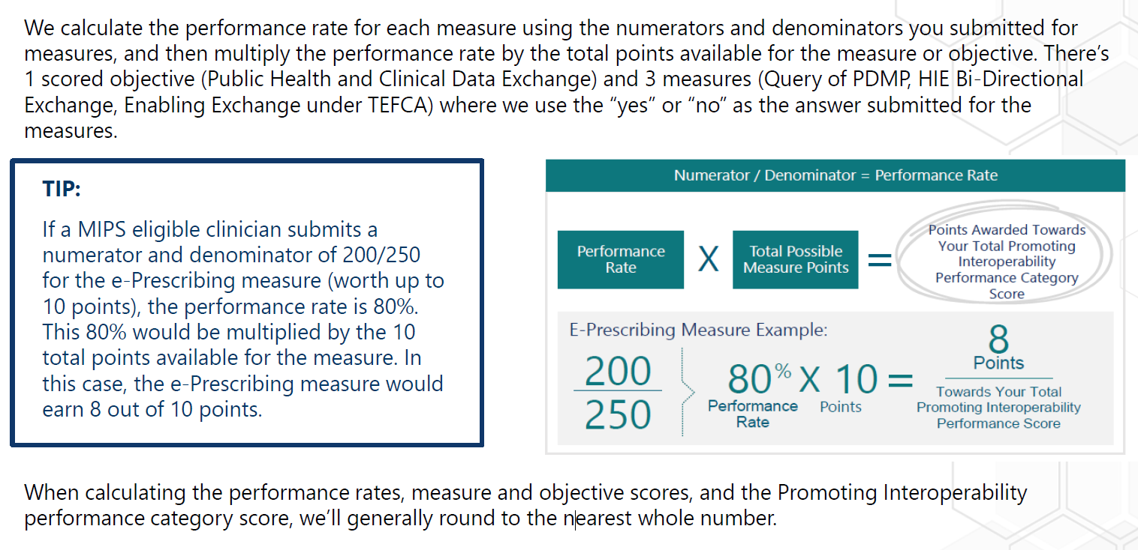
How are Measures Scored?

Slide 19
Step 4: Complete Required Attestations
Perform or Review a Security Risk Analysis
Perform an Annual Assessment of the High Priority Guide (from the SAFER Guides)
Complete the Actions to Limit or Restrict Interoperability of CEHRT Attestation
ONC Direct Review Attestation
Notes:
You must conduct or review a security risk analysis on your CEHRT functionality (that meets ONC’s certification criteria in 45 CFR 170.315) on an annual basis, within the calendar year of the performance period.
Additional guidance on conducting a security risk analysis is available here: https://www.hhs.gov/hipaa/for-professionals/security/guidance/guidance-risk-analysis/index.html?language=es
You must conduct an annual self-assessment using the High Priority Practices Guide (a part of the SAFER Guides), within the calendar year of the performance period.
Beginning with the 2024 performance period, a “yes” response is required. A “no” response will no longer satisfy this measure.
Resource: https://www.healthit.gov/topic/safety/safer-guides
This attestation statement aims to identify whether you or your health IT vendor acted in good faith and took necessary steps to prevent limiting or restricting the compatibility or interoperability of CEHRT.
To complete this attestation, you will attest to the statement by entering a “yes” (certify that you acted in good faith when implementing and using your CEHRT to exchange electronic health information) or “no” (you don’t certify that you acted in good faith when implementing and using your CEHRT to exchange electronic health information) response.
Failure to attest “yes” to the following will result in a score of 0 for the Promoting Interoperability performance category.
ONC Direct Review Attestation:
This is an optional attestation.
To complete the attestation, you may attest “yes” or “no”

Slide 20
Step 5: Submit Your Data
You’ll need to report the required Promoting Interoperability performance category data during the 2024 submission period (1/2/2025 – 3/31/2025).

Slide 21
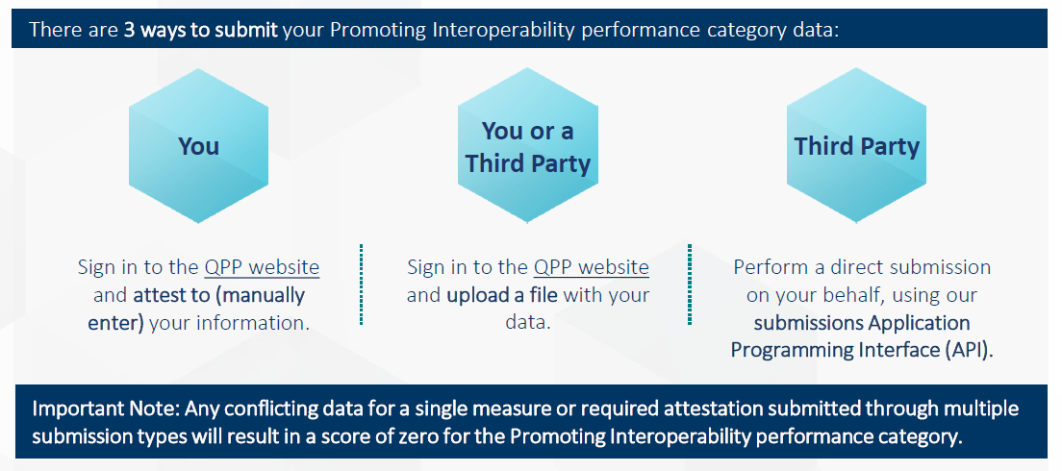
Submit Your Data (continued):
Notes:
You don’t need to include supporting documentation when you attest to your Promoting Interoperability performance category data, but you must keep documentation for 6 years subsequent to submission.

Slide 22
Reference Websites:
Quality Payment Program Website: http://qpp.cms.gov/
2024 Promoting interoperability Program Specs: https://www.cms.gov/files/zip/cms-2024-promoting-interoperability-pi-specification-sheets.zip
2023 MIPS Quick Start Guide: https://qpp-cm-prod-content.s3.amazonaws.com/uploads/2621/2024MIPSQuickStartGuide.pdf
Check your current participation status: https://qpp.cms.gov/participation-lookup
SAFER Guides: https://www.healthit.gov/topic/safety/safer-guides
2024 AUR Specification Sheet: https://www.cms.gov/files/document/cy-2024-antimicrobial-use-and-resistance-surveillance-specification-sheet.pdf

