Slide 1
Leading Change Management
Victoria Kennel, PhD
University of Nebraska Medical Center

Slide 2
Learning Objectives
Prepare your approach for leading change in your organization

Slide 3
Small Group Discussion
What works well when leading change for quality improvement in your facility?
What challenges do you encounter?

Slide 4
Change and Improvement
All improvement requires change
But not all change leads to improvement

Slide 5
What is change management?
The Working Environment
The “Event”
The Psychological Response

Slide 6
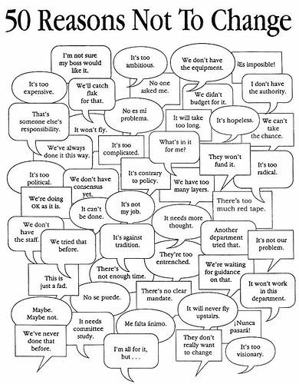
Every reason not to change

Slide 7

Your Capstone Project

Slide 8
Individual change through the ADKAR Change Model
Awareness
Aware of the change AND the reasons/need for it
Desire
Desire to participate and support the change
Knowledge
Knowledge to change – “how to change” and “how to perform”
Ability
Where the change happens – ability to perform the change as expected
Reinforcement
Reinforce the change to sustain it until you see results and it becomes the norm
Hiatt JM. ADKAR: A Model for Change in Business, Government, and Our Community. Prosci Research: Loveland, CO. 2006.

Slide 9
ADKAR Change Model: Awareness
Awareness
Aware of the change AND the reasons/need for it
Why?
Challenges
Success when
Get there by
Clear communication from trusted leaders, sponsors – drivers, opportunities, need for change
A clear, compelling case for the change
Comfort with status quo
“I understand the nature of the change and why this change is needed”
Credibility of source of change messaging
Denial that reasons for change are real/debate over reasons for change
Rumors/misinformation
Access to credible information
Observable event/situation occurred (if relevant)
Hiatt JM. ADKAR: A Model for Change in Business, Government, and Our Community. Prosci Research: Loveland, CO. 2006.
https://www.prosci.com/resources/articles/adkar-model-desire?hsLang=en-us

Slide 10
ADKAR Change Model: Desire
Desire
Desire to participate and support the change
Why?
Challenges
Success when
Get there by
Visible, active sponsor(s)/coalition(s) of sponsors
Personal engagement
Proactively managing resistance
Engaging staff in creating the solution
Incentives aligned with change
Incentive to change and/or fear of consequences
I want to be a part of this
I’ll follow you
Not changing is worse than changing
Translate reasons for change into motivation for personal, organizational change
Fear of unknown
Change misaligned with self-interest, values
I don’t know ‘what’s in it for me’
Poor history with past change/low confidence of success (personal, organizational)
Comfort/security with the way we’ve always done things
“I will be a part of this change”
Hiatt JM. ADKAR: A Model for Change in Business, Government, and Our Community. Prosci Research: Loveland, CO. 2006.
https://www.prosci.com/resources/articles/adkar-model-desire?hsLang=en-us

Slide 11
ADKAR Change Model: Knowledge
Knowledge
Knowledge to change – “how to change” and “how to perform”
Why?
Challenges
Success when
Get there by
Well-designed education and training programs
How to change (what I do during this transition)
Knowledge gaps (current vs. desired knowledge)
“I know how to change and how to perform”
How to perform as desired in the future (what I do – skills and behaviors – to support the change)
Mentoring and coaching
Time demands
Lack of resources
Lack of information
Individual capacity to learn
Knowledge/cognitive aids
Individuals already have awareness and desire
Hiatt JM. ADKAR: A Model for Change in Business, Government, and Our Community. Prosci Research: Loveland, CO. 2006.
https://www.prosci.com/resources/articles/adkar-model-knowledge?hsLang=en-us

Slide 12
ADKAR Change Model: Ability
Ability
Where the change happens – ability to perform the change as expected
Why?
Challenges
Success when
Get there by
Engage coaches
Gap between knowledge gained and translation of knowledge into ability to perform
Lack of time to develop skills
“I can put my knowledge into practice and perform”
Hard to break old habits
Psychological barriers and physical limitations
Individual capabilities to perform
Lacking support
Provide opportunities for hands-on practice, demonstration
Availability of experts to help
Monitor performance
Access to feedback
Hiatt JM. ADKAR: A Model for Change in Business, Government, and Our Community. Prosci Research: Loveland, CO. 2006.
https://www.prosci.com/resources/articles/adkar-model-ability?hsLang=en-us

Slide 13
ADKAR Change Model: Reinforcement
Reinforcement
Reinforce the change to sustain it until you see results and it becomes the norm
Why?
Challenges
Success when
Get there by
Visible performance dashboards, scorecards
Natural for us to revert to old ways
Lack of meaningful recognition
“I am doing my job differently and seeing the results”
We too quickly move on to the next change without hardwiring what we did change
Recognition not associated with achievement
Lack of recognition altogether
Negative consequences for performing desired behavior
Incentives directly oppose the change
Direct feedback from leaders, peers
Visible recognition from sponsors, leaders
Celebrating program/project success
Performance appraisals, compensation supports the change
Make the most of the investment made in the change
Hiatt JM. ADKAR: A Model for Change in Business, Government, and Our Community. Prosci Research: Loveland, CO. 2006.
https://www.prosci.com/resources/articles/adkar-model-reinforcement?hsLang=en-us

Slide 14
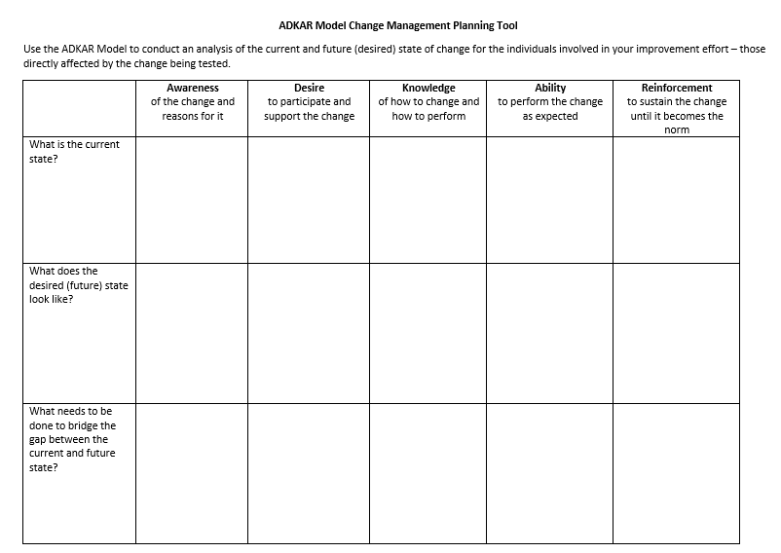
Resource: ADKAR Change Management Planning Tool
Created by Victoria Kennel, PhD, University of Nebraska Medical Center
ADKAR Model: Hiatt JM. ADKAR: A Model for Change in Business, Government, and Our Community. Prosci Research: Loveland, CO. 2006

Slide 15
Your Capstone Project

Slide 16

Using principles of psychology to troubleshoot problems

Slide 17
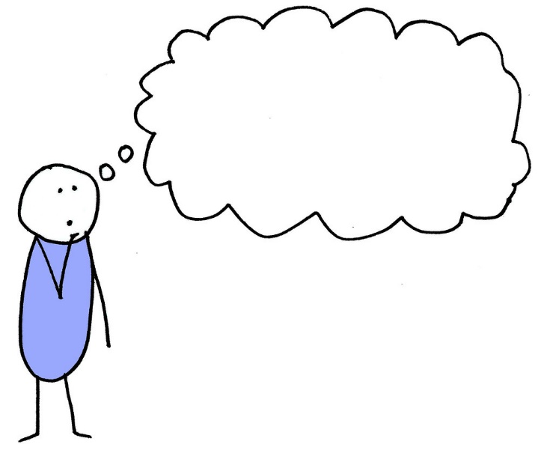
What do they know?
"When did we learn about this?"
"I didn't know I was supposed to do this."
"Why are we doing this?"
Understand the challenge
What do staff know?
Action to encourage behavior change
Match the education method to the type of knowledge
Do staff know that they should be doing this?
Do staff know why they should be doing this?
Evaluate what was (and wasn't) learned (e.g., post-test, pre-post test)
Is the knowledge used on an infrequent or irregular basis? Consider use of reference guides, alerts/reminders, cognitive aids, etc.
Michie, S., Johnston, M., Abraham, C., Lawton, R., Parker, D., Walker, A., & "Psychological Theory" Group (2005). Making psychological theory useful for implementing evidence based practice: a consensus approach. Quality & safety in health care, 14(1), 26–33. https://doi.org/10.1136/qshc.2004.011155

Slide 18
What can they do?
"I know I'm supposed to do this, but I don't know how."
"I can't do this the way we were told, so I did it another way."
Understand the challenge
Action to encourage behavior change
Offer opportunities for staff to practice or demonstrate the skill, and receive feedback
How easy/difficult is it for staff to do this so that their action meets the desired standards?
Identify the workarounds used, and remove barriers to encourage action consistent with desired protocols
Do staff know how to do this?
Michie, S., Johnston, M., Abraham, C., Lawton, R., Parker, D., Walker, A., & "Psychological Theory" Group (2005). Making psychological theory useful for implementing evidence based practice: a consensus approach. Quality & safety in health care, 14(1), 26–33. https://doi.org/10.1136/qshc.2004.011155

Slide 19
What do they believe about their capabilities?
"I know how to do it, and can do it, but I just don't feel confident in my ability to do it well in this situation."
Understand the challenge
Do staff believe that they can do this?
Action to encourage behavior change
Provide ample opportunities to practice under different circumstances
How confident are staff in doing this in this specific situation?
Pair staff with role models who can assist and demonstrate successful completion of the activity
Offer positive verbal feedback and encouragement
Encourage staff to visualize themselves performing this activity successfully
Michie, S., Johnston, M., Abraham, C., Lawton, R., Parker, D., Walker, A., & "Psychological Theory" Group (2005). Making psychological theory useful for implementing evidence based practice: a consensus approach. Quality & safety in health care, 14(1), 26–33. https://doi.org/10.1136/qshc.2004.011155

Slide 20
What are their professional roles and identities?
"This isn't my responsibility"
or “This isn't my job"​
“[My profession] doesn't do this"
Understand the challenge
How does doing this align (or create conflict) with staff professional identity?
Action to encourage behavior change
Reinforce the importance of ‘task assistance,’ ‘mutual support,’ and 'back-up behavior' as key aspects of team-based care
Revisit job descriptions and task responsibilities
Do staff perceive this activity as ‘beyond’ or ‘beneath’ their role?
Identify opportunities for cross-training
Michie, S., Johnston, M., Abraham, C., Lawton, R., Parker, D., Walker, A., & "Psychological Theory" Group (2005). Making psychological theory useful for implementing evidence based practice: a consensus approach. Quality & safety in health care, 14(1), 26–33. https://doi.org/10.1136/qshc.2004.011155

Slide 21
What do they see others do?
“Other staff members do (don't do) it this way."
"Provider X does (doesn't) do this, so neither do we."
Understand the challenge
Do staff see others doing this? Do others like them do this?
Action to encourage behavior change
Have well-respected role models, champions share information in support of the desired behavior, against the undesired behavior
Are social norms encouraging or discouraging staff from doing this?
Show staff how their performance compares against others
Offer verbal/non-verbal rewards for effort and/or progress
Michie, S., Johnston, M., Abraham, C., Lawton, R., Parker, D., Walker, A., & "Psychological Theory" Group (2005). Making psychological theory useful for implementing evidence based practice: a consensus approach. Quality & safety in health care, 14(1), 26–33. https://doi.org/10.1136/qshc.2004.011155

Slide 22
What are their goals and motivations?
"I can't do this and this at the same time."
"I know this will keep the patient safe, but the patient will be really upset with me."
Understand the challenge
Do staff feel like they need to do this?
Action to encourage behavior change
Help staff with goal prioritization
Do staff understand the goal of this action?
What competing goals influence staff behavior?
What incentives exist to motivate staff to act?
Ensure goals are clearly defined, explained, and understood
Identify areas where goals are in competition, in conflict with one another
Revisit how you recognize, reward new behavior
Michie, S., Johnston, M., Abraham, C., Lawton, R., Parker, D., Walker, A., & "Psychological Theory" Group (2005). Making psychological theory useful for implementing evidence based practice: a consensus approach. Quality & safety in health care, 14(1), 26–33. https://doi.org/10.1136/qshc.2004.011155

Slide 23
What do they think will (or won’t) happen if they do (or don’t) act?
“I've done this many times, nothing bad has happened."
"Is adding one more intervention really going to help reduce risk?
Understand the challenge
What will happen if staff do this?
Action to encourage behavior change
Help staff draw connections between their actions and outcomes
What are the perceived costs of doing this? What are the perceived costs of the consequences of doing this?
Do the benefits outweigh the costs?
What will staff feel like if they do, or don't do, this?
Understand staff perceptions of costs vs. benefits of the action
Understand staff perceptions of risk and the why behind them; educate accordingly to ensure perceptions of risk reflect reality
Michie, S., Johnston, M., Abraham, C., Lawton, R., Parker, D., Walker, A., & "Psychological Theory" Group (2005). Making psychological theory useful for implementing evidence based practice: a consensus approach. Quality & safety in health care, 14(1), 26–33. https://doi.org/10.1136/qshc.2004.011155

Slide 24

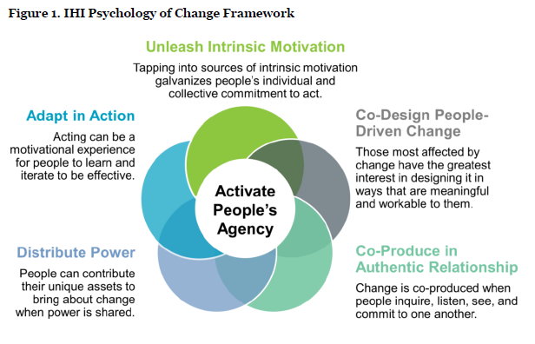
IHI’s Psychology Of Change Framework
Hilton K, Anderson A. IHI Psychology of Change Framework to Advance and Sustain Improvement. Boston, Massachusetts: Institute for Healthcare Improvement; 2018. (Available at ihi.org)

Slide 25
Wrap-Up

