Slide 1


HcBTAM: Behavioral Threat Assessment Management: A Primer on Violence Risks, Consequences and Solutions
Presented by:
Kristine Sanger, BS, MT (ASCP), CHPCP, CEPA
Co-Executive Director
Association of Healthcare Emergency Preparedness Professionals (AHEPP)
Project Coordinator & Educator
Center for Preparedness and Response Solutions
College of Public Health, University of Nebraska Medical Center

Slide 2


Objectives
Define Behavioral Threat Assessment and its importance in public health, healthcare, and the public sector
Explain the key components of the Behavioral Threat Assessment process
Explain the key steps in forming and leading a Behavioral Threat Assessment Team
Numerous slides are taken from the National Threat Evaluating and Reporting Program Office
WARNING
Notes:
Talk about a trigger warning for those that have been affected by Incel’s, stalked, harassed, etc.
Slides with the NTER logo are adapted from the National Threat Evaluation and Reporting Program Office

Slide 3

Safe2Help NE
https://safe2helpne.com/
Notes:
This is a career.
How far down the rabbit hole should we go, Alice?
And…..here is a fluffy puppy to help make up for the dark topics ahead.
Safe 2 Help NE is a reporting hotline for potential threats, suicides, and domestic violence.

Slide 4
BASELINE KNOWLEDGE about Behavioral Threat Assessment Management

Slide 5
Targeted Violence Defined
Generally, any premeditated act of violence directed at a specific individual, group, or location, regardless of motivation, that violates the criminal laws of the United States or of any State or subdivision of the United States.
Adapted from: Making Prevention a Reality: Identifying, Assessing, and Managing the Threat of Targeted Attacks – FBI

Slide 6
IS
HcBTAM
Healthcare Behavioral Threat Assessment Management
1
Identify
2
Inquire
Individual
4
Manage
3
Assess
Notes:
As discussed, this all revolves around and individual(s). There are four general steps in BTAM, but you may see three or five at times.
These will be discussed later in the presentation.

Slide 7
IS
1
Identify
2
Inquire
Individual
About behavior
About management
A systematic, fact-based method of inquiry and examination
Focused on an individual’s patterns of thinking and behavior
A course of action that responds to and mitigates a threat
A pro-active, multi-disciplinary process
Risk & Protective Factors
Predatory vs. Affective
Posing vs. Making Threats (Hunters & Howlers)
The Pathway
“BTAM is an evidence-based and systematic process to identify, inquire, assess, and manage potential threats. Multidisciplinary teams, … can use a BTAM process to provide alternatives to criminal justice interventions for individuals who may be at risk of moving toward violence.” U.S. DHS. (2025). Behavioral threat assessment and management in practice (CP3 Publication No. 0214).
4
Manage
3
Assess
Notes:
Items in the bracket will be covered soon, and in more depth.

Slide 8

IS NOT
Patient risk assessment
Rejection & punishment
Perfect prediction
Magic wand
Linear
One size fits all
Outcome (process instead)
One & done
A criminal or disciplinary (HR) investigation
A physical security risk assessment
A surveillance or collection program (although needed)
Criminal profiling

Slide 9






Profiling vs. BTAM
Threat Assessment is the opposite of profiling.
TA is never applied to a theoretical situation. It is always an assessment of a real situation.
Notes:
BTAM is NOT profiling. There is no profile for this. Ages are from early teens to retirement. White collar and blue collar. Male and female. Employed and unemployed, etc.
Profiling is when you study all conference hecklers in the U.S. You then determine whether there are common characteristics. In our example, the profile of a common conference heckler is that they are red-headed females with an eye-patch and a peg-leg.
BTAM, by contrast, is looking at the BEHAVIOR of individuals, regardless of demographics.

Slide 10

Let’s ruin a myth
“Offenders Don’t ‘Snap’— They Decide”
IS
Premeditated, involves intentional planning and preparation
All instances of targeted violence and almost all mass murders are premeditated
The planned nature provides an opportunity for the BTAM process to prevent an attack
Predatory
Planned
IS NOT
Impulsive
Reactive
Emotional and impromptu
Frequently a defensive or reactionary behavior in response to a perceived imminent threat
Adapted from: Making Prevention a Reality: Identifying, Assessing, and Managing the Threat of Targeted Attacks – FBI
Notes:
BTAM is not about impulsive or reactive violence. It IS about predatory or planned violence.

Slide 11
Example
A television news report described a man who shot and killed his wife at her work.
He was served a restraining order and divorce papers on his birthday.
He made threats, was fired, stalked her, and put a gun to his wife’s head the week before the killing.
The reporter concluded the segment with….
“Officials concede that no-one could have predicted this would happen.”
The Gift of Fear. Gavin De Becker
Notes:
An example from Gavin De Beckers “The Gift of Fear”.

Slide 12

Sandy Hook Promise

Slide 13

Doin’ok?

Slide 14
Why should Healthcare be involved?

Slide 15
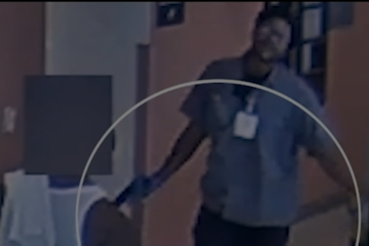
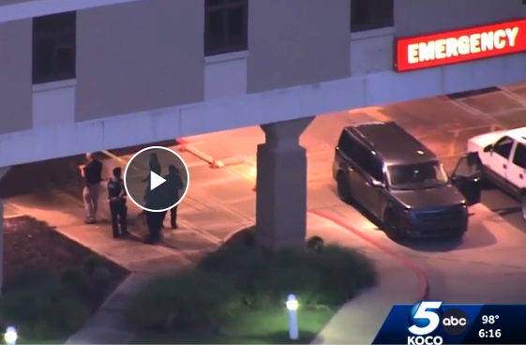
2025 Healthcare Incidents
University of Pittsburgh Medical Center
United Healthcare Headquarters, Minnetonka, MN
Aultman Hospital, Canton, OH
Provident Hospital, Chicago, IL
HCA Palms West Hospital, Loxahatchee, FL
University of Illinois, Chicago
Integris Health, Enid OK
Henry Ford Hospital, Detroit, MI
Mr. R. 07-21-2025. University of Illinois Chicago Hospital.
Aramark (food service). Shot two off campus.
Channel 7 Eyewitness News. Chicago & Suburban Cook Co.
Mr B. 08-17-2025. Integris Health Center. Enid, OK.
Domestic violence nearby. Killed 72yo security guard.
KOCO News 5.
Notes:
The list on the left are only items that hit Keith’s news feed.
Upper right. The gentleman with the gun shot two roommates off campus then can to the hospital. Additionally, this was NOT a hospital employee. He worked for Aramark (food service). Hospitals have a LOT of contractors with wide access to the facility. Hc cannot only focus on employees. They must include patients, patient families, contractors (EVS, Food service, construction), AND employees.
Bottom right. Mr. B. severely abuse his girlfriend. She was transported to the hospital. He came hours later and killed a 72yo unarmed security guard on the way to her room. The security delayed Mr B long enough for law enforcement to come and shoot him.

Slide 16
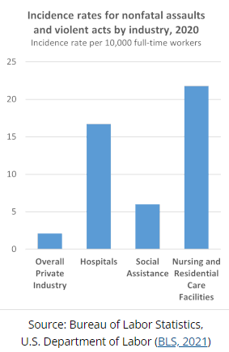
Nursing Data
From 2016 to 2020 there were 207 deaths due to violence in the workplace in the health care and social assistance industry within the private sector (BLS, 2021).

Slide 17
More Nursing Data
80% of nurses do not feel safe in their workplace (Peek-Asa et al., 2009).
In a survey of 125 ED nurses, intensive care unit and general floor nurses at a regional medical center, 82% of ED nurses had been physically assaulted at work in one year (May & Grubbs, 2002).
25% of psychiatric nurses experienced disabling injuries from patient assaults (Quanbeck, 2006).

Slide 18
Healthcare is DIFFERENT
“…the act or threat of violence, ranging from verbal abuse to physical assaults directed toward persons at work or on duty.”
Hc is often a person’s “worst day”
Hc workers treat the severely ill and injured
Federal legislation (Emergency Medical Treatment and Labor Act - EMTALA) requires emergency treatment from any hospital that receives Medicare payments
Hc is designed and legislated to attract and serve high-stress, high-emotion individuals
Hc has a “lot of Tuesday’s” which encourages complacence
https://www.cdc.gov/niosh/topics/violence/default.html
Notes:
and…..misdemeanor battery
When a nurse gets slapped by a patient ”it’s just another Tuesday” Assault of nurses is normalized to a certain extent and we need to get past this normalization.

Slide 19
Individuals and Warning Signs
Notes:
The following “white slides” are from the National Threat Evaluation & Reporting office in the Department of Homeland Security.

Slide 20
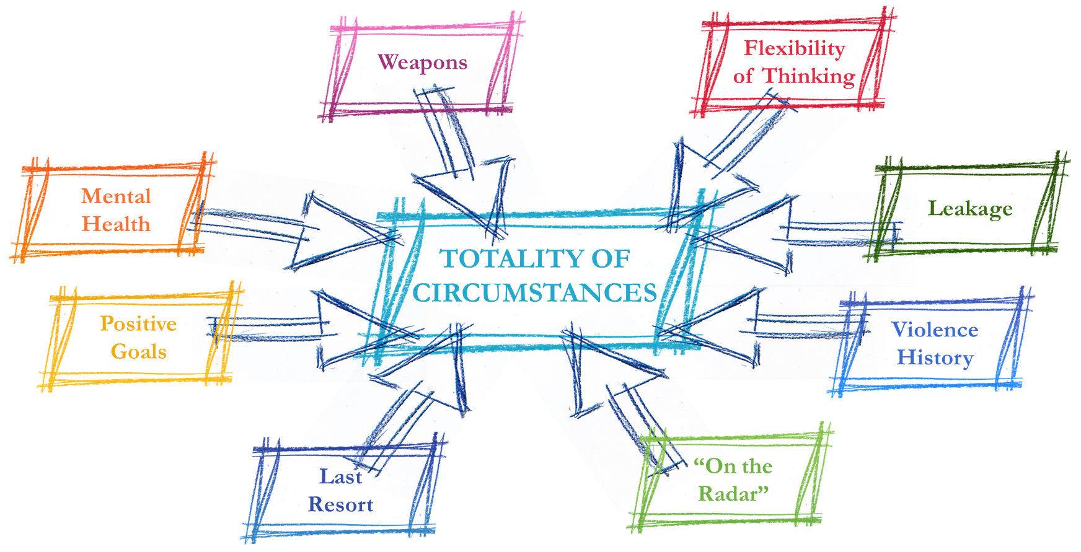
Totality of Circumstance
Notes:
Some of these are risk factors or warning signs (leakage, violence history, last resort).
Some are protective factors (positive goals, flexibility of thinking, “on the radar”)
One could be risk or protective (mental health)
One is neutral by itself (weapons), It is not automatically a risk factor – Remember…..TOTALITY OF CIRCUMSTANCE

Slide 21

Can You Identify Any Warning Signs

Slide 22
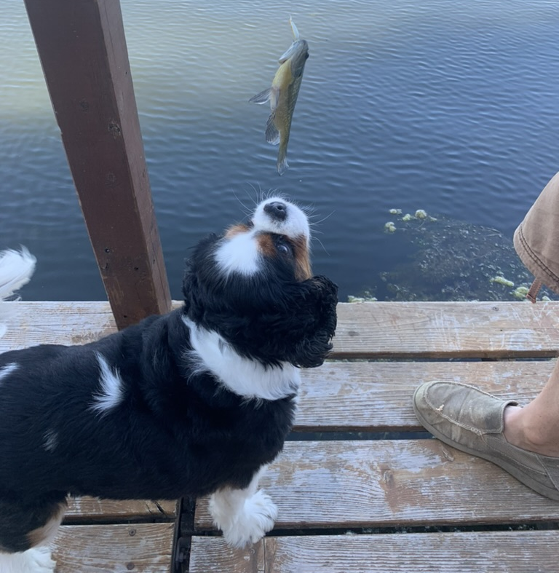

Safe2Help NE
https://safe2helpne.com/

Slide 23





Risk
Factors
Triggers and Stressors
Warning Behaviors
Warning Behaviors That Could Signal Imminence
Mitigators

Slide 24
VIOLENCE HISTORY
OTHERS ARE CONCERNED
HEALTH/MENTAL HEALTH
SOCIAL/ENVIRONMENTAL
PERSONALITY DISTURBANCES/DISORDER
PROBLEMATIC
BEHAVIORAL HISTORY
SEVERE MENTAL ILLNESS
WEAPONS
HISTORY OF SUICIDALITY

Slide 25
Risk
Factors
Triggers and Stressors
Warning Behaviors
Warning Behaviors That Could Signal Imminence
Mitigators

Slide 26
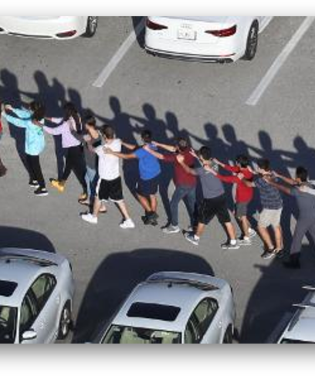
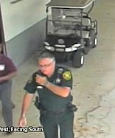
Case Example: Parkland, FL
Warning Behaviors
Identification
Novel Aggression
Leakage
Directly Communicated Threat
Approach Behavior
Pathway to Violence Warning Behaviors
Behavior that Could signal Imminence
Fixation
Notes:
All examples are from the Parkland H.S. shooter (Nicolas Cruz - NC) and indicated by PHSS.
Fixation = Obsession (increased focus on the person or cause). NC “My love toward her grows, without her I’m nothing all this madness inside is about to Burst without her I have nothing I wish we could love, I wish we could live, but a the end to her it’s probably nothing, but that’s ok cause I love her, I love my angel (name redacted) if I don’t die please see me it will bring happiness to me I want to love……….”
Identification = “pseudo commando” or beginning to identify with other extremists (NC when talking about the Pulse Nightclub Shooting said “I’m glad they killed all those gay people.” ). Sometimes they will start to dress in fatigues or Camo (Colorado Theatre shooter dies his hair). Again….think of totality of circumstance….is this Unusual behavior for this person? It may be for Kristi, but not for Shawn!
Novel aggression = NC…three months prior to the shooting, knocked out three of his mother’s teeth. Had never previously assaulted a family member.
Leakage = information to a third party “Don’t come to school tomorrow but watch the news”. NC said “I am going to get this gun when I turn 18 and shoot up the school.” Pay specific attention to the use of past tense.
Directly Communicated Threat = Statement of intended violence made to the target or others prior to the act. NC threatened a fellow student saying he would kill her, rape her, and hurt her family. This is uncommon. Most people won’t “warn” their target. IF someone makes a directly communicated threat, the level of concern should increase.
Approach Behavior = an attempt to gain proximity to a target. Generally not considered in workplaces because people go there all the time. In a Midwest hospital, an abusive husband sent his wife pictures of himself in the nurses locker room….just to prove he could get access. NC was seen on campus by security and they knew he wasn’t supposed to be there.
Pathway to Violence Behaviors = Personal grievance; Violent ideation; Research/planning; Preparation; Probing/Breaching; Attack. These will discussed in a few slides.
Behaviors that signal imminence = These will be discussed in a few slides.

Slide 27
Pathway to Violence Warning Behaviors
Personal Grievance
Violent Ideation
Research/ Planning
Probing/ Breaching
Prepare for Violence
Attack
Escalation Pathway
Adapted from: Calhoun & Weston, 2003

Slide 28
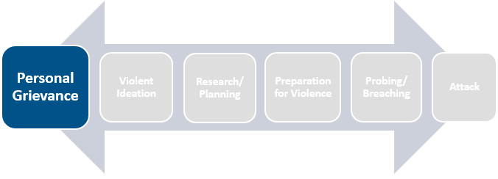
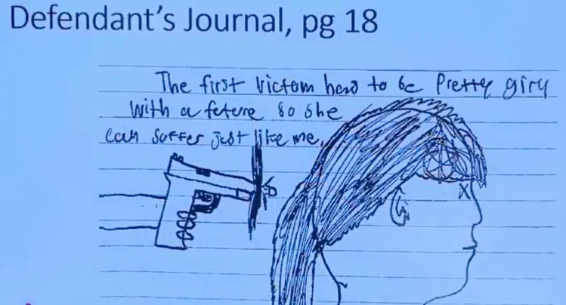
Pathway to Violence: Grievance
Grievance: the formation of a deeply held personal complaint, resentment, or humiliation based upon real or perceived injustices inflicted upon the grievant. It is highly personal and can cause great distress. This feeling of being wronged often generates behaviors related to a sense of mission, destiny, loss, or a desire for revenge.
This is from the Oxford High School offender’s journal. “The first victim has to be pretty girl with future so she can suffer just like me.”
Adapted from: Dias and Talbot, 2024

Slide 29
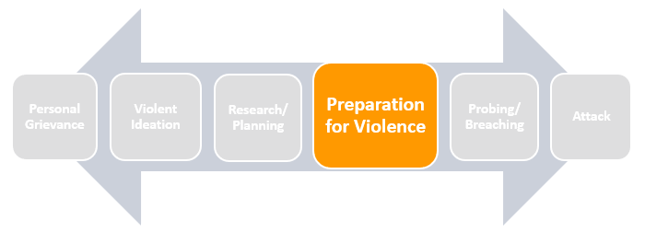
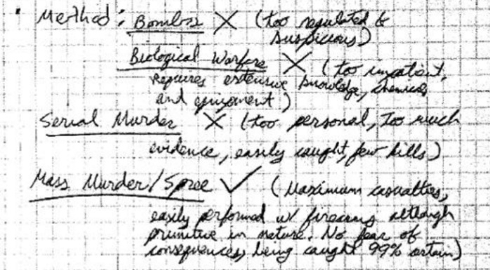
Pathway to Violence: Preparation for Violence
Preparation for Violence: Once an individual decides that violence should or must be used to seek justice for real or perceived wrongs, under most circumstances they must then begin to think and plan.
After deciding on a course of action and conducting the necessary background work, an individual may begin to prepare physically and psychologically to conduct an actual attack.
The Aurora movie theater offender noted in his journal about the methods he could use – “bombs (too suspicious), Biological warfare (requires chemicals and equipment), Serial Murder (too personal-few kills), Mass Murder/Spree (Maximum Casualties, Easily Performed).”
Adapted from: Dias and Talbot, 2024

Slide 30
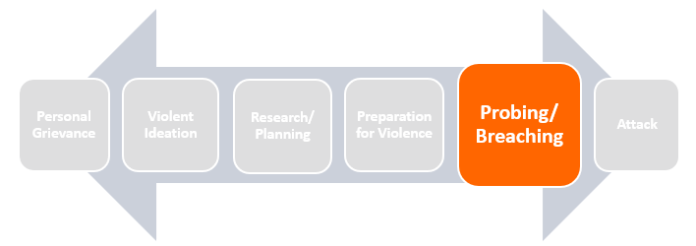
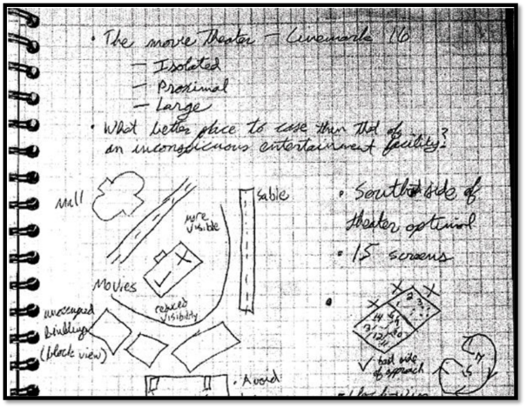
Pathway to Violence: Probing/Breaching
Probing/Breaching: involves an individual circumventing both physical and online security measures at the target location and can include activities such as: conducting dry runs, engaging in approach behaviors including stalking, and testing physical security at the target location.
The Aurora movie theater offender journaled – “What better place to case than that of an inconspicuous entertainment facility.”

Slide 31


Safe2Help NE https://safe2helpne.com/

Slide 32
Risk
Factors
Triggers and Stressors
Warning Behaviors
Warning Behaviors That Could Signal Imminence
Mitigators

Slide 33
Warning Behaviors that Could Signal Imminence
Energy burst behavior
End of life planning
Last resort
Sudden withdrawal from life pattern
Sudden cessation of medications or other substance use
Adapted from: Making Prevention a Reality: Identifying, Assessing, and Managing the Threat of Targeted Attacks – FBI

Slide 34
Risk
Factors
Triggers and Stressors
Warning Behaviors
Warning Behaviors That Could Signal Imminence
Mitigators

Slide 35
Mitigators
CONFLICT RESOLUTION
FLEXIBILITY OF THINKING
“ON THE RADAR”
ACCESS AND RECEPTIVENESS TO ASSISTANCE
POSITIVE, REALISTIC GOALS
SUPPORTIVE FAMILY
POSITIVE COPING MECHANISMS
HEALTHY SOCIAL SUPPORTS
Adapted from: Making Prevention a Reality: Identifying, Assessing, and Managing the Threat of Targeted Attacks – FBI

Slide 36
Key Components of the Behavioral Threat Assessment Management Teams

Slide 37
BTAM Teams
Threat assessment and management teams are effective proactive and protective measures that are designed to prevent – not predict – potential acts of targeted violence and terrorism.
Through identifying and managing potential threats, these teams provide alternatives to investigation and/or prosecution for bystanders who are actively seeking intervention assistance with a known individual at risk of mobilizing to violence. (USDHS, 2021)

Slide 38
BTAM Team Members
Administrators,
Mental health providers
Social service provider
Faith leaders
Medical personnel
TA Professionals
Law enforcement
Technology experts
Risk Management
Legal
Security
Emergency Management
Others?

Slide 39
What do BTAMs Teams do?
1
Identify
2
Inquire
Individual
4
Manage
3
Assess
Identify Persons of Concern
Gather Information
Assessment
Management
Concerning behaviors
Risk factors
Protective factors
Triggers
Level of concern
Provide assessment to appropriate parties
Policies & procedures
See something, say something right away
Authority
Training
Reporting channels
Notes:
Assessment is the phase that most teams are NOT capable of performing by themselves.
Bring in the community teams as well. SCHOOL, LE, FAITH BASED ORGANIZATION – for information gathering

Slide 40
Goal of the CP3 Grant
HcEM
BTAM Team

Slide 41
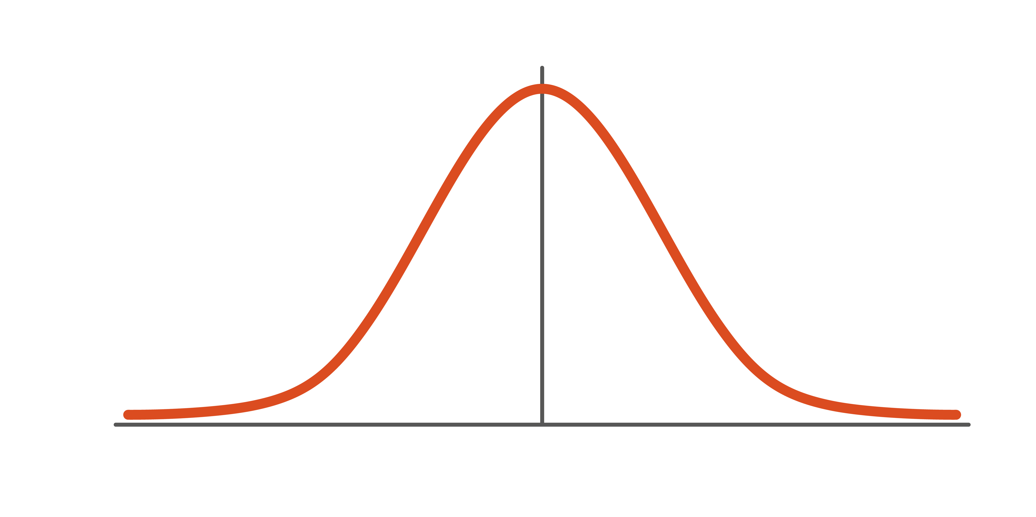

HcBTAM & HcEM/PHEM
Boom
BTAM
BTAM
Preparedness
Response
Mitigation
Recovery
Prevention
Notes:
Prevention focuses on preventing human hazards, primarily from potential natural disasters or terrorist (both physical and biological) attacks. Preventive measures are designed to provide more permanent protection from disasters; however, not all disasters can be prevented. The risk of loss of life and injury can be limited with good evacuation plans, environmental planning and design standards.
Preparedness is a continuous cycle of planning, organizing, training, equipping, exercising, evaluating, and taking corrective action. Training and exercising plans is the cornerstone of preparedness which focuses on readiness to respond to all-hazards incidents and emergencies.
Response is comprised of the coordination and management of resources (including personnel, equipment, and supplies) utilizing the Incident Command System in an all-hazards approach; and measures taken for life/property/environmental safety. The response phase is a reaction to the occurrence of a catastrophic disaster or emergency.
Recovery consists of those activities that continue beyond the emergency period to restore critical community functions and begin to manage stabilization efforts. The recovery phase begins immediately after the threat to human life has subsided. The goal of the recovery phase is to bring the affected area back to some degree of normalcy.
Mitigation is the effort to reduce loss of life and property by lessening the impact of disasters and emergencies. Mitigation involves structural and non-structural measures taken to limit the impact of disasters and emergencies. Structural mitigation actions change the characteristics of buildings or the environment; examples include flood control projects, raising building elevations, and clearing areas around structures. Non-structural mitigation most often entails adopting or changing building codes

Slide 42

Contact
Keith F Hansen
kfhansen@ahepp.org
Kristine Sanger
ksanger@ahepp.org
Safe2Help NE
https://safe2helpne.com/

Slide 43
Where Can I Learn More?
DHS Center for Prevention Programs and Partnerships (CP3)
https://www.dhs.gov/CP3
Association of Threat Assessment Professionals (ATAP)
https://www.atapworldwide.org/

Slide 44
Where Can I Learn More?
Association of Healthcare Emergency Preparedness Professionals (AHEPP – Soon)
www.ahepp.org
Secret Service – National Threat Assessment Center
https://www.secretservice.gov/protection/ntac

Slide 45
References
AHA. (2022). Strengthening the Health Care Workforce: Strategies for Now, Near and Far. Retrieved from https://www.aha.org/system/files/media/file/2022/09/Strengthening-the-Health-Care-Workforce-Complete-20220909.pdf
CISA. Hospitals & Healthcare Facilities: Security Awareness for Soft Targets and Crowded Places Retrieved from https://www.cisa.gov/sites/default/files/publications/19_0515_cisa_action-guide-hospitals-and-healthcare.pdf
DeBecker, G. (2021). The Gift of Fear: Survival Signals That Protect Us from Violence: Back Bay Books.
Maguire, B. J., & Smith, S. (2013). Injuries and Fatalities among Emergency Medical Technicians and Paramedics in the United States. Prehospital and Disaster Medicine, 28(4), 376–382. doi:10.1017/S1049023X13003555
Lipscomb, J., & Borwegen, B. (2000). Health care workers. Occupational Health: recognising and preventing work-related disease and injury. 4th ed. Philadelphia, PA: Lippincott, Williams & Wilkins, 767-78.
Meloy, J. R., & Hoffmann, J. (2021). International handbook of threat assessment: Oxford University Press.
Ryan, S. (2019, May, 2019). Threat, Intimidation, or Something Else? (and Why it Matters). The Beat.

Slide 46
References
UIIPRC 2021
U.S. Bureau of Labor Statistics. Fact Sheet-Workplace Violence in Healthcare, 2018. Website.
U.S. Department of Homeland Security. (2025). Behavioral threat assessment and management in practice (CP3 Publication No. 0214). Retrieved from https://www.dhs.gov/sites/default/files/2025-02/2025_0214_cp3_behavioral-threat-assessment-and-management-in-practice.pdf
U.S. Department of Homeland Security. (2024). Behavioral Threat Assessment and Management. Retrieved from https://www.dhs.gov/sites/default/files/2024-10/240730IABTAM508.pdf
U.S. Department of Homeland Security. (2021). Threat Assessment and Management Teams. Retrieved from https://www.dhs.gov/sites/default/files/2021-12/Threat%20Assessment%20and%20Management%20Teams_0.pdf
United States Secret Service (2023). Mass Attacks in Public Spaces: 2016 – 2020.
United States Secret Service (2022). Hot Yoga Tallahassee: A Case Study of Misogynistic Extremism.
Calhoun, F. S., & Weston, S. W. (2003). Contemporary threat management: A practical guide for identifying, assessing, and managing individuals of violent intent: Specialized Training Services.

