Slide 1
Management of Clostridioides difficile Infection in Adults
Danny Schroeder, PharmD, BCPS
Antimicrobial Stewardship Pharmacist
Nebraska ASAP

Slide 2
Objectives
Discuss best practices in management of Clostridioides difficile Infection (CDI)
Understand the treatment of initial and recurrent CDI
Evaluate possible strategies for CDI prophylaxis

Slide 3
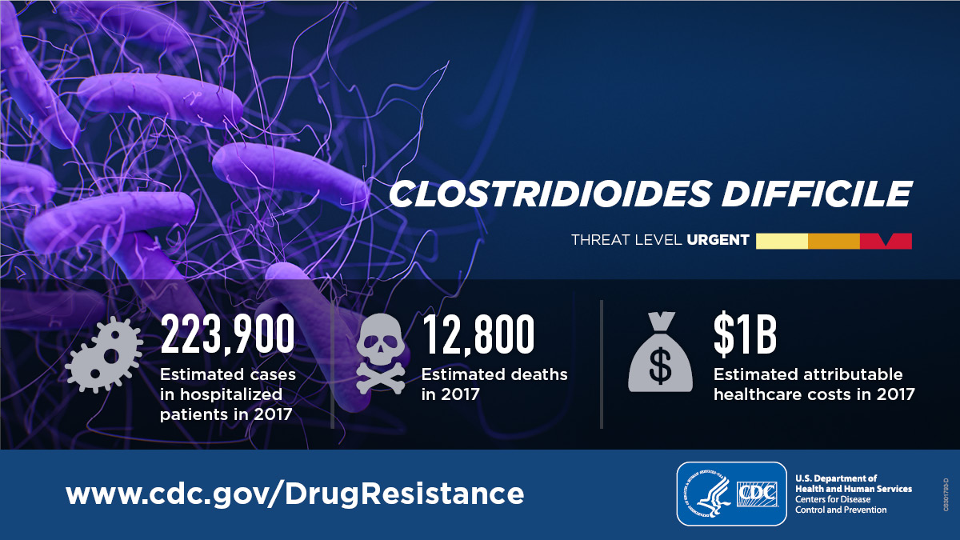
Clostridioides difficile (C. diff)
A bacterium that causes severe diarrhea and colitis
Categorized as an urgent threat by the CDC
  Infection with C. diff usually occurs most often in people who have taken antibiotics for other conditions
    C. diff is the most common healthcare-associated infection
    C. diff can be life threatening
      Fourth level
        Fifth level
CDC’s Antibiotic Resistance Threats in the United States, 2019
Notes:
Urgent threat – germs that are public health threats that require urgent and aggressive action

Slide 4
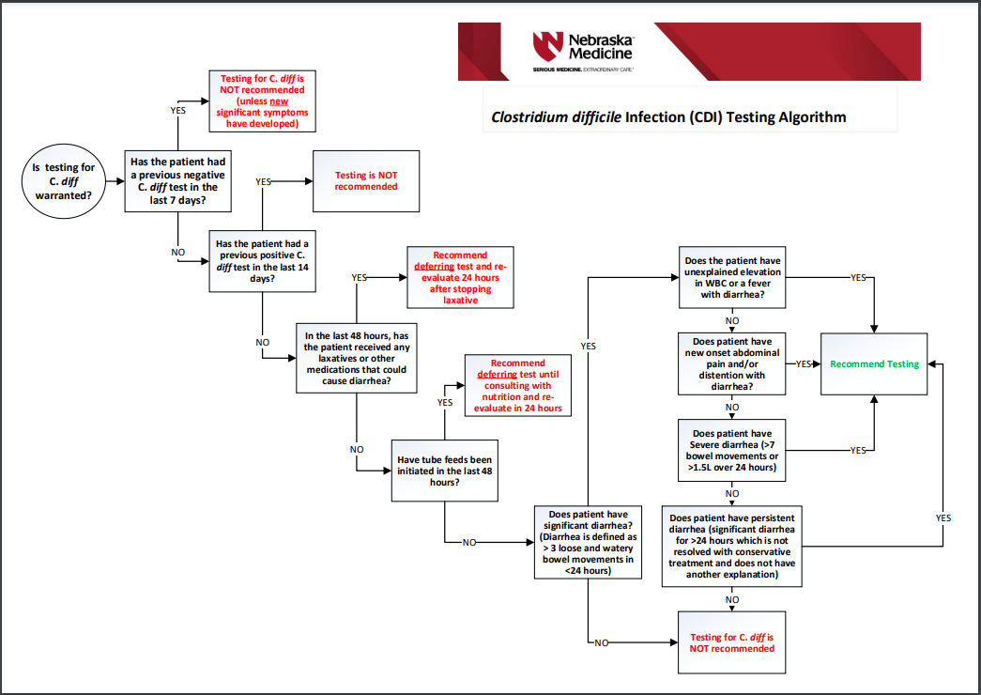
Who Should be Tested for C. diff?
https://www.unmc.edu/intmed/divisions/id/asp/clinical-pathways/docs/CDI-Testing-Algothrithm.pdf
Notes:
Rule out other causes
Don’t test formed stool, asymptomatic patients, or perform “test of cure”

Slide 5
Who Should be Tested for C. diff?
https://www.unmc.edu/intmed/divisions/id/asp/clinical-pathways/docs/CDI-Testing-Algothrithm.pdf
Notes:
Rule out other causes
Don’t test formed stool, asymptomatic patients, or perform “test of cure”

Slide 6
Who Should be Tested for C. diff?
https://www.unmc.edu/intmed/divisions/id/asp/clinical-pathways/docs/CDI-Testing-Algothrithm.pdf
Notes:
Rule out other causes
Don’t test formed stool, asymptomatic patients, or perform “test of cure”

Slide 7
Testing Methods
C. diff PCR
Highly sensitive, but not specific
Should be coupled with a toxin assay
C. diff Toxin Assay
Antigen via glutamate dehydrogenase (GDH)
  Detects vegetative C. diff bacteria
  High negative predictive value
Toxin
  Disease causing component of CDI
  Positive result in the setting of diarrhea is strongly suggestive of CDI
https://www.unmc.edu/intmed/divisions/id/asp/protected-antimicrobials/docs/CDI_final.pdf

Slide 8
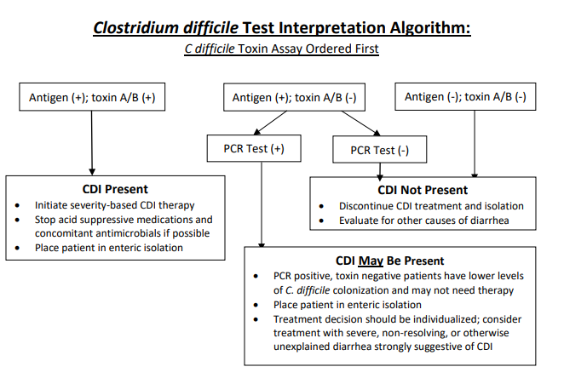
Test Interpretation
https://www.unmc.edu/intmed/divisions/id/asp/protected-antimicrobials/docs/CDI_final.pdf

Slide 9
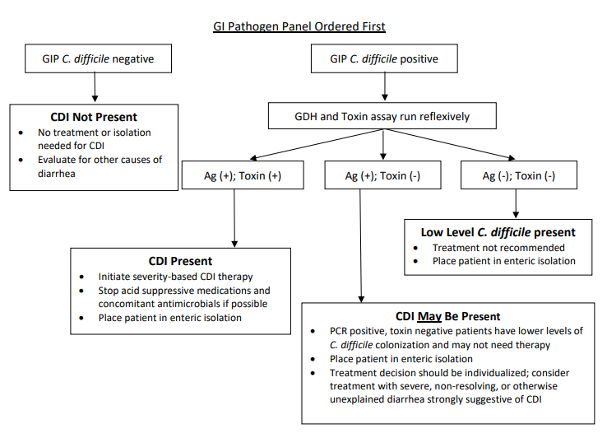
Test Interpretation
https://www.unmc.edu/intmed/divisions/id/asp/protected-antimicrobials/docs/CDI_final.pdf

Slide 10
General Treatment Recommendations
Replace fluids and electrolytes as needed
Stop acid suppressive medications if possible
  Continued use is associated with increased risk for CDI and CDI recurrence
Stop concomitant antibiotics if possible
  If unable to stop antibiotics, use the most narrow spectrum agent for shortest safe duration
  Continued antibiotic use is associated with prolonged time to symptom resolution and increased CDI recurrence
Discontinue anti-motility and pro-motility medications
Monitor for clinical worsening and adjust therapy if needed
https://www.unmc.edu/intmed/divisions/id/asp/protected-antimicrobials/docs/CDI_final.pdf

Slide 11
Disease Severity
Non-severe CDI
  CDI that does not meet criteria for a severe or complicated episode
Severe CDI
  WBC ≥ 15,000 cells/mm³
  OR
  Serum creatinine ≥ 1.5 mg/dL
Clinical Infectious Diseases, Vol 73, Issue 5, 1 September 2021, Pages e1029–e1044

Slide 12
Treatment – 2021 IDSA/SHEA Guidelines
Initial Episode
Preferred therapy
  Fidaxomicin 200 mg PO BID x10 days
  Emphasis that fidaxomicin has a better sustained response (fewer recurrent episodes)
  Implementation depends on available resources
Acceptable alternative
  Vancomycin 125 mg PO QID x10 days
Acceptable alternative for non-severe CDI if neither of the above are available
  Metronidazole 500 mg PO TID x10 days
Clinical Infectious Diseases, Vol 73, Issue 5, 1 September 2021, Pages e1029–e1044

Slide 13
Treatment – 2021 IDSA/SHEA Guidelines
First CDI Recurrence
Preferred therapy
  Fidaxomicin 200 mg BID x10 days
  OR
  Fidaxomicin 200 mg BID x5 days then every other day for 20 days
Alternative therapy
  Pulse tapered oral vancomycin
  125 mg QID x10-14 days, then 125 mg BID x7 days, then 125 mg daily x7 days, then 125 mg every 2-3 days for 2-8 weeks
Alternative therapy if metronidazole used for initial occurrence
  Vancomycin 125 mg QID x10 days
Adjunctive therapy
  Bezlotoxumab 10 mg/kg IV x1 dose given during standard of care (SOC) antibiotics
Clinical Infectious Diseases, Vol 73, Issue 5, 1 September 2021, Pages e1029–e1044

Slide 14
Treatment – 2021 IDSA/SHEA Guidelines
Second CDI Recurrence
Preferred therapy
  Fidaxomicin 200 mg BID x10 days
  OR
  Fidaxomicin 200 mg BID x5 days then every other day for 20 days
Alternative therapy
  Pulse tapered vancomycin
  OR
  Vancomycin 125 mg QID x10 days followed by rifaximin 400 mg TID x20 days
Adjunctive therapy
  Bezlotoxumab 10 mg/kg IV x1 dose given during SOC antibiotics
Fecal microbiota transplantation (FMT)
  Can be attempted after 3 courses of antibiotics have been used (2 recurrences)
Clinical Infectious Diseases, Vol 73, Issue 5, 1 September 2021, Pages e1029–e1044

Slide 15
Treatment – 2021 IDSA/SHEA Guidelines
Fulminant CDI
Severe CDI + hypotension or shock, ileus, toxic megacolon, or fulminant colitis
Preferred therapy
  Vancomycin 500 mg PO/Per tube QID
  PLUS
  Metronidazole 500 mg IV Q8H (especially if ileus present)
Adjunctive therapy if ileus present
  Vancomycin 500 mg per rectum Q6H
Fidaxomicin not preferred due to lack of evidence in fulminant CDI
Clinical Infectious Diseases, Vol 73, Issue 5, 1 September 2021, Pages e1029–e1044

Slide 16
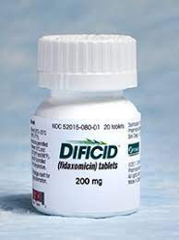
Why Fidaxomicin?

Slide 17
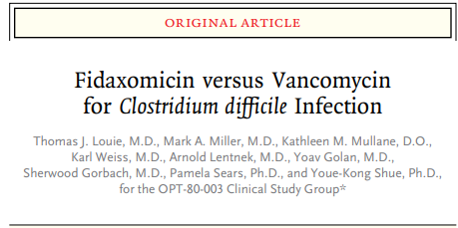
Multicenter, double blind, noninferiority RCT
629 patients from 52 sites in US and Canada
May 2006 – August 2008
N Engl J Med 2011;364:422-31.
Notes:
Primary endpoint – clinical cure; secondary endpoint – recurrence of c diff during 4-week period after end of course of therapy and global cure rate
Diarrhea (>3 unformed BMs in last 24 hours and + toxin test)
MITT (596 patients) – randomized and received at least one dose, PP (548 patients) – received 3 days (for failure) and 8 days (for clinical cure), adhered to protocol and had end of treatment eval
59% inpatient
Severity of disease differences in definition, recurrence was within 4 weeks of clinical cure

Slide 18
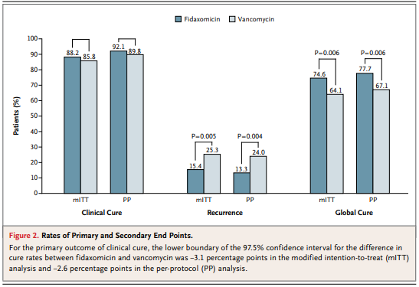
N Engl J Med 2011;364:422-31.

Slide 19
N Engl J Med 2011;364:422-31.

Slide 20
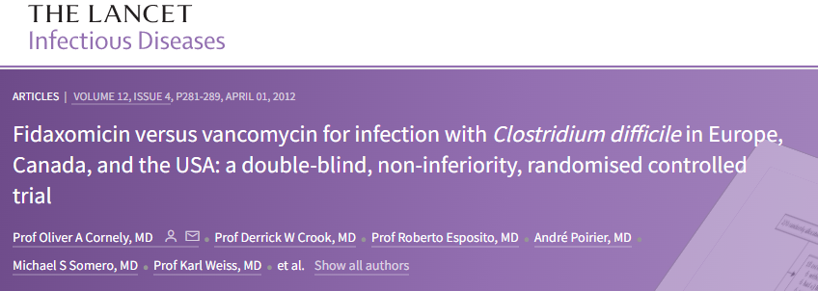
Multicenter, double-blind, randomized, non-inferiority trial
535 patients from 45 Sites in Europe and 51 sites in USA and Canada
April 2007 – December 2009
Lancet Infectious Diseases: February 8, 2012 – Volume 12, Issue 4; P281-289. https://doi.org/10.1016/S1473-3099(11)70374-7
Notes:
Same structure as previous study
509 patient in mITT, 451 in PP
68% inpatients

Slide 21
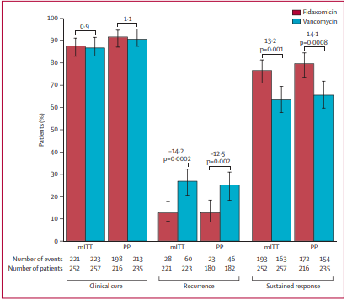
Lancet Infectious Diseases: February 8, 2012 – Volume 12, Issue 4; P281-289. https://doi.org/10.1016/S1473-3099(11)70374-7
Notes:
Clinical cure % mITT – fidoxomicin 88.2% / vanco 85.8% ---- PP – fidaxo 92.1% / vanco 89.8%
Recurrence mITT – fidax 15.4% / vanco 25.3% ----- PP – fidaxo 13.3% / vanco 24%

Slide 22
Lancet Infectious Diseases: February 8, 2012 – Volume 12, Issue 4; P281-289. https://doi.org/10.1016/S1473-3099(11)70374-7

Slide 23
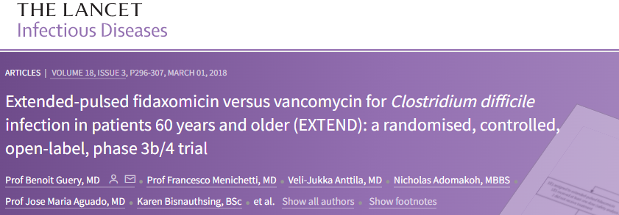
Randomized, controlled, open-label, superiority study
364 hospitalized patients, aged 60 years or older, from 86 sites in Europe
November 2014 – May 2016
Randomized 1:1 to
  Vancomycin 125 mg PO QID x10 days
  Fidaxomicin 200 mg PO BID x5 days then 200 mg every other day for 10 doses (day 7-25)
Lancet Infectious Diseases – March 1, 2018 – Volume 18, Issue 3; P296-307. https://doi.org/10.1016/S1473-3099(17)30751-X
Notes:
Primary endpoint – sustained clinical cure of CDI at 30 days after end of treatment (day 40 for vanco and day 55 for fidaxo)
Secondary endpoinat – Sustained clinical cure and recurrence rates at days 40, 55, and 90 for both groups, among many others

Slide 24
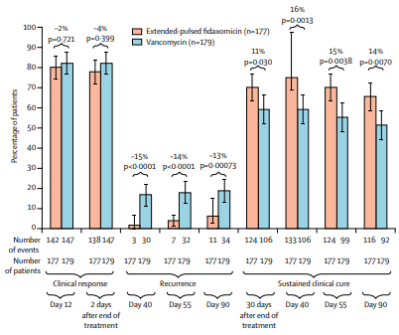
Lancet Infectious Diseases – March 1, 2018 – Volume 18, Issue 3; P296-307. https://doi.org/10.1016/S1473-3099(17)30751-X
Notes:
Sustained clinical cure 30 days after end of tx – fidax 70% / vanco 59%
Recurrence 2 vs 17% at day 40 / 4 vs 18 at day 55 / 6 vs 19 at day 90

Slide 25
Lancet Infectious Diseases – March 1, 2018 – Volume 18, Issue 3; P296-307. https://doi.org/10.1016/S1473-3099(17)30751-X
Notes:
Sustained clinical cure 30 days after end of tx – fidax 70% / vanco 59%
Recurrence 2 vs 17% at day 40 / 4 vs 18 at day 55 / 6 vs 19 at day 90

Slide 26
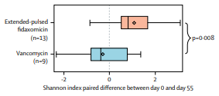
Lancet Infectious Diseases – March 1, 2018 – Volume 18, Issue 3; P296-307. https://doi.org/10.1016/S1473-3099(17)30751-X
Notes:
Shannon Index of fecal microbiota diversity, higher number is more diverse

Slide 27
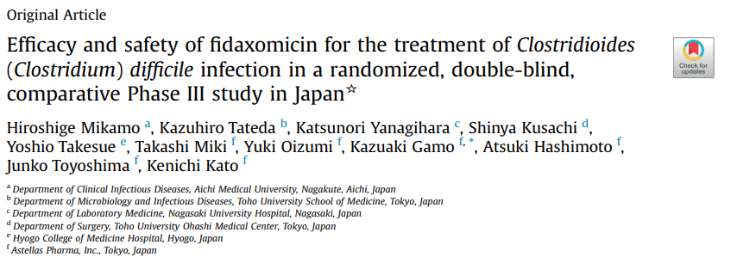
Multicenter, randomized, double-blind, non-inferiority study
212 hospitalized patients from 82 sites in Japan
June 2014 – September 2016
J Infect Chemother 24 (2018) 744e752. https://doi.org/10.1016/j.jiac.2018.05.010
Notes:
Primary endpoint – global cure rate; secondary – global cure rate in secondary populations, clinical cure rate, recurrence rate, time to recurrence

Slide 28
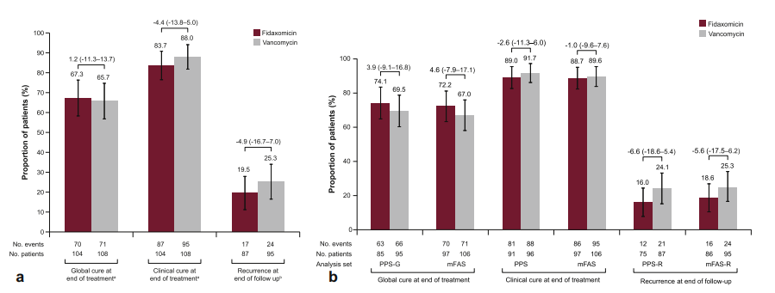
J Infect Chemother 24 (2018) 744e752. https://doi.org/10.1016/j.jiac.2018.05.010
Notes:
Enrolled only hospitalized patients
A uses full analysis set
B uses secondary analysis populations – developed due to higher amount of premature withdrawal from fidaxo arm
-PPS-G (per protocol set for global cure), mFAS (modified full analysis set, patients in FAS who received at least 3 days of tx)

Slide 29
J Infect Chemother 24 (2018) 744e752. https://doi.org/10.1016/j.jiac.2018.05.010
Notes:
Enrolled only hospitalized patients
A uses full analysis set
B uses secondary analysis populations – developed due to larger amount of premature withdrawal from fidaxo group compared to vanco

Slide 30
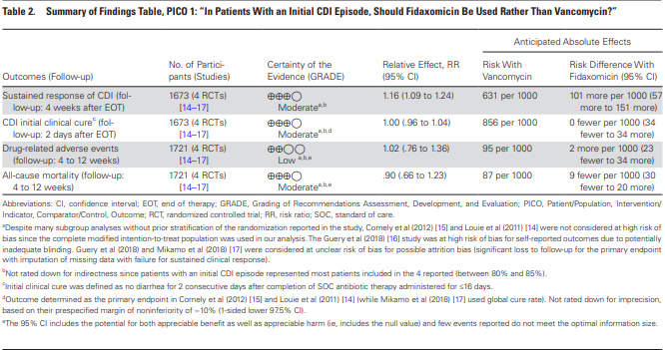
2021 IDSA/SHEA Guidelines
Clinical Infectious Diseases, Vol 73, Issue 5, 1 September 2021, Pages e1029–e1044
Notes:
Moderate certainty due to open-label nature of Guery study and attrition bias in both Guery and Mikamo studies

Slide 31
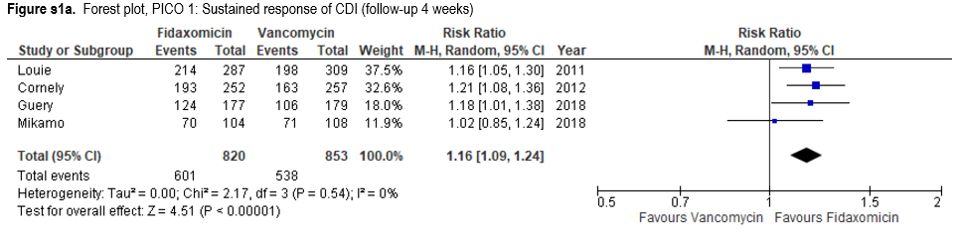
2021 IDSA/SHEA Guidelines
Clinical Infectious Diseases, Vol 73, Issue 5, 1 September 2021, Pages e1029–e1044
Notes:
Moderate certainty due to open-label nature of Guery study and attrition bias in both Guery and Mikamo studies

Slide 32
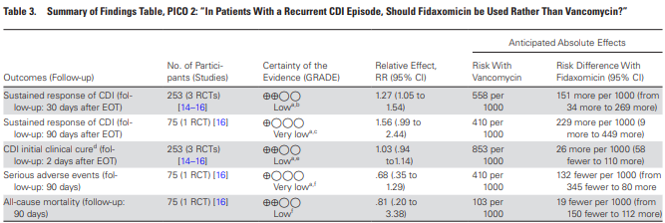
2021 IDSA/SHEA Guidelines
Clinical Infectious Diseases, Vol 73, Issue 5, 1 September 2021, Pages e1029–e1044
Notes:
Lower quality evidence due to small sample sizes and potentially indadequate blinding from Guery study

Slide 33
Fidaxomicin Cost Effectiveness
Limited number of cost-effectiveness models to compare cost of fidaxomicin and vancomycin
  Suggest fidaxomicin is cost effective
  Likely outdated
Cost of fidaxomicin has gone up
  $4000-5000 per course
Cost of vancomycin has gone down
  ~$100 per course
Impact on quality of life for patients with recurrence
  How much value does each patient put on sustained response?
Clinical Infectious Diseases, Vol 73, Issue 5, 1 September 2021, Pages e1029–e1044
Notes:
-cost-effectiveness studies are highly influenced by the assumptions made and data input in the model. Publication bias is a concern since most cost-effectiveness studies are funded by industry.
-ACG says cost effectiveness analysis favors vanco over fidaxo for initial severe episode of CDI

Slide 34
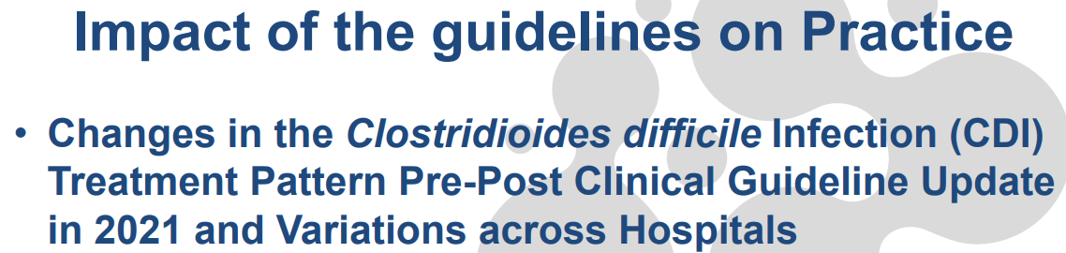
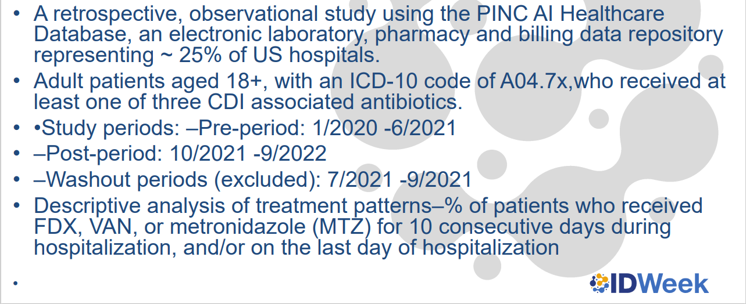
Dubberke et al. IDWeek 2023

Slide 35
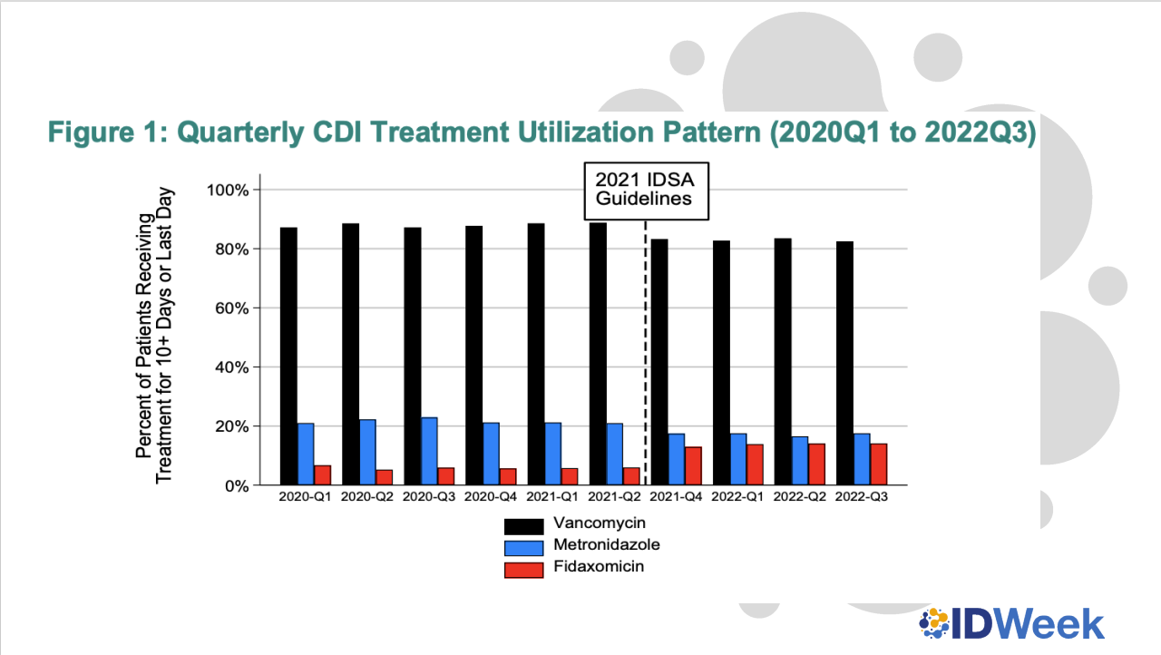
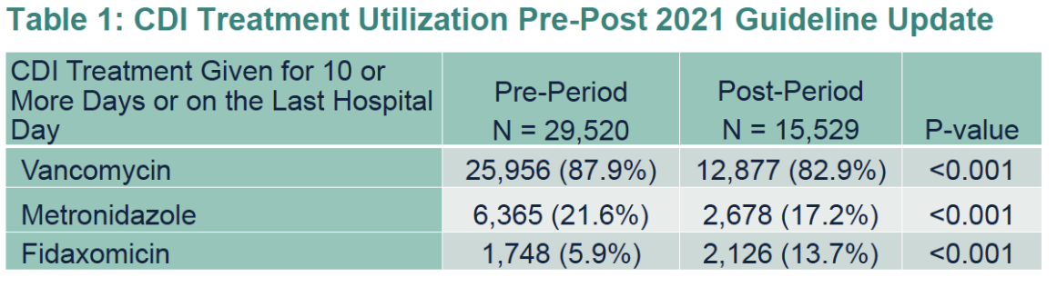
Dubberke et al. IDWeek 2023

Slide 36
Treatment – 2021 ACG Guidelines
Initial Non-Severe Episode
Preferred therapy
  Vancomycin 125 mg PO QID x10 days
  OR
  Fidaxomicin 200 mg PO BID x10 days
Acceptable alternative in a low risk patient with non-severe infection
  Metronidazole 500 mg PO TID
  Low risk defined as younger outpatients with minimal comorbidities
    Particularly in cost-sensitive environments
The American Journal of Gastroenterology: June 2021 - Volume 116 - Issue 6 - p 1124-1147
Notes:
-stong, low quality for vanco
-strong, moderate low for fidaxo
-ACG notes a retropsective, multicenter, propensity score matched analysis of the VA database which showed no statistically significant difference for the primary outcome of combined clinical failure or recurrence 31.9% vs 25.5%. No difference in mortality.

Slide 37
Treatment – 2021 ACG Guidelines
Initial Severe Episode
Severe disease is defined as
  WBC ≥ 15,000 cells/mm³
  OR
  Serum creatinine ≥ 1.5 mg/dL
Preferred therapy
  Vancomycin 125 mg PO QID x10 days
  OR
  Fidaxomicin 200 mg PO BID x10 days
Do not recommend metronidazole as an alternative in severe disease
The American Journal of Gastroenterology: June 2021 - Volume 116 - Issue 6 - p 1124-1147

Slide 38
Treatment – 2021 ACG Guidelines
First CDI Recurrence
Recurrence after an initial course of fidaxomicin, vancomycin, or metronidazole
  Pulse tapered oral vancomycin
Recurrence after an initial course of vancomycin or metronidazole
  Fidaxomicin 200 mg PO BID x 10 days
The American Journal of Gastroenterology: June 2021 - Volume 116 - Issue 6 - p 1124-1147

Slide 39
Prevention of Recurrent CDI – 2021 ACG Guidelines
Fecal Microbiota Transplantation (FMT)
Recommended for patients experiencing their second or further recurrence of CDI
Suggest repeat FMT for patients experiencing a recurrence of CDI within 8 weeks of an initial FMT
Bezlotoxumab
10 mg/kg IV x1 dose during SOC antibiotics can be considered in patients at high risk for recurrence
  65 years or older with at least one of the following
    Second episode of CDI within the last 6 months
    Immunocompromised
    Severe CDI
The American Journal of Gastroenterology: June 2021 - Volume 116 - Issue 6 - p 1124-1147

Slide 40
Bezlotoxumab
Monoclonal antibody that binds to toxin B and prevents it from entering the GI cell layer
60 minute infusion that must be given prior to completion of SOC antibiotics
Limited evidence when used with fidaxomicin
Caution advised for use in patients with CHF
  Higher incidence of heart failure, ADEs, serious ADEs, and deaths
  Mechanism for these effects is unclear
IDSA/SHEA 2021 Guidelines
Patients with a recurrent CDI episode within the last 6 months
Patients with primary CDI and other risk factors for recurrence
  Age ≥ 65
  Immunocompromised host
  Severe CDI on presentation
ACG 2021 Guidelines
65 years or older with one of the following
  Second episode of CDI within the last 6 months
  Immunocompromised
  Severe CDI
The American Journal of Gastroenterology: June 2021 - Volume 116 - Issue 6 - p 1124-1147:
Clinical Infectious Diseases, Vol 73, Issue 5, 1 September 2021, Pages e1029–e1044
Notes:
ACG does not recommend BEZ in patients with CHF
IDSA only notes FDA warning "in patients with hx of CHF, BEZ should be reserved for use with the benefit outweighs the risk"
Immunocompromised – per history or use of immunosuppressive therapy

Slide 41
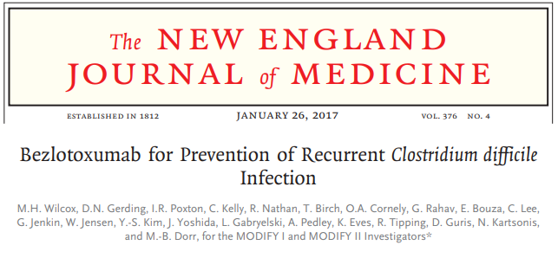
Two double-blind, randomized, controlled, phase 3 trials
2655 adult patients from 322 sites in 30 countries
November 2011 – May 2015
Randomized 1:1:1:1
  Bezlotoxumab alone
  Actoxumab plus bezlotoxumab
  Placebo (0.9% saline)
  Actoxumab alone (only in MODIFY I)
68% inpatients
N Engl J Med 2017; 376:305-317
Notes:
Primary endpoint – proportion of participants with recurrent c diff infection during 12 weeks of follow up in the mITT population
Exploratory endpoint – Initial clinical cure (no diarrhea for 2 consecutive days after completion of SOC tx administered for <= 16 days)
Secondary endpoint – Rate of sustained cure (aka global cure), no recurrence through 12 weeks)
Secondary analyses – rate of recurrent CDI in subgroup of participants in the mITT who had an initial clinical cure as well as in prespecified subgroups of participants with risk factors for recurrent CDI or ADEs related to CDI: age 65 or older, a hx of c diff infection, compromised immunity, clinically severe CDI, and infection with a strain associated with poor outcomes

Slide 42
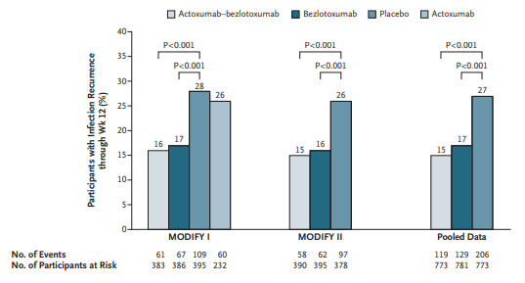
N Engl J Med 2017; 376:305-317

Slide 43
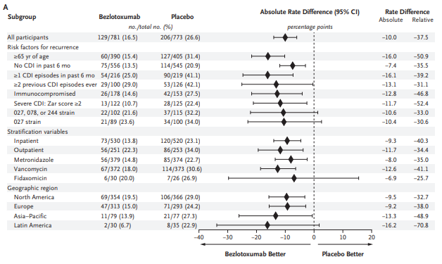
N Engl J Med 2017; 376:305-317

Slide 44
Rebyota (fecal microbiota, live-jslm)
FDA approved 11/30/2022 for the prevention of recurrence of CDI in individuals 18 years of age or older, following antibiotic treatment for recurrent CDI.
  History of 1 or more recurrences of CDI
It is a fecal microbiota suspension manufactured from human fecal matter sourced from qualified donors.
Rebyota (fecal microbiota, live-jslm) suspension [prescribing information]. Roseville, MN: Ferring Pharmaceuticals; Revised 11/2022
Notes:
Primary endpoint – treatment success, absence of CDI-related diarrhea at 8 weeks

Slide 45
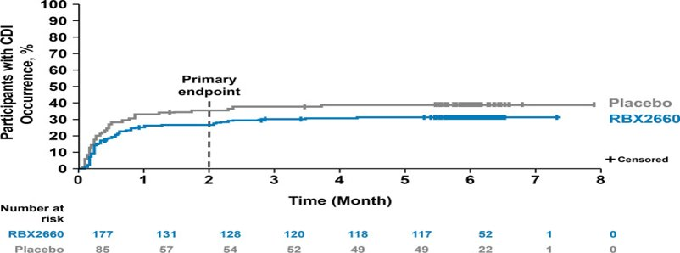
PUNCH CD3
Population | Modeled estimated treatment success |  | Treatment effect [95% CI]
 | Placebo | RBX2660
mITT | 58.1% | 70.4% | 12.3 [1.4-23.3]
ITT | 56.7 | 69.1 | 12.5 [1.6-23.3]
PP | 57.2 | 70.9 | 13.7 [2.4-25.1]
Khanna S, AssiM, et al. Drugs. 2022; 82(15): 1527–1538
Notes:
Primary endpoint – treatment success, absence of CDI-related diarrhea at 8 weeks

Slide 46
Rebyota (fecal microbiota, live-jslm)
Administer one 150 mL suspension rectally 24-72 hours after completion of CDI treatment (requires office visit)
Must be stored in an ultracold freezer (-60 to -90°C)
  Requires 24 hours to thaw in a refrigerator (2 to 8°C) and can be stored at that temperature for 5 days
Administration tube must be manually held up (cannot be hung from IV pole) and delivered via gravity
Patient must remain laying down for 15 minutes
Wholesale acquisition cost - ~$9000
Rebyota (fecal microbiota, live-jslm) suspension [prescribing information]. Roseville, MN: Ferring Pharmaceuticals; Revised 11/2022
Notes:
Primary endpoint – treatment success, absence of CDI-related diarrhea at 8 weeks

Slide 47
Vowst (fecal microbiota spores live-brpk)
FDA approved 4/26/2023 for prevention of recurrence of CDI in individuals 18 years of age or older following antibacterial treatment for recurrent CDI (first recurrence).
  Trial enrolled those with ≥ 3 episodes of CDI within 12 months.
It is a bacterial spore suspension made from human fecal matter than is donated and tested for transmissible pathogens.
Vowst (fecal microbiota spores, live-brpk) [prescribing information]. Cambridge, MA: Seres Therapeutics, Inc; Published April 2023.

Slide 48
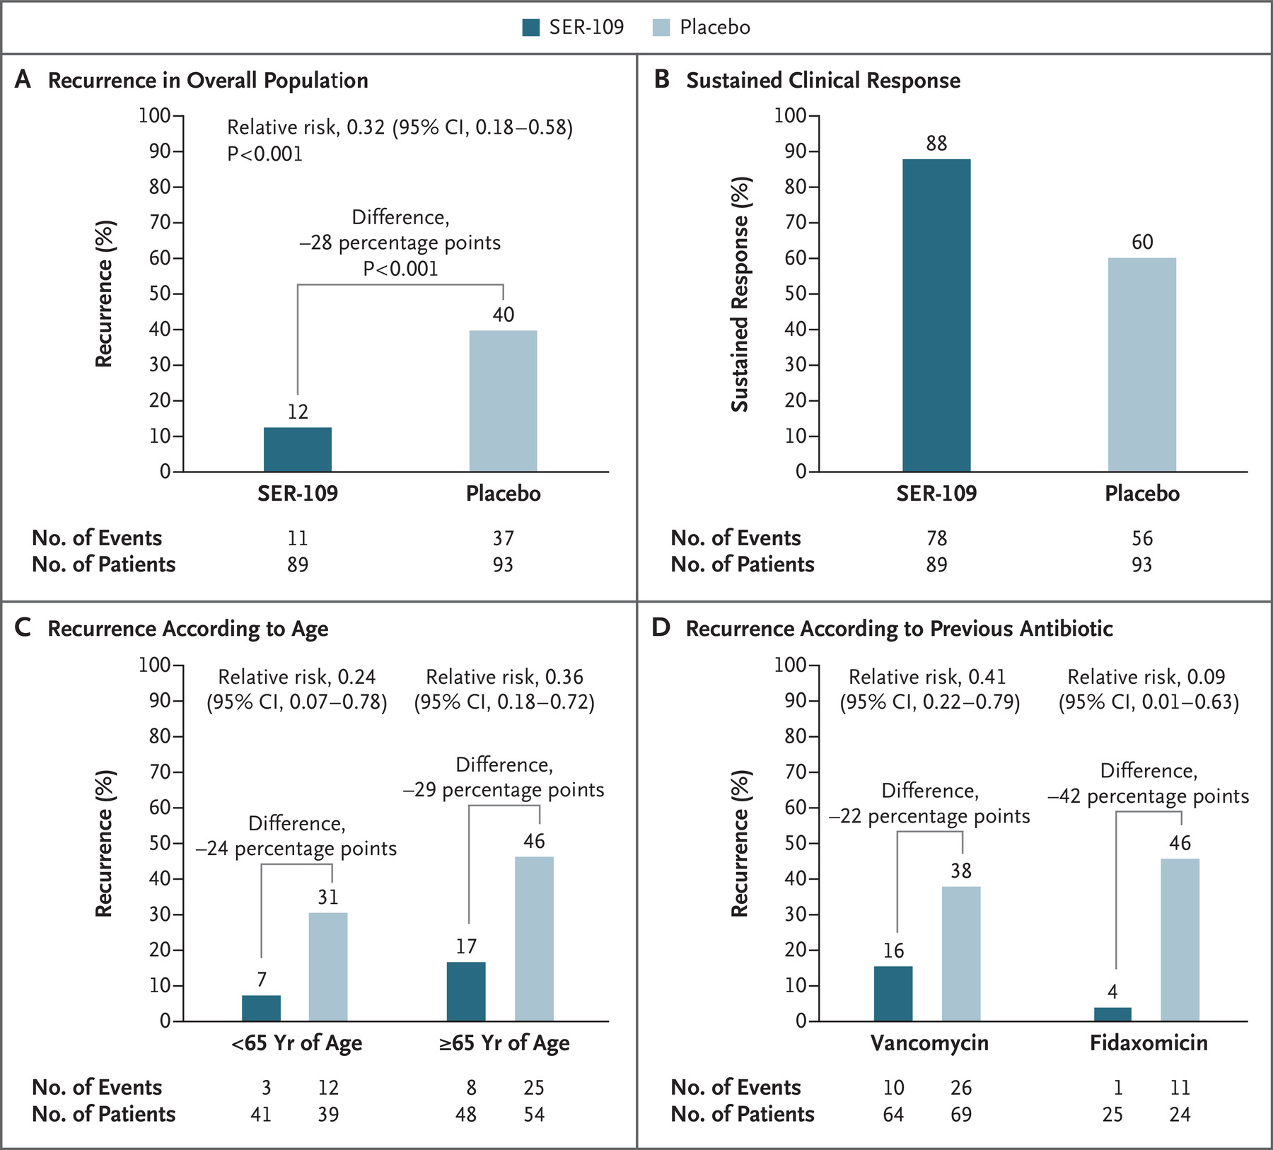
ECOSPOR III
Feuerstadt, et al. N Engl J Med 2022; 386:220-229

Slide 49
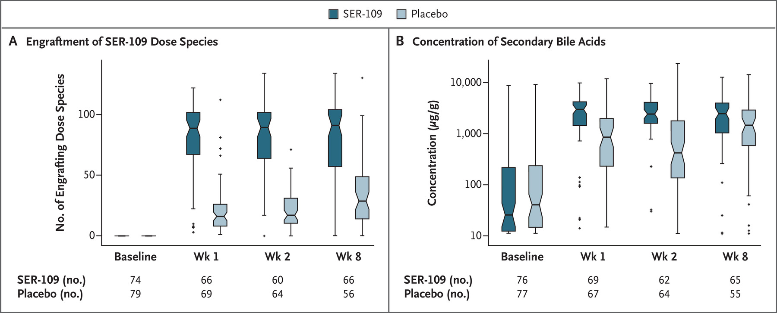
ECOSPOR III
Feuerstadt, et al. N Engl J Med 2022; 386:220-229

Slide 50
Vowst (fecal microbiota spores live-brpk)
Complete CDI treatment 2-4 days before taking Vowst
Drink 296 mL of magnesium citrate the day before and at least 8 hours prior to the first dose.
  250 mL of polyethylene glycol electrolyte solution (GoLYTELY) was used for patients with renal impairment
Do not eat or drink except for small amounts of water for at least 8 hours prior to the first dose
Dosing
  4 capsules by mouth once daily for 3 consecutive days on an empty stomach prior to the first meal of the day.
Wholesale acquisition cost - $17,500 ($1458 per capsule)
Vowst (fecal microbiota spores, live-brpk) [prescribing information]. Cambridge, MA: Seres Therapeutics, Inc; Published April 2023.

Slide 51
Probiotics
IDSA/SHEA provides no recommendation citing insufficient evidence for use of probiotics for primary prevention of CDI
ACG recommends against use of probiotics for both primary prevention in patients on antibiotics and for prevention of recurrence
  Probiotics are not regulated by the FDA
  Case reports of bloodstream infections with probiotic organisms in critically ill patients
  Microbiome analyses show probiotics may impede normal recolonization of colon after a course of antibiotics
The American Journal of Gastroenterology: June 2021 - Volume 116 - Issue 6 - p 1124-1147

Slide 52
Prevention of Recurrent CDI – 2021 ACG Guidelines
Suppressive Oral Vancomycin
Very limited evidence for this approach
One retrospective study with 20 patients
Included patients who:
  Weren't candidates for FMT
  Refused FMT
  Relapsed after FMT
  Median age of 80, median of 4 episodes of CDI
Treated with PO vancomycin followed by long term PO vancomycin at a dose of 125 mg daily
  One relapse during 200 patient months of follow up
  Of those who stopped therapy, 31% relapsed
  No ADEs or incidents of VRE were observed
Further research is needed
The American Journal of Gastroenterology: June 2021 - Volume 116 - Issue 6 - p 1124-1147

Slide 53
Prevention of Recurrent CDI – 2021 ACG Guidelines
Oral Vancomycin prophylaxis (OVP)
OVP may be considered during subsequent systemic antibiotic use in patients with a history of CDI who are at high risk of recurrence to prevent further recurrence
  65 years or older or with significant immunocompromise who were hospitalized for severe CDI within the past 3 months.
  125 mg PO daily continued until 5 days after completion of systemic antibiotics
Further prospective clinical trials needed
  Impact on gut microbiome and risk of drug resistant organisms needs to be addressed
The American Journal of Gastroenterology: June 2021 - Volume 116 - Issue 6 - p 1124-1147
Notes:
Two retrospective studies, dosing regimens varied, unknown factors that dictated Rx for oral vanco
IDSA states there is no prospective, randomized studies in this area to guide recs, but if the decision is made it may be prudent to use low doses of vanco or fidaxo while abx administered. Factors to consider are length of time since last CDI tx and patient characteristics (number of previous CDI episodes, severity of previous episodes, underlying fragility of patient)

Slide 54
Summary
Fidaxomicin and vancomycin are both acceptable first-line treatment options for primary and recurrent CDI
  Fidaxomicin may be more beneficial in patients at high risk for recurrence
  Cost is a major barrier to fidaxomicin use
Bezlotoxumab can be considered in certain high-risk patients
  Insurance coverage and logistics play a role in feasibility
New FMT products are promising, more data is needed to determine place in therapy
More evidence is needed regarding prophylaxis and suppression

Slide 55
Questions?
Danny Schroeder, PharmD, BCPS
Nebraska ASAP
Dschroeder@nebraskamed.com

