Slide 1
Confidence in Value-Based Care -
A Real-World Simulation
Stephen Mohring, MD – General Internist, Medical Director of Population Health and Quality
Leslie Eiland, MD – Endocrinologist, Medical Director of Patient Experience and Digital Health
Diabetes On Track is a collaborative effort between UNMC/Nebraska Medicine, select Health Departments, and select health care facilities in Nebraska. This effort is made possible by funding provided by The Diabetes Care Foundation of Nebraska. The Project ECHO® logo is used with permission from the University of New Mexico Health Sciences Center (UNMHSC).

Slide 2
Disclosures
Dr. Mohring: board of directors, Nebraska Health Network ACO
Dr. Eiland: advisory board participant for Cecelia Health, Eli Lilly, Roche

Slide 3
Objectives
Identify the challenges that rural PCPs face while balancing value-based care in a primarily fee-for-service landscape
Understand diabetes as a primary driver of quality-related metrics
Create a vision for fee-for-service and value-based care revenue streams for future success

Slide 4
Diabetes In Nebraska
Approximately 143,900 Nebraskans (9.3% of adults) have diagnosed diabetes
Every year, an estimated 9,100 adults in Nebraska are diagnosed with diabetes
Americans with diabetes have medical expenses approximately 2.6 times higher than those who do not have diabetes
In 2017 it was estimated that:
Total direct medical expenses for diagnosed diabetes in Nebraska were $993 million
Total indirect costs from lost productivity due to diabetes were $384 million
The Burden of Diabetes in Nebraska, adv_2024_state_fact_nebraska.pdf

Slide 5
Diabetes On Track: Project Goals
At-Risk for Prediabetes
↑ screening for prediabetes
↑ community preventive services
Prediabetes
↓ population with prediabetes
↑ utilization of CDC diabetes prevention programs
Diabetes Patients
↓ population with diabetes
↓ hospital admissions for diabetes
↓ the population with an A1c >9%
↑ formal diabetes education
Notes:
Leslie

Slide 6
Increased Screening & Monitoring and Improved Glycemic Control over 2 years

Slide 7
Health Care System Methods
The Diabetes On Track (DOT) team identified and partnered with 2 rural clinics
Clinics completed needs assessment, then offered a menu of potential strategies to implement
Clinics worked with DOT team to implement, refine and adapt these initial interventions and develop further strategies
Six core indicators were established as primary outcome measures
Process measures were established based on the strategies chosen
Notes:
Leslie

Slide 8
Intervention Toolkit
ECHO Sessions
Sharing of Hypoglycemia Protocol
Value-based Care Consultation
Provider Dashboard
Incentives for Improving Metrics
Pharmacy Mentorship
ADCES Membership
ADCES7 Self Care Behaviors®
Health Coach or CDCES
Nursing and CDCES Mentorship
Notes:
Sarah

Slide 9
Value Based Care Consultation
Nebraska Medicine has had increasing revenue from value-based contracts over the past 5 years​
Re-investment of shared savings revenue is an ongoing source of funding for population health initiatives, such as improved diabetes team-based care​
Consultations provided to each site to assess readiness to change, stage in the value-based journey, and potential for long-term success and sustainability​
​

Slide 10
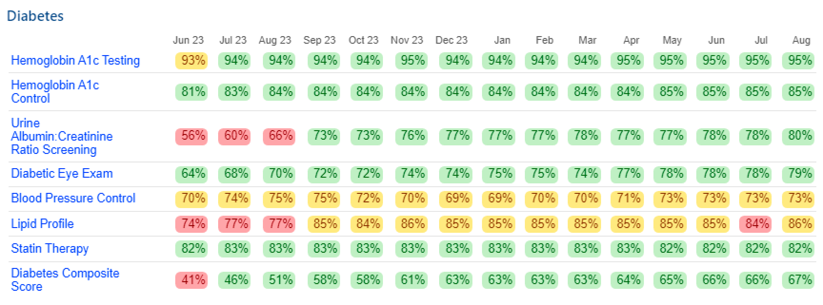
Epic Provider Dashboards
Transparent, reliable data-sharing is key to stakeholder engagement​
Provider and clinic-level performance detail, drill-down reports​
Sample Provider Dashboard View

Slide 11
Technology Training
At-the-elbow education provided to each provider at both sites about My Panel Metrics dashboard
Physician champion and clinic manager education and feedback about My Clinic Panel (practice-level dashboard)
Advice and training about panel clean-up and maintenance procedures
Ongoing listening sessions with providers about their individual dashboards during clinic site visits

Slide 12
Incentives for Improving Metrics
Metrics currently being used by public and private payers in various value-based contracts.
Gain provider buy-in to their individual dashboard (my actual patients) ​
Physicians and clinics have current visibility to metrics as part of existing dashboards (clinic, UNMC have visibility) ​
Target and stretch goals identified semi-annually, and funds weighted based on priority metrics
Goals are improved outcomes and long-term project sustainability​

Slide 13
Incentive Program – Quality Metrics

Slide 14
Dashboard: Site A
Green/Yellow/Red Targets set based on aiming for certain HEDIS targets, or quartile performance where targets are not specified
Data through August 31, 2024
Notes:
Stephen

Slide 15
Site A Improvement Strategies
Clinic manager attention to dashboards
Frequent check ins with clinic providers and staff
Regular updates during staff meetings
Staff input taken into consideration for how to use earned funds
Physician buy-in
One-on-one training sessions with individual providers about how to access patient lists
Color coded metrics drive individual performance and competition between providers
Direct financial incentivization
Nurse driven changes
Individual nurses set yearly goals based on performance improvement for their assigned providers

Slide 16
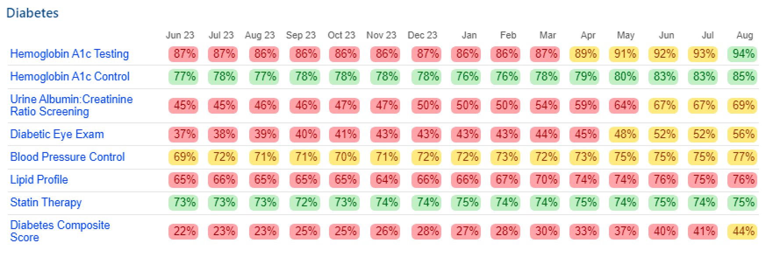
Dashboard: Site B
Green/Yellow/Red Targets set based on aiming for certain HEDIS targets, or quartile performance where targets are not specified
Data through August 31, 2024
Notes:
Stephen

Slide 17
Site B Improvement Strategies
Nurse driven changes
Clinic health coaches designated specific time each week for patient outreach to address gaps in care
Nurses check in with providers on a regular basis to highlight opportunities for improvement
Leadership buy-in
After a slow start due to lack of physician buy-in, DOT team discussed with clinic manager and health system leaders
Improvement was noted quickly after those discussions

Slide 18
Incentive Program
Site A
Clinic has achieved stretch goals for 10/10 metrics
Clinic reinvested funds into purchase of point-of-care lab equipment
Individual providers highly motivated to improve, compete; driven by physician champion
Performing at or above even top-performing NM clinics
Confidence in achieving ACO metrics as a result
Site B
Clinic achieved stretch goals for 9/10 metrics
Incentive supports general clinic funds, working toward purchase of point-of-care AI Retinal Scanner
Performance largely driven by RN health coaches
Gradual dashboard adoption by physicians and APPs
Clinic manager now involved in payer negotiations

Slide 19
Sustainability
Both sites realize value of dashboards, and plan to continue this functionality beyond the DOT project, even at a cost
Both clinics have vastly improved metric performance, commenting on the downstream effect (total cost of care, ER utilization, etc.)
Site A joined an ACO
Site B clinic leadership now participating in payer-level conversations to increase value-based revenue
Site A using incentive funds to trial an increased pharmacy presence in clinic, focusing on multiple conditions
Health systems continuing to fund RN Health Coach roles at project end, funded by shared savings revenue and/or billing for diabetes education
Notes:
Drs. Leslie Eiland, Stephen Mohring, Cyrus Desouza
RNHC: Connecting with patients/education/services; Taking initiative to change the workflow (e.g., abstracting from EHR, creating call lists)
Dashboards: Does require personnel investment to actually make changes (call lists etc) to improve metrics
Providers perceive patients are reluctant to change behavior
Connecting with community resources for diabetes is more prevalent in Wayne (less territoriality, fewer resources within clinic itself).

Slide 20
Summary
Improving diabetes-related quality metrics requires:
Transparent data
Multidisciplinary clinic teams
Local champions
Direct incentivization and competition drives performance
Success is achieved over the long term and can be sustainable
Notes:
Drs. Leslie Eiland, Stephen Mohring, Cyrus Desouza
RNHC: Connecting with patients/education/services; Taking initiative to change the workflow (e.g., abstracting from EHR, creating call lists)
Dashboards: Does require personnel investment to actually make changes (call lists etc) to improve metrics
Providers perceive patients are reluctant to change behavior
Connecting with community resources for diabetes is more prevalent in Wayne (less territoriality, fewer resources within clinic itself).

Slide 21
Questions? Thank you to:
Smohring@unmc.edu
Leslie.eiland@unmc.edu
Diabetes Care Foundation
University of Nebraska Foundation
Stephanie Nygaard, RN
Sarah Keegan, RD, CDCES
Cyrus Desouza, MBBS
Hastings Family Care
Mary Lanning Healthcare
David Dzewaltowski, PhD
Marisa Rosen, PhD
Kristin Pullyblank, RN, PhD
Chris Wichman, PhD
Melissa Baron
Wayne Family Medicine
Faith Regional Health System
Diabetes On Track is a collaborative effort between UNMC/Nebraska Medicine, select Health Departments, and select health care facilities in Nebraska. This effort is made possible by funding provided by The Diabetes Care Foundation of Nebraska. The Project ECHO® logo is used with permission from the University of New Mexico Health Sciences Center (UNMHSC).

