Slide 1
Genetic Insights Project
Nebraska Hospital Association Annual Convention
October 2025
Douglas Stoller, MD PhD

Slide 2
Disclosures
No financial disclosures related to this talk.

Slide 3
Outline
What is Genetic Insights?
Research from Genetic Insights/Helix Research Network
Potential Clinical Implications
Notes:
Overview of the Genetic Insights Project
how DNA impacts health
why it is important to our state.
They will want to know why this matters to them and their hospitals and what it means for the future of research, advancing precision medicine, and the impacts it could have on care delivery.
Potentially discuss how it will improve access to personalized health care and support new research discoveries for our communities and provide access to underserved populations.

Slide 4
Genetic Insights
Partnership and Program Overview
Nebraska Medicine, UNMC and Helix have launched a major population genomics initiative and will work together to recruit 100K+ research participants over five years.
  5-year research study (“Genetic Insights Project”)
  Enroll participants (age 19+) to receive no-cost genetic (exome) sequencing (i.e. no billing implications)
  Build research database linking clinical data to exome sequencing
  Goal: 100k participants (NebMed/UNMC)
Nebraska Medicine is a founding member of the Helix Research Network, a federated learning network of normalized EHR + Genetic information
Notes:
Agreement signed June 2023
Genetic Insights opened late 2023 to “friendlies”
Employees Jan 2024
Patients mid 2024 >

Slide 5
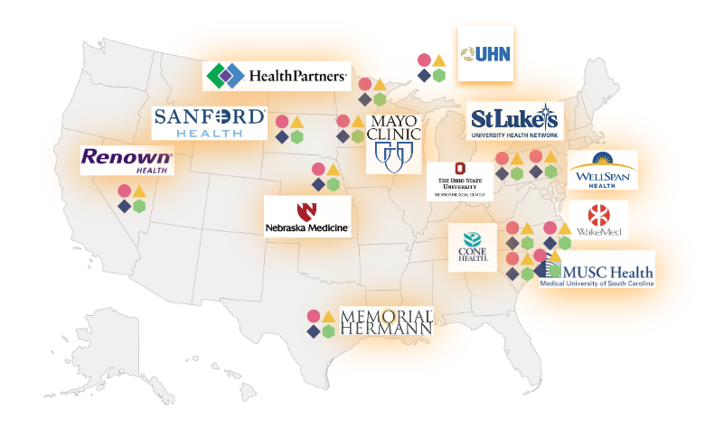

Helix Research Network (HRN)
Founded by Helix
15+ institutions (and growing)
Genetic Insights =
UNMC/NebMed arm of HRN
5 yr study
Goal: 100k participants
Notes:
Agreement signed June 2023
Genetic Insights opened late 2023 to “friendlies”
Employees Jan 2024
Patients mid 2024 >
Renown Health, Nevada, Mayo Clinic, Medical University of South Carolina, Health Partners, Minnesota, Memorial Hermann, Wellspan (Maryland and Pennsylvania), St. Lukes (Pennsylvania and New Jersey), Nebraska Med, Cone Health (North Carolina), Sanford (South Dakota), Ohio State, WakeMed (Wake Forest), TriHealth (Cincinnati OH), Parkview (Northeast Indiana), Rochester (Western New York)

Slide 6
Inclusion/Exclusion criteria
Inclusion | Exclusion
Age 19+ years (Nebraska*) | Allogenic bone marrow or stem cell transplant

Slide 7
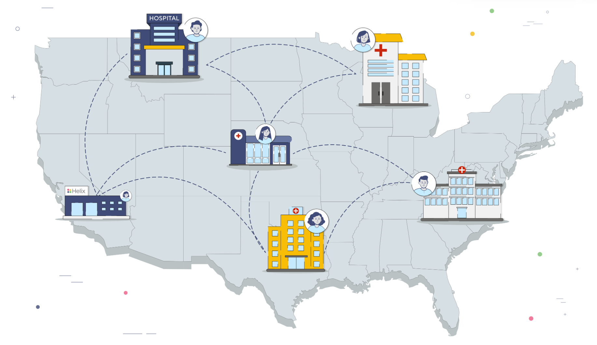
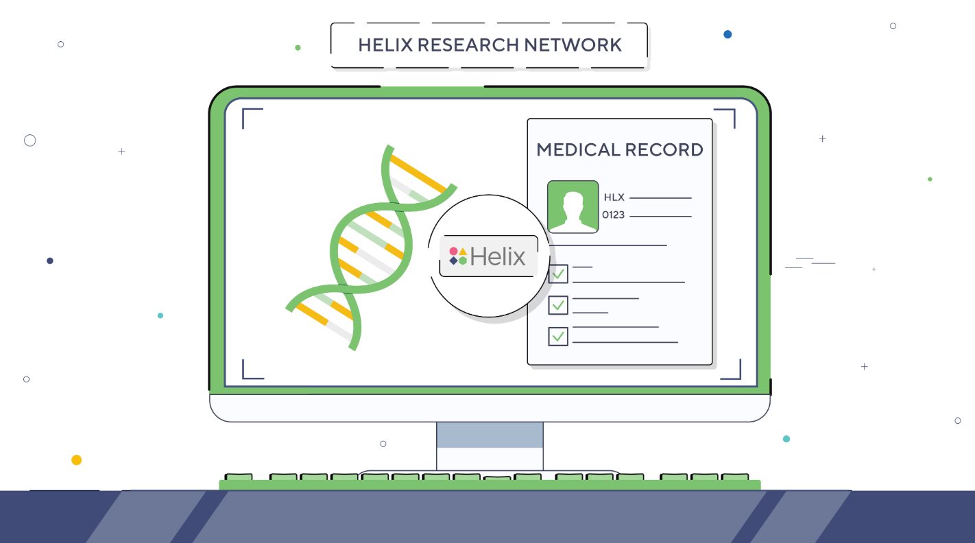
What does research participation entail?
Consent
Provide a sample (blood or saliva)
Helix will sequence and store the genomic data
Receive actionable results (CDC Tier 1), GC referral for positive results
Genomic + EHR data will be combined for research
Possible future clinical use of the genomic data via provider order and additional consent
Central/UNMC IRB Involvement

Slide 8
What tests are included in the project?
FH
Genes: LDLR, APOB, PCSK9 and LDLRAP1
Hypercholesterolemia and increased risk for cardiovascular events
HBOC
Genes: BRCA1 and BRCA2
Significantly increased lifetime risk of breast, ovarian and other cancers
Lynch
Genes: MLH1, MSH2, MSH6, PMS2 and EPCAM
Significantly increased lifetime risk of colorectal, endometrial, ovarian and other cancers
1-2% of all patients (~1 in 75) have one of these conditions
Notes:
179/12391 = 1.44% positive
(179+25)/12391 = 1.65% positive

Slide 9
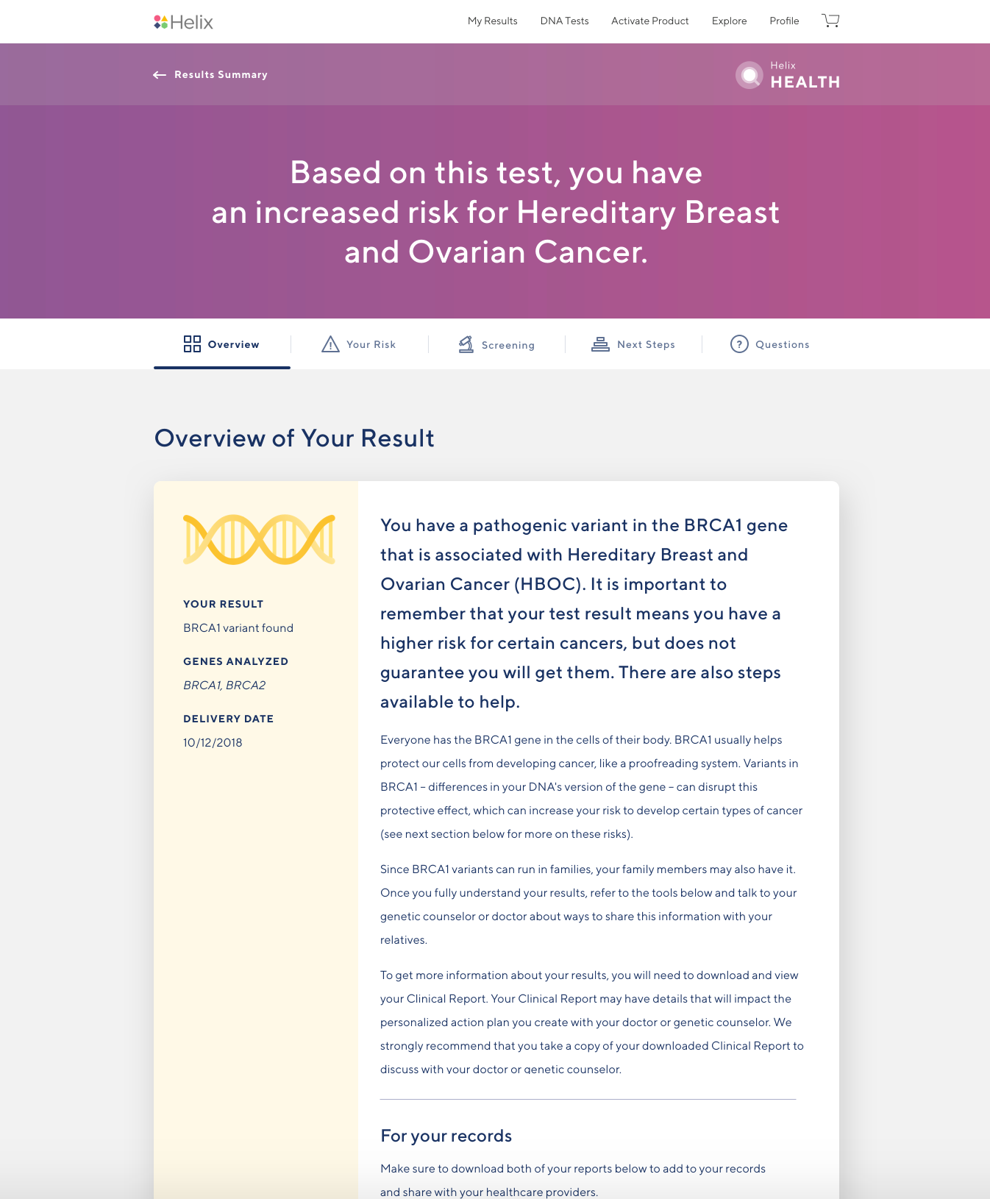


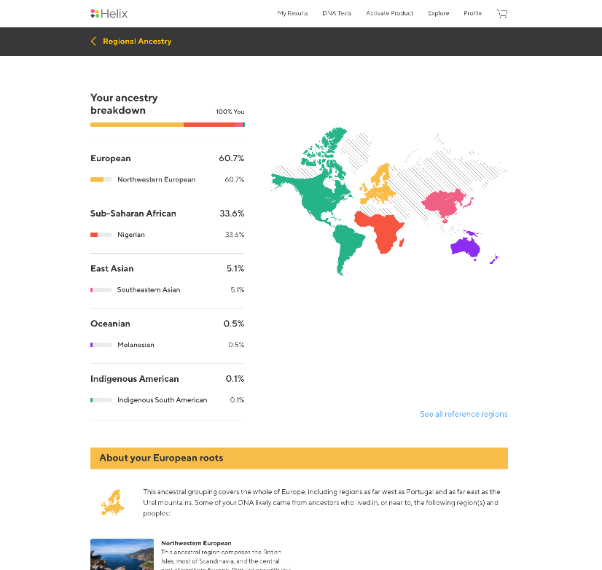

External Helix portal: Delivering health, ancestry & trait insights to participants
Helix Health:
A genetic health screen that looks for variants that predispose people to the CDC Tier 1 conditions
Helix Ancestry:
A genetic analysis that helps individuals understand their regional ancestry
Helix Traits:
A genetic analysis that helps individuals understand the traits that affect wellness, appearance & fitness
Creating a Helix Health account is optional

Slide 10










Genetic Insights/Helix Workflow
Digital recruiting & enrollment
Digital Consent
Order placed via EHR
Sample collection
Sample sent to Helix and sequenced
Patient receives
trait updates
CDCT1
results returned
to EHR
Genetic counseling visit
Genomic data stored for future use
Cannot have had a Bone Marrow/Stem Cell Transplant

Slide 11





Post-test workflow
All patient CDCT1 Results Returned to EHR
98-99% Negative Results
Patient’s Primary Provider: Follow up recs based on personal and family history, as needed
1
2
3
4
5
Study contacts patient with positive results
Genetic Counseling Appt Scheduled
GC consult and genomic indicator documented
Clinical mgt recs available in the GC note (OneChart)
Patient triaged to NebMed/UNMC specialty clinics
1-2%
Positive
Results
NebMed/UNMC Genetic Insights Project Team

Slide 12
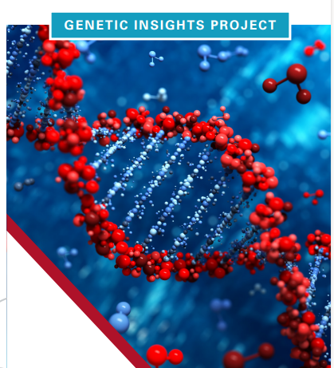
Genetic Insights Progress Report – 10/06/2025
Helix Consent Completed | Samples Received by Helix
23,869 | 17,080
Results Received | Genetic Counseling
16,346 | 141 (262 positives) 22 pending
Notes:
1.6% positive – 262/16346
1.7% positive – (262+22)/16346

Slide 13
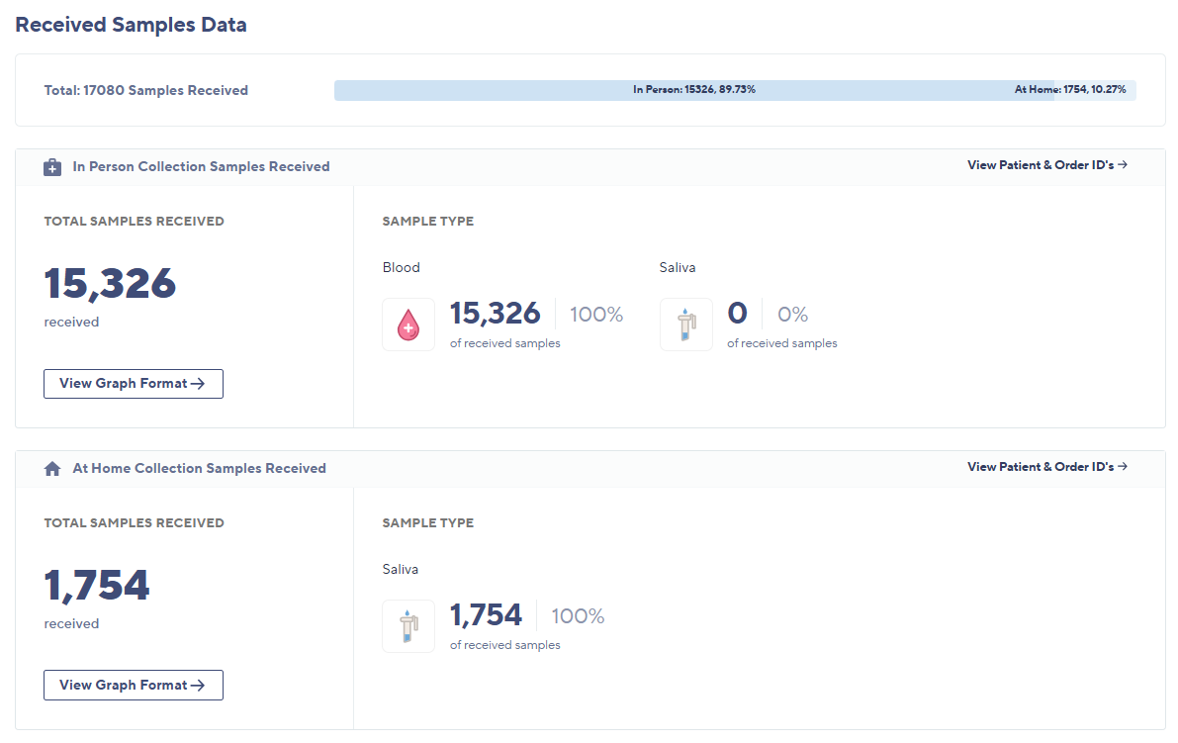
10/6/2025
Source: Helix Builder
Collection & Sequencing | Received Samples | All Time

Slide 14
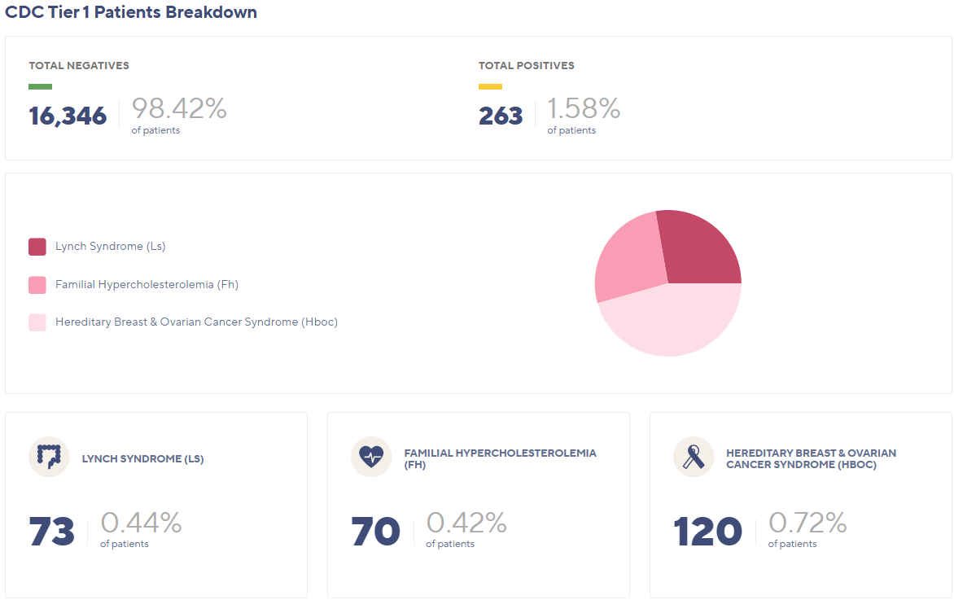
10/6/2025
Source: Helix Builder
Delivery & Results | CDC Tier 1 Total Results Delivered | All Time

Slide 15
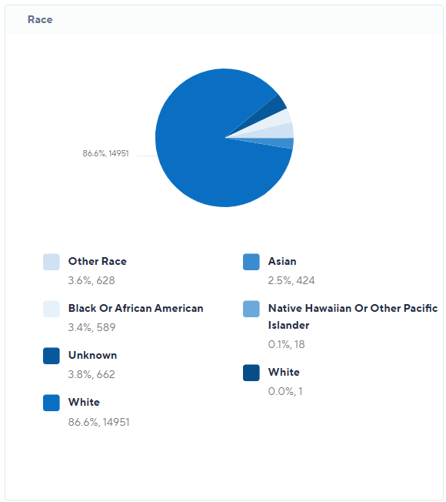
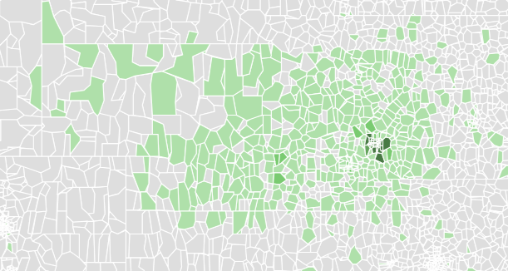

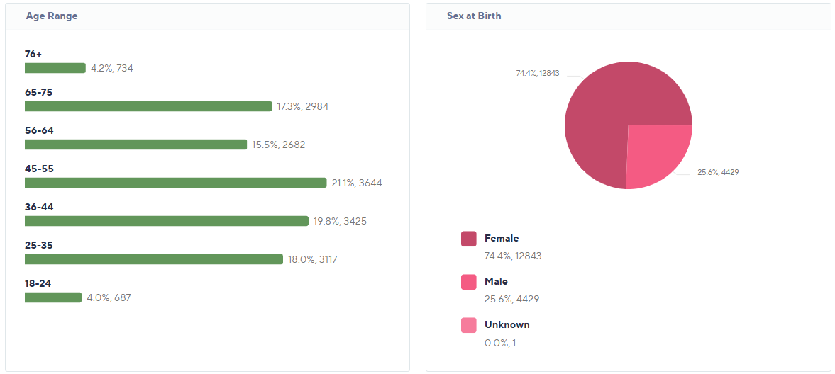
10/6/2025
Source: Helix Builder
Participant Recruitment | Consented Participants Location Density | All Time
Source: Helix Builder
Collection & Sequencing | Sequenced Samples | All Time | Demographics

Slide 16
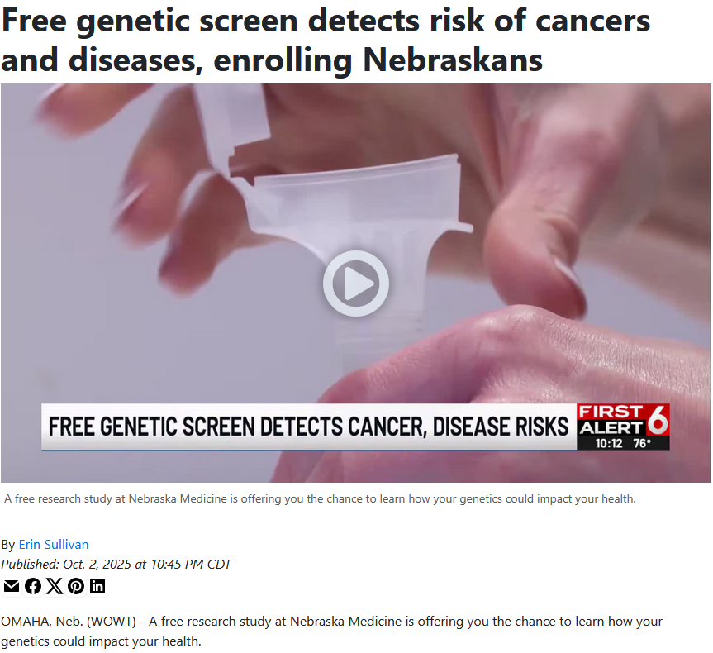

Slide 17
Outline
What is Genetic Insights?
Research from Genetic Insights/Helix Research Network
Potential Clinical Implications
Notes:
Overview of the Genetic Insights Project
how DNA impacts health
why it is important to our state.
They will want to know why this matters to them and their hospitals and what it means for the future of research, advancing precision medicine, and the impacts it could have on care delivery.
Potentially discuss how it will improve access to personalized health care and support new research discoveries for our communities and provide access to underserved populations.

Slide 18
Research: Genetic Insights Project
Broadly accessible and useful data
Available to faculty investigators at partner institutions
Utilized by many with appropriate safeguards and oversight

Slide 19
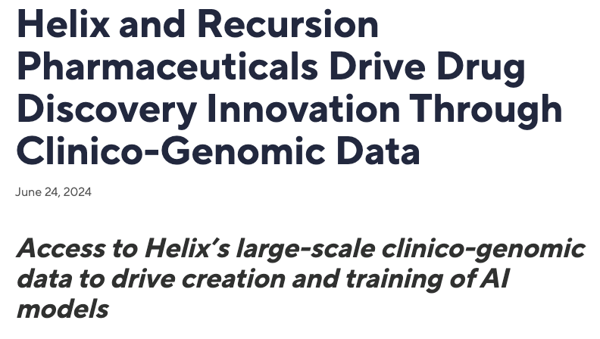
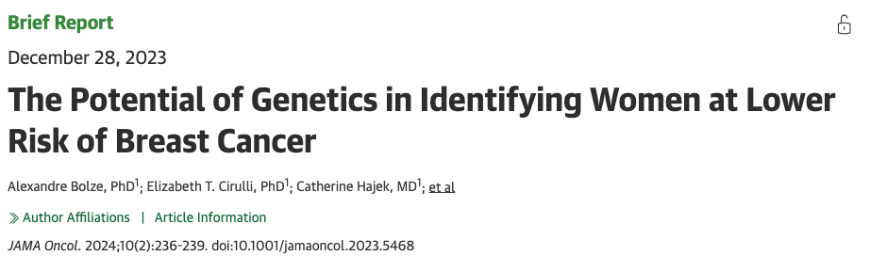
Working with partners, Helix has been sharing insights from the HRN dataset
Strategic Initiatives
Helix Research Network Initiatives
Notes:
CN

Slide 20
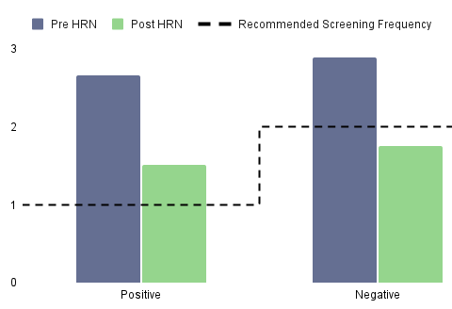
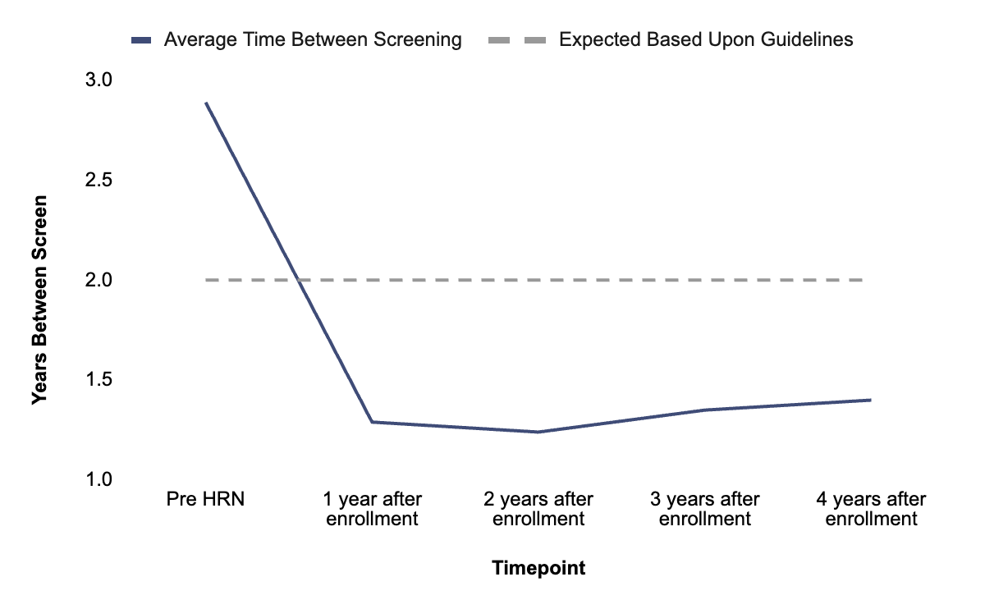
HRN RWE STUDY
Genetic screenings results in early detection of disease risk
Improved compliance with guideline driven results in primary prevention / early detection of serious disease
>200K
CDCT1 Results Returned
>2,500
Positive Results Returned
3 Year
ROI
Positive
2.7 yrs
2.8 yrs
Takeaways
Proactive approach identifies underlying risk
Increased mammograms even with negative population
Personalized approach drives longitudinal durability
1.5 yrs
1.8 yrs
Average Years Between Screenings (1/rate)
Average Years Between Screen
BRCA1/2
Positive
BRCA1/2
Negative
Multi-Year Analysis of Behavior Change
Hajek et al, under review

Slide 21
Increased adverse events from clopidogrel in poor metabolizers
HRN Network
>100k individuals
3.8k clopidogrel users
Compiled events following initiation of clopidogrel prescription
29% mismatch between recommended dosage based CYP2C19 genotype and that given
Telis et al, under review
Notes:
41 projects
18 manuscripts
20 publications
Genetic variant identification analysis techniques
Impact on lipid management

Slide 22
Impact of Lynch Syndrome mutations on cancer risk
 | average HRN population | P/LP MLH1 het | P/LP MSH2 het | P/LP MSH6 het | P/LP PMS2 het
Number | 126,947 | 41 | 25 | 201 | 181
% dx with any Lynch relevant cancer by age 60 | 1.8% | 51.7% | 31.2% | 12.8% | 1.5%
% dx with colorectal, endometrial/uterine, ovarian, kidney/ureter or small bowel cancer by age 60 | 1.0% | 51.7% | 21.3% | 10.7% | 1.5%
% dx with colorectal cancer by age 60 | 0.4% | 41.0% | 17.9% | 4.5% | 0.6%
Barrett et al, under review

Slide 23
Outline
What is Genetic Insights?
Research from Genetic Insights/Helix Research Network
Potential Clinical Implications
Notes:
Potential clinical implications for genetic data in general – not just Genetic Insights

Slide 24
Risk prediction
Genetics are probabilistic, not deterministic.

Slide 25
Polygenic Risk Score for CAD
Utilized the UK Biobank (~400k patients) and ~6.6 million variants
Goal: Identify individuals with CAD risk similar to FH mutation carriers (>3x)
Identified 8% of the population with >3x CAD risk
Easily obtained from genetic results – and your genetics do not change
Khera AV et al. Nature Genetics 2018
Notes:
FH mutations 1:220
UK Biobank 410k patients with linked genetic and clinical information

Slide 26
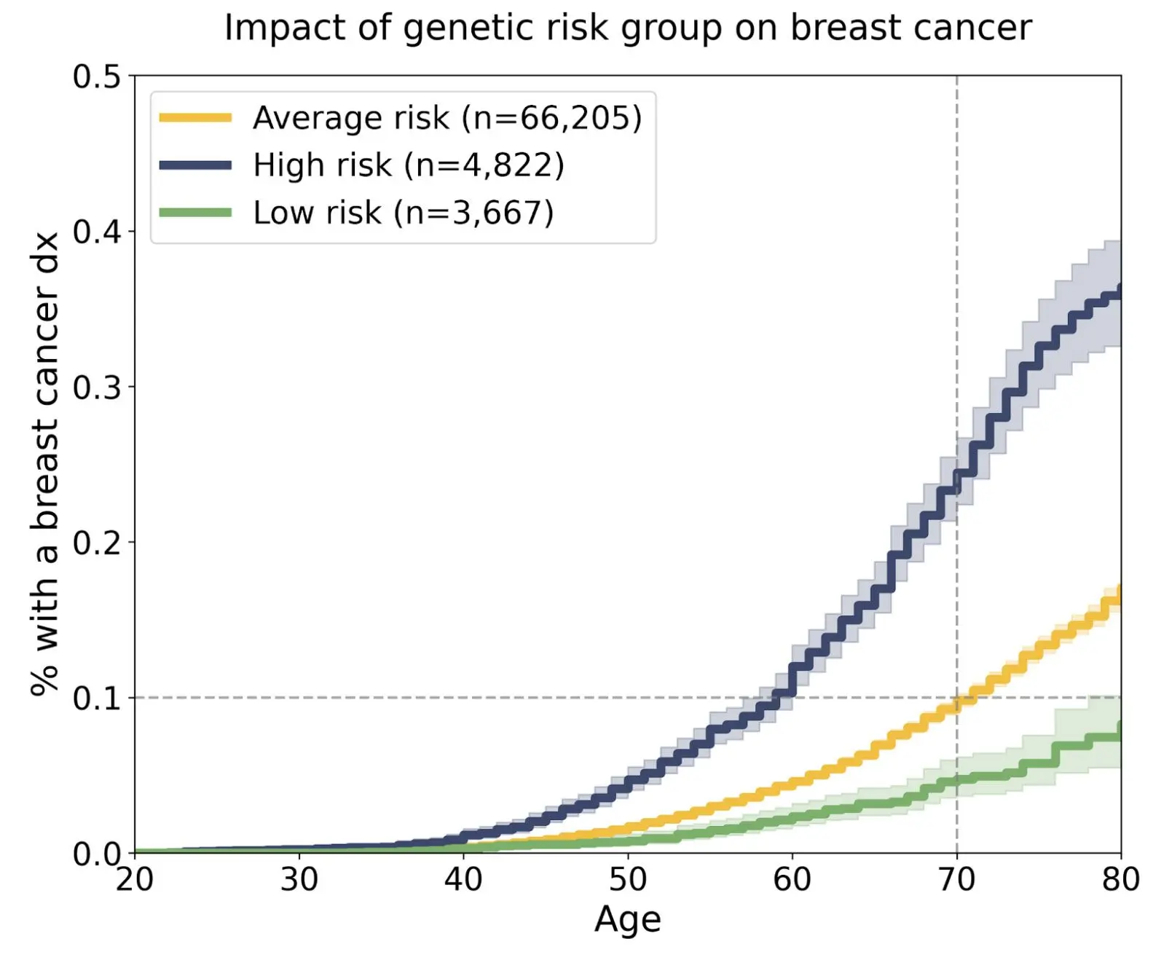
Risk/Response prediction > Improve Allocation of limited resources
Women at low risk for breast cancer could safely delay screening.
~300k mammograms/year
Bolze et al, presented European Society of Human Genetics Conference, 2025

Slide 27

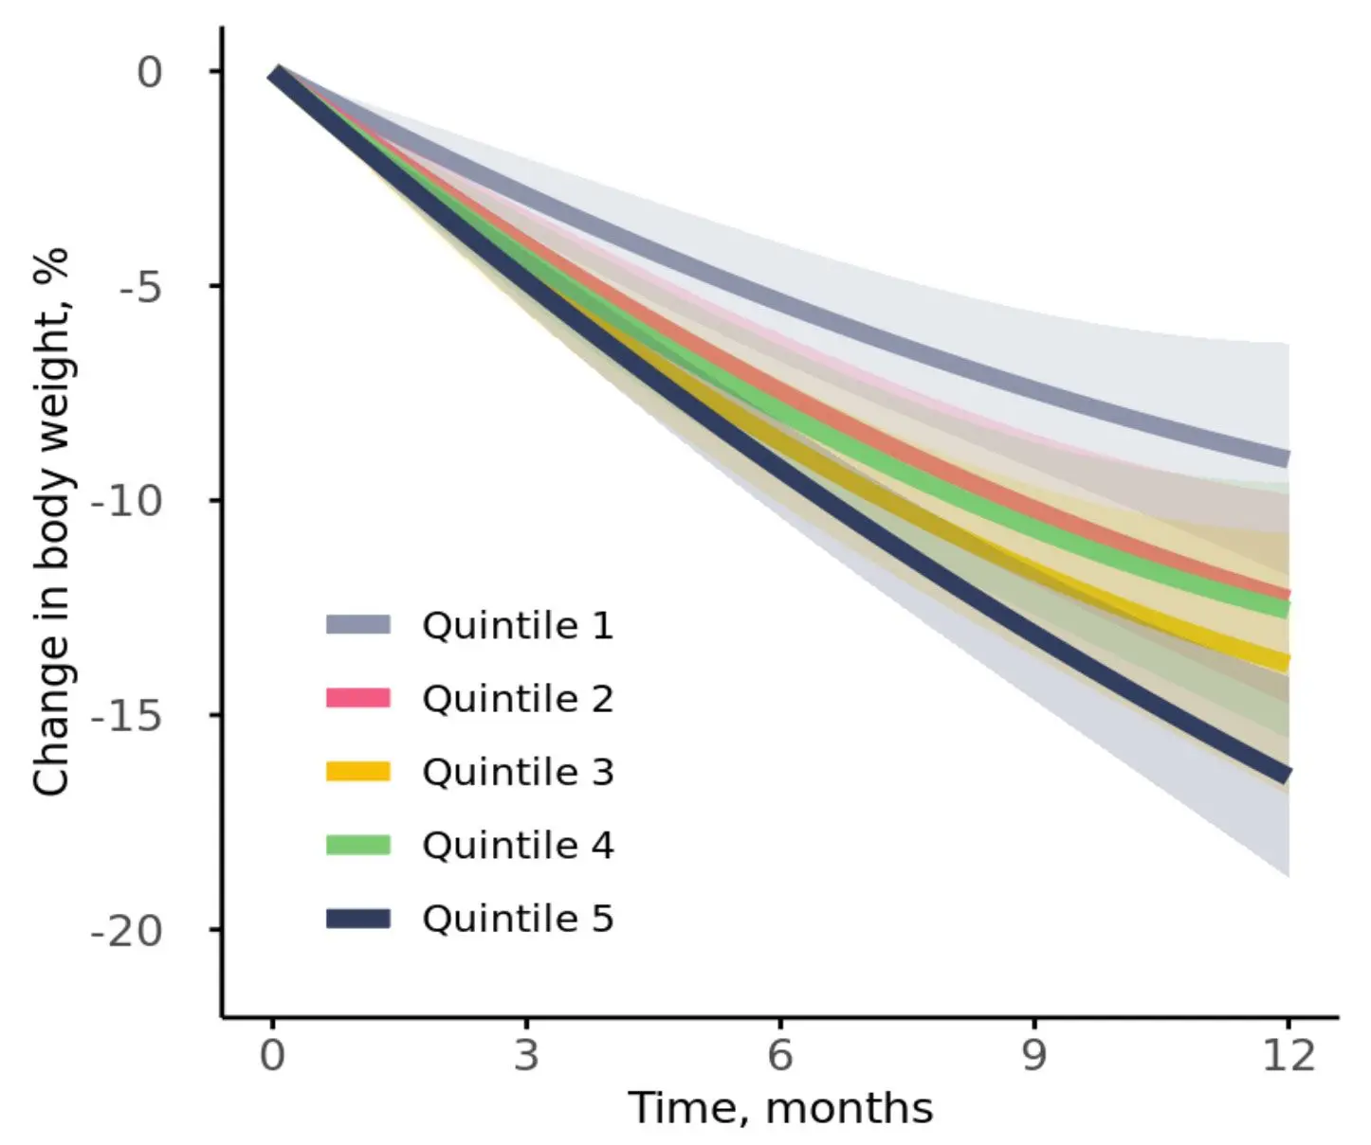
Risk/Response prediction > Improve Allocation of limited resources
Top 20% = 67% ≥10% weight loss
Bottom 20% = 36% ≥10% weight loss
Levy et al, presented European Society of Human Genetics Conference, 2025

Slide 28
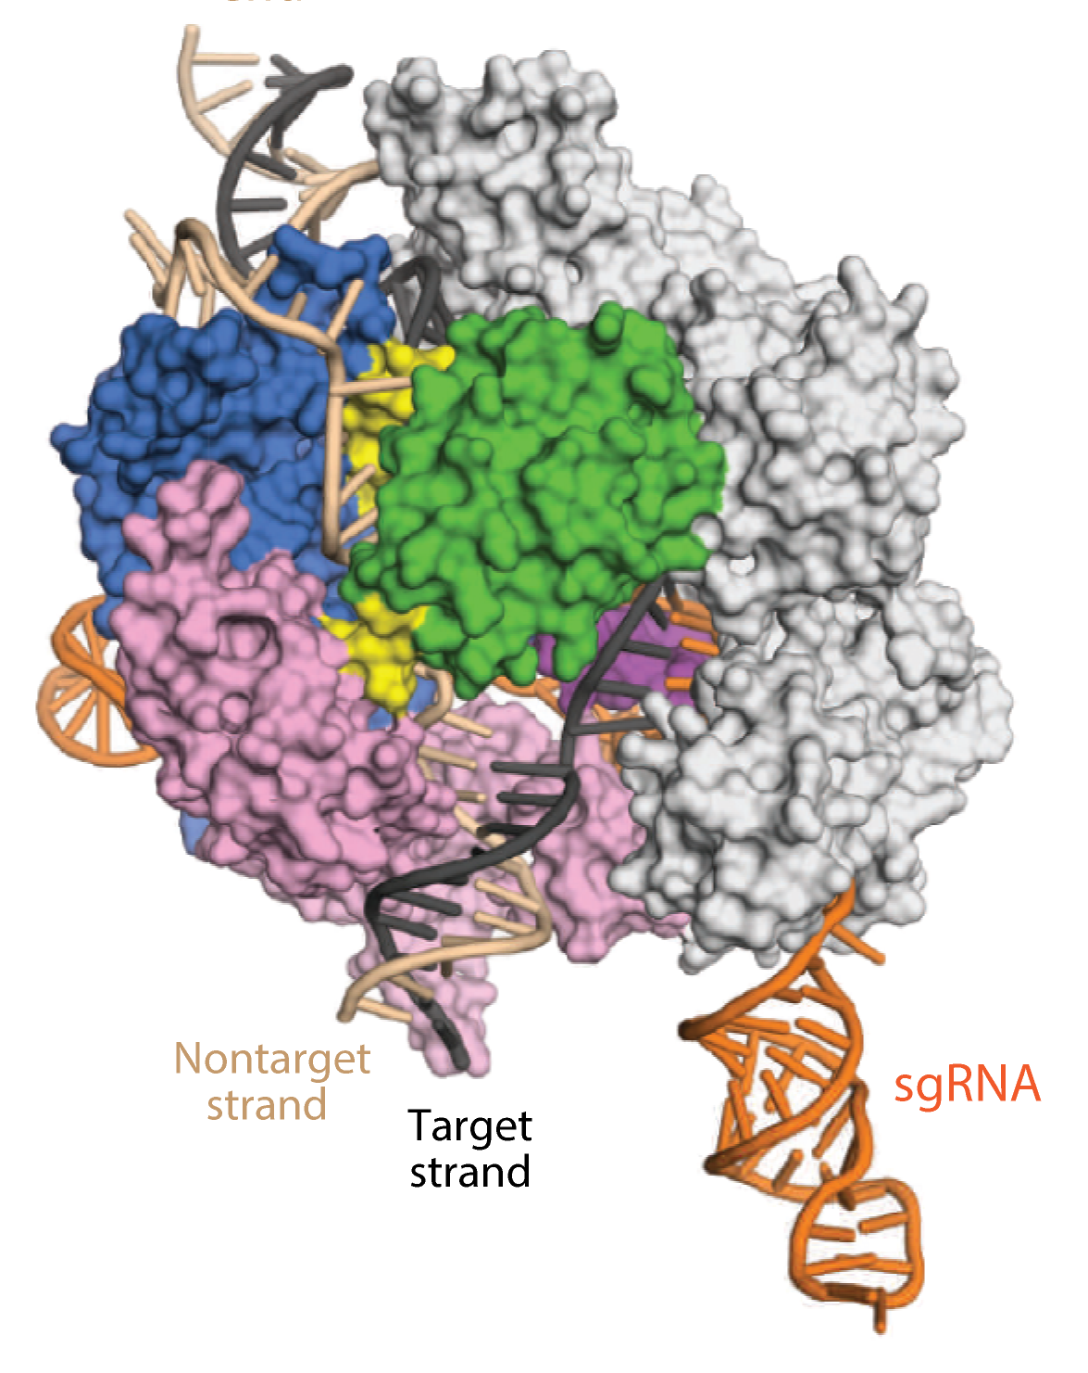
Gene Therapy
Jiang and Doudna. Annual Rev Biophys 2017
Notes:
CRISPR sequences identified
food scientists using strep bacteria to make yogurt linked sequences to bacterial immunity against bacteriophages
Killed virus subsequently used to generate DNA template ab’s against future attack
From bacteria to provide adaptive immunity against virus and plasmid
Scientists manipulated CRISPR-Cas9 to target any DNA
Scientists manipulate CRISPR to edit the genome of mouse and human
2020 Nobel Prize for crispr – Emmanuelle Charpentier and Jennifer A Doudna
Can be targeted to a specific gene sequence
CRISPR – clustered regularly interspaced short palindromic repeat sequence
Cas9 - endonucleoase

Slide 29
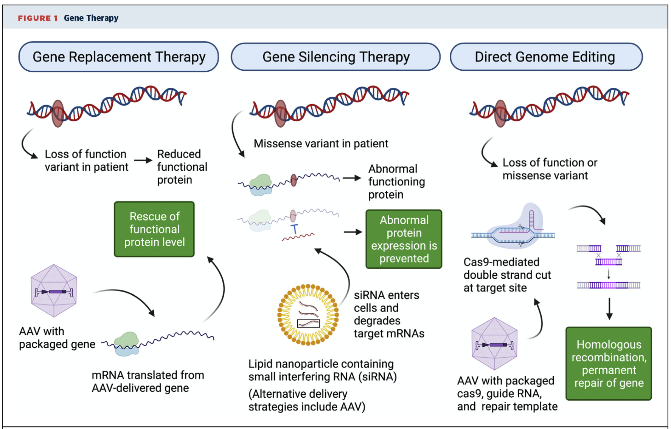
Gene Therapy Overview
Helms JACC Basic Trans 2022

Slide 30
And now trials in patients…
Frangoul et al. NEJM 2020 (Dec 5, 2020)

Slide 31
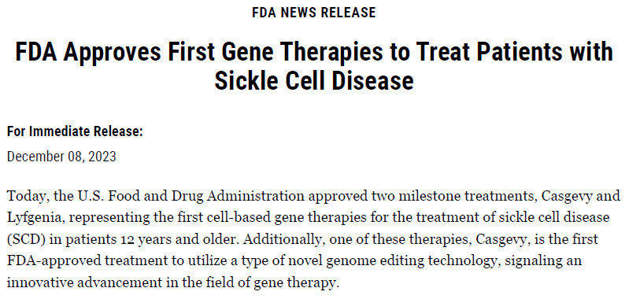
FDA approved December 8, 2023
*Institute for Clinical and Economic Review, WSJ accessed 12.08.23
Notes:
Casgevy. 2.2 million/patient
Lyfgenia. 3.1 million/patient
Nonprofit*. 1.35-2.05 million/pt

Slide 32
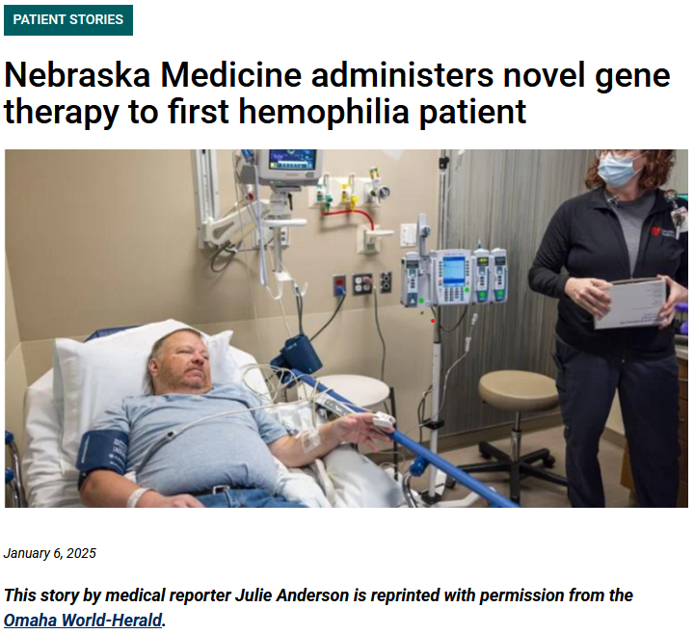
~3.5-6% population have a “rare” disease
~250+ million worldwide
Wakap et al, Eur J Hum Genet 2020
Notes:
Identify the rare individuals who will benefit

Slide 34
Lifestyle impacts outcomes in patients with high genetic risk
Do lifestyle choices impact CAD outcomes in patients with equal genetic risk?
YES
Khera AV et al. NEJM 2016

Slide 35
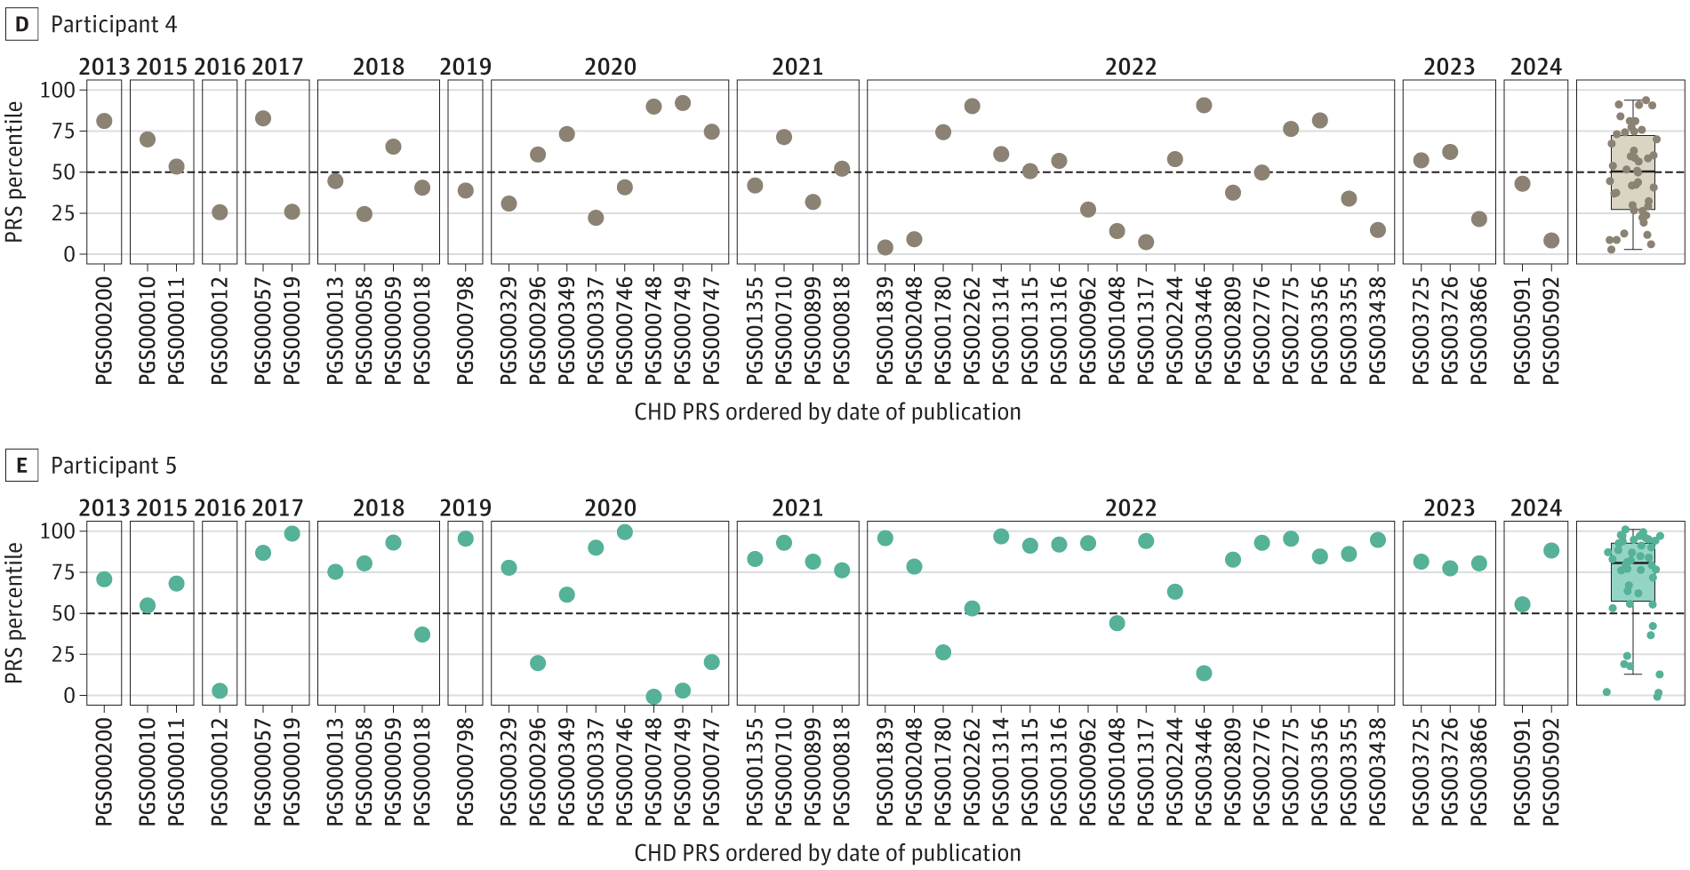
Marked individual PRS variability
46 CAD PRS – similar population level performace
Tested in AllofUs (171k), Penn (41k) and UCLA (53k) biobanks
Abramowitz et al. JAMA 2024

