Slide 1

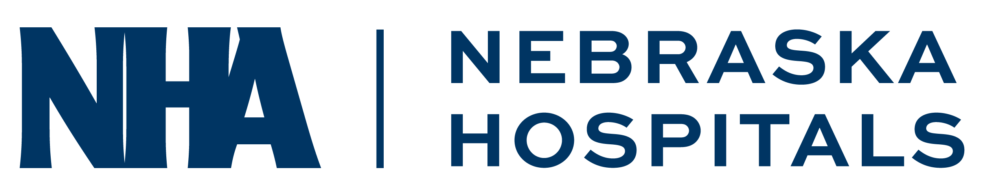
Leveraging Data Analytics and Automation in the Revenue Cycle

Slide 2


Your Speakers
Timothy Johnson
Michael Brown, CRCE, CHAM
NHA Chief Financial Officer
National RCM Consulting Leader
Prior to his role with the NHA, Tim held senior advisory & management positions within industry-leading organizations such as Deloitte Consulting, Cerner, SCL Health and LifeLinc Anesthesia.
Michael Brown is the RSM National Revenue Cycle Consulting Leader, with extensive expertise in financial management and strategic initiatives within the health care industry.
Notes:
Michael to start

Slide 3



Health data & business intelligence NHA Advisory services

Slide 4

Health Data & Business Intelligence Services
CEO Advisory Strategic Financial Planning Board Summaries & Ops Dashboards CMS Organizational Transformations
CFO Advisory Targeted WISeR Model Audits Chargemaster Coding Reviews & Updating
Revenue Cycle Operations Support IT Implementations & AI Integration Service Line & Physician Performance
Patient Migration Studies
Utilization & Productivity Assessments Monthly Financial Reporting
Annual Operating Budget Development
Quality / Nursing Board & Leadership Dashboards
Clinical Operational Assessments
Third-Party Outcomes Reporting
NE State & Federal Reporting
Marketing Internal/External Marketing & Assessments
Human Resources Productivity & Operational Assessments
Strategic Workforce Planning
$1,295 - $6,475 Annual Subscription Fees Includes 8 to 40 Professional Fee Hours
Experienced & Unlimited Professional Resources
Value-Based % | Negotiated Fixed Fee | Time & Materials

Slide 5
Medicare prior authorizations
The wiser model

Slide 6


NEW Medicare Prior Authorizations – WISeR Model
The WISeR Model | Changing The World As We Know It
On January 1, 2026, CMS is expected to roll out the new prior authorization process for traditional Medicare patients – The WISeR Model.
The Wasteful and Inappropriate Service Reduction (WISeR) Model is initially designed to "implement and streamline the prior authorization process for select items and services that may be fraudulent, and wasteful, or of low-value to beneficiaries in original Medicare".
The Wiser Model will bake in discrete clinical requirements that are conditions of payment from existing NCDs, LCDs and other related sub-regulatory sources into the prior authorization process.
The WISeR Model is voluntary for participating hospitals and will begin on January 1, 2026, and run for two three-year agreement periods, until December 31, 2031. The initial demonstration will include 6 states - New Jersey, Ohio, Oklahoma, Texas, Arizona and Washington.

Slide 7
NEW Medicare Prior Authorizations – WISeR Model
NHA Advisory Services | Targeted WISeR Model Preparation Audits
A critical first step in the process will be for each provider to perform independent and targeted WISeR Model preparation audits.
Targeted WISeR Model audits should incorporate all CMS sub-regulatory requirements on each CMS focus areas, including medical necessity, documentation and other billing/coding payment criteria (i.e., NCDs, WPS LCDs, CMS Manuals, CPT/HCPCS, ICD-10, AHA Coding Clinic, etc.).
NHA Advisory Services staff is working closely with national Medicare compliance experts to leverage a history of proven success with 10,000+ Medicare appeals and bring vital resources to completing targeted WISeR Model audits for our Nebraska hospitals.
Please join our CFO call on November 10 for an in-depth and detailed discussion of the WISeR Model introduction, its initial focus areas and the expected impact on Nebraska hospitals.

Slide 8
Agenda
The Power of Data Analytics in RCM
Insights on how data analytics can enhance decision-making and improve efficiency, accuracy, and financial outcomes in RCM
Analytics Case Studies
Examples of health care organization using data analytics to reduce billing errors and improve collection rates
Potential Risks of Data Analytics and Automation
Overview of risks associated with data security and over-reliance on technology
Strategies to Mitigate Risks
Best practices for ensuring data security and maintaining human oversight
Implementing Data-Driven Solutions
Steps for integrating analytics into existing workflows
Automation in Health care Workflows
Key drivers for automation and AI programs
Ethical Considerations in AI and Automation
Insights to the regulatory and compliance aspects of AI and Automation
AI & Automation Case Studies
Examples of automation and artificial intelligence case studies
Actionable Strategies for Continuous Improvement
Key steps for fostering a culture of ongoing evaluation and adaptation in RCM practices
Notes:
Michael

Slide 9
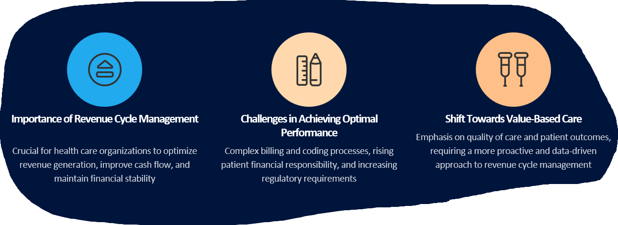
The Need for Continuous Innovation
Effective revenue cycle management is essential for health care organizations to thrive in the evolving healthcare landscape, and advanced analytics can play a pivotal role in overcoming the challenges and driving performance improvement.
Notes:
Michael
1. Dynamic Healthcare Environment 2. Increasing Complexity of Payment Models
3. Rising Administrative Costs 4. Consumerism and Patient Expectations
5. Rapid Evolution of Technology 6. Responding to Market Competition
7. Mitigating Risk 8. Workforce Adaptation
9. Sustainability and Scalability

Slide 10
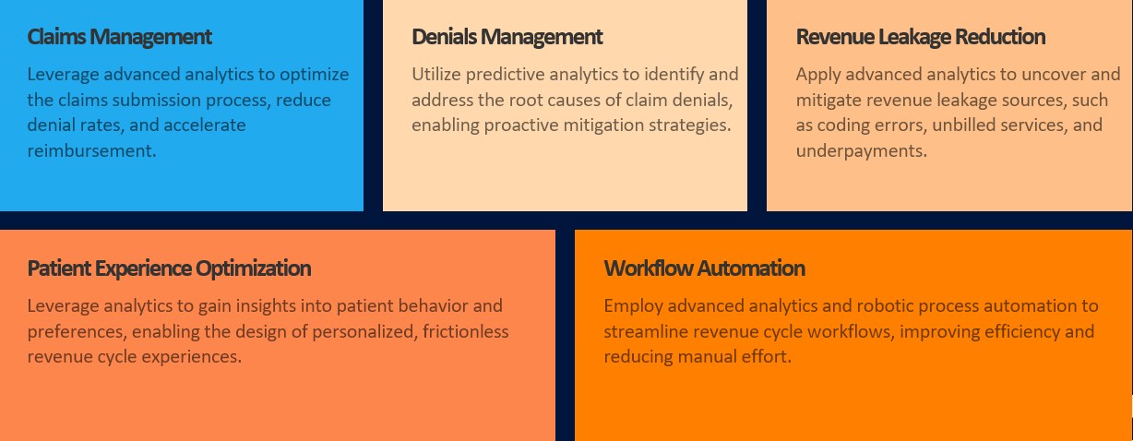
Driving Performance Improvement
Notes:
Opening Transition
“Thanks, Michael. Building on what you shared, let’s talk about how we identify high-value opportunities for performance improvement—and it all starts with the data.”
Lead with Data
“Every performance improvement initiative we undertake begins with data. It’s our compass—it tells us where to look and what levers to pull.”
Key Focus Areas
“We monitor payer behavior to anticipate and prevent denials before they happen.”
“We identify revenue leakage—whether it’s undercoding, missed charges, or not being paid what we’re contractually owed.”
“We examine patient experience trends. For example, if Mandarin-speaking patients consistently rate us poorly, that may signal a need for more translators.”
“We explore automation opportunities—how can we do more with less? RPA can streamline workflows and reduce manual effort.”
Real-World Automation Examples
“Bots that send out pre-authorizations based on scheduled orders.”
“Bots that improve charge capture by comparing physician orders to actual billing.”
Transition to Analytics Framework
“All of these efforts are guided by the questions we ask—and those questions fall into an analytics maturity model.”

Slide 11
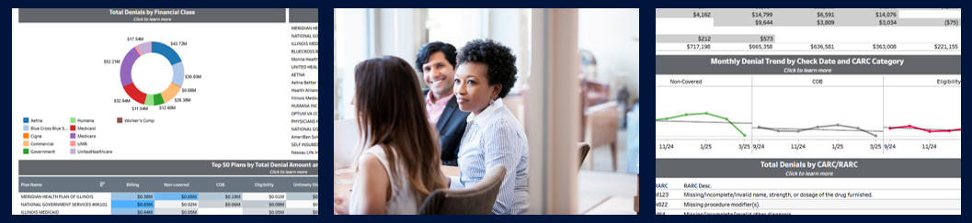
Case Study: Prescriptive Denial Avoidance through Analytics
Identify Patterns
Prescriptive Denial Avoidance
Tracking / Machine Learning
Leverage 835 and 837 data to identify trends by facility, payer, provider, procedure, and diagnosis
Work across the revenue cycle, finance, and clinical continuum to implement defensive strategies
Measure the impact of corrective actions and recalibrate
Leverage billing system activity reporting to understand activities taken in response to denials or delays in payment
Notes:
~Michael Introducing~
Micah:
Surface level tells you what happened and on what cadence it happened.
Descriptive
Ability to drill down with filters and leverage expertise within staff to perform analysis of why something happened
Diagnostic
We like to bring a wide variety of people to these sessions to enable cross-department collaboration
As we implement changes we can track progress to make determinations if they’re working or not, speaking to continuous improvement

Slide 12

Case Study: Optimized Cash Reconciliation and Posting through Analytics
Cash Reconciliation Dashboard
Reduced Time to Post Cash
Saved Employee Work Hours
Track bank deposits and remittances to identify ready-to-post and pending items without manual excel workbooks
Decrease in days to post cash from 9 to 2 days
14,000 annual work hours saved by automating reconciliation
Notes:
Reliance on human reconciliation of bank deposits to remittance receipts and remittance posting creates several challenges:
6-8 hours per week downloading files, populating spreadsheets and identifying discrepancies
Delays to cash posting from human delays or missed reconciliations
Rework from missed checks or batch balancing errors caused by human data entry errors
Leveraging descriptive analytics to match bank deposits with electronic remittance data and EMR posting data in a dashboard layout produces several key benefits to drive transparency and margin.
Making real-time cash flow data accessible to cash posters, revenue cycle leaders, and CFO’s provides transparency to current cash flow, provides insights to bottlenecks in posting processes, and highlights any payer driven delays for immediate attention
Reducing reliance on manual reconciliation cuts posting lag by 60-70%
Moving away from human driven reconciliation not only reduces time to post but also reduces resource requirements providing the freedom to focus those resources on more complex, high value tasks.
This type of descriptive analytics can be built to support many other forms of reconciliation which rely on data moving between different modules, different departments, different systems, or even different organizations. Other areas where we have seen benefits include charge reconciliation, claims reconciliation, and client to vendor reconciliation.

Slide 13
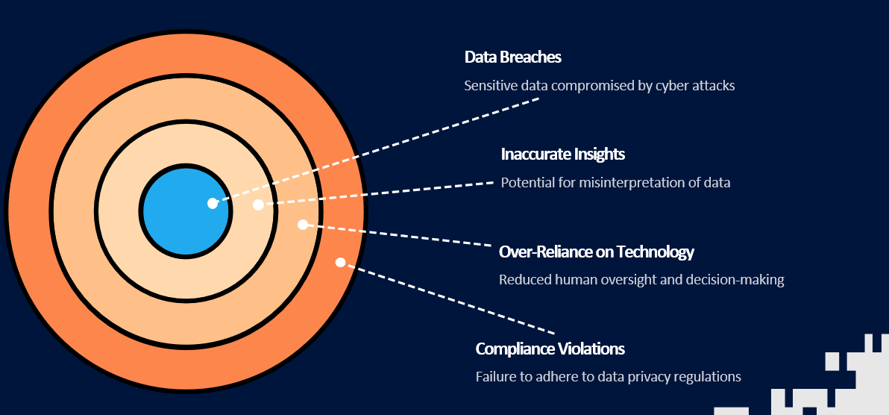
Potential Risks of Data Analytics and Automation
Notes:
[Colin]
Intro: Before we talk about how to implement automation, let’s pause and acknowledge the risks. Technology isn’t neutral—it can solve problems, but it can also create new ones if not managed well.
Speaking Points:
• Data breaches: Healthcare sees more breaches than any other industry. AI requires sensitive data—security must be engineered from day one.
• Inaccurate insights: Poorly trained models or incomplete data can drive the wrong decisions. For example, a flawed denial prediction model can waste staff time instead of saving it.
• Over-reliance: AI should augment—not replace—human judgment. If staff defer blindly to algorithms, compliance and patient trust can be put at risk.
• Compliance violations: HIPAA and emerging AI regulations are still evolving. Early adopters need to stay ahead of compliance requirements to avoid penalties and reputational damage.
Outro: These risks are real, but they’re not show-stoppers. With the right guardrails, AI and automation can deliver value while keeping organizations safe.

Slide 14
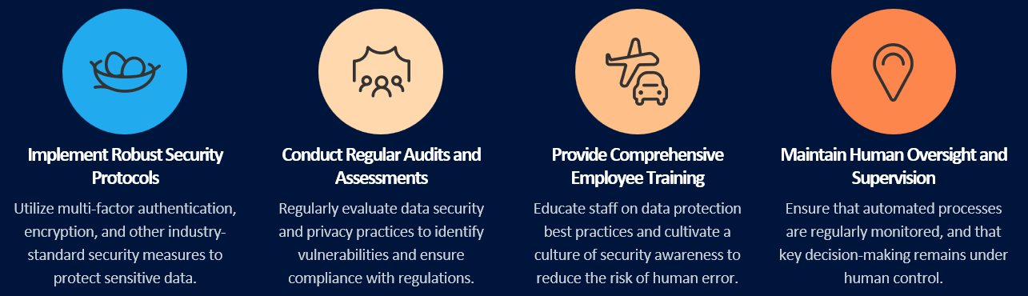
Strategies to Mitigate Risks
By implementing these strategies, health care organizations can mitigate the risks associated with data analytics and automation, ensuring the security of sensitive information and maintaining the necessary human oversight to make informed, data-driven decisions.
Notes:
[Colin]
Intro: So how do leading organizations manage these risks without slowing down innovation?
Speaking Points:
• Start with security: Utilize industry-standard security measures, such as multi-factor authentication and encryption, to protect all sensitive data
• Audits and monitoring: Risk doesn’t end at go-live. Regular audits and assessments—both on the data pipelines and the models—help ensure tools are accurate and compliant over time.
• Staff empowerment: Many risks arise when staff don’t understand how or why automation works. Training equips your team to use AI responsibly and catch anomalies early.
• Maintain human oversight: Consider keeping a “human in the loop” for AI workflows. For example, having an automated workflow flag high-dollar claims for staff review rather than letting them go fully automated.
Outro: With the right governance, audits, training, and oversight, organizations can adopt automation confidently—without falling into the common pitfalls.

Slide 15
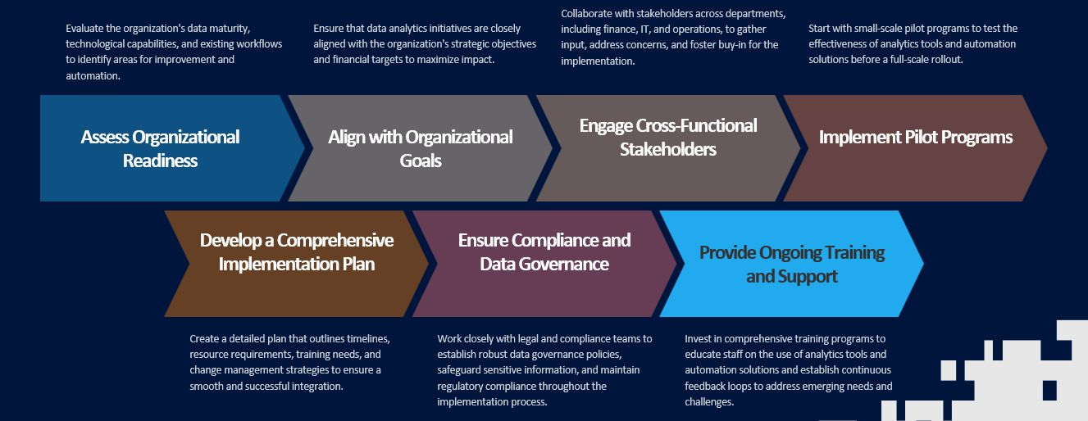
Implementing Automation Solutions
Notes:
[Colin]
Intro: Once risks are managed, the next challenge is: how do you actually implement automation in a sustainable way?
Speaking Points:
• Readiness assessment: Start with a maturity assessment. Is your data infrastructure reliable? Are processes standardized enough to automate? Do we have the human capital to maintain and manage automation in the long term? If not, automation may fail before it starts.
• Strategic alignment: Automation for its own sake rarely works. Tie every initiative back to measurable business goals—cash acceleration, reduced denials, improved patient access.
• Pilot first, scale second: The best implementations start small—one denial category, one scheduling process—and prove ROI before scaling.
• Cross-functional involvement: Finance, IT, clinical ops, and compliance all need a seat at the table. Automation cuts across silos; successful rollouts reflect that.
Outro: Automation success is less about the technology itself and more about aligning people, processes, and goals. That’s how you ensure it sticks.

Slide 16
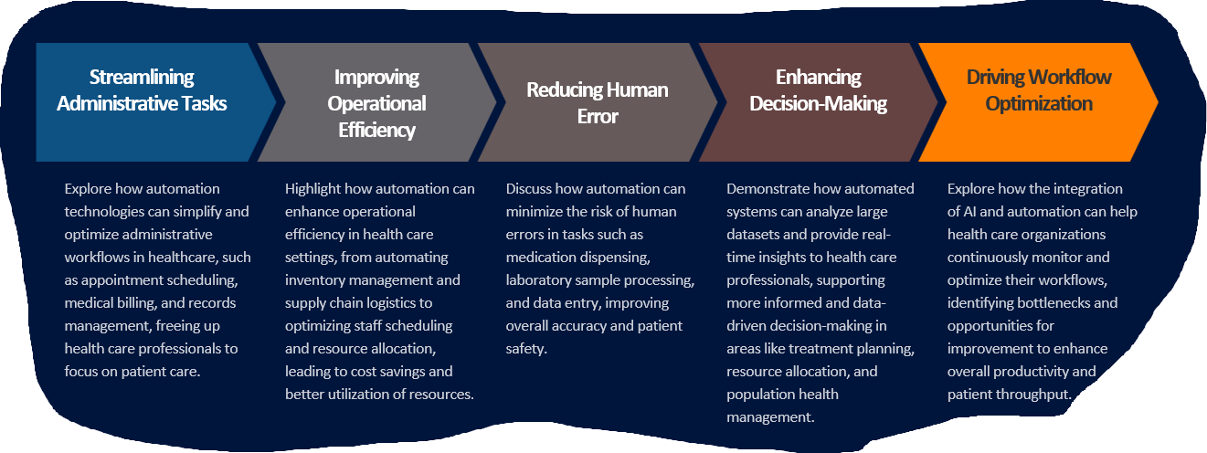
Automation in Health Care Workflows
Notes:
[Colin]
Intro: Let’s look at where automation is already having a tangible impact on healthcare workflows.
Speaking Points:
Administrative relief: When we talk about automation in healthcare workflows, it’s really about giving time back to staff and improving the overall patient experience. Take administrative relief, for example—things like eligibility checks or payment posting are repetitive but necessary. Automation handles those tasks so your staff can spend their energy on the cases that truly need human attention.
Improving Operational Efficiency: It also drives efficiency behind the scenes. Instead of employees juggling inventory levels or staff scheduling, automation ensures the right resources are in the right place at the right time. That means lower costs, smoother operations, and more time for people to focus on care instead of logistics.
Error reduction: And importantly, automation helps cut down on errors. Automating coding audits or claim edits reduces preventable denials and compliance issues—catching mistakes early so they don’t become lost revenue later.
Decision support: On top of that, AI-enabled dashboards can provide decision support by pushing recommendations directly into workflows—for example, flagging the highest-priority accounts to work first each morning.
Patient impact: And all of this ladders up to the patient experience. When the back office runs faster and more accurately, patients get fewer billing surprises and a much smoother financial journey.
Outro: The real opportunity isn’t just cost savings—it’s shifting human effort from transactional tasks to value-added activities that improve both margins and patient trust.

Slide 17
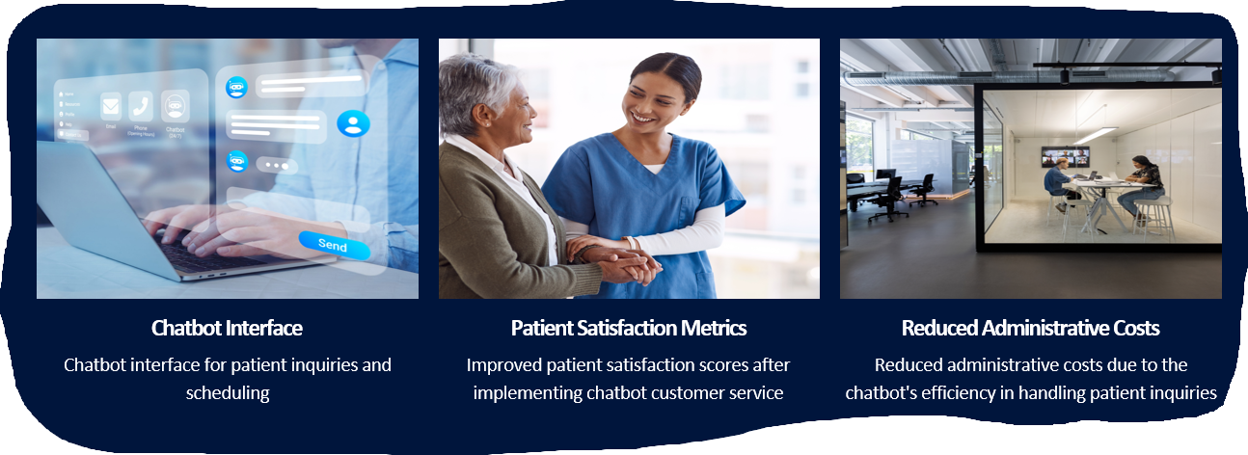
Real-World Example of AI Customer Service
Notes:
[Colin]
Intro: Here’s an example of how automation is improving the patient experience.
Speaking Points:
Chatbots reduce friction: Patients can ask billing questions or schedule appointments 24/7—without waiting on hold.
Cost reduction + satisfaction: This combination is rare—most cost cuts erode experience. But here, automation both reduces call center load and improves patient satisfaction.
Data advantage: Every chatbot interaction generates structured data that can be mined for common patient pain points, guiding service improvements.
Outro: This is a great example where automation directly benefits both the bottom line and the patient.

Slide 18
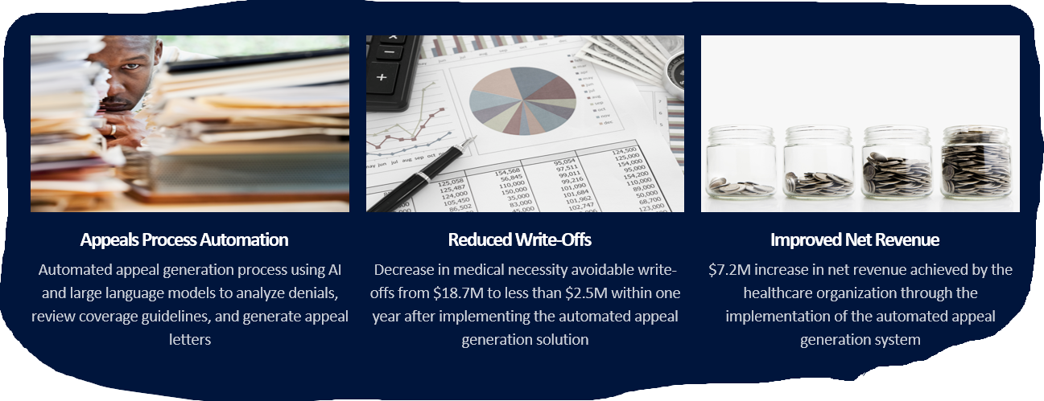
Real-World Example of Automated Appeal Generation
Notes:
[Colin]
Intro: On the revenue side, let’s look at how automation can transform appeals.
Speaking Points:
Manual pain point: Appeals are labor-intensive, often requiring staff to gather clinical documentation and draft letters.
Automation advantage: Tools can auto-generate appeals by pulling from EMR data, payer guidelines, and prior templates.
Financial impact: Fewer write-offs, faster revenue recovery, and higher staff morale because teams spend less time on rote, frustrating tasks.
Scalability: Instead of focusing only on high-dollar denials, automation lets you address a much wider set of denials profitably.
Outro: Automated appeals are a perfect example of how AI can protect revenue while freeing staff for complex, high-value cases.

Slide 19
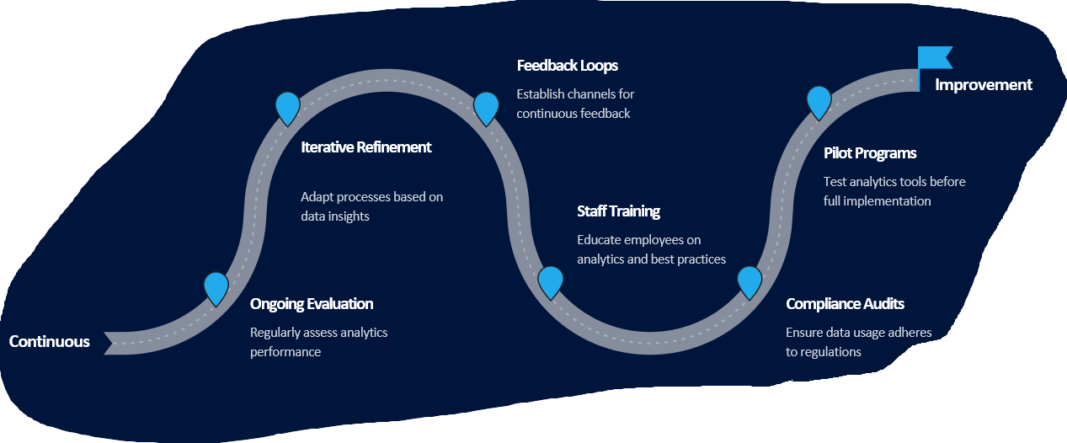
Actionable Strategies for Continuous Improvement
Notes:
Michael

Slide 20
“The true sign of intelligence is not knowledge but imagination.”
Albert Einstein – Theoretical Physicist and Mathematician
Notes:
Michael

Slide 21
Thank You!
Timothy Johnson
Chief Financial Officer, Nebraska Hospital Association
tjohnson@nebraskahospitals.org
Michael Brown
National Revenue Cycle Consulting Leader, RSM
Michael.Brown@rsmus.com

