Slide 1
Quality Residency
Capstone Project
nebraskahospitals.org
Name, Date, Organization

Slide 2
Introduction to the Organization, Project, Team
Columbus Community Hospital is a 50-bed Acute Care Hospital in Columbus, NE
Services include:
Project Overview: Security Team. Why? Focus – entire hospital
Team: SBH Director, Facilities, Quality, Emergency Preparedness
Reviewed with Senior Leaders and approval given

Slide 3
AIM Statement
AIM Statement:
Increase the usage of the Security Team to ensure safety to the nurse and patient throughout the hospital.

Slide 4
Measuring Success
Plan:
Measure number of security events reported
Measure number of security team activations

Slide 5
Selecting Changes
What changes will be made to work towards improvement goals?
Emailed all staff regarding the new Security Team Emergency Code
Educated all staff at Safety Days about the “NEW” Security Team Page
Monitor number of pages – to ensure team is being utilized

Slide 6
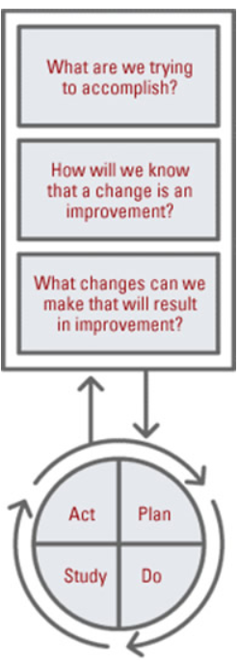
Plan ~ Do ~ Study ~ Act
Plan
I plan: Execute a Security Team House wide due to multiple staff/patient events in SBH
I hope this produces: increase in response of paging the new security team
Steps to execute: assembled team members and educated staff on new process
Do
How long will you observe new changes? ongoing
What did you observe? Increase use of security page
Are the changes creating consequences – intended consequences include: designated staff response to the event. Will continue to monitor for unintended consequences.
Study
What did you learn? Looked at the incidents happening in the SBH unit due to patients having dementia & mental health issues and increase in 1:1 patients within unit
Did you meet your measurement goal? ongoing
Do you need more observation time? Yes, ongoing measure
Act
With the support of the Senior Leadership team we launched a new Emergency Code to bring more staff to assist with these incidents.
What did you conclude from this cycle? Identified the need for a Security Team
Will you sustain the changes? Yes.
Does the change need adjusted or removed? Will reassess as Security Team is used.

Slide 7
Data and Trends

Slide 8
Return on Investment (ROI)
Explore the financial implications of the project:
Will costs/expenses be incurred to make noted changes?
Additional staff? On site
Additional hours? None, team consists of staffing on duty
Equipment? None. Use current paging system
IT expense? None. Use current paging system
What savings/revenue will be noted?
Decreased harm to staff.
Reduce turnover.

Slide 9
Spreading / Sustaining / Maintaining / Replicating
Ensure successful changes is spread to all units, staff, appropriate areas
Audits and spot checks to assess sustainability
Can the program be replicated in other areas or organizations?

Slide 10
THANK YOU/Questions
Lisa Backman
Columbus Community Hospital
nebraskahospitals.org

