Slide 1

Talk the Talk: Effective Communication Strategies
nebraskahospitals.org
March 2025
Molly Herzberg MSN RN
VP Patient Care Services, CNO
Community Hospital, McCook

Slide 2
Objectives
Students will identify tools to use for effective communication.
Students will be able to apply learned tools into their practice to improve communication and provide patient safety.

Slide 3
Outline
  AIDET
    Define AIDET
    Demonstrate how to use the tool
    Benefits of AIDET
  TeamSTEPPS
    Define TeamSTEPPS and the evidence to support
    Demonstrate tools SBAR, Call-out, Handoffs, CUS, Brief, Huddles, Debrief
  Bedside Rounding
    Explain rationale including patients/ families
    Explain communicating to understanding level
    Benefits of using bedside rounding
    Focus on patient education and repetitive education

Slide 4
Outline:
    Calling Providers
      Demonstrate using SBAR
      Using Critical Thinking Skills
      Time Management
      Texting information
      Read back orders
    Crucial Conversations
      With peers
      With providers
      With leadership

Slide 5
COMMUNICATION
communication
COMMUNICATION
COMMUNICATION
COMMUNICATION
cmmniounitaoc
cOm Un IcAti On
COMMUNICATION
communication
noitacinummoc
Notes:
According to Joint Commission: Ineffective Communication is listed as the top 3 causes of sentinel events 2013-2015. Sentinel event is categorized as causing severe injury or death
WOW just because of how we communicate
Bold
Fragmented
Interruptive
Unclear
Unorganized
Backwards
Transparent
Repetitive

Slide 6
AIDET
Acknowledge- Greet people with a smile and use their names (if applicable)- First impression
Introduce- Introduce yourself to others. Tell then who you are and how you are going to help them.
      Go the extra mile- instead of pointing out directions- take them
Duration-Explain waiting times.
      Be honest about delay, follow up/ update, service recovery
Explanation- Explain what you are doing, educate on process, who to contact
        Can I do anything else for you?
Thank- Foster an attitude of gratitude
Notes:
Examples:
Acknowledge
Greet people with a smile and use their names if you know them. Attitude is everything. Create a lasting impression.
"Good morning/afternoon, Ms. Jones. We've been expecting you and we're glad you are here."
"Good morning/afternoon, Mr. Smith. Welcome to Sharp. We want to make your visit as convenient as possible. Would you please take a moment to confirm that we have your most current information?"
Introduce
Introduce yourself to others politely. Tell them who you are and how you are going to help them. Escort people where they need to go rather than pointing or giving directions.
"My name is Molly and I will be conducting your test today. I am a certified ultra sonographer and I do about six of these procedures a day. The doctors say that my skills are among the best. Do you have any questions for me?"
"Mrs. Smith, you will be seeing Dr. Hoegrefe today. He is an excellent physician. He is very good at listening and answering patient questions. You are fortunate that he is your physician."
"Mr. White, Dr. Williams would like you to have an X-ray in our radiology department. We have an excellent team of radiology technicians who use state-of-the-art equipment. I'm confident you will have a great experience."
Duration
Keep in touch to ease waiting times. Let others know if there is a delay and how long it will be. Make it better and apply service recovery methods when necessary.
"Dr. Heart had to attend an emergency. He was concerned about you and wanted you to know that it may be 30 minutes before he can see you. Are you able to wait or would you like me to schedule an appointment for tomorrow?"
Explanation
Advise others what you are doing, how procedures work and whom to contact if they need assistance. Communicate any steps they may need to take. Make words work. Talk, listen and learn. Make time to help. Ask, "Is there anything else I can do for you?"
"The test takes about 30 minutes. The first step is drink this solution and the we'll have you wait 20 minutes before we take a blood sample. Would you like to read while you wait?"
Thank you
Thank somebody. Foster an attitude of gratitude. Thank people for their patronage, help or assistance. Use reward and recognition tools.
"Thank you for choosing Sharp. It has been a privilege to care for you."
"Thank you for your call. Is there anything else I can do for you? I have the time."

Slide 7
TeamSTEPPS
High-Performing Teams
Teams that perform well:
  Hold shared mental models
  Have clear roles and responsibilities
  Have clear, valued, and shared vision
  Optimize resources
  Have strong team leadership
  Engage in a regular discipline of feedback
  Develop a strong sense of collective trust and confidence
  Create mechanisms to cooperate and coordinate
  Manage and optimize performance outcomes
  (Salas, et al., 2004)
AHA Team Training

Slide 8
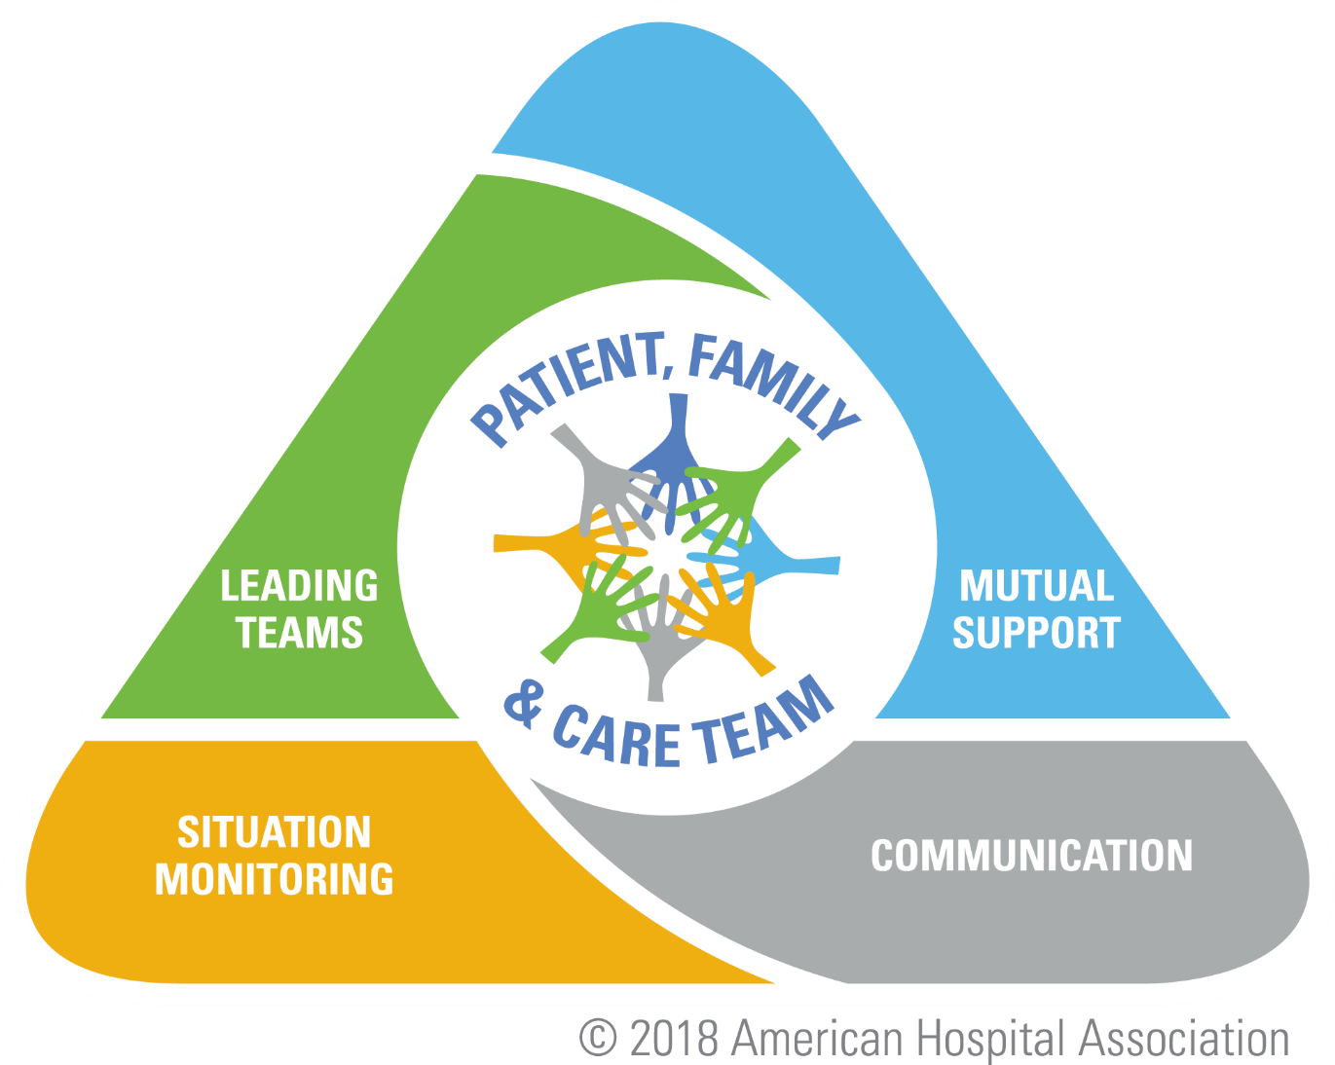
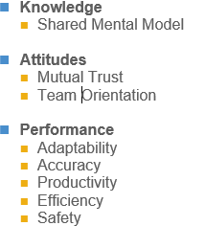
AHA Team Training
Notes:
this is the goal and roadmap to gaining more competent teams

Slide 9
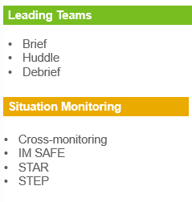

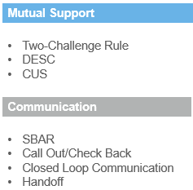
AHA Team Training
Notes:
We’ll talk about a majority of these tools today in their specific sections. And in all transparency, these are the tools that makes my cousin’s skin boil. He’s a pilot in the Air Force and is “forced” to use them on a daily basis. He grew up on a farm and many a time has complained to me…“It’d be like if dad sat us down every morning and we talked for 2 hours about what we’re going to do today. Then we’d go do the thing for an hour. Then we’d come back and talk about doing the thing for 2 hours.”
Well for as many flights and missions that take off and land without accidents in the Air Force, this strategy must be working. And unfortunately, we all know the farmer that has a list longer than Santa’s Christmas list of stupid accidents that have happened around their farm that were entirely preventable had a little forethought gone into the planning stages.
These tools are not designed to take up HOURS of your life. Initially, they will require a little additional time and planning, but ultimately with practice, they will become second nature and improve the efficiency throughout the entire hospital.

Slide 10
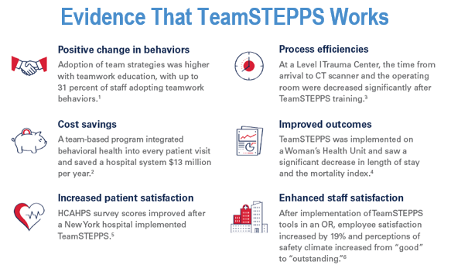
AHA Team Training

Slide 11
Barriers to Team Performance
Inconsistency in team
Lack of time
Lack of Information sharing
Hierarchy
Defensiveness
Conventional thinking
Varying communication styles
My boss is a jerk
I was retaliated against for calling someone out
AHA Team Training
Notes:
Barriers: We kind of talked about this earlier. The two I want to highlight are Hierarchy and Defensiveness. This specifically involves being a leader who is empowered to lead UP and DOWN the chain of command. This requires the “Titled Leader” to create an environment that doesn’t stifle leadership development. TeamSTEPPS offers the tools and framework for creating that culture.
Which leads us into… people take critiques too personally. BUT also, too often critiques are delivered in a way that involve some degree of gaslighting or don’t convey their team value despite making a mistake. Telling someone they did a terrible job is not the same as saying they are a terrible person. TeamSTEPPS provides a language for offering feedback and critiquing our teammates. Own your mistakes and failures and implement a “From now on” approach. “Thanks for letting me know, from now on, I’ll be better.” And better can mean 40 million different things depending on the scenario. People want to feel validated and if your response makes them feel like an idiot, you can guarantee they’re going to be hesitant to bring up something else in the future. No matter where you are within the chain of command within this hospital…you’ll make another mistake again and you’ll want your team to support and correct you.
Now I’d like everyone to grab a few sticky notes from the center of your table and write down a few barriers that you have run into or know of that is affecting your team / department’s performance. Could be a personal experience, could be something told to you. Please don’t write down specific departments or people. This is not the time or place for that specifically but hopefully over the course of this training, you can figure out a specific barrier to address as well as a few tools to help you address it. We’ll be using the themes of what you write down to somewhat tailor our specific sections. We want this training to be useful and encouraging to cause culture change.
***************FACILIATOR TIP – STICKY NOTE EXERCISE​
Each person gets 3 sticky notes to write down their assessment of the top 3 barriers in their unit or org that keeps people from speaking up​
Group sticky notes to identify THEMES​
Report out later in the afternoon TOP 3 and discuss possible solutions​

Slide 12

Lego Building Exercise
Each team will have 2 minutes to build the tallest tower
Rules:
  Each person must decide whether they are a runner or a builder
    You cannot switch between the two roles
  Runners: can only grab no more than 5 pieces per trip
  Builders: no same-colored piece can touch
    The pattern must follow “ 1 Big, 3 Small”
  Each piece left “unattached” when the timer goes off, will count against your total height
AHA Team Training
Notes:
Team Training Tower (aka Lego) exercise. See “Team Training Tower Instructions” for more details.
Instructions: You will have 2 minutes to create the tallest tower.
Rules:
There are none!
Be vague, quick and start the timer right away to create a sense of urgency.
When Finished: Give each group time to decompress and look at each other’s towers.
Debrief Notes
Decompression time (1-2 minutes)
Allow the participants to chatter, laugh, talk and “decompress” with each other and talk about what they did for a minute or two.
Debrief (3-5 minutes)
Ask:
1) What went well?*
2) What could be improved?
3) What is one thing you will do different next time?
TeamSTEPPS Debrief (5-7 minutes)
As participants respond, rephrase their responses back to them as TeamSTEPPS skills that will be covered in the training. Notes/questions to ask:
How did you identify roles and responsibilities? Point out a group in which someone assumed a leadership role and helped the team plan. If none of the groups had a member who did this, ask how this would have helped.
Was anyone standing around wondering what to do because a clearly defined role was lacking?
What was the noise level like in the room?
Instructions were given often fast and with little time for you to prepare. What was that like for you?
What information was communicated during the task and how it affected (i.e., helped or hindered) the team's ability to perform the task?
Potential TeamSTEPPS tools/skills that were used or could have been used: call-out, check-back, briefs.

Slide 13
Applying TeamSTEPPS Exercise
What is the patient safety/organizational issue you encounter that is linked to a problem with teamwork and communication with building the Legos?
AHA Team Training
Notes:
Lack of instructions
No time to read the instructions
Assigned positions
Did you know the expectations

Slide 14

Effective Communication
Effective communication skills are vital for patient safety
Enables team members to effectively relay information and collaborate
Improves healthcare outcomes
AHA Team Training
Notes:
Communication is crucial for patient safety because it ensures accurate info exchange among healthcare providers and patients. It prevents:
errors
facilitates timely intervention
supports informed decision-making
promotes team collaboration
reduces readmissions and complications
ensures patient understanding of their care.
Ultimately, effective communication enhances overall patient safety and improves healthcare outcomes.

Slide 15
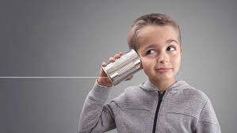
Standards of Effective Communication
Complete
  Communicate all relevant information
Clear
  Convey information that is plainly understood
Brief
  Communicate the information in a concise manner
Timely
  Offer and request information in an appropriate timeframe
  Verify authenticity
  Validate or acknowledge information

Slide 16
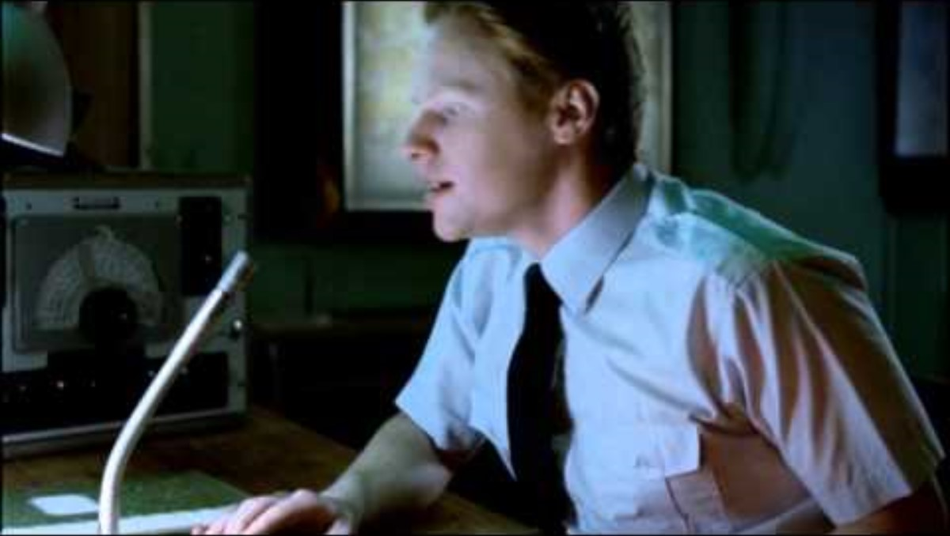
https://youtu.be/0MUsVcYhERY?si=vgIkM3NEcJOADrtN
Notes:
We can all see that was obviously a very ineffective method of communication…so BIG Group, what went wrong?
Language barrier
Extreme novice being left in control
Commanding officer giving what appears to be a very brief explanation of the process in a very fast manner
No confirmation the junior officer actually understood anything
Communication challenges
Personalities
Workload
Varying communication styles
Conflict
Lack of information
Faculty Note:
https://www.youtube.com/watch?v=0MUsVcYhERY
[or use other video at faculty’s discretion]

Slide 17

S.B.A.R
Situation- What is going on with the patient?
Background- What is the clinical context?
Assessment- What is the concern?
Recommendation or Request- What would I recommend?
Notes:
Specifically say that they need to use the full word.
-Situation
-Background
-Assessment
-Recommendation (or Request)
* You can SBAR about non-clinical as well.
Example for non-clinical:
S- The printer in the office isn’t working
B- It’s been acting up for the past few days, but now its completely down
A-Without the printer, we can't print important documents for the meeting later today.
R-Could someone from IT take a look at it asap to get it up and running before the meeting?
SBAR examples
Medical records
S-i need to access a patient's medical records
B-the patient was admitted last month for a surgical procedure
A-I need the patient's medical history, surgical notes and any recent test results to inform their current treatment plan
R-Could someone from the medical records dpt. provide me with access to the patients records so I can review them for the current treatment.
Admissions
S- a distressed pt. is lingering near the admission desk refusing to provide personal info.
B-the pt. seems disoriented and hesitant to engage with staff
A-their behavior raises concerns about their well-being and safety
R-Could admission staff approach to offer assistance and assess the situation further?
EVS: shower head leaking or a coffee spill
S- There’s a spill in the break room that needs to be cleaned up
B-It’s coffee and its starting to spread across the floor
A- the spill poses a slip hazard for anyone walking through the break room, and it could damage the flooring if not cleaned up quickly
R-Could someone from EVS please come to the break room to clean up the spill asap to prevent accidents and maintain a safe environment for everyone?

Slide 18

Call-Out
A strategy used to communicate important or critical information
  It informs all team members simultaneously
  during situations
  It helps team members anticipate next steps
  It directs responsibility to a specific individual assigned to carrying out the task
AHA Team Training
Notes:
OR will call-out Apgar scores during L&D
example: “baby’s apgar scores: 7 at 1 minute, 8 at 5 minutes post-delivery”
Code / Trauma
These are generally highly time sensitive environments where everyone needs to know the information immediately. Make sure to SPEAK UP. This is not called a “hesitant or whisper-out”

Slide 19
CUS
Concerned- I’m concerned about the medication that you are giving.
Uncomfortable- I am uncomfortable with you giving the medication now as it is scheduled for
tonight, as the patients blood pressure is already low.
Safety Concern- This is a safety concern as it doesn’t follow policy on giving medications.
Notes:
Hopefully you’ll have them at “Im concerned” but if you don’t get a response proceed with the rest of the CUS​
​
To CUS someone means that there is critical patient safety on the line. It requires immediate cessation of the process and resolution of the safety issue​
​
It seems silly, but we have to use the words. I am Concerned (ears perk). I am Uncomfortable (people turn), STOP, This is a Safety Issue (people stop).​
​
Example Clinical: ​
Scenario: You are a nurse working in a busy hospital emergency department. It's a hectic evening, and the staff is stretched thin attending to multiple patients. You notice that one of your colleagues, a newly hired nurse, is preparing to administer medication to a patient. However, you observe that the medication dose seems unusually high for the patient's condition.​
Application of CUS:​
Concerned: Approach your colleague in a respectful and non-confrontational manner, expressing your concern about the medication dosage. You might say, "Hey Linda, I'm concerned about the dosage you're about to administer to Mr. Smith. It seems higher than what I'd expect for his condition."​
Uncomfortable: Express your discomfort with the situation, emphasizing the importance of patient safety. You could add, "I feel uncomfortable with proceeding without double-checking the dosage. I want to ensure we're giving the right medication at the right dose."​
Safety: Highlight the priority of patient safety and the need to take appropriate action to prevent potential harm. You might conclude with, "Our primary concern is the safety of our patients. Let's pause for a moment and verify the dosage together to ensure we're following the correct protocol."​
​
Example Non-Clinic​
Scenario: You work in the quality assurance department of a healthcare organization responsible for ensuring compliance with regulatory standards and best practices. During a routine audit of documentation, you notice discrepancies in the records related to patient consent forms for a particular procedure. Upon further investigation, it becomes apparent that there may have been a lapse in obtaining informed consent from patients.​
Application of CUS:​
Concerned: Approach the staff member responsible for obtaining consent forms in a professional and non-accusatory manner, expressing your concern about the discrepancies. You might say, "Hi Sally, I'm concerned about the inconsistencies I've noticed in the patient consent forms for Procedure X. It's important that we ensure all patients provide informed consent before any procedure."​
Uncomfortable: Share your discomfort with the situation and emphasize the potential consequences of inadequate documentation. You could add, "I feel uncomfortable proceeding with the audit without addressing these discrepancies. Incomplete or inaccurate documentation could pose legal and ethical risks for both the patients and the organization."​
Safety: Stress the importance of patient safety and the organization's commitment to upholding high standards of care. You might conclude with, "Our top priority is ensuring the safety and well-being of our patients. Let's work together to review the consent procedures and ensure they align with regulatory requirements to prevent any potential harm or legal issues."​
GROUP PRACTICE:​
Ask for a volunteer – who can CUS the situation.​
​
Scenario: You are a nurse working on a hospital unit where teamwork and communication are crucial for patient care. Recently, you've noticed that one of your colleagues, Nurse Sarah, has been gossiping about another nurse's clinical competence behind their back. This behavior is causing tension among the team and may be impacting patient care.​
Application of CUS:​
​
Concerned: Approach Nurse Sarah in a private setting, expressing your concern about the negative impact of her gossiping behavior on team dynamics and patient care. You might say, "Hey, Sarah, I'm concerned about the rumors I've been hearing about Nurse Emily's clinical competence. Gossiping about our colleagues undermines trust and teamwork, which is essential for providing quality patient care."​
​
Uncomfortable: Share your discomfort with the situation, emphasizing the need to address the issue promptly to prevent further harm. You could add, "I feel uncomfortable being part of conversations that involve spreading rumors about our colleagues. It creates a toxic work environment and distracts us from focusing on what's really important—our patients' well-being."​
​
Safety: Highlight the importance of maintaining a supportive and professional work environment to ensure patient safety and quality care. You might conclude with, "Our patients rely on us to work together as a cohesive team. Spreading rumors not only damages morale but also compromises our ability to provide effective care. Let's commit to fostering a culture of respect and collaboration moving forward."​
​
​
​

Slide 20

AHA Team Training
Notes:
URL: https://www.aha.org/system/files/media/video/2022/02/pfl-CUS_Video_02_MM.mp4

Slide 21
CUS Coaching Tips
1
Use the language consistently
2
Use briefs and debriefs to practice; encourage everyone to speak up and ask if others have concerns
3
  If you get pushback:
  Continue to escalate your CUS and focus on patient safety
4
Use your teammates to back you up
5
Utilize your chain of command
AHA Team Training
Notes:
`

Slide 22
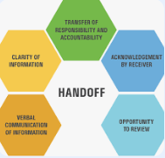
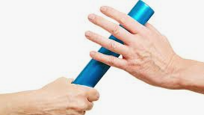
Handoff
Why are handoffs so dangerous?
Frequent
High Stakes
Error-prone
Gaps in Care
Notes:
Sim option: Pair and share: How many handoffs does it take to receive an orthopedic fracture patient from EMS to the inpatient floor?
It typically takes six hand-offs from EMS to the pt. floor.
1. ambulance to ER
2. ER to radiology for xray
3. radiology back to the ER
4. ER to surgery (if applicable) for treatment
5. Surgery to post-op care unit (PACU)
6. PACU to patients room.
**********Discuss the importance of acknowledgement by the receiver. Repeat back

Slide 23
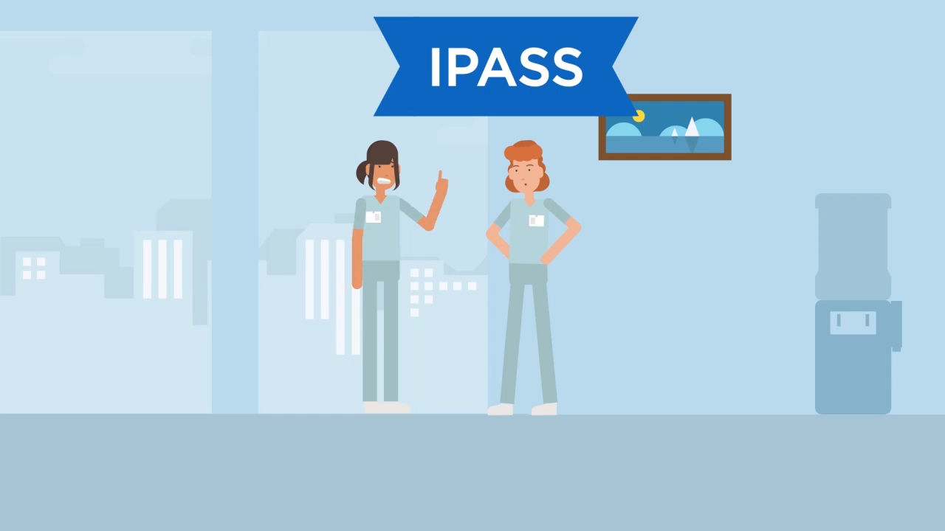
Notes:
https://www.aha.org/system/files/media/video/2022/02/pfl-Handoff_Video_02_MM.mp4

Slide 24
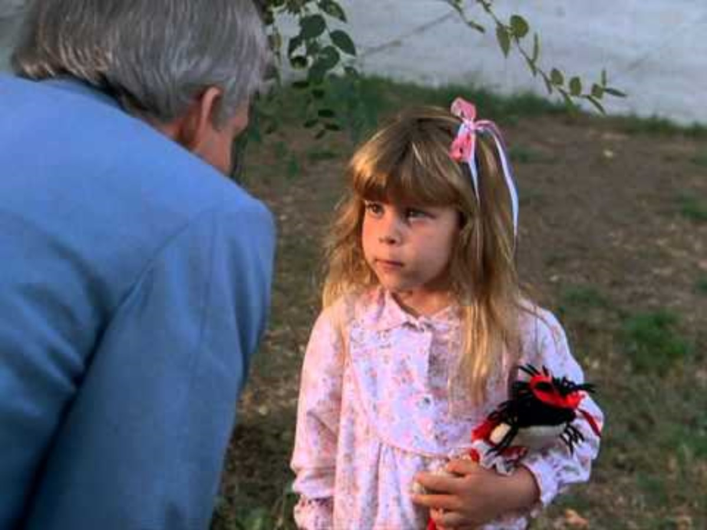
Closed Loop Communication
AHA Team Training
Notes:
https://youtu.be/7-a2QBfFQeA

Slide 25
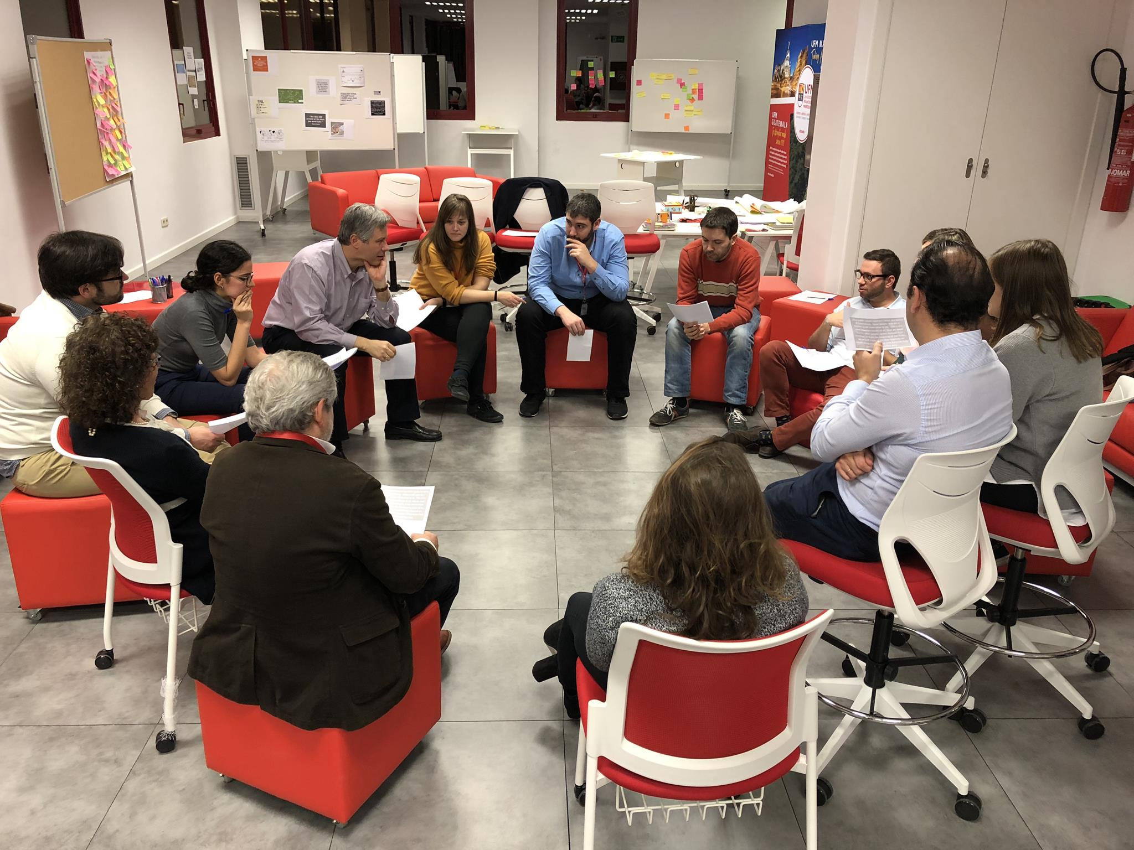
Tools for Team Events
Brief—planning
Huddles—Problem solving
Debrief—Process improvement
Notes:
Briefs: Briefs are used for planning and outlining the objectives, tasks, and expectations for a specific project, initiatives, or event. A brief typically includes key information such as a project goals, timelines, roles and responsibilities, resources needed, and any relevant background information.
Huddles: Huddles are short, focused meetings designed for problem solving, decision-making and quick communication within the team. Huddles are often held daily or several times a week, depending on the urgency and complexity of the tasks at hand.
Debriefs: Debriefs are used for process improvements and reflection after completing a project, task, or event. During a debrief, team members review what went well, what didn’t go as planned, and identify lessons learned and areas for improvement.

Slide 26
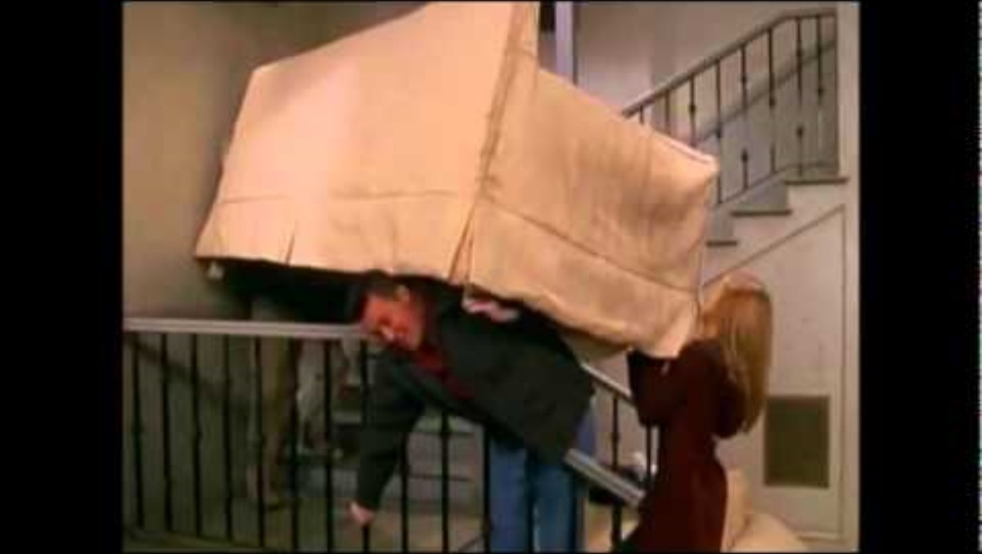
Disseminating the Plan: Brief
A team briefing is an effective strategy for sharing the plan
Briefs should help:
  Form the team
  Designate team roles and responsibilities
  Establish climate and goals
  Engage team in short- and long-term planning
Notes:
Friends PIVOT
Https://www.youtube.com/watch?v=ISCrrkSg8Zw
A team briefing serves as an essential strategy for disseminating the plan and ensuring everyone is on the same page. It plays a crucial role in aligning team members, clarifying expectations, and fostering a collaborative and goal-oriented environment. Here's why briefs are integral to effective teamwork
team briefings serve as a foundational tool for effective teamwork, ensuring that everyone understands their roles, objectives, and the overall direction of the project. By fostering clear communication, alignment, and engagement, briefings lay the groundwork for successful collaboration and achievement of organizational goals
Football Team: Before the game.

Slide 27
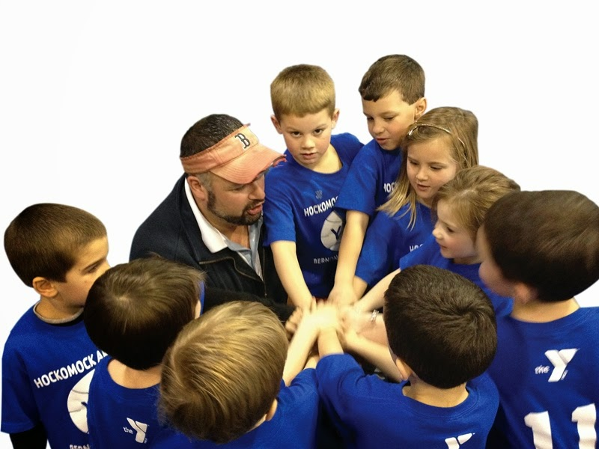
Huddle
A brief gathering of teammates who are involved
Goal to make a new plan
Redistribute workload
Answer questions and concerns
This Photo by Unknown Author is licensed under CC BY-SA-NC
Notes:
`
Hold Ad Hoc, "Touch Base" Meetings to Regain Situation Awareness: Huddles provide an opportunity for team members to quickly gather and assess the current situation, especially in rapidly changing or uncertain environments.
Discuss critical issues and emerging events: During huddles, team members can openly discuss critical issues and emerging events that may impact the project plan or require immediate attention. By sharing information and insights, teams can collaboratively identify potential solutions and strategies to address pressing challenges and mitigate risks.
Anticipate outcomes and likely contingencies: Huddles enable teams to anticipate potential outcomes and identify likely contingencies based on current trends, data, and insights. By considering various scenarios and discussing possible responses, teams can proactively prepare for contingencies, minimize disruptions, and maintain project momentum.
Assign resources: Huddles provide a platform for teams to assess resource needs and allocate resources effectively to support plan execution.
By discussing resource availability, constraints, and priorities, teams can make informed decisions about resource allocation to optimize project outcomes.
Express concerns: Huddles create a safe and supportive environment for team members to express concerns, raise issues, and seek assistance.
By encouraging open communication and active listening, teams can address concerns promptly, prevent misunderstandings, and foster a culture of transparency and trust
REEVALUATE:
Once the dust settles – HUDDLE AGAIN - can we return to the previous plan? On a busy day, you huddle more often.
Busy days have multiple huddles to continue to adjust to the changing status of the team

Slide 28
Reviewing the Team’s Performance: Debrief
Process Improvement
Brief, informal information exchange and feedback sessions
Occur after an event or shift
Designed to improve teamwork skills
Designed to improve outcomes
  An accurate recounting of key events
  Analysis of why the event occurred
  Discussion of lessons learned and reinforcement of successes
  Revised plan to incorporate lessons learned
AHA Team Training
Notes:
`Try to hold a debrief as close to the event as possible
Nursing holds briefs after a delivery, code, “hot wash” after mass drills
What are the goals of a debrief?
Chaplain, social services, Peer Support Team have been vital to holding some debriefs and offering peer support
Tips for success: invite the person with lowest rank to go first
Try to prioritize 1 changeable point
Bigger events with several changeable points need a robust Root Cause Analysis process
Plan to loop in anyone who couldn’t be there

Slide 29
LEGO Exercise #2
Teams will have 30 seconds to brief
After the briefing period is over, teams will have 2 minutes to build the tallest Lego tower
Same rules apply as before
  Each person must decide whether they are a runner or a builder
    You cannot switch between the two roles
  Runners: can only grab 5 pieces per trip
  Builders: no same-colored piece can touch
    The pattern must follow “1 Big, 3 Small”
AHA Team Training
Notes:
Instructions: You will have 30 seconds to brief followed by 2 minutes to create the tallest lego tower
Rules:
30 seconds to brief (facilitator will let them know when the briefing starts and stops in which they can then begin building their lego tower
No building during the briefing
When Finished: Give each group time to decompress and look at each other’s towers
Debrief Notes
Decompression time (1-2 minutes)
Allow the participants to chatter, laugh, talk and “decompress” with each other and talk about what they did for a minute or two.
Debrief (3-5 minutes)
Consider asking for a participant to lead the debrief with the three questions below.
1) What went well?*
2) What could be improved?
3) What is one thing you will do different next time?
*Always start with what went well. Participants will naturally want to talk about what didn’t go well but insist that they think about the bright spots.
TeamSTEPPS Debrief (5-7 minutes)
As participants respond, rephrase their responses back to them as TeamSTEPPS skills that will be covered in the training. Notes/questions to ask:
How did the briefing go? Point out that they had time to brief, less time to build yet the same amount of time total (2 minutes) as they did before. Many teams will likely have longer chains compared to the first round. Emphasize that this is the argument against people saying “we don’t have time to brief.”
How did you assign roles and responsibilities?
What was the noise level like in the room this time compared to the first round? It likely was quieter!
Point out situations in which participants helped each other, rather than simply waiting for another team member to complete a task.
Potential TeamSTEPPS tools/skills that were used or could have been used: call-out, check-back, briefs, huddles, debriefs.
Although this was an activity you have done before, was it valuable to brief?

Slide 30

Bedside Rounding
    Improves communication and collaboration, coordination of care, and patient centered shared decision making
    Allows the patient/ family to be invested in their care- value their expertise
    Avoid medical language or if you use it make sure to back it up in lay terms
    Benefits overall quality and outcomes
    Focus on patient education and repetitive education
Notes:
Be a good listener
Make sure to ask if the patient/ family has any questions
If they do have questions for providers or other ancillary departments document on white board so that the question doesn’t get forgotten about

Slide 31

Bedside Rounding Tool
What do you do at your hospital?
Provider/ Nurse
Nurse/Nurse
Hourly
Notes:
Open discussion about the different tools that are being used.
Provider/ nurse
Review of events, Labs, Diagnostics,
I&O, Drains, medications, plan of care
Nurse- hourly
Position, pain, potty, proximity to the patient (are the remote, phone, ect within reach.

Slide 32




    Communication with Providers
  SBAR
    Situation, Background, Assessment, Recommendation
  Critical Thinking Skills
    The bigger picture
  Time management
    When to call- emergent vs urgent
  Read Back
    Always clarify orders or instructions
Texting Information
  Be aware of your facility policies
Notes:
`
Demonstrate using SBAR
Using Critical Thinking Skills
When calling anesthesia – what are the allergies- if eggs can't have propofol, what kind of surgery is it? General or spinal.
Time Management
Texting information
Read back orders

Slide 33
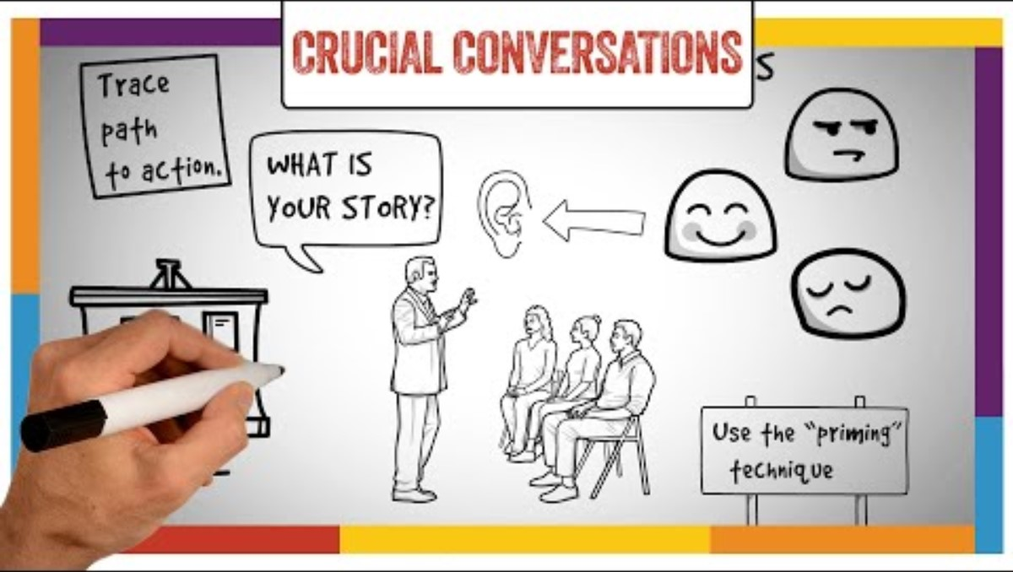
Notes:
Crucial Conversations
https://youtu.be/Q2yG142cyNg?si=0sR3Uhu9IWcpsbOh

Slide 34
    Crucial Conversations
      With peers
        Direct Resolution
        Documentation
        Chain of Command- policy?
      With providers
        Think out what you are going to say
        Practice
        Include your supervisor
      With leadership
        Include your supervisor
        Chain of Command
Notes:
Crucial Conversations
These are the conversations that happen everyday in your life can be personal or professional
Remember to take out emotion-
may need to wait until emotions are uncder check
Uncomfortable
Respect
Way to build relationships
Consider the other side
Emotional Intelligence

Slide 35

AHA Team Training
Notes:
Optional Video: https://www.youtube.com/watch?v=-4EDhdAHrOg

Slide 36
Resources:
American Hospital Association. https://www.aha.org/center/team-training/getting-started-teamstepps
A nurse’s guide to effective communication with patients’ families. (2021, December 21). Bethel University Online - Online degree programs for professional and personal success. https://ags.betheluniversity.edu/nursing/communication-with-patients-families/
Grenny, J., Patterson, K., McMillan, R., Switzler, A., & Gregory, E. (2021). Crucial conversations: Tools for talking when stakes are high (3rd ed.). McGraw Hill Professional.
Heip, T., Van Hecke, A., Malfait, S., Van Biesen, W., & Eeckloo, K. (2022). The Effects of Interdisciplinary Bedside Rounds on Patient Centeredness, Quality of Care, and Team Collaboration: A Systematic Review. Journal of patient safety, 18(1), e40–e44. https://doi.org/10.1097/PTS.0000000000000695
Notes:
`

Slide 37
THANK YOU
nebraskahospitals.org

