Slide 1
National Pediatric readiness Quality initiative at nemaha county hospital Maxcey Smith rn, bsn, cphq

Slide 2
objectives
Overview of NPRQI
Present quality improvement measures used to track progress
Highlight areas needing improvement based on NPRQI findings
Discuss next steps and future plans for sustaining and advancing pediatric care

Slide 3
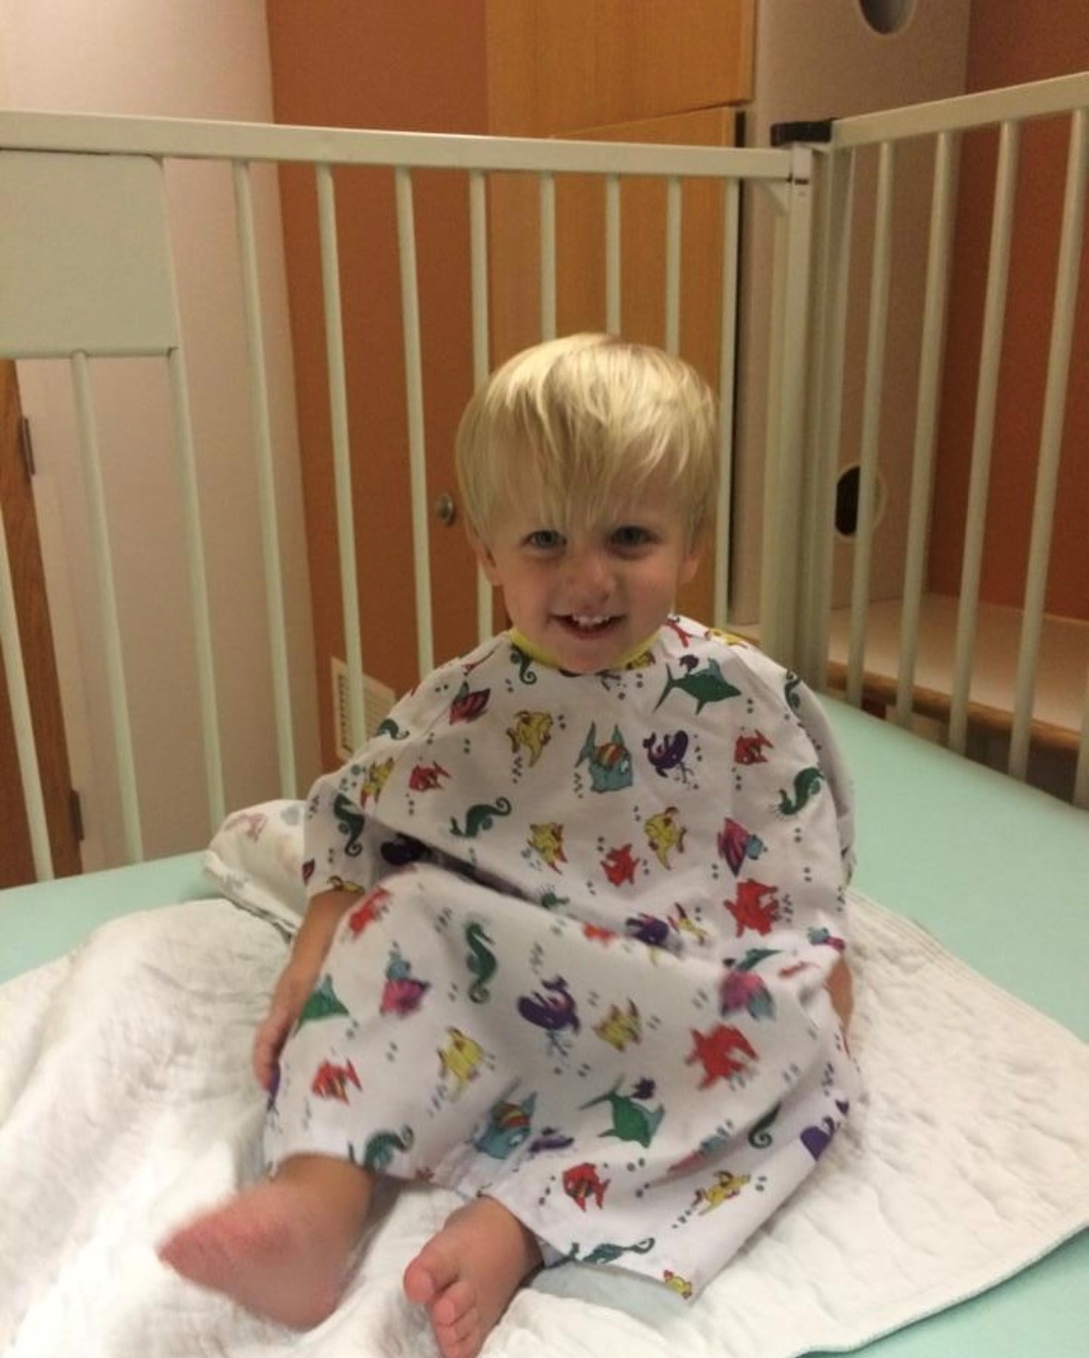
National Pediatric Readiness Project
In 2003, an assessment of all U.S. hospitals completed to determine compliance with the American Academy of Pediatrics (AAP)/American College of Emergency Physicians (ACEP) “Care of Children in the Emergency Department: Guidelines for Preparedness.”
From 2009-2021 work completed by the National Pediatric Readiness Project including conducting other national assessments of hospitals. In 2013, strategies and resources were initiated to assist emergency department’s in quality improvement activities.
ED’s that are pediatric ready have a 76% lower mortality rate in ill children, 60% lower mortality rate in injured children.
Notes:
Work started in 2003 when a steering committee conducted an assessment on all US Hospitals to determine compliance with the 2001 Guidelines for Preparedness when caring for a child in the emergency department. Results revealed that most hospitals were not aware of the national guidelines and very few had the appropriate equipment and policies to follow the guidelines.
High pediatric readiness in ED’s is associated with 76% lower mortality rate in ill children, 60% lower mortality rate in injured children.

Slide 4
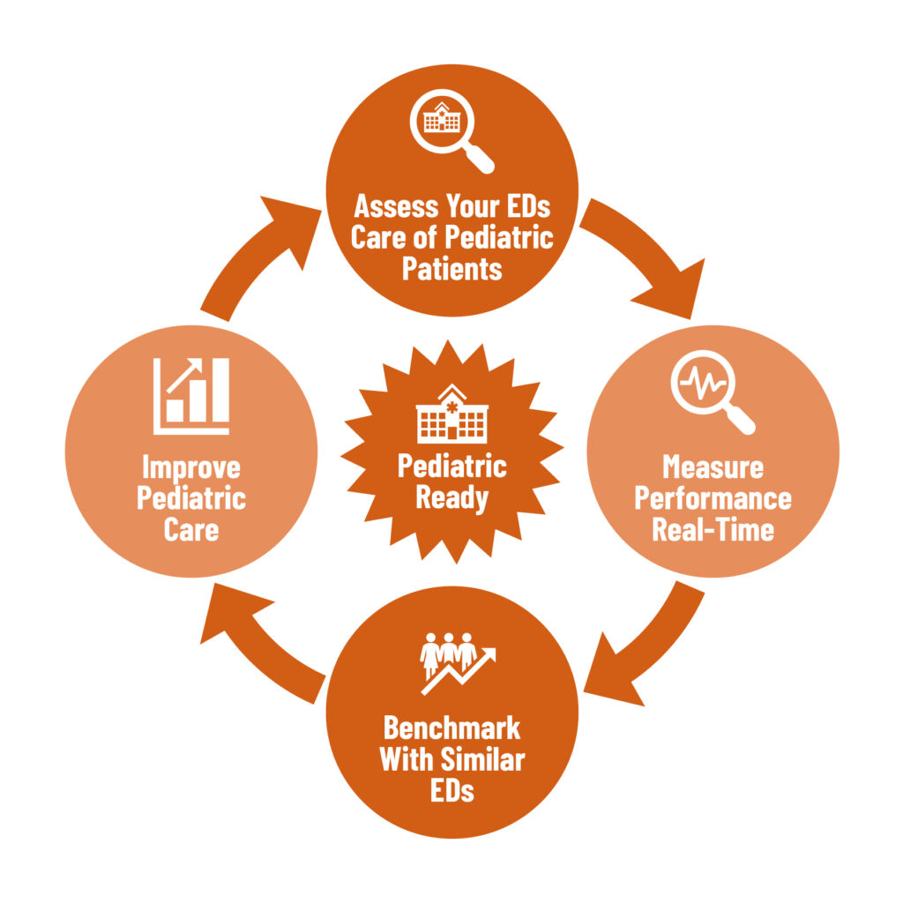
National pediatric readiness quality initiative
Overall goal is to make sure all children have access to high quality care.
Drive quality improvement efforts for pediatric emergency care delivery.
Established standardized quality measures with benchmarking capabilities.
Notes:
The National Pediatric Readiness Quality Initiative is an implementation arm from work done by the National Pediatric Readiness Project. The goal of NPRQI is to ensure children have access to high quality emergency care regardless of geographic location by providing all EDs with a national platform to measure, reflect, and improve pediatric emergency care delivery.
The NPRQI was created to drive national quality improvement efforts for pediatric emergency care delivery. Most children are seen in general EDs many of which are in rural communities, and less than 50% of these EDs engage in pediatric quality improvement efforts. Given low pediatric patient volumes at an individual site and lack of standardized measures for common pediatric conditions, NPRQI was developed to establish standardized quality measures with benchmarking capabilities.

Slide 5
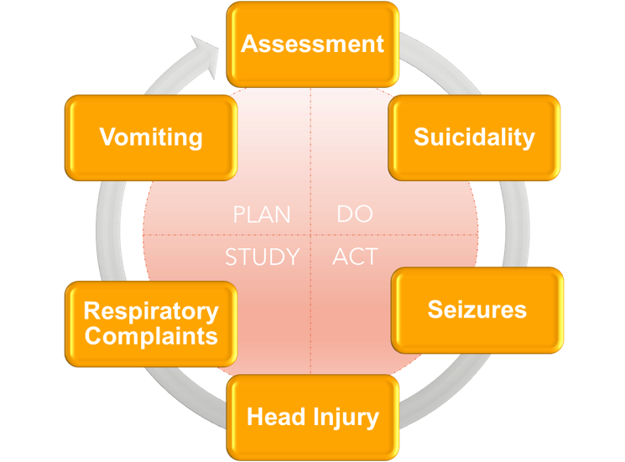
Areas of focus and metrics
Pediatric Assessment
Pediatric Interfacility Transfer
Management of Pediatric Blunt Head Trauma
Management of Pediatric Seizures
Management of Pediatric Respiratory Complaints
Management of Pediatric Vomiting
Management of Pediatric Suicidality
Notes:
These domains were chosen because they represent the most common reasons children present to the emergency room. These conditions can range vary in acuity from manageable to critical. The core patient safety processes include patient assessment/reassessment, weighing children in kilograms, and interfacility transfers. The clinical conditions of focus include: head trauma, seizures, respiratory distress, vomiting, and suicidality.

Slide 6
Assessment
Notes:
Children cannot tell us how they are feeling or symptoms they are having sometimes. Their vital signs can be very different compared to adults. In the ER, ensuring that vital signs are being moninotred is a reliable way for us to evaluate their condition and identify if there are changes while we are caring for them.

Slide 7
Transfers
Notes:
In most CAH’s, emergency room staff are balancing multiple patients. We need to be able to recognize clinical needs of the pediatric patient and optimize the use of available resources. Paring down transfers of patients to only those necessitated by lack of resources decreases the burden on patients, their families, and local EMS assets. For example, a question asked is how they were transported. One option to choose if the children's facility transport team was used.

Slide 8
Blunt head trauma
Notes:
There are evidenced based guidelines for the care of a pediatric patient with a blunt head trauma injury involving unnecessary exposure to radiation, avoidable transfer, and missing a significant brain injury.

Slide 9
Seizures
Notes:
There are evidenced based guidelines for the care of a pediatric patient with seizures that ensures that the correct diagnostic procedures are used and unnecessary procedures are avoided.

Slide 10
Respiratory Complaints
Notes:
A pediatric patient with respiratory distress needs quick intervention with evidence based care.

Slide 11
vomiting
Notes:
Timely intervention with antiemetics allows for oral rehydration measures rather than invasive iv therapy treatment.

Slide 12
Suicidality
Notes:
Having a standardized suicide screening and utilizing best practices with patients mental health issues allows for effective use of behavioral health consultations, admissions and safety plans.

Slide 13
Relevance of NPRQI to CAH’s
Designed for non-pediatric specialty facilities.
Ability to compare to similar ED structures and volumes.
Zero cost to join.
Opportunity to measure aspects of high-quality pediatric emergency care for the pediatric population.
Addresses equity.
Data entry is self-paced.
Notes:
NPRQI was designed for non-pediatric specialty facilities, specifically community, rural, and critical access hospitals. The goal of NPRQI is to make implementation of pediatric quality improvement efforts as easy as possible. Participants will be able to compare themselves to similar ED structures and volumes.
NPRQI is funded by Health Services and Resources Administration – Emergency Medical Services for Children (HRSA-EMSC) for the purposes of improving pediatric emergency care. There is no fee associated to join NPRQI, submit data, or view performance on dashboards.
NPRQI addresses the unique needs of diverse patient populations to reduce variability in care. Users can filter aggregate data by patient demographic variables (e.g. race, gender, payor source) to measure comparative performance.
After an approximately 2hr onboarding activity, data entry is self-paced and organizations can decide when and how often to submit data.

Slide 14
Participation
Notes:
There are 103 sites nationwide and approx. 14,798 records entered. Nebraska is listed as a low volume patient category. Low volume patient category is less than 1,800 pediatric patients annually. There are 5 sites in Nebraska with 827 records entered.

Slide 15
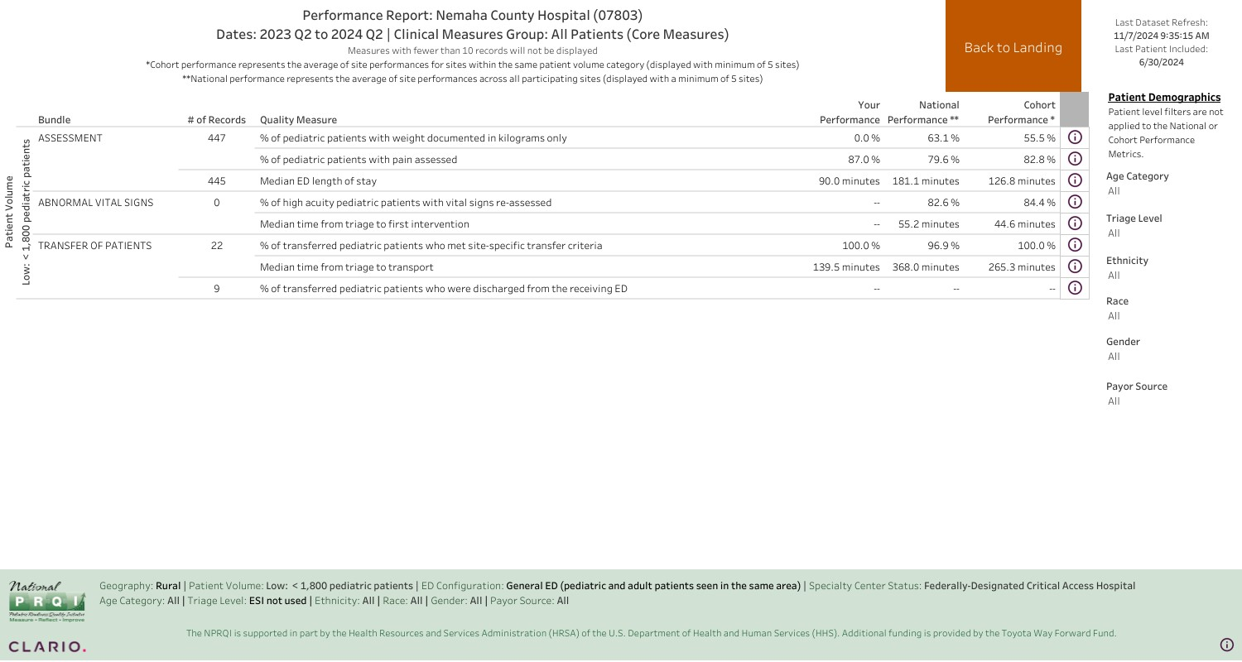
Areas of Improvement
Notes:
Nemaha County Hospital is a 16 Critical Access Hospital. At this time, I’ve entered 447 pediatric patient records. The percent of patients with weight documented in kilograms only is 0%. Unfortunately at this time, our EMR is a barrier to implement any intervention. The median ED length of stay is 90minutes, compared to national sites average of 181 mins and cohort performance (low volume) site average of 126.8 minutes. Out of 22 records 100% of transferee pediatric patients met site-specific transfer criteria and the median time from triage to transport was 139 minutes. Which compared to national sites average of 368 mins and cohort performance (low volume) site average of 265 minutes.

Slide 16
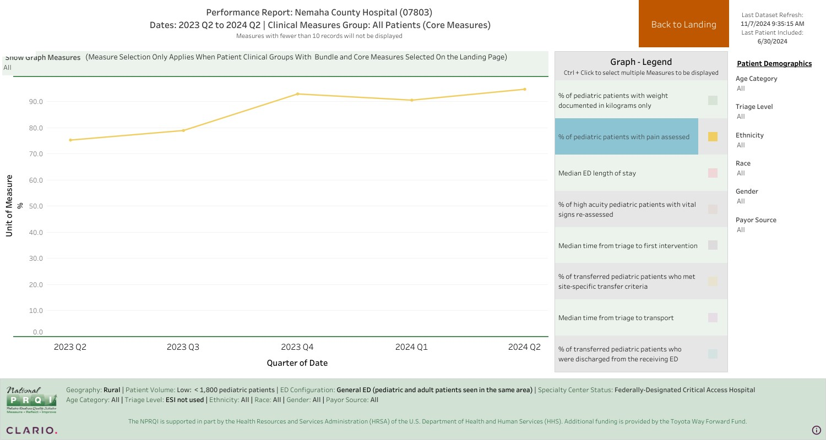
Notes:
87% of pediatrics have pain assessed. Compared to national sites average of 79.6% and cohort performance (low volume) site average of 82.8%. This data visualization is a great because you can see where you are with performance and see the performance overt time. And then you can specifically see if you’ve implemented a specific intervention and evaluate the progress towards improved performance. Also see if you’ve had a decrease in performance- barrier can be identified. For example, travel nurses increased during a specific time.

Slide 17
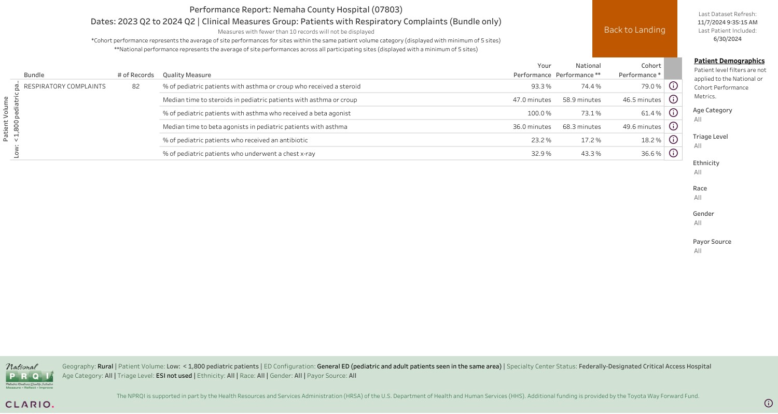

Slide 18
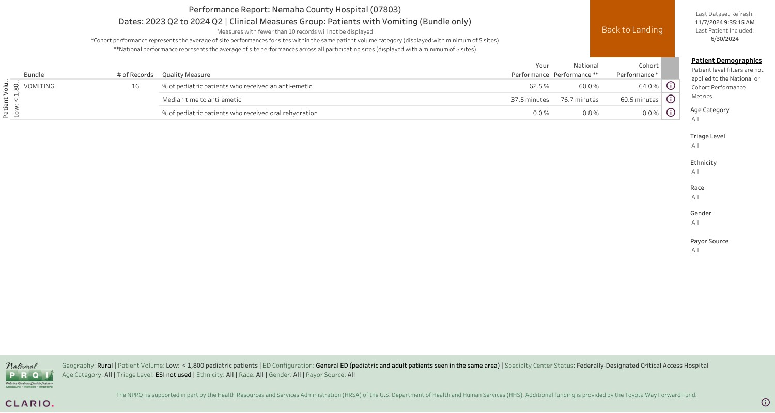

Slide 19
Future plans and impact
Providing equitable care
Improving the care given to pediatric patients
National impact
Notes:
Studies show that care often varies depending on patient demographics and ED characteristics. NPRQI provides the necessary elements to eliminate these disparities. Meaningful quality measures of pediatric emergency care are needed to assess equity. These measures address all aspects of an ED visit – assessment, diagnostics, interventions, disposition-to optimize care for a critically ill or injured child. Having a low volume of pediatric patients can make it difficult to assess the delivery of care. This platform combines all data from participating sites and allows you to compare your ED to other facilities based on geography, patient volume, and resources. As the NPRP QI data registry grows our ability to assess pediatric emergency care delivery at a national level will grow exponentially.

Slide 20
Become a NPRQI Site
Registration and Onboarding Steps

Slide 21
Questions?

Slide 22
References
https://sites.utexas.edu/nprqi/
https://emscimprovement.center/domains/pediatric-readiness-project/

Slide 23
Thank you
Maxcey Smith
402-274-6147
msmith@nchnet.org

