Slide 1
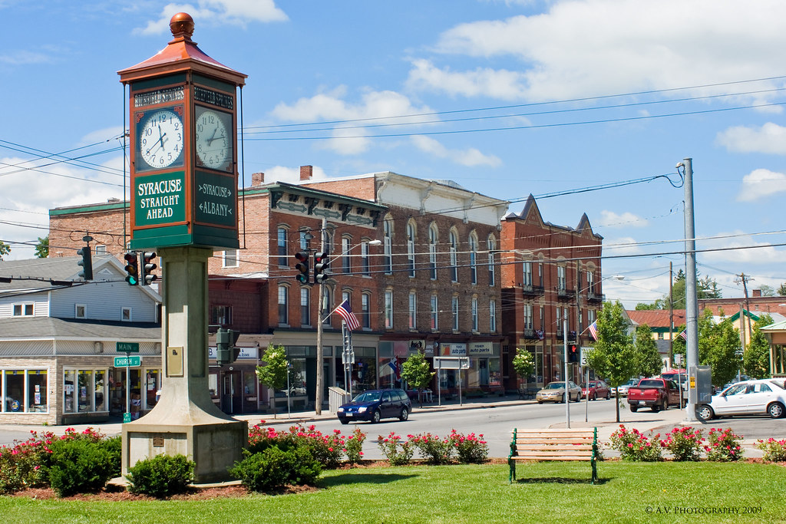
Building A Community-Based Rate Structure
Core Tenets – DOs & DON’Ts
Defining The Charge Description Master (CDM)
Reviewing The CDM - Critical Inputs
Considering Charge Capture Processes
Medicare Cost Report Considerations
Summary & Questions
This Photo by Unknown Author is licensed under CC BY-NC

Slide 2
Community-Based Rate Structure – Definition
A thoughtful & deliberately built digital “master list” or database of all items charged to patients in the hospital. includes facility fees, diagnostic services, therapeutic services, medical supplies, pharmaceuticals, equipment, procedures, etc.

Slide 3
Community-Based Rate Structure – Core Tenets
The DOs – Understand The Landscape
Always focus on the needs of your COMMUNITY and the numbers will take care of themselves
Use comparative data thoughtfully & deliberately – understand and consider the uniqueness of your community, hospital, service profile, payer mix and workforce
Be sensitive when setting rates or making changes in those areas where increases are the most difficult to explain
Recognize that patients are not healthcare finance experts and may struggle to understand the “why” behind the numbers
Recognize that Board members are patients too and are often on the front lines of fielding billing related questions
Understand the nuances of local traditional media and modern social media sources

Slide 4
Community-Based Rate Structure – Core Tenets
The DOs – Lots Of Other Stuff
Establishing your incremental, net revenue goal is always step #1
Take some time to review – GL accounts, Revenue Codes, CPT/HCPCS, J-code units, current payer fee schedules and any updates to payer payment integrity & billing policies
Use a comprehensive revenue & use data set and consider true revenue recognition impacts
Always ensure patient acuity and equity within the charge structure
Details matter - bake in “realistic” revenue into the operating budget and don’t forget about payer contract limits
Remember rate change notice requirements to payers & request updates to CCRs

Slide 5
Community-Based Rate Structure – Core Tenets
The DON’Ts – Seriously…
DON’T charge any more than is necessary!
DON’T let comparative data dictate your rates!
DON’T charge less than your costs!
DON’T pay for charge capture technology you don’t use!
DON’T cut corners… a lot of people are counting on you!

Slide 6
Community-Based Rate Structure – CDM Elements Defined
Charge Description Master (CDM)
CDM information includes
Basic Information
General Ledger Department Number
Charge Number
Charge Description
Charge Amount
CPT/HCPCS Code if required
Modifier Codes if required
National Revenue Codes
Optional Information:
Payer Fee Schedules
Productivity factors
Acquisition Costs
Other
This Photo by Unknown Author is licensed under CC BY

Slide 7
Community-Based Rate Structure – CDM Element Definitions
Definitions of the Basic Requirements
General Ledger Department Number
Defines where the revenues generated by the charge go in the General Ledger
Charge Number
Unique charge number that is used by revenue reports
Charge Description
Describes the service or procedure
Charge Amount
Amount charged for service or procedure
CPT/HCPCS Codes
The procedure code that goes on the insurance bill
Modifier Codes
Modifier codes are adjustment codes to the CPT/HCPCS codes

Slide 8
National Revenue Code Definition
Community-Based Rate Structure – Revenue Codes
The National Uniform Billing Commission is responsible for the creation of these codes.
The revenue code is an “all payer” classification system for the type of service.
All payers utilize these codes.
The revenue code identifies the department the service is provided, the type of service provided, and the supplies and drugs utilized.
250 for drugs, 270 for medical supplies, 300 for lab, 320 for diagnostic imaging, 360 for operating room

Slide 9
National Revenue Codes
Community-Based Rate Structure – Claims & Revenue Codes
11X – R&B – Private
12X – R&B – Semi-private
17X – Nursery
25X – Pharmacy
27X – Med/Surg Supplies
30X – Laboratory *
31X – Pathology *
32X – Radiology-Diagnostic *
35X – CT Scan *
36X – Operating Room *
37X – Anesthesia
41X – Respiratory Therapy *
42X – Physical Therapy *
43X – Occupational Therapy *
44X – Speech Therapy *
45X – Emergency Room *
46X – Pulmonary *
48X – Cardiology *
61X – MRI *
710 – Recovery Room
72X – Labor/Delivery
730 – EKG/ECG *
740 – EEG *
761 – Treatment Room *
762 – Observation Room *
92X – Other Diagnostic Svcs *
94X – Other Therapeutic Svcs *
960-989 Professional Fees *
* Requires a CPT or HCPCS code
The revenue codes are what Medicare uses to calculate the Medicare cost for the cost settlement.

Slide 10
National Revenue Codes
Community-Based Rate Structure – Claims & Revenue Codes
11X – R&B – Private
12X – R&B – Semi-private
17X – Nursery
25X – Pharmacy
27X – Med/Surg Supplies
30X – Laboratory *
31X – Pathology *
32X – Radiology-Diagnostic *
35X – CT Scan *
36X – Operating Room *
37X – Anesthesia
41X – Respiratory Therapy *
42X – Physical Therapy *
43X – Occupational Therapy *
44X – Speech Therapy *
45X – Emergency Room *
46X – Pulmonary *
48X – Cardiology *
61X – MRI *
710 – Recovery Room
72X – Labor/Delivery
730 – EKG/ECG *
740 – EEG *
761 – Treatment Room *
762 – Observation Room *
92X – Other Diagnostic Svcs *
94X – Other Therapeutic Svcs *
960-989 Professional Fees *
* Requires a CPT or HCPCS code
The revenue codes are what Medicare uses to calculate the Medicare cost for the cost settlement.

Slide 11
Community-Based Rate Structure – Critical Inputs
Quantitative – Building Baseline Gross Revenue
Define Period Under Review | Pull Data Set
Specialty (MDC) MS-DRG [or ICD-10-PCS for o/p] GL Department Code Department Description Charge Code Charge Code Description CPT/HCPCS Modifier National Revenue Code Financial Class Payer Description Patient Type Utilization Total Gross Revenue Patient Charge Payer Fee Schedule Amount (if available)
Direct Per Unit Cost (if available)

Slide 12
Community-Based Rate Structure – Critical Inputs
Quantitative – Building Baseline Net Revenue
Add Net Revenue (reimbursement) amounts by payer & patient type to create “realization” rates
Add reimbursement methodologies and create “incremental realization” rates by payer & patient type
Work with your local database wizard to create “weighted-average incremental realization” rates for each charge code
Incorporate any prospective, known revisions to steps 1 – 3 above
* Add comparative rates by charge code to the completed file
Time To Get To Work!

Slide 13
Community-Based Rate Structure – Critical Inputs
Understanding The “Rate Structure”
Don’t be afraid to ask questions!
Rate structures can differ hospital-to-hospital – patient chargeable v. non-chargeable, Peri-Operative Services, ER acuity systems, observation charges, specialty clinic charges, etc.
For Critical Access Hospitals, understanding the rate structure and matching of expense/revenue flows is vital to Cost Report compliance & outcomes
Challenge the use of traditional “mark-up schedules”
Ongoing review of payer policies and use of claim templates and enhanced scrubbing business rules can help

Slide 14
Community-Based Rate Structure – Capturing Charges
Even More On Process – Charge Capture
Working directly with operational staff to gain short-term insights and build long-term relationships will be key to success
Asking tons of questions, understanding “the business” and becoming knowledgeable about house wide charge capture processes is critical
Spending time with Patient Access / Charge Entry / HIM / Coding / Billing staff is a great way to see how the whole picture comes together
Leveraging technology and leaning into the enhanced development of EHR platforms can make a big, big difference
Some examples include:
Operative Case Carts
ER Acuity Systems
EHR Interface / Auto-Generated
Room & Bed Master
Results Reports, Auto-Generated
Charge Sheets
Superbill Templates
Does anyone still use stickers?

Slide 15
Community-Based Rate Structure – Crunching The Numbers
The Process – Important Final Steps To Consider
Research payer billing, reimbursement & payment integrity policies – add this insight to your review outcomes
Review payer contracts for charge increase limits, timelines & notice provisions
Account for changes in payer audit procedures and analytical review processes
Double-check usual & customary impacts and be “transparent”
Understanding internal revenue relationships between the GL & Revenue Codes is critical to ensuring compliant outcomes
Don’t lose sight of that initial, incremental net revenue target!
Keeping A Community First Focus Is The Key To Success!

Slide 16
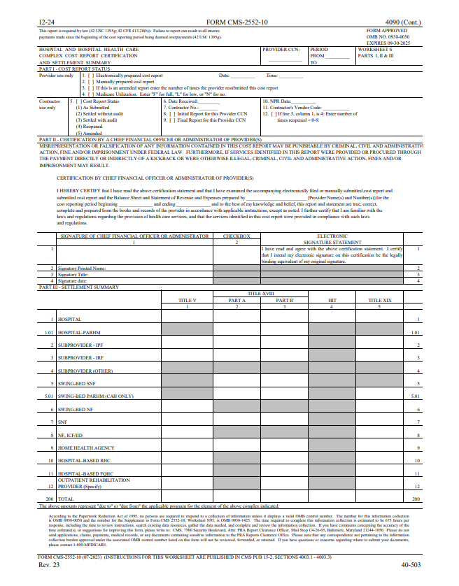
Medicare Cost Report Schedules
Community-Based Rate Structure – Cost Report Overview
Worksheet S Series
Informational and Statistical Data
Worksheet A Series
Cost data
Worksheet B Series
Cost allocation
Worksheet C Series
Charge data
Worksheet G Series
Financial Statement information

Slide 17
Community-Based Rate Structure – Worksheet C
This is the schedule in the cost report where the total charges go.
The charges that flow to the cost report start from the Charge Description Master and flow through the General Ledger to the cost report.

Slide 18
Community-Based Rate Structure – Worksheet C
The costs flow to WS C through the A and B Series of the cost report.
The cost comes from the general ledger.

Slide 19
Community-Based Rate Structure – Worksheet C
The Cost-to-Charge Ratios are calculated on WS C

Slide 20
Community-Based Rate Structure – Building RCCs
Formula for Cost-to-Charge Ratio (Worksheet C)
Total Costs / Total Charges = Ratio of Cost-to-Charges (RCC %) RCC % x Outpatient Medicare Charges ____________________________________________________________
= Outpatient Medicare Costs
It is critical that costs and charges match on a department-by-department basis.
And that the Medicare Charges also need to match the Total Charges on a department-by-department.
The Cost to Charge ratio drives the reimbursement for outpatient ancillary departments from a CAH perspective.

Slide 21
Building A Community-Based Rate Structure
Questions
[No price transparency questions allowed!]

