Slide 1

Missing Pieces in the Rural Behavioral Health Puzzle
Ryan Larsen
EdD, MHA, MBA, FACHE

Slide 2
Our problem
“…the mental health needs of rural America are immense, and it is increasingly recognized the implementation of adequate services in non-metropolitan areas is a critical national health imperative.”
(Roberts et al., Frontier ethics: Mental health needs and ethical dilemmas in rural communities,1999)
“…rural issues are often misunderstood, minimized, and not considered in forming national mental health policy. Too often, policies and practices developed for metropolitan areas are erroneously assumed to apply to rural areas.”
(President’s New Freedom Commission on Mental Health, 2003)

Slide 3
Continuum of Behavioral Health Care
Severity | Description | Suicidal | Disposition | Other
Stable | Functional, able to work | None | Outpatient | Therapy/counseling as needed; med management
Low | Functional, but with a recent medical or psych stressor | Mild | Outpatient, psychiatric monitoring | Increased therapy, case management, group outpatient (low-intensity)
Moderate | Decompensating, agitated | Moderate | Psychiatric consultation | Psychiatric observation, crisis response team, intensive group outpatient/partial hospitalization
Severe | Severe decompensation | High | Inpatient care | Inpatient psychiatric care
Detox | Significantly impaired; may or may not be ready to change | Mild to High | Typically inpatient care | Overnight to 1-2 months to get clean
Substance Abuse Support | Functional, able to work | None to Mild | Outpatient | Therapy/counseling; med management; support groups; halfway house

Slide 4

Initial Approach:
Obtain and throw a bunch of ingredients together and hope it works.

Slide 5

It Didn’t work.

Slide 6
Building Blocks of a Behavioral Health System
Crisis
MH Emergency Services
Crisis Response Teams
Expedited Transfers
Inpatient Psychiatric
Intensive Substance Abuse
Inpatient Centers
Escalating
Mental Health First Aid
Emergency Services
Urgent Psych Consults
M.H. Observation
Case Management
Short-term Detox
Intensive Outpatient
De-Escalating
Case Management
Intensive Outpatient
Long-term Drug Weening
Drug Court Deferrals
Addiction Recovery
Group Structured OP
Halfway Housing
Basic Behavioral
• Screenings & Referrals • Counselors & Therapy (CAC, PsyD, LMHC, LCSW, LDAC, MFT, etc)
• Pain Management • Psychiatric Practitioners (MD, DO, APRN, etc)
• Group Structured OP • Support Groups (AA, NA, Al-Anon, Grief, Cancer, Family, etc)
• Awareness Outreach • Coordination/Navigation
Healthy Environment
• Safe, Affordable Housing • Sufficient Access to Food & Water • Basic Transportation
• Job Opportunities • Social Connections • Cultural Connections
• Activities • Exercise/Recreation • Access to Medical Care

Slide 7

Framework: Behavioral Health Pyramid
Levels must be strong enough to support the levels above.
More Intensive
Crisis
Escalation
& De-escalation
Basic Behavioral
Less Intensive
Healthy Environment

Slide 8
Our Local Behavioral Health Pyramid
Fragmented, missing pieces, maybe a little better than before.

Slide 9

Goal: Develop a systemic approach
Build on what we have
Strengthen the base
Partner to improve crisis service access and coordination
Pick some intermediate-level services to help those escalating from reaching crisis and to support those returning from crisis
Cannot offer all services, so pick intelligently
Do not try to run faster than we are able

Slide 10
Early Activities
Helped APRN certify in behavioral health
Helped employee get LDAC
Increase use of MH screenings
Started suboxone clinic
Financial support for BVBH to maintain extra counselor
Financial support to school district for counselor
Outside assessment of market for IP and SOP
Add chronic care management (CCM)
Add PT child psychologist
Telehealth for B.H. emergencies

Slide 11
Subsequent Activities
Created Board Community Committee for accountability
Added 2nd psychiatric nurse practitioner
Integrating counselors/therapists into family practice
Added intranasal esketamine for severe depression
Added community health workers overseen by social worker
Added [limited] transportation assistance focused on Behavioral Health
Psychiatric consultation availability for acute patients
Supporting development of half-way house
Increasing community awareness
Explored geriatric group OP therapy
Promoting mental health first aid
Administration initially prioritized integrated behavioral health and group OP, but practitioners asked us to reconsider and move first with esketamine and transportation.

Slide 12
Planned Activities
Expanding counseling in RHC (Good clinically and financially)
Low-intensity Structured OP, focused not just on senior population
Facility enhancements to improve safety of patients in psychiatric crisis that need short-term care or cannot be transferred
Further community advocacy (rec opportunities, housing, judicial, economics)
Because of limited resources, it is critical that we determine if interventions are working and whether they should be expanded, corrected, or ended to allow resources to go elsewhere.

Slide 13
Example Activity: Adding Intranasal Esketamine
17 Million Americans suffer from Major Depressive Disorder (MDD) (Greenberg et al., 2023)
30% are considered to have Treatment-Resistant Depression (TRD) (Gautam et al., 2017)
Rural residents have similar rates of depression as urban, but have much higher suicide rates, and the difference is growing (Morales et al., 2020)

Slide 14
Intranasal Esketamine
Food and Drug Administration approved intranasal esketamine for TRD in 2019 (Kaur et al., 2021)
Potentially fast-acting and long-lasting (Shoib et al., 2022)
Requires 4 weeks (sometimes 6 months or more) of treatment, 2-3 times per week, 2-3 hours per treatment (Kasper et al., 2021)
Patients unable to drive for 24 hours (Khorassani & Telreja, 2020)
Some questions of true effectiveness (Ng et al., 2021)
Some questions of viability due to staffing and infrastructure requirements and reimbursement levels (Wilkinson et al., 2019)

Slide 15
Background
Ketamine introduced in 1970 for surgical anesthesia, used “off-label” for depression by 2010 (Moore et al., 2022)
Esketamine is a ketamine enantiomer (Corriger & Pickering, 2019)
N-methyl-D-aspartate (NDMA) receptors play a role in depression; ketamine is an NDMA antagonist (Kaur et al., 2022)
NDMA receptors were found by Carter et al. (2020) to be clearly superior to anti-psychotics, mood stabilizers, psychological therapies, and other medications for TRD
Arketamine faster acting, but esketamine has greater bio-availability, greater NDMA receptor affinity, and less impairment (Shoib et al., 2022)
Both produce altered mental states and has high potential for abuse (Baudot et al., 2022)

Slide 16
Background
TRANSFORM-2, phase II study by Popova et al. (2019) showed mean reduction in depression from baseline MADRS of 21.4 for esketamine + oral AD and 17.0 for placebo + oral AD
Wajs et al. (2020) replicated results and studied longer-term outcomes
While available evidence supports esketamine for TRD, not all studies were conclusive (Floriano et al., 2023; Lima et al., 2022)
Only 1 of 3 phase III trials had statistically significant results (Moore et al., 2022)
No research was found that studied esketamine in rural settings

Slide 17
Methods
To improve sample size for analysis, we partnered with a similar CAH with an esketamine program. Research conducted by myself and Lisa Fee, EdD, MA, BS, NBCT, of Nebraska Methodist College.
Context: Two rural Midwest counties with Critical Access Hospitals
  County A: Population of 4,095, 9.9% poverty rate, $61,667 median income
  County B: Population of 7,781, 11.4% poverty rate, $46,085 median income
  (U.S. Census Bureau, 2023)
  Both listed as Health Professional Shortage Areas (HPSA) for mental health
  (Health Resources and Services Administration, 2023)
  Both report poorer mental health than state and national average
  (University of Wisconsin Population Health Institute, 2023)
Intervention: Pilot intranasal esketamine clinics for TRD
Study of Intervention: Retrospective analysis of performance

Slide 18
Data Analysis
Measures
  Patient Health Questionnaire (PHQ-9): 9 patient assessed questions with 2-week look-back, score range 0 – 27
  Montgomery-Asberg Depression Rating Scale (MADRS): 10 practitioner administered questions with 1-week look-back, score range 0 – 60
  Completion/discontinuation of treatment
  Treatment-Emergent Adverse Event (TEAE): Undesired symptoms appearing or worsening due to treatment
  Severe TEAE: Reaction to medication resulting in hospitalization, permanent damage, death, threat to life, or requiring medical intervention to prevent any of the above.
  Reimbursement dollars compared to costs

Slide 19
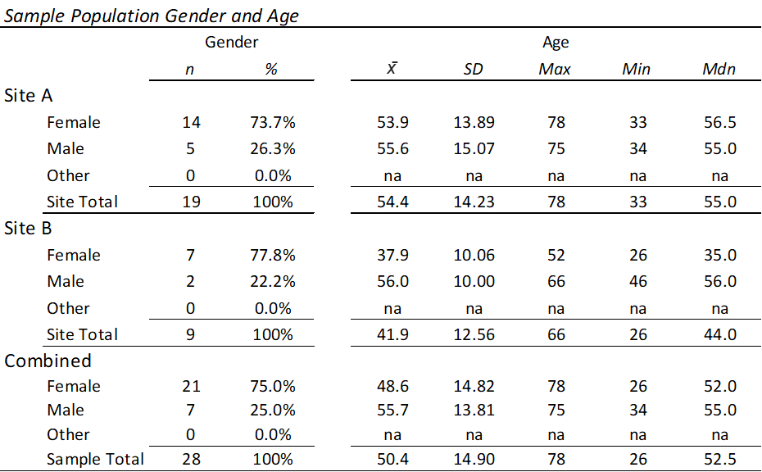
Results: Sample Population

Slide 20
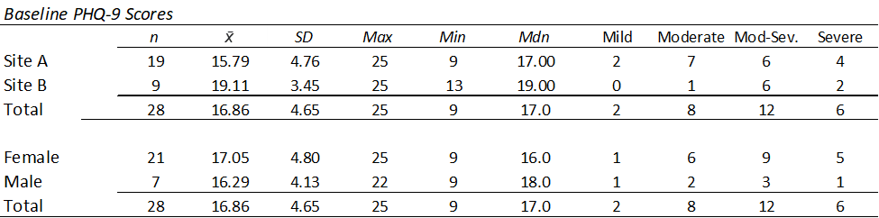
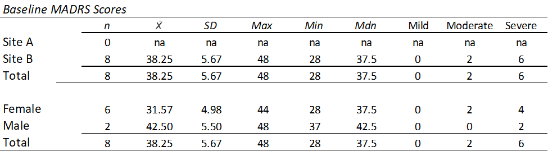
Results: Sample Population

Slide 21
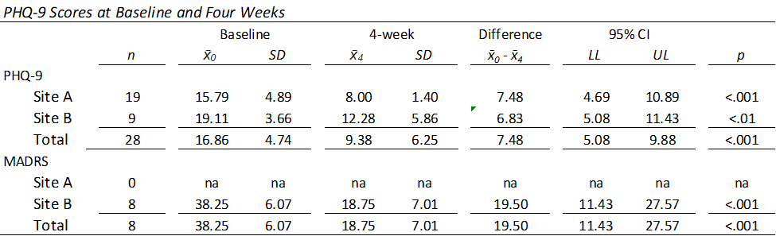
Results: Clinical Outcomes

Slide 22
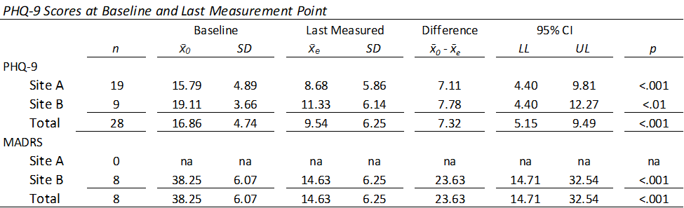
Results: Clinical Outcomes

Slide 23
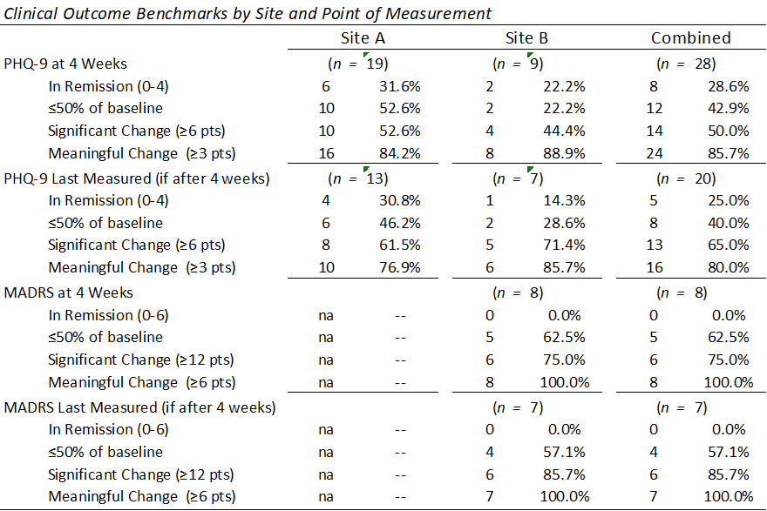
Results: Clinical Outcomes

Slide 24
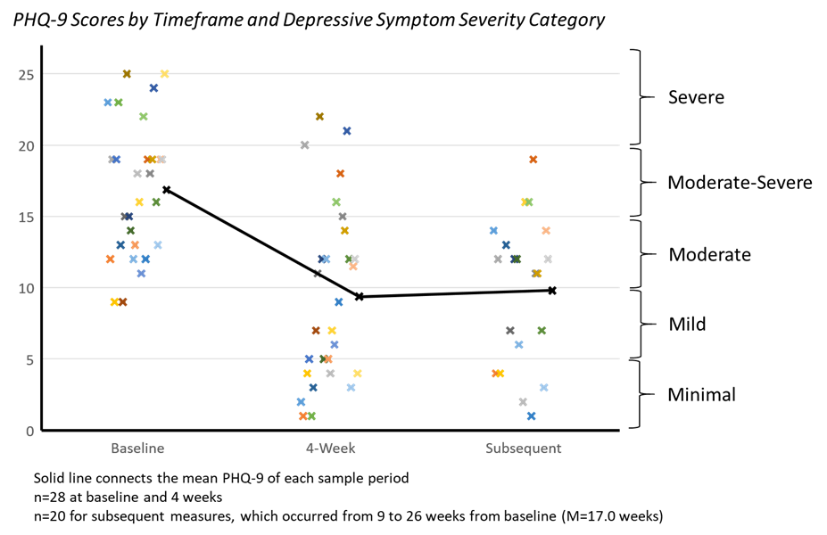
Results: Clinical Outcomes

Slide 25
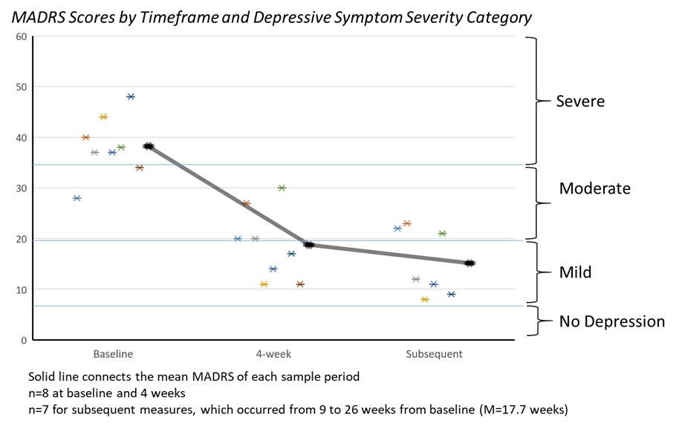
Results: Clinical Outcomes

Slide 26
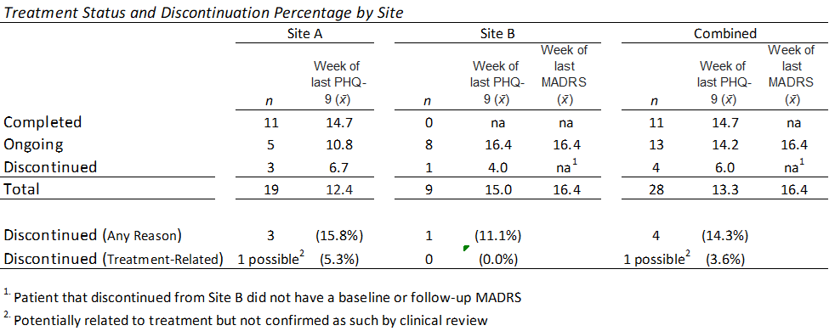
Results: Safety

Slide 27
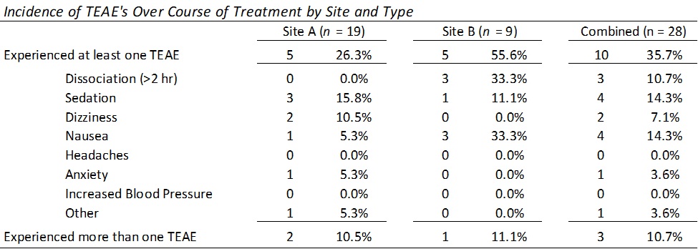
Results: Safety

Slide 28
Results: Financial, Operational & Other
Average direct facility cost per treatment of $1,224.77
  Drug costs represent 88.6%
  If utilized, 340B could save approximately 35% on drug cost
  Overhead costs not calculated
Reimbursement generally exceeded cost; but not all claims paid
Lengthy prior authorization requirements
Loss/change in insurance caused challenges
Requires quiet space, perhaps transportation assistance
Staff reported stories of deep patient gratitude from those helped
Staff also reported patients with limited impact
Staff wondered if structured support outside of home might be part of the benefit; perhaps consider adjunctive group therapy

Slide 29
Discussion
Results showed statistically significant improvement in depression scores from baseline
  At 4 weeks (PHQ-9 M₀ – M₄ = 7.48, p < .001; MADRS M₀ – M₄ = 19.50, p < .001)
  And endpoint (PHQ-9 M₀ – M_{E} = 7.23, p < .001; MADRS M₀ – M_{E} = 23.63, p < .001).
Since previous studies predicted a large placebo effect, however, it was important to compare results to those studies
  Popova et al. (2019)
  Wajs et al. (2020)
  Turkoz et al. (2021)

Slide 30
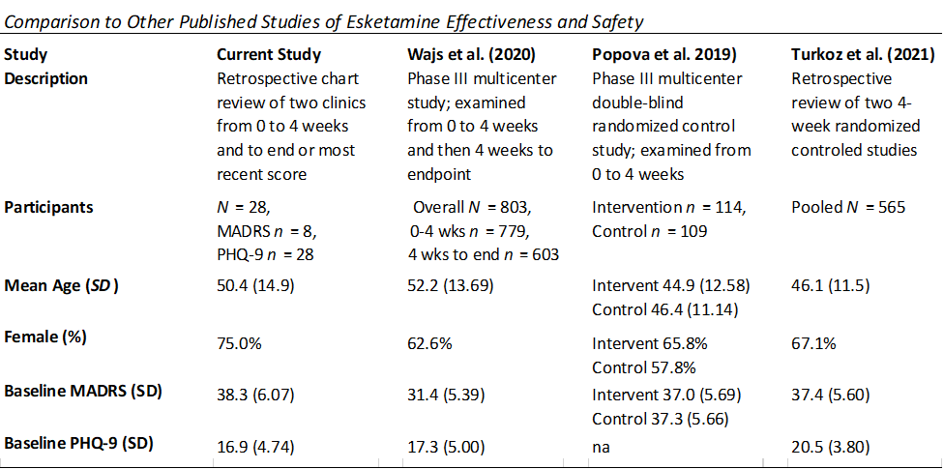
Discussion

Slide 31
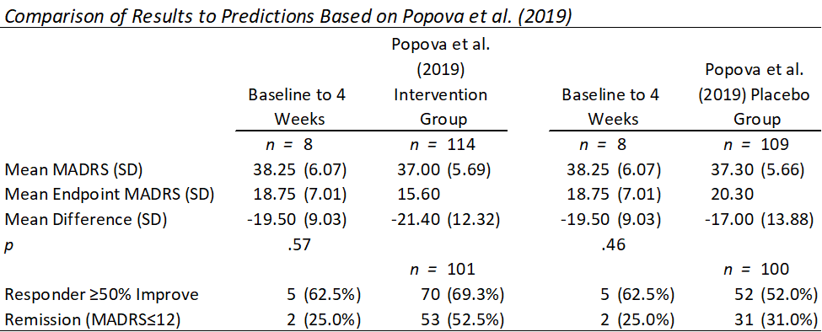
Discussion

Slide 32
Discussion
Compared to results of Popova et al. (2019)
  Mean MADRS change was not different from predicted to a statistically significant degree when compared to the intervention group or control group
  Roughly similar proportion of responders as in intervention group, but slightly lower proportion of patients achieving remission
  Limited MADRS sample size in study (n = 8) limited impact

Slide 33
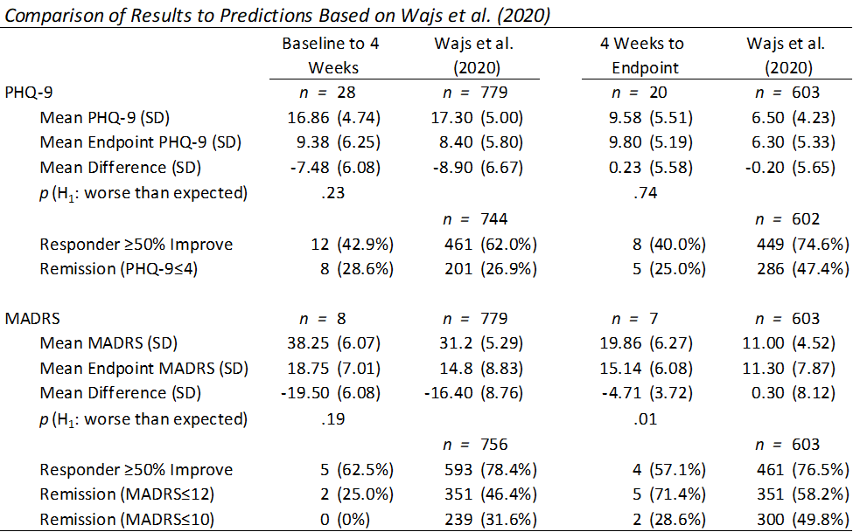
Discussion

Slide 34
Discussion
Compared to results of Wajs et al. (2020)
  Changes in PHQ-9 were not different to a statistically significant degree compared to Wajs et al. (2020) at 4 weeks or from 4 weeks to endpoint
  Proportion of responders was lower
  MADRS scores improved more than found by Wajs et al. (2020) at 4 weeks and from 4 weeks to endpoint, but only the endpoint was statistically significant (p = .01)
  Due to small endpoint MADRS sample (n = 7), results are questionable
  Proportion of responders and remitters similarly difficult to compare due to small MADRS sample

Slide 35
Discussion
MADRS improvement matched intervention group
PHQ-9 improvement lagged behind prediction
Z-score analysis found the PHQ-9 difference significant at α = .001

Slide 36
Discussion
Difficult to compare due to potential differences in methodology, but general contours do not appear, at minimum, to be worse than those of prior studies.

Slide 37
Conclusions
Pilot programs had clinical outcomes similar to those of previous studies
Limited statistical significance due to small sample size
Improvements were more pronounced using MADRS than PHQ-9
Discrepancy between those showing exceptional improvement and those with minimal benefit (Predictive tools needed)
Overall safety seems reasonable
Financial and operational concerns about administrative challenges with insurance carriers, but reimbursement seemed adequate if compensated
Limited generalizability to rural areas with different circumstances

Slide 38
Thank you
Teresa Frahm, APRN, PMHNP
Gayle Keller, APRN, PMHNP
Cassandra Muñoz-Parsons, APRN, PMHNP
Julie Wehrman, RN
Jina Santo
Kaylea Speckmann
Michael Zweifel, Ph.D., M.A., B.S.
Kari Wade, Ed.D., MSN, RN, CNE
Jeannie Hannan, Ph.D., B.S., MSHP

