Slide 1
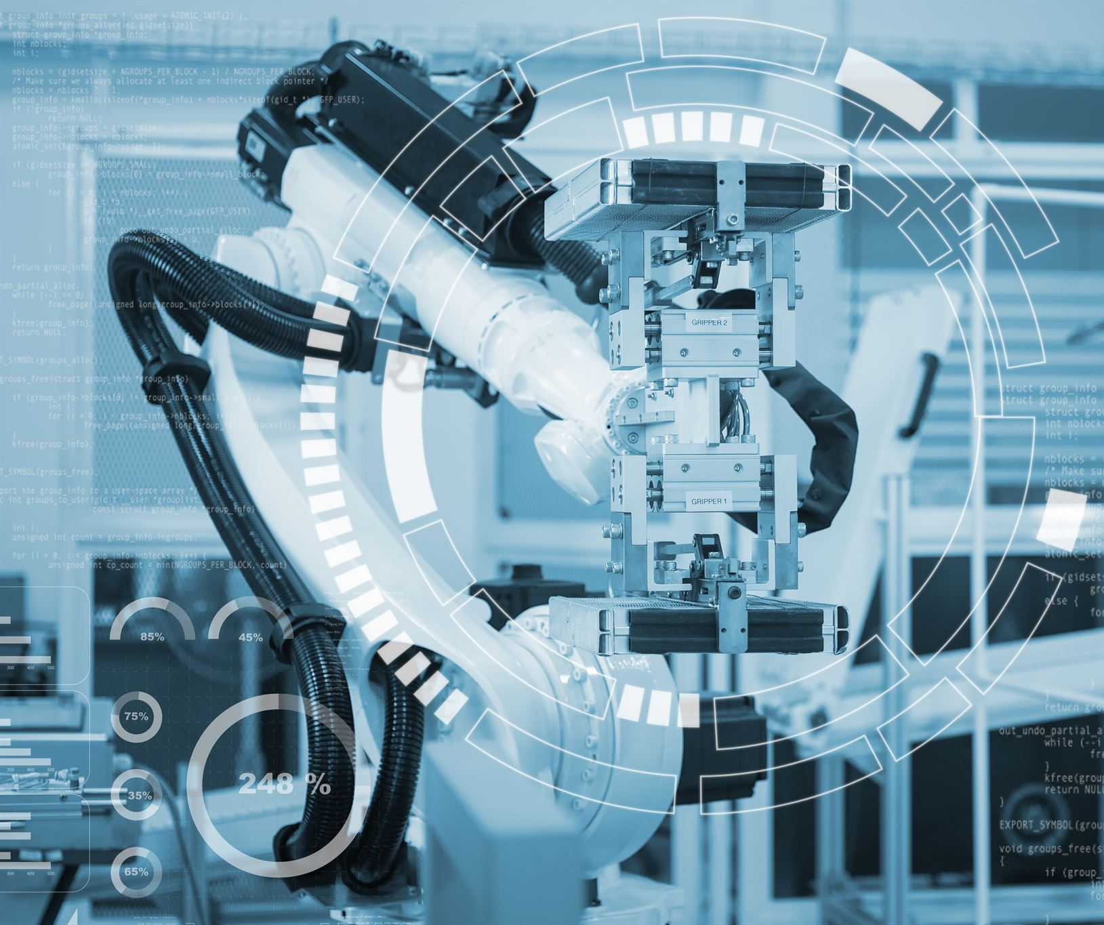
AI in Healthcare
Transforming Healthcare with AI-powered Tools
David Cloyed, MS, RN, NI-BC
Connected Health Applications Director
Nebraska Medicine
Notes:
Artificial Intelligence (AI) is transforming the healthcare industry. In this presentation, we will explore how AI is used in healthcare through the lens of LLMs, predictive analytics, and ambient note generation. We will also discuss 3 specific AI-powered tools that are used in healthcare, including Microsoft Copilot, Nuance DAX, and Palantir Foundry.

Slide 2

How smart is your right foot?
While sitting in a chair…
Lift your right foot off the floor and make clockwise circles
2. While doing this…
Draw the number ‘6’ in the air with your right hand…

Slide 3
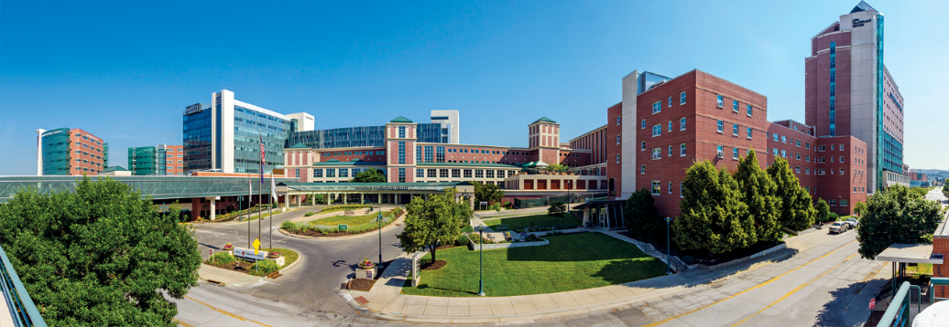
About Us
Nebraska Medicine
$2.5 billion academic health system
10,253 employees and more than 1,200 affiliated physicians
Primary clinical partner of University of Nebraska Medical Center
Two hospitals, anchored by tertiary/quaternary academic medical center
More than 70 specialty and primary care clinics, with 50 specialties and subspecialties
809 licensed inpatient beds in Omaha and Bellevue
Nebraska Medical Center: 718 licensed beds
Bellevue Medical Center: 91 licensed beds
In fiscal year 2024:
31,147 discharges
842,310 in-person primary and specialty patient visits
91,269 telehealth visits
97,800 emergency department visits
Fred & Pamela Buffett Cancer Center – Kearney opens in December 2024
Planning underway for Project Health, including a state-of-the-art academic medical center

Slide 4

Presentation Overview
AI in healthcare
Introduction to the benefits and impact of AI in the healthcare industry and its ability to revolutionize the field.
LLMs
Explanation of Local Language Models (LLMs) and how they are used in healthcare to improve patient outcomes.
Ambient Note Generation
Explanation of Ambient Note Generation and how it is used in healthcare settings to automate documentation and improve the accuracy of medical records.
Predictive Analytics
Overview of Predictive Analytics and how it is used in healthcare to predict patient outcomes and improve patient care and increase operational efficiency.
Notes:
We will start by introducing the overall topic of AI in healthcare and how it is revolutionizing the industry. Then, we will delve into the specifics of LLMs, predictive analytics, and ambient note generation. We will also discuss the tools that are making these AI applications possible.

Slide 5




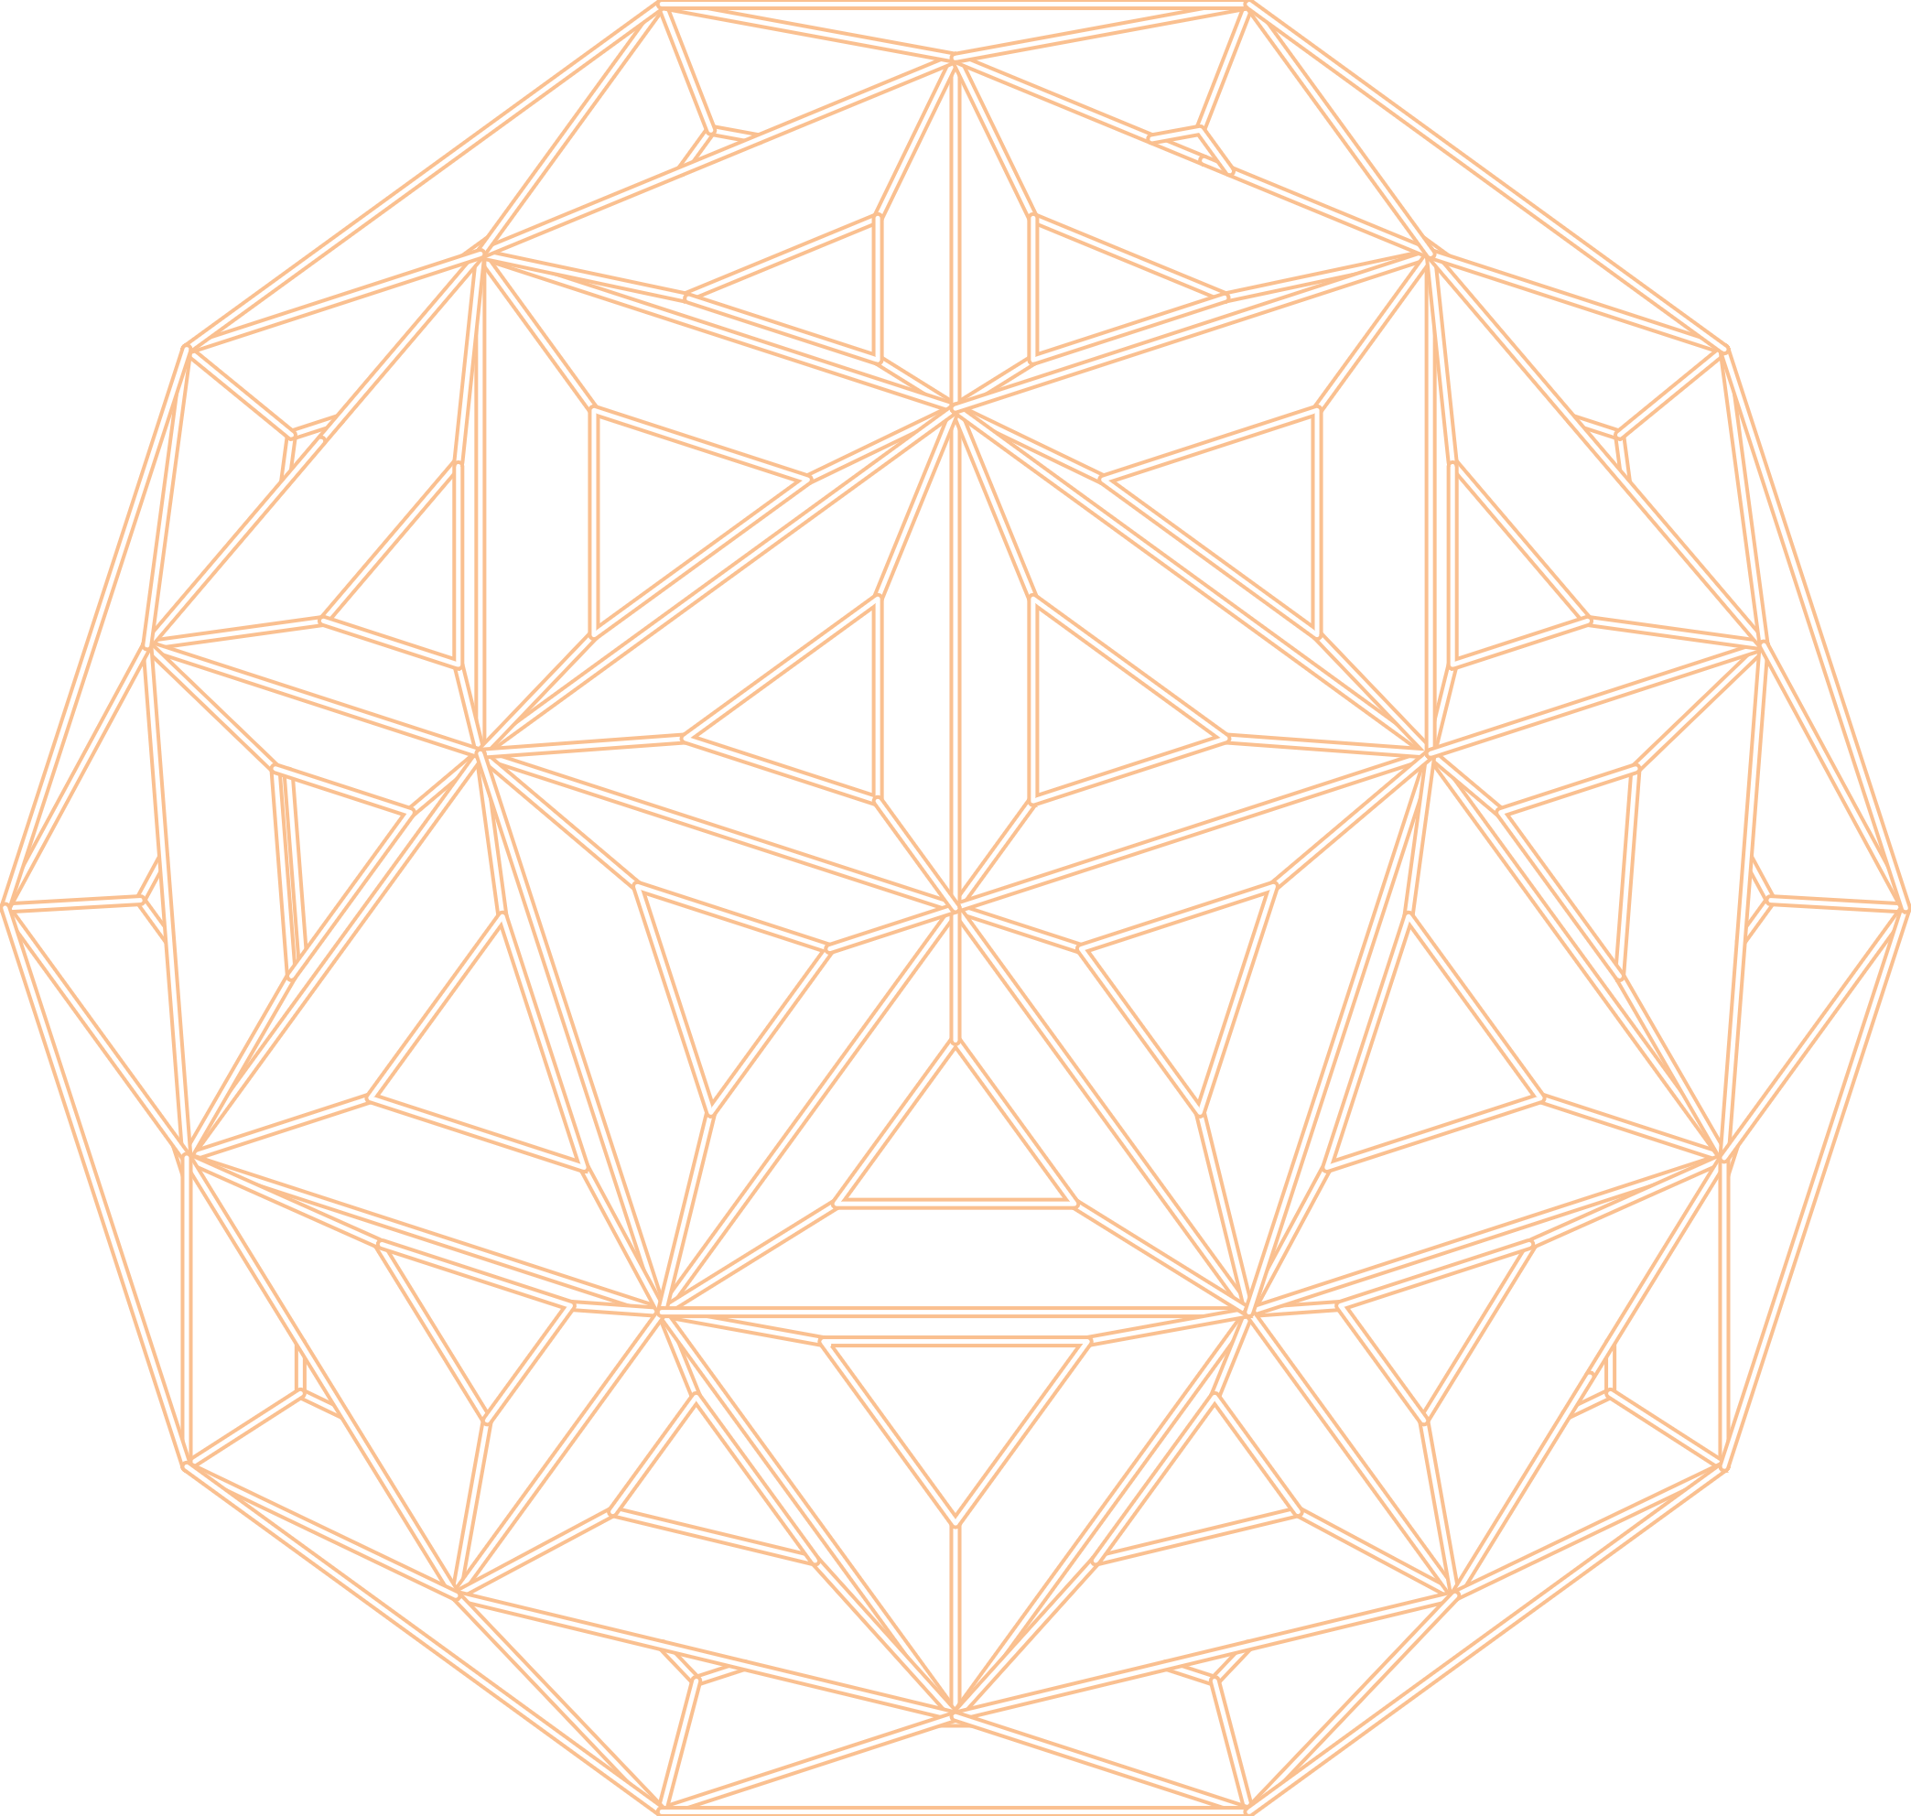

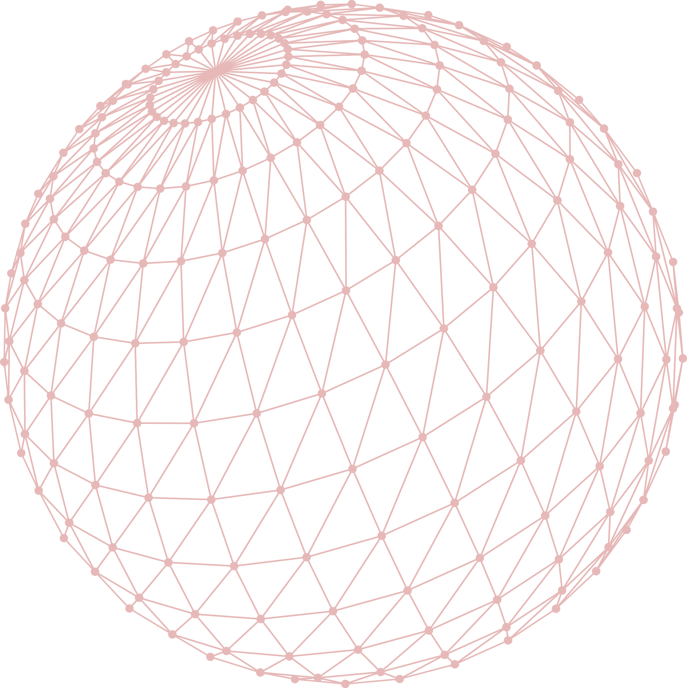

The Spectrum of Artificial Intelligence
Risk scores
Targeted neural nets
ChatGPT
Rules-based logic
Generative AI
(Large Language Models)
Predictive models
Deterministic
More targeted
Probabilistic
More generalized
Notes:
When we talk about AI, we’re actually discussing a whole spectrum of tools.
On the left we have rules – this includes things like med/allergy interactions,
In the middle we have Predictive models – risk of falls, end of life care
And on the right, we have Generative AI (e.g., ChatGPT).
Generally, left-to-right they go from <less compute intensive, more deterministic and very targeted> to <compute intensive, probabilistic and general.>

Slide 6
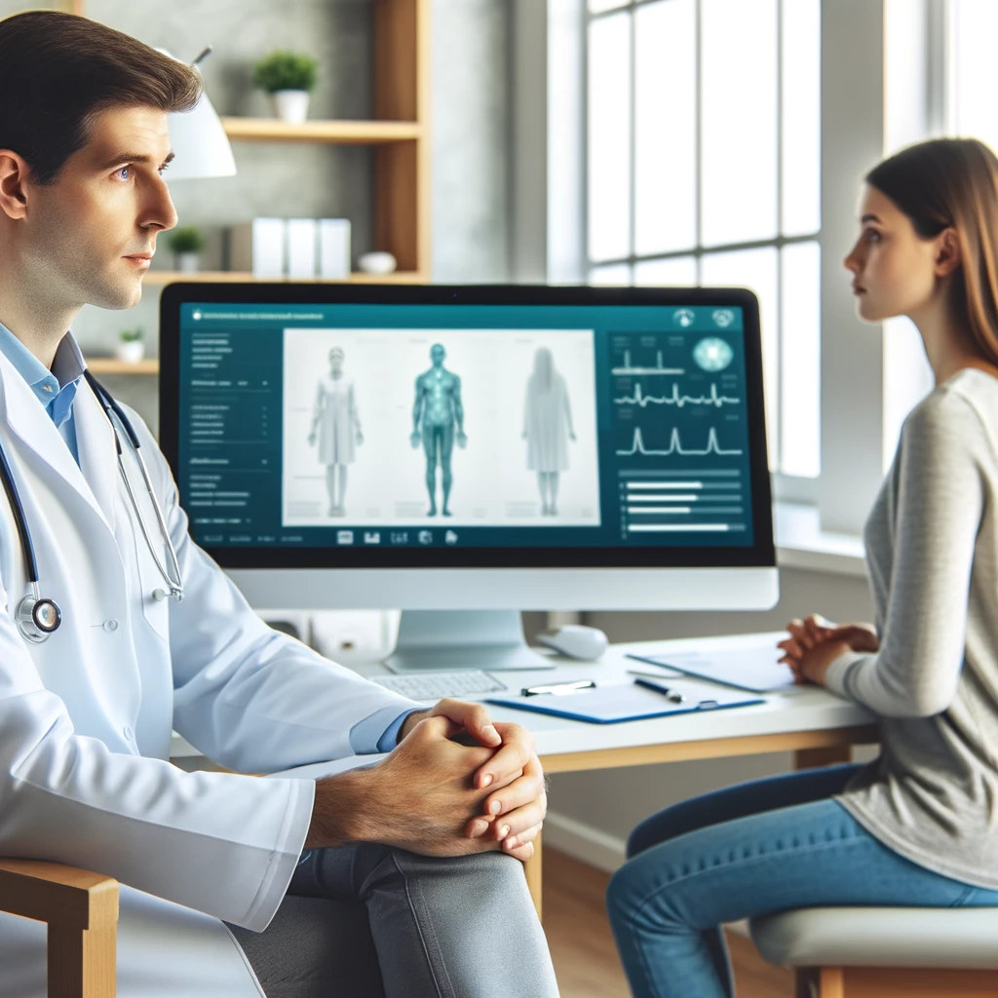
AI at Nebraska Medicine
Screening – Philips Lung Cancer Orchestrator
Uses Natural Language Processing to review radiology reports performed on emergency room patients
Early detection of cancer
Detection - Sepsis predictive models for early detection
Workflow - Ambient voice recognition documentation
Epic AI driven workflow enhancements
Operations – Palantir
Echo – VizAI (in progress) – Automated Measurement of Echo
Image generated by GPT-4 DALL-E
Notes:
Tabatha

Slide 7
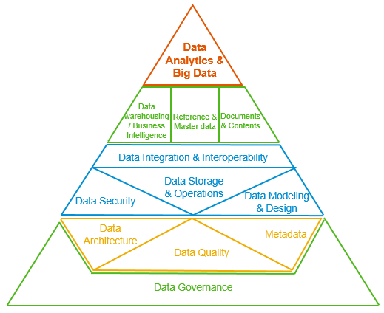
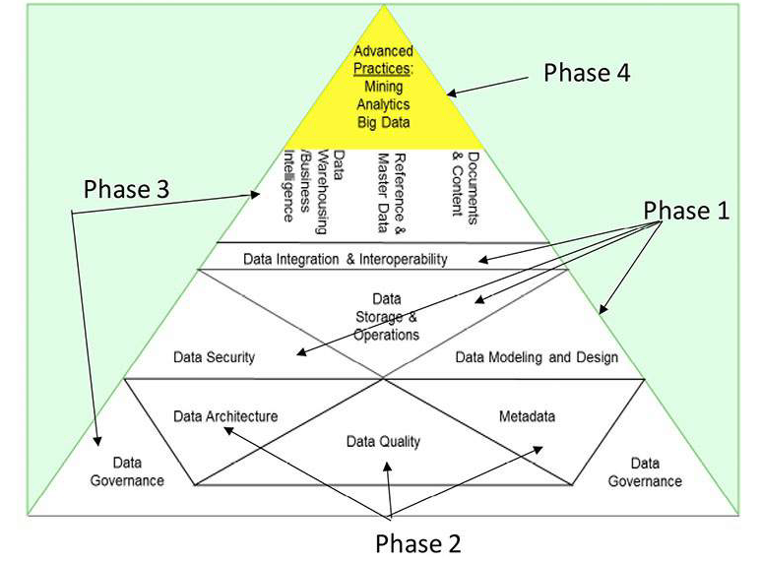
Data Management and AI
Reference: International, D. (2017). DAMA-DMBOK: Data management body of knowledge. Technics Publications, LLC.

Slide 8

LLMs in Healthcare
Improving Natural Language Processing in Healthcare
Language models, such as GPT-4, are being used to improve natural language processing in healthcare. They can help to improve patient care and offer better support to clinicians in writing clinical notes and analyzing patient data.
Predicting Diagnoses
LLMs are being used to predict diagnoses in healthcare. They can offer clinicians greater insight and support in making more accurate diagnoses for patients.
Analyzing Patient Data
LLMs are also being used to analyze patient data in healthcare. They can help to identify patterns and trends that might not be immediately discernible, allowing clinicians to provide better care and support for their patients.
Notes:
Language models, such as OpenAI's GPT-3, are being used to improve natural language processing in healthcare. These models can help clinicians with tasks such as writing clinical notes, predicting diagnoses, and analyzing patient data. In this section, we will explore how LLMs are being used in healthcare.

Slide 9

Microsoft Copilot
Microsoft Copilot is an AI-powered tool that offers AI infused in the M365 suite. In healthcare they also have tools that can navigate the chart, provide summaries, and help clinicians write more accurate clinical notes that improve documentation.
Notes:
Microsoft Copilot is an AI-powered tool that helps developers write better code by providing suggestions and auto-completing code. In healthcare, this tool can be used to help clinicians write more accurate clinical notes and improve documentation.

Slide 10

Ambient Note Generation in Healthcare
Real-time Clinical Notes
Ambient note generation uses natural language processing to generate clinical notes in real-time, reducing the burden of documentation for clinicians and improving patient outcomes.
Improved Efficiency
Ambient note generation can help improve the efficiency of healthcare professionals by reducing the time spent on documentation and allowing them to focus more on patient care.
Enhanced Accuracy
Ambient note generation can help improve the accuracy of clinical notes by reducing errors caused by manual data entry and allowing for quick and easy updates.
Notes:
Ambient note generation is an AI-powered tool that uses natural language processing to generate clinical notes in real-time. This tool can help reduce the burden of documentation for clinicians and improve patient outcomes. In this section, we will explore how ambient note generation is being used in healthcare.

Slide 11

Microsoft DAX
Ambient Clinical Intelligence Tool
Microsoft DAX is ambient clinical intelligence tools that use AI to listen to physician-patient conversations and generates clinical notes in real-time.
Reducing Documentation Burden
Ambient documentation can help reduce the documentation burden for clinicians, allowing them to focus more on patient care.
Improved Patient Outcomes
By reducing the documentation burden for clinicians, AI can help improve patient outcomes by allowing clinicians to spend more time with their patients.
Notes:
Nuance DAX is an ambient clinical intelligence tool that uses AI to listen to physician-patient conversations and generates clinical notes in real-time. This tool can help reduce the burden of documentation for clinicians and improve patient outcomes.

Slide 12
Note Generated by ambient listening
Patient Name: John Doe Date: August 23, 2024 Time: 2:00 PM Provider: Dr. Smith
S: Subjective
Chief Complaint: Patient reports experiencing persistent headaches for the past two weeks.
History of Present Illness: John describes the headaches as throbbing, primarily located on the right side of his head. The pain intensity is 7/10 and worsens with physical activity. He denies any visual disturbances or nausea.
Past Medical History: No significant medical history.
Medications: None.
Allergies: No known drug allergies.
O: Objective
Vital Signs: BP 120/80 mmHg, HR 72 bpm, Temp 98.6°F, RR 16 breaths/min.
Physical Exam:
HEENT: No signs of trauma, pupils equal and reactive to light, no sinus tenderness.
Neurological: Cranial nerves II-XII intact, no focal neurological deficits.
A: Assessment
Primary Diagnosis: Tension-type headache.
Differential Diagnoses: Migraine, cluster headache, sinusitis.
P: Plan
Medications: Prescribed ibuprofen 400 mg as needed for pain.
Diagnostics: Ordered MRI of the brain to rule out any structural abnormalities.
Follow-Up: Patient to return in two weeks for a follow-up appointment or sooner if symptoms worsen.
This note captures the key elements of a patient encounter using ambient listening technology, allowing the provider to focus more on the patient interaction rather than on documentation¹².

Slide 13
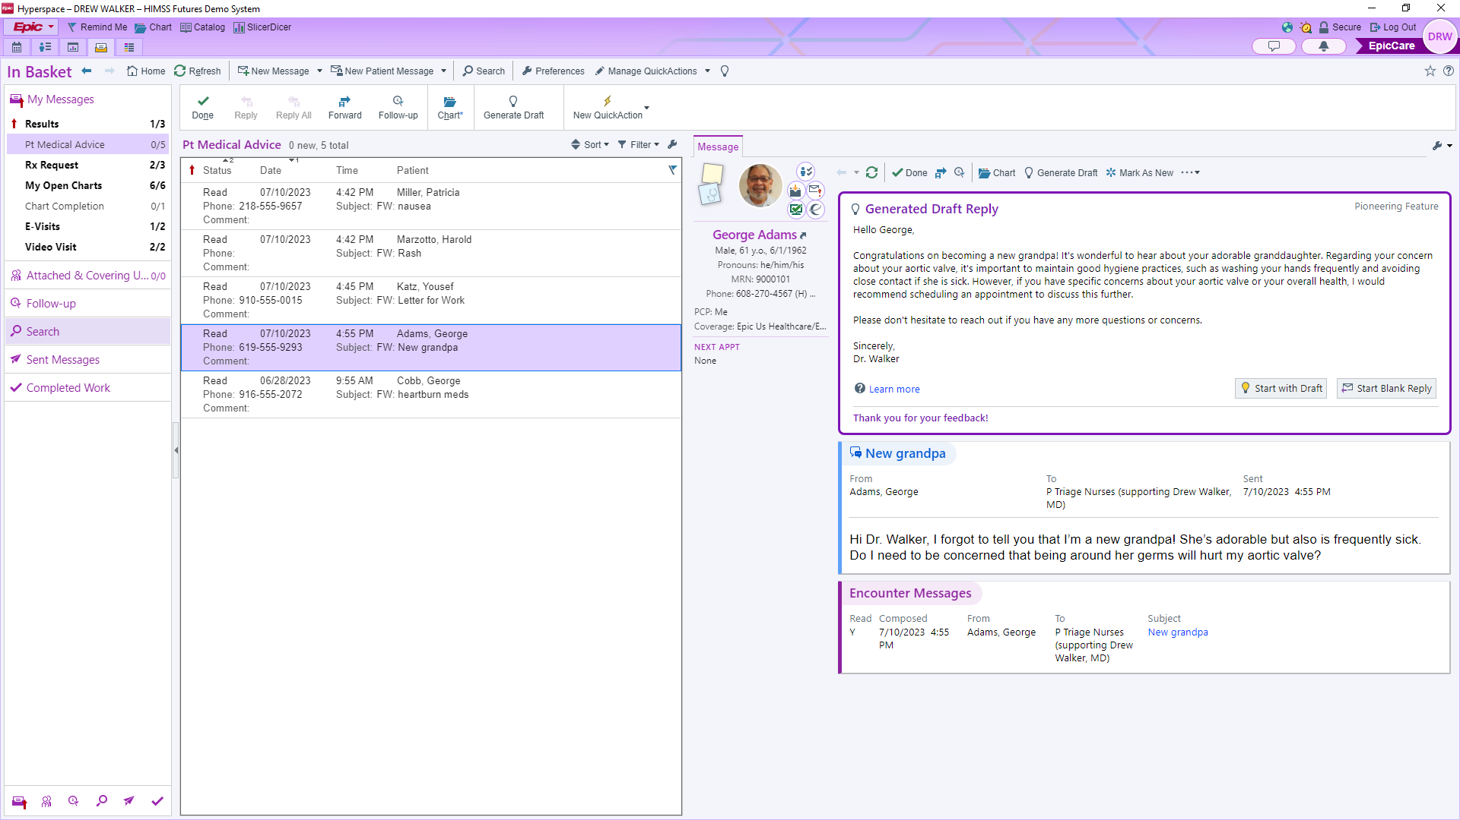
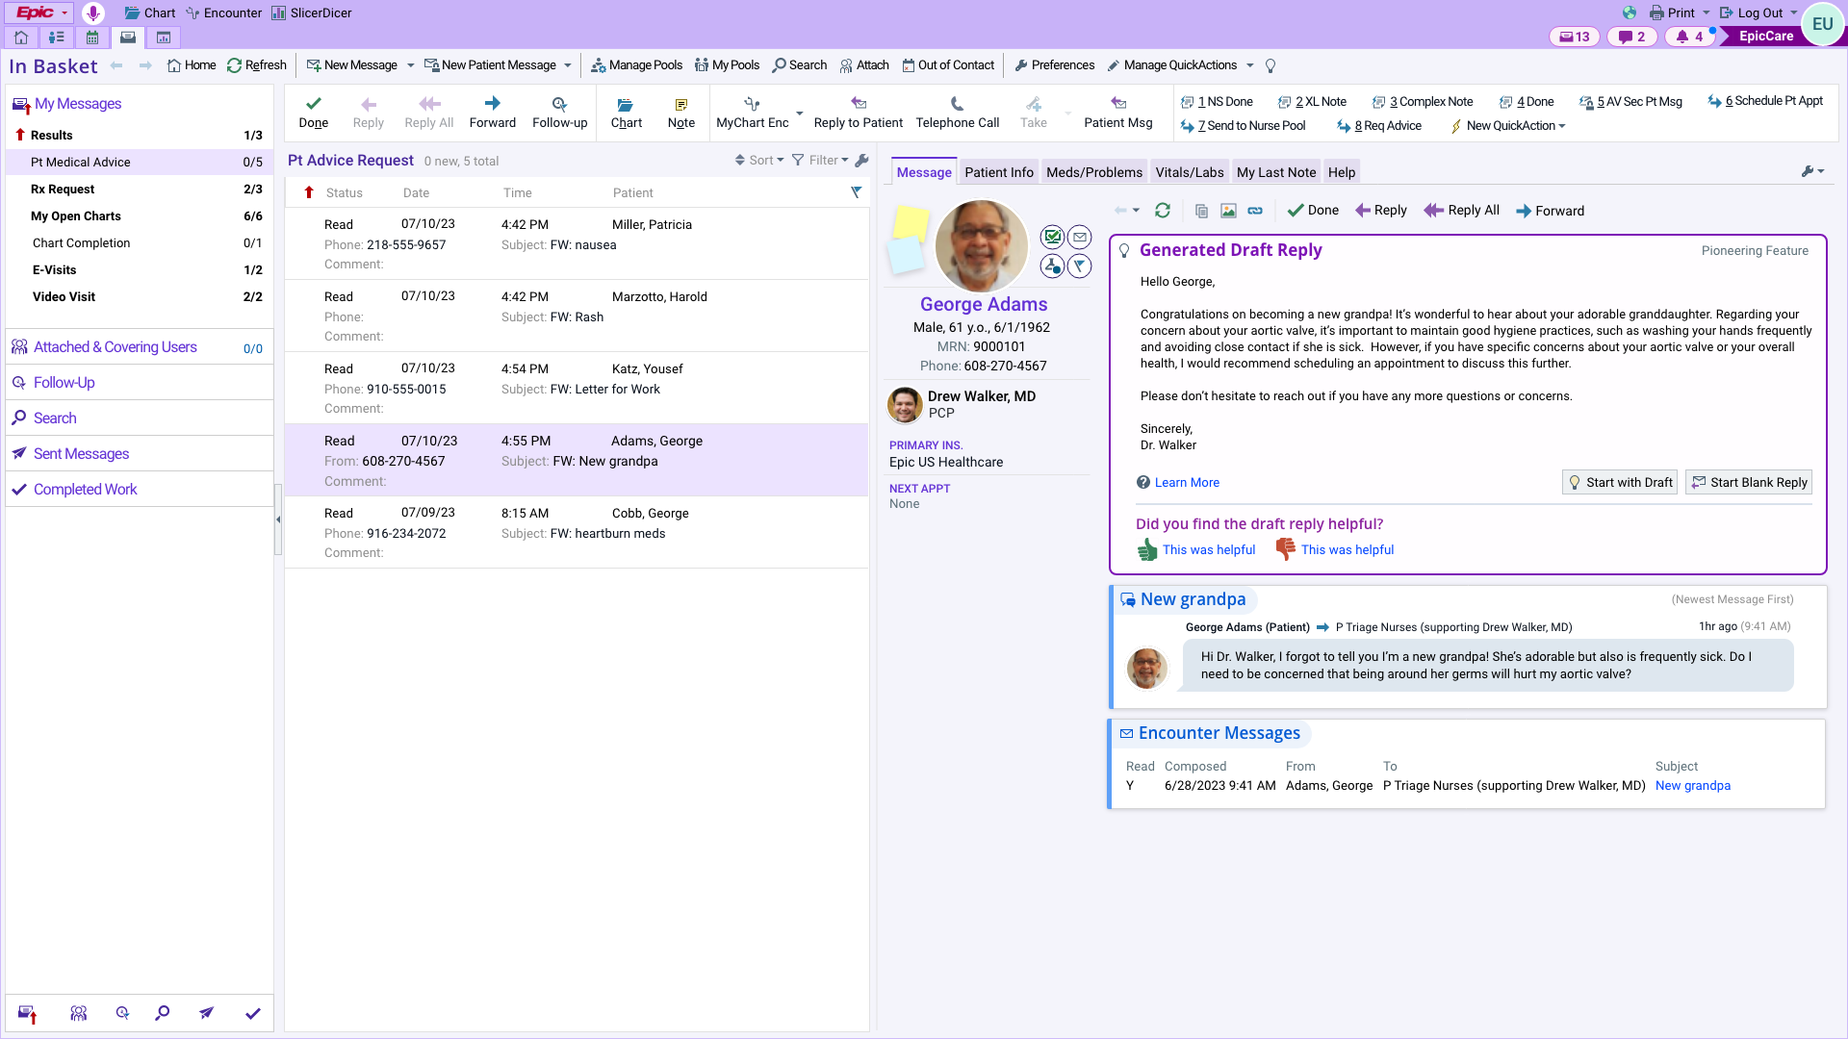
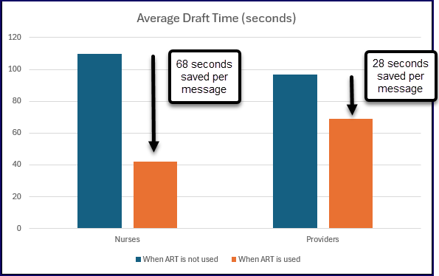
In Basket Augmented Response Technology (ART)

Slide 14
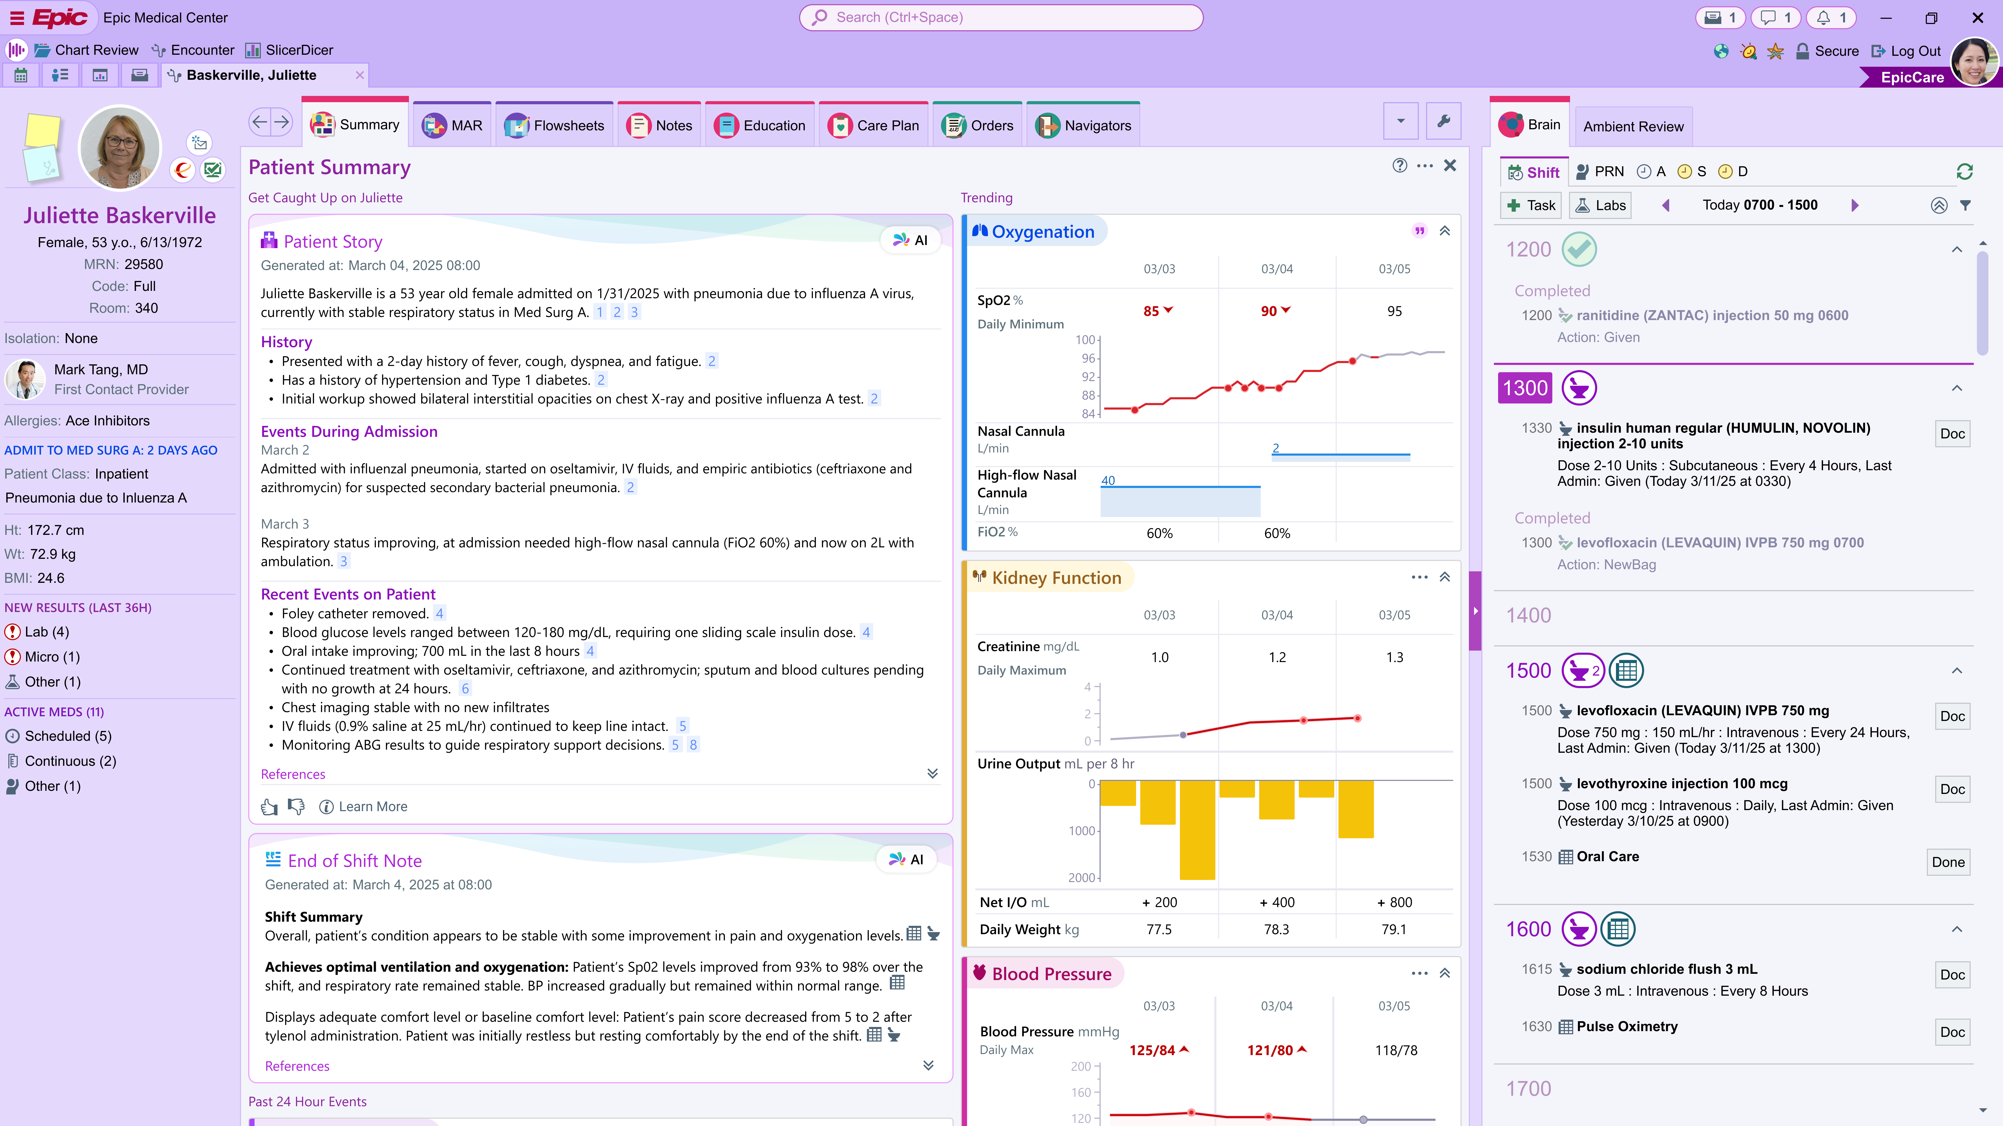
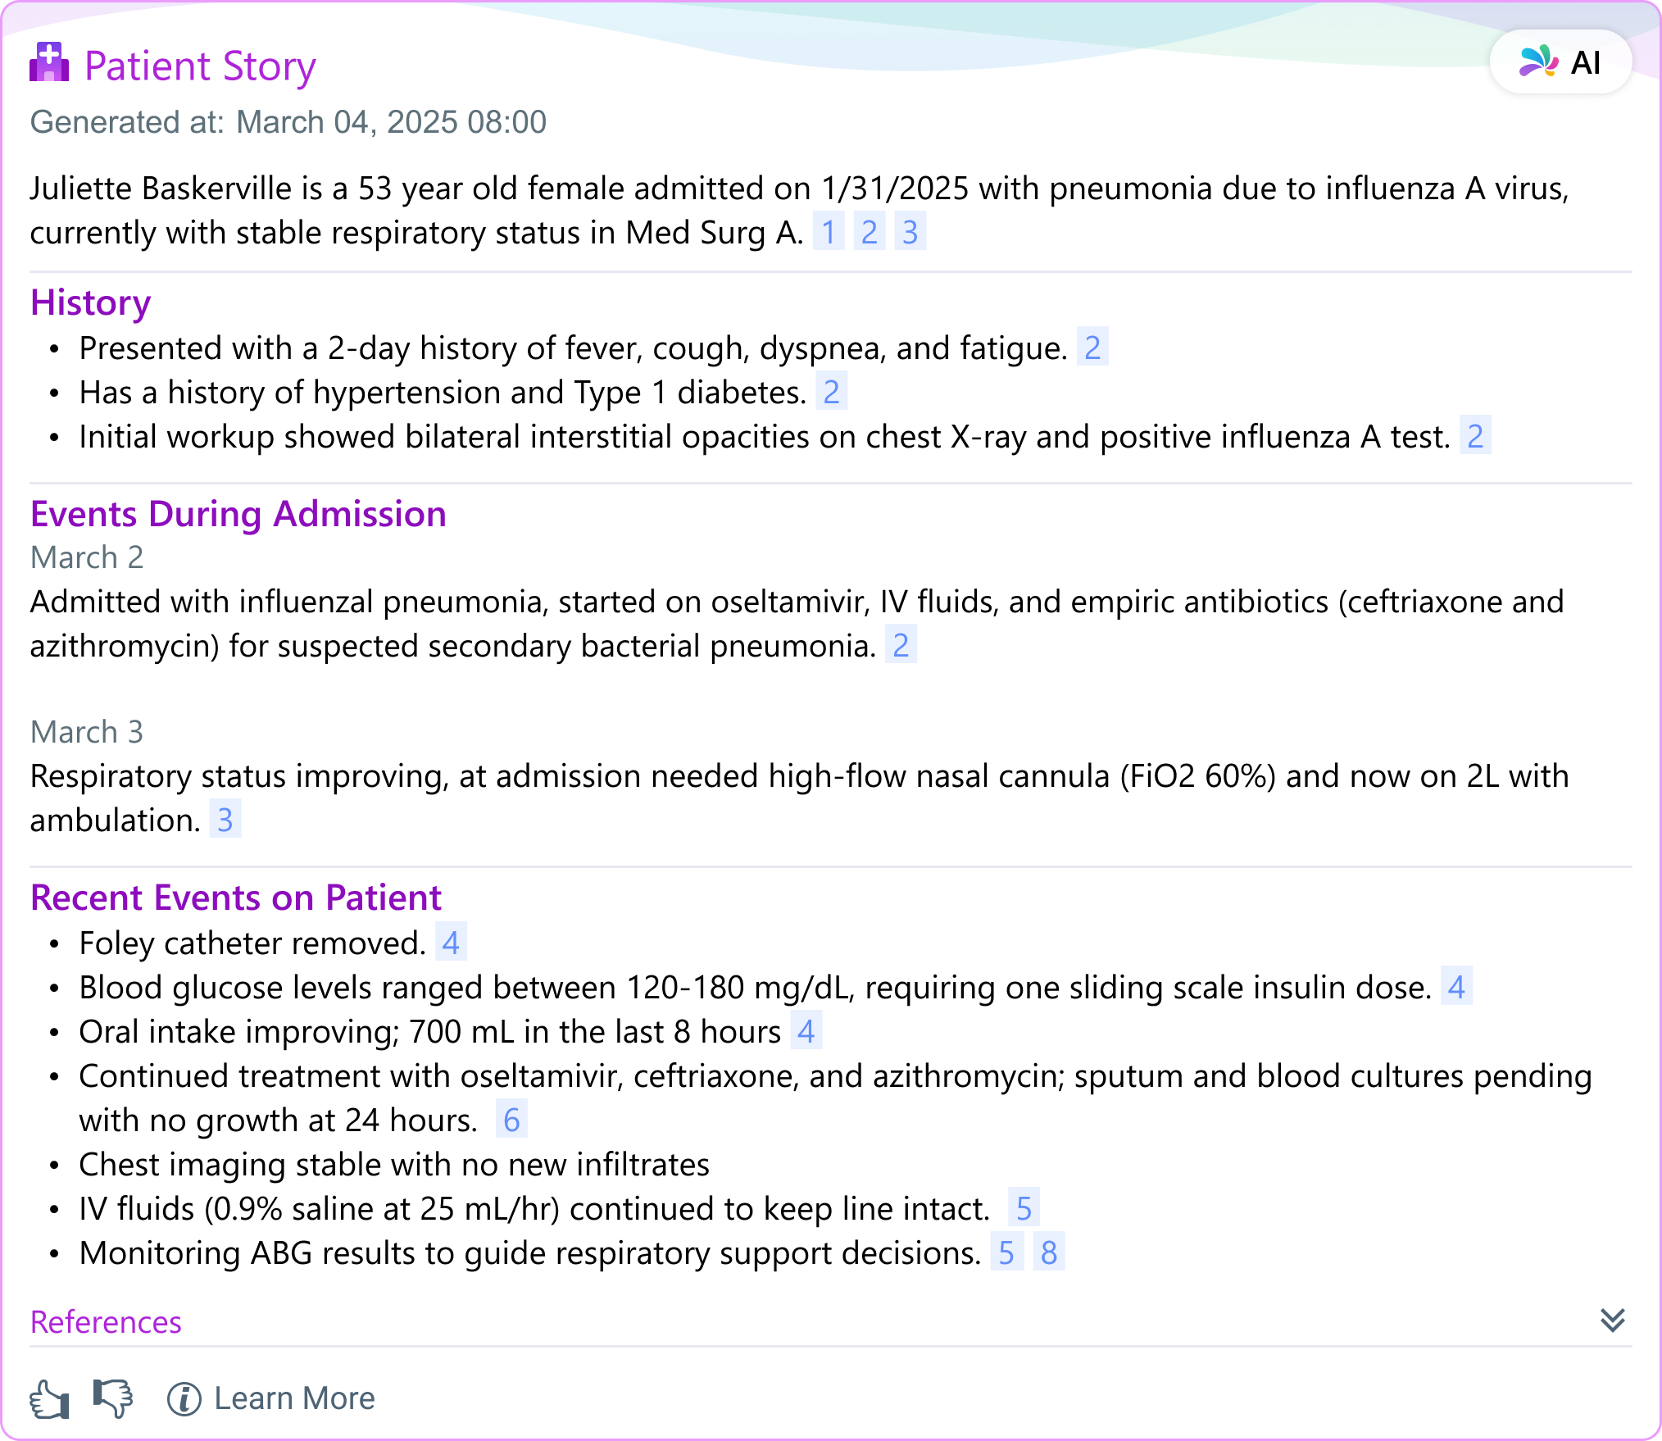
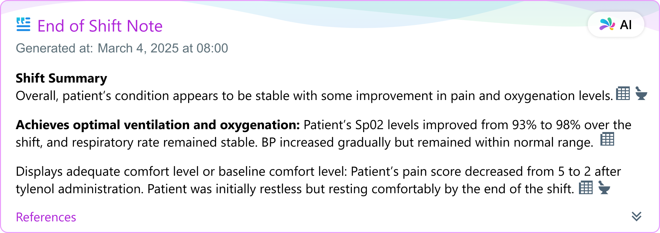



Epic AI Driven workflows
>90%
AI drafts used
AVAILABLE NOW

Slide 15
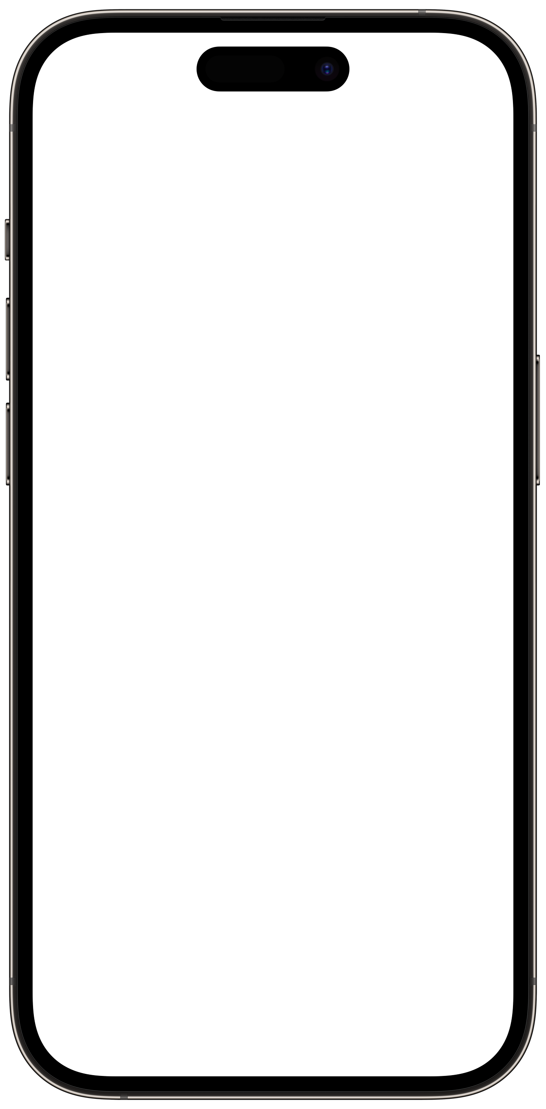
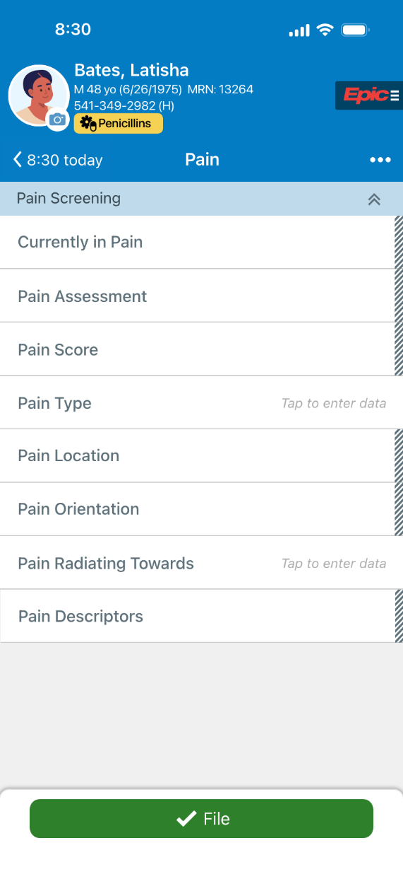
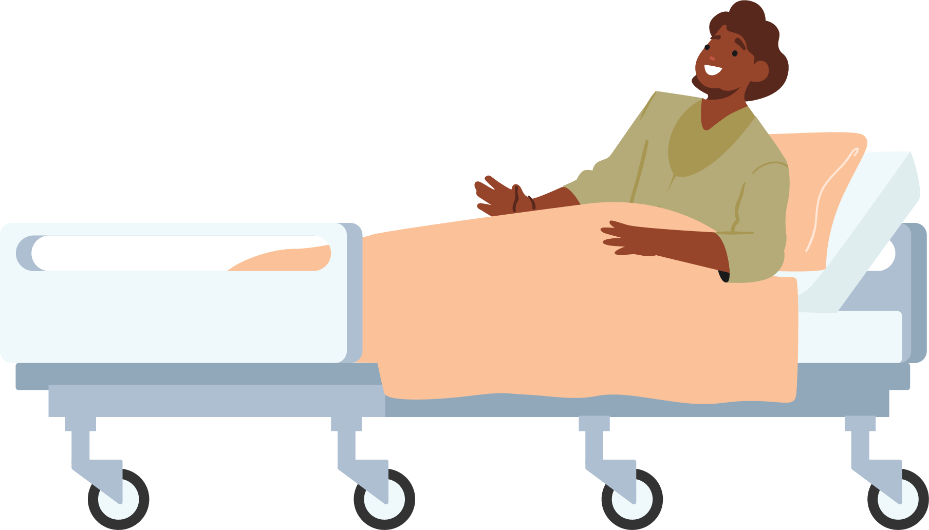









AVAILABLE NOW
Chart with AI
“You said your pain was the same as yesterday, that is a 4 in your lower back.”
“Yes, and it feels achy”

Slide 16
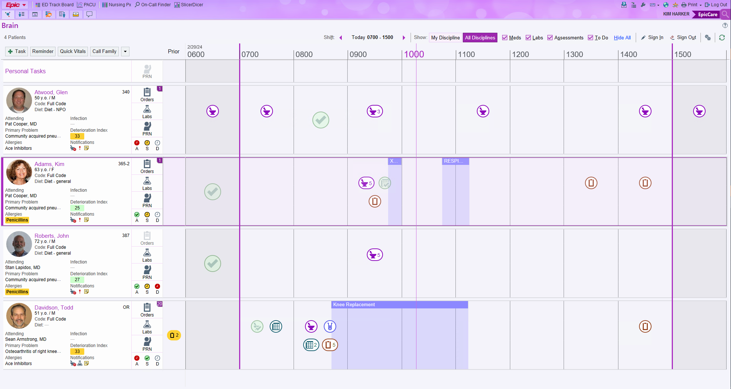
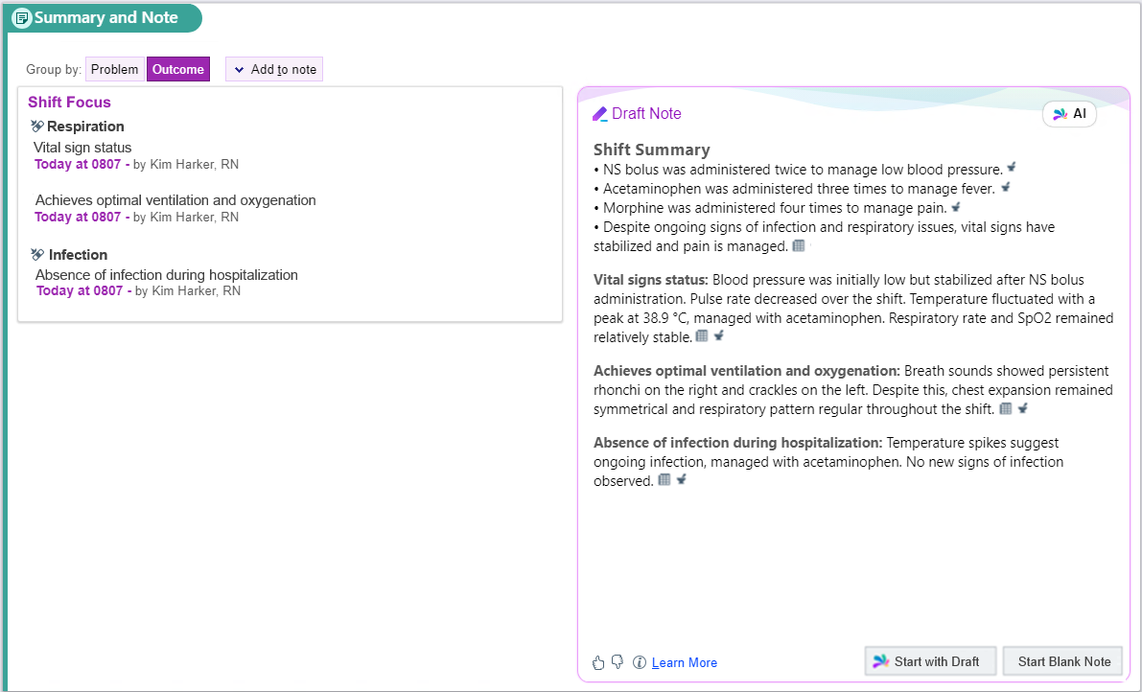
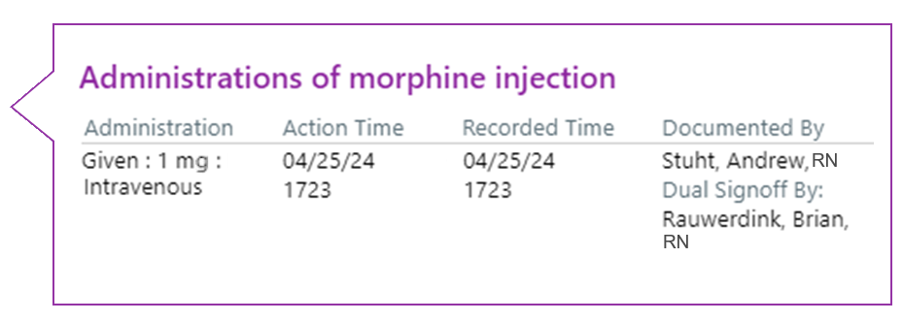
Wrap Up Your Shift with AI
AVAILABLE NOW

Slide 17
© 2025 Epic Systems Corporation. All rights reserved. PROPRIETARY INFORMATION - This item and its contents may not be accessed, used, modified, reproduced, performed, displayed, distributed or disclosed unless and only to the extent expressly authorized by an agreement with Epic. This item is a Commercial Item, as that term is defined at 48 C.F.R. Sec. 2.101. It contains trade secrets and commercial information that are confidential, privileged, and exempt from disclosure under the Freedom of Information Act and prohibited from disclosure under the Trade Secrets Act. After Visit Summary, ASAP, Aura, Beacon, Beaker, Beans, BedTime, Best Care Choices for My Patient, Bones, Break-the-Glass, Bugsy, Caboodle, Cadence, Canto, Care Everywhere, Charge Router, Cheers, Chronicles, Clarity, Cogito ergo sum, Cohort, Comfort, Community Connect, Compass Rose, Cosmos, Cosnome, Cupid, Discovery, Epic, EpicCare, EpicCare Link, Epicenter, EpicShare, EpicWeb, Epic Earth, Epic Nexus, Epic Research, Garden Plot, Grand Central, Haiku, Happy Together, Healthy Planet, Hello World, Hey Epic!, Hyperdrive, Hyperspace, Kaleidoscope, Kit, Limerick, Lucy, Lumens, MyChart, Nebula, OpTime, Phoenix, Powered by Epic, Prelude, Radar, Radiant, Resolute, Revenue Guardian, Rover, Share Everywhere, SmartForms, Sonnet, Stork, System Pulse, Tapestry, Trove, Welcome, Willow, Wisdom, With the Patient at Heart, and WorldWise are registered trademarks, trademarks, or service marks of Epic Systems Corporation in the United States of America and/or other countries. Other company, product, and service names referenced herein may be trademarks or service marks of their respective owners. Patents Notice: www.epic.com/patents.

Slide 18

Predictive Analytics in Healthcare
Identifying Patients at Risk
Predictive analytics can help clinicians identify patients who are at risk for certain conditions, such as heart disease or diabetes, by analyzing patient data and identifying patterns that may indicate an increased risk.
Accurate Diagnoses &Improved Treatment Outcomes
Predictive analytics can help clinicians make more accurate diagnoses by analyzing patient data and identifying patterns that may indicate a particular disease or condition. Predictive analytics can help improve treatment outcomes by analyzing patient data and identifying the most effective treatments for particular conditions
Improved Operational Efficiency
Optimize bed capacity, enhance patient flow, and refine nurse staffing and scheduling, all while maintaining the agility and flexibility to expand to additional areas such as Revenue Cycle Management or Clinical Pathway Management
Notes:
Predictive analytics uses machine learning algorithms to analyze data and make predictions about future events. In healthcare, these predictions can help clinicians identify patients at risk for certain conditions, make more accurate diagnoses, and improve treatment outcomes. In this section, we will explore how predictive analytics is being used in healthcare.

Slide 19

Palantir Foundry
Palantir Foundry is an AI-powered tool that helps healthcare organizations with data integration, management, and analysis, streamlining data analysis for predictive analytics to improve patient outcomes.
Notes:
Palantir Foundry is an AI-powered tool that helps healthcare organizations with data integration, management, and analysis. This tool can be used to streamline data analysis for predictive analytics and improve patient outcomes.

Slide 20









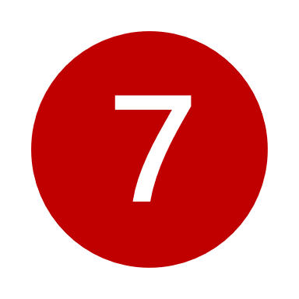


Stable workflows
Present Day Workflows Across the Patient Journey
Workflows in progress
NMC Discharge Lounge
Identify patients eligible for the discharge lounge to decrease time from order to discharge and increase discharge lounge usage across NMC inpatient units.
Charge Capture
Capture mismatches between HB and PB transactions as well as missing HB charges
Jan 24
OR PACU / PPU
Predict OR case inpatient bed needs and provide PPU with real time proactive visibility of bed requirements
Aug 24
11
AI-Generated Prior Auth Packets
Write a draft authorization packet for upcoming procedures requiring prior auth
Transfers Back
Analyze accepted inpatient transfers and identify patient eligibility for transfer back to their original facility
12
Physician Charge Reconciliation
Flag progress notes with no matching professional billing charges
May 24
BMC Discharge Lounge
Expand the discharge lounge to Bellevue Medical Center
Oct 24
13
Staffing Reporting
Provide real time staffing data to automate data access and support live, data-driven management of staffing resources
Upcoming Inpatient Only Procedures
Flag upcoming procedures with a CMS inpatient only CPT code where the patient is marked as ambulatory
14
Physician Satisfaction
Leverage AIP to generate a peer to peer (P2P) patient summaries and guideline evaluations for providers
AI-Generated Appeal Letters
Write a draft for auth, non-medically necessary, and experimental appeal letters
15
Barriers to Discharge
Leverage Foundry to identify barriers to discharge, evaluate patient complexity, and manage social work and CTN case assignment.
14
UM Appeals
Write a draft UM note for inpatient to observation denials with a daily breakdown of patient treatment and evaluation of the patient's chart against payor guidelines
16
OR Optimization
Optimizing OR case prediction, staff skill distribution, and add-on case prioritization.
Dec 24
14
June 24
Supply Management
Manage, locate, and track supply availability across Nebraska Medicine
17
Hospital 360
Workflows kicking off beginning of February
Staffing Bed Board
Provide real time staffing data to automate data access and support live, data-driven management of staffing resources
14
Notes:
Hospital 360 – air traffic control – the Command Center/ Capacity Optimization Unit

Slide 21
Discharge Lounge

Slide 22
Metrics
Tracking increasing impact metrics across a subset of production, live tools being used daily both in the hospital and across RCM offices at Nebraska Medicine.
Discharge Lounge:
Transfers Back:
OR PACU/PPU:
Staffing Bed Board:
Staffing Reporting:
2834 patients attended for 2965 total hours spent since March
60 min decrease in time from order to discharge across all eligible patients
25 patients transferred back since launch
100% increase in patients transferred back month over month
30 mins saved for PACU nurse leads each day from having automated views
15 mins saved each day from automated inpatient bed predictions
2hr saved per shift in manual bed board updates
30min saved for 30+ lead nurses from shortened bed meetings
2+ days saved in generating staffing reports upon state visits
Clinicals for Prior Auth:
CMS Inpatient Only:
UM Appeals:
HB/PB:
Appeals:
100+ packets generated with 94% responses approved
Onboarding 50+ users to move packet generation to be entirely AI generated
167 procedures validated
144+ correctly categorized patients to inpatient
800% increase in FTE efficiency – from 80 to 9 minutes required per letter
91 cases actioned on through Palantir to date saving 107+ hours
98% accuracy in transaction flags
3500+ validated missed or mismatched transactions
500% increase in FTE efficiency (15 min to 3 min)
9300+ appeals sent, saving 1300 hours
Notes:
Did not have clear operational guidelines on who was eligible
Palantir does the chart abstraction and surfaces to a dashboard
Discharge lounge nurses called up to the units to have the nurses
First met with resistance on the units
To address, all managers were given the same dashboard – the unit managers have clarity on which patients are enabled
Culture shift – expectation that nurses to send
Brand new discharge lounge

Slide 23
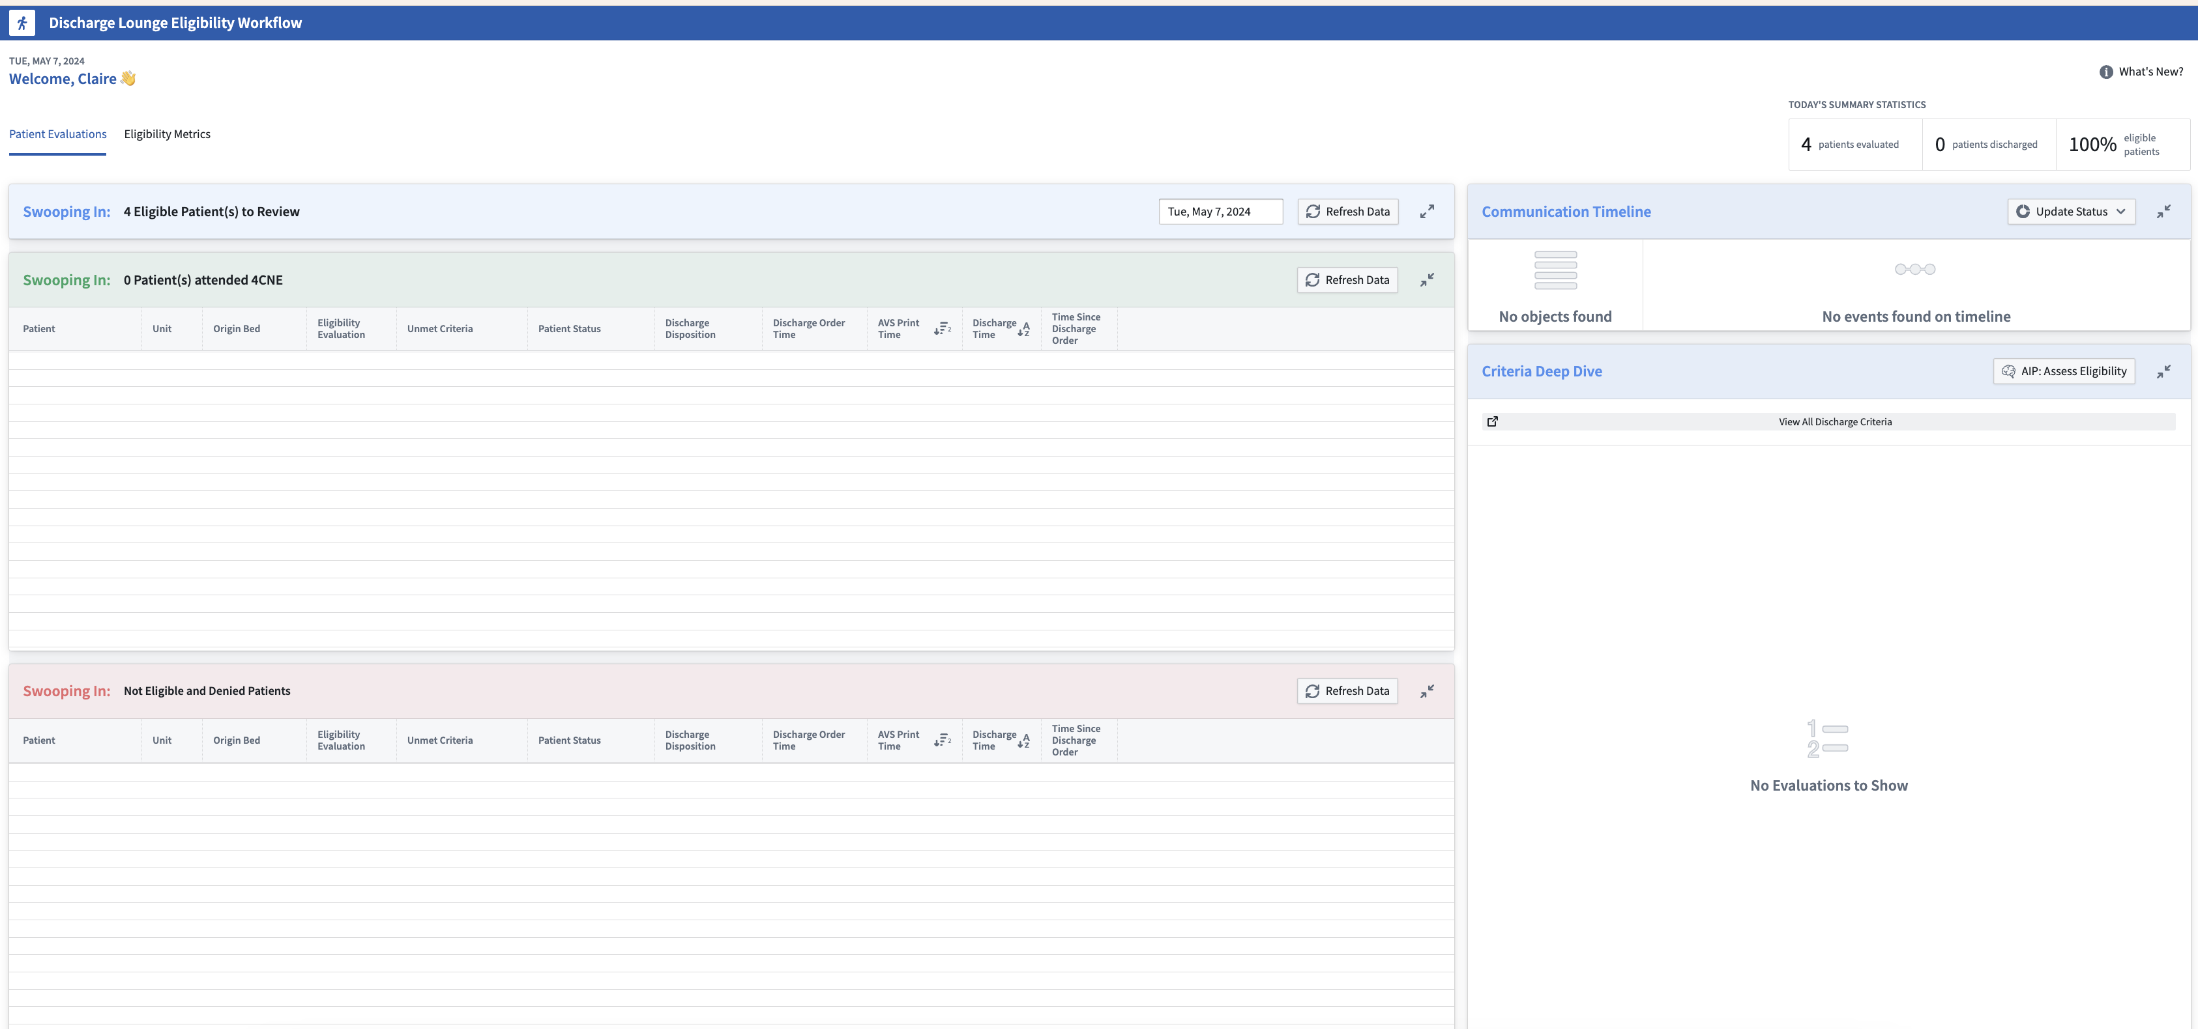
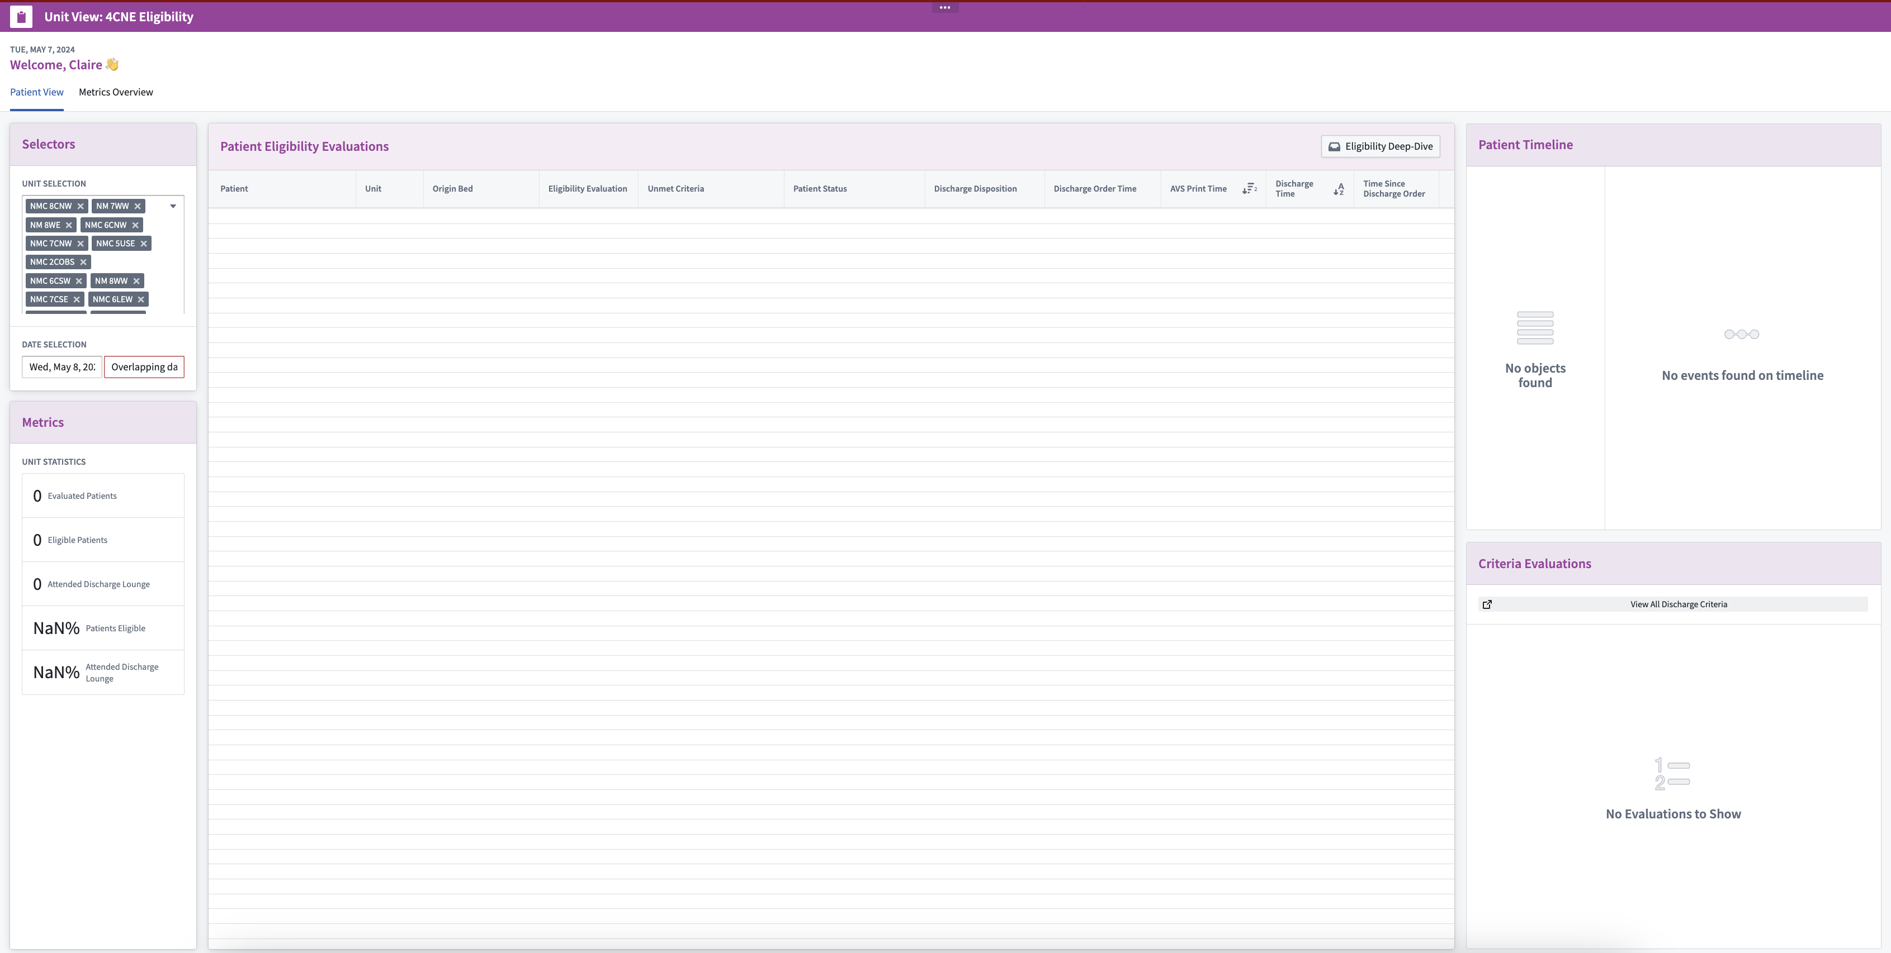
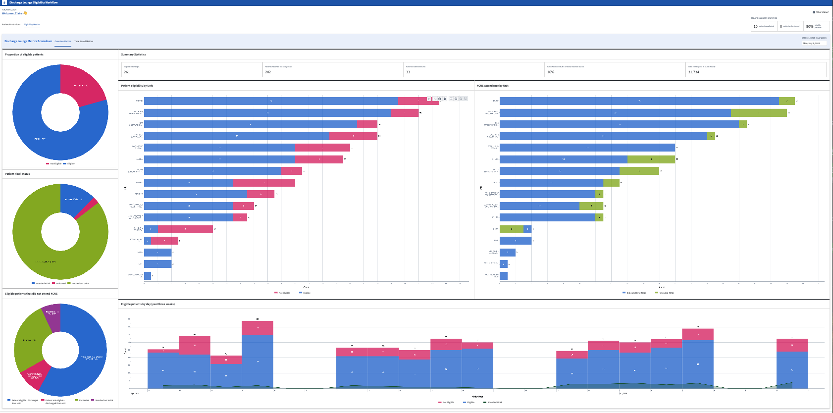
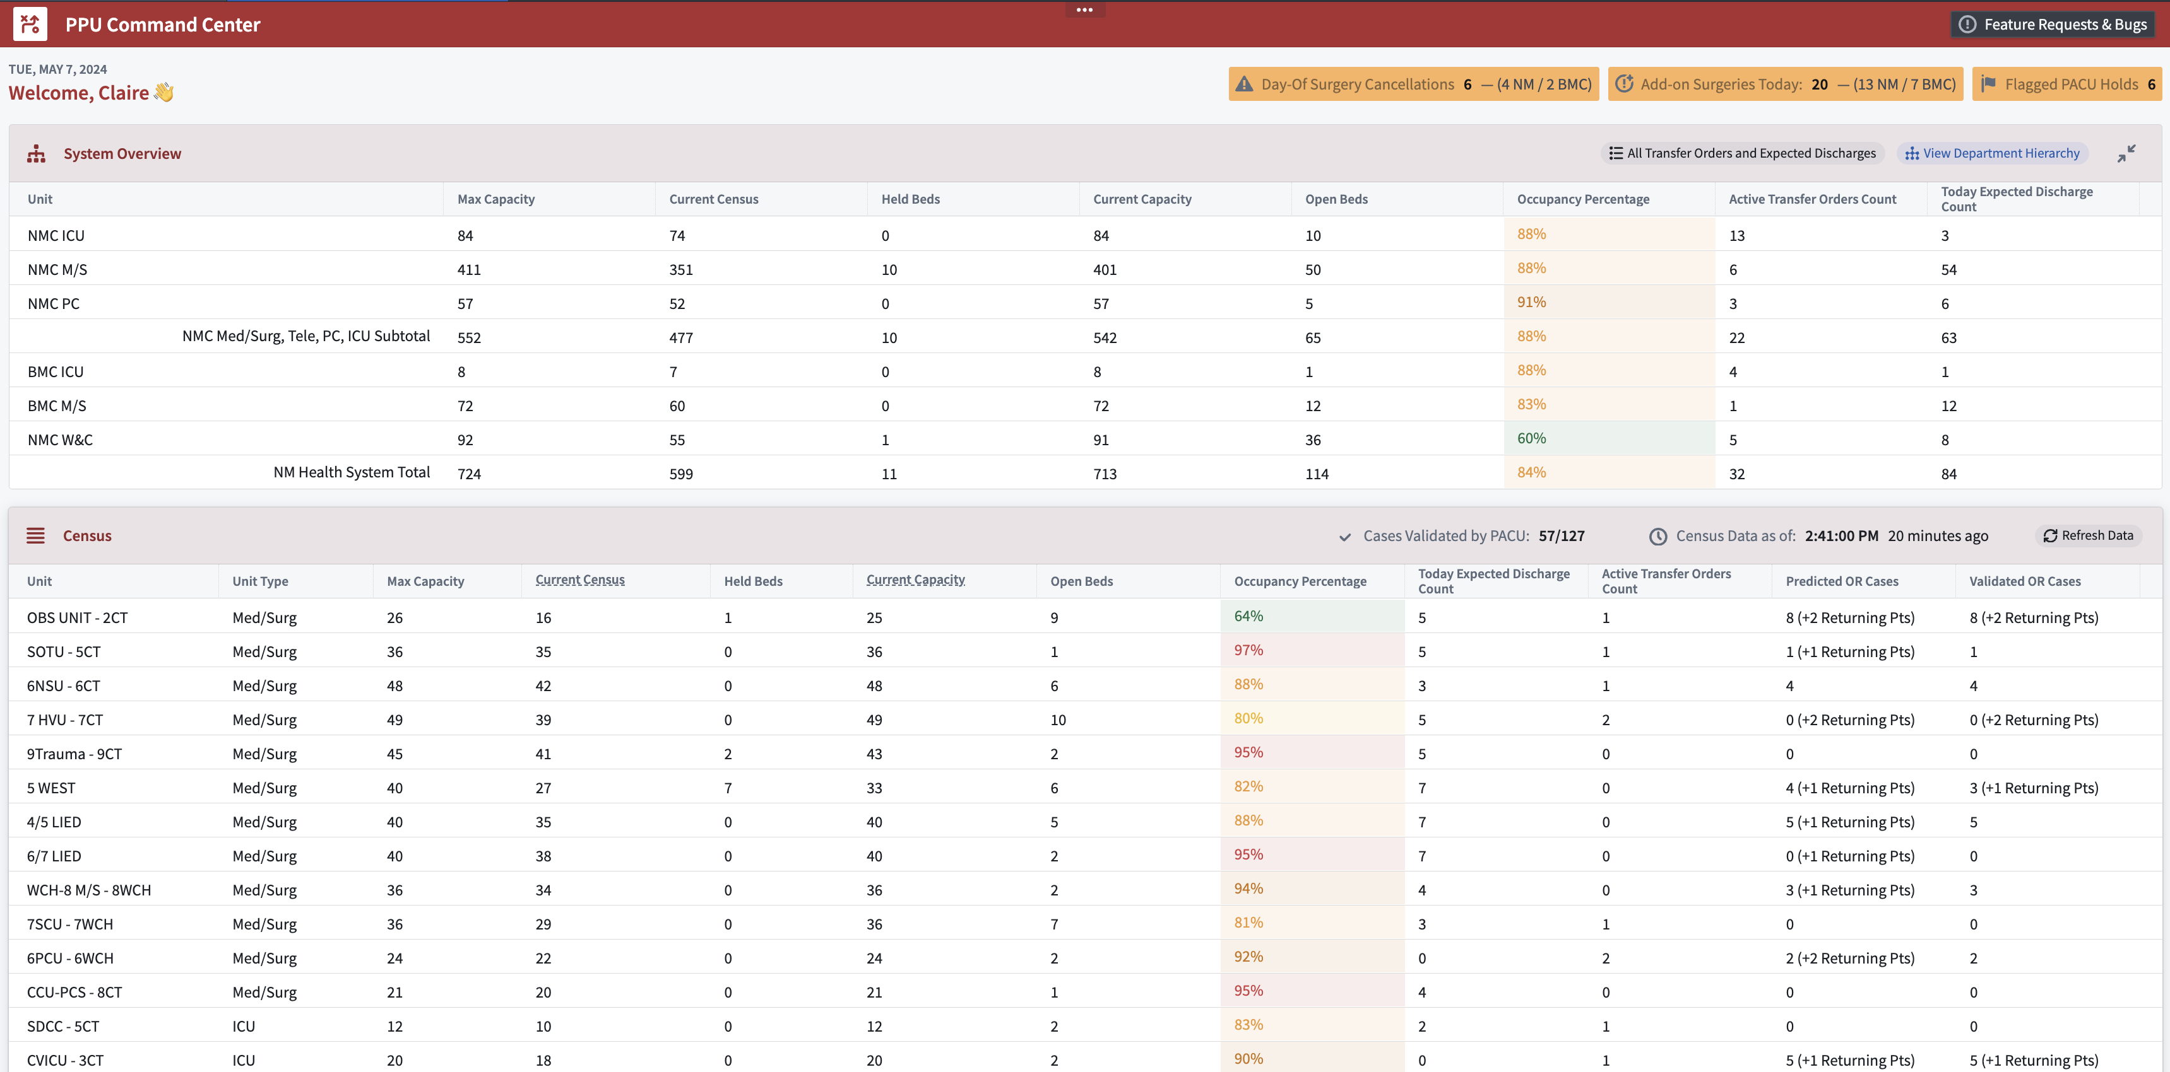
Problem Statement [+] Discharge Lounge Eligibility
Problem Statement
Prior to Palantir involvement, 4CNE nurses were spending time chart diving to identify eligible patients, bringing ~0-1 patients per day, or ~15 patients per month to the discharge lounge with:
Discharge Lounge Eligibility Hub
Discharge Lounge workflows have expanded beyond the initial 4CNE Nurse Workflow and more towards a suite of applications for nurse managers unit overviews, metric views, eligibility engine views, etc.
1
2
Limited ability to identify eligible patients
Manual tracking of discharged patients, eligibility assessment and communications
Challenges to communicate with floor RNs and coordinate bringing patients to the discharge lounge.
4CNE Nurse Workflow
Identify patients eligible for the discharge lounge and leverage the workflow to initiate and track communications with floor RNs and nurse managers
4CNE Nurse Manager View
Monitor patient eligibility based on nurse manager-specific units and compare department metrics over time
Goal: Configure a Discharge Lounge Workflow to enable nurses to more efficiently identify eligible patients and bring them to the discharge lounge, decreasing time to discharge and improving bed availability.
4CNE Metrics
Extensive KPIs to identify current progress opportunities for process improvements. Measure change over time in terms of time to discharge, patients attending 4CNE, etc.
PPU View
Consider discharge orders and discharge lounge eligibility alongside wholistic hospital metrics when managing patient placement

Slide 24
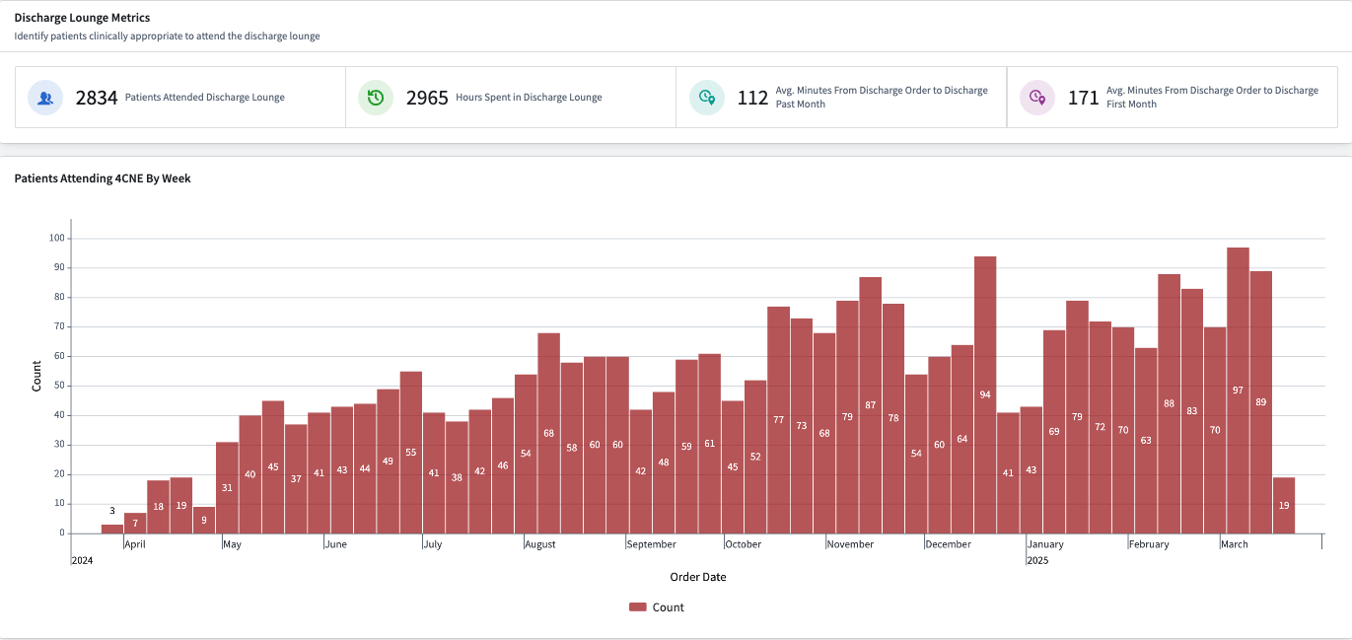
Progress Across RCM Use Cases: Moving towards business changing work

Slide 25
Bed Board + Staffing Forecasting

Slide 26
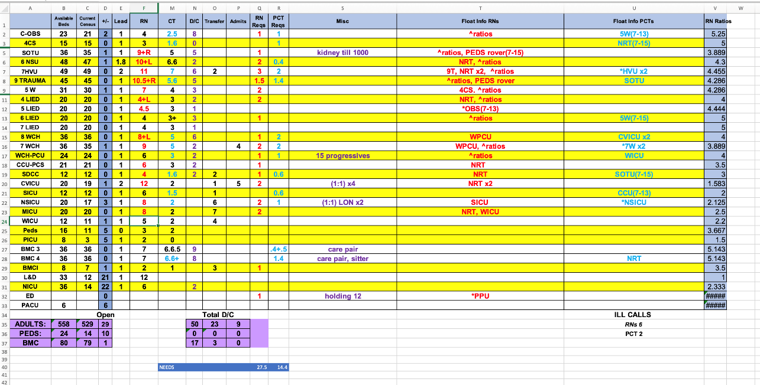
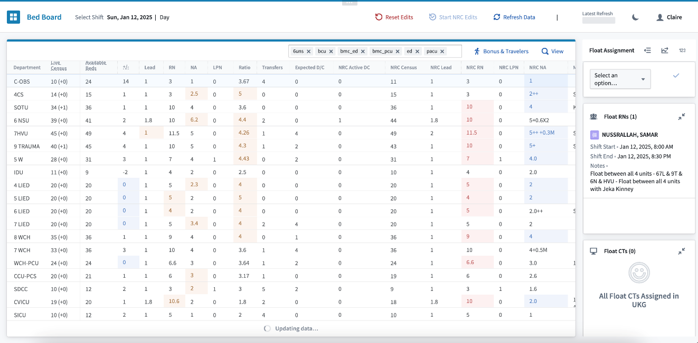
Bed Board: Automating a static, manual view of hospital census data
Prior status: manual excel sheet to manage hospital staff requiring 2+ hours each shift to fill in data the immediately becomes inaccurate as patient statuses/locations change
Palantir tool: A live source of truth to support decision making on real time census and staff availability across inpatient units in the health system
Notes:
Real time data
Requires a more robust integration to get to this level for accuracy

Slide 27
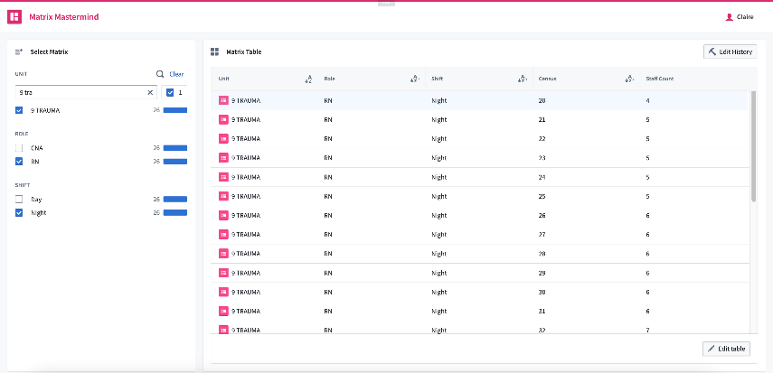
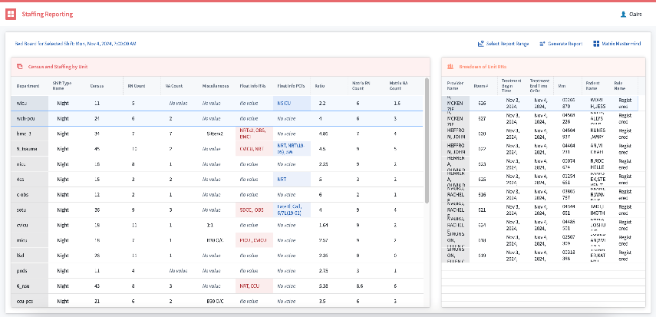
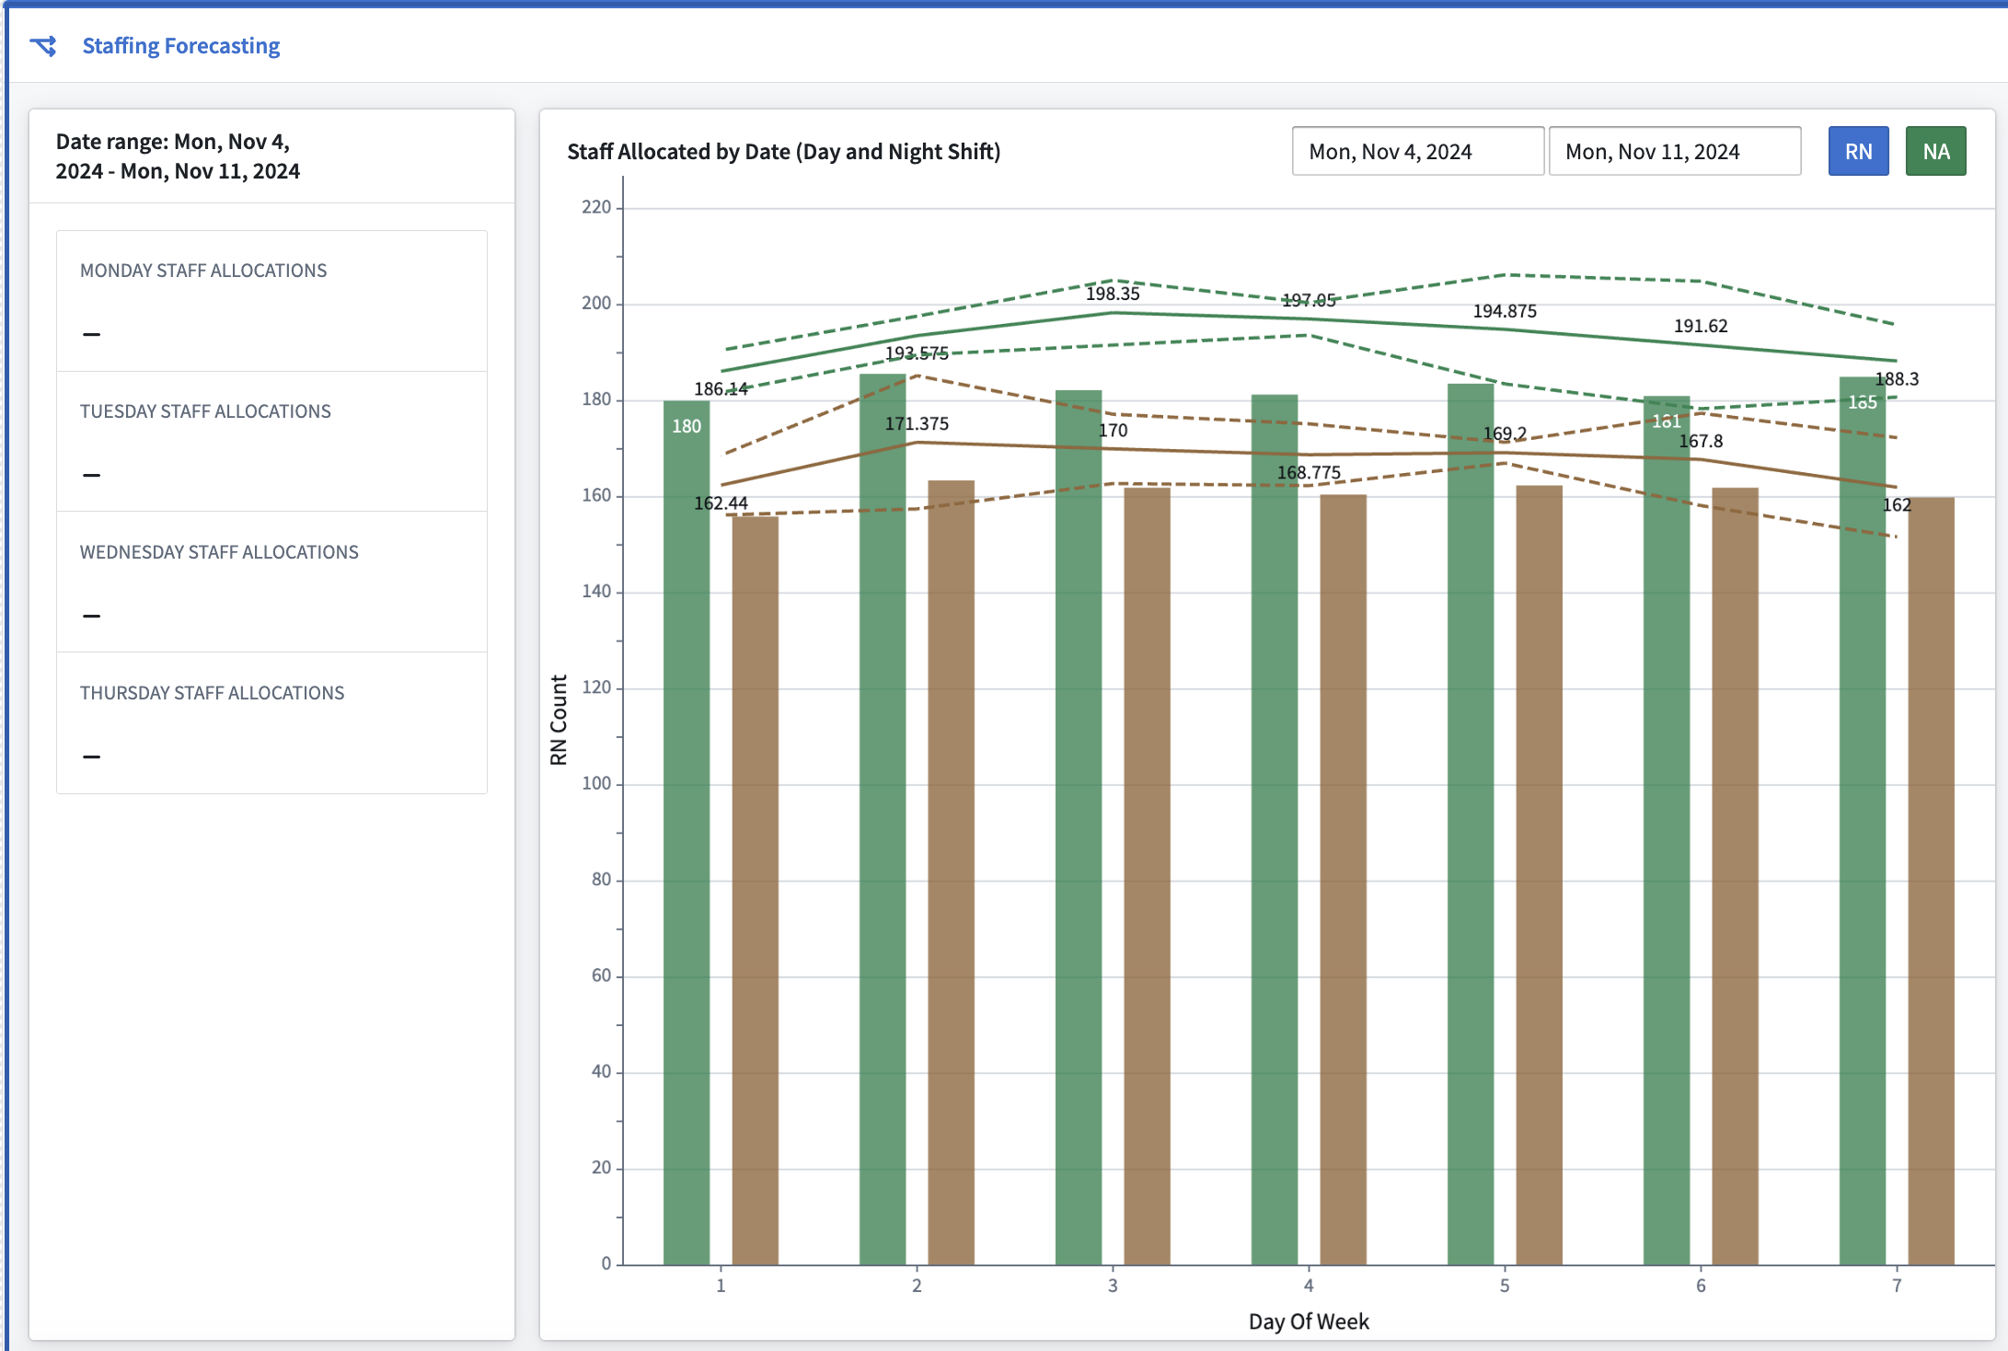
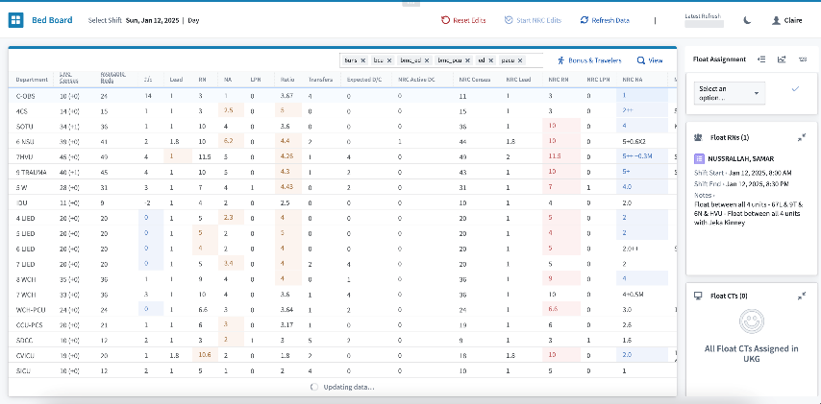
Broadening Staffing Work to Reporting and Forecasting
A few months after launch, we’re working with 100+ hospital staff to leverage live views of census, report on historical staffing allocation, and forecast future staff requirements based on census trends.
Matrix Mastermind
Staffing Reporting
Centralized view of target staffing balance metrics and ratios to replace paper and excel data sources.
Generate staffing reports for federal investigations based on historical Palantir bed board inputs
Staffing Forecasting
Bed Board
Visualize staffing mix for the next month to see gaps and plan score staff to avoid last minute traveler and bonus shift requirements
Source of truth to support decision making on real time census and staffing across inpatient units
Notes:
Build staffing models based on weather, based on
Predict within 1 or 2 patients the number of patients we are discharging
Staffing work

Slide 28
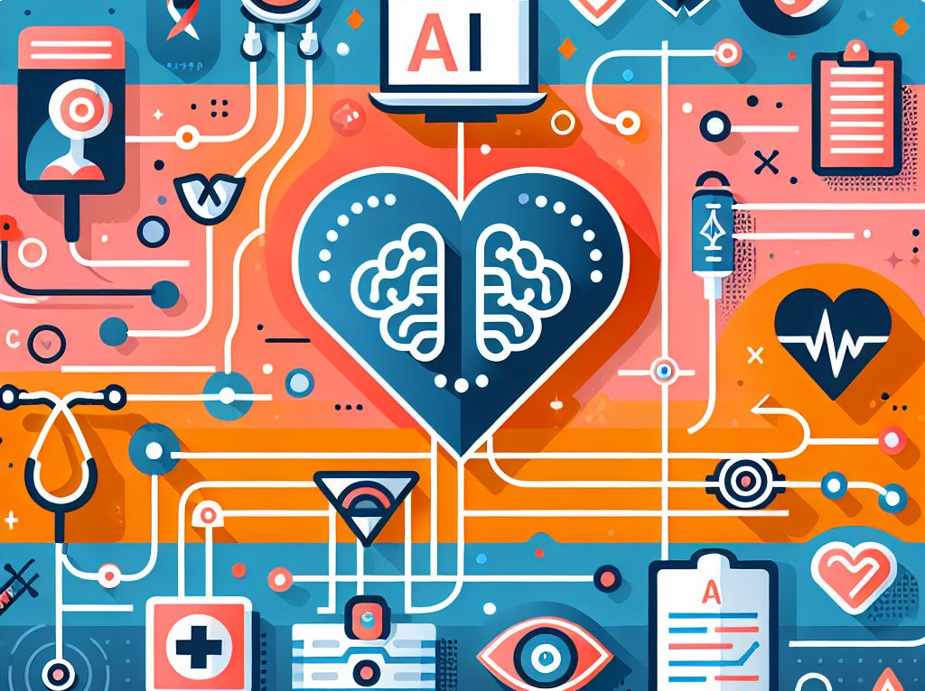
UNMC/NM AI Task Force
List 3 SMART goals for UNMC related to this subcommittee area. Consider FY25 through FY28.
1. Use and adoption of AI/ML/LLMs in clinical documentation, chart review, inbasket, reports, medical inquiry, and patient interactions and follow ups by 50% of medical staff by FY26
2. Use and adoption of AI/ML/LLMs in imaging for triage, diagnostic review, accuracy, explain-ability, workflow enhancement and efficiencies for 50% of reads by FY26
3. Provide dedicated staff to support AI/ML/LLM initiatives, applications, and workflows before implementing these technologies.
4. Collaboration/crossover with research is an imperative for clinical care.

Slide 29
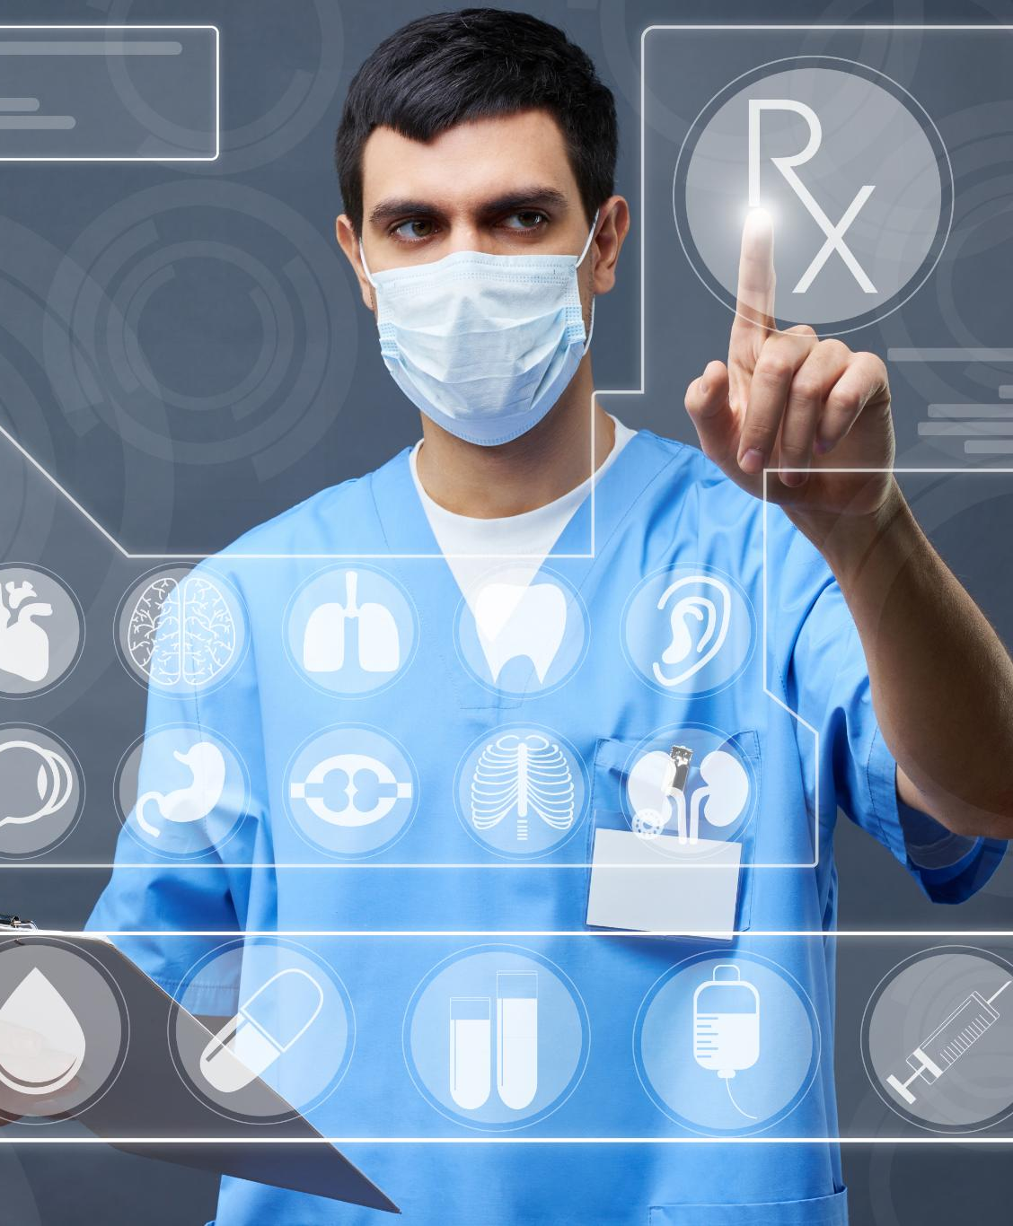
Conclusion
AI in Healthcare
AI is transforming the healthcare industry and improving patient outcomes through LLMs, predictive analytics, and ambient note generation.
Accurate Diagnoses
AI is helping clinicians make more accurate diagnoses and improve treatment outcomes.
Reduced Documentation Burden
AI is helping reduce the burden of documentation for clinicians, allowing them to spend more time delivering care.
Increased Operational Efficiency
Use of data integration, management, and analysis, streamlining data analysis for predictive analytics to improve workflows, processes, and outcomes
Notes:
AI is transforming the healthcare industry and improving patient outcomes. Through LLMs, predictive analytics, and ambient note generation, clinicians can make more accurate diagnoses, improve treatment outcomes, and reduce the burden of documentation. The tools we discussed, including Microsoft Copilot, Nuance DAX, and Palantir Foundry, are helping make these AI applications possible.

Slide 30
CEU Questions
Enhance Diagnostic Accuracy and Speed:
Explain how AI can assist healthcare professionals in documentation, diagnosing diseases more accurately and quickly by analyzing medical images, patient data, and genetic information.
Improve Patient Outcomes and Personalization:
Explain how AI can tailor treatment plans to individual patients by predicting responses to different therapies, monitoring patient progress, and providing personalized recommendations.
Optimize Healthcare Operations and Efficiency:
Highlight how AI can streamline administrative tasks, manage hospital resources, and reduce operational costs, allowing healthcare providers to focus more on patient care.

