Slide 1

Age-Friendly Health Systems
nebraskahospitals.org
Session 3

Slide 2
Objectives
Discuss and understand what an Age-Friendly Health System is, its goals, and why it is important
Review the 4Ms of Age-Friendly and how they affect the elderly patient
  Medication
  Mentation
  Mobility
  What Matters
Outline of the Age-Friendly process within various health settings
  How to join
  Timeline
  Recognition

Slide 3

Age-Friendly Partners
Age-Friendly Health Systems is an initiative of The John A. Hartford Foundation and the Institute for Healthcare Improvement (IHI) in partnership with the American Hospital Association (AHA) and the Catholic Health Association of the United States (CHA)

Slide 4

What is Age-Friendly?
“Age-Friendly” describes environments that promote access to options, services and opportunities for people as they age, and that promote the inclusion and participation of older adults in all aspects of life (Age Friendly Institute, 2023).
Age Friendly Health Systems use evidence-based measures to provide high-quality patient care and align with the specific health outcomes for the elderly patient.

Slide 5
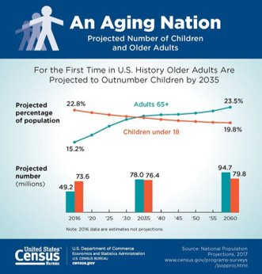
Why Age-Friendly is Important
According to the US Census Bureau, the US population aged 65+ is expected to almost double over the next 30 years to an estimated 83.7 million people by the year

Slide 6
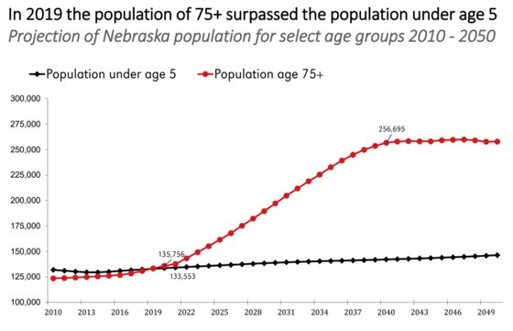
What Age-Friendly is Important - Nebraska
The State of Nebraska is no different as our 75+ year old population is expected to eclipse 250,000 prior to the year 2040, far surpassing the populations of those under the age of 5

Slide 7

Goals of an Age-Friendly Health System
The Aim of the Age-Friendly Health System is to:
  Guide by an essential set of evidence-based practices (4Ms)
  Cause no harms
  Align What Matters to the older adult and their family

Slide 8
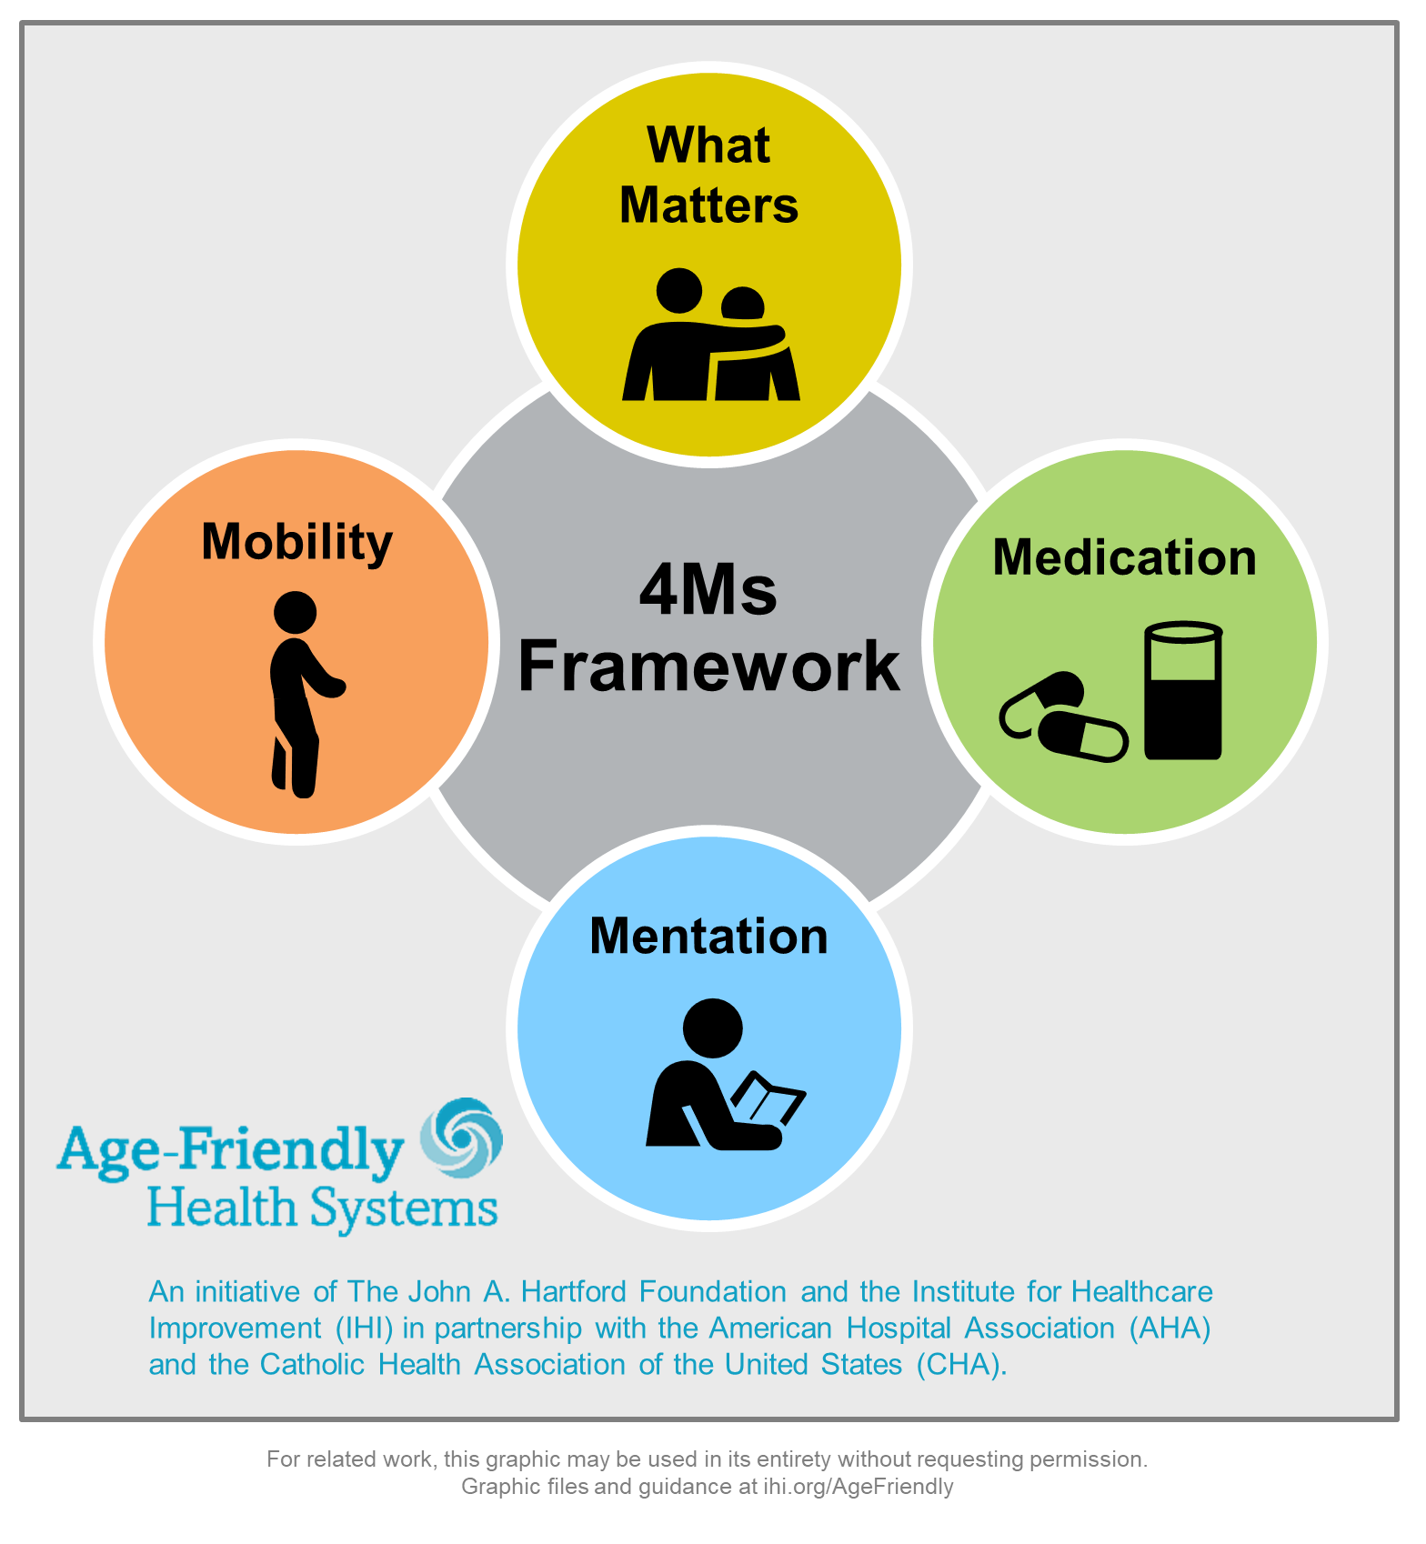
The 4Ms of Age-Friendly
Age-Friendly Health Systems break down the core care into four main areas:
  What Matters
  Medication
  Mentation
  Mobility
These represent core health issues for older adults
They are built on strong evidence base
The process simplifies and reduces implementation and measurement burden on systems while increasing effect
All the core elements are synergistic and reinforce one another
The goal with this process is to progress and implement through out each community.

Slide 9
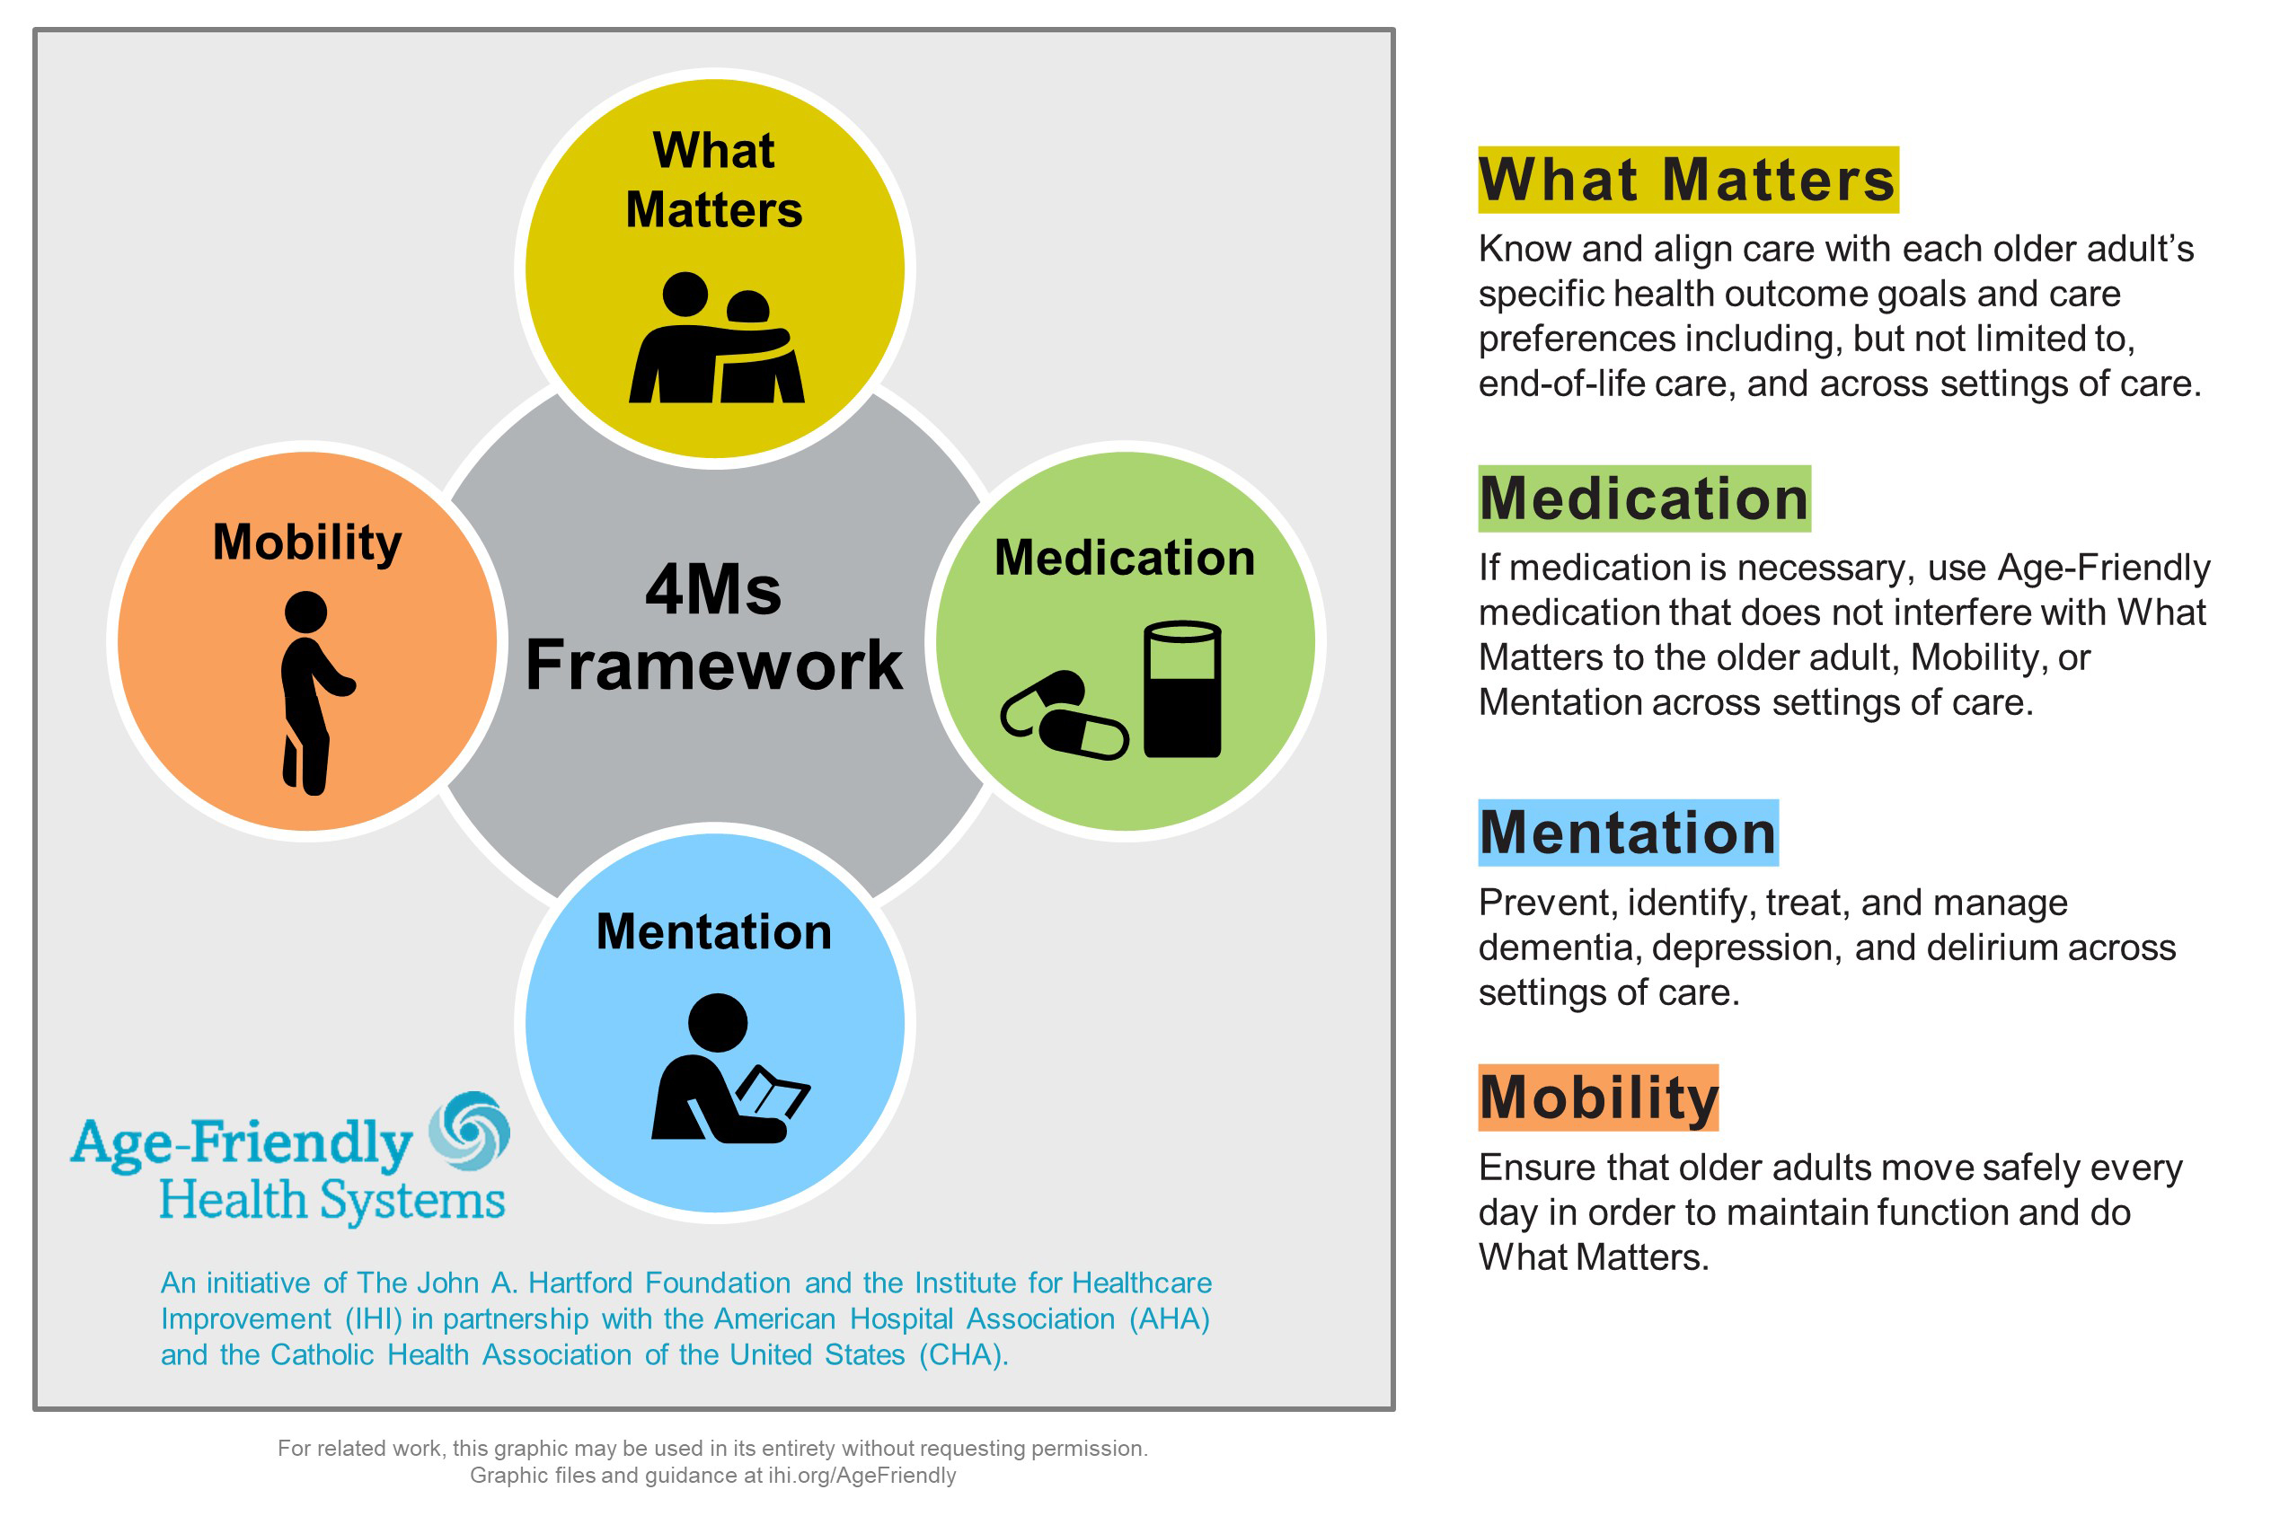
The 4Ms of Age-Friendly

Slide 10

What Matters
Know and align care with each older adult’s specific health outcome goals and care preferences.
What matters involves a wide-array of questions, including but not limited to specific health outcomes, crossing settings of care, end-of-life, financial implications, religious considerations, race, gender, ethnics health out come goals, and health preferences.
Example questions include:
  What Matters most to you for this visit? ​
  What outcome are you most hoping for? ​
  What concerns you most when you think about your health today? ​
  What concerns do you have about your health as you think about the future? ​
  What is something important for us to know about you? What would make tomorrow a good day?​

Slide 11

Mentation
Delirium | Dementia | Depression​
Delirium occurs in up to:​
  25% of Medical Inpatients​
  50% of Surgery Patients​
  75% of Intensive Care Patients, 90% in Dementia​
Delirium & Dementia can lead to long-term function, cognition, and social impairments. Delirium can result in long-term care. ​
  Delirium costs over $152 billion a year​
  Depression occurs in 1/10 in and is under-diagnosed​
  Average hours for caregiving post-hospitalization = 50 hours a week​

Slide 12

Medication
Understanding “What Matters” to the patient​
Partner with patients to co-develop in a shared decision-making approach and a personalized medication treatment plan.​
Ensure safety, quality, and better outcomes​
Ensure access to medications – focus on cost and availability​
Communicate with other healthcare professionals​
Provide appropriate monitoring and coordinate care appropriately

Slide 13

Mobility
Patients spend 95% of time in the bed or chair
Decrease muscle mass and strength → decondition → most common cause of delay in discharge
Decrease ADLs and increased SNF admission adjusting for illness severity
Linked to pressure ulcers, delirium, decreased function and mobility, increased length of stay, early readmission

Slide 14
Why the 4Ms are Important
What Matters:​
  Asking what matters and developing an integrated systems to address it lowers inpatient utilization (54% decrease), ICU stays (80% decrease), while increasing hospice use (47.2%) and patient satisfaction (AHRQ 2013)​
Medications:​
  Older adults suffering an adverse drug event have higher rates of morbidity, hospital admission and costs (Field 2005)​
  1500 hospitals in HEN 2.0 reduced 15,611 adverse drug events saving $78m across 34 states (HRET 2017)​
Mentation: ​
  Depression in ambulatory care doubles cost of care across the board (Unutzer 2009)​
  16:1 ROI on delirium detection and treatment programs (Rubin 2013)​
Mobility: ​
  Older adults who sustain a serious fall-related injury required an additional $13,316 in hospital operating cost and had an increased LOS of 6.3 days compared to controls (Wong 2011)​
  30+% reduction in direct, indirect, and total hospital costs among patients who receive care to improve mobility (Klein 2015)

Slide 15

Nebraska Outcomes
Decreased Adverse Drug Events to less than 0.2%, preventing over 750 extra patient days, saving over $750,000, and preventing over five hundred ADE’s.
Decrease Readmissions to 4.6% for Age-Friendly Facilities. This has saved hospitals over $1.2 million and prevented over seventy-five readmissions, saving patients over one hundred hospital days.

Slide 16
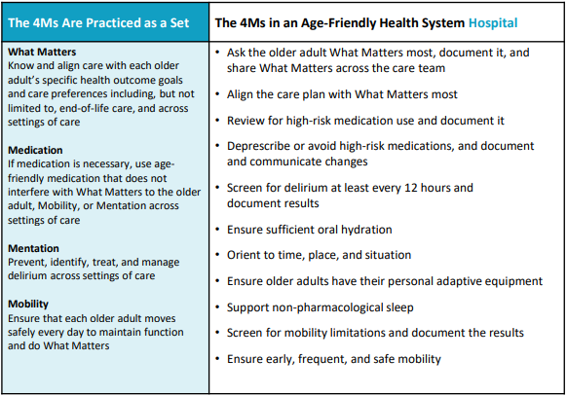
4Ms in the Hospital Setting in Action

Slide 17
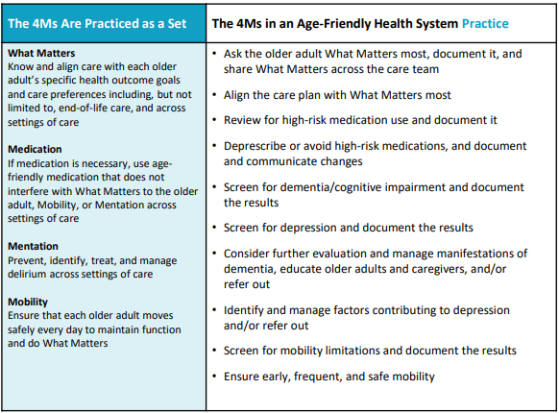
4Ms in the Ambulatory Setting in Action

Slide 18
How Age-Friendly is Implemented
Health care entities can become Age-Friendly certified by either completing the process on their own or using action community
Action Communities enable teams to accelerate reliable practice of the 4Ms in an active community of learners and testers. This 7-month journey to Recognition provides a structure for learning with and from other health systems and expert faculty. Over the course of the Action Community, teams participate in webinars and attend an in-person meeting (when possible) and develop their plan for practicing the 4Ms. ​If your health system or practice is interested in the Action Community,​​ see the upcoming opportunities below.
  The NHA is a facilitator of these action communities, not only using the IHI pathway, but adding supplemental assistance and educational opportunities for all involved.

Slide 19
How Age-Friendly is Implemented
7 Months
Participate in monthly interactive webinars
Monthly content calls focused on 4Ms
Opportunity to share progress and learnings with other teams
Test Age-Friendly Interventions
Test specific changes in your practice using the Guide to Using the 4Ms in the Care of Older Adults
Join monthly peer-to-peer topical learning calls
Join other teams for measurement and testing support in monthly drop-in coaching sessions on various subjects
Leadership track to support system-level scale up
Leaders join monthly C-suite/Board level calls to set-up local conditions for scale up (hosted by IHI)
NHA Age-Friendly Coaching and Support of Community Spread
On-site Consultation/Education
Share Description of 4Ms Care
Submit monthly qualitative feedback on your progress and description of 4Ms Care

Slide 20
Recognition
Facilities who undertake the Age-Friend process can achieve recognition through either level 1 (Participant) or level 2 (Committed to Care Excellence). It’s a distinction based on an evidence-based framework known as the 4Ms.
Level 1 (Participant) teams have successfully developed plans to implement the 4Ms.
Level 2 (Committed to Care Excellence) teams have three months of verified data to demonstrate early impact of using the 4Ms.

Slide 21
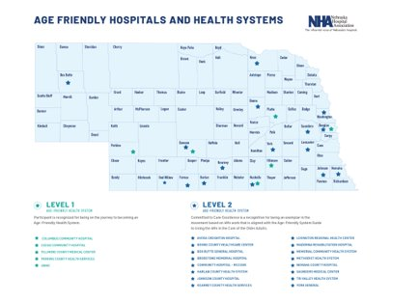
Spreading Age-Friendly
As of June 2024, over 3000 sites of care have earned either level 1 or level 2 distinction. Nationally over 2.8 million lives have been cared fore in an Age-Friendly setting.
The state of Nebraska has successfully implemented the Age-Friendly Health System in over 70+ facilities have participated in Age-Friendly

Slide 22
Why Join Age-Friendly?
Patient Safety
Streamlined implementation
  Many time patient safety initiatives fail due to difficulty to reproduce, may not translate across care settings, or are difficult to disseminate
  The IHI process tries to work within your current processes to coordinate for the most effective elderly patient care.
Return on Investment
Elderly patient care
  81% of older adults would rather go to a hospital that provides age-friendly care than one that does not (John A Hartford Foundation, 2022).
  “I feel like I matter” – Patient at Sharp Healthcare CA USA

Slide 23
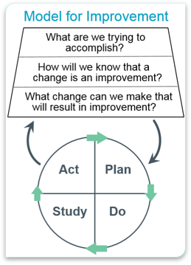
Measuring Success
Know where and how the 4Ms are already in practice and secure leadership support and commitment​
Define what it means to provide care consistent with the 4Ms​
Design/adapt your workflow to deliver care consistent with the 4Ms, including how you will assess, document and act on the 4Ms​
Provide care consistent with the 4Ms​
Study your performance. Measure and share – how reliable is your care? What impact does your care have? Track progress and celebrate successes​
Improve and sustain care consistent with the 4Ms and share learnings with others

Slide 24

Next Steps
Decide to Join
Sign Letter of Intent
Identify Team
Review 4Ms Processes
Complete Description Worksheet
Collect Data ( 3 Months)
Submit Data
Celebrate becoming an Age-Friendly Health System
Begin working with other entities within your community to progress the Age-Friendly health System

Slide 25
Contact Information
Matt Lentz RN, MSN
Quality Consultant
Nebraska Hospital Association
3255 Salt Creek Circle, Suite 100 | Lincoln, NE 68504
(402) 382-8025 (cell)
mlentz@nebraskahospitals.org

Slide 26
References
Age Friendly Institute. (2023). What is age-friendly? Retrieved from: https://www.agefriendly.org/about.
Agency for Healthcare Research and Quality (AHRQ). (2013). System-Integrated Program Coordinates Care for People With
Advanced Illness, Leading to Greater Use of Hospice Services, Lower Utilization and Costs, and High Satisfaction. (n.d.). Retrieved August 9, 2018. from https://innovations.ahrq.gov/profiles/system-integrated-program-coordinates-care-people-advanced-illness-leading-greater-use.
Field, T. S., Gilman, B. H., Subramanian, S., Fuller, J. C., Bates, D. W., & Gurwitz, J. H. (2005). The costs associated with adverse drug events among older adults in the ambulatory setting. Medical Care, 43(12), 1171-1176.
Fulmer, T., & Berman, A. (2016, November 3, 2016). Age-Friendly Health Systems: How Do We Get There? Accessed August 8, 2018, from http://healthaffairs.org/blog/2016/11/03/age-friendly-health-systems-how-do-we-get-there
Health Research & Educational Trust (HRET). (February 2017). Adverse Drug Events Change Package: 2017 Update. Chicago, IL: Health Research & Educational Trust. Accessed August 9, 2018. Retrieved from: www.hret-hiin.org.
Institute for Healthcare Improvement. 2023. Age-friendly health systems. Retrieved from: https://www.ihi.org/Engage/Initiatives/Age-Friendly-Health-Systems/Pages/Join%20the%20Movement.aspx
Klein, K., Mulkey, M., Bena, J. F., & Albert, N. M. (2015). Clinical and psychological effects of early mobilization in patients treated in a neurologic ICU: A comparative study. Critical Care Medicine, 43(4), 865-873.
Mate, K. S., Berman, A., Laderman, M., Kabcenell, A., & Fulmer, T. (2017) Creating Age-friendly health systems: A vision for better care of older adults. Healthcare, 6(1), 4-6. doi: https://doi.org/10.1016/j.hjdsi.2017.05.005
Reuben, D. B., Evertson, L. C., Wenger, N. S., Serrano, K., Chodosh, J., Ercoli, L., & Tan, Z. S. (2013). The University of California at Los Angeles Alzheimer’s and Dementia Care Program for Comprehensive, Coordinated, Patient-Centered Care: Preliminary data. Journal of the American Geriatrics Society, 61(12), 2214-2218.
The State of Aging and Health in America 2013. Atlanta: Centers for Disease Control and Prevention, US Department of Health and Human Services; 2013. https://www.cdc.gov/aging/pdf/State-Aging-Health-in-America-2013.pdf “Fact Sheet: Healthy Aging.” National Council on Aging; 2016. https://www.ncoa.org/resources/fact-sheet-healthy-aging/
Unützer, J., Schoenbaum, M., Katon, W. J., Fan, M. Y., Pincus, H. A., Hogan, D., & Taylor, J. (2009). Healthcare costs associated with depression in medically ill fee-for-service Medicare participants. Journal of the American Geriatrics Society, 57(3), 506-510.
Wong, C. A., Recktenwald, A. J., Jones, M. L., Waterman, B. M., Bollini, M. L., & Dunagan, W. C. (2011). The cost of serious fall-related injuries at three Midwestern hospitals. Joint Commission Journal on Quality and Patient Safety, 37(2), 81-87
John A Hartford Foundation (2022). Age-friendly insights polls: older adults feel good about hospitals but want age friendly care. Retrieved from: https://www.johnahartford.org/dissemination-center/view/age-friendly-insights-poll-older-adults-feel-good-about-hospitals-but-want-age-friendly-care

Slide 27
Telligen: Medicare Beneficiary Quality Improvement Program (MBQIP)
nebraskahospitals.org
Session 3

Slide 28
Transitions of Care in Nebraska
nebraskahospitals.org
Session 3

Slide 29
How it Started…
COVID-19 challenged our health care facilities
Large Health Systems were working at capacity
Critical Access Hospitals were keeping critically ill patients
Post-Acute Settings were faced with strict regulations
Patients awaiting discharge had no placement options
Workforce challenges

Slide 30
How it Started…
Statewide Transitions of Care Council began in January 2022
Met on a quarterly basis
Identified barriers and opportunities for improvement
Moved to monthly meetings due to increased challenges
Monthly throughput data collection survey launched – Sept. 2022

Slide 31
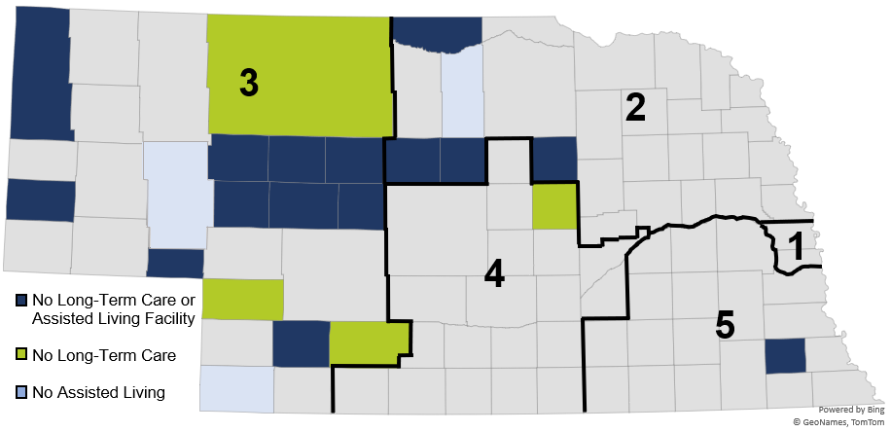
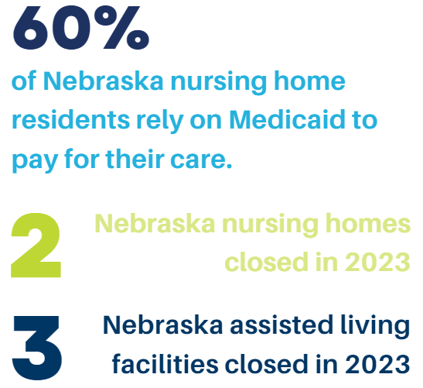
Why this Work is Important…

Slide 32

Building our Team…
Governor Ricketts Task Force
Key Stakeholders
  C-Suite Leaders
  Nurse Leaders
  Quality Leaders
  Social Workers
  Clinic Managers
  Post-Acute Setting Leads
  DHHS NE
  Office of Public Guardianship
  Rural Representatives
  Large System Representatives
  Nebraska Hospital Association

Slide 33
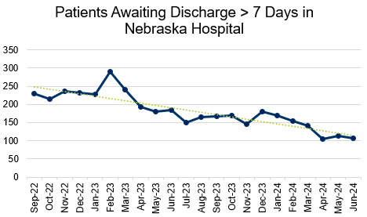
How it’s Going…

Slide 34
Post-Acute Challenges in the Legislature
LB227
Provides a per diem Medicaid reimbursement to a hospital for a Medicaid patient who is eligible for discharge after receiving care but is unable to be transferred to an appropriate nursing facility due to a lack of available nursing facility beds or in cases where the State Court Administrator is unable to appoint a public guardian. The inability for acute care hospitals to discharge patients to skilled nursing facilities or similar long-term care facilities can cause capacity issues for hospitals and have an impact on their care. It is important that patients be placed in the appropriate level of care. Some patients essentially live in hospital rooms receiving one-on-one care and taking up precious bed capacity with no compensation provided to the hospital. Sometimes patients’ stays can exceed 400 days.
The most common barriers include, but are not limited to:
• pending Medicaid;
• lack of a guardian;
• medically complex patients that may include tracheostomy, bariatric, traumatic brain injury, dialysis, or expensive medication; and
• Medicaid Advantage and private insurer claims being denied.

Slide 35
Post-Acute Challenges in the Legislature
LB517
Creates a pilot program that provides financial incentives to post-acute facilities to accept patients with complex health needs when hospitals are at or near capacity. The goal is for patients with complex health needs to access timely transition from an acute care hospital to a post-acute care setting so that patients receive the appropriate type of care. The pilot program will develop a process to direct payments to post-acute care facilities that support care to patients with complex health needs. The bill will appropriate $1 million to this program
LB434
Long-term acute care hospitals (LTACHs) are facilities that specialize in the treatment of patients with serious medical conditions that require care on an ongoing basis but no longer require intensive care or extensive diagnostic procedures. These patients are typically discharged from the intensive care units and require more care than they can receive in a rehabilitation center, skilled nursing facility, or at home. Without this care available in Medicaid, patients receive rehabilitation services in acute care hospitals that are not designed to meet their specialized rehabilitation needs. This also takes additional resources away from acute care hospital capacity. Ensuring that LTACHs receive Medicaid funding would allow for more long-term acute care patients to be transferred to the appropriate level of care, freeing up precious bed capacity in hospitals.
Notes:
434 July 1, 2024

Slide 36
Post-Acute Challenges in the Legislature
LB219
Directs the DHHS to rebase inpatient interim per diem rates for critical access hospitals. The department shall rebase the rates using the most recent audited Medicare cost report on an annual basis within ninety days of receiving the cost report. Critical Access Hospitals get paid a per diem rate shortly after providing patient care, which in Nebraska currently covers about 50-60% of the costs of this care. The Critical Access Hospitals then wait 18-24 months to receive the full payment from Medicaid. LB 219 would rebase the initial per diem rate to ensure Nebraska’s Critical Access Hospitals can cover more of the costs of providing this care at the time the service is provided. There are 63 Critical Access Hospitals in Nebraska and more than half report that they have been operating with a negative margin for the past several years.

Slide 37
Key Improvements…
Data Collection and Distribution
Guardianship Efforts
Medicaid Education, Support, and Toolkits
Case Management Calls
Omnibus Health Services Package
Travel Positions Decline
Preceptor Academy Partnership
Invaluable Partnerships

Slide 38
Improvement Opportunities…
Community Collaboration
Early Discussions on Medicaid and Financial Needs
Advanced Care Planning and Advanced Directive Discussions
Crucial Partnerships Across the Care Continuum
Bed Capacity Platform
Education – Education - Education

Slide 39
Pitfalls of Medicare Advantage Plans
MA plans now cover 51% of all Medicare eligible individuals
Nearly 1/3 of Nebraska Hospitals refuse to contract with certain MA plans
Prior authorization requirements delay necessary care

Slide 40
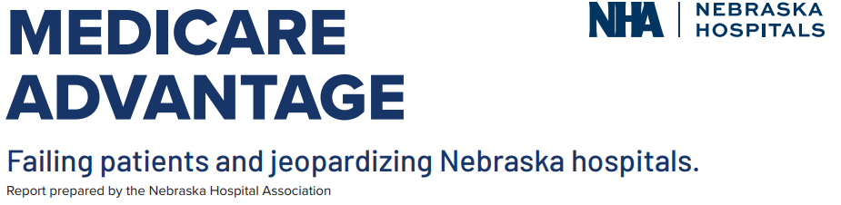
Recent NHA Report…

Slide 41
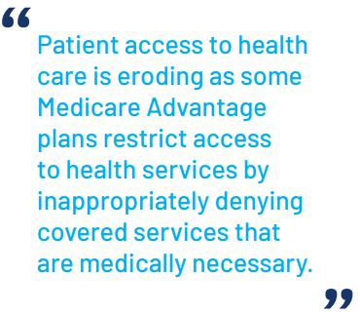
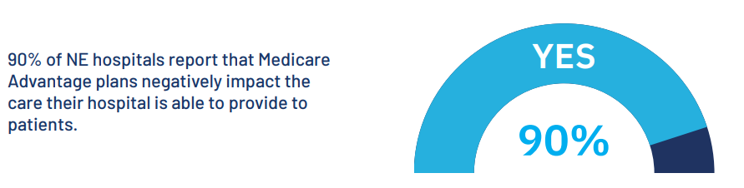
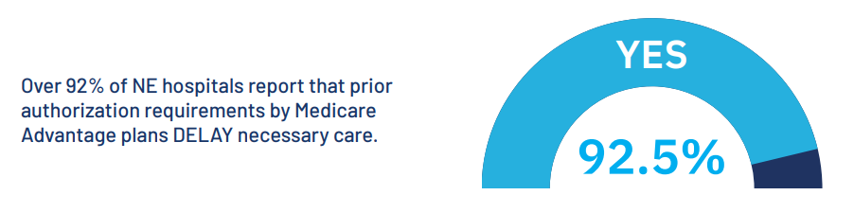
Recent NHA Report…

Slide 42
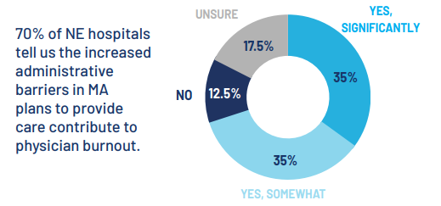
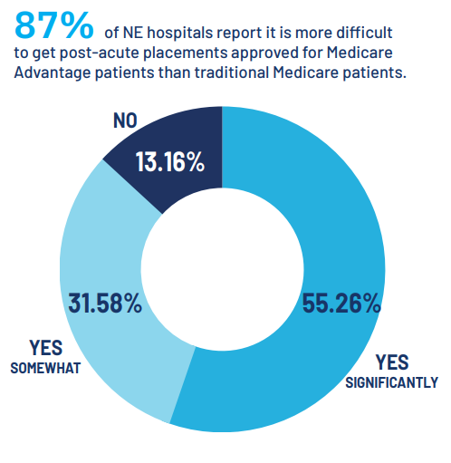
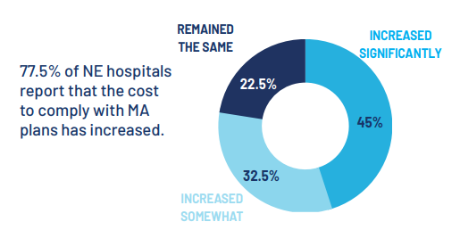
Recent NHA Report…

Slide 43
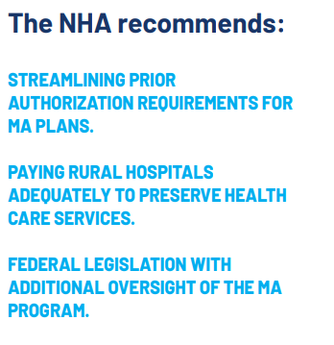
Biggest Challenges with MA Plans
Poor patient education
Prior authorization requirements
Lower reimbursement
Results in…
Restricting necessary care
Post-acute placement delays
Administrative burden
Negative financial impact

Slide 44
What’s Next…
LB517 Medically Complex Patient Pilot Project
$1 Million to use by June 30, 2025
Received 32 Request for Proposals
7 projects awarded to 6 organizations
Projects initiating this year
Support placement of complex patients

Slide 45
LB227 Recipients
CHI Plainview | Bariatric
Cozad Community Health System | Bariatric
Douglas County Health Center | Dialysis and Bariatric
Emerald Nursing and Rehab, Columbus | Bariatric
Florence Home | Total ADLs
The Ambassador Lincoln | Dialysis

Slide 46
Health Equity in
Health Care
nebraskahospitals.org
Session 3

Slide 47
Defining Health Equity
Attaining the highest level of health for all people, where everyone has a fair and just opportunity to attain their optimal health regardless of race, ethnicity, disability, sexual orientation, gender identity, socioeconomic status, geography, preferred language or other factors
Needs in Nebraska
  Rurality → Access to Care
  Elderly → 65+
  Disabled → Vulnerable Populations
  Low-Income → Medicaid Population
  Diverse communities

Slide 48
CMS Health Equity Framework
Priority 1:
  Expand the collection, reporting, and analysis of standardized data
Priority 2:
  Assess causes of disparities within CMS programs, and address inequities in policies and operations to close gaps
Priority 3:
  Build capacity of health care organizations and the workforce to reduce health and health care disparities
Priority 4:
  Advance language access, health literacy, and the provision of culturally tailored services
Priority 5:
  Increase all forms of accessibility to health care services and coverage

Slide 49
CMS’s New Health Equity Measures
  CMS’s IPPS Final Rule for CY2023
  Hospital Commitment to Health Equity
    Broken down into 5 domains
    Each domain is worth 1 point for a total of 5 possible points
    Must affirmatively attest to ALL of the elements within that domain
    Scores for this measure will be publicly reported

Slide 50
Domain 1
Equity is a Strategic Priority
Your hospital has a strategic plan for advancing health care equity
Domain 2
Data Collection
Your hospital is actively engaged in 3 key data collection activities:
Domain 3
Data Analysis
Your hospital is stratifying key performance indicators by demographic and/or SDOH variables to identify equity gaps and including this information on hospital performance dashboards
Identifies priority populations who currently experience health disparities
Establishes health care equity goals and discrete action steps to achieving those goals
Outlines specific resources which have been dedicated to achieving your equity goals
Describes your approach for engaging key stakeholders, such as community partners
Collecting demographic information, including self-reported race and ethnicity and/or social determinant of health (SDOH) information on the majority of your patients
Training staff in culturally sensitive collection of demographic and/or SDOH information
Inputting demographic and/or SDOH information collected from patients into structured, interoperable data elements using a certified EHR technology
Domain 4
Quality Improvement
Your hospital participates in local, regional, or national quality improvement activities focused on reducing health care disparities
Domain 5
Leadership Engagement
Your senior leadership, including your chief executives and your entire hospital board of trustees, demonstrates a commitment to equity through 2 activities:
Annual reviews your strategic plan for achieving health equity
Annual reviews of key performance indicators stratified by demographic and/or social factors

Slide 51
Screening for Social Drivers of Health
  Numerator:
    Number of patients admitted to an inpatient hospital stay who are 18 years or older on the date of admission and are screened for one or all of the following five HRSNs.
  Denominator:
    Number of patients who are admitted to a hospital inpatient stay and who are 18 years or older on the date of admission
  Exclusions:
    Patients who opt-out of screening
    Patients who are themselves unable to complete the screening during their inpatient stay and have no legal guardian or caregiver able to do so on the patient’s behalf during their inpatient stay

Slide 52
Screen Positive Rate for Social Drivers of Health
  Numerator:
    Number of patients admitted to an inpatient hospital stay who are 18 years or older on the date of admission who are screened for an HRSN, and who screen positive for having a need in one or more of the five HRSNs.
  Denominator:
    Number of patients admitted for an inpatient hospital stay who are 18 years or older on the date of admission and are screened for an HRSN.
  Exclusions:
    Patients who opt-out of screening
    Patients who are themselves unable to complete the screening during their inpatient stay and have no legal guardian or caregiver able to do so on the patient’s behalf during their inpatient stay

Slide 53
The 5 Domains of SDOH Screening
  Food Insecurity
    Food insecurity is defined as limited or uncertain access to adequate quality and quantity of food at the household level
  Housing Instability
    Housing instability encompasses multiple conditions ranging from the inability to pay rent or mortgage, frequent changes in residence including temporary stays with friends and relatives, living in crowded conditions, and actual lack of sheltered housing in which an individual does not have a personal residence
  Transportation Needs
    Unmet transportation needs include limitations that impede transportation to destinations required for all aspects of daily living

Slide 54
The 5 Domains of SDOH Screening
  Utility Difficulties
    Inconsistent availability of electricity, water, oil, and gas services is directly associated with housing instability and food insecurity
  Interpersonal Safety
    Assessment for this domain includes screening for exposure to intimate partner violence, child abuse, and elder abuse
  Required for PPS hospitals, voluntary for CAHs participating in IQR Program
  SDOH Screening is a piece of the Medicaid Provider Assessment and is required for all Nebraska Hospitals

Slide 55
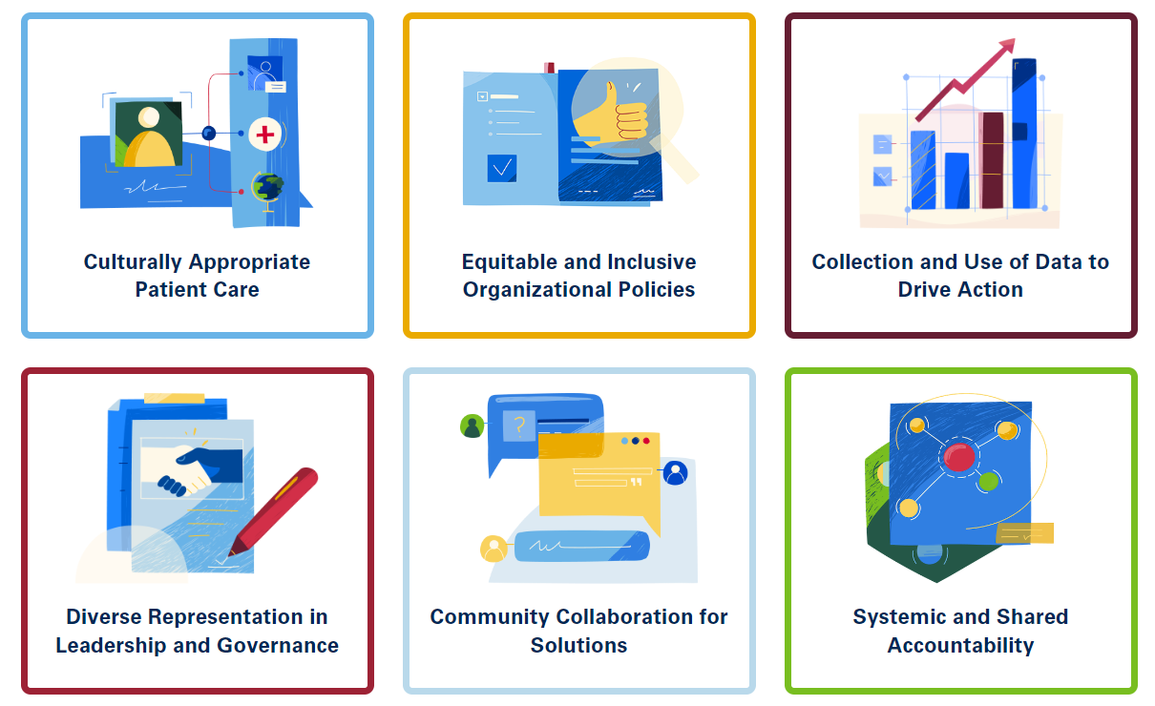
AHA Health Equity Roadmap

Slide 56
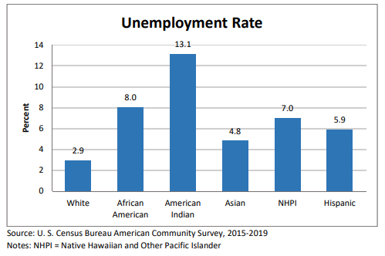
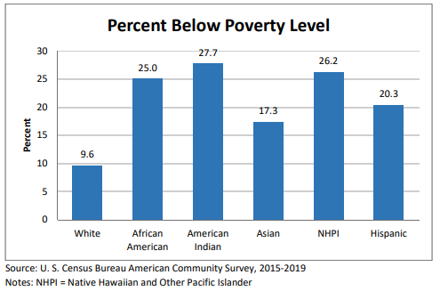
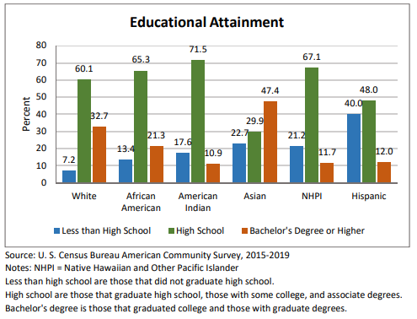
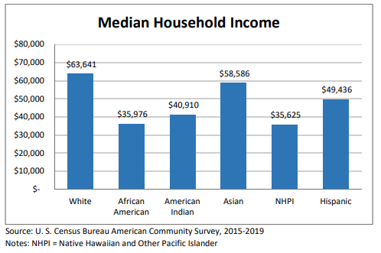
Data in Nebraska
Nebraska Social Determinants of Health Report Card

Slide 57
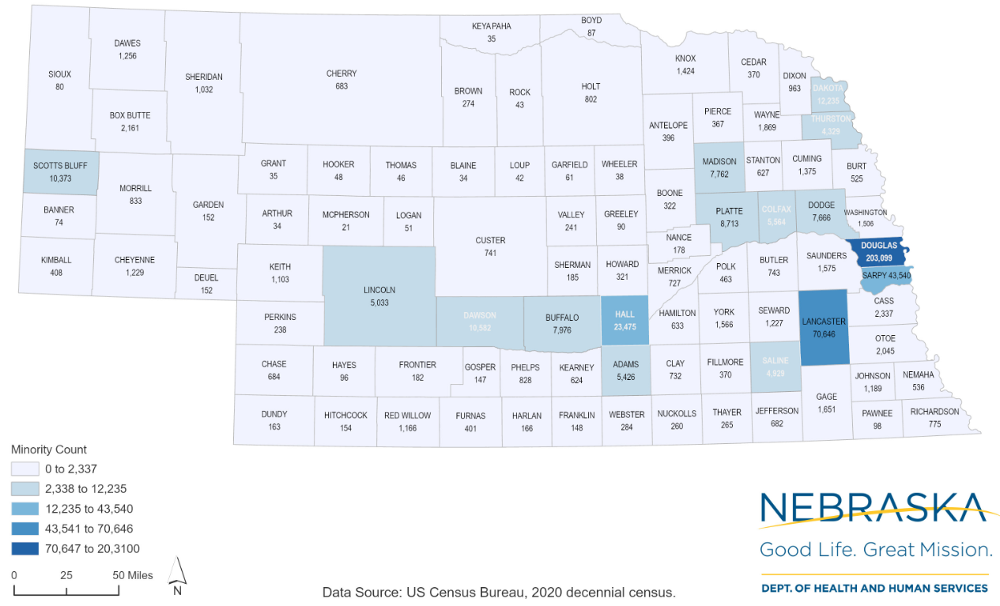
Data in Nebraska
Minority Population by County, Nebraska 2020

Slide 58
Save the Date!

Slide 59
REaL Data
nebraskahospitals.org
Session 3

Slide 60
What is REaL Data?
Race, Ethnicity and Language (REaL) data allows hospital and health systems the ability to:
Capture information on a patient’s race, ethnicity and language preferences
Understand clinically relevant and unique aspects of their patient and communities
Apply culturally competent care that that does not vary with a patient’s race, ethnicity or language (AHA,2024)

Slide 61
Why Collect REaL Data?
Quality Implications: Hospitals that understand their patient populations and work to make quality improvements across individual patient groups will improve their overall performance
Financial implications: Disparities may increase the cost of care provided to patients
Elimination of disparities: It is the just and equitable thing to do (AHA,2024)

Slide 62
REal Data Reports
Real Data information can be pulled within most Electronic Health Records either through reports or dashboards
NHA also reports out REaL Data in the quarterly CDS Scorecards
  NHA tracks and trends to increase compliance within reporting
  Education is provided as need to facilities
  NHA is also collecting and reporting out on the documentation of patient age

Slide 63
Real Data Barriers
To best address and identify areas of health care disparity, REaL (Race, Ethnicity, and Language) and Age Data have proven to be increasingly important for all hospitals. Health care leaders have noted significant barriers to collecting this data such as :
  Electronic Health Records systems
  Data collection
  Staff training

Slide 64
How to Improve REaL Data Collection
Metric | Assess | Interventions
Electronic Health Record | Do we currently collect SDOH/REaL/Age data within the EHR? Where do we document SDOH/REaL/Agedata within the system? -What is the complexity to find the SDOH/REaL/Agedata assessment? Are any aspects of SDOH/REaL/Age data a hard stop (required) data point? Does our EHR allow for adequate data collection (ex. Are we missing applicable ethnicities that we serve)? | Require hard stops on all SDOH/REaL/AgeData requirements Have SDOH/REaL/AgeData requirements easily found/and documentable within the system

Slide 65
How to Improve REaL Data Collection
Metric | Assess | Interventions
Staff Training/Education | Does our staff understand why we collect SDOH/REaL/Age data? Does our staff understand the definitions of ethnicity, race, and nationality? What concerns does our staff have with asking these questions? How do we fix these concerns? Does your staff understand which SDOH measures are screened, and why? | Provide education and training to all staff We Care Campaign RJW Consider Scripting Role play and script training Provide follow-up education (quarterly and as needed). Consider education at pre-set facility meetings (Nursing, Managers, Quality, etc.)

Slide 66
How to Improve REaL Data Collection
Metric | Assess | Interventions
Data Collect Process | Who is collecting this data? What do we do after hours? | Set standard person(s) to collect data Consider Scripting

Slide 67
How to Improve REaL Data Collection
Metric | Assess | Interventions
Data Review Process | Are we review our data? What is our follow up process with individuals? | Use NHA generated quarterly scorecards Use EHR generated SDOH/REaL/Agedata reports Make data review a standing agenda item in applicable meetings (quality)

Slide 68
Sample Scripting
Metric | Question suggestion
Conversation Starters | I’m going to ask you some questions about your background. We ask these questions so we can provide the best care to every patient.”
Language | “In what language would you prefer to communicate with the medical team?”
Race | “Is there a racial group you identify with?”
Ethnicity | “What ethnic background do you identify with?” If they don’t understand ask, “Where is your family from?”*
Hispanic | “Do you identify as Hispanic or Latino?”

Slide 69
Excel Basics
nebraskahospitals.org
Session 3

Slide 70
Excel Questions
Who uses Excel daily?
How do you use Excel?
Who is comfortable with Excel?
How would you explain what Excel is to a brand new user?

Slide 71

What is Excel
Microsoft Excel is a program in the Office 365 suite typically used to store, sort, and manipulate data. Although Excel is not a database, it is often used in data analytics and finance careers to assess large amounts of information and create visualizations (forage.com, 2024)
In other words, a fancy organization machine that can do a lot of stuff quickly

Slide 72
What is Excel
Financial vs Data Entry vs Data Organization
  Financial Spread Sheet
  Data Organization
  Formula Computer
With each aspect, it organizing based on patterns and trends
It acts on commands inputted by you
  Meaning- if a formula does not work, almost always it is the end user not the program

Slide 73
How Excel Works
Excel uses a large collection of cells formatted to organize and manipulate data and solve mathematical functions. Users can arrange data in the spreadsheet using graphing tools, pivot tables and formulas. The spreadsheet application also has a macro programming language called Visual Basic for Applications (techtarget, 2024)
  Examples of functions:
    SUM, SUMIF, COUNT, MAX and a lot more
  Graphs
    Line, Bar, Pie etc.

Slide 74
Excel Basics
Microsoft Website:
  https://support.microsoft.com/en-us/office/basic-tasks-in-excel-dc775dd1-fa52-430f-9c3c-d998d1735fca

Slide 75

How Excel Works
Go to the NHA Download Center
  Sample Data (Excel File)
    Three Tabs:
      ADE,
      Falls
      Readmissions
    This is fake data randomly generated
    Pick one hospital and one measure. How would you show this if you needed to present this at a board meeting?

Slide 76
Excel Tips
Basic How-To’s:
  https://support.microsoft.com/en-us/office/basic-tasks-in-excel-dc775dd1-fa52-430f-9c3c-d998d1735fca
Excel Quick Keys:
  https://support.microsoft.com/en-us/office/keyboard-shortcuts-in-excel-1798d9d5-842a-42b8-9c99-9b7213f0040f
Formula’s Overview:
  https://support.microsoft.com/en-us/office/overview-of-formulas-in-excel-ecfdc708-9162-49e8-b993-c311f47ca173

Slide 77
Data Collection Processes
nebraskahospitals.org
Session 3

Slide 78
Data Collection:
What is Data Collection?
A systematic process of gathering, measuring, and recording information or observations for the purpose of research, analysis, or decision-making.
Why is Data Collection Important?
Generates accurate and reliable information to form the foundation of evidence-based decision-making.
Provides the raw material necessary for conducting thorough analyses, identifying patterns, trends, and relationships, and deriving meaningful insights
Key Elements to Data Collection?
Basis for sound decision-making
Identifies trends and patterns
Facilitates performance evaluation
Enables monitoring and evaluation
What is Data’s Role?
Identification and definition of a problem and creation of a goal
Identification of information gaps
Enable trending and forecasting
Enhance performance measurement and evaluation

Slide 79
Key to Reliable and Valid Data Collection:
Reliability and validity are criteria by which we assess measurement quality.
Reliability relates to the consistency of measures, and validity addresses whether the measurements are quantifying the correct attribute.
Reliability
Consistency of the measure.
High reliability = measurement system produces similar results under the same conditions.
  i.e. If you measure the same item multiple times, you want to obtain comparable values.
  If you take measurements multiple times and obtain very different values, your data are unreliable.
  i.e. Patient days average 102 days per month – but over 6 months the number has jumped from 40 to 299
Validity
Does measurements reflect what it is supposed to measure.
A broader concept than reliability…Researchers need to consider whether they’re measuring what they think they’re measuring
i.e. quietness around your room at night – are they measuring noise – or – sleep interruptions?
Inconsistency hampers your ability to draw conclusions and understand relationships.

Slide 80
Is your Data Valuable?
Analyze your raw data
Confirm a hypothesis
Determine needed change
Identify a theory
  What do you want to prove or disprove?
Collect data
  Use your resources
Define the purpose of your story
  Write and develop your goals
Ask questions
  Use data that supports and doesn’t support your hypothesis

Slide 81
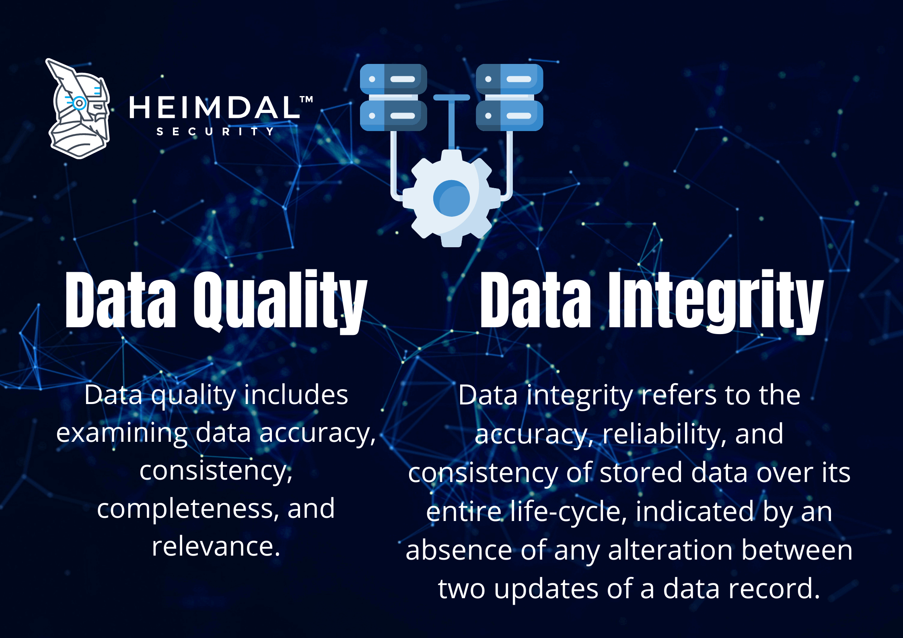
Is your Data Reliable?
Is your data trustworthy and consistent?
Can you produce the same results under the same conditions over time?
Crucial for data-driven improvement projects
Data integrity can drive buy-in and successful outcomes
Factors that influence reliability
Credible data source
Comprehensive coverage
Data collection methods
Data integrity
Time sensitivity
Consistency and repeatability
Data cleaning and preprocessing
Standardized metrics
Error management
Data is only as good as it’s source!

Slide 82
Data to Define a Problem and Set a Goal
What does this data tell us?
What would your next steps be if this was your internal data?
What would your problem statement be?
What would you goal or AIM Statement be?

Slide 83
Data to Define a Problem and Set a Goal
What does this data tell us?
What would your next steps be if this was your internal data?
Has your problem statement changed?
Did you meet your goal or AIM Statement?

Slide 84
Data Visualization
Tell a Story
nebraskahospitals.org
Session 3

Slide 85
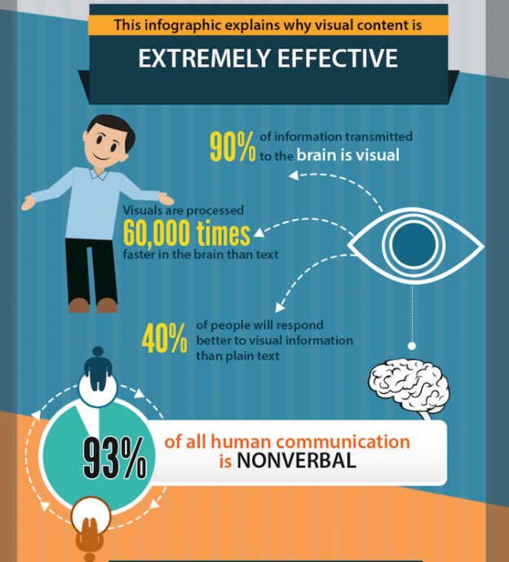
The Benefits of Data Storytelling
Add value to your data and insights
Interpret complex information
Highlight essential key points for the specific audience
Provide a human touch to your data
Offer value to your audience and health care leaders
Build credibility on your topics
Be a thought leader

Slide 86







How to Tell a Great Data Story
Determine what question you want answered
Make sure that the problem the organization needs to solve is clearly articulated
Determine what data is needed to answer the question
If your organization employs data scientists or analysts, take advantage of their expertise and knowledge
Identify your data sources
As discussed, stories needn’t be limited to internal data
Determine your visualization options
Present data in customizable charts. The key is to work with the person who will be writing the narrative so the visuals support the story
Construct the narrative
Once you’ve collected the data and put together some useful charts, adding a creative written or spoken narrative is the final step in creating your data story

Slide 87

Use Data Visualization to Enhance Data
Reveal patterns, trends, and findings from an unbiased viewpoint
Provide context
Interpret results
Articulate insights
Streamline data
Improve audience engagement

Slide 88
3 Key Elements of Data Storytelling
Build your narrative
  Think about your mission, vision, values
  Connect data to a patient story
Use visuals to enlighten
  Which chart/graph best demonstrates the information
  Choose a variety of formats
Show data to support
  Use tools/resources available
    Excel
    Tableau
    Dashboards
    3rd party vendors

Slide 89
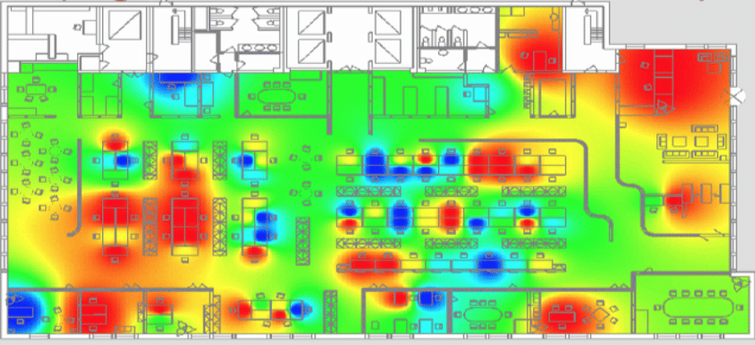
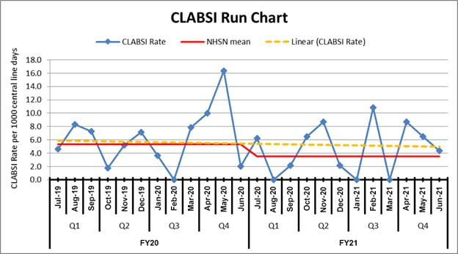
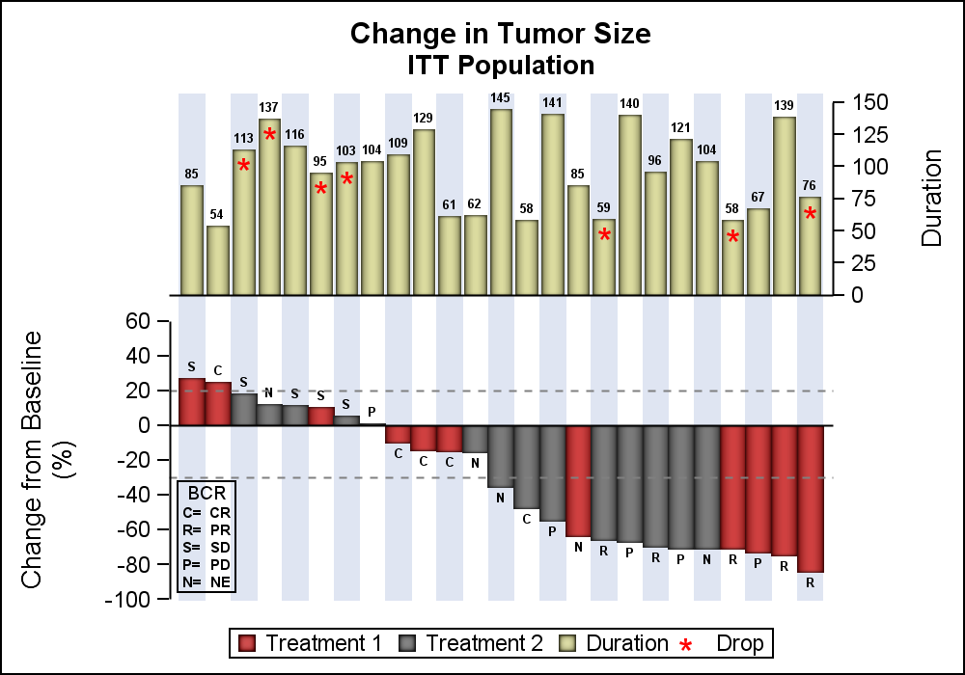
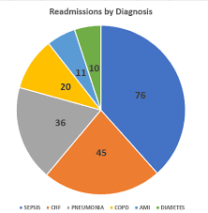
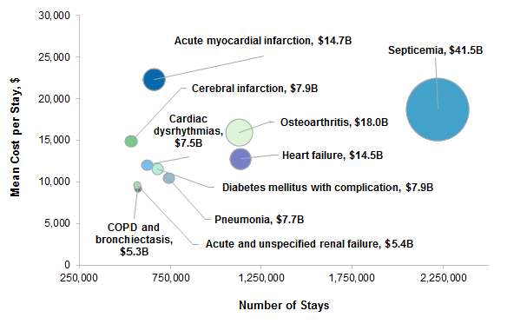
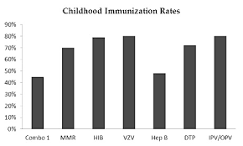
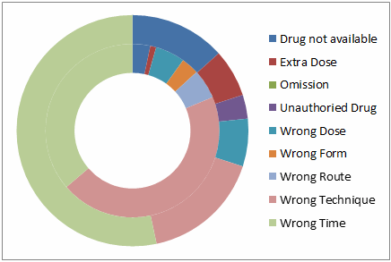
Vary Chart Types
Tables
Bar charts
Waterfall charts
Pie charts
Donut charts
Area charts
Scatter pots
Bubble charts
Heat maps

Slide 90
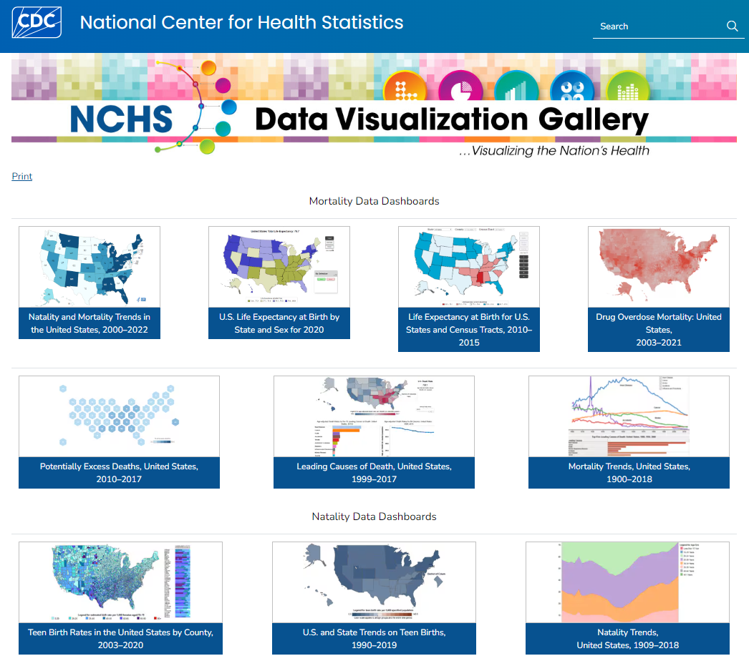
National Data Dashboards
Data Visualization Gallery

Slide 91
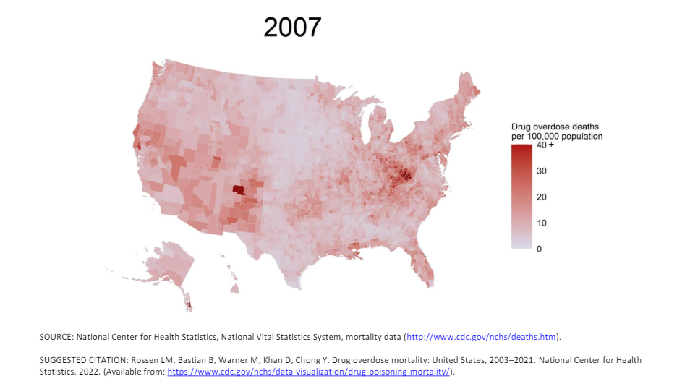
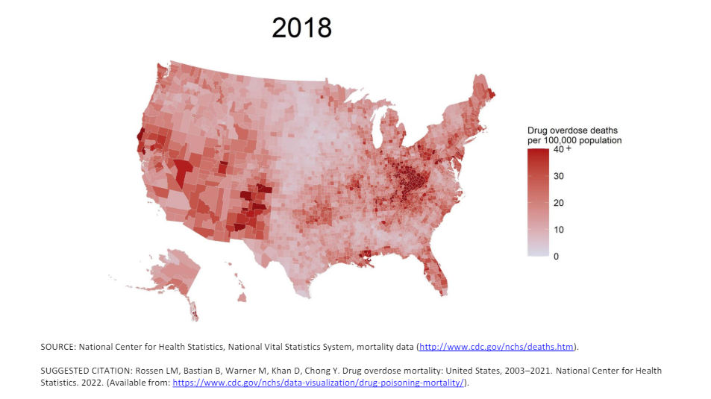

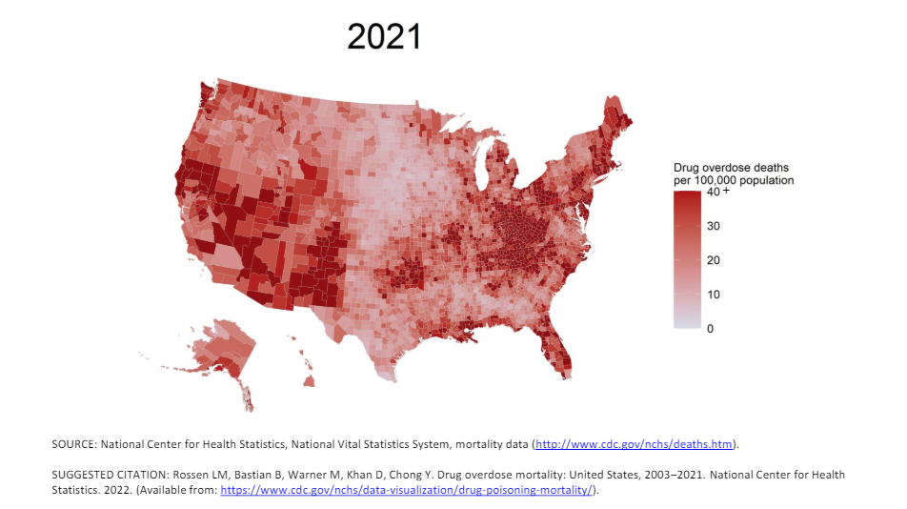


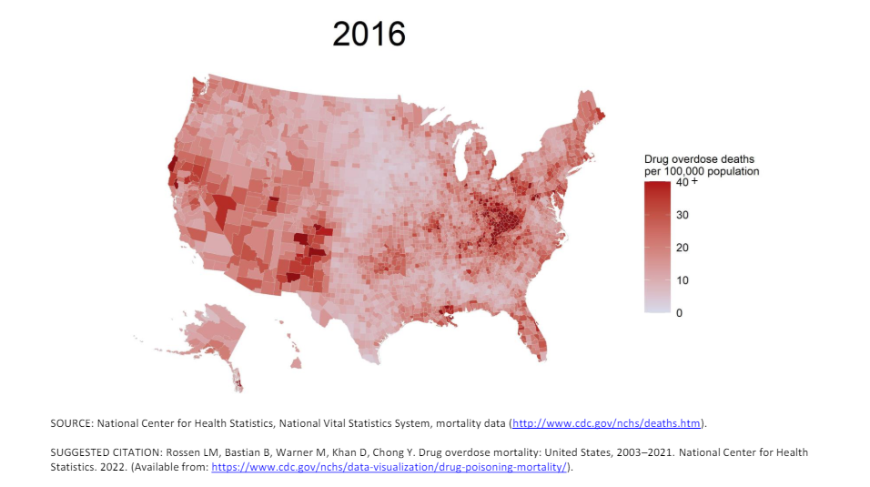
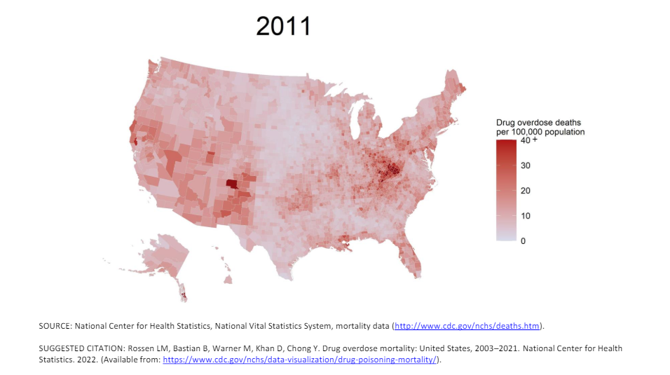
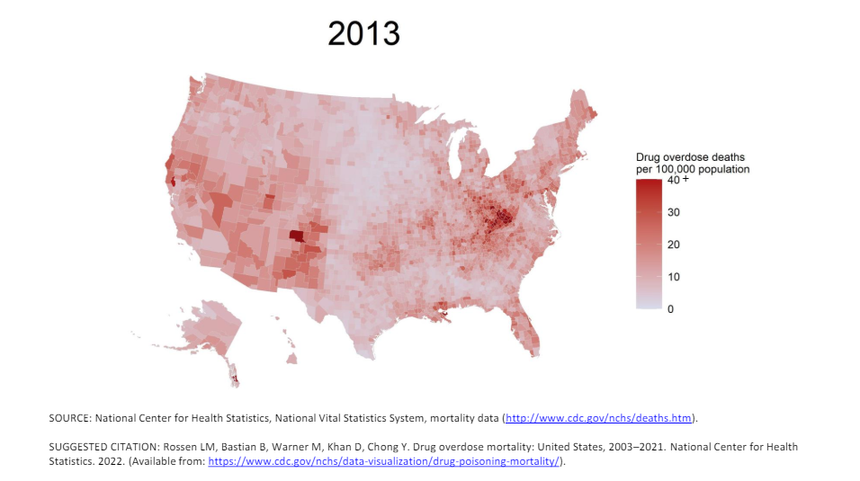



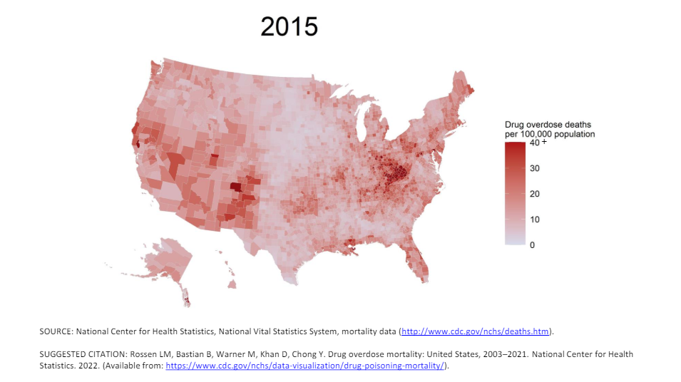

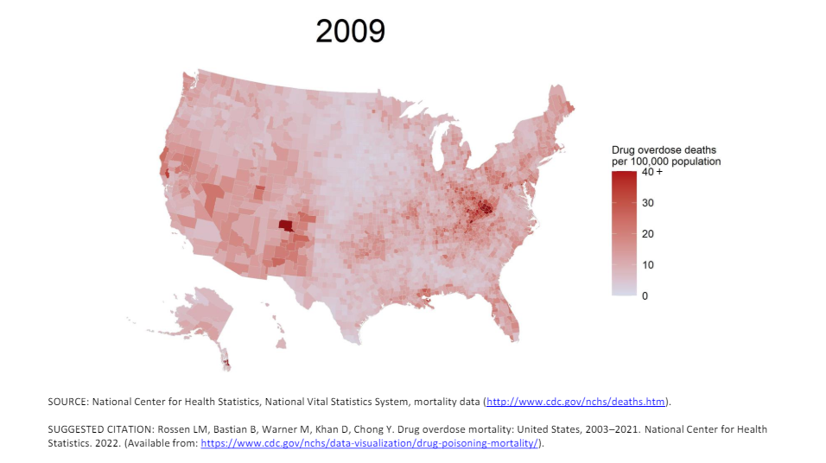


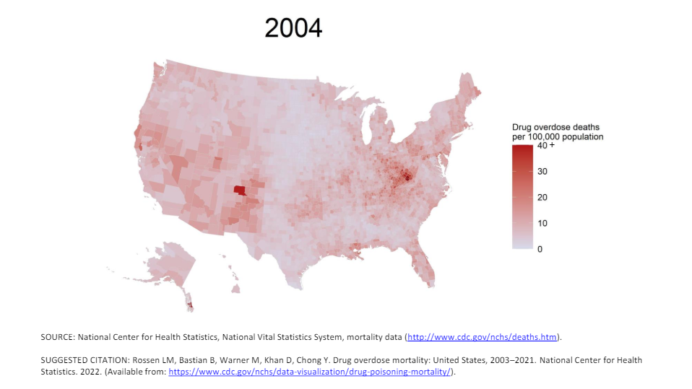
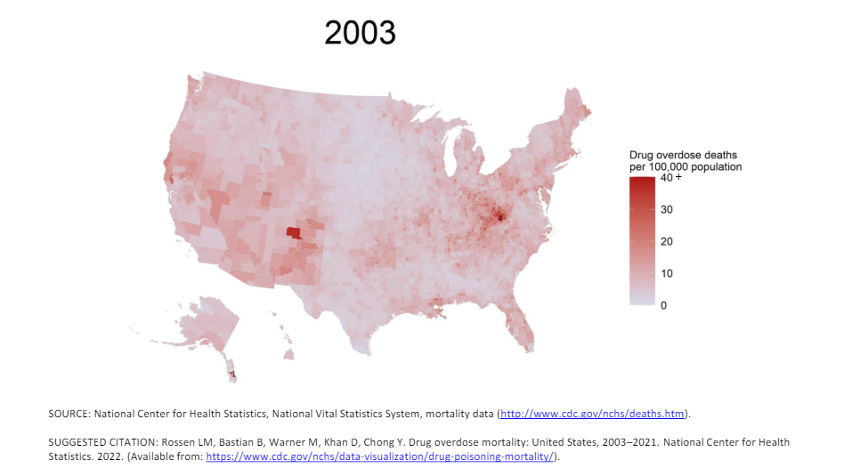

Slide 92



Data Storytelling is a Strategic Work of Art
Engage
Narrative
Visuals
Change
Explain
Enlighten
Data

Slide 93

NHA Tools
https://www.nebraskahospitals.org/
Toolkits and Resources:
  Health Equity
  Sepsis
  Human Trafficking
  Safe Opioid Use (update in progress)
  Workplace Violence
  Infection Prevention
  Rural Roadmap
  Quality Handbook

Slide 94
End of Day 1
See you tomorrow!
nebraskahospitals.org
Session 3

Slide 95
Scorecards, Dashboards, Board Reports
nebraskahospitals.org
Session 3

Slide 96
Dashboards and Scorecards:
Dashboards:
Allow users to quickly visualize actionable data to inform and optimize clinical and organizational performance
Provide feedback to clinical teams and managers, in order to monitor care quality and stimulate quality improvement
Do’s | Don’ts
Be Clear Be Concise Be Accurate Use Color and Graphs Prioritize Data – Important First State your goal – what is good and bad | Don’t create clutter Don’t change the format frequently Don’t use a lot of words

Slide 97
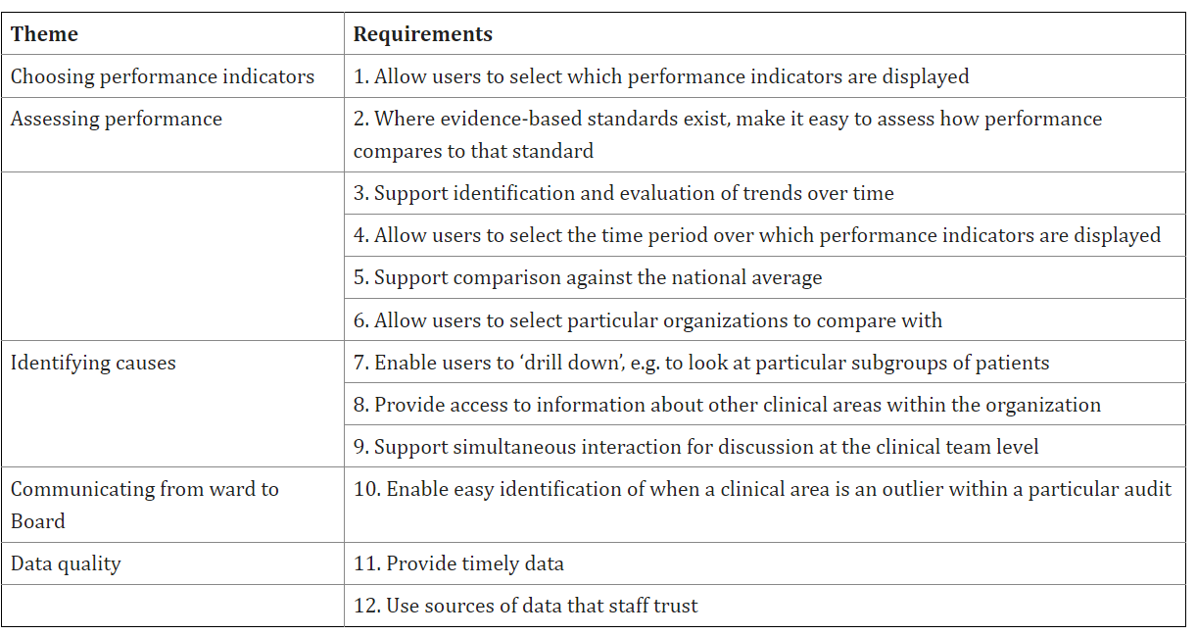
Requirements for a Quality Dashboard:

Slide 98
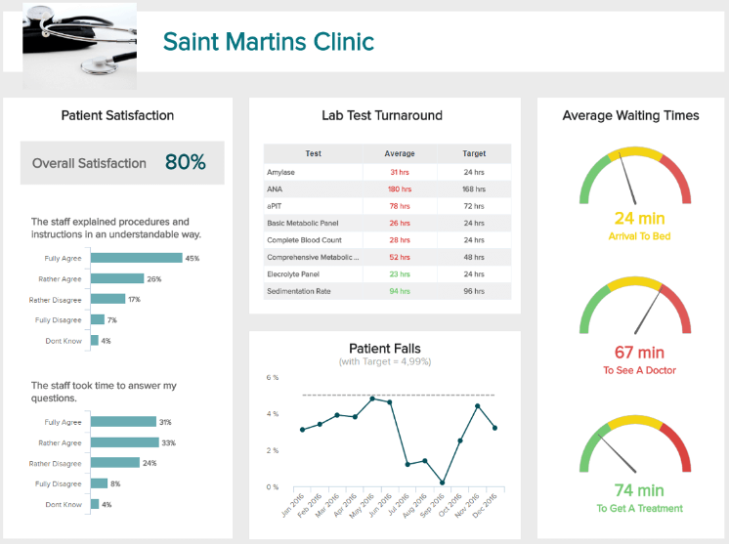
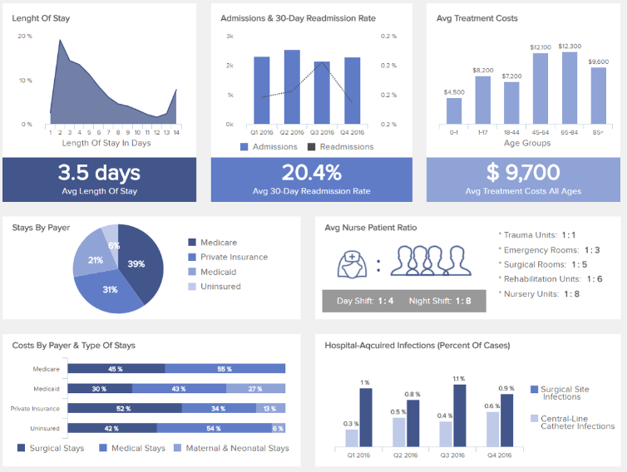
Dashboards and Scorecards:

Slide 99
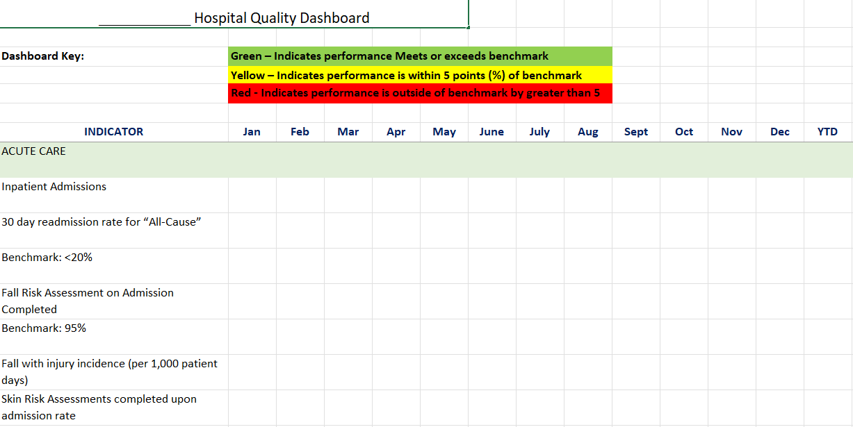
Dashboards and Scorecards:

Slide 100

Use Data to Accelerate Strategy
Follow your mission and vision
Conduct a SWOT analysis
Set strategic objectives
Develop action plan
Implement and evaluate your plan
Review and update your plan
Improved processes
Improved competitive position
New and improved services – better patient satisfaction and appealing market
Informationalization – build data into services
Improved human capabilities
Improved risk management
Improved patient outcomes
Results in!
Is your quality team involved in strategic planning?

Slide 101
Data in Strategic Planning:
The strategic plan must be clear and well communicated
Have fewer than 10 key goals
Make sure those goals are well defined with measurements included
  What initiatives support reaching those goals?
    How will you know if you are moving towards your goal?
DATA
Example of a Strategic Goal: Sunrise Hospital will offer highly satisfactory care to all patients in our hospitals evidenced by improved CAHPS scores.
Initiative to Drive Goal: Sunrise Hospital will offer distribute CAHPS surveys in all available units of the hospital.
AIM Statement: Sunrise Hospital will have a top box in overall satisfaction of 85th percentile or greater by end of 2026.
Data: Complete quarterly satisfaction reports to working group, executive team, and board.

Slide 102
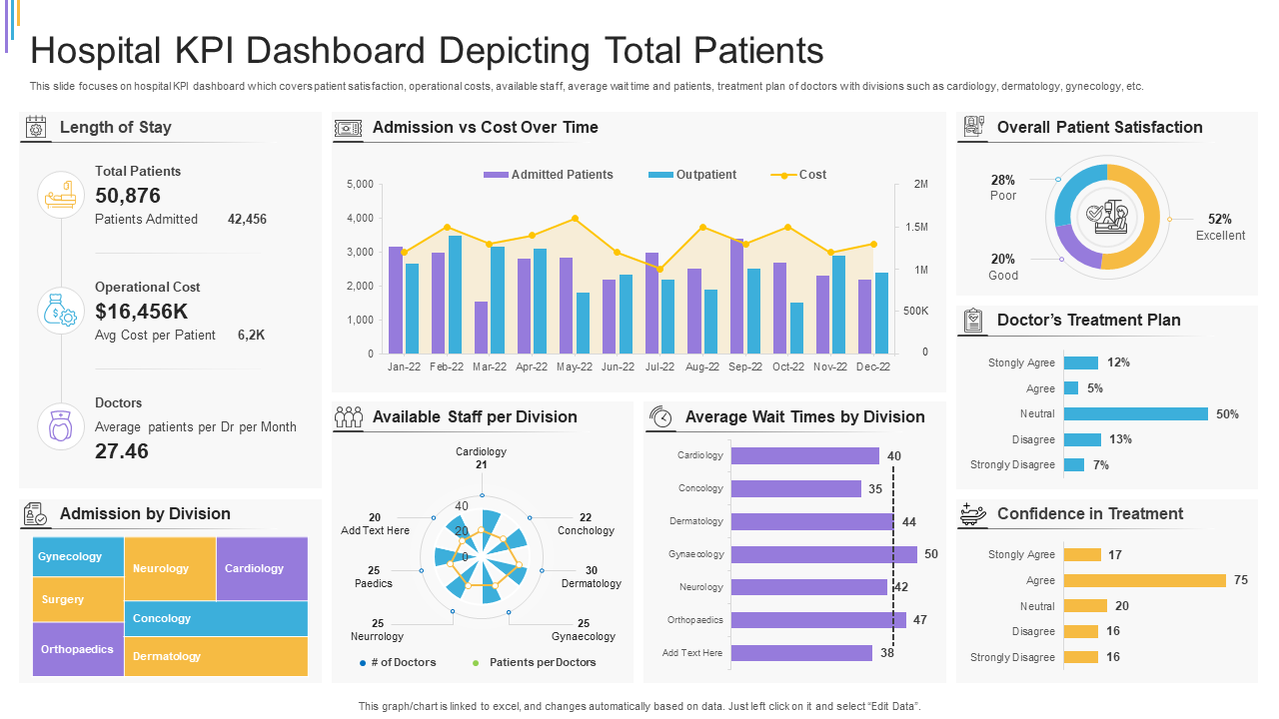
Look at Specific Data
What to measure?
Patient satisfaction
Service utilization
LOS
Health care costs

Slide 103

Look at Specific Data
What to measure?
Patient satisfaction
Provider performance
# of responses

Slide 104

Look at Specific Data
What to measure?
Patient satisfaction
Wait times
Fall rate

Slide 105

Look at Specific Data
What to measure?
Health care costs
Volume
Diagnosis
Things to consider…
Diagnosis specific expenditures
Preventive health and wellness needs
Length of stay per diagnosis

Slide 106

Look at Specific Data
What to measure?
Diagnosis
Patient population
Things to consider…
Market area
Service expansion
Target patient population
Translation services
Diverse staff

Slide 107

Use Data to…
Drive change
Understand your patient population
Identify community needs
Identify weak spots and look for opportunities for improvement
Demonstrate success
Decrease costs
Improve outcomes
Celebrate wins!

Slide 108
Reporting Quality to the Board:
Most board members are not in healthcare so use common measurement and words
Educate the board regularly about quality key initiatives
Report what is important – not EVERYTHING
Be concise and direct
Ideas for Board Reports:
Chasing ‘0’ Report –everything that you want a low number in
i.e. falls, readmissions, SSI
Chasing ‘100’ – everything you want a high number in
i.e. patient satisfaction, revenue, patient days, procedures

Slide 109
Data that is not used is useless…
Make the data work for you and get actionable insights
Create valuable and meaningful observation derived from analyzing data
Then, make specific recommendations for taking tangible actions.
Benefits of Strong Data Use:
  Informed decision-making
  Competitive Advantage
  Improved Performance
  Risk Mitigation
Understand what all data is being collected, where it is going and why…
Then ask…how are we improving patient care with this data?

Slide 110
Tracking Performance
nebraskahospitals.org
Session 3

Slide 111

Identify Performance Metrics
Patient Harm
Medication Errors
Readmissions
Falls
Adverse Drug Events
Compliance
Patient Satisfaction
BCMA
ALOS
Transfers
Admissions
ED Readmissions
Employee Satisfaction

Slide 112

Set Goals and Targets
SMART goals
You can’t track what you don’t monitor
Set expectations with teams
Communicate clearly
Practice what you preach – walk the walk
Review your mission, vision, values
Prioritize

Slide 113

Monitor Regularly
Check in with teams
Audit charts
Utilize “secret shoppers:
Ask for feedback
What’s working? What’s not working?
Check in with the data

Slide 114

Provide Training and Support
Support your team
Identify education gaps
Utilize evidence-based practice and research
Advocate for your teams

Slide 115

Create a Culture of Accountability
Team approach
Action items and takeaways from meetings
Frequent follow-up
Don’t micromanage
Emphasize autonomy
Motivate
Inspire
Lead

Slide 116
PivotTables
nebraskahospitals.org
Session 3

Slide 117
What is a PivotTable
A PivotTable is a powerful tool to calculate, summarize, and analyze data that lets you see comparisons, patterns, and trends in your data. PivotTables work a little bit differently depending on what platform you are using to run Excel (Microsoft, 2024)
Allows you to edit and move data into a table quickly to see results
Functions very similar to NHA’s Dimensions

Slide 118

How to Start
Build/Download your data
Highlight the data
Select Insert>Pivot Table

Slide 119

PivotTable Build
Pivot Tables allow you to custom the filters, rows and columns and decide which data you see where
Use the PivotTable Field Tab to edit as needed

Slide 120
Practice
Go to the NHA Download Center
  Sample Data (Excel File)
    The fourth tab is for a PivotTable Build
    This is fake data randomly generated
    Pick one hospital and one measure. How would you show this if you needed to present this at a board meeting?

Slide 121
PivotTables
Microsoft Website for PivotTables:
  https://support.microsoft.com/en-us/office/create-a-pivottable-to-analyze-worksheet-data-a9a84538-bfe9-40a9-a8e9-f99134456576

Slide 122
ROI Calculators
nebraskahospitals.org
Session 3

Slide 123
Why build a ROI Calculator?
Over the course of several years of working with data, several facilities have mentioned they would like the ability to compare themselves to others, the nation, and possible track the financial impact
NHA’s Calculator is built from CDS data entered by the facility, and uses national benchmarking and financial markers published by AHRQ
The goal of the Calculator is make easy comparison of established data points

Slide 124
How to Build a Calculator
What data do you consistently have?
Are there national thresholds (Federal Agencies, Vendors, etc)
What do you want to see?
  $ impact
  Patient Days
  State comparisons

Slide 125
Excel Aspects of a Scorecard
Learn functions within excel
  =filter
  =sumif
  =sumsif
Take your time (the first few take forever)
Plan out your reports
  Different sheets can tie together, try not to complicate things
  Make it simple to edit
    If you need an edit, one change is easier than 10
Use your resources
  Microsoft
  YouTube (Probably the Best)

Slide 126
Putting it all Together
nebraskahospitals.org
Session 3

Slide 127

Data can be a Game Changer!
Increase efficiency
Improve productivity
Eliminate inefficiencies
Reduce costs
Optimize resource allocation
Improve patient and employee satisfaction
Enhance decision-making
Lead the way in health care quality

Slide 128

Strategies for Success
Don’t get stuck in a data silo
Use your tools and peers with varying expertise
Shift to data-driven decision-making
Be open to change
Explain the “why”
Focus on short-term results

Slide 129

NHA Updates
  Process Precept
    Next session July 10th | Atkinson
  Vulnerable Populations Conference
    September 19th - 20th | Lincoln, NE
  CAH/RHC Quality Conference
    November 14th – 15th | Kearney, NE

Slide 130
NHA Quality Team:
Margaret Woeppel MSN, RN CPHQ | Vice President, Quality & Data & Workforce
  mwoeppel@nebraskahospitals.org
Dana Steiner BSN, MBA, CPHQ | Senior Director, Quality & Performance Improvement
  dsteiner@nebraskahospitals.org
Amber Kavan RN, BSN, CPHQ | Director Quality & Performance Improvement
  akavan@nebraskahospitals.org
Matt Lentz RN, MSN | Quality & Performance Improvement Consultant
  mlentz@nebraskahospitals.org

Slide 131






Our Great
Team
Amber Kavan, BSN, RN, CPHQ
Quality and Performance Improvement Director
akavan@nebraskahospitals.org
Dana Steiner, BSN, MBA, CPHQ
Matt Lentz, MSN, RN
Quality Consultant
Senior Director, Quality and Performance Improvement
mlentz@nebraskahospitals.org
dsteiner@nebraskahospitals.org

