Slide 1

Advancing Age-Friendly Care in Ambulatory Settings:
Strategies for Better Outcomes
nebraskahospitals.org
November 2025

Slide 2
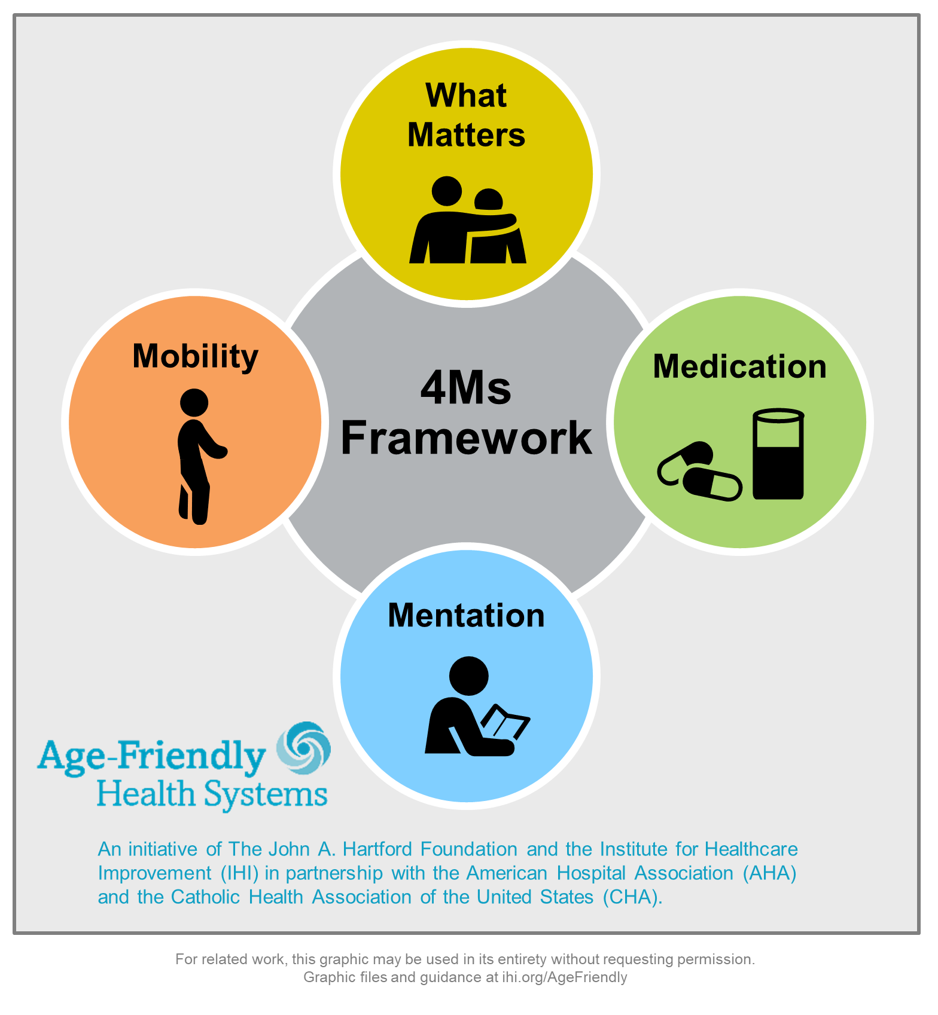
Objectives
Identify the core principles of the Age-Friendly Health Systems framework and their application in ambulatory care.
Examine practical approaches to integrating the 4Ms into routine outpatient workflows.
Evaluate strategies to improve patient engagement, safety, and care coordination for older adults across ambulatory settings.

Slide 3

Age-Friendly Partners
Age-Friendly Health Systems is an initiative of The John A. Hartford Foundation and the Institute for Healthcare Improvement (IHI) in partnership with the American Hospital Association (AHA) and the Catholic Health Association of the United States (CHA).

Slide 4

What is Age-Friendly
“Age-Friendly” describes environments that promote access to options, services and opportunities for people as they age, and that promote the inclusion and participation of older adults in all aspects of life (Age Friendly Institute, 2023).
Age-Friendly Health Systems use evidence-based measures to provide high-quality patient care and align with the specific health outcomes for the elderly patient.

Slide 5
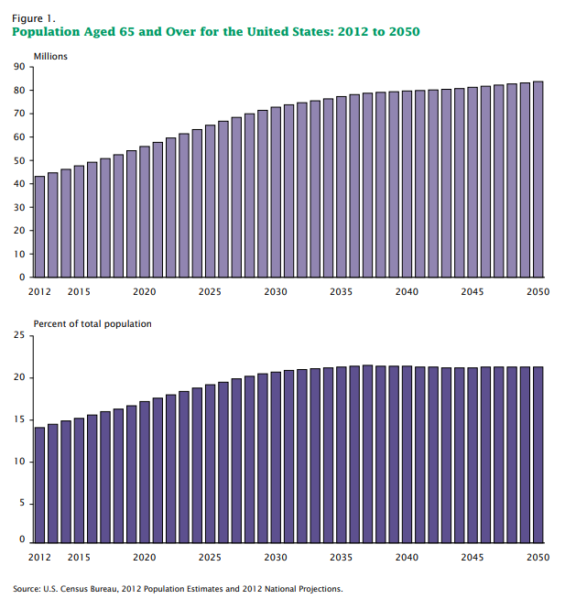
Why is Age-Friendly Important?
Between 2012 and 2050, the US will experience considerable growth in its older population.
In 2050, the population 65+ is projected to be 83.7 million, almost double its estimated population of 43.1 million in 2012.
Baby boomers are largely responsible for this increase in the older population, as they began turning 65 in 2011.

Slide 6
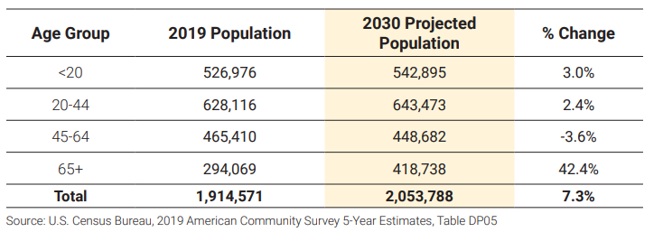
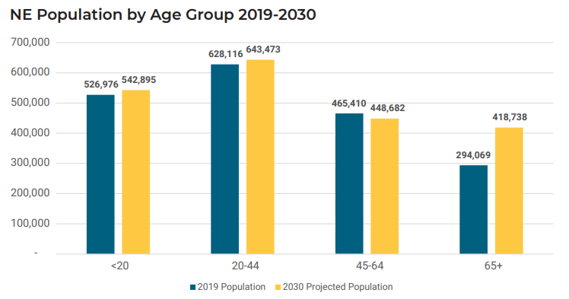
Age-Friendly in Nebraska…
From 2019 to 2030 the population of Nebraska residents age 65+ years old is expected to increase by 42.4% while other age groups will have minimal change.

Slide 7

Goals of an Age-Friendly Health System
The AIM of the Age-Friendly Health System:
The program is guided by an essential set of evidence-based practices – known as the 4Ms:
    Medication
    Mobility
    Mentation
    What Matters
Cause no harms – prevent potential harms
Ensure that older adults and their families are part of the care team

Slide 8

Where Can you Find Age-Friendly Health Systems
Hospital
Ambulatory Care
Nursing Home
Emergency Department
Geriatric Surgery
Convenient Care Clinic
Home Health
Each location uses the 4Ms model to drive Age-Friendly Care but considers the setting to create effective programming.

Slide 9
Age-Friendly Recognition
Facilities undergo the Age-Friendly Health Systems journey can achieve recognition as Level 1 (Participant) then move to Level 2 (Committed to Care Excellence).
  Level 1 (Participant) teams have successfully developed plans to implement the 4Ms.
  Level 2 (Committed to Care Excellence) teams have three months of verified data to demonstrate early impact of using the 4Ms.

Slide 10
Age-Friendly in Ambulatory Settings
nebraskahospitals.org

Slide 11
Age-Friendly Health Systems: Ambulatory Setting
Key Considerations Ambulatory v. Hospital Age-Friendly Care:
Frequency of Screenings:
  Screening frequency occurs less frequently – often annually or with change in patient status.
Understanding baseline and communication of changes:
  Ambulatory screening is more indicative of actual status – changes with illness or upon need for hospitalization.
  Communicate baseline and changes to hospital staff if admitted.
What Matters and End of Life Care Discussions with trusted professional:
  Often ambulatory care is more relationship-based so discussion regarding healthcare wishes are often more in-depth and can be supplemented at future visits.

Slide 12
Age-Friendly Health Systems: Ambulatory Setting
Workflow Example:
Intake into care setting
Check history for baseline on 4Ms
Conduct 4Ms screening
Co-create goal-oriented care aligned with What Matters
Check-out

Slide 13
Age-Friendly Health Systems: Ambulatory Setting
Key Actions | Getting Started | Tips and Resources
What Matters? | Does your organization have an existing question bank to start a “What Matters?” conversation? “What is the one thing about your healthcare you most want to focus on?” “Addressing your healthcare needs so that you can do what more often or more easily?” “What are your most important goals if your health situation worsens?” | Knowing What Matters has 2 purposes: Get to know the person to help provide better care. “What is a good day for you?” “Who is important to you?” “What brings you joy?” “What makes life worth living?” Align care with What Matters. The desired outcomes and fears, concerns, and questions. Include family or other caregivers in the discussion about What Matters (if OK with the patient); while remembering it is most important to learn What Matters to the older adult. Ask people with dementia What Matters. Integrate asking What Matters into Welcome to Medicare and the Medicare Annual Wellness Visit or Pre-Visit Planning.

Slide 14
Age-Friendly Health Systems: Ambulatory Setting
Key Actions | Getting Started | Tips and Resources
Medications Review for high-risk and potentially inappropriate medication use | Specifically, look for: Benzodiazepines Opioids Highly anticholinergic medications (e.g., diphenhydramine) All prescription and over-the- counter sedatives and sleep medications Muscle relaxants Tricyclic antidepressants Antipsychotics Mood stabilizers | Medication risk assessment – include OTC medications at least annually in this assessment. Engage the older adult and family member or other caregiver in providing all medications (including over-the-counter medicines) for review. Medicare beneficiaries may be eligible for an annual comprehensive medication review. Medication reconciliation, part of the Medicare Annual Wellness Visit, to identify high-risk medications. Target medications: Without indication Not the intended response No longer needed Duplicate effects (both benefits and harms) Not being taken and adherence is not critical

Slide 15
Age-Friendly Health Systems: Ambulatory Setting
Key Actions | Getting Started | Tips and Resources
Mentation Screen for dementia / cognitive impairment Screen for depression | Assess EHR available screening. Screening Options: Mini-Cog → If screen is + → MoCA or SLUMS for a more detailed assessment If dementia is established -- consider using a staging tool such as the Global Deterioration Scale, FAST, or MoCA for annual or episodic visits. Depression Screen -- Patient Health Questionnaire – 2 (PHQ-2) reflex to PHQ- 9. | Normalize cognitive screening → “I’m going to assess your cognitive health like we check your blood pressure, or your heart and lungs.” Document thoroughly so that all providers have a baseline cognitive screen. If a sudden change in cognition, consider and rule out delirium. Screening for cognitive impairment and depression are part of Welcome to Medicare and the Medicare Annual Wellness Visit. Create a process to follow up if a screening is positive.

Slide 16
Age-Friendly Health Systems: Ambulatory Setting
Key Actions | Getting Started | Tips and Resources
Mobility Screen and assess for mobility limitations | Assess if your EHR has an embedded tool Optional Screening Tool: Timed Up & Go (TUG) Determine what supports are needed. | Older adults may be worried about having their mobility screened. Remind patients that mobility screen recognizes strengths and is key to functioning and doing What Matters. Screening for mobility is part of Welcome to Medicare and the Medicare Annual Wellness Visit. Engage the full care team in assessing mobility: Does the person walk into the waiting room? Are they able to stand up from the waiting room chair when called? Can they walk to the exam room? What ambulatory devices do they use? Create a process to follow up on the results of the screen. The focus is ensuring safe mobility, not only preventing falls. Consider also conducting a functional assessment: Barthel Index of ADLs (in Epic) The Lawton Instrumental Activities of Daily Living (IADL) Scale Katz Index of Independence in Activities of Daily Living (ADL)

Slide 17
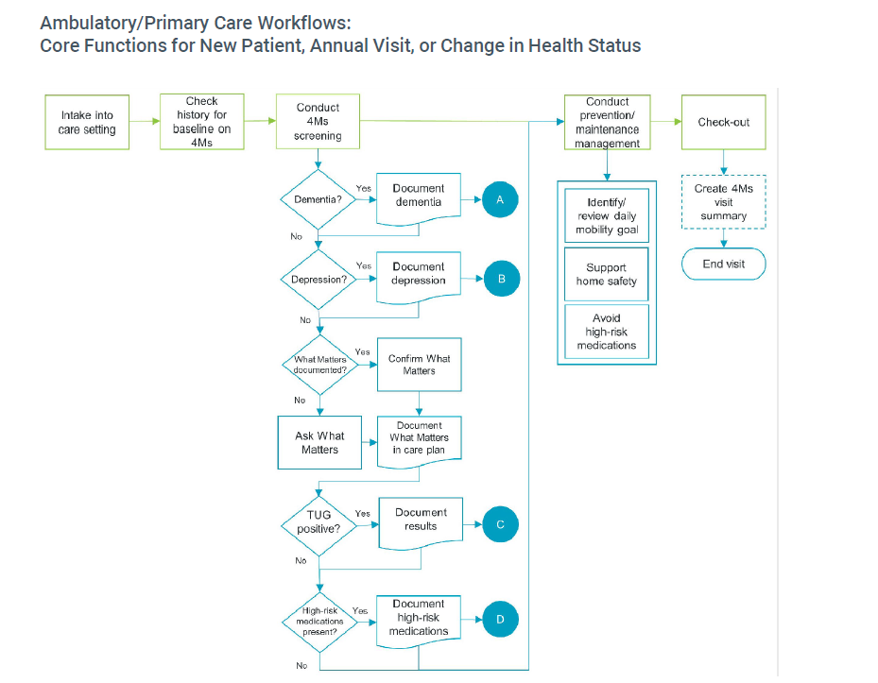

Slide 18
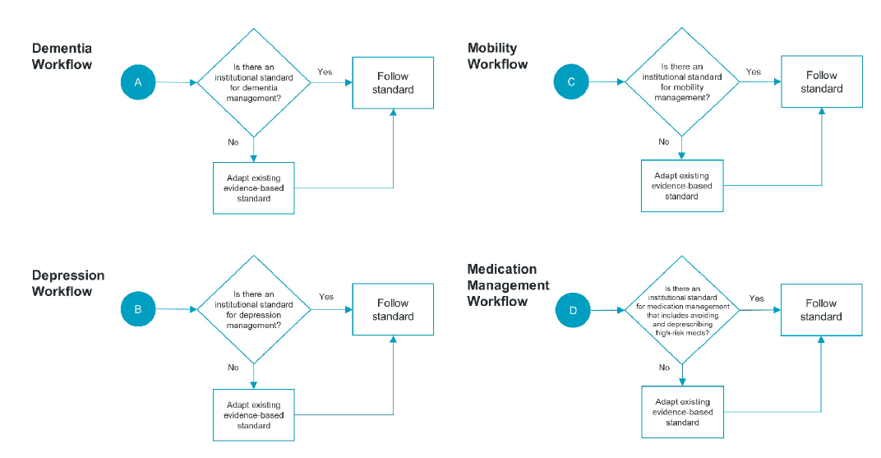

Slide 19

Medication: BEERS Criteria
Applied to adults 65 years old and older in all ambulatory, acute, and institutionalized settings of care, except hospice and end-of-life care settings:
Reduce older adults’ exposure to Potentially Inappropriate Medications (PIMs) by improving medication selection;
Educate clinicians and patients; and
Serve as a tool for evaluating quality of care, cost, and patterns of drug use in older adults.
Review medications and document high-risk medication use → Deprescribe, adjust doses, and avoid high-risk medications

Slide 20
Medication Resources
Geriatrics Care | Geriatric Resources | Online events | Updates - Geriatrics Care Online
2023 AGS Beers Criteria Pocket Cards | Downloadable PDF
TaperMD – Pause and Monitor: Approach to reducing medication burden of polypharmacy
Annual Wellness Visit - Medicare Interactive
Microsoft Word - MedMaIDE.doc

Slide 21
Mentation:
Screen for dementia/cognitive impairment. (Consider using a staging tool for older adults who have been diagnosed with dementia.)
Screen for depression
If screen is positive for cognitive impairment, refer for further evaluation and manage manifestations of cognitive impairment
If depression screen is positive, identify and manage factors contributing to depression and initiate, or refer out for, treatment

Slide 22
Mentation Resources
SLU Mental Status Exam : SLU - Saint Louis University
mocacognition.com
LEA.FUNCTIONAL.ASSESSMENT.SCREENING.TOOL
Phqscreeners
Geriatric Depression Scale
  Dementia screen per visit (Clinic & Nursing Home) – assists in knowing baseline during hospitalization
  Depression screen per visit(Clinic & Nursing Home) - assists in knowing baseline during hospitalization

Slide 23
Mobility
Mobility: gait and balance assessment and fall prevention strategies with an emphasis on safe mobility.
More than 1/3 of adults over 65 fall each year.
Proactive management of falls can decrease mortality and morbidity issues and decrease overall healthcare costs.
Tools you use to screen for mobility limitations:
Timed Up & Go (TUG) 2
JH-HLM
POMA
Refer to physical therapy (PT)

Slide 24
Mobility Resources
Microsoft Word - Tinetti-Balance-Gait--POMA.rtf
JHHLM-FAQs-and-Scale.pdf
Screen for mobility limitations →
Ensure safe mobility, including safe home environment; identify and set a daily mobility goal

Slide 25
What Matters?
Ask the older adult What Matters
Document What Matters
Document the older adult’s preferred support person or caregiver
Align and provide care according to What Matters

Slide 26
What Matters Resources
Template for Corporate and Internal Documents (IT Manual, Board Meeting Materials) – Accessible
The Conversation Project - Have You Had The Conversation?
"Conversation Ready": A Framework for Improving End-of-Life Care | Institute for Healthcare Improvement
Home - Patient Priorities Care
Serious-Illness-Conversation-Guide.2023-05-18.pdf
Letter | Letter Project | Stanford Medicine
“What Matters to You?” Instructional Video - Health Quality BC
A Guide to Having Conversations About What Matters - Health Quality BC
CMS-Payment-One-Pager.pdf

Slide 27
Outcomes
Improved patient satisfaction
Fewer hospital admissions
Decreased ED utilization
Better management of chronic conditions
Increased revenue → more AWV
Reduced healthcare costs
Aligns with value-based care strategies

Slide 28
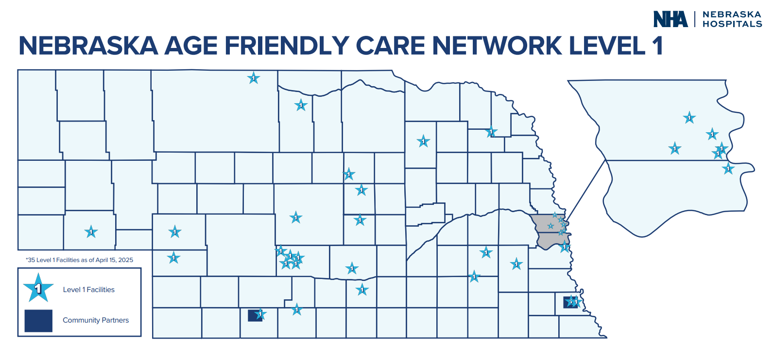
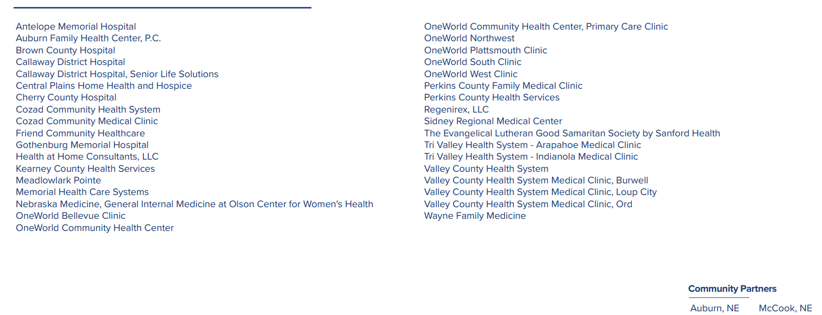

Slide 29
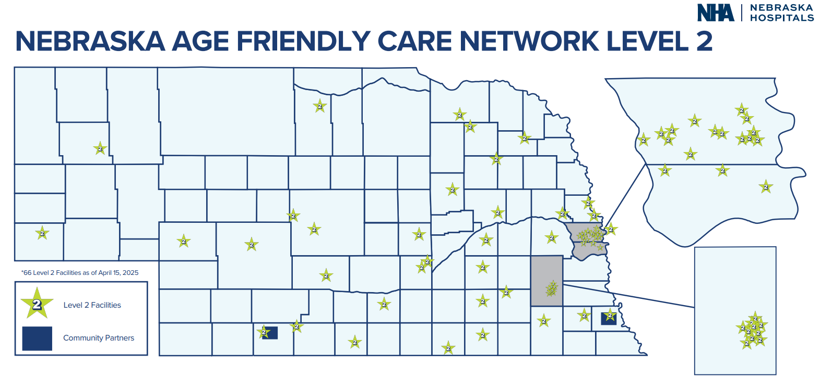
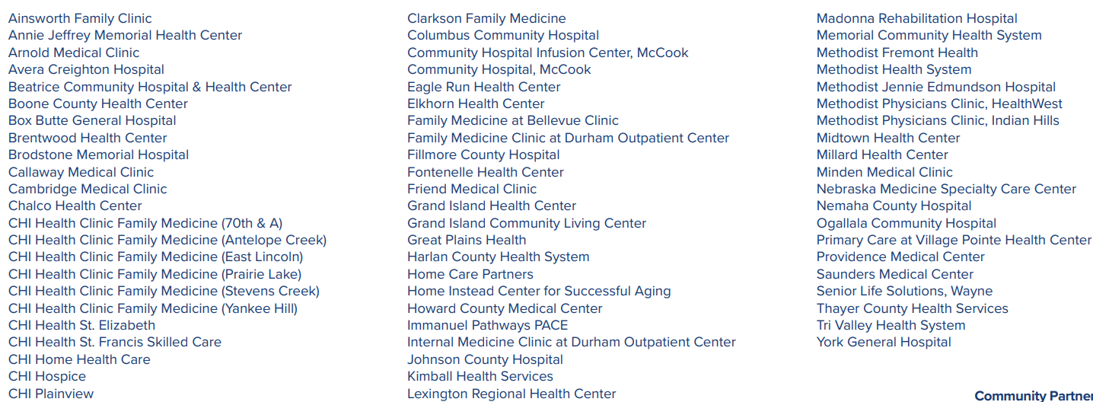

Slide 30
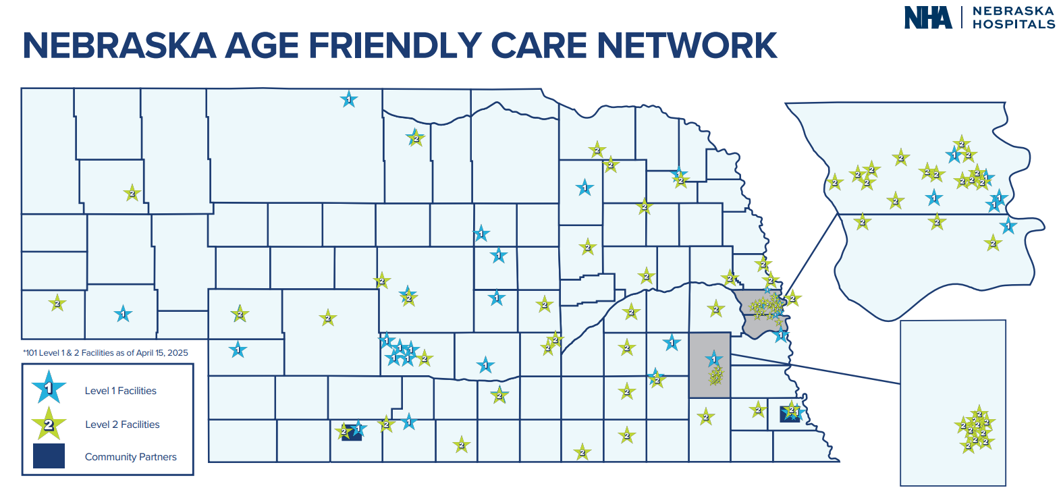

Slide 31
Next Steps
Connect with the NHA
Create a multi-disciplinary team
Review processes – What are you already doing?
Review patient experience surveys to identify opportunities
Review submission worksheet
Join the movement

Slide 32
Thanks! Questions?
nebraskahospitals.org

