Slide 1
Connecting to Impact Cardiovascular Disease Improvement throughout Nebraska
Sharon Leners BSN, RN Bryan Health Connect
Lisa Schuetze BA, RN Pender Medical Clinic

Slide 2

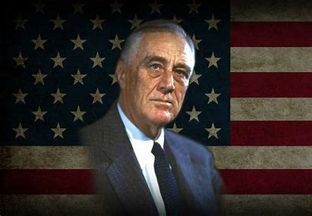



What do these celebrities have in common?
Notes:
They all have or had high blood pressure.
High blood pressure usually doesn’t come with any physical symptom, which is dangerous because when this condition is left untreated, it can lead to heart failure, heart disease, and stroke. If you have any doubt, you should get your blood pressure checked by your doctor regularly.
High Blood pressure does not discriminate. Young, old, thin, overweight, black or white. Anyone can have hign blood pressure and not know it due to it causing no symptoms, many times until it is to late.
Anyone can be affected by high blood pressure, and since it can be caused by chronic stress, many celebrities with busy work schedules are suffering from this serious condition.
Here are five famous celebrities with high blood pressure, and unfortunately many of them have died as a result of their condition.
Franklin D. Roosevelt
Franklin D. Roosevelt was the 32nd President of the United States, from 1933 to his death in 1945. In 1944, he was diagnosed with different health issues, including high blood pressure and coronary artery disease.
He died on April 12, 1945, from a massive cerebral hemorrhage. His death came as a surprise to the public since his declining health was kept a secret
Whitney Houston
Whitney Houston was a singer and an actress. On February 11, 2012, she was found unconscious in the bathtub of her hotel suite, and was pronounced dead a bit later.
Even though it was revealed that cocaine and a few other drugs were found in her body, the official cause of her death was drowning, along with atherosclerotic heart disease which was linked to undiagnosed high blood pressure.
Oprah Winfrey
Oprah Winfrey, the famous talk show host, actress, and philantropist, is one of the most famous celebrities with high blood pressure. It was believed that these issues were related to her unhealthy lifestyle and diet.
With the right changes to her lifestyle and diet, she has managed to put these high blood pressure problems under control.
David Cook
David Cook, the singer and songwriter who won the seventh season of the singing competition American Idol in 2008, has also been struggling with signs of high blood pressure.
After taping one of the shows, in August 2008, he had to be rushed to the hospital because his blood pressure was too high, and he was not feeling well. After getting some medication, things improved for him.

Slide 3
Objectives
Understand the role of value-based care and its importance in enhancing healthcare delivery and outcomes.
Discover the impact of collaboration to improve cardiovascular disease.
Learn effective strategies for implementing targeted interventions into the clinical setting.

Slide 4
About Bryan Health Connect
Bryan Health Connect is a physician-led Physician Hospital Organization (PHO) and Accountable Care Organization (ACO), organizations created to represent physician practices, facilities, hospitals and other providers to offer a broad, clinically and financially-integrated, high-quality, cost-effective network of providers. Bryan Health Connect represents more than approximately 2,000 providers.
We work closely with our members, assisting them to maintain independence in an ever-changing healthcare environment, and supporting them by offering services that add value to their membership.
Mission
We connect a network of resources, innovative leadership and data to drive cost-effective population health improvement.
Vision
Leading exceptional healthcare transformation.

Slide 5

Bryan Health Connect ACO Members
Current Members
Beatrice Community Hospital & Health Center
Bryan Medical Center
Bryan Physician Network
Crete Area Medical Center
Merrick Medical Center
Saunders Medical Center
Boone County Health Center
Pender Community Hospital
Howard County Medical Center
Kearney Regional Medical Center
Antelope Memorial Hospital
Great Plains
Mary Lanning
Inpatient Physicians Associates
Supporting the process toward clinical integration

Slide 6
Bryan Health Connect ACO Members
Members starting 2025
Hart & Arndt Family Health PC
Jefferson Community Health & Life
Memorial Community Health
Midwest Independent Physician Practice Association
York Medical Clinic PC
Supporting the process toward clinical integration

Slide 7

What is an Accountable Care Organization (ACO)?
An ACO is a group of hospitals, physicians and other health care providers working together to provide improved coordinated care for their patients.
ACOs are leading the change from a volume-based care model to a
value-based one
VALUE-BASED
VOLUME-BASED
Notes:
Providers get paid based on the number of patients they see and the services they provide, rather than meaningful patient outcomes
This model can lead to repetitive tests, miscommunication or even conflicting medications and treatments
Can drive up the cost of health care
Not in the patients’ best interest

Slide 8
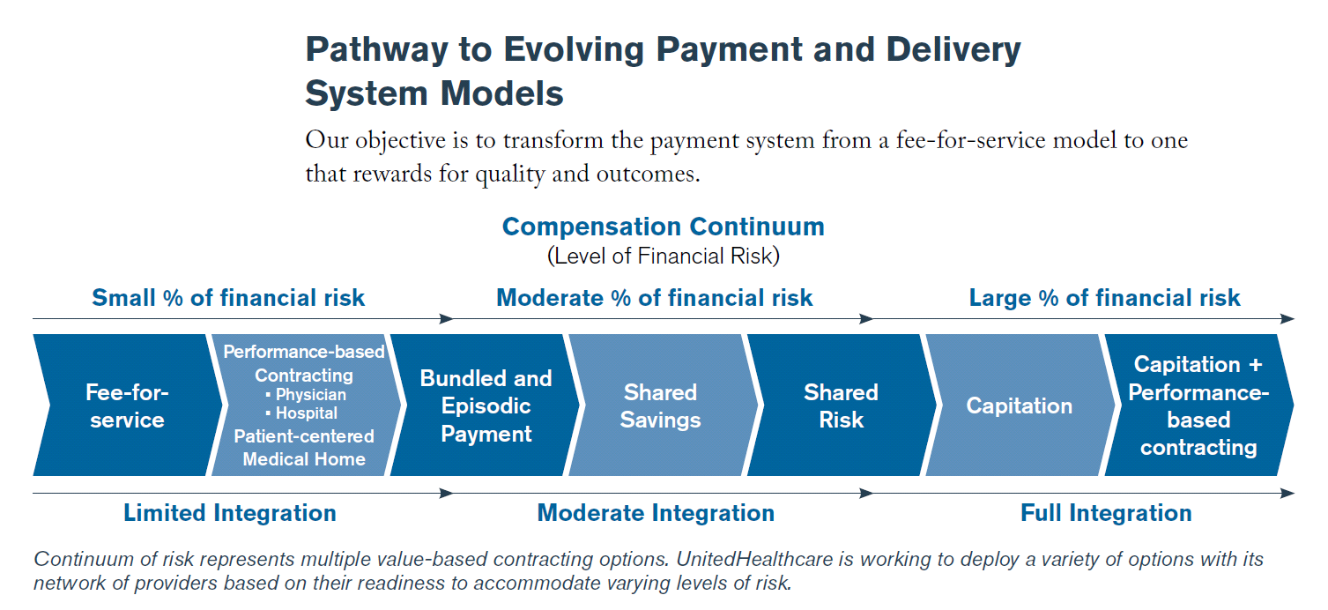
The Healthcare Landscape is Shifting
We Are Here
Notes:
VBC upside and downside risk, we earn shared savings if we do well or may have to pay back if we do not, collectively as a whole.

Slide 9
Value-Based Care
Value = Quality/Cost
A value-based care model shifts the focus to the PATIENT
  Access to high quality care
  A positive health-care experience
  Improved outcomes and quality of life
  Decrease in cost of care
Value-based healthcare is a healthcare delivery model in which providers, including hospitals and providers, are reimbursed based on patient health outcomes

Slide 10
How Does an ACO Succeed?
The Quadruple Aim
Improve the work life of all health care providers
Improve the patient experience
Improve the health of a population
Reduce the cost of care

Slide 11
Improve the Health of the Population
Data analysis drives quality and helps improve patients’ overall care
BHC collects and analyzes data from a number of sources
  Medical records
  Insurance claims
  Pharmacy records
Data identifies population health needs
  Quality Measures
  Focus on services that patients need the most, such as:
    Preventive screenings
    Immunizations
    Disease management
    Medication management
  Cost Measures
  The cost performance is measured against benchmarks on projected spending based on demographics and the documented risk of the patient population within the agreement

Slide 12

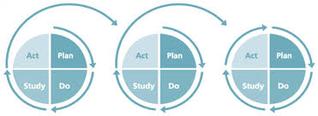

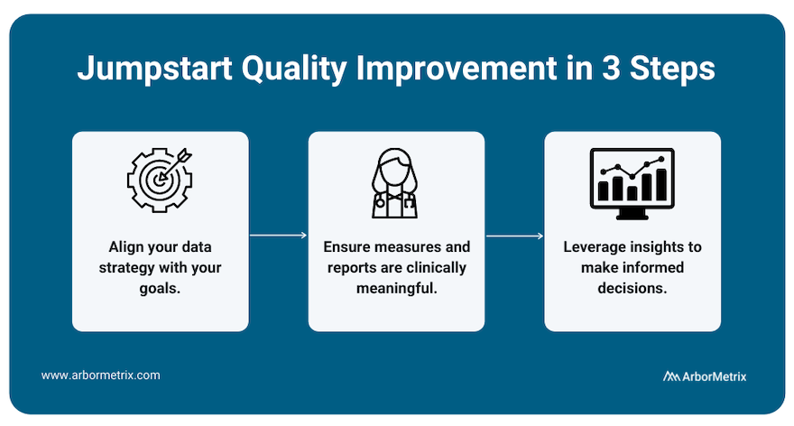

Where does quality fit in?
Notes:
So where does quality fit in? I would say all of it!
Many of our members have their quality team as their lead for ACO initiatives.
Work on practice transformation, process improvement projects, organizational goals and projects are related to ACO initiatives
Some projects; CRCS project-HM, AWV plans, eye exams with retinavue
CHBP Performance improvement- We put project together so it’s a win, win for your organization.

Slide 13

2023-2024 Clinical Campaign
Accurate Blood Pressure Measurement
Onsite training for your front-line staff
ABFM Performance Improvement MOC for physicians
Action plan, quality tool, and patient education created
Notes:
Two areas of focus
Connected Care is Better Care
Essential for all Bryan Health Connect Clinical Teams
American health Rankings Data Source and Years(s): CDC, Behavioral Risk Factor Surveillance System, 2021
Definition: Percentage of adults who reported being told by a health professional that they had high blood pressure
US Value: 32.4% NE 31.7% ranked 23rd
Top State(s): Colorado: 26.0%
Bottom State(s): Mississippi: 43.9%
VBC- Metric that is across the board on contracts and can make the largest health impact to improve the lives of those we serve.

Slide 14
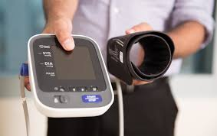
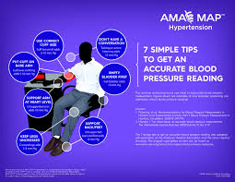
Connecting & Collaborating
American Board of Family Medicine
Bryan Health Connect
Bryan Rural Division
Bryan Medical Center & Practices
American Heart Association (AHA)
TMF Nebraska's QIN ( CMS Quality Innovative Network)
Grant Funding through AHA
BH/BHC CHBP Project (2023)- $5,000.
Pender Hospital & Clinic-$2,500
Jefferson Community Health & Life- $5,000
Notes:
Connecting/Collaborating
American Board of Family Medicine- BHC Applied and offered out to all three Bryan Entities
Bryan Health Connect
Bryan Rural Division
Bryan Medical Center & Practices
American Heart Association-Connected with AMA for TA support, resources, community engagement, grant funding, and awrad recgogition programs such as Target BP and Outpace
TMF Nebraska's QIN ( CMS Quality Innovative Network)- TMF created a quarterly cohort- BHC, DHHS, AHA, Elkhorn-Logan Health Department
22.6% relative improvement rate for Nebraska in HTN since the beginning of the 12th Scope of Work ( SOW).
DHHS-CDP will be starting 10 new SMBP clinic support trainings at RHC and FQHC in the middle of the state.
They are scheduling 4 learning collaboratives
Upcoming HCHC training is scheduled for Sept/Oct and then CDP will release more funding to support new HCHC coaches to facilitate HTN workshops.
UNL extension has 9 new HCHC coaches and they will be scheduling 20 HTN workshops across Nebraska to improve access to HTN workshops.
Starting in November-CDP will start a healthy heart radio ad campaign.
AHA
Target BP, continues to work with South Central AAA. They will continue to support the 4 BP hubs and 3 clinics, and they are adding 4 more BP hubs also in the South Central AAA region.
Continues to work with clinics on accurate measure training with clinics in Omaha area.
Looking for new partners anywhere in the state to work on Target BP tools, training and recognition programs.
Tim is meeting with Antelope Memorial Hospital. They are interested in working with AHA community partners and support AHA initiatives. Pender Hospital is also working with AHA to support community outreach on HTN initiatives.
There is a new Heart Corps position opening in Auburn.
This current CMS contract ends on November 7th. As of right now, all QIN-QIO’s are waiting for CMS to awardee the 13SOW contract so nobody knows which QIN-QIO’s will be awarded what states. But we do know that the states will be awarded by CMS regions instead of individual states.

Slide 15
Nebraska Impact 2022-2024
American Board of Family Medicine
Bryan Health Connect applied and was approved for an Organizational Quality Improvement Pathway
Controlling High Blood Pressure Oct. 2022-Oct. 2024
Measure Accurately Training- 398 Individual staff 2022-2024
Bryan Health Connect Participants- QI lead by Sharon Leners
Bryan Medical Center Participants- QI lead by Lynne Nelson
  Saunders Medical Center
  Henderson Family Clinic
  Ainsworth Family Clinic
  Jefferson Community Health & Life
  Valley County Health System Medical Clinic
  Pender Medical Center
  Antelope Memorial Hospital Family Practice Clinic
Community Screenings
  Kearney- Two up and running end of June
    Peterson center over 500 screenings, kiosk
    Ravenna just 20+ screenings, home monitor style.
Collaboration with Bryan Rural Division- QI lead by Jayne Van Asperen
  Created CHBP toolkit- AMA MAP framework
  Measure accurately training
  Wymore clinic, part of the Beatrice hospital - 4 attended
  Butler County Hospital, David City - 14 attended
  Fillmore County Hospital , Geneva both clinic and hospital staff – 13 attended.
  Bryan Heart
  Crete Medical Center
  Merrick Medical Center
  Bryan Physician Network- includes Bryan Woman's clinic and OB
  Bryan Medical Center- Specialty Clinics, testing areas
  Grand Island Regional Medical Center
  Platte Valley Medical Group in Kearney

Slide 16
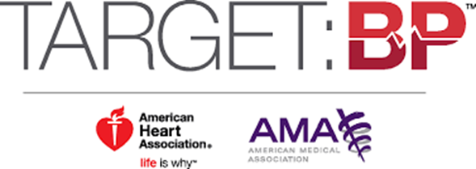
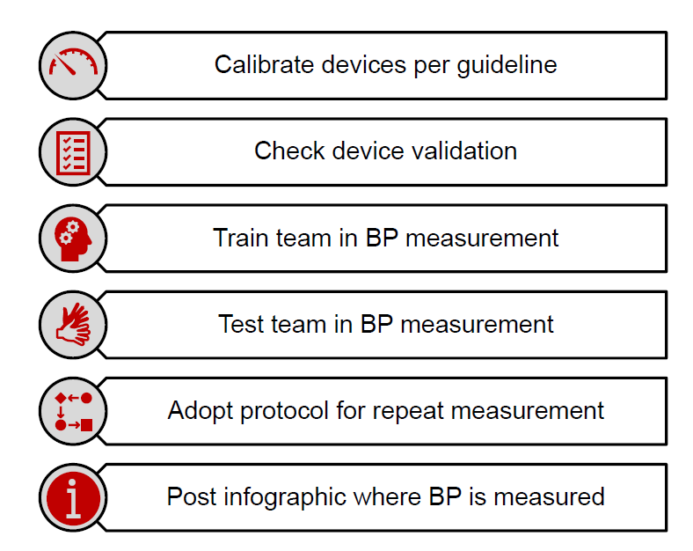
Nebraska Impact 2022-2024
2023 NEBRASKA Gold
Bryan Heart
Bryan Physician Network
Crete Area Medical Center Physicians Clinic
Merrick Medical Center Rural Health Clinic
2024 NEBRASKA Gold
Plate Valley Medical Clinic
2024 Nebraska Silver
Beatrice Community Hospital and Health Center
Notes:
It’s not just about the award but being recognized for the steps you have taken to improve CHBP rates and decrease the risk of heart attack and stokes in the communities we serve.
Prior to 2023 Bryan Health Connect membership had not been recognized through through Target BP for best practices in blood pressure control.
Why is this important?
Target: BP recognition is tangible evidence of the care team’s hard work and commitment to better blood pressure control. It’s an accomplishment worth sharing with the community and stakeholders. These achievements will ultimately lead to a reduction in the number of Americans who suffer heart attacks and strokes.
Participant
Attested to fewer than 4 of 6 criteria
Reported < 70% BP control rate
Silver
Attested to at least 4 of 6 evidence-based activities
Reported < 70% BP control rate
Gold
Attested to fewer than 4 of 6 evidence-based BP activities
Achieve ≥ 70% BP control rate
Gold+
Attested to at least 4 of 6 evidence-based BP activities
Achieve ≥ 70% BP control rate

Slide 17
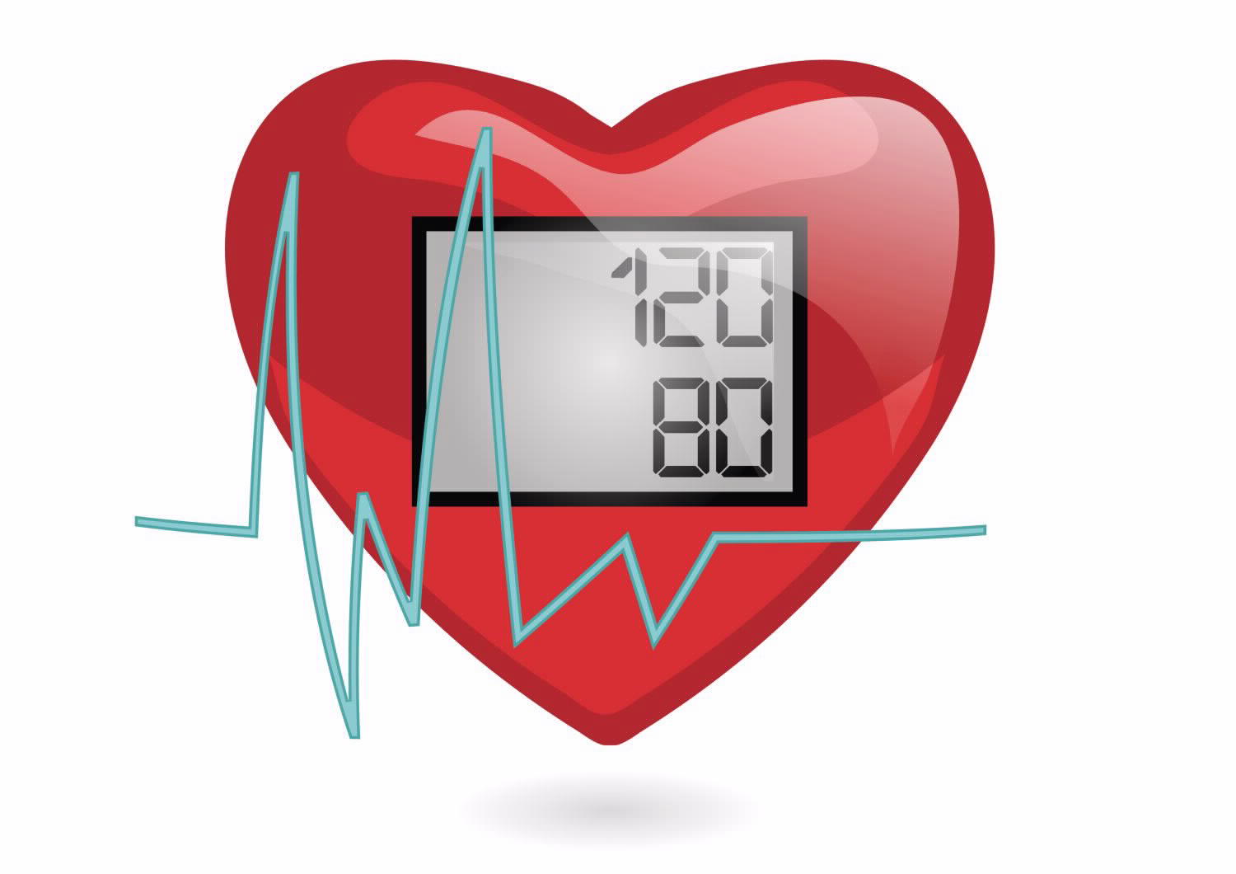
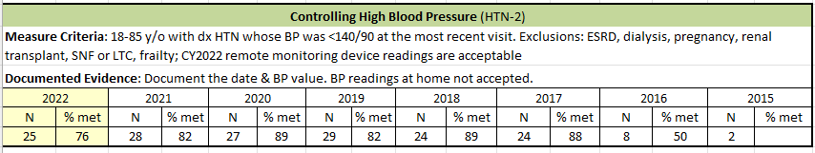
Do we provide the quality of care we think we do?
How do we compare to national benchmarks?
How well do we manage a patient’s blood pressure and minimize their risk for complications?
Notes:
MSSP for several years
Low pt population in audits to be statistically significant
Heard Sharon present on at ACO
No obvious baseline data or benchmarks so no real sense of gaps/opportunities
No structured “process management” in place

Slide 18


Aligned with our quality initiatives
Evidenced based program in a teamwork structure
AMA-MAP Framework
  Measure Accurately
  Act Rapidly
  Partner with Patients
Benchmark data
Extensive resource library
Opportunity for performance-based recognition
Provided funds to purchase needed equipment
Support and assistance from American Heart Association staff
PDSA process improvement framework
Opportunity for other Outpace CVA programs (diabetes, cholesterol)
Augmented our existing SMBP program and resources
Notes:
Aligned with NQF metrics we were already familiar with
Provided structure to workflows
Provided structure to analyze data
Many ‘ready to use’ resources
Recognition for internal/external stakeholders
Grant funds enabled us to fill the gaps identified by the Target BP process
Strong engagement with AHA and ACO staff
Sustainable cycle of process improvement with PDSA

Slide 19
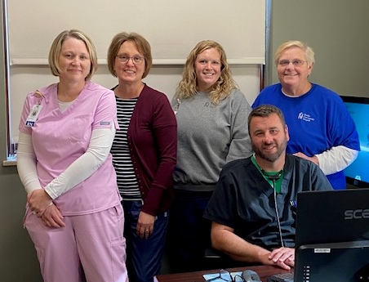
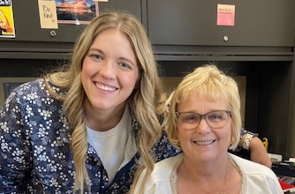
Building our Team
Physician Champion
Clinic Nurse Champion
Clinical IT Nurse
Clinical Pharmacist
Clinical Health Coach
Clinic Nurse Manager
Clinic Manager
Clinical Quality Coordinator
Notes:
Various nursing roles
Clinical pharmacist-provider and staff support in treatment algorithm, patient outreach and clinical inertia feedback/support
Clinical IT-new EMR, work to align clinical workflow with EMR documentation and data management
Physician champion-critical to have strong provider support in building program components and advocate to other providers for buy-in

Slide 20
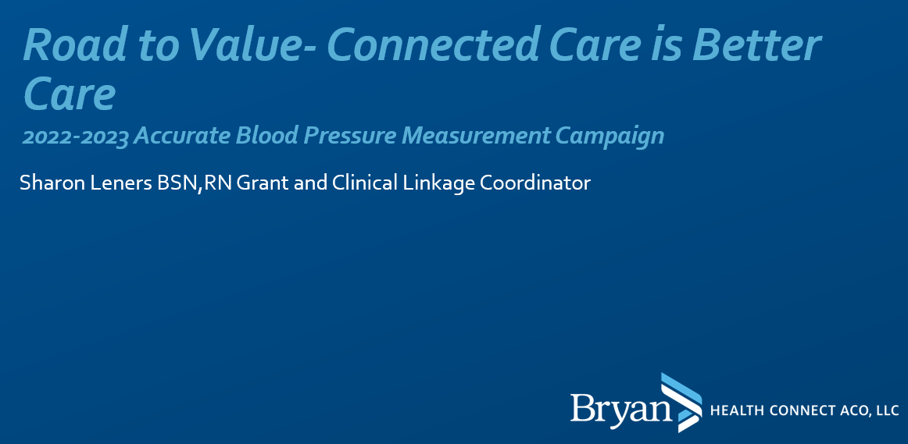
  Increase knowledge on how accurate blood pressure measurement lays the foundation for diagnosis and management of high blood pressure.
  Identify factors that can cause blood pressure reading to be inaccurate and how to overcome those factors.
  Increase knowledge of measure accurately tools and resources to help achieve accurate blood pressure measurement.
  Discuss SMBP (self measured blood pressure monitoring) for clinical management of hypertension
  Process used for ‘every patient, every time’.
Notes:
Obtain accurate measurement so we identify pts not in control
Understand and mitigate variables impacting BP readings
Ensure proper equipment available (cuff sizes, foot stools)
Pt education (Infograph)
Pt support to follow same process at home for accurate measurement
Strong staff feedback on impact of training and variables affecting accurate measurement
Completed by providers and clinical staff

Slide 21
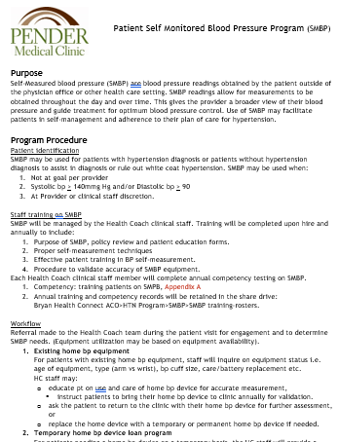
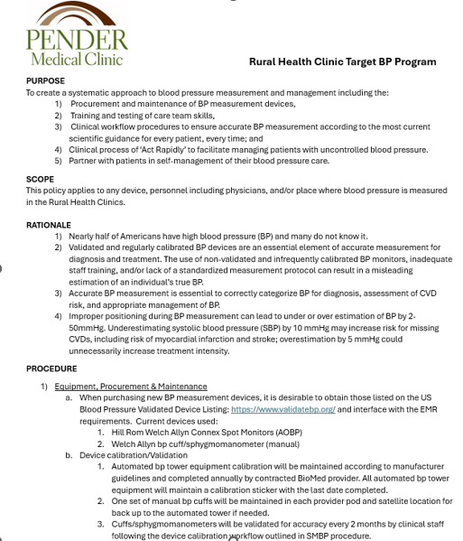
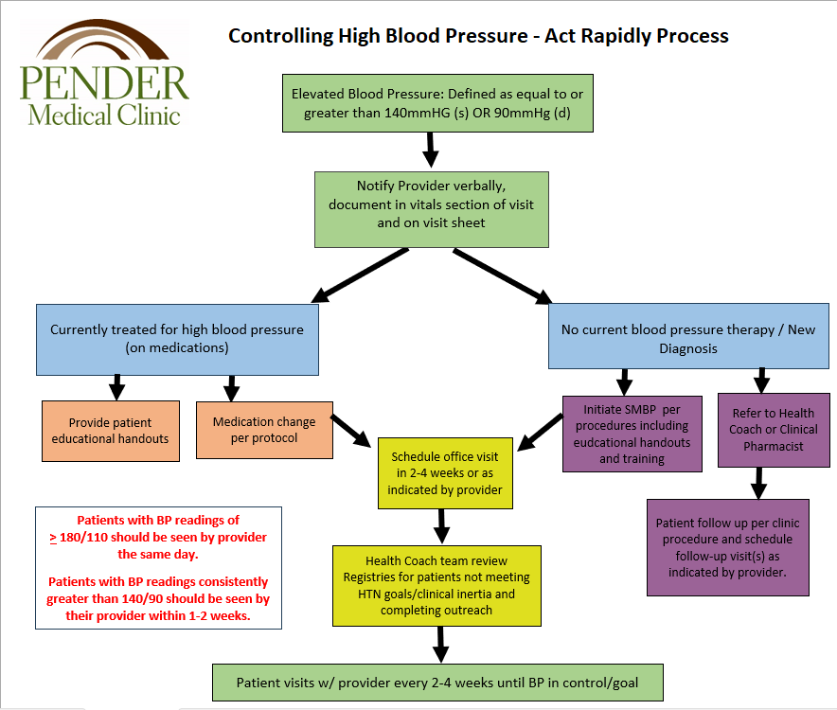
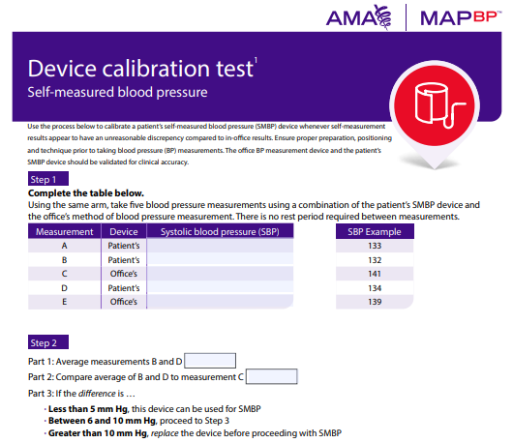
Notes:
Documenting workflow and setting staff expectations
Getting everyone ‘on the same page’
Empowering staff with tools (AHA)

Slide 22
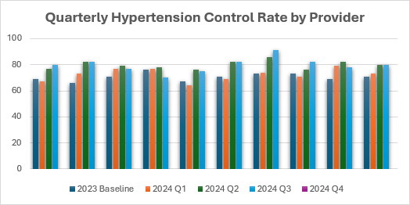
Quarterly Audits: Small changes, Big results
Hypertension control defined as blood pressure < 140/90)
Baseline control rate: 71%
2024 Goal: 73%
Q1: 73%
Q2: 80%
Q3: 80%
American Heart Association benchmark: 70%
Million Hearts benchmark: 80%
Group
2023 Baseline | 69 | 66 | 71 | 76 | 67 | 71 | 73 | 73 | 69 | 71
2024 Q1 | 67 | 73 | 77 | 77 | 64 | 69 | 74 | 71 | 79 | 73
2024 Q2 | 77 | 82 | 79 | 78 | 76 | 82 | 86 | 76 | 82 | 80
2024 Q3 | 80 | 82 | 77 | 70 | 75 | 82 | 91 | 82 | 78 | 80
Notes:
Within EMR-able to obtain data from quality dashboard for NQF 165: Controlling HBP
Quarterly measurements with data given to Providers, Admin and staff
Data managed by PDSA cycle

Slide 23


The REALLY BIG “small wins”
“Malcolm” always had high blood pressure readings in the clinic and at home. After staff training on accurate measurement, updated BP equipment implemented and use of the SMBP program, Malcolm, was found to have normal readings. No medications were needed. Malcolm was educated how to monitor, and self manage his blood pressure at home and able to sustain good control of his blood pressure.
“Mary” was waiting to have surgery until her blood pressure was in control. Through SMBP and health coach nurse/provider support, her blood pressure was monitored, medication adjustments were made and education given on self management and monitoring at home. Mary was able to proceed with her surgery and able to sustain good control of her blood pressure.
Notes:
Patient stories
Team building opportunity
Provider engagement

Slide 24

Great success but new opportunities
Further optimize tools and data management in our EMR
Registries
Patient outreach through Patient Portal
Data Mining
Need for clinic-based process to assess and mitigate Social Determinants of Health (SDoH) gaps
Meeting the patient ‘where they are’ and the role of Community Health Workers (CHW)
Target BP became a steppingstone to receiving the DHHS Chronic Disease Prevention and Control Program (CDPCP) grant to further the work started in Hypertension control.
Notes:
With Target BP we found other opportunities for improvement
Able to apply for and receive additional grant funds to further the work started with Target BP

Slide 25

Sharon Leners Grant & Clinical Linkage Coordinator
Bryan Health Connect
402-806-0408 or 483-8893
Sharon.leners@Bryanhealth.org
Lisa Schuetze RN, Clinical Quality Coordinator
Pender Community Hospital and Medical Clinics
402-385-3303
lisa.schuetze@pchne.org

