Slide 1
Infection Control in the Critical Access Hospital
Jessica Trutna BSN, RN

Slide 2
Tell me a little about yourself?
Name and Title
Where you work
Are you the infection preventionist at your facility?

Slide 3
Infection Prevention Regs
Infection Prevention and Control is a common deficiencies for CAH
Infection Prevention and Control Program was 6 out the 10 most common
Notes:
This was the last year.
The CMS worksheet for Infection Prevention and Control is 50 pages
There are many resources to help IP meet the regulations

Slide 4
Infection Prevention Regs Cont.
Designated IP with evidence they are qualified and maintain qualification through education, training, etc.
P&P on general infection practices, construction, reportable illnesses, etc.
Have to show how the infection control program is a part of QAPI
Notes:
Will more about the Infection Plan in later slides
Recent survey, still asked for copy of Covid policy

Slide 5
AHRQ
Agency for Healthcare Research and Quality
CUSP toolkits
  Antibiotic usage
  Surgical care
  Preventing CLABSI and CAUTI
Notes:
One tool to help IP’s in their work
Toolkits were created for clinicians by clinicians
Can be modified to fit your needs
Name a few toolkits

Slide 6
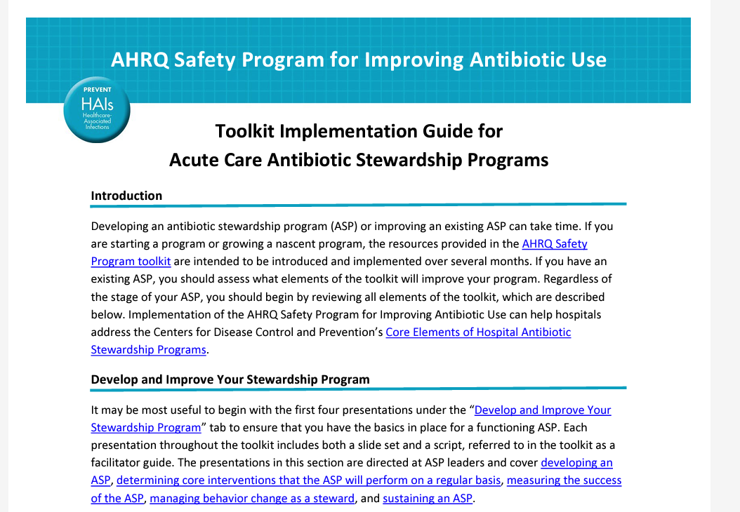
AHRQ
Notes:
Screen shot of the AHRQ toolkit for Antibiotic Stewardship Program.

Slide 7
What is an IP?
Infection Preventionist
  According to the CMS regulation §485.635(a)(3)(vi)
    A designated individual who is qualified by education and/or experience and who is responsible for the infection control program.
    But we are so much more…
Notes:
So what exactly is an IP
Discuss how some facilities designate lab personnel while others use LPNs or RNs from multiple different departments.
Ask what role each person plays.

Slide 8
Roles of an IP
Leader
Mentor
Subject Matter Expert
Educator
Mediator
Liaison
Collaborator
Evaluator
Customer Service
Notes:
Leader- when anything infectious going on in your facility i.e Ebola, RSV, Influenza, COVID-19, Zika virus
Mentor/Educator- everyday teaching on how to prevent infections
Subject Matter Expert- people look to you for the answers. Have to keep up to date on latest happenings locally, state, nation, and the world
Mediator- Sometimes one department might be upset another department didn’t let them know a patient was infectious and in isolation
Liason- for facility to public health and sometimes between departments i.e hospital and long term care
Collaborate- with local, regional and state public health. One example we had a local pharmacy giving COVID 19 vaccines. Had a patient with anaphylactic reactions to vaccines. Collaborated with the pharmacy to get the patient here to get their vaccine while being monitored.
Evaluator- Constantly evaluating hand hygiene, donning and doffing of PPE, monitor foley inserts, central line dressing changes

Slide 9
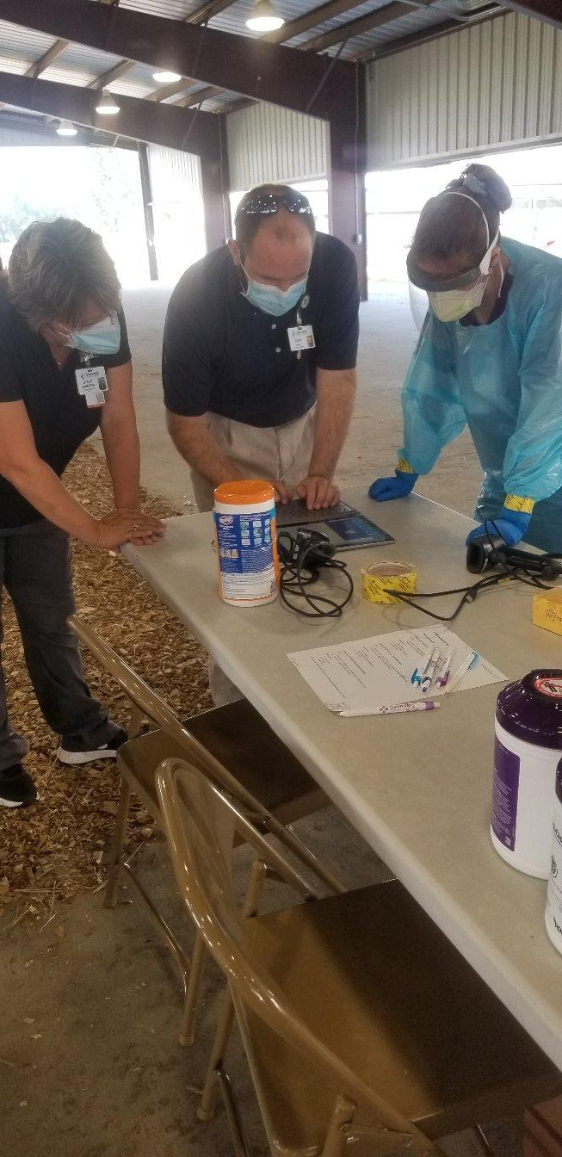
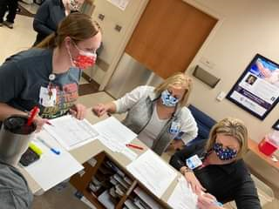

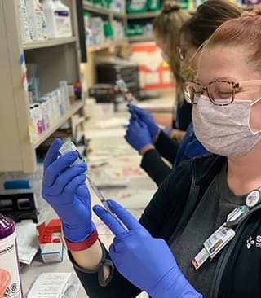
Notes:
This is a picture from our days starting out with Test Nebraska. We were getting ready to do mass testing at our local fair grounds.
The other 3 are from our mass vaccination clinics we did during the pandemic
Teamwork and Collaboration is what makes Infection Prevention and Control work.

Slide 10
Regulations – What You Need
Infection Control Plan
  A system to identify, report, investigate, and control infections and communicable disease for patients and employees
    Document surveillance activities, including measures selected for monitoring, collection, and analysis.
      Address issues in a timely manner and monitor interventions
Notes:
Discuss how this works and how you can extract data each year. We have daily huddle/standup/multidisciplinary rounds. Attend, keep track of infections on a monthly report. Do have manually extract data from EMR.
Work closely with employee health and public health especially with COVID 19 pandemic
Discuss the daily micro check with all labs.
Surveillance activities must be conducted in accordance with recognized infection control surveillance practices, such as, for example, those utilized by the CDC’s National Healthcare Safety Net (NHSN).
The CAH must develop and implement appropriate infection control interventions to address issues identified through its detection activities, and then monitor the effectiveness of interventions through further data collection and analysis.

Slide 11
Regulations – What You Need
Legionella Water Management Plan
  42 CFR §485.635(a)(3)(vi) for critical access hospitals (CAHs):
    CMS expects Medicare certified healthcare facilities to have water management policies and procedures to reduce the risk of growth and spread of Legionella and other opportunistic pathogens in building water systems.
  Tool Kit
    https://www.cdc.gov/legionella/maintenance/wmp-toolkit.html
Notes:
Legionella, a severe sometimes fatal pneumonia, can occur in persons who inhale aerosolized droplets of water contaminated with the bacterium Legionella. In a recent review of Legionella outbreaks in the United States occurring in 2000–2014, 19% of outbreaks were associated with long-term care facilities and 15% with hospitals.
Outbreaks generally are linked to environmental reservoirs in large or complex water systems, including those found in healthcare facilities such as hospitals and long-term care facilities. Transmission from these water systems to humans requires aerosol generation, as can occur from
showerheads, cooling towers, hot tubs, and decorative fountains. Legionella is less commonly spread by aspiration of drinking water or ice.
Do you have a water flushing system in place?

Slide 12
Measurements and Outcomes
Hand Hygiene
HAI (Hospital Acquired Infection)
  SSI (Surgical Site Infection)
  C. Diff (Clostridium Difficile)
  CAUTI (Catheter Associated Urinary Tract Infection)
  CLABSI (Central Line and Blood Stream Infection)
  NHSN Training
    https://www.cdc.gov/nhsn/acute-care-hospital/index.html
Notes:
SSI
KPRO, Breast, HIP, Cardiac – 90 days
COLO, HYST, C-sec, appy, choly – 30 days
Superficial, deep, and organ/space – reported must reflect the deepest tissue space met
Cdiff
A positive laboratory result for C. difficile toxin A and/or B (EIA or PCR) tested on unformed stool, OR a toxin-producing C. difficile organism detected by culture or other laboratory means on an unformed stool.
Healthcare facility onset – specimen collected >3 days after admission (on or after day 4)
Community onset - specimen collected less than or equal to 3 days after admission (on days 1, 2, or 3)
Community onset healthcare facility associated – patient discharged less than or equal to 4 weeks prior to the date specimen was collected.

Slide 13
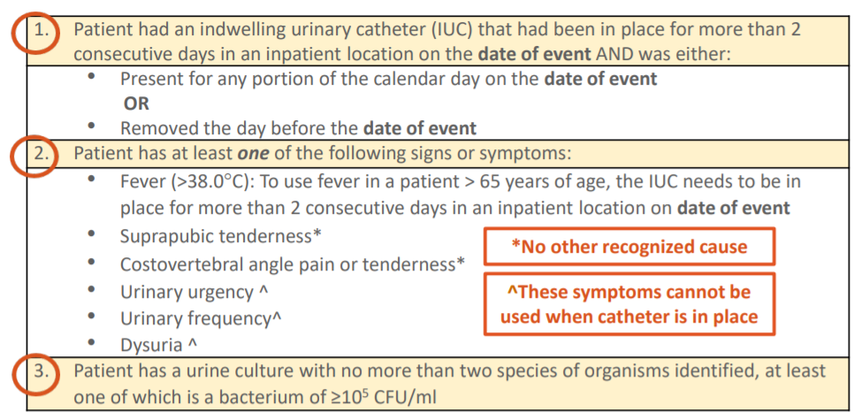
Measurements and Outcomes
CAUTI Criteria
Notes:
CAUTI: Must meet ALL 3
Cath in place greater than 2 days on date of event = CAUTI, HAI
Day inserted is day one
If Criteria is met on day 3, it is a CAUTI
Excluded organisms include candida species, yeast, mold, dimorphic fungi, or parasites
Urine cultures with greater than 2 organisms or including “mixed flora” are regarded as contaminated and can not be used.
Must be greater than 100,000 count

Slide 14
Measurements and Outcomes
CLABSI
Notes:
What is a Central Line - An intravascular catheter that terminates at or close to the heart or in one of the great vessels which is used for infusion, withdrawal of blood, or hemodynamic monitoring
Mid-line is NOT a central line
Must be a central line in place greater than 2 consecutive calendar days following the first access of the line, in an inpatient location, during the current admission.
Date of event will always be the date of the blood specimen collection which identified an organism in the blood. NO SYMPTOMS REQUIRED
Count for denominator device days will begin on the 1st day the central line is present
Count for making a CLABSI determination will begin on the 1st day of access on an inpatient unit
Eligible for CLABSI events until the day after removal from the body or patient discharge, whichever comes first
* There is some talk about monitoring peripheral IV infections in the near future.

Slide 15
Metrics for Infection Prevention
Take number of infections over patient/line days or procedures performed by 1000 patient days
Count your Foley and Central Line days at the same time every day
NHSN reporting can give you benchmark reports to show how you are doing compared to other CAHs

Slide 16
Challenges in Infection Control
MDROs (Multi Drug Resistant Organisms)
  Track and Identify Trends
Safe Practices by Staff
  Exposures
Ambulatory Care
  Quick turn around of patients
Communicable Disease Outbreaks and Bioterrorism
  Emergency Preparedness
  - Ebola, Zika, SARS-CoV-2…
Notes:
MDROs - The prevention and control of MDROs is a national priority that requires all healthcare facilities and agencies assume responsibility and participate in
community-wide control programs. MDROs are defined as microorganisms – predominantly bacteria – that are resistant to one or more classes of antimicrobial agents. A notable example is methicillin-resistant Staphylococcus aureus (MRSA).
Increase in numbers of MDROs can signal a breach in infection control practices **Handwashing**
Ambulatory Care – EDs and Clinics have patients that have a quick turn around with limited cleaning at times. Important that these areas identify and follow precautions quickly. Receptionist/unit clerks serve as a great resource to flag patients with suspicious/infectious symptoms. This requires educating these staff as they aren’t always medical professionals.
Emergency Preparedness – Be sure your IP sits on the emergency preparedness committee to address disease outbreaks and bioterrorism. You do have to have a policy that addresses Highly Infectious Diseases

Slide 17

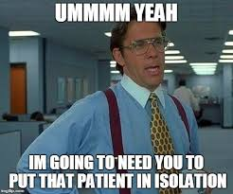
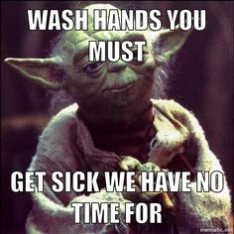
https://www.cafepress.com/gigglemed/7943712

Slide 18
Mitigating Risk
Hand Hygiene
Respiratory Hygiene/Cough Etiquette
Use of Transmission-Based Precautions such as: contact precautions, droplet precautions, and airborne precautions
Use of personal protective equipment (PPE) for healthcare personnel such as gloves, gowns, masks, respirators, face shields/eye protection
Appropriate use of Foleys and central lines
Safe work practices to prevent healthcare worker exposure to blood borne pathogens
  Annual Sharps Safety Evaluation
Safe medication preparation and administration practices
  Safe Injection Champion(s)
Patient Dedicated Equipment
Policies to ensure that reusable patient care equipment is cleaned and reprocessed appropriately before use on another patient
Role specific education for staff
Education to patients and visitors
Notes:
incorporate infection control techniques and standard precautions including, but not limited to what is listed.
Safe med prep:
Routine preparation of injectable medications takes place in a designated clean medication area
• Proper hand hygiene before handling medications;
• Always disinfecting a rubber septum with alcohol prior to piercing it;
• Always using aseptic technique when preparing and administering injections;
• Never entering a vial with a used syringe or needle;
• Never administering medications from the same syringe to more than one patient, even if the needle is changed;
• Recognizing that. after a syringe or needle has been used to enter or connect to a patient’s IV it is contaminated and must not be used on another patient or to enter a medication vial;
• Never using medications labeled as single-dose or single-use for more than one patient.
• If multi-dose vials are used for more than one patient, they must not be kept or accessed in the immediate patient treatment area.
• Never using bags or bottles of intravenous solution as a common source of supply for more than one patient
• Wearing a surgical mask when placing a catheter or injecting material into the spinal canal or subdural space
• Never using insulin pens and other medication cartridges and syringes intended for single-patient-use only for more than one person
Role specific education
on proper hand hygiene, standard and transmission-based precautions, asepsis, sterilization, disinfection, food sanitation, housekeeping, linen care, medical and infectious waste disposal, injection safety, separation of clean from dirty, as well as other means for limiting the spread of infections.

Slide 19
Audit Techniques:
Trust… But Verify
Chart Review
  100% or Random Sampling
Secret Shoppers
  Hand Hygiene
Watch and Wait
Patient Rounds with Providers
ATP Testing, Glow Spray, and Powder
  High Touch Areas
  Hand Hygiene
Notes:
What I do:
100% chart reviews in hospital including culture reports
Secret shoppers for hand hygiene- taped to nurses’ station deck for secret shopper and for any other staff that may have seen good or bad hand hygiene
ATP testing done by EVS monthly and report
In Sterile Processing check each scope ATP tester to verify clean before putting in the Medivator. Survey’s commented they really liked this process.

Slide 20
IP Daily Activity
Review Patient Charts
  Look for:
    Foleys
    Central lines
    Infections requiring isolation
    Updated lab results
Round on Patients and Visit with Nurses and Providers
Verify Isolation Signage is up
  Educate patients and family on isolation precautions
  Educate staff on isolation precautions
Conduct Hand Hygiene Observation
Review Daily Microbiology Report
  Address any gaps in treatment

Slide 21
IP Weekly Activity
Run report on 30 day and 90 day SSIs
  Create SSI cases as needed
Run report for possible CAUTIs and CLABSIs
  Create HAI cases as needed
Perform room cleaning surveillance
  Spray high touch areas in patient room prior to environmental services cleaning and go through with black light
  Swab with ATP tester swab after EVS cleaning
Notes:
SSI and HAI surveillance technique will depend on your facilities ability to manually or electronically abstract the data.
**Explain how to do manually abstract**
Surgery Manager keeps list of surgeries and follow ups
Enter all into NHSN that would count

Slide 22
IP Monthly Activity
Prepare infection control report for med staff
Collect hand hygiene observations from secret observers
  Remind secret observers for upcoming month to perform duties
NHSN reporting
  Abstract all procedures
  Abstract HAIs
  Export procedures and HAIs
  Upload procedures and denominator data into NHSN
  Upload any SSI, CAUTI, or CLABSI cases into NHSN
Check negative airflow rooms
MDRO Report
Notes:
Infection Control report puts all metrics on one report for the CEO, Board, and medical staff to see
MDRO report can be manual or electronic or a hybrid of both

Slide 23
IP Yearly Activity
Conduct and collaborate with department managers for education in these areas
  Hand Hygiene
  Standard & transmission-based precautions
  Asepsis
  Sterilization
  Disinfection
  Food Sanitation
  Housekeeping
  Linen Care
  Medical/Infectious Waste
  Injection Safety
  Separation of clean from dirty
Send letters to specialty providers’ office for documentation of influenza vaccine for their staff that come to facility
Perform Annual Sharps Review
Perform Annual Infection Control Risk Assessment
Send out letters to surgeons for previous year regarding SSI rate at facility

Slide 24
Know Your CAH
Get comfortable with the following departments:
  Operating Room
  Sterile Supply and Processing
  Lab
  Radiology
  Nursing Floor
  Emergency Department
  Nutrition
  Environmental Services and Facility Maintenance
  Clinic

Slide 25
ICRA (Infection Control Risk Assessment)
Used for construction to assure any and all precautions regarding infection control and patient safety are addressed and followed.
Must work closely with maintenance.
Daily audits of work being done.
  Document audits and any interventions.
Notes:
ICRA Class

Slide 26
Antibiotic Stewardship
CDC Published the 7 Core Elements for CAHs in 2014, then updated in 2019
  https://www.cdc.gov/antibiotic-use/healthcare/pdfs/core-elements-small-critical.pdf
ASAP with UNMC can provide education and assist in building your stewardship
  https://asap.nebraskamed.com/
Notes:
Discuss our journey is ASAP from UNMC- come to do onsite survey of program then offer feedback
Surveyors do like to hear if you have ASAP or ICAP come in to evaluate your program

Slide 27
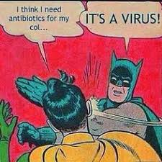
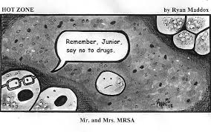
Why Antibiotic Stewardship?

Slide 28
Resources and Guidelines for Best Practice
APIC
SHEA
ASAP
  https://asap.nebraskamed.com/
ICAP
  https://icap.nebraskamed.com/
NHSN
  https://www.cdc.gov/nhsn/index.html
  Healthcare Infection Control Practices Advisory Committee (HICPAC)
CDC
  https://www.cdc.gov
AORN
OSHA
Clarkson College Infection Control Training
  https://www.clarksoncollege.edu/academics/professional-development/courses/primary-infection-prevention-courses/

Slide 29
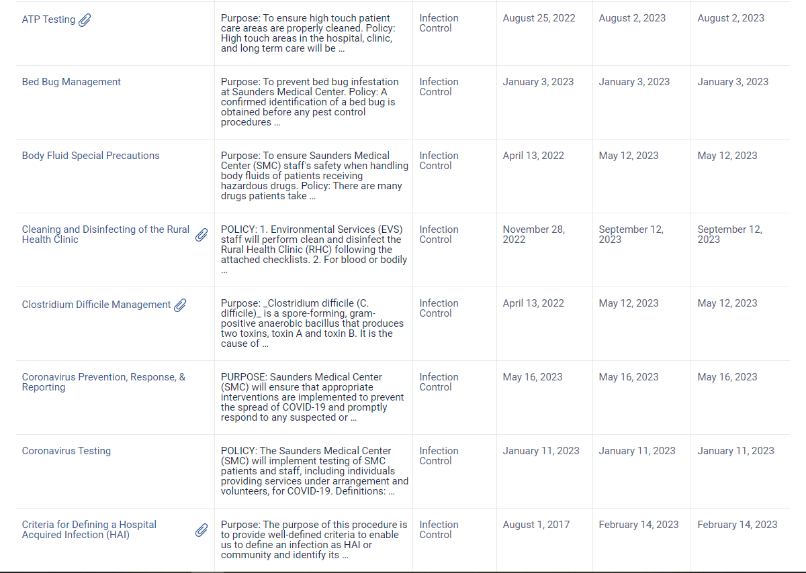
Some good policies:

Slide 30

That was A LOT of information…
Questions?
http://www.washingtonindependentreviewofbooks.com/index.php/features/information-overload

Slide 31
References
State Operations Manual. Appendix W - Survey Protocol, Regulations and Interpretive Guidelines for Critical Access Hospitals (CAHs) and Swing-Beds in CAHs. (Rev. 183, 10-12-18)42 CFR §485.635(a)(3)(vi)
https://www.youtube.com/watch?v=5rPk9XhA700
https://www.cdc.gov/antibiotic-use/healthcare/implementation/core-elements-small-critical.html

