Slide 1
AgriSafe’s Total Farmer Health Model: A Holistic Approach to Serving Midwest Farmers, Ranchers and their Families
Linda Emanuel BSN, RN

Slide 2
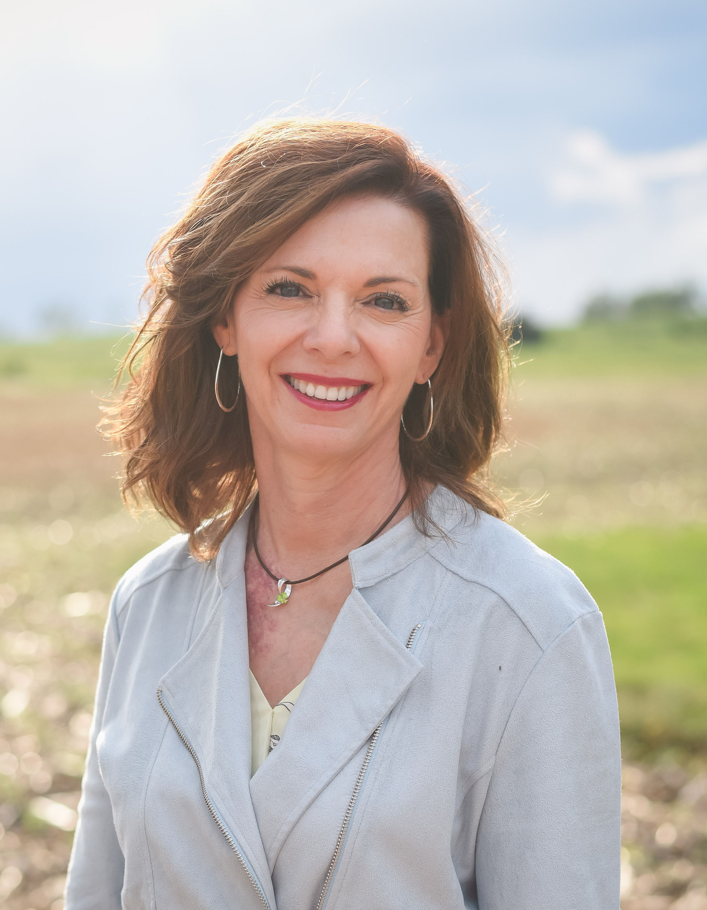
Presenter Information
Topic:
AgriSafe’s Total Farmer Health Model: a Holistic Approach to Serving Agricultural Populations
Contact:
lemanuel@agrisafe.org
Linda Emanuel, BSN, RN
Community Health Director
AgriSafe Network

Slide 3
OBJECTIVES
Understand the unique occupational health exposures and stressors of the farming/ranching population
Apply concepts of the Total Farmer Health Model in strategizing community-based education and outreach practices.
Identify two disparities related to the mental well-being of the agricultural population.
Identify two evidence based best practice suicide prevention training courses for health care professional implementation.

Slide 4
Protecting the People Who Feed the World
AgriSafe protects the people who feed the world by:​
Performing ongoing needs assessments of agricultural producers and workers (following the Total Farmer Health® model).​
Training rural health professionals across the United States.​
Establishing partnerships with NIOSH ag. centers, rural research centers, and other non-government-based organizations.​
Maintaining a culture of readiness and organizational expectation to protect and respond.

Slide 6
Total Worker Health® Approach
Total Worker Health® is defined as policies, programs, and practices that integrate protection from work-related safety and health hazards with promotion of injury and illness-prevention efforts to advance worker well-being.
The Total Worker Health (TWH) approach prioritizes a hazard-free work environment for all workers.
Notes:
Total Worker Health® is defined as policies, programs, and practices that integrate protection from work-related safety and health hazards with promotion of injury and illness-prevention efforts to advance worker well-being.
The Total Worker Health (TWH) approach prioritizes a hazard-free work environment for all workers.
What it is?
The TWH approach brings together all aspects of work in integrated interventions that collectively address worker safety, health, and well-being. This integrated approach:
Focuses on how the workplace environment can eliminate or reduce risks and enhance overall worker health.
Goes beyond traditional safety and health concerns in recognition of the relationship between work and nonwork conditions.
Offers a holistic model for improving workforce safety, health, and well-being.
Provides a path to improving worker creativity, innovation, and productivity by creating work environments that are safe, health-enhancing, and fulfilling.
What it matters
The TWH approach benefits workers, employers, and communities. Employers indicate that, by emphasizing a TWH focus, they accrue competitive advantages related to:
Recruitment
Retention
Employee satisfaction
Community engagement and reputation
Sustainable workforce culture1
Risk factors in the workplace may contribute to health problems previously considered unrelated to work. For example, there are work-related risk factors that can lead to health conditions like:
Obesity23
Sleep disorders4
Cardiovascular disease5
Depression678
The program fosters research to increase understanding of health conditions that may not arise from work but are affected by work. The approach targets the conditions of work to both protect workers from hazards and advance their health and well-being.

Slide 7
Notes:
CDC/NIOSH Total Worker Health Affiliate since August 2017
NIOSH launched in 2011a total worker health model. It is integrated worker related safety and health practices founded on research and belief that successful programs include both employer and employees responsibility and collaboration
AgriSafe adopted the model to the many stressors affecting the total farmers health. Components stand alone yet all intersect having significant impact on the total farmers health and wellbeing, mental, physical, spiritual, and emotional.
Cognition-brain health mental health supports effective decision making, problem-solving, emotional regulation, healthy relationships, situational awareness, healthy lifestyle choice and reality testing.
Spirituality- Spirituality is a pathway we use to find value, meaning, hope, comfort and inner peace. Historically, rural families and agricultural workers experience spirituality through their connection with the land, animals, their values and principles, faith-based practices, and the arts. Spirituality may or may not involve organized religion. Spirituality is a flowing dynamic balance that allows and created healing of body-mind-spirit.
Our physical health, mental health and spiritual health are all interconnected and are equally weighted measures in achieving Total Farmer Health.
Stop- Ask audience to contribute in the chat some examples of unique stressors in this industry.

Slide 8
Placeholder Poll Everywhere question: Assess audience clinical experience of Agriculturist greatest health disparity.
Instructions to access poll everywhere.

Slide 9
Poll Everywhere question word cloud

Slide 10
Placeholder Poll Everywhere question #2, What are the perceived and actual barriers to care

Slide 11
Placeholder word cloud #2

Slide 12
Farmworkers are at high risk for fatal and nonfatal injuries, work-related lung diseases, noise-induced hearing loss, skin diseases, and certain cancers associated with chemical use and prolonged sun exposure. Variety of exposures in agriculture result in multiple hazards:
Dusts (organic: bacteria, endotoxin, fungal spores; pesticide residues)
Pesticides and chemicals
Gases (Anhydrous ammonia, hydrogen sulfide, welding)
Vapors (fumigants, gasoline, diesel)
Confined space (oxygen deficient atmosphere)
Flying objects (cutting, grinding, sawing, drilling, mowing)
Noise (machinery, livestock, tools)
Hazardous equipment and machinery
Livestock
Off Road Vehicles

Slide 13
Farm & ranch work requires upper and lower body strength as well as repeated twisting and turning.
Notes:
Photo property of AgriSafe- Broad Stance wide protective and using core muscles. Overall posture is good.

Slide 14
Health insurance coverage places a significant financial burden on farm families.
Farmers are more likely than their rural counterparts to purchase in the individual insurance market which had limitations in care benefits.
Farmers are at high risk to be underinsured.

Slide 15
Farm Producers
3.4 million Producers
58.1 years average age
1.9 million farms
36% female
Military Veterans 68.2 average age
Beginning Producers Highest % (Rhode Island, Alaska, Maine)
Source: USDA NASS, 2022 Census on Agriculture
Notes:
Demographics in the Census of Agriculture
The Census of Agriculture, conducted once every five years, is a complete count of U.S. farms and ranches and the people who operate them. Demographic information is available at national, state, and county levels, as well as for classes of farm and congressional districts. Results from the 2022 Census, as well as previous censuses, are available online. See the searchable database Quick Stats, downloadable PDF reports, maps, and a variety of topic-specific products. Highlights featuring demographic groups and profiles by race, ethnicity, and gender will become available throughout 2
2024.
Average age of female producers, contribution to agriculture

Slide 16
Producers by Ethnicity and Race
The Census of Agriculture, conducted once every five years, is a complete count of U.S. farms and ranches and the people who operate them.
Notes:
The Census of Agriculture is a complete count of U.S. farms and ranches and the people who operate them. Even small plots of land - whether rural or urban - growing fruit, vegetables or some food animals count if $1,000 or more of such products were raised and sold, or normally would have been sold, during the Census year. The revised questions, which identified a producer as someone involved in making decisions for the farm, led to more people identifying as producers. The 2017 Census also collected data on young producers, new and beginning producers, and (for the first time) those with military service.
Farmers by ethnicity 2022 -
Nationwide, the 2022 census shows the ethnic and racial identities of U.S producers to be: 112,379 of Hispanic, Latino or Spanish origin; 3,419 Native Hawaiian or Pacific Islander; 22,788 Asian; 41,807 Black or African American; 56,203 American Indian or Alaska Native; 30,564 reported more than one race; 3.2 million are white.
https://www.gfb.org/news/ag-news/post/2022-census-of-agriculture-the-numbers-are-in

Slide 17
Emerging Issues/ Public Health Threats
Mental Health and Stress
Zoonotic Diseases
Aging Workforce
Extreme Weather Impact
Farmers' Access to Healthcare
Respiratory Health
Global Pandemic Preparedness/ Infection Control
Diversity, Equity, Inclusion, Accessibility
Notes:
1. **Mental Health and Stress:**
- Farmers often face high-stress levels due to financial pressures, unpredictable weather conditions, and market fluctuations. Mental health issues, including anxiety and depression, are increasingly recognized as important concerns in the agricultural sector.
2. **Zoonotic Diseases:**
- The interface between agriculture and animal husbandry poses a risk for transmitting zoonotic diseases. Farmers and farmworkers may be exposed to diseases that can transfer from animals to humans, highlighting the importance of proper hygiene and biosecurity measures. Seventy- Five percent of new emerging diseases are zoonotic.
3. **Aging Workforce:**
- In many regions, the agricultural workforce is aging. Older farmers may face unique health and safety challenges, such as reduced physical abilities and increased susceptibility to certain health conditions. Strategies are needed to support the aging agricultural workforce.
4. **Extreme Weather Impact:**
- New challenges for agriculture, including extreme weather events, changing disease patterns, and alterations in crop yields. These factors can impact the health and safety of farmers, requiring adaptation and resilience strategies.
5. **Farmers' Access to Healthcare:**
- Access to healthcare services in rural areas can be limited, affecting farmers' ability to receive timely medical attention. Improving healthcare infrastructure and increasing awareness of available services are essential for maintaining the health of agricultural communities.
6. **Respiratory Health:**
- Dust and airborne particles in agriculture, especially during plowing and harvesting, can pose respiratory health risks. Proper use of protective equipment and awareness of respiratory health issues are critical.
7. **Global Pandemic Preparedness/ Infection Control:**
- The COVID-19 pandemic has highlighted the importance of preparedness and response in the agricultural sector. Strategies for ensuring the continuity of food production while protecting the health of agricultural workers during pandemics need attention.
8. **Diversity, Equity, Inclusion, Accessibility: **
- Diversity, Equity, Inclusion, and Accessibility (DEIA) are essential considerations across all sectors, including agriculture. Addressing these aspects in agriculture not only contributes to social justice but also enhances the sustainability and resilience of the industry.

Slide 18
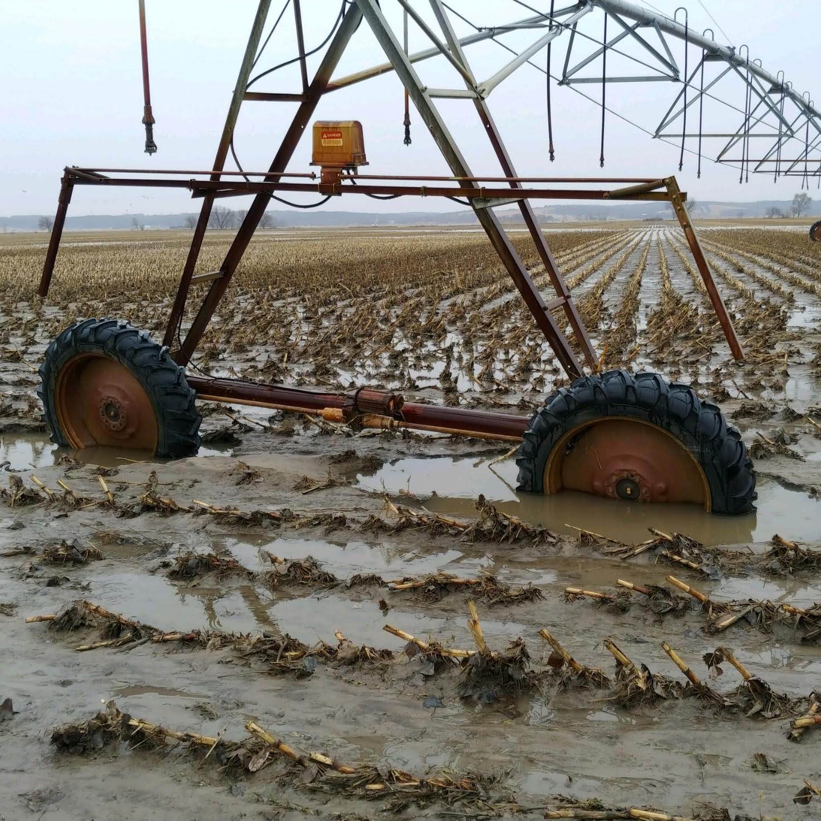
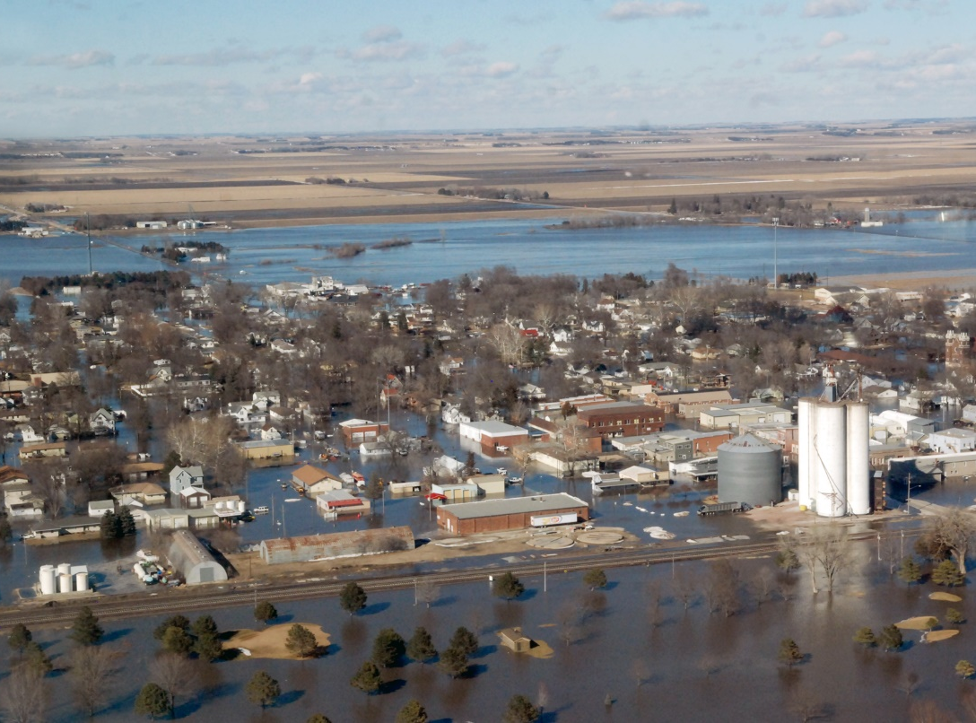
Extreme Weather Events’ Impact on Worker Health

Slide 19
AgriSafe’s Flood Response
Resources available for urban communities and businesses
None were available that were directed to agriculture –
Issues include (not limited to)
Zoonotic disease transmission i.e.: Leptospirosis
Animal carcasses
Chemical/Pesticide storage
Contaminated well water
Access to healthcare providers – travel routes cut off
Mold

Slide 20
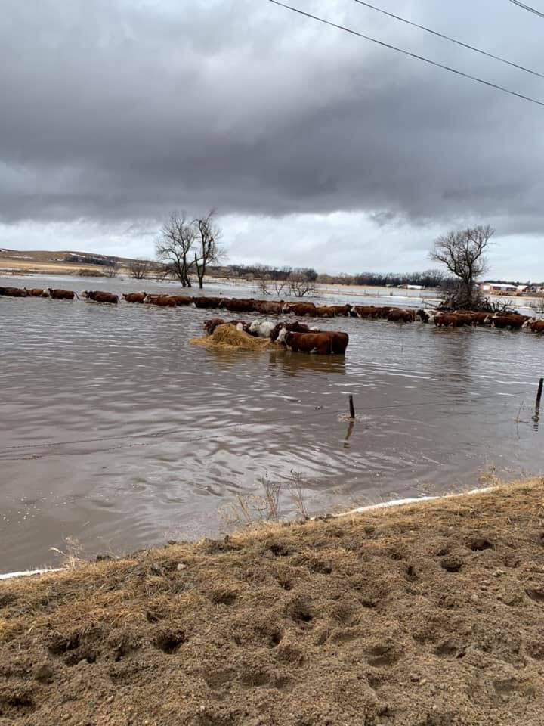
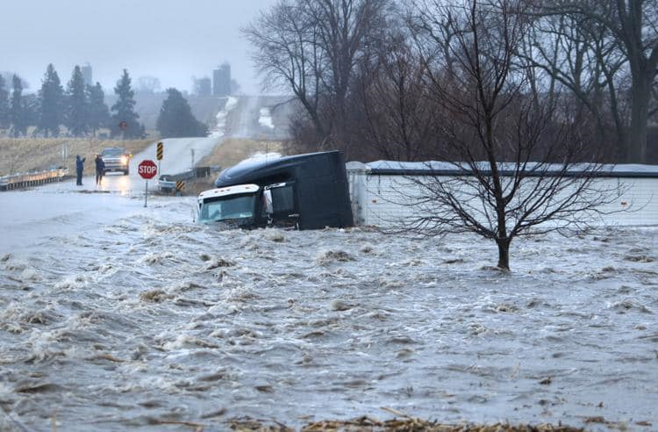
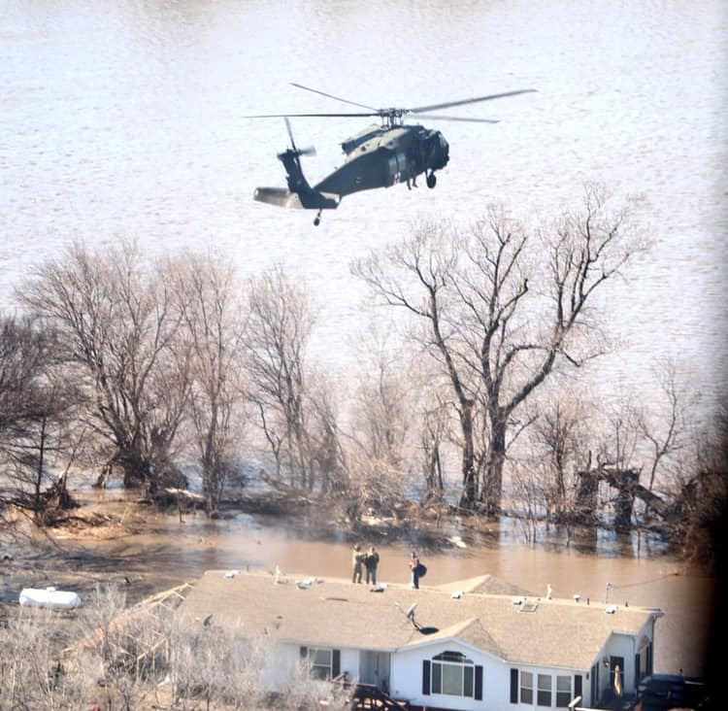
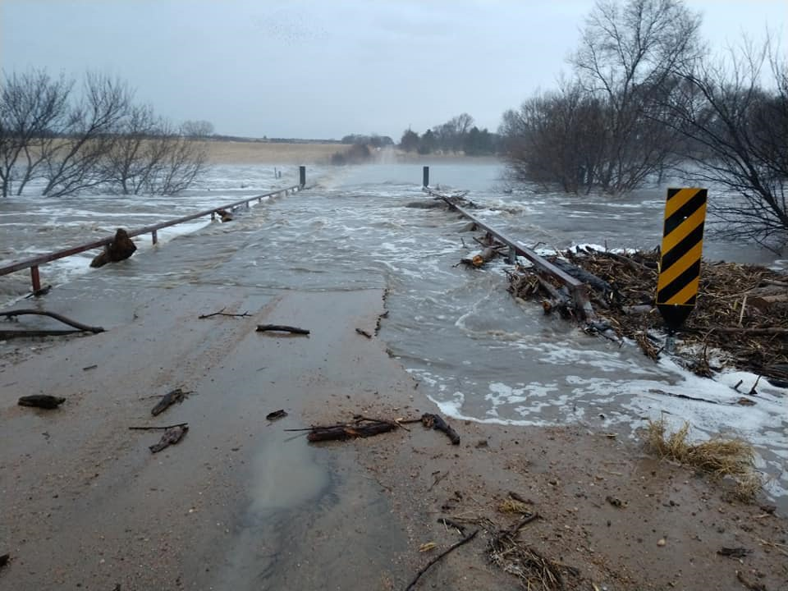

Slide 21
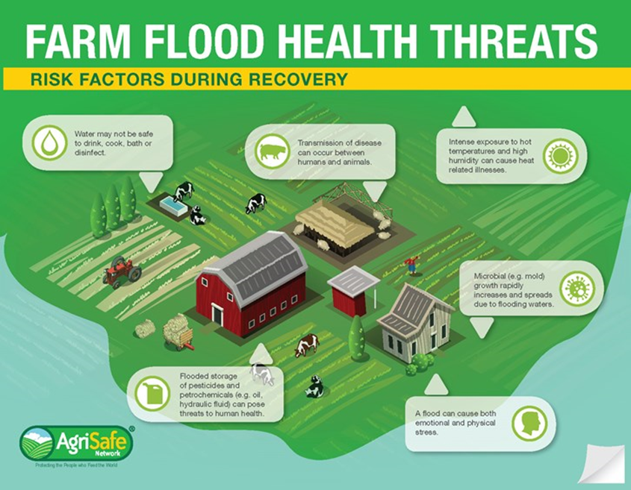

Slide 22
Research to Practice
Notes:
Add in comments on AgriSafe team in Virginia

Slide 23
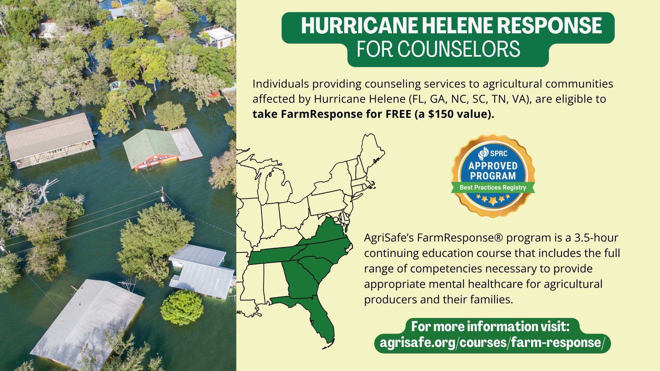

Slide 24
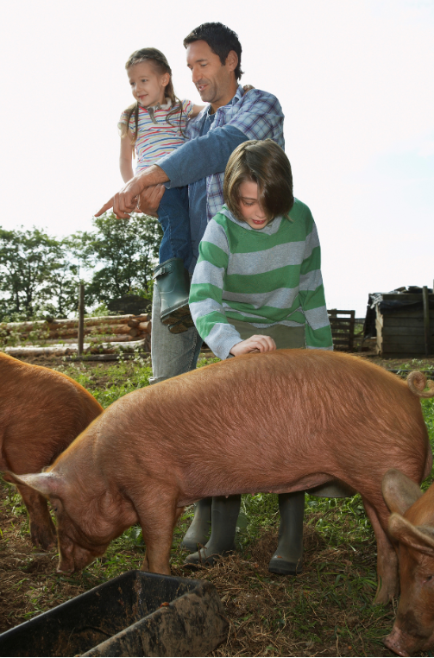
Rural Mental Health
There is a significant lack of access to specialty mental health care in rural areas in the USA. It is estimated that as many as 65% of nonmetropolitan counties do not have psychiatrists, and
over 60% of rural Americans live in designated mental health provider shortage areas.
Source: A call to action to address rural mental health disparities
www.ncbi.nlm.nih.gov/pmc/articles/PMC7681156/
Notes:
Center for Rural Affairs
What is Nebraska’s Behavioral health shortage stats?

Slide 26
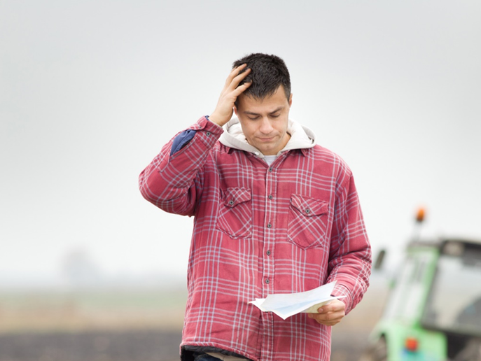
Lack of social support and isolation can compound a farmer’s ability to handle high stress situations:
low commodity prices
natural disasters
family conflict involving succession planning
workforce shortages
medical or injury event
Notes:
Photo property of AgriSafe- Broad Stance wide protective and using core muscles. Overall posture is good.

Slide 27
Notes:
FarmResponse® is 3.5-hour health provider training that addresses farm and ranching cultural competencies, financial stress, land ownership, and legal issues as well as the work of agriculture relevant for communication, and collaborative mental health strategies. This training is delivered on-demand through AgriSafe’s Learning Lab for the busy healthcare professional. Upon successful completion, healthcare professionals receive a continuing education credit that can be used for their professional license renewals. First and second year registrations and program completion indicate a strong interest and need for continued outreach collaboration
FY 2, goal 120, Registrants = 147, Course completions= 95.

Slide 28
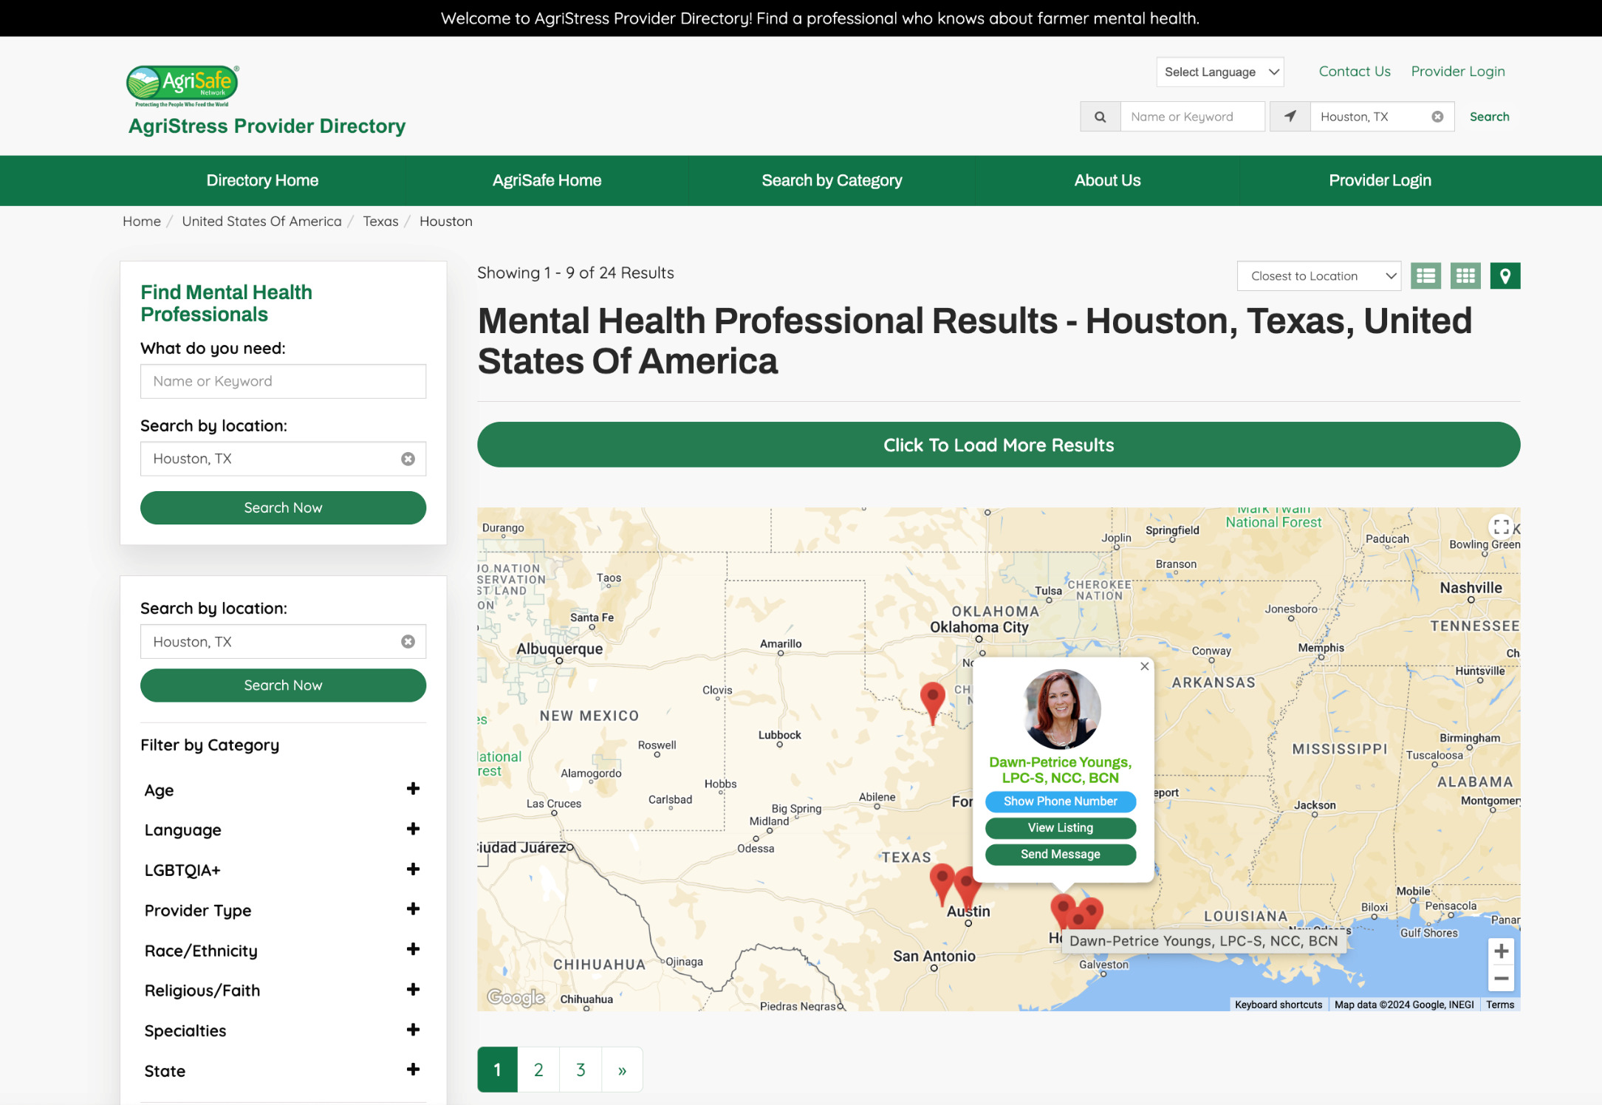
AgriStress
Provider
Directory
Website: directory.agrisafe.org
Notes:
directory.agrisafe.org

Slide 30
Notes:
Findings from “Preliminary Exploration of Weekly Peer Group Discussions as a Strategy for Coping with Feelings Associated with Euthanasia in Dairy Caretakers” Key findings of this study were that discussion sessions did not have a direct impact on the study outcomes as measured using a pet bereavement scale, as there was no difference in the change in bereavement scores during the 8 week study period between the treatment and non-treatment groups. Thematic analysis of peer discussions revealed that compassion towards dairy cattle is a prominent factor in areas of decision making, protocols, and training.

Slide 31
Wildfires
Generic wildfire protection is NOT applicable to those in agriculture
Standard advice:
“Avoid going outside”
“Public advised to stay indoors”
“Keep activity levels low”
Just doesn’t work in agriculture!

Slide 32
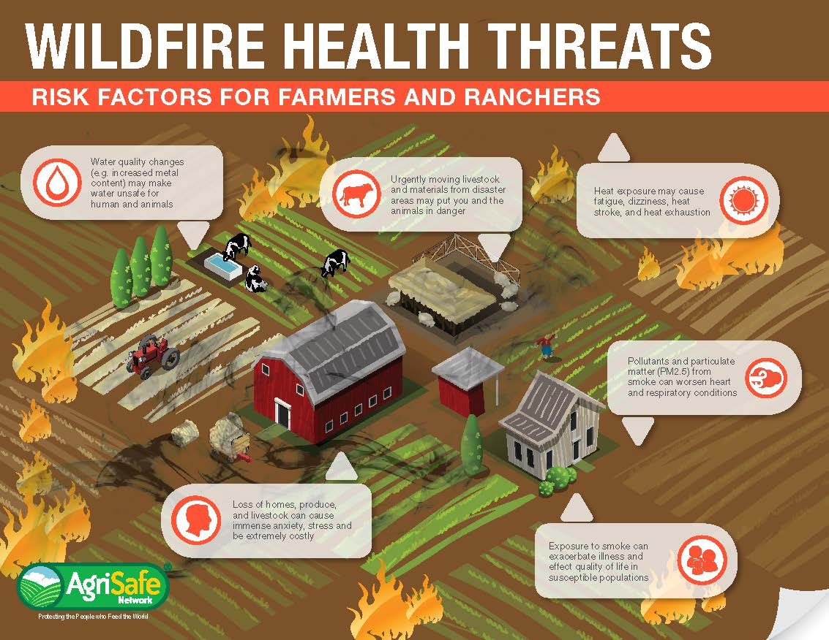

Slide 33
Mental Wellness Resource

Slide 34
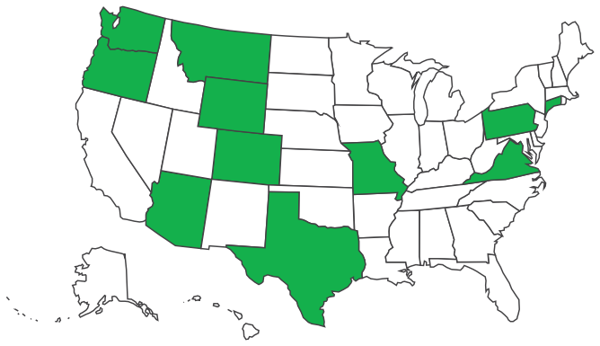
Now available in: AZ, CO, CT, MO, MT, OR, PA, TX, VA, WA, and WY!.
Website: agrisafe.org/agristress-helpline
Notes:
Launched in
Totals to Date:
908 calls
93 texts
Resources/referrals (trend was ½ mental health and ½ agricultural resources): 627
Number of callers identified at risk of suicide: 19
Number of third party calls on behalf of someone concerned about suicide: 15

Slide 35
Learn when it's convenient for your schedule!
AgriSafe's Learning Lab provides learners with over 70+ online agricultural health and safety trainings!

Slide 36
FREE On-Demand Webinar
(Continuing Education is Available)
BEST PRACTICES IN THE DETECTION AND MONITORING OF PESTICIDE EXPOSURE
Summary: This webinar focuses on cholinesterase testing and monitoring, drawing on best practices from California and Washington’s agricultural safety programs. This session covers:
The function of ChE in the body and the effects of its inhibition.
Routes of exposure to OPs and N-methyl carbamates.
Identification of at-risk workers and common signs and symptoms of exposure.
Treatment options and preventive measures for exposure.
A review of an updated, evidence-based protocol for cholinesterase monitoring, which provides a structured approach to medical surveillance.
Continuing Medical Education: This activity has been planned and implemented in accordance with the accreditation requirements and policies of the Accreditation Council for Continuing Medical Education (ACCME) through the joint providership of the Minnesota Medical Association and AgriSafe Network. The Minnesota Medical Association (MMA) is accredited by the Accreditation Council for Continuing Medical Education to provide continuing medical education for physicians. The Minnesota Medical Association designates this enduring activity for a maximum of 1 AMA PRA Category 1 Credit(s)™. Physicians should claim only the credit commensurate with the extent of their participation in the activity.
Nursing Continuing Professional Development: This nursing continuing professional development activity was approved by the Midwest Multistate Division, an accredited approver by the American Nurses Credentialing Center's Commission on Accreditation.
Scan the QR code to register or visit learning.agrisafe.org

Slide 37
Image courtesy of https://farmtownstrong.org/
Notes:
Roughly 21 to 29 percent of patients prescribed opioids for chronic pain misuse them.⁶
Between 8 and 12 percent develop an opioid use disorder.^{7–9}
An estimated 4 to 6 percent who misuse prescription opioids transition to heroin.^{7–9}
About 80 percent of people who use heroin first misused prescription opioids.⁷
Opioid overdoses increased 30 percent from July 2016 through September 2017 in 52 areas in 45 states.¹⁰
The Midwestern region saw opioid overdoses increase 70 percent from July 2016 through September 2017.¹⁰
National Institute on Drug Abuse
Opioids are a class of drugs that include the illegal drug heroin, synthetic opioids such as fentanyl, and pain relievers available legally by prescription, such as oxycodone (OxyContin®), hydrocodone (Vicodin®), codeine, morphine, etc.
Mostly prescribed to treat moderate to severe pain
Opioid effects
Can cause slowed breathing (hypoxia)
Dangerous when combined with benzodiazepines
Can lead to coma, permanent brain damage, death
More Aware of the opioid crisis than 5 years later
We've seen that the data tells us 60 percent of respondents say adults in their community are more aware of the opioid crisis than they were five years ago,
Nearly eight in 10 adults, which is 77 percent, report feeling comfortable having a conversation about opioid misuse. So, we're very encouraged by the trends that we're seeing.

Slide 38
Opioid Response
Notes:
Preventing Opioid Misuse In the SouthEast: The PROMISE Initiative
Work began in Fall 2017 emerging issue in ag population in line with National Crisis.

Slide 41
on the Horizon
*Curriculum expansion to include multiple healthcare disciplines
*CUSTOMIZED EXPERIENCE OPTION
*PROFESSIONAL DEVELOPMENT FOR COMMUNITY HEALTH WORKERS
Notes:
Curriculum expansion to include multiple healthcare disciplines, exploring an ag-medicine course structure
2) Customized experience, to set basic electives and then list options to diversify the educational experience
3) PD Community Health Workers, we see the value in meeting a diversity of rural community populations where they live and work. Community health workers (CHWs) are valuable for engaging a wide range of populations and building critical connections between health care systems and communities¹. They form strong bonds with citizens, as well as area health care and social services providers². The benefits of CHWs who come from the communities they serve are multifold, from preventing emergency department visits and hospitalizations to heading off serious disease and achieving better outcomes for people with chronic conditions³. They can also fill knowledge gaps in the medical system³. As trusted advocates, educators and counselors embedded in their communities, CHWs facilitate culturally competent service delivery

Slide 42
Resources

Slide 43
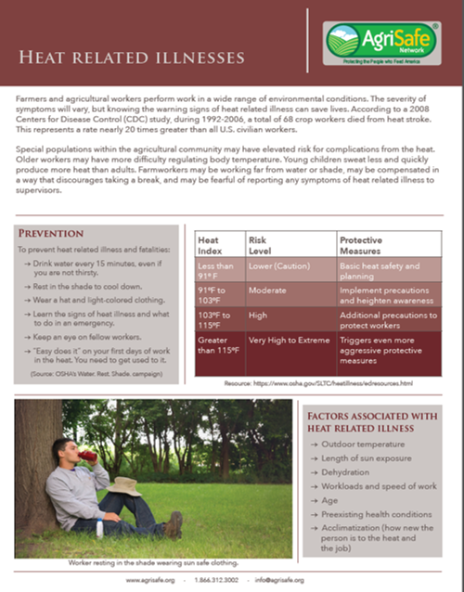
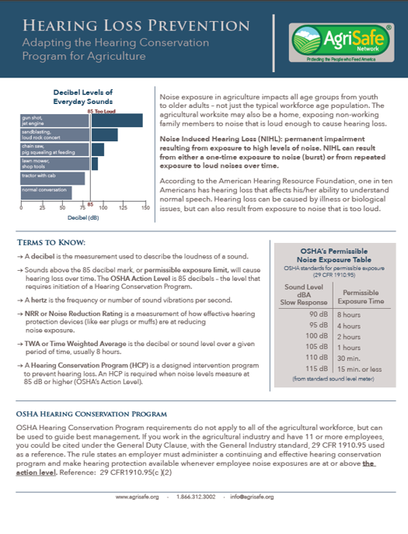
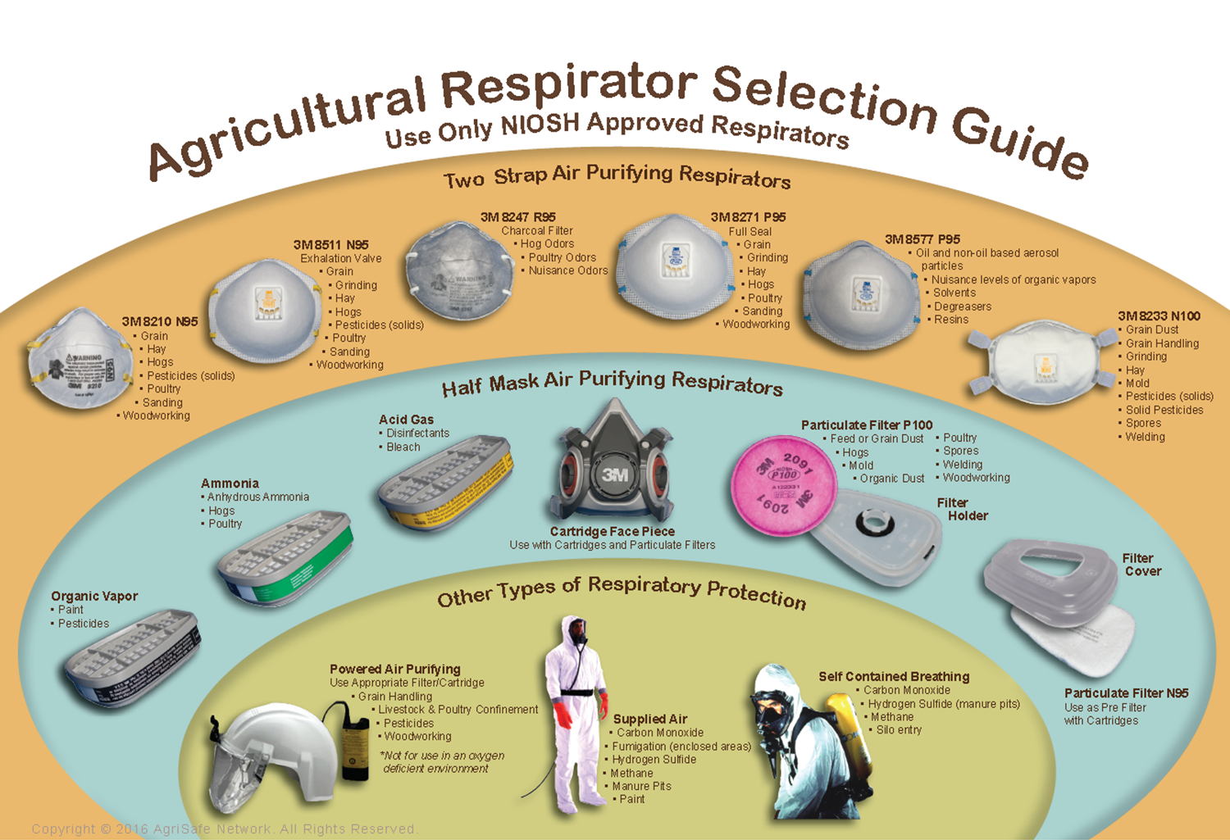

Slide 46
Talking Total Farmer Health Podcast info

Slide 47
Thank You
Questions on this content please contact:
Linda Emanuel lemanuel@agrisafe.org
Tara Haskins thaskins@agrisafe.org

