Slide 1

Bridging the Gap: Communicating Quality
to Boards and Medical Staff
Renee Lighthall BHA, MLT (ASCP)
Director of Quality
Cozad Community Health System

Slide 2
Objectives
Translate quality data into strategic and clinical language that supports informed decision-making.
  Understandable Engagement
Understand how to communicate quality in ways that help board members and medical staff connect with its relevance and impact.
  Relevant Impactful
Apply engagement strategies that foster trust, alignment, and shared accountability for quality outcomes.
  Trust Relationships Collaboration

Slide 3

Effective Quality Communication

Slide 4











Translating the Language of Quality

Slide 5

Translate Data into Strategic and Clinical Language
Simplifying Complex Data
  Transforming complex data into clear, understandable language.
Aligning Metrics with Strategy
  Connecting data metrics to strategic goals and patient outcomes.
Data Communication
  Communicating data in terms that make it relevant and actionable.

Slide 6

Connecting with Stakeholders

Slide 7
Communicate Quality with Relevance and Impact
Power of Storytelling
Storytelling and real-world patient success stories make quality data meaningful and emotionally engaging.
Tailor Messages by Audience
Effective quality communication adapts messages to resonate with board members and medical staff distinctly.
Link Quality to Mission and Outcomes
Linking quality metrics to organizational mission promotes strategic relevance and drives collaborative efforts.

Slide 8
Engaging Medical Staff
Translating Quality Data
  Translating complex quality data into language relatable to medical staff.
Active Feedback Participation
  Gather feedback to refine quality dashboards and reports.
Highlighting Tangible Wins
  Emphasizing achievements helps staff feel ownership and pride.
Fostering Shared Accountability
  This approach built a culture of continuous improvement and shared responsibility among clinicians.

Slide 9
Engaging with the Board
Aligning Data with Strategic Goals
  Presenting quality data to help board members see its strategic relevance.
Patient Stories Influence
  Framing reports around patient stories that focus on our mission and vision.
Building Stronger Relationships
  This approach strengthened ties between the quality department and the board through shared understanding.

Slide 10

Trust and Relationships:
The Foundation of Collaboration

Slide 11

Building Trust Between Quality and Stakeholders
Trust is the foundation for meaningful collaboration and better outcomes.
Be Transparent: Share data, decisions, and processes.
Communicate Consistently: Keep updates clear, timely, and relevant.
Invite Shared Decisions: Bring stakeholders into planning and evaluation.
Own Our Commitments: Follow through and be accountable.
Show Empathy: Listen actively and respect different perspectives.
Deliver Results: Demonstrate progress with measurable outcomes.

Slide 12

Building Connections for Shared Success
Strong relationships with stakeholders are built through intentional, inclusive, and adaptive engagement strategies.
Personalized Engagement: One-on-one conversations help uncover unique perspectives and shape communication that truly connects.
Dialogue for Stronger Teams: Meaningful dialogue building trust and shared ownership.
Closing Gaps Between Departments: Direct connections break down silos and align teams around common goals.
Dynamic Engagement: A flexible approach that adapts to feedback ensures the process remains responsive and values individual experiences.

Slide 13

Encouraging Collaboration
Collaboration is central to advancing quality and transform data into shared action and drive sustainable improvement.
Shared Organizational Mission: Collaboration shifts quality efforts from isolated departments to a collective organizational mission and shared goals.
Stakeholder Involvement: Engaging board members and clinical staff fosters ownership and accountability in quality improvement initiatives.
Celebrating Collective Wins Recognizing the wins and shared communications reinforces it’s a team achievement.
Cultural Strengthening: Collaborative strategies strengthen hospital culture and drive sustained improvements in patient care.

Slide 14
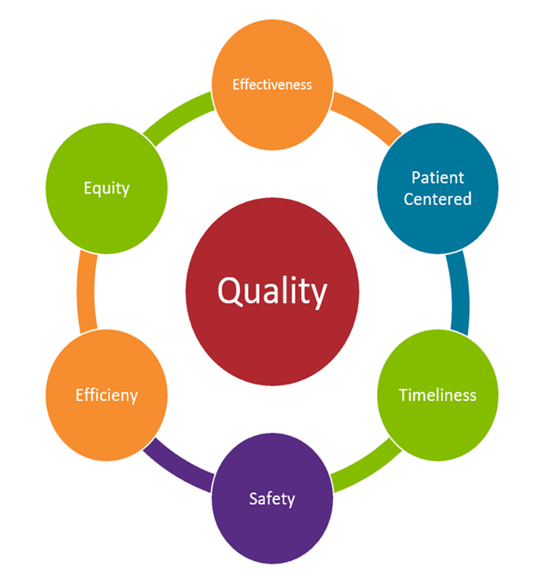
Key Takeaways
**Translate Quality Data**
Simplify complex metrics into strategic and clinical language.
Align data with organizational goals and patient outcomes.
**Engage Stakeholders**
Use storytelling and tailored messaging to connect with boards and medical staff.
Highlight relevance through real-world examples and mission alignment.
**Build Trust & Relationships**
Foster transparency, empathy, and shared decision-making.
Strengthen collaboration through consistent communication and follow-through.
**Drive Collaboration**
Involve stakeholders in quality initiatives to build ownership.
Celebrate collective wins to reinforce a culture of continuous improvement.

