Slide 1
CLINE WILLIAMS
THE H-1B MODERNIZATION RULE: IMMIGRATION OPTIONS FOR HEALTH CARE EMPLOYERS AND PROVIDERS
presented by:
Daniel Oldenburg

Slide 2

Daniel W. Oldenburg
Practice Areas:
Immigration and Nationality
Labor and Employment
doldenburg@clinewilliams.com
402-474-6900

Slide 3

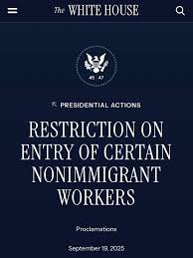
The Elephant In the OR
September 19, 2025 Presidential Proclamation
Imposing a $100K Fee on H-1B Visa Petitions
Who does it apply to?
When does it take effect?
Exemptions?
Litigation?

Slide 4
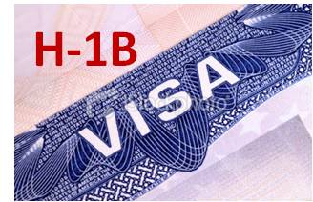
H-1B Modernization Rule Overview
The rule revises the definition of the H-1B specialty occupation, strengthens cap gap protections for F-1 students awaiting a change of status to H-1B, strengthens USCIS’s site visit authority, clarifies the processes and requirements for amending nonimmigrant petitions, and codifies the agency’s longstanding policy of deference to its prior approvals, among other provisions.

Slide 5

Qualifying Specialty Occupations
The rule revises the definition of an H-1B specialty occupation. Some of the revisions introduce greater flexibility to the definition, and some could narrow eligibility. In particular, the rule clarifies that an occupation “normally” requiring a bachelor’s degree doesn’t mean that it must “always” require a bachelor’s degree. It also clarifies that a position may qualify as a specialty occupation even if the employer accepts a range of qualifying degree fields, as long as each of those fields is “directly related” to the duties of the H-1B position. In the final rule, DHS has added a reasonable definition of “directly related,” defining the term to mean that there is a “logical connection” between the required degree and the H-1B position duties.
Off site third parties- H-1Bs “staffed” third parties – look at the requirements of the third party and not the petitioner.
Most nursing positions are still not “specialty occupations.”

Slide 6

Deference to prior nonimmigrant adjudications
The rule codifies and slightly expands USCIS’s current policy of deference to its prior adjudications, giving employers greater predictability when filing a Form I-129. The regulation provides that when adjudicating a Form I-129 involving the same parties and same underlying facts, USCIS should defer to its prior I-129 approval, unless there has been a material change in circumstances or eligibility requirements, a material error in the prior approval, or new material adverse information.
The general deference policy was rescinded during the first Trump Administration, resulting in a significant surge in requests for evidence (RFEs) and case denials. The Biden Administration reinstated the policy and, in codifying it now, makes the policy less vulnerable to rescission.

Slide 7

H-1B Location Changes and Petition Amendments.
The rule codifies U.S. Citizenship and Immigration Services’ (USCIS) longstanding requirement that an employer must amend a nonimmigrant petition due to material changes in an H-1B worker’s place of employment, and requires the amendment to be filed before the change takes place. The rule also codifies the circumstances under which a location change would not require an amendment, including location changes within the area of intended employment listed in the DOL labor condition application (LCA) supporting the existing petition.

Slide 8

Business Owners’ H-1B eligibility.
The regulation clarifies that H-1B beneficiaries who have a controlling interest in the petitioning entity may be eligible for H-1B status, as long as the beneficiary will perform H-1B-caliber specialty occupation duties a majority of the time; however, the initial and first extension of such petitions will be limited to 18 months, rather than the normal H-1B maximum petition validity period of three years.

Slide 9

Bona Fide H-1B employment.
The rule shifts the focus from the current regulation’s requirement to show an employer-employee relationship to establishing the existence of a bona fide job offer, and it codifies the agency’s longstanding practice of requesting contracts and other evidence of a bona fide job offer but eliminates the itinerary requirement for H-1B petitions. In response to public comments, the final rule adds a new provision clarifying that a petitioner is not required to establish specific day-to-day assignments for the entire time requested in the H-1B petition. The rule also adds a requirement that the H-1B petitioner have a legal presence in the United States and be amenable to service of process here.

Slide 10

Greater F-1 Cap-Gap Protections
The final rule provides a longer cap-gap protection period (extending the period from October 1 to potentially as late as April 1 of the following calendar year) for F-1 students who are beneficiaries of timely filed, nonfrivolous petitions to change status to H-1B. The rule provides up to an additional six months of status and employment authorization to help qualifying F-1 status holders avoid lapses in status and work authorization while awaiting a change to H-1B status.

Slide 11

Codification of the Site Visit program
The final rule codifies and strengthens USCIS’s long-established Fraud Detection and National Security (FDNS) unit’s site visit program and clarifies that refusal to comply with a site visit could result in the denial or revocation of a petition. The rule also codifies the authority of DHS to conduct site visits at the location where the H-1B employee works, has worked, or will work, including and third-party worksites, among other locations related to the H-1B employment.

Slide 12
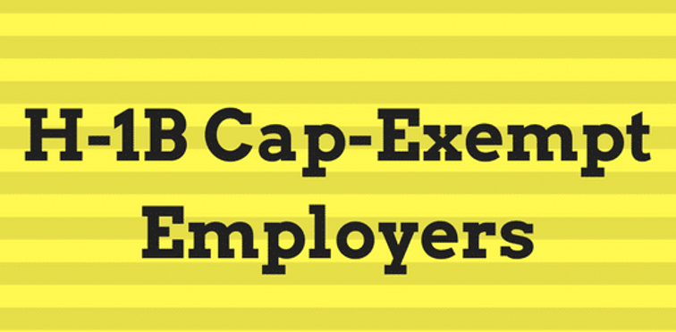
Modest Expansion of Cap Exemptions.
The final rule modestly expands the scope of certain H-1B cap exemptions. The revisions are intended to recognize that qualifying cap-exempt nonprofit and governmental research organizations and nonprofits affiliated with institutions of higher education may have more than one fundamental activity or mission, beyond just research or education, and the revised regulations allow for cap exemption even if research or education is not the organization’s primary activity or mission, as long as research or education is one of the organization’s fundamental activities.

Slide 13

The Anatomy of the H-1B: Not all H-1Bs are Created Equal
Cap Subject
Cap Exempt
-Not subject to any numerical quota
-Must be for a job with an Institution of Higher Education – No-profit entities which are related to or affiliated with Institutions of Higher Ed.
-Nonprofit research organizations
-Government research organizations
-Can file at anytime, no registration lottery to win, no new FY to wait on.
-65K visas allotted every FY
-20K additionally if you have a U.S. Master’s Degree
-Quota met for FY2026
-Subject to the H-1B Registration Lottery (FY2027)
3/1-3/20, 2026
-Notified of Selection after April 1, 2026 for a start date October 1, 2026 (FY2027).

Slide 14


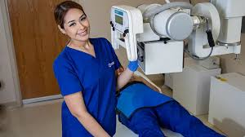



We know that RNs, LPNS, CNAs, etc. do not normally qualify for H-1B visas. What about other healthcare/allied health positions/professions?

Slide 15

H-1B Candidate already in the United States
Change Visa
of Status Consular
Processing
Bringing a Foreign National to the United States

Slide 16
The Elephant In the OR
September 19, 2025 Presidential Proclamation
Imposing a $100K Fee on H-1B Visa Petitions
Who does it apply to?
When does it take effect?
Exemptions?
Litigation?

Slide 17

J-1 Exchange Visitors
J-1 Program Sponsors
J-1 Academic Training – Generally 18 months post completion.
J-1 Employers (J-1 Employees are Not Subject to FICA Withholding)

Slide 18

J-1 Exchange Visitor and Looking beyond the Academic Training Period
212(e) of the Immigration and Nationality Act
Is the Exchange Visitor really subject to 212(e)?
J-1 Waiver Required In Order to Complete a Change of Status to H-1B
If subject and waiver requested, when to file the Change of Status to H-1B
Consider Country of Origin (Chinese Government Will Not provide a No Objection Statement while FN is in the United States)
Note: Post No Objection Statement – Option to return to the U.S. in B-1/B-2 Visitor Status and seek a COS to H-1B

Slide 19
J-1 Exchange Visa
Change of Status
H-1B Non-Immigrant Visa

Slide 20

There are three reasons a J-1 visitor may be subject to the 212(e):
• J-1 program is funded in part or wholly by the United States government, the visitor's government, or an international organization.
• the J-1 program is engaged in one or more of the skills listed on the Exchange Visitor Skills List (1997 Amendment) for his/her country.
• the J-1 visa holder is receiving graduate medical education or training. N/A.
If your program was funded in whole or in part by a U.S. Government agency, your home country’s government, or an international organization that received funding from the U.S. Government or your home country’s government, you will be subject to the 2 year rule based on Government Financing. The Fulbright and FLEX programs often involve substantial U.S. Government Funding and are the reason one is subject. There is no designated amount of funding that would make one subject or not subject (but the amount may be relevant when seeking waiver options).
Skills List:
J1 exchange program involving a field of specialized knowledge that has been designated as “in demand” by the government of your home country and if this field appears on State Department’s Exchange Visitor Skills List for your home country, then you are subject to the 2 year rule based on the skills list.
If your country does not appear on this list, you cannot be subject to the 2 year rule based on the skills list.
The main update is the U.S. Department of State's revised Exchange Visitor Skills List, effective December 9, 2024, which removes 37 countries from the list, including China, India, and Brazil. This change means that J-1 visa holders from these newly removed countries are now no longer subject to the two-year home residency requirement based on the skills list, a major shift from the previous 2009 list.

Slide 21

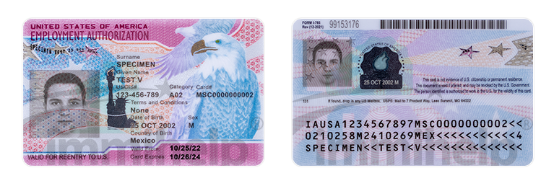
F-1 Student Visa Permits status in the United States in a “Durational Status” (D/S). Foreign nationals can remain in the U.S. as long as they are enrolled full time as students. Employment is confined to on campus employment 20 hours a week or less. Unless authorized by CPT or OPT.
Curricular Practical Training (CPT) students can be employed while taking classes.
Optional Practical Training (OPT) Post completion 1 year of work authorization. Many F-1 students who want to be employed as educators will work first using their OPT and then look for H-1B Sponsorship for the following year.
OPT provides an extra year of work authorization before seeking H-1B status which is a 6 year visa status given in two 3 year increments.
Change of Status from F-1 to H-1B.
No 212(e) Waiver needed
Can go directly from OPT to H-1B

Slide 22

H-1B
No Job - No Visa
Requires a minimum of a Bachelor’s Degree.
Degree must be related to the field in which the beneficiary seeks employment.
Will be issued for calendar 3 years, not the academic year.
Foreign national beneficiary must be compensated at or above the prevailing wage. CBA can be supplied to confirm the offered wage.
H-1B employees’ wages ARE subject to FICA withholding.
H-1B can be renewed/extended for an additional 3 years total of 6 years.
H-1Bs can be transferred “ported” from another cap-exempt H-1B employer.
H-1B allows for dual intent.
Need actual H-1B visa stamp in your passport for international travel.

Slide 23
Change of Status F-1/J-1 to Cap Exempt H-1B
Cap Exempt
  Nonprofit entity
  Affiliated with an Institution of Higher Learning
Confirm you meet all of the requirements for the specialty occupation job offer, i.e. educational and licensing requirements etc. and that you will meet these requirements prior the employer filing the H-1B petition.
Confirm the prevailing wage (Labor Condition Application certification) and that your employer is willing to pay the prevailing wage.

Slide 24
Related or Affiliated nonprofit entity
“The term ‘related or affiliated nonprofit entity’ is defined, both for ACWIA fee (8 CFR §214.2(h)(19)(iii)(B) and cap exemption purposes, to include nonprofit entities that satisfy any one of the following conditions:
(1) the non-profit is connected or associated with an institution of higher education through shared ownership or control by the same board or federation;
(2) the non-profit is operated by an institution of higher education;
(3) the non-profit is attached to an institution of higher education as a member, branch, cooperative, or subsidiary; or
(4) the non-profit has entered into a formal written affiliation agreement with an institution of higher education that establishes an active working relationship with the institution of higher education for the purposes of research or education; and a fundamental activity of the non-profit is to directly contribute to the research or education mission of the institution of higher education.” 8 CFR §214.2(h)(8)(ii)(F)(2)

Slide 25
Affiliated with an Institution of Higher Learning
(4) the non-profit has entered into a formal written affiliation agreement with an institution of higher education that establishes an active working relationship with the institution of higher education for the purposes of research or education; and a fundamental activity of the non-profit is to directly contribute to the research or education mission of the institution of higher education.” 8 CFR §214.2(h)(8)(ii)(F)(2)
Rotation of Medical Students, Nursing Students or Allied Health students through the institution.
Other affiliations

Slide 26
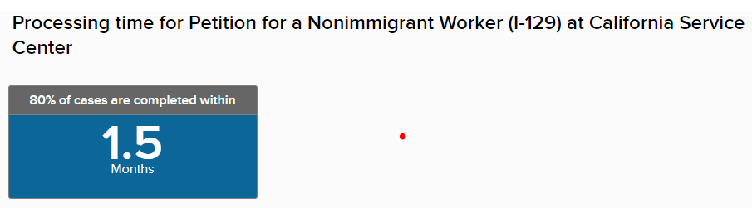
The Anatomy of an H-1B
-A Job Offer
-Labor Condition Application (LCA)
-Prevailing Wage (CBA)
-Terms and Conditions of Employment (worksite location)
-Specialty Occupation Degree
-Educational Credentials
-Education Equivalency Evaluation
I-129 H-1B Petition with H- Supplement
Pay applicable USCIS filing fees:
$780.00 Base filing fee
$500.00 Anti-fraud fee
$2805.00 optional Premium Processing fee
-Current processing times for H-1B

Slide 27

H-1B Considerations
Do you need first secure a J-1 waiver of section 212(e)?
Do you have OPT available and seek to exhaust your OPT first?
What does it cost?
Who pays for it?
  Can the H-1B Beneficiary be required cover some of the H-1B costs?
H-1B as a pathway to permanent residency in the United States.
  Would I be subject to visa retrogression?

Slide 28
QUESTIONS?
Notes:
JRY TO CLOSE OUT SEMINAR.

Slide 29
THANK YOU!
Daniel Oldenburg
doldenburg@clinewilliams.com
This presentation and its accompanying materials are offered for educational and informational purposes only and are not intended as legal advice. You should contact your attorney to obtain advice with respect to any particular issue or problem. Use of and reference to this presentation and its accompanying materials do not create an attorney-client relationship.
Notes:
JRY TO CLOSE OUT SEMINAR.

