Slide 1

Quality Residency
Capstone Project
nebraskahospitals.org
Chelsie Edwards
October 4th, 2024
Merrick Medical Center

Slide 2
Merrick Medical Center
Merrick Medical Center is a member of the Bryan Health System. We are a Critical Access Hospital located in Central City Nebraska. We have 6 Inpatient beds and 6 universal beds. 3 ED beds, 2 of which are trauma beds. We offer in-house PT, OT, ST services. We have a Cardiac rehab Program and a full time Respiratory Therapist. We offer full service Radiology (Mobile MRI services 2x/week and PET Scan PRN) and Laboratory services. Specialty clinic with several visiting specialty practices. Outpatient surgery with a full time CRNA on staff. We do not have labor and delivery, ICU, or NICU services.
My project is the process of becoming Age Friendly Certified. After listening to Matt’s presentation I felt like we were doing most of the work already so why not take credit for it. Age Friendly Certification will give us an opportunity to focus on our main patient population.
My team is Me, social services, care management, pharmacy, nursing, physical and occupational therapies. Matt came to our Quality Council Meeting in July and his presentation was very well received by each department, administration, and providers.

Slide 3
AIM Statement
The aim of this project is to become Age Friendly Certified by April of 2025. 100% of MMC swing bed patients over the age of 65 will be screened for Medication, Mobility, Mentation, and What Matters. Data will be collected from October 2024-April 2025 for certification and monitored going forward.

Slide 4
Measuring Success
The team will use quantitative metrics to determine if the specific changes are leading to improvement.
This project and certification will help Merrick Medical Center achieve one of it’s strategic goals of Decreasing Inpatient ReAdmissions to 4.5% or less consistently by 2026.
Data will be collected and entered by each department and monitored by Quality. Quality Department will submit data for certification. Quality Department will provide staff education and ongoing training for data requirements.

Slide 5
Selecting Changes
What changes will be made to work towards improvement goals?
  The biggest road block we have came across is the Mentation piece of the Age Friendly requirements. We have the approved CAM-ICU assessment in our EPIC EMR, but this was not something that our nursing staff was currently charting on.
  I contacted Bryan Health’s EPIC Training team to see if the CAM-ICU could be made a shift requirement for MMC swing beds. – The answer was NO
  I then thought we could add it to the nursing shift task list for MMC swing beds. The answer was again NO
  I presented the problem to our CNO and she was on board with sending an educational email to nursing staff as well as presenting at a meeting and posting educational material at the nurses station
  Brainstorm change options with team
  Assess feasibility of implementation
  Create a plan for education and support of change management
  PDSA Cycles

Slide 6
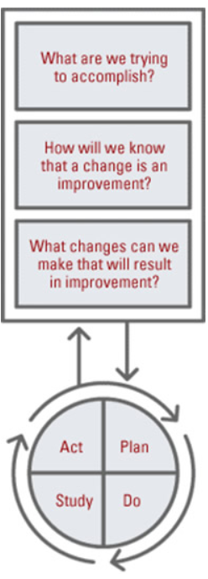
Plan ~ Do ~ Study ~ Act
Plan
I plan to: Become Level 2 Age Friendly Certified
I hope this produces: lower ReAdmission rates, more engaged staff, and happier and more satisfied patients.
Steps to execute: Informational Meeting to gauge interest, Meeting to lay out steps and who will take each area, staff education, then data collection begins
Do
How long will you observe new changes? Minimum of 6 months
What did you observe?
Are the changes creating consequences – intended or unintended?
Study
What did you learn?
Did you meet your measurement goal?
Do you need more observation time?
Act
What did you conclude from this cycle?
Will you sustain the changes?
Does the change need adjusted or removed?

Slide 7
Data and Trends
No Data to show yet. Still in the staff education phase.

Slide 8
Return on Investment (ROI)
Explore the financial implications of the project:
Will costs/expenses be incurred to make noted changes?
  Additional staff? No additional staff
  Additional hours? This project has been put on hold twice with staff changes and new roles added to my position.
  Equipment? Small/minor cost for staff print outs and educational material for nursing staff.
  IT expense? none
What savings/revenue will be noted?
  Decreased harms? This is a potential and a goal. With increased staff monitoring and emphasis on medications, mobility, mentation, and what matters patient harm rates should decrease.
  Increased billable codes? no
  Decreased staff hours? no
Total Savings/Revenue – Total Costs/Expenses = Total ROI
Positive ROI = Dollars Earned ~~ Negative ROI = Dollars Lost

Slide 9
Spreading / Sustaining / Maintaining / Replicating
1st phase is to implement Age Friendly to MMC Swing Beds 65yrs and older and collect data for a minimum of 3 months. Phase 2 is to expand to all in Inpatients 65yrs and older. Phase 3 is to expand to the clinic and screen all patients 65yrs and older that come to the clinic for a Medicare Wellness Visit. Quality will be the owner of this project. Staff education will be provided to those involved with each phase along with educational materials. Ongoing chart audits and monitoring will be preformed by Quality.

Slide 10
THANK YOU/Questions
Chelsie Edwards, RN
Quality and Health Services Coordinator
Merrick Medical Center
2802 28th St.
Central City, NE 68826
Phone: 308-624-6795
Email: chelsie.edwards@bryanhealth.org
nebraskahospitals.org

