Slide 1
Barriers to Success – Navigating the Evolving Healthcare Landscape and While Keeping Quality a Priority
Erin Starr, RN, BSN, CPHQ, MHA
Chief Nursing Officer/Quality
Jefferson Community Health and Life, Fairbury, NE

Slide 2
What is the definition of quality in healthcare?
According to the Institute of Medicine (IOM) of the National Academy of Sciences, they defined quality health care as “safe, effective, patient-centered, timely, efficient and equitable.”
The Agency for Healthcare Research and Quality (AHRQ) define quality health care “as doing the right thing for the right patient, at the right time, in the right way to achieve the best possible results.”
Notes:
While these are the definitions of two very reputable organizations, how do you define quality in your organization, or what does it mean to provide quality care??
I personally think the measurement of quality in hospitals is skewed, but let’s discuss how some of you see quality in your organization…..

Slide 3





What does quality look like at your organization?
Notes:
How does quality differ from a CAH to a PPS, or does it? OPEN DISCUSSION
Patient satisfaction, infection rates, variety of services offered, staff and provider satisfaction….

Slide 4

Top Performers in Nebraska:
Nebraska Medical Center named top hospital for 13th straight year
Top 20 CAH Hospitals- Antelope Memorial, Beatrice, & Boone
Columbus Community Hospital recognized as a top 100 rural/community hospital
Notes:
This is only a handful of the many organizations that are thriving in their performance, NE has many outstanding organizations. So how do we maintain being a top performing in today’s healthcare?

Slide 5
Evolving Healthcare Landscape
Digital technology
Healthcare analytics
Telemedicine
Volume to Value
Notes:
Because healthcare is changing and/or evolving. This is just a few of the areas of healthcare that have evolved over the last several years. Digital technology, for example telehealth, has been one of the fastest growing integrations due to COVID. For rural healthcare, telehealth means more access to doctors and specialists, helping to decrease the costs related to travel.
Healthcare analytics: The phrase “Big Data in Healthcare” is often used in relation to healthcare analytics, which refers to the abundant health data that comes from numerous sources such as the ehr, claims, medical devices, payor records, smart phones, to name a few.
We have heard volume to value now for several years, seeing more facilities becoming accountable care organizations, and patient-centered medical homes to help drive reductions in the cost of care and receiving incentive payments based on quality outcomes.

Slide 6
What trends are you seeing?
Expansion of retailers providing healthcare
More procedures at outpatient facilities
Insurance companies having more control over patient services
New CMS suggestions/requirements
HCAHPS
AUR reporting
eCQMs
SDOH
Notes:
In the 2023 IPPS Final Rule, CMS mandated that hospitals reporting to the Inpatient Quality Reporting (IQR) program submit two brand new measures: SDOH-1 and SDOH-2. These measures are voluntary in 2023 and required by 2024

Slide 7
Barriers to your Success?
Cost
Staffing
Knowledge
Required or not?
Return on investment
Notes:
-Costs could include additions to the EHR, such as for AUR reporting, staffing to take on additional duties of compliance, monitoring and reporting
-Staffing, how is everyone’s hospitals looking today, travelers? What staff are begging for more to do?

Slide 8
Questions?
Erin Starr, RN, BSN, CPHQ, MHA
Chief Nursing Officer/Quality
Jefferson Community Health and Life
Fairbury, NE
Erin.starr@jchealthandlife.org
402-729-6889

Slide 9
References:
Agency for Healthcare Research and Quality, www.ahrq.gov
Institute of Medicine, now National Academy of Medicine, www.nam.edu
World Health Organization, www.who.int

Slide 10
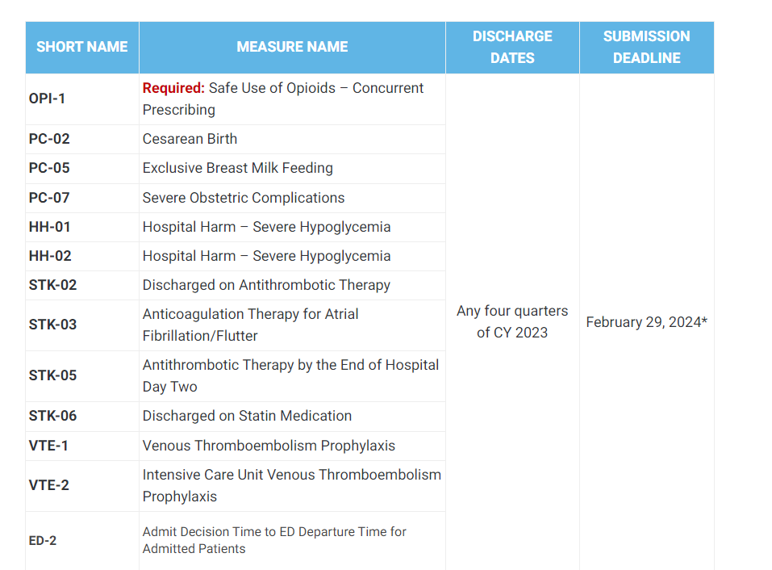
Additional information:
CQMs

