Slide 1

Why is Health Care Quality Important to You?
Common Quality Initiatives
nebraskahospitals.org
Dana Steiner and Amber Kavan |March 2025

Slide 2
Learning Objectives
Demonstrate knowledge about process improvement and engage in activities within your organization
Recognize the importance of quality and incident reporting and adopt safe practices in your day-to-day schedule
Review nursing roles for infection prevention strategies
Demonstrate knowledge on regulatory requirements and why nurses play a key role in compliance and improvement
Review how nurses can increase patient and family engagement and satisfaction.

Slide 3

What is Health Care Quality?
According to World Health Organization:
  Quality of care is the degree to which health services for individuals and populations increase the likelihood of desired health outcomes
According to the Institute of Medicine:
  The Institute of Medicine defines health care quality as "the degree to which health care services for individuals and populations increase the likelihood of desired health outcomes and are consistent with current professional knowledge.“
According to the National Academy of Medicine:
  Quality health care is care that is safe, effective, patient-centered, timely, efficient, and equitable.

Slide 4
Quality in your Organization…
Who leads your quality program?
Do you have department specific quality goals / projects?
Have you been asked to serve on a team that is working on improving the care in your organization?
Quality Assurance: Continual monitoring for compliance
Quality Improvement: Making a process better to improve outcomes
Benchmark
AIM
Process Improvement
Audit and Sustainability

Slide 5

Quality is Required…
https://www.cms.gov/Regulations-and-Guidance/Guidance/Manuals/downloads/som107ap_w_cah.pdf
Give an example of a process you have done in your work that is hard, inefficient, creates opportunity for errors...
Here is one to start…
At night nurses were checking medications out of the pharmacy – average three times per shift.
Frequently used medications were not in the PIXUS / Med Dispense
Med Dispense was not set with Par Values related to use
New providers had differing preference for prescribing
How could we improve this process?

Slide 6
Examples of QA and QI:
Quality Assurance:
Refrigerator Temps Checks
Blanket Warmer Checks
Outdated supplies
  Quality Improvement:
Nursing: Increase medication bar-coding compliance by 19% by December 31, 2025.
Laboratory: Decrease number of contaminated specimens by 10% by December 31, 2025.
Human Resources: Decrease percent of agency staff by 15% by December 31, 2025.

Slide 7
Infection Prevention Strategies in the Nursing Role
nebraskahospitals.org

Slide 8

Infection Prevention Role and Nursing Partners
What is an Infection Preventionist?
Professional who makes sure healthcare workers and patients are doing all the things they should to prevent infections.
What does Infection Preventionist do?
Infection and disease surveillance and reporting: Influenza, Surgical Site Infection, MRSA, C.diff, CAUTI, CLABSI
Policy and Procedure Development and Training: room cleaning process, isolation precaution practices
Education and Training: hand hygiene, bloodborne pathogens
What can you do?
Wash your hands
Stay home when you are ill
Cover your cough and sneeze
Always wear appropriate PPE
Remember to follow the hierarchy of control for occupational hazards

Slide 9
CDC’s Core IP and IC Practices
National Healthcare Safety Network
The practice and promotion of hand hygiene
Consistent use of aseptic technique
Cleaning and disinfection practices
Use of standard precautions
Patient assessment and additional precautions
Patient education
Use of safety devices
Removal of unnecessary invasive devices
Use of bundle strategies for infection prevention
Fit for duty
CDC's Core Infection Prevention and Control Practices for Safe Healthcare Delivery in All Settings | Infection Control | CDC
Known as NHSN hosted by the CDC
Nation’s most widely used healthcare-associated infection tracking system
Provides data needed to identify problem areas, measure progress of prevention efforts, and ultimately eliminate healthcare-associated infections
Track and report infections in real-time
Identify infection trends
Meet regulatory requirements
Implement targeted interventions to reduce infections
NHSN | CDC

Slide 10


Patient and Family Engagement – Creating Value for the Customer
nebraskahospitals.org

Slide 11
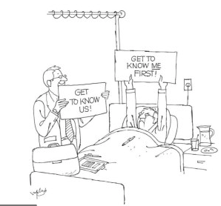

Slide 12
Value Equation
Quality
Cost
Value =
Value can be increased by increasing quality while maintaining cost or by reducing cost while maintaining quality.

Slide 13
Value Equation
Quality + Service
Cost
Value =

Slide 14
Guide to Patient and Family Engagement in Hospital Quality and Safety - AHRQ
Strategy 1: Working with Patients and Families as Advisors
Strategy 2: Communicating to Improve Quality
Strategy 3: Nurse Bedside Shift Report
Strategy 4: IDEAL Discharge Planning

Slide 15

Strategies for Patient and Family Engagement
Engage leaders
Enlist patients and families as partners
Empower and energize staff
Encourage family participation in care
Equip, enable, and support patients to engage
Emphasize patient and family engagement in all initiatives

Slide 16
Successful Implementation of PFE Practices = Improved Outcomes
Reductions in hospital-acquired infections and conditions including falls with injury
Reductions in preventable 30-day readmission rates
Improved patient experiences and higher HCAHPS scores
Improved patient outcomes and reduced length of hospital stay
Lower cost of healthcare delivery
Increased employee satisfaction
Reductions in health and healthcare disparities

Slide 17
Introducing the PDSA Cycle
nebraskahospitals.org

Slide 18

IHI Model for Improvement
Plan
Team, AIM, current state, identify the problem, analyze causes and potential solutions, create an action plan
Do
Implement the action plan, collect data, document problems, unexpected effects, general observations
Study
Using the aim statement from PLAN – and data from DO:
Did your plan result in an improvement? By how much/little?
Was the action worth the investment?
Do you see trends?
Were there unintended side effects?
Act
Reflect on the plan and the outcomes:
  Did your plan result in success – if so spread and standardize
  Does the plan need to be adjusted → Return to step 1 (PLAN)
What are we trying to accomplish?
How will we know that a change is an improvement?
What change can we make that will result in improvement?
Plan
Study
Act
Do

Slide 19

Activity
nebraskahospitals.org

Slide 20
Mr. Potato Head PDSA Activity
A fun, interactive, innovative way to demonstrate:
  Quality improvement concepts
  Patient safety/medical errors
  LEAN process management
  Teamwork
  Communication

Slide 21

There’s been a terrible accident!

Slide 22
The Situation…
A bus filled with Potato Head family members has been in a terrible crash. At the scene of the accident, EMS arrives to find only scattered body parts. There were men, women, and children on the bus.
Luckily, one of the uninjured family members was carrying a photo album with a photo of each family member.

Slide 23
The Game…
Your team is the Trauma Team in the ER
  Split into 2 groups
The goal of the game is to accurately assemble the “patients” in 4 minutes

Slide 24
The Rules…
Only 1 person from each team can physically implant the Potato Head body parts (Implantation Specialists)
Completed “patients” must be inspected
There are no other rules

Slide 25

Assemble your Teams
Implantation Specialist
Timekeeper
Quality Inspector
Documentation Specialist
Nurses

Slide 26
Review the Rules…
Goal: Assemble 5 Potato Heads Correctly
Time begins when the first piece is touched.
Accessories must begin in the bag.
Implantation Specialist is the ONLY person who can put pieces into the potato at any time.
Quality checks must be completed BEFORE time stops.
You have 4 minutes to complete.

Slide 27

Make your plan

Slide 28

Inspection Stations
Bring completed patient AND photo to your designated inspection station.

Slide 29

Ready? Set?
Go!!!!!!!!!!!

Slide 30
So how’d that go?
We’ve identified a potential quality improvement project!
We want to improve our time to assemble the Mr. Potato Head family and increase our accuracy.
Time to implement some PDSA!

Slide 31
Tracking Data/Progress
PDSA 1 | # Built | # Errors | # Started
Team 1
Team 2

Slide 32
PDSA Cycle 1
How many patients did you treat correctly during this cycle?
How many errors did your team make?
How long did it take you to complete the first one?
What changes will your team make for the next cycle to eliminate waste and improve both quality and efficiency?

Slide 33

Sharing Best Practices
Team with Most # of Patients Seen
Team with Least # of Errors

Slide 34
Back to your Teams
Take 2 minutes to discuss how your team will improve the quality and efficacy of your patient care

Slide 35
PDSA Cycle 2
Switch Bags!
  You don’t see the same patients every day!
Notice there are many differences in each body part (i.e. ears, eyes, mouths)
  Demonstrates how each patient is unique!
You have 4 minutes!

Slide 36
Ready? Set?
Go!!!!!!!!!!!

Slide 37
PDSA Cycle 2
How many patients did you treat correctly during this cycle?
How many errors did your team make?
How long did it take you to complete the first patient?
How would you plot your data?
What changes will your team make for the next cycle to eliminate waste and improve both quality and efficiency?

Slide 38
Tracking Data/Progress
PDSA 1 | # Built | # Errors | # Started
Team 1
Team 2

Slide 39
Run Chart: Plotting Your Data/Progress
Team 1
Team 2

Slide 40
PDSA Cycle 3
There’s been a change at work.
Your Implantation Specialists has decided to work for your competing medical system across town and you now have Locums filling in.
Implantation Specialists must switch teams!

Slide 41
Back to your Teams
Take 2 minutes to discuss how your team will improve the quality and efficacy of your patient care with NEW TEAM MEMBERS!

Slide 42

Start Cycle 3
Switch Bags Again!
You have 4 minutes!

Slide 43
Ready? Set?
Go!!!!!!!!!!!

Slide 44
Review PDSA Cycle 3
How did your new team do?
How did having new team members effect your quality and/or efficiency?
Did you change your system?

Slide 45
If we did PDSA Cycle 4…
Unfortunately, federal budget cuts continue and reimbursements from Medicare and Medicaid are down substantially.
We have to lay off one team member from each team…
The tallest person on the team has to step away from the table and observe.

Slide 46

Team Outcome Review

Slide 47
What did we Learn?
The system is the critical determinant of performance.
Good communication is essential for a high-functioning team.
Good ideas for improvement can come from anyone on the team.
Data is essential to drive improvement efforts.
Repeating PDSA cycles is a valuable process.
Efficiency is enhanced when value-added work is increased and waste is reduced.
With very simple changes in system, you can improve quality, efficiency, and safety.
Quality improvement can be fun!

Slide 48

Health Care is a Team Sport

Slide 49

Remember… There are Different Ways to Achieve the SAME GOALS…

Slide 50
Quality Program and Acronyms
nebraskahospitals.org

Slide 51
Terms and Acronyms
ACO - Accountable Care Organization
ADE – Adverse Drug Event
Balanced Scorecard – Typically measures Financial, Customer, Learning and Growth and Internal Business Processes
CAH - Critical Access Hospital Care Compare
CAUTI – Catheter-Associated Urinary Tract Infection
CDI – Clinical Documentation Improvement
CLABSI – Central Line-Associated Blood Stream Infection
CMS - Centers for Medicare and Medicaid Services
CUSS – I’m Concerned, I’m Uncomfortable (about a Safety issue), please STOP.
DHHS - Nebraska Department of Health and Human Services
HAPI - Hospital Acquired Pressure Injury
HCAHPS – Hospital Consumer Assessment of Healthcare Providers and Systems
NCPS – Nebraska Coalition for Patient Safety
NESIIS - Nebraska State Immunization Information System
NHSN - National Healthcare Safety Network NPSG - National Patient Safety Goals
OSHA - Occupational Safety and Health Administration
PCMH - Patient-Centered Medical Home
PDS(C)A – Plan, Do, Study (Check), Act
PDMP - Prescription Drug Monitoring Program
PFE/PFAC – Patient and Family Engagement / Patient and Family Advisory Council
QAPI – Quality Assessment Performance Improvement
QIN-QIO – Quality Innovation Network-Quality Improvement Organization
RCA – Root Cause Analysis
ROI - Return on Investment
SBAR – Situation, Background, Assessment, Recommendation
SSI – Surgical Site Infection
VAE – Ventilator-Associated Event
VTE – Venous Thromboembolism

Slide 52
CMS National Quality Strategy
Programming to Reduce Patient Harm in Hospitals
  Readmissions
  Falls
  Adverse Drug Events
  Infections
Programming to improve quality of care provided by eligible clinicians
  Quality
  Cost
  Improvement Activities
  Interoperability

Slide 53
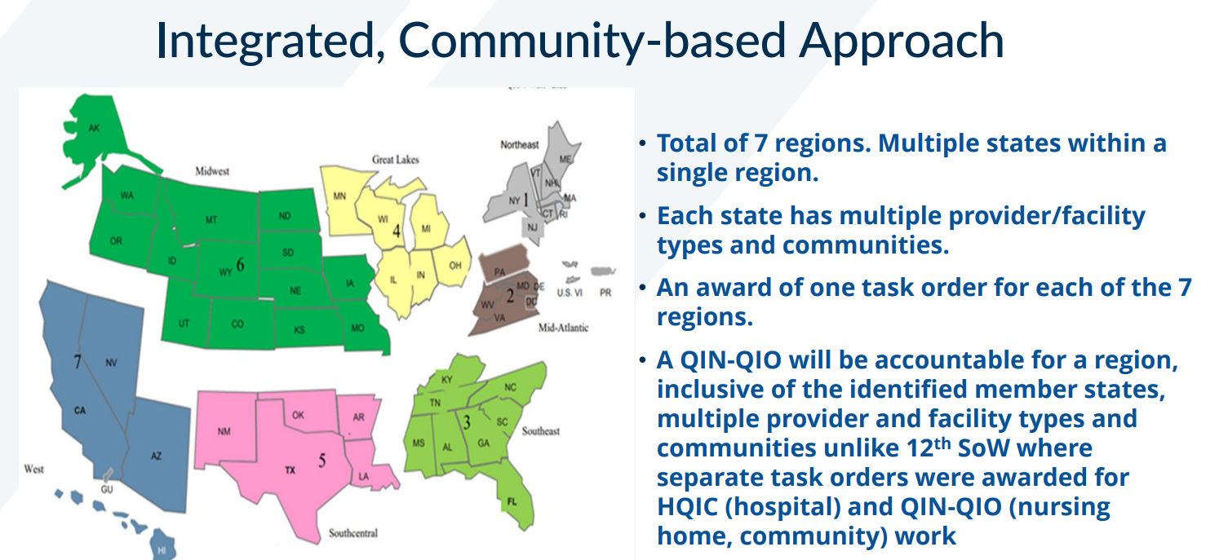
13th Scope of Work Overview

Slide 54
MBQIP: (Medicare Beneficiary Quality Improvement Project)
Aims to improve the quality-of-care patients receive in Critical Access Hospitals (CAH).
45 states participate with 1,360 rural Critical Access Hospitals (CAHs) to use quality measure data for quality improvement activities.
Hospital Inpatient / Outpatient Reporting
Hospital IQR Program data is publicly available on the Care Compare website at: https://www.medicare.gov/care-compare/?providerType=Hospital.
Hospital OQR Program, hospitals receive a2% reduction in payment for failing to meet requirements. Payment adjustment results are available on the QualityNet website.
Provides CMS data to help Medicare beneficiaries make more informed decisions about their healthcare through the public reporting of measure data on the Care Compare website.
eCQM (Promoting Interoperability)
Interoperability helps clinicians deliver safe, effective, patient-centered care. It also provides new ways for individuals and caregivers to access electronic health information to manage and coordinate care.

Slide 55
HCAHPS (Hospital Consumer Assessment of Healthcare Providers and Systems
A survey that asks discharged patients 29 questions about their recent hospital stay. The survey contains 19 core questions about critical aspects of patients' hospital experiences.
The first national, standardized, publicly reported survey of patients' perspectives of hospital care
Hospital Accrediting Organizations
A self-assessment and external peer assessment process used by health care organizations to accurately assess their level of performance in relation to established standards and to implement ways to continuously improve.
  The Joint Commission
  DMV
  CMS – State of Nebraska
Infection Prevention / NHSN (National Healthcare Safety Network/CDC)
The nation’s most widely used healthcare-associated infection tracking system
collects and analyzes data on healthcare-associated infections, blood safety errors, and other healthcare process measures. NHSN provides resources, tools, and report

Slide 56
Importance of Incident Reporting
The purpose of an incident report is to draw attention to disruption as a way of preventing or minimizing similar future incidents
Incident reporting is a continuous process improvement tool
  Looks at how to prevent things from happening n the future
  Identify needs and opportunities for improvement
Unanticipated incidents
  Needle sticks
Avoided incidents
  Near misses or good catches
Adverse incidents
  Reactions to medications
Awareness incidents
  Noncompliance with a policy

Slide 57
What is Just Culture
A fair and balanced approach to safety incidents in health care that focuses on learning and improvement rather than blame
Recognizes that humans make mistakes and that the goal is to create a system that supports learning from incidents
Prevents harm from happening again
Holds staff accountable for actions
Improves patient safety

Slide 58
Normal Error
Inadvertent action: slip, lapse, mistake
Manage through changes in:
- Processes
- Procedures
- Training
- Design
- Environment
A choice: risk not recognized or believed justified
Manage through:
- Removing incentives for at-risk behaviors
- Creating incentives for healthy behaviors
- Increasing situational awareness
Reckless Behavior
Conscious disregard of unreasonable risk
Manage through:
- Remedial action
- Punitive action
At-Risk Behavior
The 3 Behaviors of Just Culture
SUPPORT
COACH
PUNISH

Slide 59
Nurse Safety and Wellbeing
Nurses face a higher risk of violence in the workplace.
Be prepared and take care of yourself
Report all threats and violent incidences
Practice de-escalation tactics
Update and practice workplace safety procedures
Stay aware of burnout and fatigue
Resources are available to help you navigate this challenging – but rewarding – career!

Slide 60
NHA Education and Support
Process Precept
  NHA in partnership with UNMC and funded by a HRSA grant, offer training to nurse preceptors. The goal of the training is to create a more robust and effective preceptor experience.
Annual Events:
  Nursing Leadership Conference (April 2025)
  NHA Rural Health Conference (June 2025)
  NHA Annual Convention (October 2025)
  NHA CAH/RHC Quality Conference (November 2025)
New Nurse Residency
  Feedback from the nurse leaders in our member hospitals stated that it would be beneficial to give new nurses support in their first year of practice. This is our 2nd class. We plan to hold a second class in the Fall.

Slide 61



Slide 62

NHA Tools
https://www.nebraskahospitals.org/
Toolkits and Resources:
  Health Equity
  Sepsis
  Human Trafficking
  Safe Opioid Use
  Workplace Violence
  Infection Prevention
  Rural Roadmap
  Quality Handbook

Slide 63
NHA Quality Team:
Margaret Woeppel MSN, RN CPHQ | Vice President, Quality & Data & Workforce
  mwoeppel@nebraskahospitals.org
Dana Steiner MSN, MBA, CPHQ | Senior Director, Quality & Performance Improvement
  dsteiner@nebraskahospitals.org
Amber Kavan RN, BSN, CPHQ | Director Quality & Performance Improvement
  akavan@nebraskahospitals.org

Slide 64

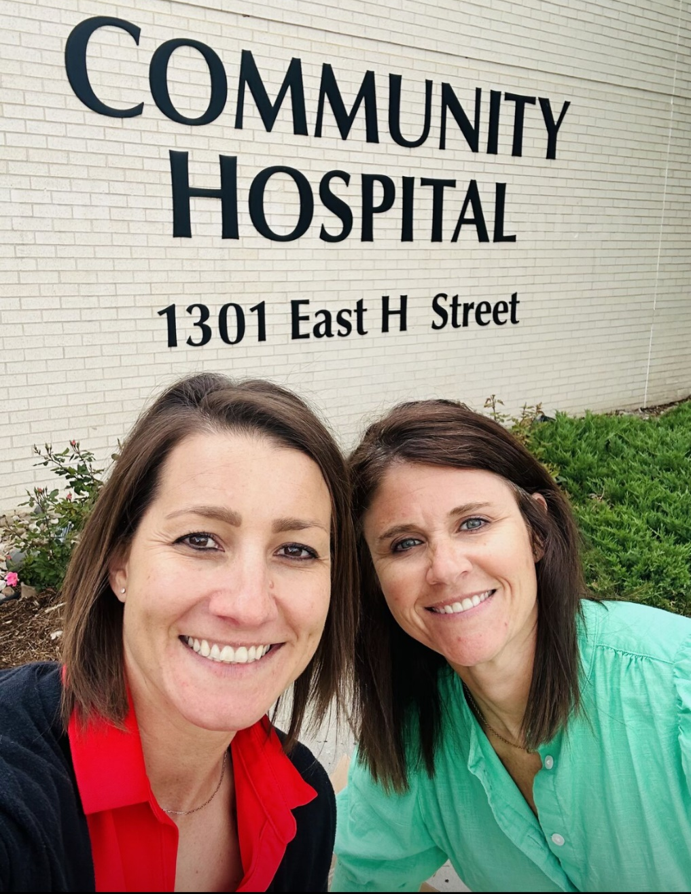




Our Great
Team
Amber Kavan, BSN, RN, CPHQ
Quality and Performance Improvement Director
akavan@nebraskahospitals.org
Dana Steiner, MSN, MBA, CPHQ
Senior Director, Quality and Performance Improvement
dsteiner@nebraskahospitals.org

