Slide 1

State & Federal Policy Update
Meghan Chaffee, J.D.
Chief Advocacy & Legal Officer
David Slattery,
Senior Director, State & Rural Policy

Slide 2
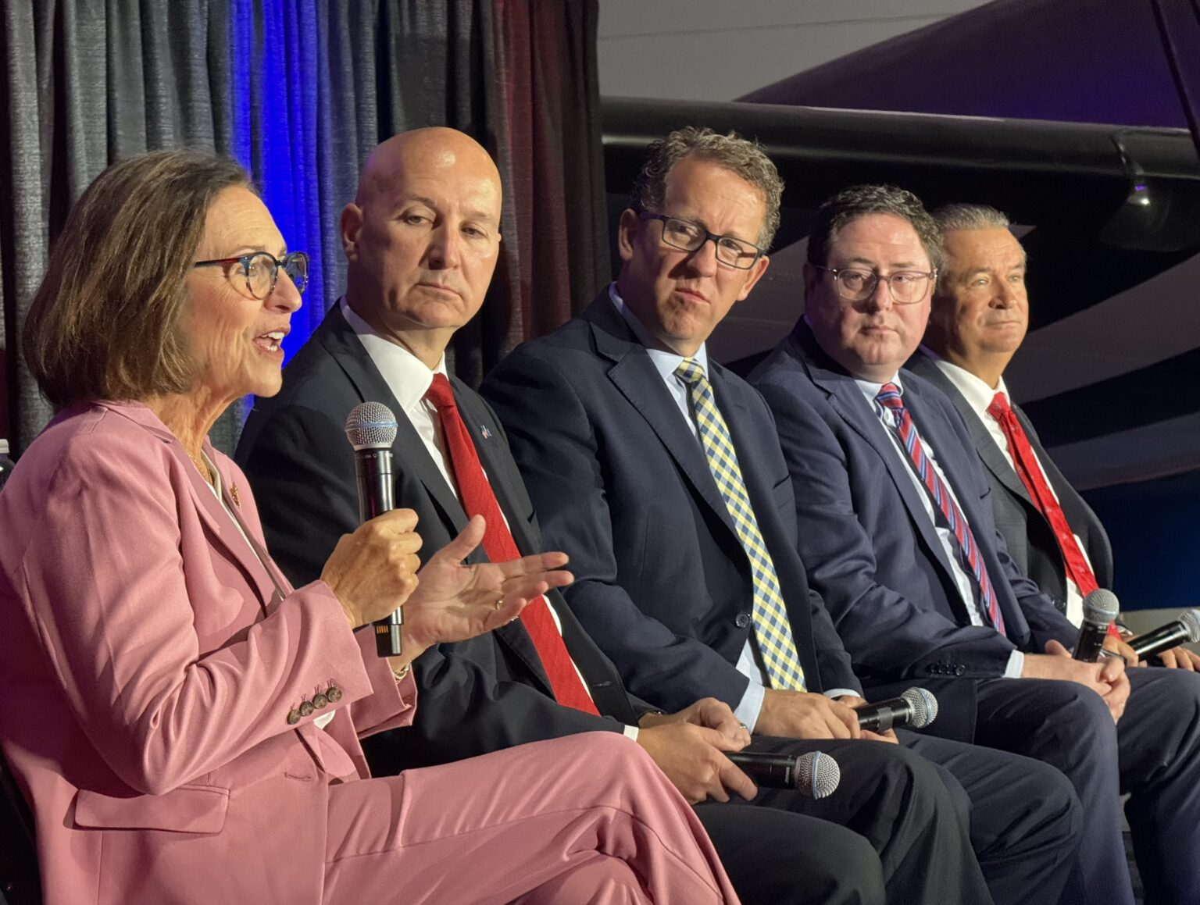
Federal Advocacy
Nebraska Federal Delegation
U.S. Senate
Senator Deb Fischer (reelection 2030)
Senator Pete Ricketts (reelection 2026)
U.S. House of Representatives
1st District - Representative Mike Flood
2nd District - Representative Don Bacon (not seeking reelection 2026)
3rd District - Representative Adrian Smith

Slide 3

Government Shutdown
Government shutdown as of Oct. 1
Failed votes to pass a clean CR
Key health care programs part of that debate
Enhanced Premium Tax Credits extender
Expire end of 2025
Telehealth and hospital-at-home extender
Expired Sept. 30
Following flurry of activity on CMS website issuing guidance on Medicare payments amid shutdown
Notes:
Telehealth:
CMS guidance reaffirmed that pandemic-era expanded telehealth flexibilities have ended for Medicare beneficiaries
CMS has issued MACs to implement a temporary claims hold for 10 business days on telehealth claims
Guidance says providers who continue performing telehealth services may consider sending Advance Beneficiary Notice of Noncoverage
Flurry of activity last week between CMS announced Wednesday night that it would pause fee-for-service Medicare payments to physicians, community health centsre, and ground ambulance providers indefinitely. Then Thursday morning, CMS stated that most payments to physicians will be paid 'in a timely manner' as govt shutdown continues.

Slide 4
Medicaid Policy Changes - OBBBA
Policy Change | CBO Savings/10 yrs | Coverage Loss | Effective Date
Community Engagement (Work Requirements) | $326B | 4.8M | 12/2026 (*12/2028)
Increase Eligibility Redeterminations | $63B | 2.2M | 1/2027
Limit Retroactive Coverage | $6B |  | 1/2027
Reduce FMAP for Emergency Medicaid to certain individuals | $28B |  | 10/2026
Increase Co-Pays for Beneficiaries in Expansion States | $7B |  | 10/2028
Reduced FMAP for Medicaid expansion states | $14B |  | 1/2026
Moratorium on Enrollment & Eligibility Rules | $139B | 600,000 | On Enactment
Moratorium on Nursing Home Staffing Rule | $23B |  | On Enactment
Limit Use of Provider Taxes | $191B | 400,000 | 1/2028
Limit State Directed Payments | $149B |  | 1/2028
Managed Care Tax Changes | $35B |  | 1/2028
CBO Estimate: More than $1T / 10 years

Slide 5


OBBBA Medicaid Cuts
“Community Engagement” Requirement 12/31/2026
Expansion Adults with Exemptions:
Parents/guardians/caretakers of child under 13 or a disabled child
Pregnant or receiving postpartum coverage
Current or former foster youth under 26
Disabled Veterans
American Indians
People who are “medically frail” or who have “special medical needs”
People who are already subject to work requirements through SNAP
People who are participating in SUD program
Released from incarceration within 90 days
“Community Engagement” is (1) working at least 80 hours; (2) at least 80 hours of community services; (3) participating in a work program for at least 80 hours; (4) being enrolled in an educational program at least half of the time; (5) some combination of the prior four activities amounting to at least 80 hours.
“Community Engagement” can be established by a monthly income of the national minimum wage (currently $7.50/hour) multiplied by 80 hours.

Slide 6
OBBBA Medicaid Cuts
Six-month Eligibility Redeterminations 1/1/2027
Requires semi-annual redeterminations for the expansion population
Limit Retroactive Coverage 1/1/2027
Limits retroactive coverage for the traditional Medicaid population to two months preceding application
Limits to one month preceding application for the expansion population
Cost Sharing Requirements 10/2028
Requires states to impose cost-sharing for Medicaid expansion adults with incomes above 100% of the FPL. Cost-sharing will be at a rate determined by the state and must be above $0 but may not exceed $35 per service.
Exempted services: primary care, prenatal care, pediatric care, emergency room care (except for non-emergency care provided in an emergency room), mental health and substance use disorder services, and services to certain community health centers.

Slide 7
Rural Health Transformation Program
$50B/5 yrs to states to carry out the activities specified in the legislation
$25 or half - $5B per yr/$100M per state/yr.
Other $25B half based on proportions of rural resident & rural facilities.
By 11/5/2025, states must apply for Program funds in the form and manner specified by the Administrator with plan to accomplish:
Improve access to hospitals to rural residents;
Improve health care outcomes of rural residents;
Emerging technologies that emphasize prevention and chronic disease management;
Strengthen strategic partnerships between rural hospitals and other health care providers for quality improvement, financial stability, economies of scale, and share best practices;
Enhanced clinician recruitment and training; and
Data and technology driven solutions.

Slide 8
Rural Health Transformation Program
Directs the Administrator to specify the terms and conditions to which a state must adhere with regard to Program funds:
Evidence-based interventions to improve prevention and chronic disease management.
Payments to providers for the provision of health care items or services, as specified by the Administrator.
Promoting consumer-facing, technology-driven solutions for chronic disease management.
Training and technical assistance for the adoption of technology-enabled solutions that improve care delivery in rural hospitals, including RPM, AI, and others
Recruiting and retaining clinical workforce talent in rural areas.
Significant IT adoption to improve efficiency, enhance cybersecurity, and improve patient health outcomes.
Assisting rural communities to right size their health care delivery systems.
Access to opioid and other substance use treatment services and mental health services.
Support innovative models of care that include value-based care arrangements and alternative payment models.
Additional uses designed to promote sustainable access to high quality rural health care services, as determined by the Administrator.

Slide 9
Rural Health Transformation
NHA Process
OBBBA Signed on July 4th
All-Member Survey on July 14th
PDC Survey Refinement
5 District meetings
More PDC Refinement
One-on-one Member Calls
77/92 members involved along the way
Meetings with DHHS
Meetings with NMA, FQHCs, NABHO, NHCA and more
DHHS targeting submission by Oct. 31

Slide 10
2025-2026 Federal issues
Nebraska's State Directed Payment Program & Preprint Approvals
OBBBA and the Rural Health Transformation Program
Extend the Enhanced Premium Tax Credits
Expire at the end of 2025
Extend Telehealth and Hospital-at-Home Waivers
Expired Sept. 30, 2025
Reject Site-neutral Payments
Protect the 340B Drug Pricing Program
Outpatient Prospective Payment System Proposed Rule included proposals to accelerate the timeline for clawing back funds resulting from the agency's unlawful policy between calendar years 2018-2022
Also includes call for agency to conduct drug acquisition survey
HHS announced new 340B rebate model pilot program
Senate HELP hearing on 10/23: The 340B Program: Examining its Growth & Impact on Patients
Drug Pricing/PBM Reform
Insolvency of Medicare Trust Fund
Notes:
ADVOCACY PRIORITIES
Extend the Enhanced Premium Tax Credits. The Enhanced Premium Tax Credits help individuals and families purchase insurance on the Health Insurance Marketplaces. Policies enabling these credits will expire at the end of 2025. Urge your members of Congress to extend the enhanced premium tax credits that enable millions of people to have health care coverage.
Reject Site-neutral Payments. Site-neutral payments would compensate hospital outpatient departments the same as independent physician offices and other ambulatory sites of care, ignoring the very different level of care provided by hospitals and the needs of the patients and communities cared for in that setting. Ask your members of Congress to reject efforts to enact additional site-neutral payments proposals.
Protect the 340B Drug Pricing Program. Hospitals depend on the 340B program to manage rising prescription drug costs and expand access to care for patients. Ask your members of Congress to oppose any harmful changes to the 340B program.
Extend Telehealth and Hospital-at-home Programs. These programs enable providers to care for patients at home, without having to make long drives to a facility. These programs are set to expire Sept. 30. Urge your lawmakers to extend these programs so providers can ensure continuity of care.
Prevent Medicaid Disproportionate Share Hospital Cuts. The Medicaid DSH program provides essential financial assistance to hospitals that care for our nation’s most vulnerable populations, including children and those who are disabled and elderly. The Medicaid DSH cut for fiscal year 2026 is $8 billion and will go into effect on Oct. 1 unless Congress acts. Urge your lawmakers to provide relief from the Medicaid DSH cuts given the vital need for the program.
Extend the Low-volume Adjustment and Medicare-dependent Hospital Programs. The enhanced low-volume adjustment and Medicare-dependent hospital programs provide rural, geographically isolated and low-volume hospitals additional financial support to ensure rural residents have access to care. Without action from Congress, the enhanced LVA and MDH programs will expire Sept. 30. Urge your lawmakers to extend these vital programs.

Slide 11
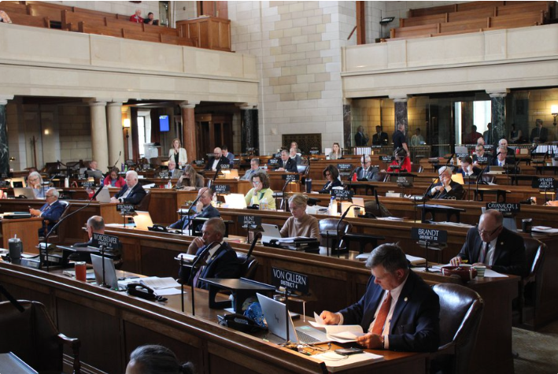
State Advocacy
• 2025 Session Review
• Looking Ahead
- 2026 Session
- Interim studies
- Legislative Candidates
• How to Be Involved

Slide 12
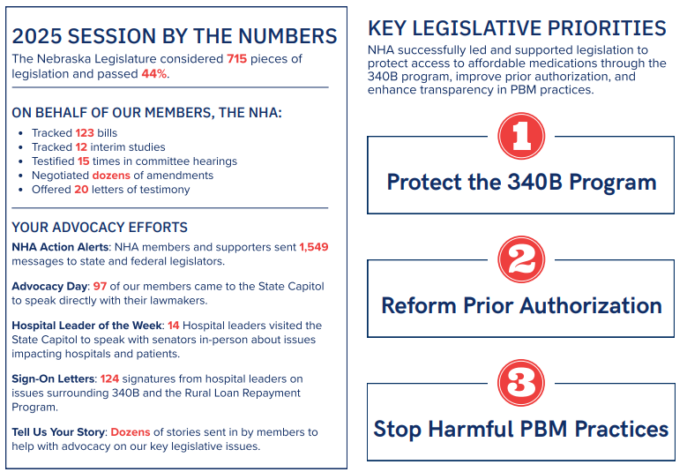
State Legislative Wrap Up

Slide 13
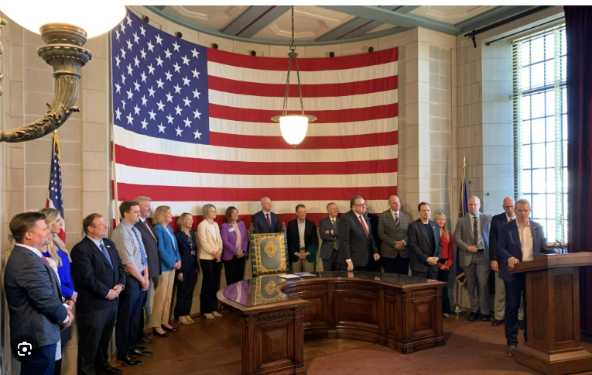
State legislation – 340B Legislation
LB168 – Protect the 340B Community Benefits Program
Governor Signing Ceremony
Law effective as of April 10, 2025
AbbVie v. Nebraska lawsuit
NHA signed onto AHA amicus brief
AG Hilgers filed motion to dismiss
Plaintiffs- drug manufacturers who participate in the federal 340B discount drug program - obviously feel aggrieved by perceived abuses and alleged noncompliance with that program's regulatory safeguards. But this lawsuit, in which Plaintiffs take aim at Nebraska statute and Nebraska law enforcement (rather than the federal program itself, the federal entities that could mitigate the alleged harms, or the wrongful actors themselves) is a clear case of misdirected anger. This Court should not indulge the Plaintiffs' temper tantrum.

Slide 14
State legislation – Prior Authorization Reform
Increase Transparency
Require insurance to make PA requirements publicly available on their website
Requires 60 days' notice to providers before implementing new PA requirements
Streamline Processes & Accountability
Create standard form for all health insurers
Adverse decisions on PA requests must be made by a physician
Requires a peer-to-peer consult when requested
Requires appeals to be reviewed by a physician of the same or similar specialty
Prohibits use of AI as sole basis of a decision to deny, delay, or modify services
Must pay providers for services that received prior auth approval
Require Response Times
72 hours urgent and 7 days non-urgent. Beginning 2028, urgent request timeframe reduced to 48 hours.
If insurance fails to meet deadlines, PA request deemed approved.
Protect Patient's Continuity of Care
A PA is valid for 1 year in most cases
Approved prior auth can follow a patient for 60 days if they switch plans
Provides clarity/accountability for inpatient care to eliminate uncompensated care
No retrospective denials after a PA is approved
Prohibit Prior Authorizations Requirements for:
Emergency services
Emergency ground transportation
Preventative services
Notes:
NDOI forms available
Reg guidance document
On or before November 1, 2025, the Department of Insurance will approve a single uniform prior authorization request form for prescription drugs, devices, and DME and a single uniform form for all other health care services. It must not exceed two printed pages.
Beginning January 1, 2026, all health care providers must use only the approved forms. This does not prohibit a URA from using a prior authorization process using an Internet webpage, portal, or similar web-based system if it is consistent with the department’s forms. A URA may request from the department an exemption if they implement an API or other electronic prior authorization methodology that automates and standardizes the process. A URA must provide at least 90 days’ notice to providers if they are using an API. Beginning January 1, 2026, a URA must meet the following timelines for determinations: Urgent health care services: within 72 hours or
Non-urgent health care services: within 7 days Beginning January 1, 2028, a URA must meet the following timelines for determinations: Urgent health care services: 48 hours or Non-urgent health care services: within 7 days Nothing prohibits a provider and carrier from contracting for shorter timeframes. Health care services are deemed authorized if a URA fails to meet these timeframes. The URA must provide the duration of approval when they provide notice of the same.

Slide 15
State legislation – PBM Reform
LB 198 – Change provisions of the PBM Licensure and Regulation Act
Introduced by Sen. Sorrentino
BCI Committee priority bill
Committee Amendment included provisions of NHA's LB109:
Prohibits patient steering by a PBM
Allows a pharmacy/pharmacist to decline to provide a drug if paid less than acquisition cost
Prohibits spread pricing on certain dates
White bagging parameters
Appeals process
Refill requests
Delivery/signature requirements
Must authorize/reimburse for drug if substantially similar
Prohibits brown bagging
Prohibits a PBM from restricting a retail pharmacy's ability to ship, mail, or otherwise deliver prescriptions to patients
Allows nationally accredited specialty pharmacies in NE to participate in PBM networks by preventing PBMs from imposing unreasonable terms beyond the requirements for national accreditation

Slide 16
State legislation
LB 322 – Prohibit assault on a pharmacy and health care professionals (LB26)
Sen. Clouse priority bill
8 hour filibuster
Advanced to Select File 37-8
Ballard amendment filed on Select to address DD concerns
Will carry forward into the 2026 legislative session
Rural Loan Forgiveness Program – Budget Bill
LB261 Committee Amendment included the $1.5M that the original bill had proposed to cut
Governor did not veto that line-item, so the Program remains funded

Slide 17
NHA Opposition remaining in Committee
LB 310 (Hansen) – Provide an exemption from newborn screening for certain diseases or conditions [HHS]
Allows a parent to refuse the newborn heal prick for certain screenings
LB 655 (Murman) – Provide for medical conscience-based objections [HHS]
Health care provider or payor has the right to opt out of the service if it has a conscience-based objection to participation in the service.
LB 676 – Certified Nurse Midwives
Sen. Hansen priority bill that included LB374 CPMs and LB701 Medicaid reimbursement for doula services
LB676 debate
Legislature voted down all amendments, including committee amendment
Advanced LB676 as originally introduced 40-3-4 pnv to Select File
Sen. Hansen amendment filed
Bill carries forward to 2026 session

Slide 18
2026 State Legislative Issues
Nebraska State Budget
General Fund pressures – Nebraska projected deficit of about $95 million after tax revenues for the year came in below forecasts
Also increased the projected deficit for the next biennium to $218 million
Coupled with Gov. Pillen's call to cut General Fund spending by 10% (~$500 million)
Protecting State Directed Payment program dollars
State Implementation of the OBBBA
Work requirements
Eligibility reviews
Rural Health Transformation Program application process
Policy factors that garner additional points
Continued push for LB322 advancement for workplace violence protections
Strengthen Rural EMS

Slide 19
Interim Studies
LR232 - Interim study to examine regulatory restrictions and opportunities in medical education in order to strengthen the medical workforce in rural and other underserved areas of Nebraska (October 16)
LR188 - Interim study to examine the significance of the state financial partnership with the federal government in delivering health services to Nebraskans through the Medicaid program (November 7)
LR124 - Interim study to examine the role of a pharmacy benefit manager within the Nebraska health insurance industry and the impact on prescription drug prices (November 19-21)

Slide 20

2026 Elections
Primary: May 12 General: November 3
• U.S. Senator Pete Ricketts re-election
• Governor Pillen and Executive Slate up for re-election
• 24 out of 49 state legislative seats are up for election
• There will be a minimum of 12 new senators elected 24% of legislature
• 12 current senators face re-election

Slide 21
2026 Legislative Elections
Interesting Races
• District 28 – Lincoln
- Former Senator Patty Pansing Brooks seeking another term
• As of October 15, 2026
- 10/12 senators seeking re-election do not have an announced opponent
- District 22 (Columbus area) and District 17 (Blair/West Point area)
- 0 announced candidates

Slide 22
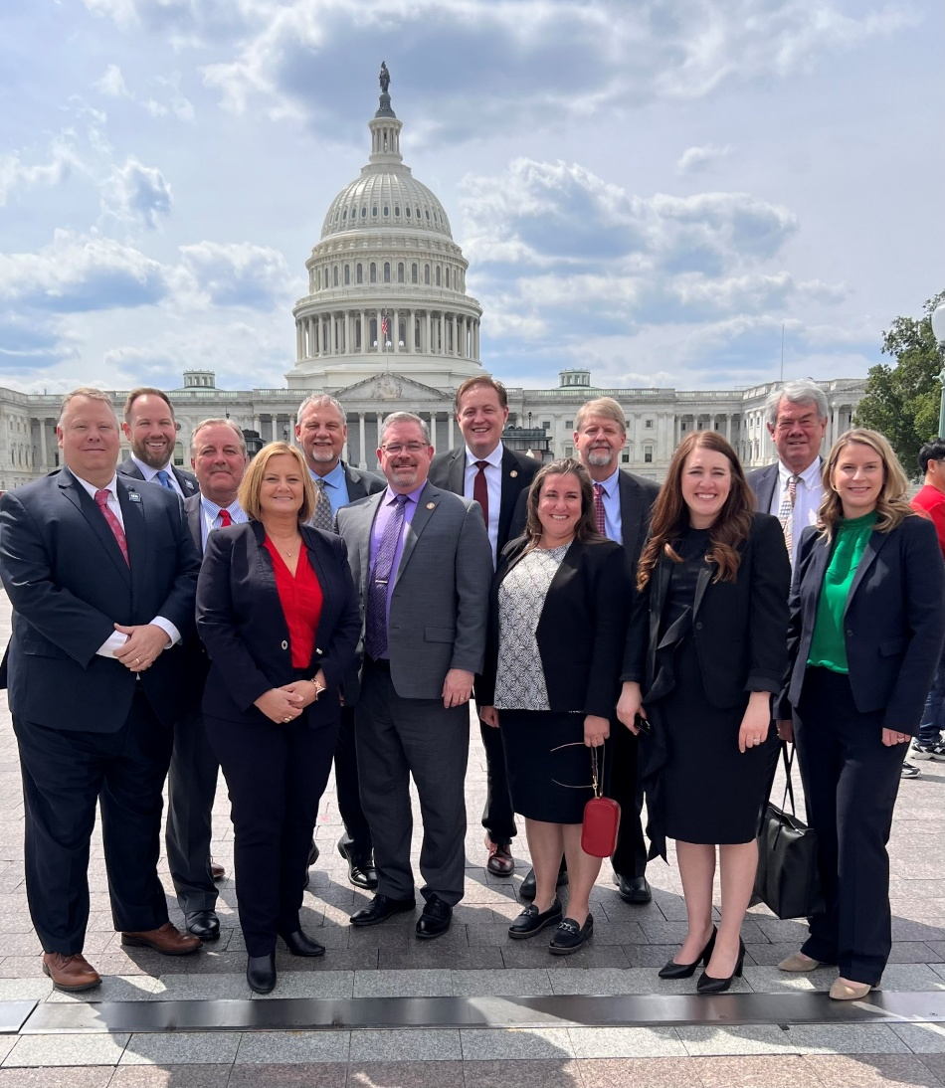
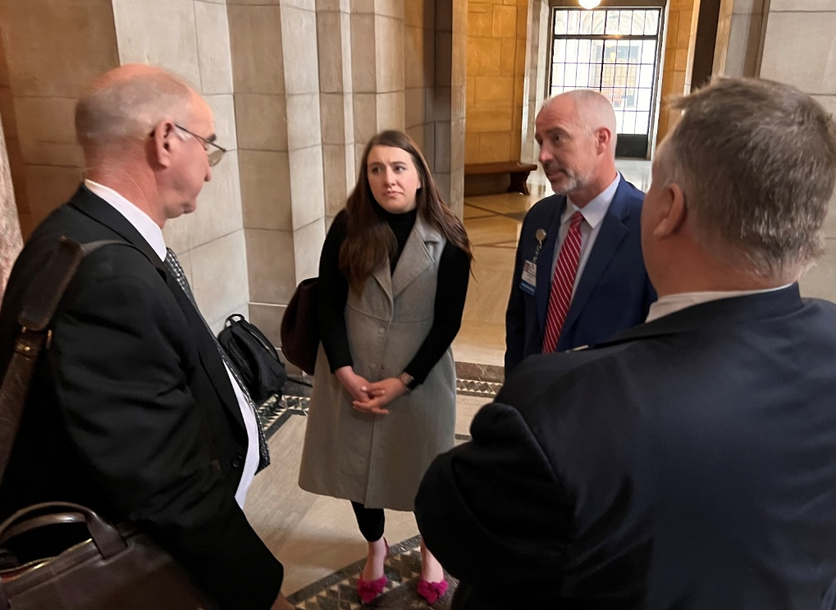
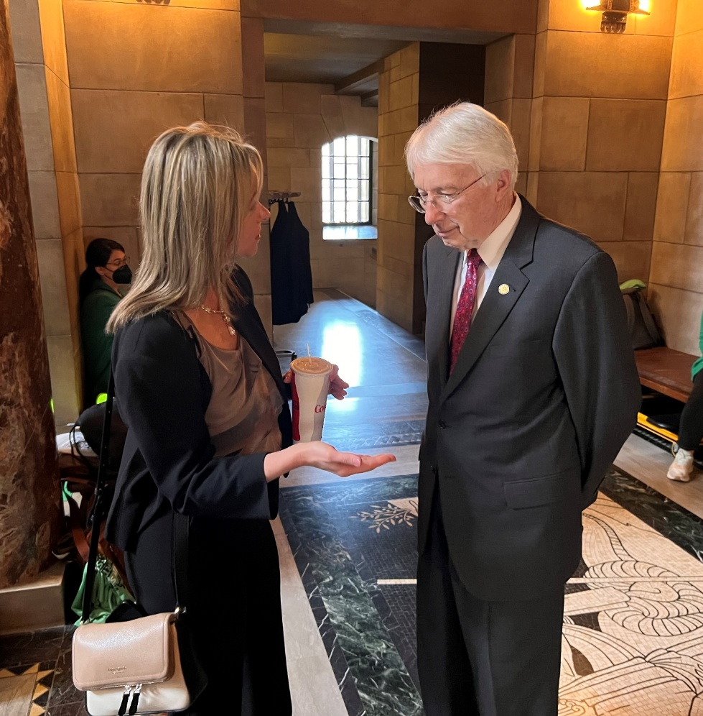
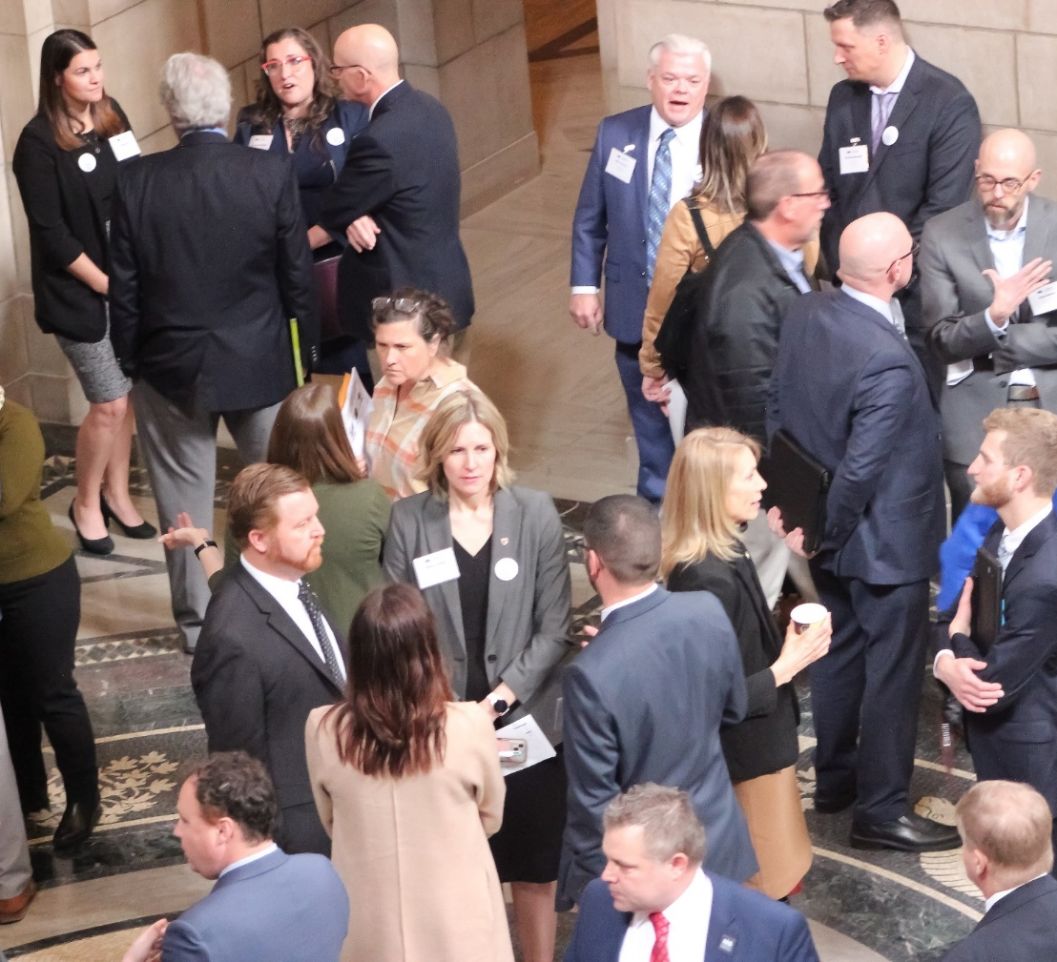
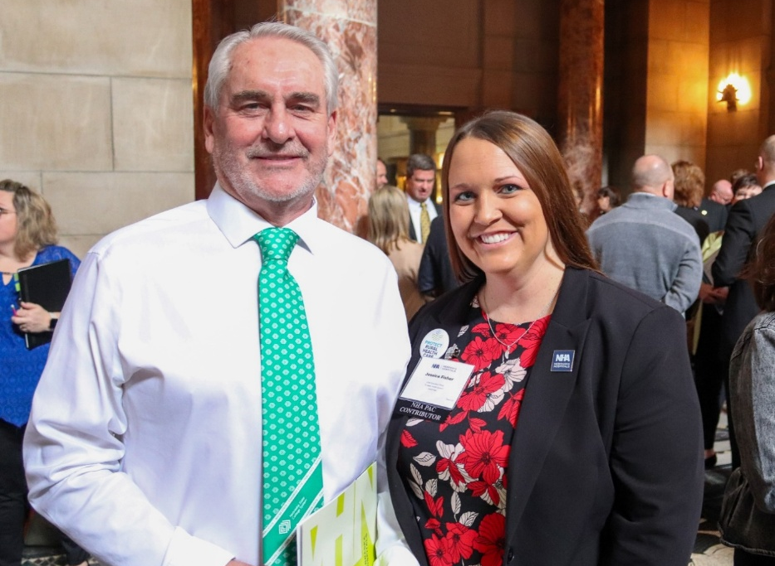
Advocacy is a team sport.
WE NEED YOU!

Slide 23
Why Advocacy Matters
Term limits have created a new dynamic in our ability to effectuate change in Nebraska’s political climate today.
• 2022 15 new senators
• 2024 16 new senators
• 2026 12+ new senators
This past session, two thirds of the Legislature had 2 years or less of experience in policy making.
The NHA is continuously engaging with and educating lawmakers and their staff.
Notes:
We're constantly educating them about the top issues that are impacting your facilities today:
Workforce Crisis
Historic Inflation
Post-Acute Placement Bottlenecks
Growing Commercial Insurance Burdens
Services are closing or at-risk
Protect Medicare & medicaid

Slide 24

How to Advocate
• NHA Guide to Hospital Advocacy
• Understand the Life on a Senator
• Personal Visits and Meetings
• Phone Calls, Letters, In-person, and Emails
- Including Thank You notes for key legislation or votes
• Submit a letter of support or opposition on a bill to a senator or committee
• Testify at a hearing on a bill
• Write an op-ed in a local newspaper on a relevant issue
• Invite Senators to Hospital and Community Tours
• Social Media
-engage with elected officials on their social accounts, like their posts
• Start an Advocacy Team at your hospital

Slide 25
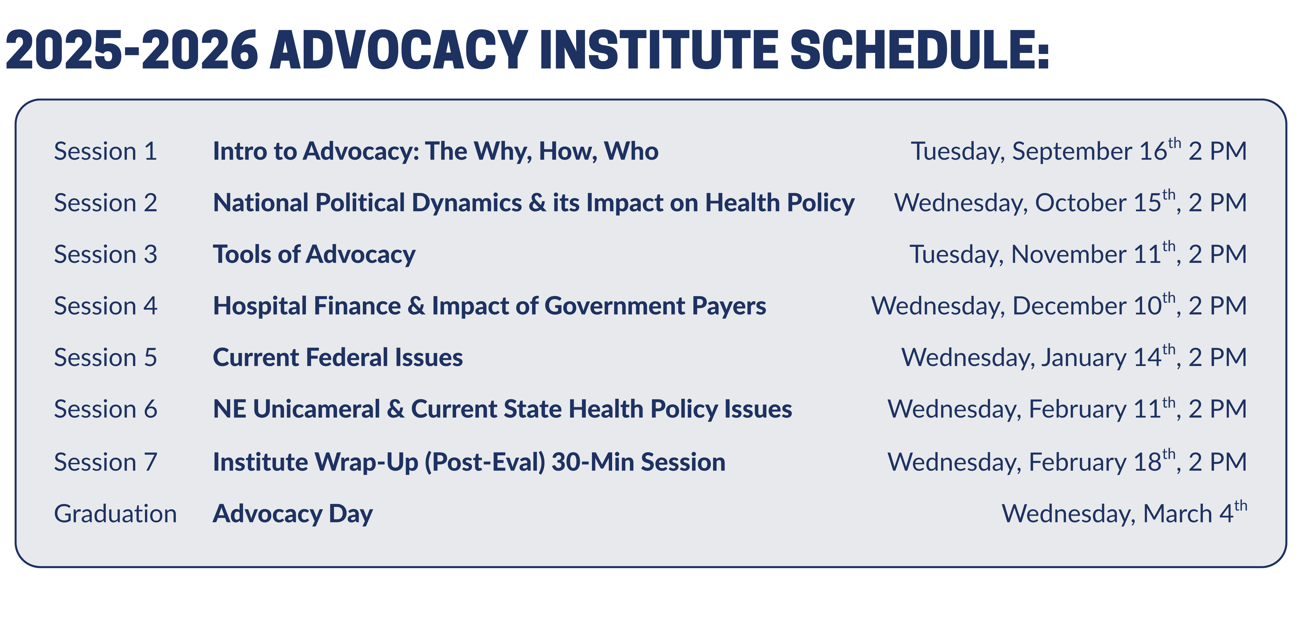
Become Involved with the NHA
www.nebraskahospitals.org
• Attend Advocacy Day (March 4, 2026, Lincoln)
• Attend NHA Annual Conference (October 22-24, LaVista)
• Attend Rural Health Conference (June 9-10, Kearney)
• Subscribe to Newslink (Weekly Newsletter)
• Attend monthly NHA Member Calls (1st Thursday of the Month, Zoom)
• Join NHA Peer to Peer Groups (Quarterly Zooms)
• Use NHA Action Center (to contact state and federal delegations on important bills)
• Submit a Story to NHA Story Bank
• Register for NHA Advocacy Institute
• Contribute to the NHA Political Action Committee (NHAPAC)

Slide 26
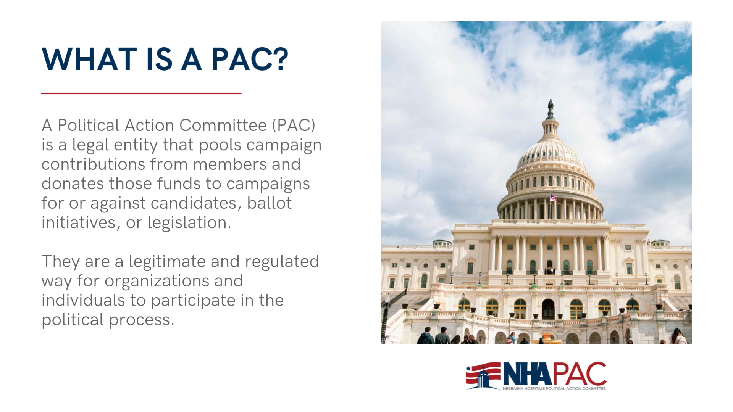

Slide 27

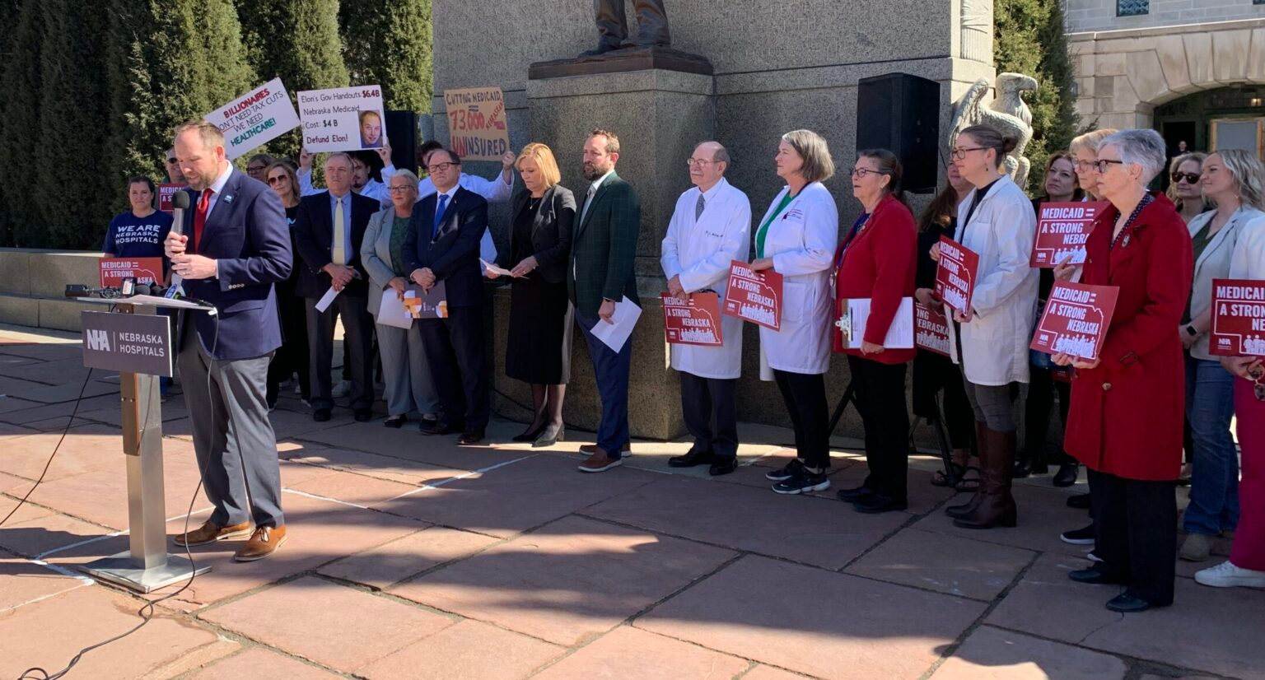

WHY WE ENGAGE
KEY ISSUES ON THE CAMPAIGN TRAIL
PROTECTING MEDICARE & MEDICAID
These programs are the financial backbone for many Nebraska hospitals, serving our most vulnerable populations. We advocate for sustainable reimbursement rates, expanded access, and policies that ensure the long-term viability of these programs.
Standing Up to Big Insurance & BIG PHARMA
We actively counter policies that favor large insurance companies and pharmaceutical corporations at the expense of hospitals and patients. This includes advocating for fair practices, increased transparency, and combating anti-competitive behaviors.
SUPPORTING INVESTMENTS IN HEALTH CARE WORKFORCE
NEBRASKA FACES CRITICAL HEALTH CARE WORKFORCE SHORTAGES. WE CHAMPION INITIATIVES THAT SUPPORT EDUCATION, TRAINING, RECRUITMENT, AND RETENTION OF NURSES, PHYSICIANS, AND HEALTH PROFESSIONALS TO ENSURE ACCESS TO CARE.

Slide 28


WHO CAN GIVE WHAT?
NON-PROFIT HOSPITALS
LIMITED BY LAW
FOR-PROFIT GIANTS = DIRECT CONTRIBUTIONS
As 501(c)(3) non-profit organizations, Nebraska hospitals are legally prohibited from making direct contributions to political candidates.
For-profit companies like UnitedHealthCare and Abbvie operate under different rules.
They can and do make direct financial contributions to Nebraska candidates at the state level.
This gives them a direct line of influence that non-profit hospitals do not have independently.

Slide 29






TOP HEALTH CARE
CONTRIBUTORS

Slide 30
YOUR CONTRIBUTION TO THE NHA PAC IS AN INVESTMENT IN THE FUTURE OF HEALTH IN NEBRASKA.
IT EMPOWERS US TO:
SUPPORT CANDIDATES WHO CHAMPION HEALTH CARE CAUSES
Identifying, vetting, and financially supporting candidates who are true allies of hospitals and patients.
EDUCATE POLICYMAKERS ON COMPLEX CHALLENGES
Providing lawmakers with accurate, timely information on the operational, financial, and patient care realities facing Nebraska hospitals.
MOBILIZE GRASSROOTS EFFORTS
Activating hospital staff, community members, and advocates to contact their legislators on critical issues, creating a powerful collective voice.

Slide 31
2025 PAC Goal $95,000 Contribute Online pac.nebraskahospitals.org Username: nhapac Password: nhapac1

Slide 32
Contact
Meghan chaffee, jd
Chief advocacy & legal officer
mchaffee@nebraskahospitals.org
402-742-8191
David Slattery
Senior director, State & Rural Policy
dslattery@nebraskahospitals.org
402-742-8153

Slide 33
Questions?

