Slide 1
Leveraging Health Information in a Meaningful Way
Jen Fletcher, MBA
Director of Health System Services, CyncHealth

Slide 2
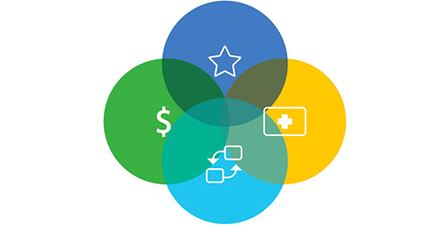
Goals
To assist Directors of Quality in gaining a better understanding of how CyncHealth Data can further improve efforts related to:
Their patients
Public Health
Social Determinants of Health (SDOH)
Readmissions, High Risk notifications
Prescription Drug Monitoring Program (PDMP)
Regulatory requirements
Meaningful use/Promoting Interoperability
Payment structure

Slide 3
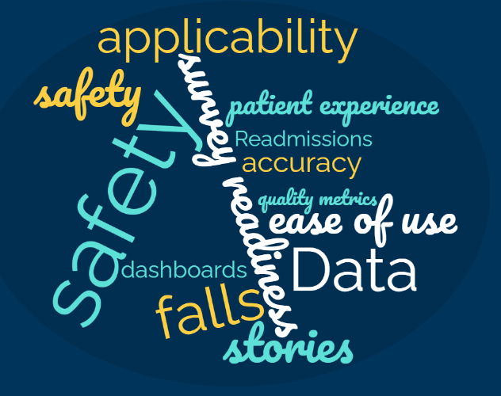
What is MEANINGFUL?
Notes:
Free online word cloud generator and tag cloud creator - WordClouds.com

Slide 4
6 Domains of Quality Healthcare
Notes:
6 domains of quality healthcare from the Institute of Medicine. This was part of our strategic plan from my former hospital. As we think about our patients and their outcomes, this is a great guide for things we must think about to improve their healthcare quality

Slide 5
Public Health, Hospital Role and Payment

Slide 6
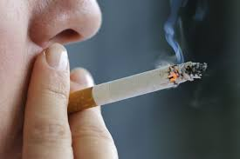
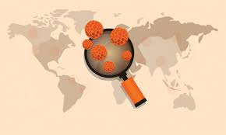
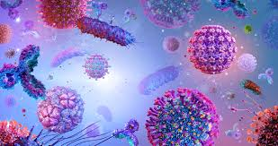
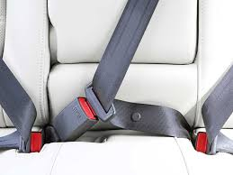
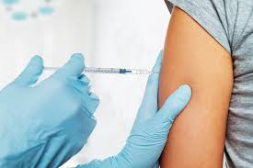
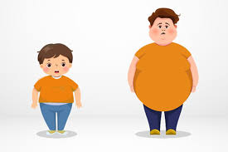
What is Public Health?
Notes:
Food safety, cancer awareness, smoking cessation, wearing your helmet, infectious diseases, your immunizations, air quality, pollution, family planning, obesity, healthy foods, wearing your seatbelt, gun safety, occupational safety, infectious disease monitoring. Everything that is related to you and the publics health

Slide 7
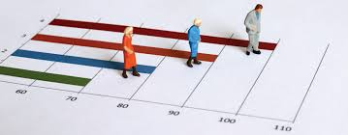
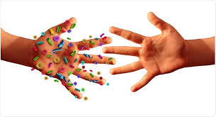
Why is Public Health Important?
Improves quality of life
Saves money
Decreased mortality rates
Increased life expectancy
Prevents and mitigates spread of disease
Notes:
One of the things that—even before the crisis—people in public health would say is, you know we're doing our job if you don’t hear from us. If, say, a food poisoning outbreak was prevented, that’s because of all the restaurant inspections that were done.
There was a study by the CDC in 2017 that your tdap vaccine (which is tetanus, diptheria and protussus) is roughly $20-40. And a child that is diagnosed with tetanus, their healthcare costs are roughly $800k. So just getting that vaccine saves a ton of money

Slide 8
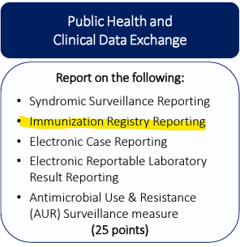
Promoting Interoperability
Notes:
Incentive program from Medicare. There are 4 components which you can see across the top in blue. There are 100 points possible for interoperability and a hospital needs 60 points to remain neutral with the payment program. If the hospital has less than 60 points, they would have downward/decreased payment from Medicare. If the hospital has over 75 points, there is opportunity for an increased payment adjustment. This can be anywhere from -9 to +9%. For a critical access hospital if they don’t demonstrate meaningful use, their Medicare reimbursement will be reduced from 101% of it’s reasonable costs to 100% that year.
The Public health one on the far right, does include 5 components. It would make sense the each of these bullets are 5 points each to account for the 25 total points. This however is inaccurate. You must participate and do all 5 in order to get the 25 points (it’s all or nothing) . The hospital must report on all 5.

Slide 9
Immunizations
VXU and QBP feeds
Vaccination Updates and Query by Parameter
Facility submits to the state Immunization Information System (IIS).
Nebraska = NESIIS (Nebraska State Immunization Information System)
Notes:
Help providers, patients, and public health officials have immunization information in one reliable source.
Guide patient care, improve vaccination rates, and reduce vaccine-preventable diseases.

Slide 10
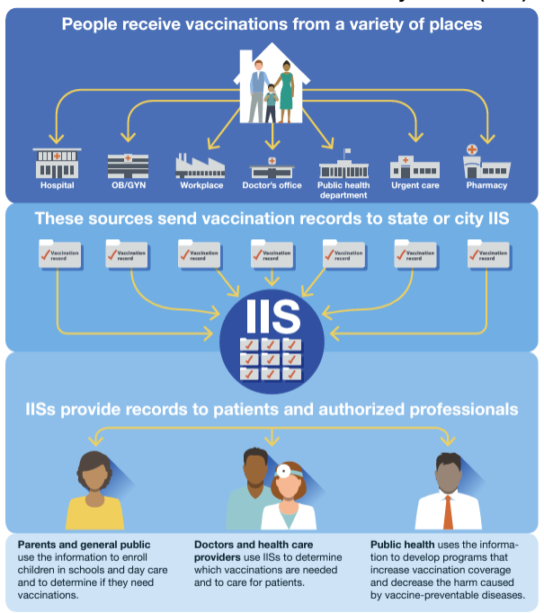
Notes:
How does this data flow work? You get a vaccination. You are required to send this to the state. This information is then sent to IIS. Alternatively, some facilities send to CH and we and we send it on to IIS. This is one place that is a reliable source for all vaccination records. (For interoperability, facilities must sent to CH. So a benefit to only have one feed. )

Slide 11
VXU
VXU vs QBP
QBP
Facility sends immunization history.
Receiving system (IIS) accepts immunization history.
Facility requests immunization history.
Receiving system (IIS) patient matches and returns immunization history. No patient match = no history returned.
Facility has ability to add the immunization history into their EHR.
Notes:
VXU’s must be submitted to the state regardless (Some facilities have 2 VXU feeds: one to the state and one to us)
All Immunizations have to go to the registry as well.
The VXU automates the process that used be faxed info.
QBP is a call to the NESIIS to pull back info on patient about their immunization history
Story: now don’t have to go into NESIIS or ask patient. You can then upload in right into the EHR. Don’t have to write it down and transcribe it into the record.

Slide 12
QBP Success Story

Slide 13
Social Determinants of Health

Slide 14
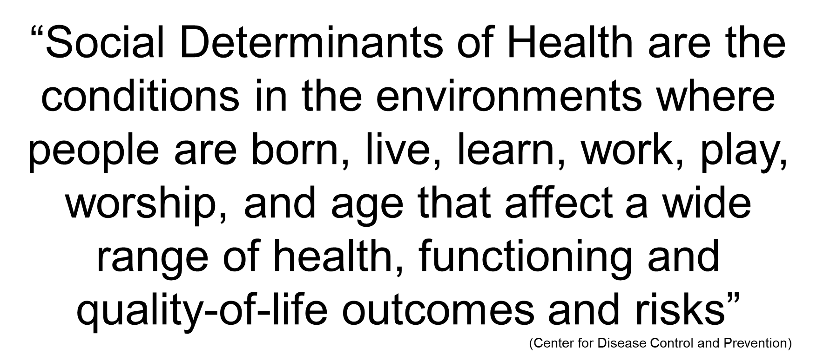
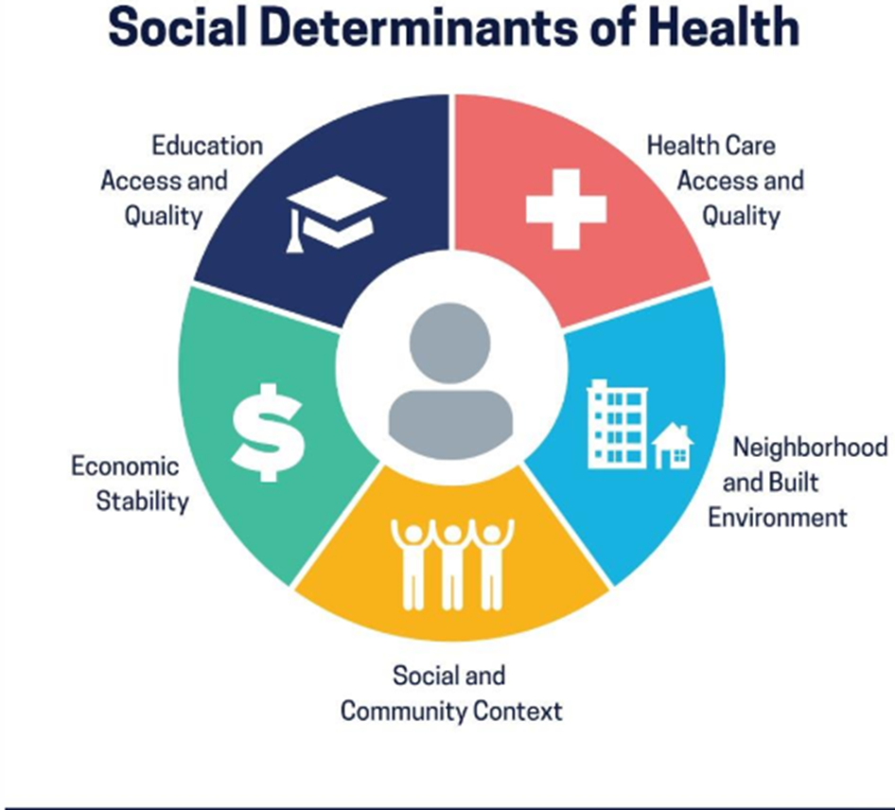
Examples of Social Determinants of Health
Affordable housing, reliable transportation
Job opportunities, stable income
Access to healthy food, safe places to exercise
Clean air and water
Ability to learn language and literacy skills
Notes:
This definition from the World Health Organization. But let me see if I can break it down a little bit more. Remember a few slides ago when I said that 80% of person’s health is made up of socioeconomic factors, physical environments and health behaviors? Well, the context of people’s lives determine their health, and so blaming individuals for having poor health or crediting them for good health is inappropriate. Individuals are unlikely to be able to directly control many of the determinants of health. These determinants—or things that make people healthy or not include a lot of things. For example--
Income and social status - higher income and social status are linked to better health. The greater the gap between the richest and poorest people, the greater the differences in health.
Education – low education levels are linked with poor health, more stress and lower self-confidence.
Physical environment – safe water and clean air, healthy workplaces, safe houses, communities and roads all contribute to good health. Employment and working conditions – people in employment are healthier, particularly those who have more control over their working conditions
Social support networks – People that have solid support systems—friends, families, communities are found to have better health.
Health services - access and use of services that prevent and treat disease influences health
Health Behavior—culture, customs, family traditions around health, personal behavior and coping skills—smoking, drinking, how we deal with stress and challenges all affect stress

Slide 15
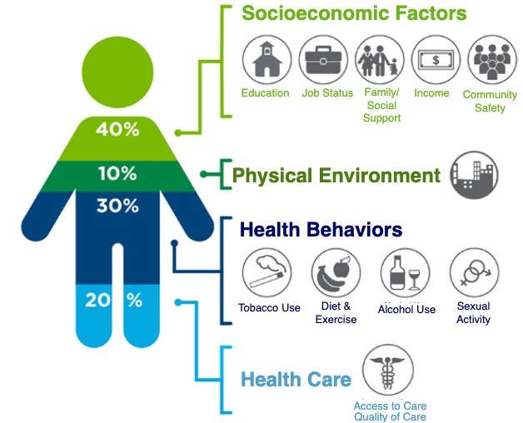
Only 20% of “Health” is determined by Healthcare. The rest is determined by:
40% Socioeconomic factors
10% Physical environment
30% Health behaviors
= 80% Social Determinants
Of Health
(Robert Wood Johnson Foundation)

Slide 16
The Value of SDOH Data to Complete the Story
Tom
“A Story about Tom and John”
John
Dr. Collins
Office visit on Thursday
Office visit on Monday
67 years old Lives in rural NE Pre-diabetic Chronic Obstructive Pulmonary Disease (COPD)
67 years old Lives in rural NE Pre-diabetic Chronic Obstructive Pulmonary Disease (COPD)
Assessments concludes age, location, and health risk are similar leading to the same health care interventions and disease mgmt. programs
Screening for SDOH can potentially
change the story
MD/Hospital Accessibility
Economic Stability
Education
Social and Community Support
Neighborhood and Built Environment
Doctor/Hospital >40 miles away
Average income <$25k last 2 years
High school education, same for family
Lives alone, no family or close friends nearby
High crime neighborhood, unsafe for outdoor exercise
Tom has several SDOH needs that are barriers to health
Doctor/Hospital <10 miles away
Average income >$200k last 2 years
Post graduate degree, family all have 4-year degrees
Lives with spouse. 5 close family members live <10 miles away
Safe neighborhood, with walking trail
John has minimal SDOH needs that are barriers to health
In home services
Transportation to MD visits
Offer telehealth appointments
Financial Services (Medicaid, Section 8 housing, SSI, etc.)
Continue to screen every 6 months

Slide 17
Event Notifications ED, Ambulatory, and Conditions of Participation (CoP)

Slide 18
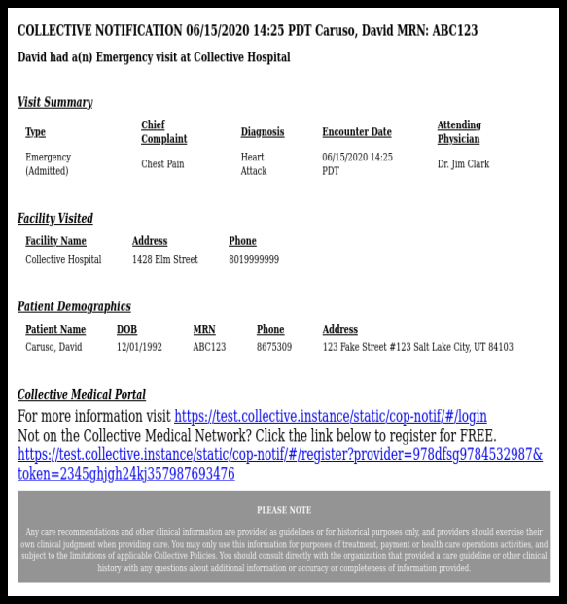
Event Notifications for Conditions of Participation
May of 2021, CMS required the submission of ADT data
The Requirement:
Under the regulation, the hospital must make a reasonable effort to send the messages to a provider about a patient's admission/discharge or transfer
Some hospitals have their own internal process for this notification. Others use our services.
Notification fatigue is real!
Example of Notification.
What happens at check-in?
Notes:
This is an example of a message a provider would receive. Hey Dr Jones, your patient David Caruso has been admitted to the Emergency Department from Chest Pain. This notification goes right into the providers inbox as a notificiation. As a front desk at the hospital, or ED< the registrar is required to ask who your primary is. This is so they receive this notification.
Provider Notifications Hospital organizations have partnered with CyncHealth and Collective Medical to provide the notification services for these encounters. Providers can expect to receive notifications in their secure Direct Message inbox when their patients are admitting, transferring, and/or discharging from the hospital. Provider information is sourced from patients and hospitals so that patient encounter information can be accurately and automatically shared. These notifications will provide pertinent care information such as encounter history, chief complaint, diagnosis, hospital provider information, and patient contact information
Providers to have an option to follow the link to opt out of receiving messages altogether or limit the frequency of the messages to daily or weekly.
The requirement is that the hospital SEND the messages. The providers actually may decline receiving the messages.
We have had some cases where physicians were being over notified and not happy campers. If there is a case where the hospital has another tool that is notifying them of the COP notifications, they may amend their ADT feeds to suppress the notifications. If that is the case for anyone on the call, please let us know and we can send you the ADT specification document which will walk you through the process to modify the ROL segments to reduce that noise.

Slide 19
Emergency Department Notifications
High Utilizing Patients 5+ ED encounters within 12 months
Traveling Patients 3+ ED locations within 90 days
Readmission Risk Patients presenting in your ED with an Inpatient or SNF discharge within the last 30 days
Patients with ED Care Guidelines entered into the network
Patients with Security & Safety Events entered into the network
Notes:
I had a phonecall recently with ahospital about ED notifications. When you ask a Director of an ED, would it be beneficial if you found out these types of notifications. The answer is always yes!
As we look to the last two on the list, I really think the next slide will be of more help. We are currently piloting a project for Imaging notification as well

Slide 20
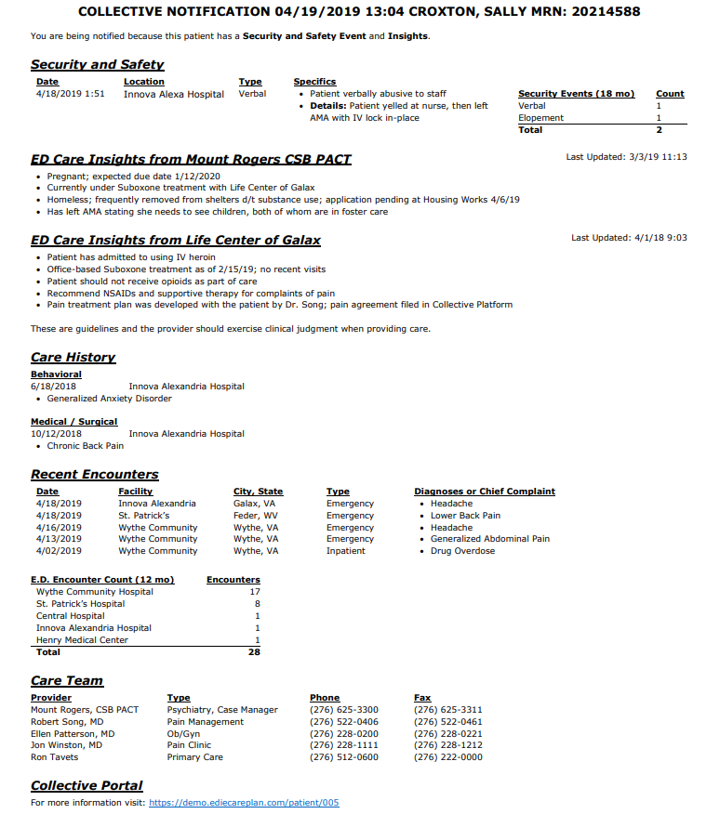
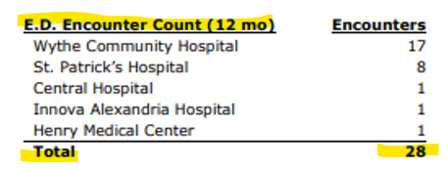
Notes:
What the notifications look like.
You can see that Sally has some specific items on the one pager.
Security and safety events are an excellent way to communication with your own organization as well as other organizations when patients may be of harm to others or themselves. By knowing this and relaying this information, it provides a safer, healthier experience for everyone.
Sally also has some care insights noted from two different facilities. Clinicians are allowed to enter what they would like, but we always suggest the information be factual and helpful for a future provider. We request that insights be concise, and relevant to the care of the patient Sometimes this has information on a patient's usual state of health, mental health, substance abuse (like Sally has here) or other information about housing or security.

Slide 21
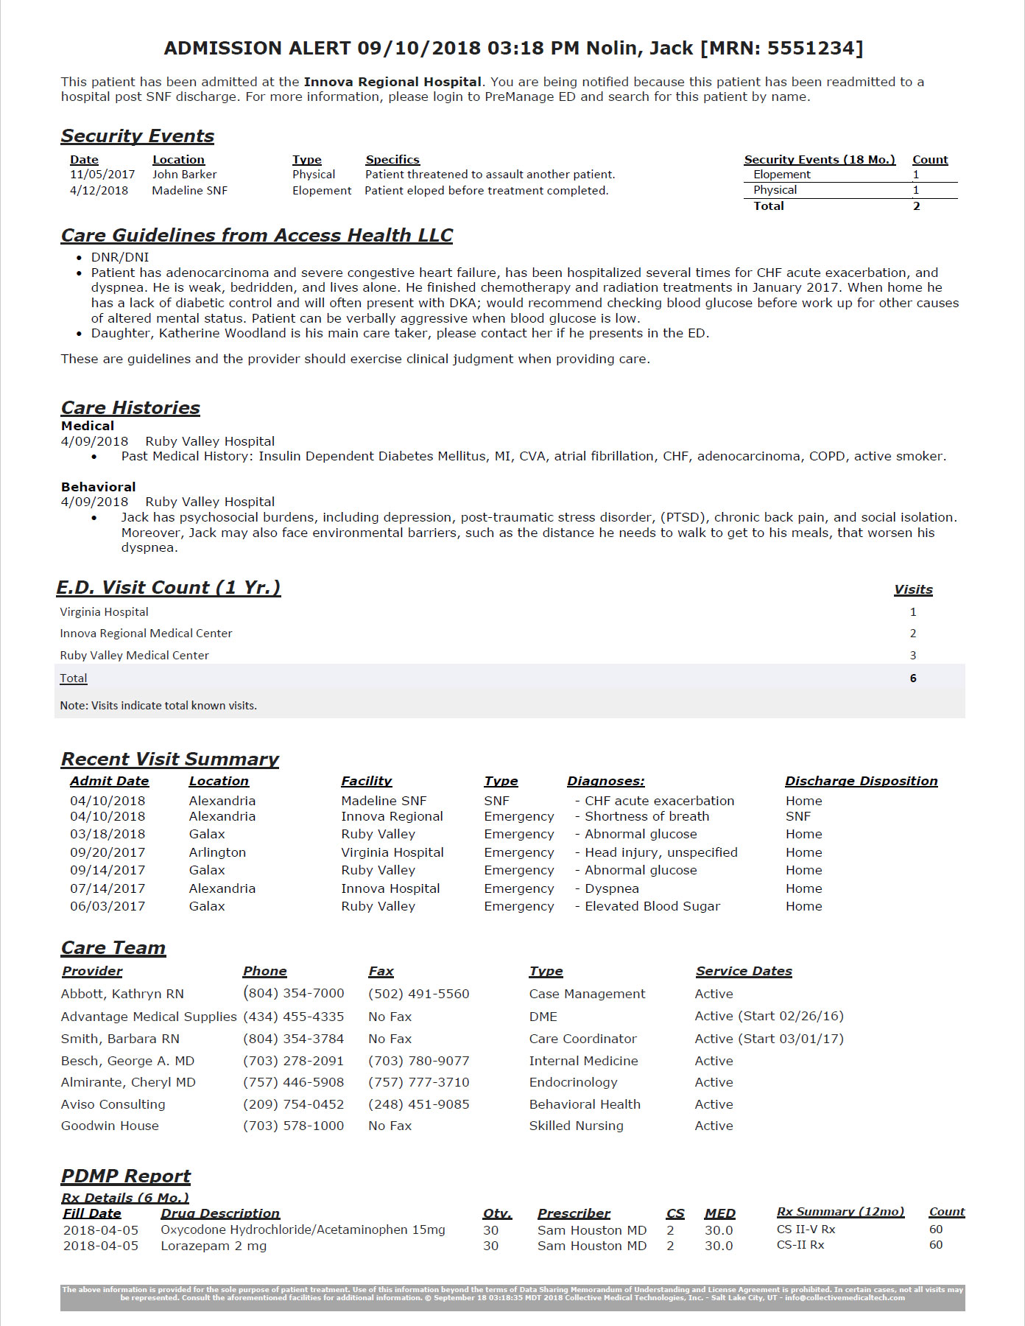
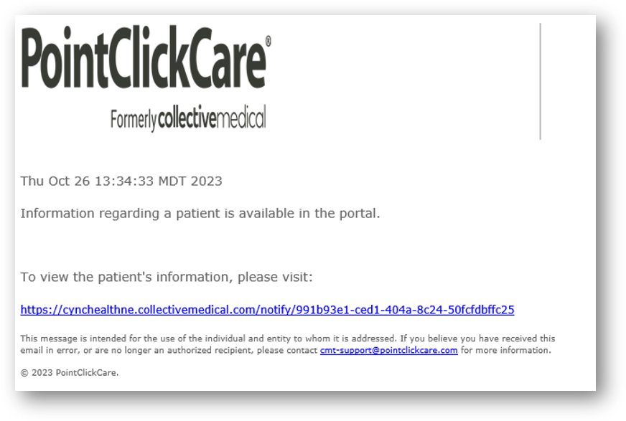
Fax and Email Notification Examples
No PHI (Protected Health Information)
Notes:
Clinics often choose to funnel their emails into another folder of their inbox, or many of them have chosen to put this into their workflow by checking the portal 1-2x/day or a couple times per week. Most of their patient volumes are so large, getting various notifications thoughout the day can be a lot, and therefore logging into the system seems to be the choice for many of our participants.

Slide 22
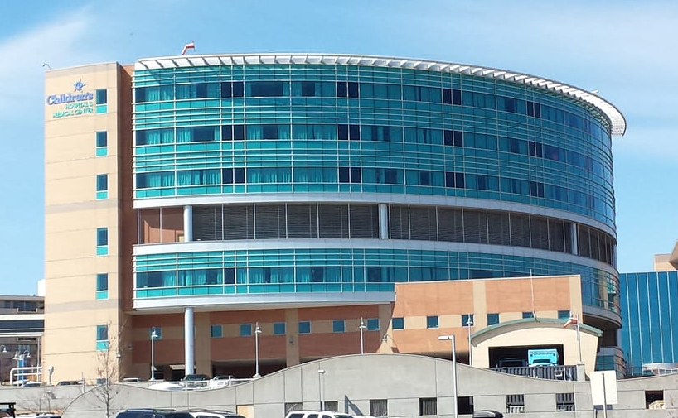
Why would a Clinic provider want ENS?
Facilitate Better Hospital Patient Care
Patient specifics/family dynamics
Improving clinical outcomes.
Timelier Follow-up
Educating patients on PCP vs. ED usage
Notes:
Asthma/Pulmonology clinic have recently been taken through ENS demos to receive notifications.
Baby in ED overnight, notification saved a 2nd return visit

Slide 23
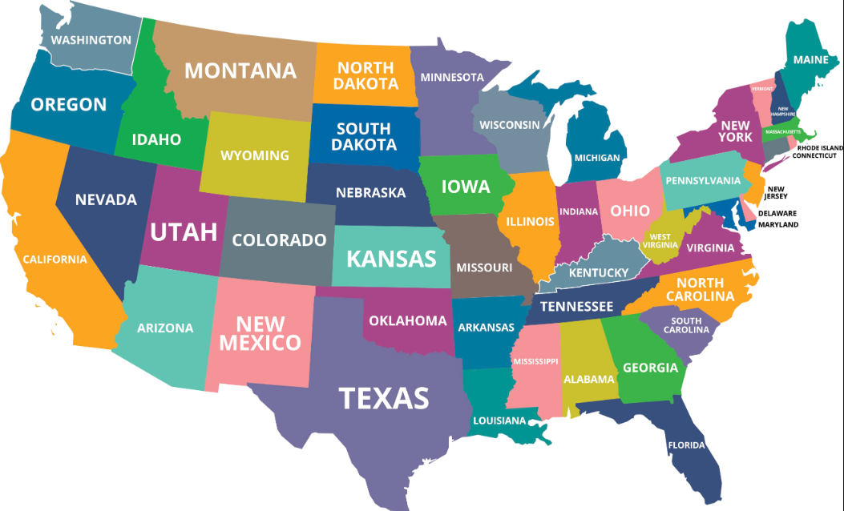
Why would a Clinic provider want ENS?
Patient Safety
The ability to prevent harm
Provider Engagement
Ability to see visits outside our bordering states
Notes:
There was a scenario at one of our PCF clinics. They received a notice on a patient in the ED. They then received another notice on a patient that was admitted to inpatient and dcd'. Multiple doctors gave this patient opiods. In getting the notification, they were able to check the HIE and recognzied a possible issue. They calledthe patient and saved them from taking 3 narcotics simulataneously.
We have another story about the partnership with PCC. Since they are a national database and tie to various hospitals and facilities throughout the nation, one of the patiets from NE was seen in an ED in Florida. They were able to clal the patient to see if there was any education they needed, a way they could help, or even offer being seen once she returned to the area.

Slide 24
PDMP and HealthCare Quality
Notes:
All states have a PDMP

Slide 25
PDMP = Prescription Drug Monitoring Program
Software solution used to record and monitor prescription dispenses
Prevent the misuse of prescribed controlled substances
Monitor patient medication care and treatment
Provide information to improve patient health and safety
Notes:
The PDMP is a software solution used to record and monitor prescription dispenses. In Nebraska, this includes controlled substances as well as non-controlled substances. Currently Nebraska is the only state that collects all medications, and not just controlled substances and drugs of concern.
The primary objectives of the PDMP are to prevent the misuse of prescribed controlled substances, monitor patient medication care and treatment, provide information to improve patient health and safety, and ensure the state of Nebraska remains on the cutting edge of medical information technology.

Slide 26
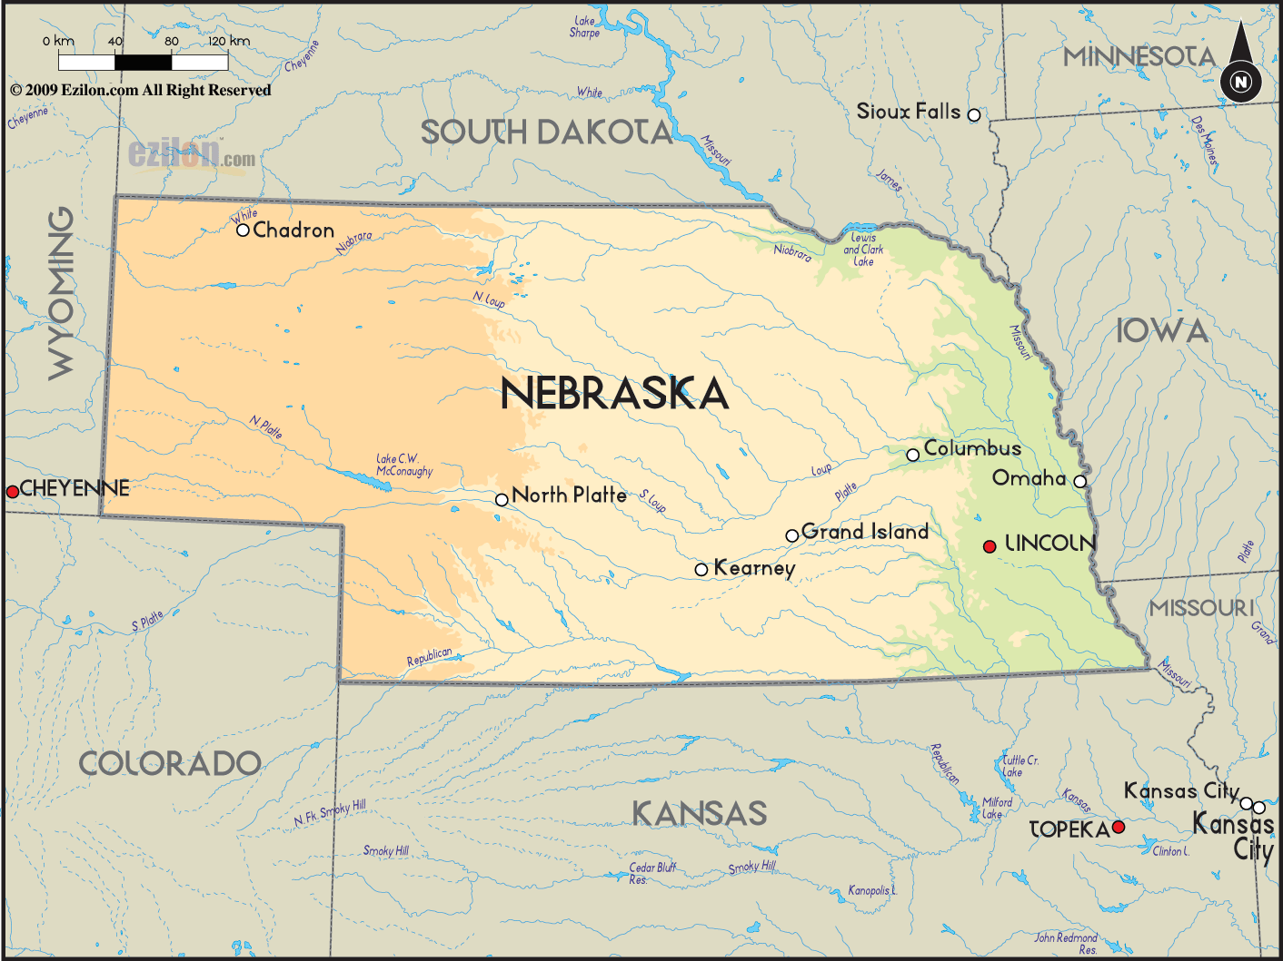
What makes Nebraska different
Nebraska collects all dispensed medications
Other states are working on it
Patients are not able to opt-out
They can still opt-out of the Clinical Portal

Slide 27
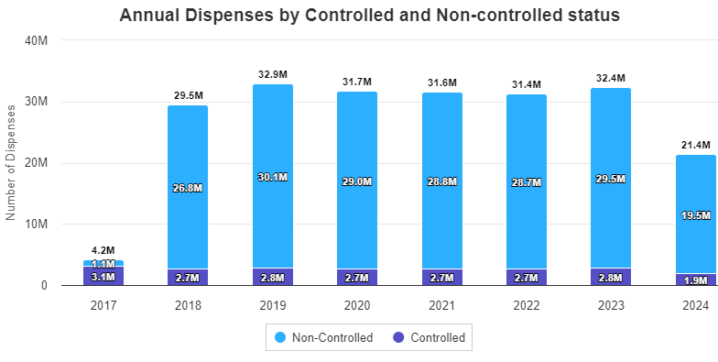
Dispenses per Year
Notes:
The reason 2017 was so low because NE only required controlled substances that year

Slide 28
Mandatory Use
Nebraska Title 471 NAC 18 (Physician Services)
Nebraska Medicaid Regulations
009. PRESCRIPTION DRUG MONITORING PROGRAM
009.01 GENERAL REQUIREMENT. Each provider prescribing a controlled substance in Nebraska to a Medicaid client must check the prescription drug monitoring program established under Neb. Rev. Stat. § 71-2454 before prescribing a schedule II medication and at dosage adjustment. Provider may delegate checking of the prescription drug monitoring program to a delegate as defined in Neb. Rev. Stat. § 71-2454 (14)(c).
009.02 EXCEPTION. Good faith exceptions must be documented in the client’s medical record and provided upon request to the Department. These requirements do not include a prescription to a client as set forth under 42 U.S.C. Sec. 1396w-3a and to a resident of a facility where schedule II medications are dispensed to a client through a single pharmacy.
Notes:
Can delegate to a nurse, or if unable to access, they must document
Most facilities require this for all patients, as Medicaid is too hard to manage/track

Slide 29
Med REC
The process of identifying the most accurate list of all medications that the patient is taking, including name, dosage, frequency and route, by comparing the medical record to an external list of medications obtained from a patient, hospital or other provider.
Definition. Medicaid Promoting Interoperability Program Modified Stage 2. Eligible Professionals. Objectives and Measures for 2018. Objective 7 of 10
Notes:
The responsible person, overall is the physician. Often it’s the RN who does it.
At the hospital level, is this pharmacy in some instances? Each facility might be different
Licensed by the Uniform credentialing act of NE

Slide 30
Challenges with obtaining medication history
Only as accurate as the history obtained
Poor historians
Patient/ family bring in all medication bottles
Time-consuming
Call pharmacies
Review EHR
Admission vs. discharge orders

Slide 31
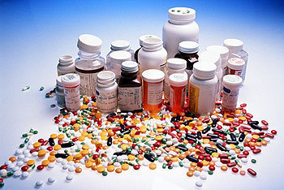
Meds Reconciliation Before and After
Aspirin
“Little white one”
The one that makes me pee
Oregonian file photo. OregonLive, 29 Nov. 2011, https://www.oregonlive.com/health/2011/11/alarming_prescription_drug_mix.html. Accessed 09 Apr. 2024.
Notes:
To recap the previous slide, this is a common example of what a patient might say. Often times patients bring in their bottles, which is only one bottle and have mixed meds in that bottle. Looking this up in the PDMP can offer insight to what these pills actually are.

Slide 32
Meds Reconciliation Before and After
Aspirin
“Little white one”
The one that makes me pee
Aspirin 325mg tablet
Simvastatin 10mg tablet
Furosemide 40mg tablet
Levothyroxine 100mcg tablet
Escitalopram 10mg tablet
Oregonian file photo. OregonLive, 29 Nov. 2011, https://www.oregonlive.com/health/2011/11/alarming_prescription_drug_mix.html. Accessed 09 Apr. 2024.

Slide 33
QUESTIONS

Slide 34
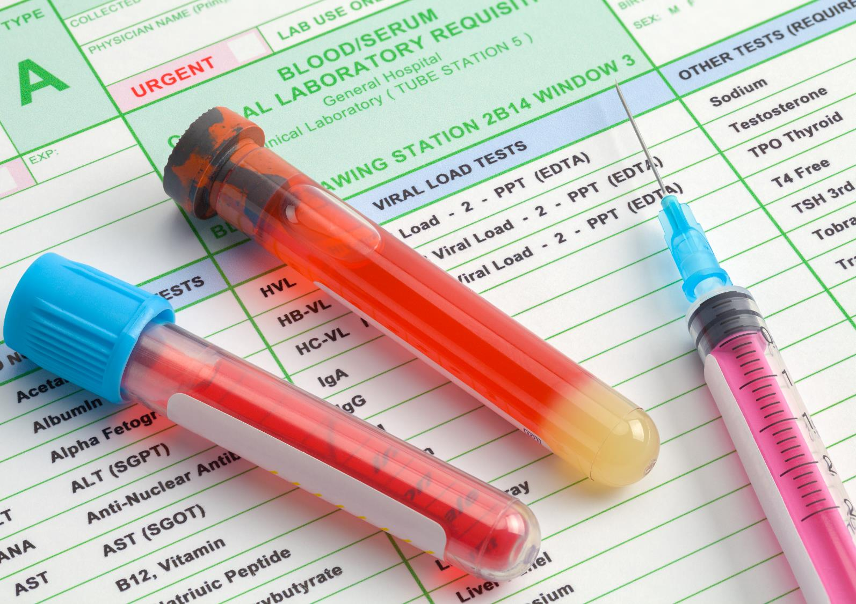
CyncHealth Services - Quality and Safety
Longitudinal health record
Health Information Exchange (HIE)
Comprehensive medication history, PDMP
Clinical portal and national network connections
Public health reporting
Social Determinants of Health
Event notifications for clinics and Emergency department
Jen Fletcher, Director of Health System Services
jfletcher@cynchealth.org
Notes:
CyncHealth leverages an interoperable infrastructure and values a vendor agnostic approach that uses technologies customized for the Midwestern community needs. However, when more appropriate we also power your solutions with data instead. Through our health data utility, many services are available now to Iowa participants to support value-based care and other state programs in Iowa.
Longitudinal Health Record powered by the clinical portal and eHealth Exchange: CH IA will provide authorized users access to the clinical portal. This clinical portal can be used to view the longitudinal patient record and enables participants to query the eHealth Exchange participants through the clinical portal. Approved eHealth Exchange participants will also be able to query CH IA. CH IA is a HUB Two-Way, giving the highest level of interaction possible.
SDOH - We understand that the continuum of care often extends beyond your facility, and seek connections or data needed to provide high quality care. Therefore, we are building a network for community connections and social care referrals across Iowa. This service, powered by the Unite Us platform, empowers providers to connect patients in need with social services. This platform is integrated within CyncHealth’s core platform, ensuring that Iowa providers can make both patient outcome and financial impact, supporting participation in value-based care models and other CMS incentive programs. To further operationalize these utilities, CyncHealth is leading the way through partnerships with Gravity Project on data standards for Social Determinants of Health and National Quality Forum on appropriate measures for SDOH.
Public Health & Data Enhancement: CyncHealth participants already have access to public health reporting functionality, including ELR and syndromic surveillance. In Iowa, we recently partnered with IDPH to deliver Syndromic Surveillance. Iowa has been a laggard in this space, and the partnership allows CDC, IDPH, and community agencies to leverage data to more effectively detect and monitor outbreaks in real-time for community health and safety. Soon your facilities will be receiving materials and outreach to join this essential program in Iowa.
Training – CH IA offers training for clinical porta, DSM, and other HIE services as determined by CH IA.

