Slide 1
CAPTURE Falls
Dawn Venema, PT, PhD
Victoria Kennel, PhD
Matt McManigal, BS, MS
University of Nebraska Medical Center

Slide 2
Learning Objective
Describe the CAPTURE and CATCH RURAL Falls programs and methods to engage with each program

Slide 3
Introductions – UNMC Team
Victoria (Vicki) Kennel, PhD
Industrial Organizational Psychologist
Matt McManigal, BS, MS
Systems Engineering, Patient Oriented Research
Dawn Venema, PT, PhD
Physical Therapist
10+ years of experience in organizational psychology; provides the human behavior, team, organizational, and quality improvement perspective
Provides the expertise in analysis, organization, and presentation of data
20+ years of experience in geriatric physical therapy; provides the clinical perspective of fall risk reduction

Slide 4
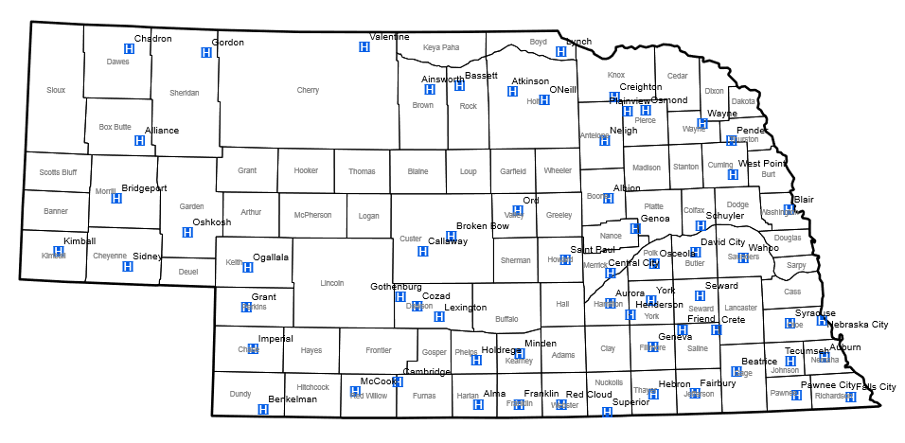
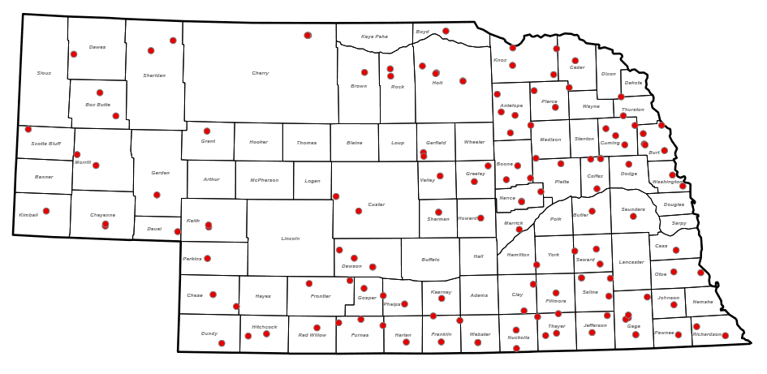
Acknowledgements: Funding
This work has been/is supported by Grant numbers R18HS021429 and R03HS024630 from the Agency for Healthcare Research and Quality, and the Nebraska Department of Health and Human Services Office of Rural Health Medicare Rural Hospital Flexibility Program.
Image Credit: https://dhhs.ne.gov
The content is solely the responsibility of the presenters
and does not necessarily represent the views of any funding source.

Slide 5
CAPTURE Falls vs CATCH RURAL Falls
Collaboration And Proactive Teamwork Used to REduce (CAPTURE) Falls
10+ years of support to over 30 Nebraska Critical Access Hospitals for quality improvement of inpatient fall risk reduction
Address patient fall risk during a hospital stay and reduce the risk of a fall
Coordinated Action Toward Community Health: RedUce Risk And Limit (CATCH RURAL) Falls
Logical extension of our work with hospitals to Rural Health Clinics
Proactive approach to try to reduce fall risk in the community
Both efforts are funded by the NE DHHS via the Medicare Rural Hospital Flexibility Program

Slide 6
CAPTURE Falls Program
Collaboration and Proactive Teamwork Used to Reduce
Falls
Purpose of the CAPTURE Falls Program
A quality improvement program
to support the implementation of evidence-based fall risk reduction practices
using an interprofessional team approach
to reduce the risk of inpatient falls in critical access hospitals

Slide 7
How to Engage with the CAPTURE Falls Program
Initial Steps
Begin engagement or re-engagement with UNMC team on a rolling basis
Complete gap analysis
Additional Resources Available
Quarterly collaborative calls for education and program updates
Sustainment
Update gap analysis when appropriate
Form your team
Further consultation with UNMC team “on-demand”
Know Falls REDCap database for reporting and learning from falls
Monitor progress towards goals
Review and sign Data Registry and Quality Improvement Agreement that acknowledges UNMC’s relationship with the Nebraska Coalition for Patient Safety (NCPS) and associated confidentiality protections for data and information sharing.
Monitor fall rates; compare with benchmarks
Participate in at least one consultative meeting with UNMC team to review gap analysis and establish priorities/goals
Use of the CAPTURE Falls online roadmap
Quarterly reports for hospitals that report into Know Falls
Participation in establishing CAH-specific fall rate benchmarks
Can also “jump in” anywhere in your fall risk reduction process for focused topic-specific support

Slide 8
Relationship with the Nebraska Coalition for Patient Safety (NCPS)
UNMC CAPTURE Falls is an analytic subcontractor for NCPS – by working with us, you are working with a Patient Safety Organization (PSO)
Confidentiality and privilege protections of the Federal Patient Safety and Quality Improvement Act of 2005 apply to our work with hospitals
Reduce reporting burden for hospitals who report to both NCPS and UNMC CAPTURE Falls
UNMC CAPTURE Falls and NCPS work together to enhance knowledge about fall events
Hospitals that participate in UNMC CAPTURE Falls sign an agreement with UNMC
Acknowledges our relationship with NCPS
Discloses that we share fall event data with NCPS for those hospitals who are NCPS members
Discloses the potential we may use de-identified fall event data for research via a UNMC Institutional Review Board-approved data registry

Slide 9
Fall Risk Reduction Program Gap Analysis
Conduct an honest assessment of the current state of your fall risk reduction program and its performance
Fall Risk Reduction Program Assessment tool available in two formats:
PDF: https://www.unmc.edu/patient-safety/_documents/fall-risk-reduction-program-assess.pdf
Electronically: we can share a link to complete electronically through REDCap
https://www.unmc.edu/patient-safety/capturefalls/roadmap/gap-analysis/index.html

Slide 10
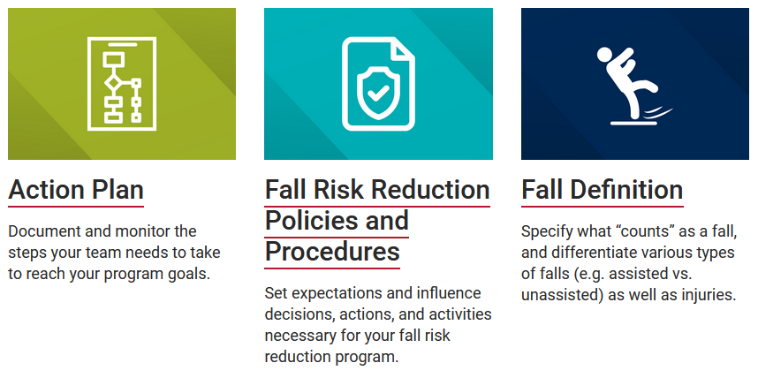
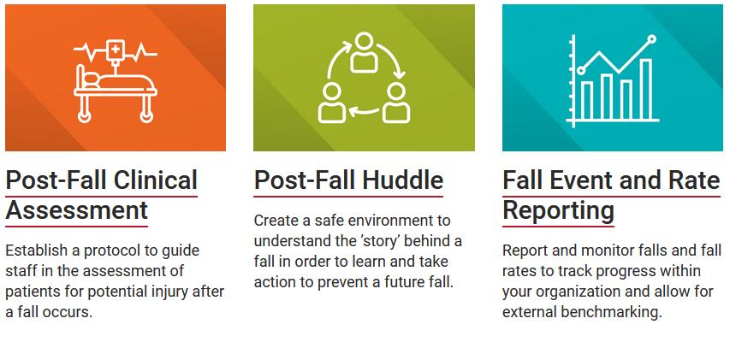
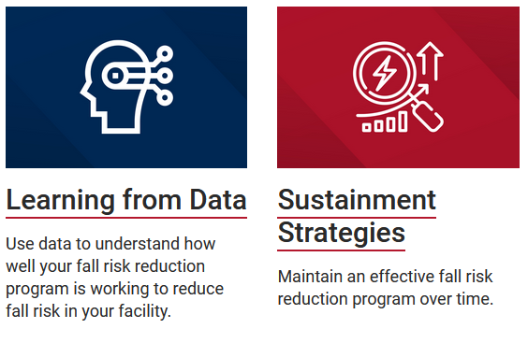
CAPTURE Falls Roadmap
https://www.unmc.edu/patient-safety/capturefalls/roadmap/index.html

Slide 11
Tracking and Learning from Fall Events through the Know Falls Database and Quarterly Fall Summary Reports
Quarterly Fall Summary Report Elements
(historical over time)
Reported falls by admission visit type (acute, swing, observation, hospice; also outpatient, ER, ambulatory care clinic, visitor, and other)
Reported total, unassisted, and injurious falls
Reported falls by extent of harm and assistance
Reported falls by day of week
Reported falls by shift
Completed post-fall huddle forms
Know Falls Database and Learning System:
Secure, HIPAA compliant online fall event reporting and learning system
CAPTURE Falls Event Learning Form:
https://www.unmc.edu/patient-safety/_documents/roadmap/capture-learning-form-and-post-fall-huddle-guide-5.5.pdf
*Reporting is voluntary and optional*
Actively engaged in collaborations to reduce documentation/reporting burden

Slide 12
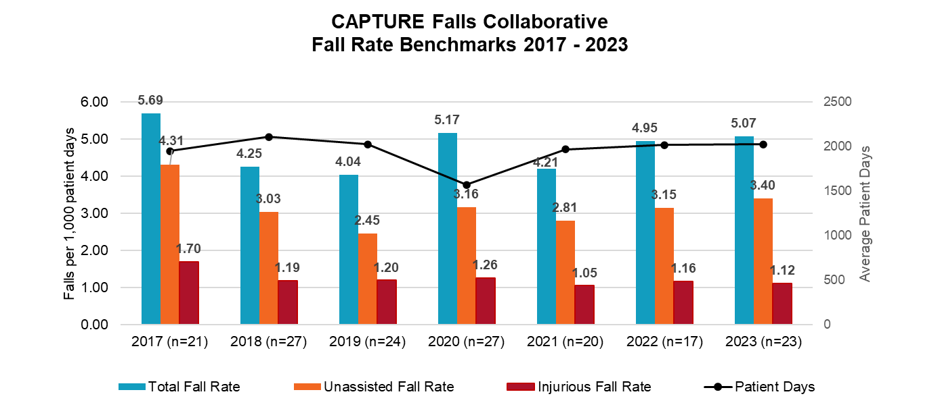
Annual Fall Rate Benchmark
Definition of a Fall used in CAPTURE Falls:
“A fall is a sudden, unintended, descent of a patient’s body to the ground or other object (e.g., onto a bed, chair, or bedside mat) that can be assisted or unassisted.”
Agency for Healthcare Research and Quality Common Formats Version 2.0
Standardized definitions allow for valid comparisons with peer hospitals
Normalized rates (x falls/1000 patient days) allow for valid comparisons:
With hospitals of varying size and/or census
Over time within hospitals when census varies
The CAPTURE Falls Collaborative is the only CAH-specific benchmark of which we are aware

Slide 13
CATCH RURAL Falls Program
Coordinated Action Toward Community Health:
RedUce Risk And Limit Falls
Purpose of the CATCH RURAL Falls Program
Provide education, resources, and improvement support for Rural Health Clinics
to adopt and implement an evidence-based fall risk management program
to improve care for older adults in your community

Slide 14
CATCH RURAL Falls Program
On-demand education
regarding fall risk management activities relevant to the cohort’s topic (a fall risk screening, assessment, and/or intervention practice; improvement strategies; implementation considerations)
Virtual cohort discussions and 1:1 consultations
to discuss implementation strategies and support practice change
Baseline data collection
to establish a baseline for measurable process(es) and/or outcome(s) relevant to the cohort’s topic
Post-cohort data collection
to evaluate outputs and short-term outcomes
Improvement tools
to establish goals, identify measures and run tests of change and support implementation of strategies into practice
Cohort-Based Approach ~6-month long cohorts focused on a specific fall risk management topic
Overarching Goal – increase the percentage of older adult patients who receive a fall risk management component (e.g., screening, various assessments and interventions)

Slide 15
Centers for Disease Control (CDC) STEADI Toolkit
Created for healthcare providers to support implementation of a coordinated approach to manage falls
Algorithm for Decision-Making
Patient Education Materials
Provider Education Materials
Implementation Strategies
Screening and Assessment Tools
Eckstrom et al. (2017); Johnston et al. (2019)
CDC STEADI: Stopping Elderly Accidents, Deaths & Injuries (2023) https://www.cdc.gov/steadi/index.html

Slide 16
Three Key Actions: Screening, Assessment, and Intervention
CDC STEADI: Stopping Elderly Accidents, Deaths & Injuries (2023) https://www.cdc.gov/steadi/index.html

Slide 17
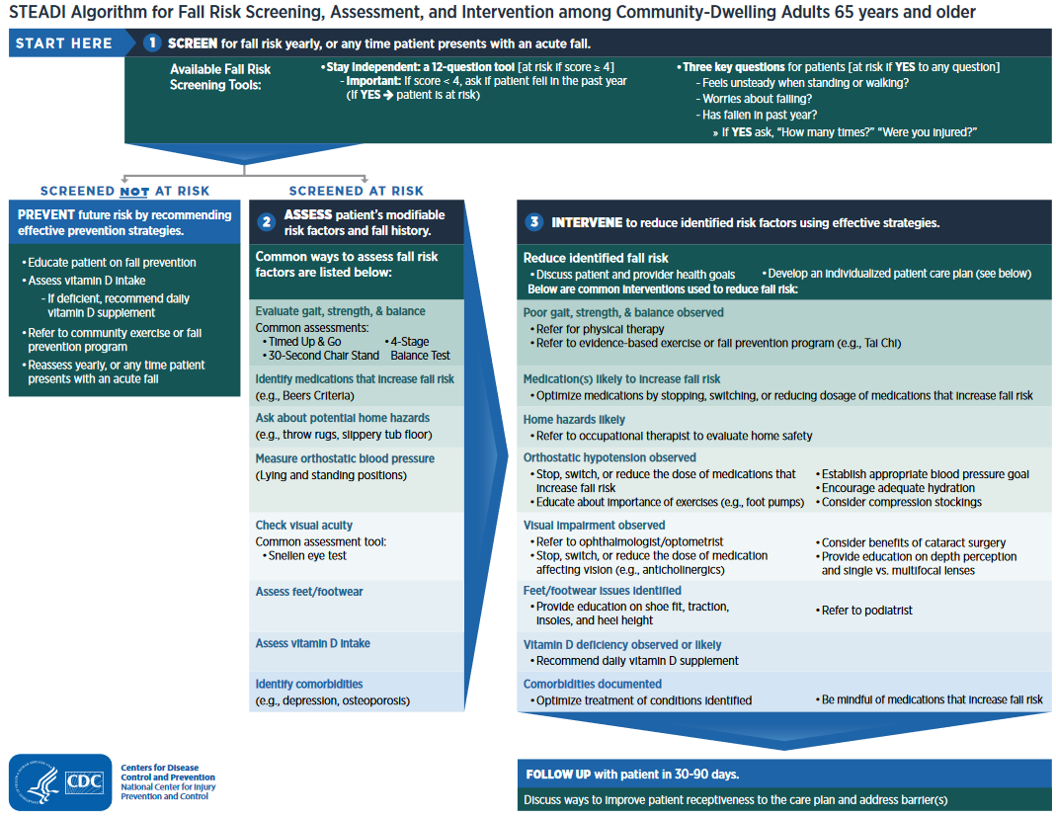
CDC STEADI Algorithm (2019) https://www.cdc.gov/steadi/pdf/STEADI-Algorithm-508.pdf

Slide 18
Factors that Influence Implementation of Fall Risk Management in Primary Care
Provider Beliefs and Practice
Enhance awareness of importance of falls
Address fragmented services and challenges with care coordination
Knowledge
Information about how to manage fall risk
Time Constraints
High volume of patients
Patient Engagement
Financial Factors
Inadequate reimbursement given the time required
Direct and indirect costs of interventions
Increase awareness of clinical guidelines
Too much to address within a single appointment
Stigma of falls
Lack of awareness falls are a medical issue
McConville & Hooven (2020)

Slide 19
CATCH RURAL Falls Program
Cohort-Based Approach ~6-month long cohorts focused on a specific fall risk management topic
Overarching goal – increase the percentage of older adult patients who receive a fall risk management component (e.g., screening, assessment, intervention)
Cohort 1:
Fall Risk Screening
January – June 2025
Cohort 2:
Gait, Strength, and Balance Assessment and Intervention
July – December 2025
Cohort 3:
Topic TBD*
Tentatively January – June 2026
Cohort 4:
Topic TBD*
Tentatively July – December 2026
etc.

Slide 20
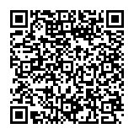
We Need Your Help! Survey of Fall Risk Management Practices in Rural Health Clinics
Clinic Demographics
Fall Risk Management Practices – Screening, Assessment, Intervention
Quality Measures for Fall Risk Management
Facilitators and Barriers
How can I complete the survey?
Click on or enter the following link into an internet browser: https://redcap.link/rhcfalls
or
Scan the QR code to ​complete the survey:

Slide 21
How to Engage with the CATCH RURAL Falls Program
Contact Dawn Venema or Vicki Kennel
dvenema@unmc.edu
victoria.kennel@unmc.edu

Slide 22
Resources and References
Bergen G, Shakya I. CDC STEADI: Evaluation Guide for Older Adult Clinical Fall Prevention Programs. Atlanta, GA: National Center for Injury Prevention and Control, Centers for Disease Control and Prevention, 2019.
CAPTURE Falls Gap Analysis Tool. https://www.unmc.edu/patient-safety/_documents/fall-risk-reduction-program-assess.pdf
CAPTURE Falls Event Learning Form: https://www.unmc.edu/patient-safety/_documents/capture-falls-event-form.pdf
CAPTURE Falls Roadmap. https://www.unmc.edu/patient-safety/capturefalls/roadmap/index.html
CDC STEADI Toolkit: Stopping Elderly Accidents, Deaths & Injuries, 2023. https://www.cdc.gov/steadi/index.html
Eckstrom E, Parker EM, Shakya I, Lee R. Coordinated Care Plan to Prevent Older Adult Falls. Edition 1.1. Atlanta, GA: National Center for Injury Prevention and Control, Centers for Disease Control and Prevention, 2021.
McConville A, Hooven K. Factors influencing the implementation of falls prevention practice in primary care. J Am Assoc Nurse Pract. 2020;33(2):108-116.

