Slide 1
Vaccines in Rural Nebraska: Addressing Hesitancy and Embracing Innovation
Brady Beecham, November 2024

Slide 2
Objectives
Discuss the current state of vaccine epidemiology in Nebraska, with a focus on changes and trends post-COVID.
Review available vaccines and present the latest advancements in vaccine science.
Identify common reasons for vaccine hesitancy in rural communities and propose evidence-based strategies for healthcare providers to address these concerns.
Provide actionable steps for rural clinics to improve vaccine communication and increase vaccination rates within their communities.

Slide 3
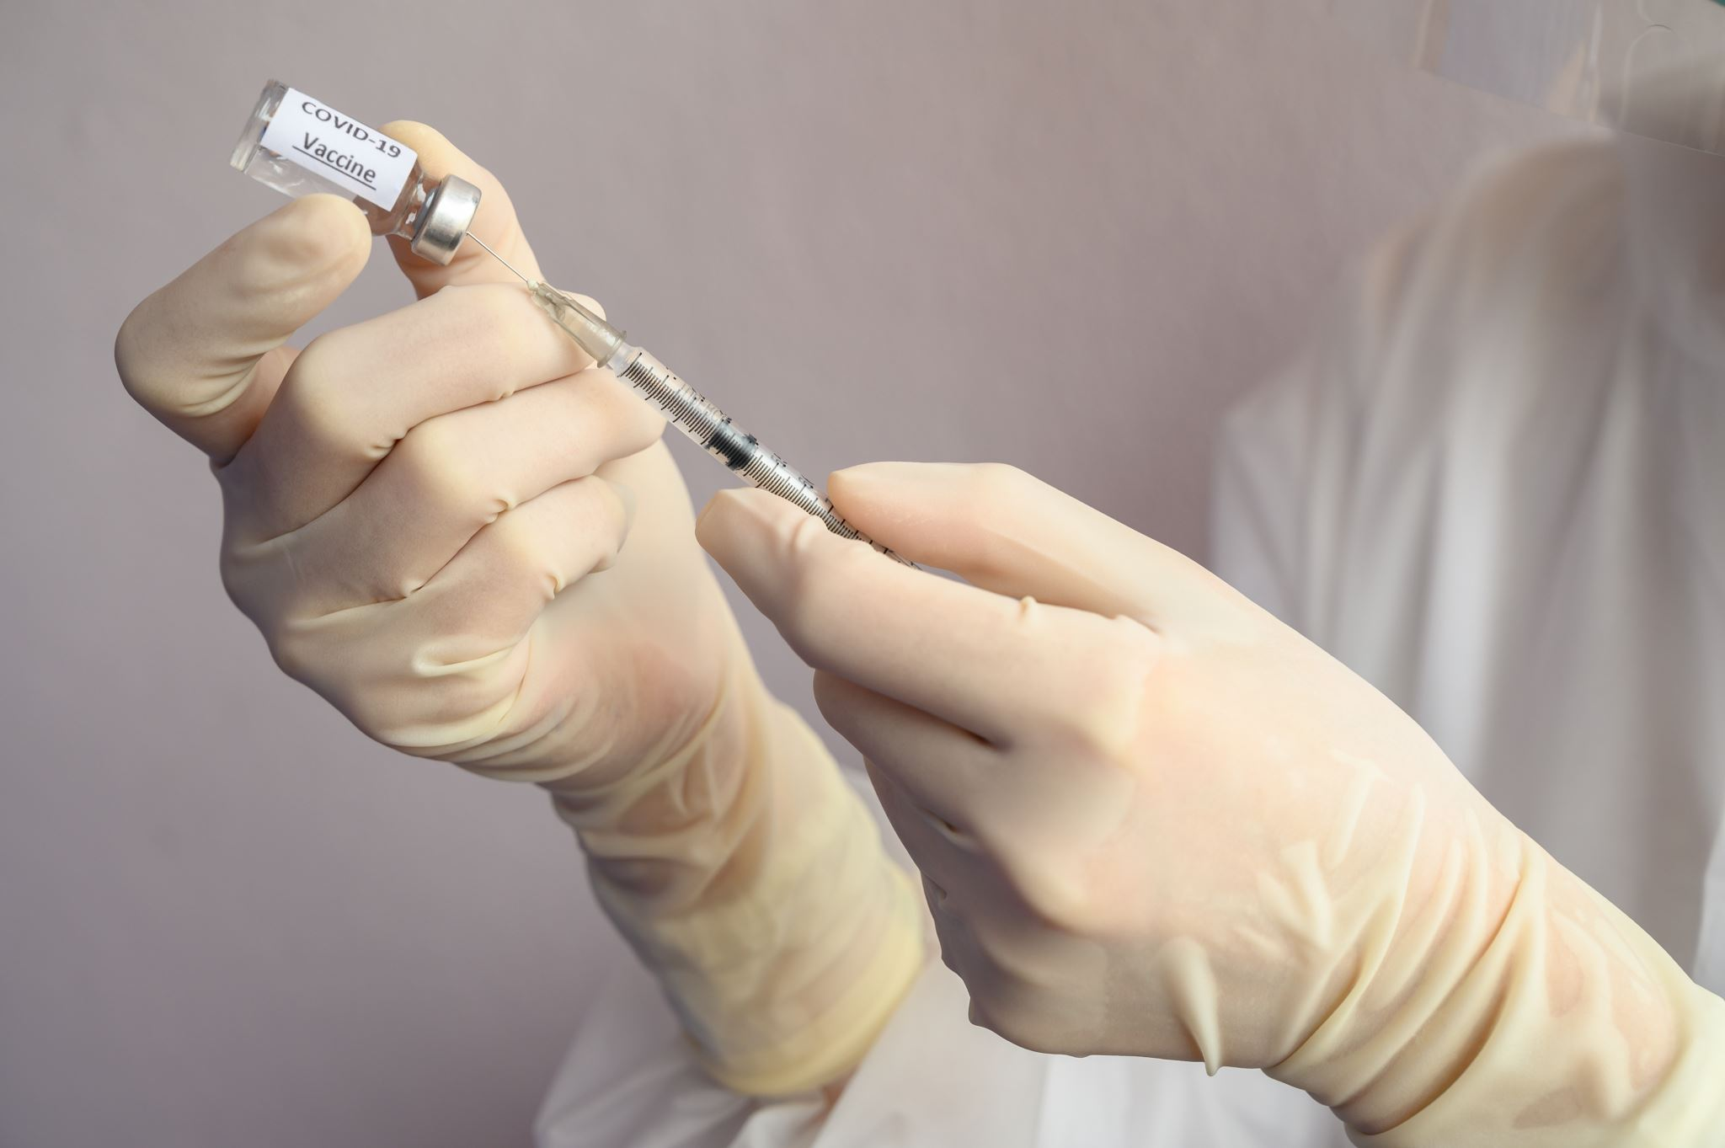
Objective 1: Trends in Nebraska’s Vaccination Rates
Slight decline in overall childhood vaccination rates post-COVID - Higher rates of vaccine exemptions in rural communities - Influenza and COVID-19 booster uptake significantly lower in rural areas
Overall childhood rates are similar but fully vaccinated rates down.
ChildVaxView Interactive Child Vaccination Coverage | CDC

Slide 4
Objective 2: Recent Advances in Vaccine Science
mRNA Vaccine Technology
Viral Vector Vaccines
Protein Subunit Vaccines
Adjuvant Formulations
Reverse Vaccinology
Structural Biology and Antibody Engineering
Synthetic Biology
Computational and AI-Assisted Vaccine Design
Nanoparticle-Based Delivery Systems
Cold-Chain Independent Stabilization Techniques
Polyvalent and Multivalent Vaccine Platforms
Personalized and Therapeutic Vaccines

Slide 5
Key New Vaccines in Last 10 Years
2014: HPV (Gardasil 9)
2015: Meningitis B (Bexsero and Trumenba)
2016: Cholera (Vaxchora)
2017: Shingles (Shingrix)
2019: Ebola (Ervebo)
2020: Ebola (Zabdeno and Mvabea)
2020: COVID-19 mRNA Vaccines (Pfizer-BioNTech and Moderna)
2020: COVID-19 Vector Vaccine (Johnson & Johnson)
2021: Malaria (RTS,S/AS01 or Mosquirix)
2021: Tick-Borne Encephalitis (TicoVac)
2022: COVID-19 Protein-Based Vaccine (Novavax)
2022: Dengue (Qdenga)
2023: RSV (Pfizer and GSK for older adults)
2023: RSV (Maternal Vaccine by Pfizer)

Slide 6
Objective 3: Addressing Vaccine Hesitancy
Common reasons for hesitancy in rural communities:
Misinformation and distrust in vaccine safety
Perception of low risk
Concerns over vaccine speed of development
Provider-patient communication strategies

Slide 7
Effective Communication Strategies
Emphasize vaccine safety and benefits
Acknowledge concerns empathetically
Provide credible resources to dispel myths
Home | Immunize.org

Slide 9
Objective 4: Steps for Rural Clinics to Improve Vaccine Rates
Assume goodwill
Community outreach and education programs
Partnering with local influencers and leaders
Offering flexible clinic hours and mobile vaccination options
Utilizing social media and local media to reach rural residents

Slide 10
Conclusion
Your voice matters to patients and the community
Vaccines are life saving and more innovations are on the way
Accepting vaccines can be challenging
Take a proactive approach to vaccine hesitancy.

