Slide 1

Creating Partnerships to Improve Lung Cancer Screening Rates
Franciscan Healthcare
West Point, Ne

Slide 2

The United States
A lung cancer diagnosis occurs almost ever 2 minutes
More than 357 fatalities occur every day, and an average of 157,000 deaths annually
Notes:
In the United States, a lung cancer diagnosis occurs almost every two minutes, and more than 357 friends and family members pass away from lung cancer every day, with more than 157,000 fatalities occurring annually.

Slide 3
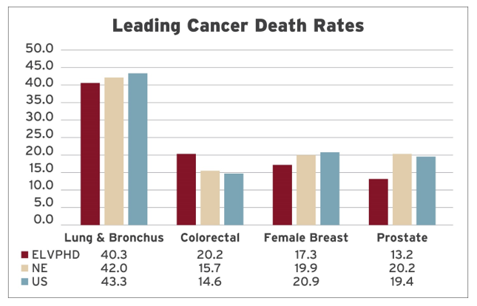
Elkhorn Logan Valley Public
Health Department (ELVPD)
Lung cancer is the 3rd leading cause of cancer
Most common cause of cancer-related deaths
One of the lowest 5-yr survival rates
Notes:
According to the Elkhorn Logan Valley Public Health Department, lung cancer ranked third among all cancers in Nebraska and was the most common cause of cancer-related deaths within the district. The American Lung Association claims that because lung cancer is often discovered at a stage when treatment options are limited, it has one of the lowest five-year survival rates. The percentage of persons nationwide who survive five years after receiving a lung cancer diagnosis is 26.6%, a 22% increase from the previous five years. Only 4.5% of eligible American adults were screened in 2022, which makes increasing lung cancer screening a priority. According to the National Lung Cancer Screening Trial, screening high-risk individuals for lung cancer using LDCT reduced lung cancer mortality by 20%. These statistics support the importance of screening and early detection of lung cancer.

Slide 4
Franciscan Healthcare
25 – Bed Critical Access Hospital with an attached Rural Health Clinic and four additional Rural Health Clinics located in Northeast Nebraska
Notes:
Franciscan Healthcare is a 25-bed Critical Access Hospital with an attached Rural Health Clinic and four additional Rural Health Clinics located in Northeast Nebraska.

Slide 5
Background
Averaged 5 Low-Dose CT (LDCT) scans per month
In 2022, only 16.7% of eligible patients received a LDCT Scan for lung ca screening
Identified inconsistent patient smoking history and pack-year documentation in EMR (only 5.6% of patients)
Notes:
In 2022, Franciscan Healthcare would average 5 LDCT scans per month. The population health platform, i2i, showed Franciscan Healthcare at 1,310 patients with a past or current smoking history, with 251 of them fulfilling the eligibility conditions for the scan, and 16.7% opting to take advantage of the screening opportunity. Despite being higher than the national average, many people were not taking advantage of this screening.
To assess the percentage of patients whose medical charts included necessary information about their smoking history and pack years, another audit was conducted. According to this baseline finding in 2022, only 5.6% of patients’ charts (ages 50-77) had complete smoking documentation in their Electronic Medical Record (EMR), including both smoking history and pack years. To ensure all qualified patients were included in the program, Franciscan Healthcare focused on capturing documentation in this area. The documentation of smoking history improved with the organization’s transfer from paper to the EMR system which includes criteria for tobacco usage

Slide 6
Improvement Strategy-Step One
Establish a team
Danelle Ehrisman – Radiology Manager
Josh Ridder – Pulmonary PA-C (Physician Champion)
Tyler Toline – Organization’s CEO
Anastasia Stokely – Clinic Manager
Anne Timmerman – Director of Quality and Safety
Brenda Wisnieski – Informatics Specialist
Dr. Neville Irani – HQUIP Champion
Debra Dougher – HQUIP Director
Notes:
Franciscan Healthcare CEO Tyler Toline heard a presentation by Neville Irani, M.D., at the 2022 Nebraska Hospital Association (NHA) conference. Dr. Irani, the founder of HQuIP, has worked with many hospitals in Nebraska and the Midwest to increase awareness and screening of lung cancer through LDCT scans. Tyler’s encounter with Dr. Irani led to a partnership with Healthcare Quality Improvement Platform (HQuIP) and their innovative lung screening initiative. Using Low-Dose Computed Tomography (LDCT) to screen patients with a specified smoking history, early detection of lung cancer and better outcomes are possible .
To create a lung cancer screening program, a committee was assembled under the guidance of Dr. Irani. Monthly meetings with Dr. Irani started in January 2023 to strategize how to improve the lung cancer screening process. A committee was formed in March of 2023 composed of the radiology manager, a physician assistant with pulmonary medicine expertise, a clinic manager, a quality manager, a clinical informaticist, and executive leadership.

Slide 7
Identifying Goals
Increasing community awareness of the LDCT scan
Increasing patient smoking history and pack-year documentation in the patient’s Electronic Health record
Increase the percentage of eligible patients screening for lung cancer
Notes:
This committee sincerely hoped to raise community awareness using the data we had collected from earlier statistics. As a hospital, we didn't put as much attention into lung cancer screening as we did into breast or colon cancer screening.
The plan looked at the current number of LDCT scans, the screening procedure for eligible patients, and the process for ordering the scan. Collecting this information led the committee to focus on tobacco use documentation in the EMR, education about the importance and availability of LDCT scans, and a tracking system. This system includes new screenings, annual screenings, lung nodule tracking, and other data.

Slide 8
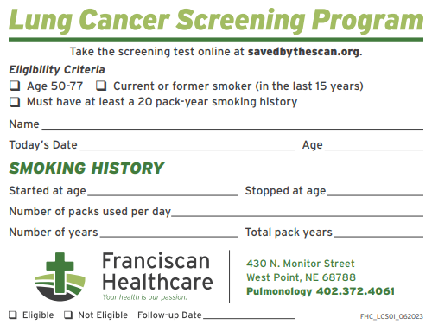
1st Goal
Increase the community’s awareness
Presented the program to the hospital’s Patient Family Advisory Council
LCDT marketing included Lung Cancer Screening Cards
Registered as a screening site on www.savedbythescan.org
Patient eligibility letters
Social media posts
Newspaper ads
Notes:
Establishing community awareness was a priority. Franciscan Healthcare looked at a number of strategies to accomplish this. With the goal of increasing the community’s awareness of the LDCT scan’s ability to detect early-stage lung cancer, Franciscan Healthcare engaged the help of their Patient and Family Advisory council (PFAC) group. The radiology manager provided the supporting data to the PFAC group to ask for suggestions on how to further involve patients and families in the program's development. The group promotes a culture in which staff, healthcare providers, patients and families work together as partners to improve the quality and safety of hospital care. The committee provides feedback on patient and family experiences, the approaches to patient care, the services given to patients and their families, and the facility's design. They shared their appreciation of education on the topic of LDCT and the importance of early cancer screening. They were alarmed to hear our area is considered to have elevated levels of radon in homes and how this also increases the risk of developing lung cancer.
A lung cancer screening card was created to provide a quick reminder of the requirements for authorization of an LDCT. These cards were distributed throughout the facility, at health fairs, and at community events. The card includes a website, www.savedbythescan.org, enabling a person to screen for LDCT scan eligibility and find the closest facility to provide the scan. Franciscan Healthcare was added to this website as a location for providing the LDCT scan. Additionally, to reach every patient who fit the qualifications based on their recorded smoking history, a targeted letter was sent to smokers and former smokers who qualify for an LDCT scan, to inform them about the screening tool and guide them through the scheduling process. Newspaper articles, advertisements, and social media posts were used to promote the program to prospective patients and their families.

Slide 9
2nd Goal
Increase patient smoking history and pack-year documentation
Radiology would start assisting in documentation by inquiring about smoking history during radiology procedures
Josh Ridder PA-C educated staff on importance of LDCT’s , smoking history, and documentation
Notes:
To determine eligibility for lung cancer screening, an accurate tobacco smoking history must be recorded for every patient and reviewed at least annually. The opportunity to address smoking habits occurs at visits with providers in the ambulatory clinic, emergency department, surgery department, and during hospital stays. The Radiology Department identified an opportunity to assist with this documentation by inquiring about and recording smoking history with patients having a mammogram, bone density, and CT scans. Josh Ridder, PA-C, pulmonology, who joined Franciscan Healthcare in 2021, provided education to nursing and radiology staff about interviewing for smoking history and documenting pack years. The medical staff of Franciscan Healthcare was informed of the focus to increase LDCT scans for lung cancer screening in April of 2023. The clinical Informaticists helped determine where to input the information for tracking and reporting.

Slide 10
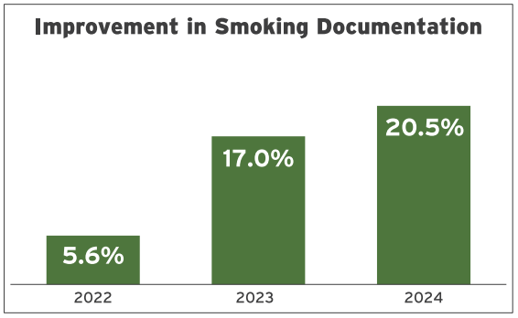
Results
Notes:
Taking an innovative approach, Franciscan Healthcare appointed their radiology manager as the project leader. This provided a range of viewpoints and the chance to evaluate the workflows. Additionally, it allowed departments within the organization to offer their assistance beyond their regular tasks, which ensured documentation was complete and patients were provided with the highest standard of care.
Education provided to nursing staff, and the Radiology Department's assistance in recording smoking history and pack years, helped show a significant increase in documentation from a baseline of 5.6% in 2022 to 20.5% thus far in 2024.

Slide 11
3rd Goal
Increase percentage of eligible patients screened for lung cancer
Clinic nurses call patients to get them in for yearly screening and follow-up based on eligibility
Database was developed to track patient results and follow-ups
Gift cards were offered to patients who were screened
Notes:
Although LDCT scans have been around for many years, the public has not been taking advantage of this service. The Centers for Medicare and Medicaid Services have consented to cover lung screenings for asymptomatic individuals between the ages of 50 and 77 who have smoked tobacco for at least 20 pack-years (one pack-year is equivalent to one pack of cigarettes per day for a year) and who have had a positive smoking history within the last 15 years (2022). In order to make sure we are including those who qualified, clinic nurses called patients to schedule follow-up exams and annual screenings. Additionally, a database was developed to monitor the patient's follow-up examination and track the CT results. Finally, as a bonus, we chose to give screened patients gift cards to our neighborhood coffee shop.

Slide 12
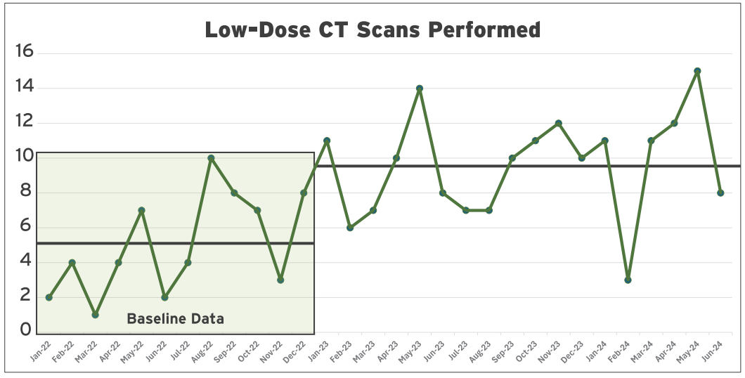
Results
Increased from an average of 5 scans per month to 9.5
Highest screening month was 15 LDCT scans
Increase the LDCT’s monthly revenue by 90%
Notes:
Members of the lung cancer screening program committee collected patient level data and statistics using i2i and the Cerner EMR system to ensure Franciscan Healthcare was headed in the right direction. This tracked the number of patients who did not have a recorded smoking history, the patients who qualified for an LDCT but did not have one scheduled, and the number of LDCTs performed. This allowed the team to observe the progress made and identify opportunities to improve. By utilizing the Plan-Do-Study-Act process, the committee was able to guide their efforts. The LDCT scans increased from an average of 5 scans per month and are on pace of averaging 9.5 per month in 2024, with the highest screening month showing 15 LDCT scans. Franciscan Healthcare has increased their LDCT’s monthly revenue by 90%. With better documentation of smoking history data and pack years, as well as increasing awareness, Josh Ridder has seen an increase in LDCT orders from not just his patients, but also from the medical team at Franciscan Healthcare.

Slide 13
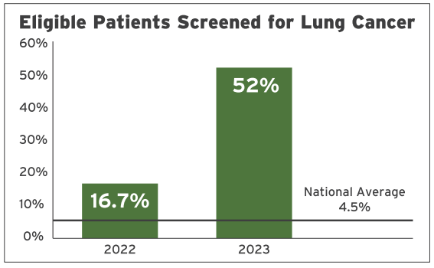
Results
Routine physicals included lung cancer screening discussion
Of the 306 individuals that qualified in 2023, 52% of them had a LDCT (National average is 4.5%)
211% increase from 2022
Notes:
Regular physicals now include a discussion of this screen, which has increased patient knowledge of the scan and reduced some of their fear related to the unknown. Of the 306 patients who qualified for the scan in 2023, 52% of them have had an LDCT, compared to the national average of 4.5% of eligible patients. This is an increase of 211% from our 2022 baseline of 16.7%.

Slide 14
LDCT Findings since June 2023
5 lung cancers
27 patients with lung nodules
45 pulmonary illnesses
1 fungal infection
8 incidental findings
14 who had pathology that required
  further investigation
Notes:
Since June 2023, with the use of an LDCT scan, Franciscan Healthcare has identified five lung cancers, 27 patients who were unaware of nodules, 45 pulmonary illnesses, one fungal infection, and eight additional incidental findings that needed further investigation. Thanks to a simple scan, Franciscan Healthcare was able to help 14 patients who had pathology requiring further testing and investigations. Without the assistance of the program, this would not have been discovered.

Slide 15
Additional Wins
Increased Pulmonary services given by Josh Ridder PA-C
Increased Respiratory Therapy
  From 1 therapists to 5
  Increased services such as PICC line insertion
  Breathing Treatments
  Higher levels of ventilator management
  Relaunch of the Smoking Cessation Program
Notes:
This initiative revealed the necessity of expanding pulmonary care. Josh's increasing patient load has allowed the clinic to expand and gain on its investment, all the while allowing patients to receive care closer to home. The facility has grown from one respiratory therapist to five after realizing there was an increased need for respiratory support. This allowed the institution to provide additional services including PICC line insertions, breathing treatments, and higher levels of ventilator management. Franciscan Healthcare relaunched their Smoking Cessation program in July of 2023 and three individuals have successfully completed it thus far.

Slide 16
Lessons Learned
Having a monthly core group with provider champion was extremely helpful
Sharing the duties of smoking history documentation
Creation of the Lung Caner Screening Cards
Targeted letters were not as effective as advertisements
Result database to track follow up exams
Notes:
Participation in this program led Franciscan Healthcare to identify multiple opportunities to improve Lung Cancer screening rates for the patients. Having a monthly core group, including a Provider champion, was tremendously helpful in moving the project along. Then, by evaluating documentation and understanding where and how frequently staff should complete smoking history and pack-year documentation, they were able to provide education to staff to increase awareness of the program, and to have multiple disciplines assist in the necessary data collection. The creation of the Lung Cancer Screening cards, initiated by Dr. Irani and his program, resulted in positive feedback from the staff. When addressing patients about the significance of their scans, the radiology team, patients, and medical professionals all found the smoking eligibility card to be a useful tool.
Next, was creating public awareness. Targeted letters were not as effective as local newspaper advertisements or social media marketing. Since the screening is annual, clinic staff assisting with the Pulmonology Clinic, created a spreadsheet to track patients who are due for their next LDCT scan, make phone calls to patients who meet criteria, encouraging them to be screened, and remind those who are due for follow-up. Individuals outside of the qualifying group also expressed interest in having an LDCT scan, because of radon exposure, family history, or their own smoking habits.

Slide 17
Future Goals
Collaborate with local health department to increase awareness of high radon risks and it’s link to lung cancer
Seek opportunities to persuade insurances to cover this screening tool for those with high radon results
Finding strategies to offer cash-only scan for those underinsured or uninscrured
Notes:
A significant risk of radon exposure has been detected in the surrounding area. Radon ranks as the second most common cause of lung cancer. Franciscan Healthcare intends to collaborate with ELVPHD to increase awareness of this and seek authorization from insurance companies to use LDCT scans for screening purposes in those patients. The organization is also forming strategies to offer cash-only scans for those who are underinsured or uninsured to assist with costs. Those who take advantage of this opportunity may detect lung cancer in its early stages, when treatments have a better chance of success.

Slide 18
References
Agency for Healthcare Research and Quality. (2024). Plan-Do-Study-Act Worksheet,
Directions, and Examples. Rockville, MD. https://www.ahrq.gov/health-literacy/improve/precautions/tool2b.html
American Lung Association. (2023). Lung cancer key findings. https://www.lung.org/research/state-of-lung-cancer/key-findings
Centers for Medicare & Medicaid Services. (2022, February 10). Screening for lung cancer with low dose Computed Tomography (LDCT). https://www.cms.gov/medicare-coverage-database/view/ncacal-decision-memo.aspx?proposed=N&ncaid=304
HQUIP. (2024). Healthcare Quality Improvement Platform. https://hquip.org/
Jessup, D. L., Glover Iv, M., Daye, D., Banzi, L., Jones, P., Choy, G., Shepard, J.-A. O., & Flores, E. J. (2018). Implementation of Digital Awareness Strategies to Engage Patients and Providers in a Lung Cancer Screening Program: Retrospective Study. Journal of Medical Internet Research, 20(2), e52–e52. https://doi.org/10.2196/jmir.8932

Slide 19


