Slide 1
From Pregnancy to Postpartum: Closing the Gap in Perinatal Depression Screening
Sydnie Carraher, DNP, APRN-NP, NNP-BC
Program Administrator, NPQIC
November 14th, 2024
Notes:
Good Morning-​
NNP and Program Administrator for the Nebraska Perinatal Quality Improvement Collaborative​
I have the pleasure today of speaking with you about the work we have done in Nebraska around perinatal mental health.

Slide 2
I have no financial interests or relationships to disclose​

Slide 3
Objectives
Provide an overview of common maternal mental health disorders during the perinatal period
Describe best practices for perinatal mental health screening​​
Identify strategies and resources available to implement perinatal mental health screening​

Slide 4
Perinatal Mental Health
A mother or birthing person’s overall emotional, social, and mental well-being from pregnancy through baby's first year of life.
Notes:
PMH refers to…

Slide 5


Why Prioritize Perinatal Mental Health?
Notes:
Sometimes it’s important to pause and remember that the current state of maternal health in our country is not “as good as it gets.” In fact, we have embarrassingly worse outcomes than other industrialized nations. Better is possible.
Start by examining the data….

Slide 6
Maternal Mortality in the United States
Maternal deaths per 100,000 live births
"We are in a crisis. The United States is in a maternal health crisis. Over 80% of maternal deaths are preventable. This is such an egregious state"
-Dr. Amutah-Onukagha
Notes: The maternal mortality ratio is defined as the death of a woman while pregnant or within 42 days of termination of pregnancy, irrespective of the duration and site of the pregnancy, from any cause related to or aggravated by the pregnancy or its management but not from accidental or incidental causes. Due to sample size limitations, data for US–AIAN cannot be displayed.
Data: All country data from OECD Health Statistics 2023 extracted on February 29, 2024, except data for US are 2022 data from the Centers for Disease Control and Prevention, National Center for Health Statistics, National Vital Statistics System, mortality and natality data files, “Maternal Mortality Rates in the United States, 2022.”
SOURCE: Munira Z. Gunja et al., Insights into the U.S. Maternal Mortality Crisis: An International Comparison (Commonwealth Fund, June 2024). https://doi.org/10.26099/cthn-st75
Notes:
This graph shows us just how far behind we are. Among wealthy nations, the U.S. is one of the most dangerous places to give birth. Despite a decline since the end of the COVID-19 pandemic, the US maternal mortality rate continues to far exceed those of other high-income nations.
In 2022, there were 22 maternal deaths for every 100,000 live births in the U.S. — more than double, sometimes triple, the rate for most other high-income countries in a recent analysis by the Commonwealth Fund. In half of the countries, there were less than five maternal deaths per 100,000 live births. For Black women, maternal mortality is exceptionally high.

Slide 7
Maternal Health Crisis in the United States
Maternal mortality rates have increased by 28% since 2018
  38% increase from 2020 to 2021 (COVID-19)
  Black women continue to endure rates 2.6 times higher than White women
Rates of severe maternal morbidity are also increasing
(Hoyert, 2023; 2024)
Notes:
Perinatal health is critical to a population’s long-term health and security, yet maternal mortality continues to rise in the United States.
5/2024: CDC’s National Center for Health Statistics released 2022 maternal mortality data showing a decrease in rates of maternal mortality since the end of the COVID-19 pandemic. However, the disparities persist.
BIPOC women bear maternal mortality 2.6 times higher than their White peers (Hoyert, 2024)
Definition CDC’s National Center for Health Statistics’ National Vital Statistics System (NVSS) reports the national maternal mortality rate: the number of maternal deaths per 100,000 live births. A maternal death is defined as a death while pregnant or within 42 days of the end of pregnancy, from any cause related to or aggravated by the pregnancy or its management, but not from accidental or incidental causes. This definition and timeframe are consistent with that used by the World Health Organization for reporting on maternal mortality rates.
SMM: Unexpected outcomes of labor or delivery resulting in significant short- or long-term consequences to health (CDC)

Slide 8

84% of pregnancy-related deaths were PREVENTABLE!
Pregnancy-Related Deaths: Data from Maternal Mortality Review Committees in 38 U.S. States, 2020
(Peterson et al., 2019; Trost et al., 2024)
Notes:
Over 80% of all pregnancy-related deaths are preventable, with access to care, missed or delayed diagnoses, and failure to recognize warning signs as contributing factors. (Trost et al. 2024. Petersen et al 2019)
Given the preventability of maternal morbidity and mortality, there is an urgency to identify and implement strategies to address these issues.
https://www.cdc.gov/maternal-mortality/php/data-research/index.html

Slide 9
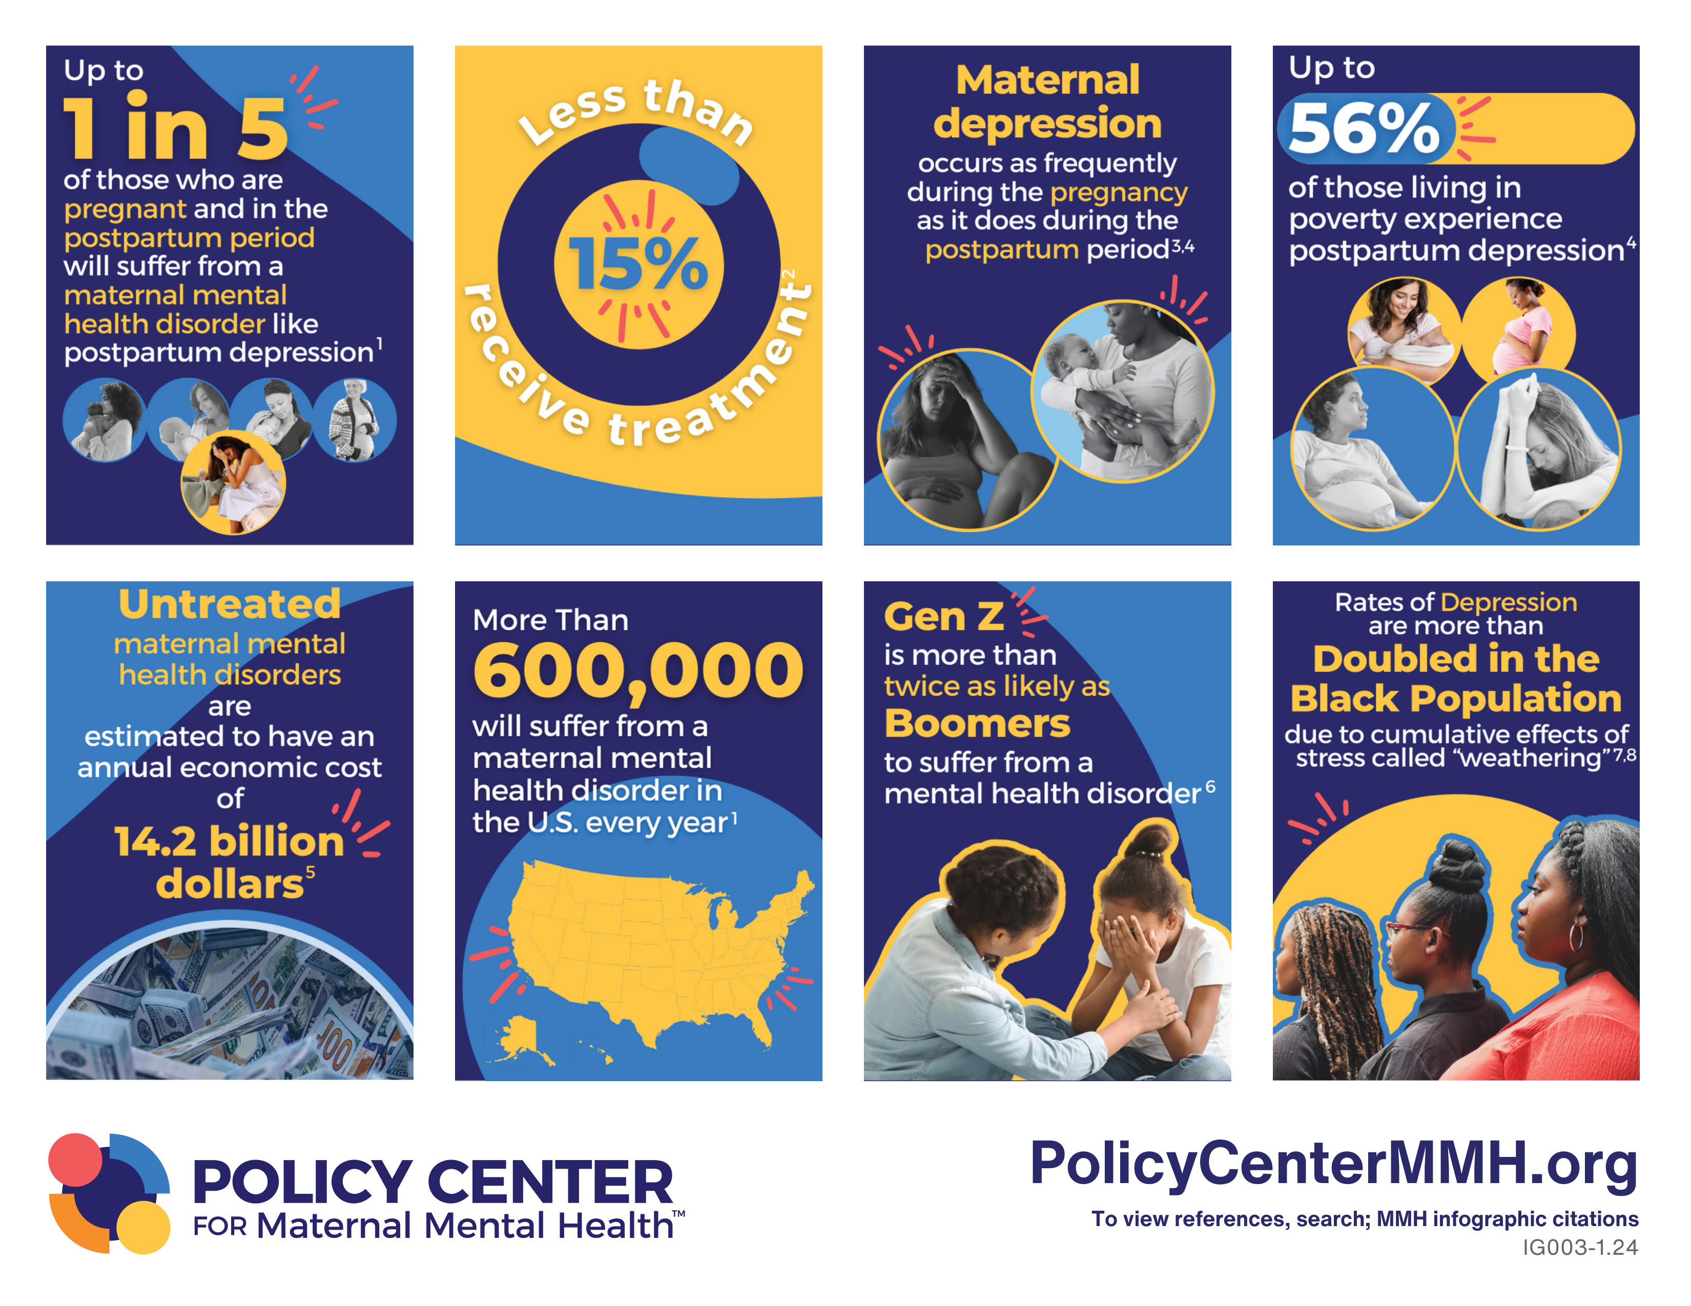
Notes:
Maternal mental health disorders are the MOST COMMON obstetric complications and can be a devastating and preventable cause of maternal and infant morbidity and mortality. Effecting up to 1 in 5 women or more than 600,000 women each year in the U.S.
Sadly, less than 15 % of women receive and follow-through with treatment.
Rates of depression are nearly double for African American women and those living in poverty.
Untreated parental mental health disorders can have a long-term negative impact on their babies, families, and society.
Equally as concerning, rates of anxiety and depression are increasing in teen girls which will likely impact the number of women suffering from PPD in the future.

Slide 10
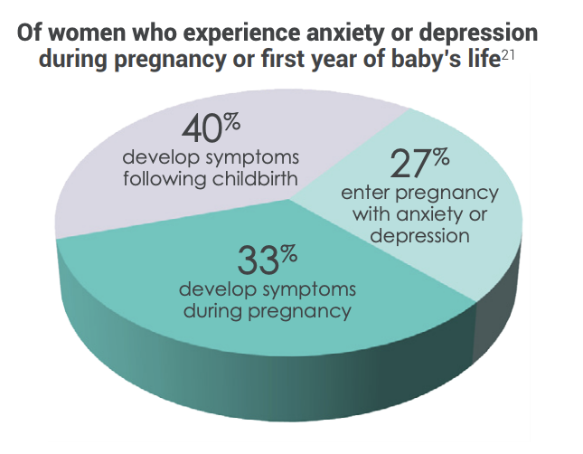
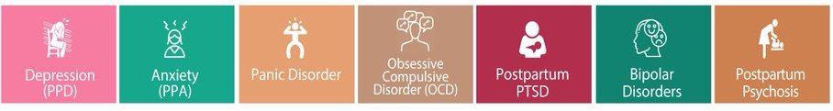
It’s not just postpartum. It’s not just depression.
(PSI, 2021; Wisner et al., 2013)
Notes:
In recent years we have shied away from using the term “postpartum” and started using the more comprehensive term “perinatal depression” due to the fact that symptoms may appear in either parent and aren’t limited to the early postpartum period.
As you can see in the pie chart, 27% of women enter pregnancy with pre-existing anxiety and/or depression, 33% will develop symptoms during pregnancy, and 40% will develop symptoms following childbirth.
Perinatal depression is actually only one of several mental health conditions women experience during pregnancy and the first year postpartum. These conditions are often collectively referred to as Perinatal Mood and Anxiety Disorders (PMAD).
Similar to Asperger’s and the autism spectrum.
Before taking a closer look at perinatal depression I want to touch briefly on the “ Baby Blues” and a couple of the other PMAD….

Slide 11
“Baby Blues”
Normal period of transition
Occurs in 70-80% of new mothers
Peak onset 3-5 days after delivery
Maximum duration of 2 weeks
Emotional sensitivity, weepiness and/or feeling overwhelmed, anxiety, and sleeplessness.
Resolves without treatment: time, self-care, and positive support from family and friends
(DC Collaborative, 2020; MCPAP 2018 & 2019; PSI, 2021)
Notes:
It is very important to remember that “perinatal depression” and “Baby Blues” are not the same!
Self-care- sleep, food and hydration

Slide 12

Anxiety
Occurs in 6-8% of pregnant and postpartum women
Can be experienced alone or with depression
Symptoms:
  Constant worry
  Feeling that something bad is going to happen
  Racing thoughts
  Disturbances of sleep and/or appetite
  Fidgeting/restlessness
  Physical symptoms like dizziness, hot flashes, and nausea
Treatment: Self-care, peer support, therapy, and medication
(DC Collaborative, 2020; MCPAP 2018 & 2019; PSI, 2021; Van Neil & Payne, 2020)
Notes:
Perinatal depression and anxiety often go hand and hand.
Women should be screened for anxiety prior to starting medications for perinatal depression to r/o bipolar disorder.

Slide 13

Perinatal Depression
1 in 7 women or up to 20% of all new mothers
  Twice as high for African American, NICU, and teen mothers, as well as those living in poverty
Tragic and preventable cause of maternal and infant mortality
Can occur during pregnancy or first year postpartum
Symptoms generally start between 4-6 weeks postpartum or greater
(ACOG, 2018; Davis et al., 2019; PSI, 2021; Van Neil & Payne, 2020)
Notes:
Approximately 1 in 7 women or up to 20% of new mothers experience significant depression during pregnancy and the first year postpartum. GDM 2-10%
These rates are twice is high for AA, NICU, teen mothers, as well as those living in poverty.
Perinatal depression is most likely under reported and in many cases untreated.
SUICIDE and OVERDOSE are the leading causes of death for women in the first year following pregnancy, with nearly 100% of these deaths deemed preventable.
While symptoms may occur at any time during pregnancy or the first-year postpartum symptoms generally start between 4-6 weeks postpartum peaking at 3-4 months.
Etiology:
No single etiology physical and emotional issues play a role…
Dramatic drop in estrogen and progesterone. Other hormones produced by the thyroid gland may also drop sharply.
Sleep deprivation

Slide 14
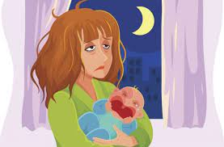
Symptoms
Feelings of anger or irritability
Lack of interest in the baby
Appetite and sleep disturbance
Crying and sadness
Feelings of guilt, shame, or hopelessness
Loss of interest or pleasure in activities
Possible thoughts of harming the baby or themself
(ACOG, 2018; Davis et al., 2019; PSI, 2021; Van Neil & Payne, 2020)
Notes:
The symptoms of perinatal depression differ for everyone, and might include the following:

Slide 15
Risk Factors for Perinatal Depression
Previous depressive episode
Lack of social support
Young maternal age
Low attained education
Single marital status
Low socio-economic status
Intimate partner violence
Psychosocial stress
Chronic illness
Maternal substance use
Infant preterm birth/significant medical concerns
(ACOG, 2018; PSI, 2021; Van Neil & Payne, 2020)
Notes:
Lack of social support (especially minority, immigrant, and refugee populations)
Young maternal age (40-60% of adolescent mothers report depressive symptoms)
Thyroid, diabetes

Slide 16
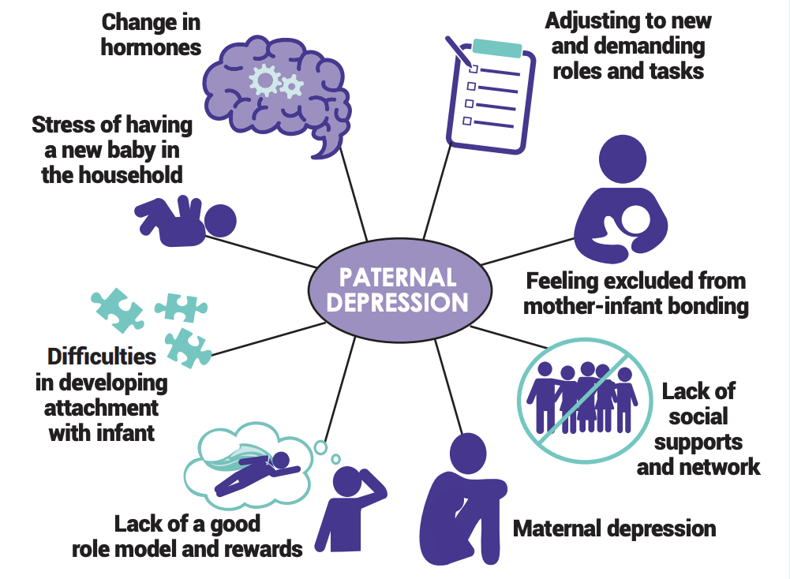
Paternal Depression
1 in 10 fathers
Highly correlated with maternal depression
Develops gradually
Peak incidence is 3-6 months
Higher levels of irritability, anger, and substance use
Reduced engagement, warmth, and sensitivity
Increased negative parenting, couple conflict, and child behavior issues
Less likely to seek help for depression
(MMHLA,2021, Walsh et al., 2020)
Notes:
Before going any further, I want to shift gears slightly to address the issue of paternal depression.
Research on paternal PPD is limited, but we know it is highly correlated with maternal depression.
Effecting 1 in 10 fathers
Depression and anxiety are twice as common in expecting and new fathers, compared to men in general.
Differences between onset and presentation of PD exist between mothers and fathers.
Develops gradually, increases over the first year postpartum.
Fathers are less likely to seek help for depression due to a lack of awareness of paternal PPD and an even greater stigma surrounding paternal depression.
Society’s view that men are stoic, self-sacrificing, and strong!

Slide 17
Postpartum Psychosis
Rare disorder that occurs in 1-2/1000 women (0.2%)
Occurs between 2-12 weeks
  Sleep deprived ≥ 48 hours
Sudden onset of psychotic symptoms
Insomnia, confusion, delusions regarding self and/or child, and hallucinations
MEDICAL EMERGENCY
Most common cause underlying bipolar mood disorder
(DC Collaborative, 2020; MCPAP 2018 & 2019; PSI, 2021; Van Neil & Payne, 2020)
Notes:
PPS the most serious of all the PMAD and while it may garner the most headlines, it is very rare 0.2%.

Slide 18

Perinatal Mental Health in Nebraska
Notes:
So what about here in Nebraska….

Slide 19
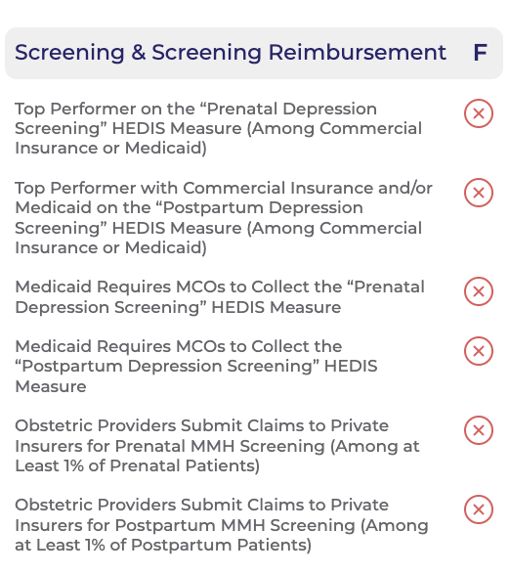

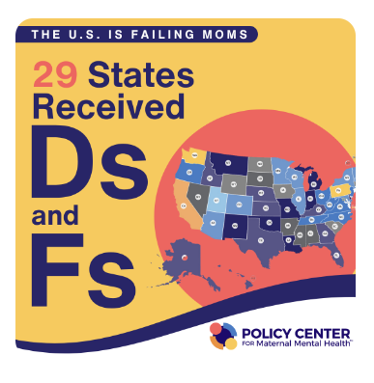
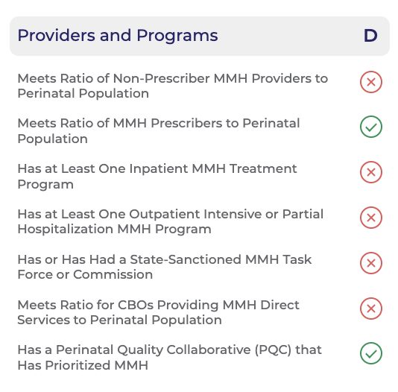
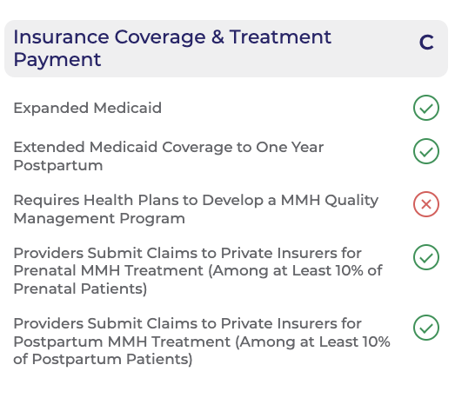
(Policy Center for Maternal Mental Health, 2024)
Notes:
In 2023, the Policy Center for Maternal Mental Health, in collaboration with George Washington University, released the first-ever grading of state efforts in addressing maternal mental health. These State Report Cards provide the first-ever comprehensive view into the state of maternal mental health in America. The U.S. is failing – with 29 receiving Ds and Fs. Nebraska improved to a D (F)- extension of PP Medicaid to 12 months.​

Slide 20

Prevalence in Nebraska
(CDC, 2024)
Notes:
As you can see the prevalence of self-reported depression in the 3 months before, during, and after pregnancy have steadily increased in NE since 2016.
According to our most recent PRAMS data (Pregnancy Risk Assessment Monitoring System) 20.3% of mothers reported depression in the 3 months before pregnancy, 19.2% reported depression during pregnancy, and 12.8% reported symptoms of depression in the postpartum period.
Even more alarming is that these percentages represent just a sampling of NE mothers and we know that perinatal depression is most likely under reported and in many cases untreated.
(PRAMS partnership with CDC ~ 2500/yr purpose to determine why some babies are healthier than others before, during, and after birth)

Slide 21
Disparities in Nebraska
(Nebraska Department of Health and Human Services, 2024 )
Notes:
Significant disparities exist in NE…. 3 months before preg by race/ethnicity for 2017-2020 and 2021-2022. The proportion of birthing people who reported depressive symptoms prior to preg highest for NA followed by Black. As well as higher proportions in rural areas.

Slide 22
Disparities in Nebraska
(Nebraska Department of Health and Human Services, 2024 )
Notes:
Significant disparities exist in NE…. During preg by race/ethnicity for 2017-2020 and 2021-2022. The proportion of birthing people who reported depressive symptoms during preg highest for NA, followed by Black. As well as higher proportions in rural areas.

Slide 23
Disparities in Nebraska
(Nebraska Department of Health and Human Services, 2024 )
Notes:
Significant disparities exist in NE…. PPD symptoms by race/ethnicity for 2017-2020 and 2021-2022. The proportion of birthing people who reported PPD symptoms highest for NA followed by Black and AS/PI. As well as higher proportions in rural areas.

Slide 24
Impact in Nebraska
~5,000 new babies per year live in an environment that predisposes them to health issues, cognitive impairment, developmental delays, and behavioral problems as a result of undiagnosed and untreated parental depression
Notes:
With ~ 20% of all new mothers experiencing perinatal depression, that equates to ~ 5000 new babies per year are living….​
4900- 2022-24,500 births

Slide 25

Impact in Nebraska
Nebraska Vital Statistics
  1 completed suicide annually for women that were pregnant or were pregnant within the last year
Nebraska Foster Care Review Office
  In 2021, 315 children <1 year of age were removed
    77 cases reviewed
      16% maternal mental health
      58% substance use
Top Recommendation of Nebraska Maternal Mortality Review Committee
  “Mental health support: screening, access, resources, and follow-up”
Notes:
According to Nebraska Vital Statistics there is, on average, one completed suicide annually for women that were pregnant or pregnant within the last year at the time of their death;³
According to the Foster Care Review Office in 2021:
315 children under the age of one were removed and placed in out-of-home placement
77 of these cases were reviewed.
16% were removed due to mother’s mental health
58% were removed due to substance use, in which mental health is often an underlying factor
These statistics reveal that maternal mental health issues have a direct impact on mothers and babies in our state.
Further, the top recommendation of the state’s Maternal Mortality Review Committee in the 2021 and 2023 report that was released earlier this year was “peripartum implementation of mental health & substance use screening, assessment and referral.”

Slide 26
Notes:
This graph shows the results of baseline surveys Feb 2021
As you can see there were significant gaps and a lot of work to be done!

Slide 27
Consequences of Untreated Perinatal Depression
Poor adherence to medical care and increased health care costs​
Higher rates of preterm birth, low birth weight, pre-eclampsia, and spontaneous abortion
Smoking and substance use
Loss of financial resources
Family dysfunction and increased risk of abuse and neglect
Impaired parent-child interaction- bonding and attachment issues
Discontinuation of breastfeeding
Failure to thrive and colic
Infantile sleep disorders
Delays in motor, cognitive, and language development
Emotional and behavioral disorders that persist into adolescence
(ACOG, 2018a & 2018b; Earls et al., 2019; Walsh et al., 2020; Wisner et al., 2013)
Notes:
Perinatal depression affects the entire family, and if untreated, can have serious adverse effects, including…

Slide 28
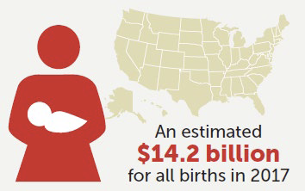
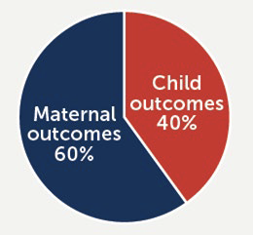
Societal Cost of Untreated Perinatal Mental Health Disorders
Economic Impact Study (Luca et al. 2020)
  Mathematical model to estimate cost of untreated perinatal mental health disorders
  Birth statistics from 2017
  Untreated perinatal mental health conditions cost $32,000 per mother-infant pair from conception through age 5 years.
Nebraska Impact (2023)
  24,111 births
  4,820 families impacted
  Annual untreated cost to state: ~$154 million
(Luca et al., 2020)
Notes:
The US economic burden of PMADs is high.
The cost of NOT treating PMH conditions is $32,000 per mother/infant pair in lost wages and productivity of the mother and addressing poor health outcomes of mother and baby.
Efforts to lower the prevalence of untreated PMADs could lead to substantial economic savings for employers, insurers, the government, and society.

Slide 29

Screening is Key
Effective, free, and validated screening tools exist to identify mothers and fathers at risk for perinatal depression
Treatment is available and can have a significant impact on outcomes
Notes:
Fortunately, perinatal mental health conditions are often temporary and extremely treatable. And it starts with screening…

Slide 30









Universal Screening Recommendations
Notes:
Universal screening of pregnant and postpartum mothers and fathers for depression is recommended by these governing bodies as a component of quality obstetric care and is considered best practice for infants and their families.
Pregnant women and new parents have frequent contact with the health care system- on average 25 times during a healthy pregnancy and first year of baby’s life.
These encounters offer providers multiple opportunities to conduct depression screening, make referrals, and provide follow-up care for new parents at prenatal, perinatal, and well-child checkups.

Slide 31

Legislation
NE Statute 38.204.01
  Effective July 21st, 2022
  Calls for the provision of education and universal screening for mothers during and after pregnancy
  Authorizes the Board of Medicine and Surgery to work with accredited hospitals and licensed healthcare professionals to create policies to facilitate perinatal mental health screening
Notes:
LB 905, introduced by Senator Lynne Walz (District 15).
NPQIC and FFN- provided data from this project and testified on behalf of this bill.
This bill recommends mental health screenings for mothers during and after pregnancy and tasks the Board of Medicine with crafting policies with providers around maternal depression screenings.
Unanimously advanced from the Health and Human Services Committee. Passed on final reading by legislature and approved by the Governor on April 18th

Slide 32

Who and When to Screen?
Mothers
  At least once prenatally
    ACOG recommends at the initial prenatal visit and later in pregnancy.
  During birth hospitalization
  At comprehensive postpartum visit
  At baby's 1, 2, 4, and 6-month well-child visits
Fathers or Non-Delivering Partner
  At least once within the first 6 months of birth
NICU parents
  At 7-14 and 30 days postpartum and then every 30 days thereafter
(ACOG, 2018; ACOG, 2023; Earls et al., 2019; Hynan et al., 2013; Murthy et al., 2021; Siu et al., 2016; Stark et al., 2023 Walsh et al., 2020)
Notes:
Timing of screening should be performed according to ACOG and AAP recommendations for mothers and current evidence-based recommendations for fathers.​
Based on their recommendations the following minimum screening timeline was identified.​
Although there is no formal recommendation, screening mothers during the birth hospitalization and NICU parents is also highly encouraged.​

Slide 33
Which Screening Tool to Use?
Edinburgh Postnatal Depression Scale (EPDS)
  Edinburgh Postnatal Depression Anxiety Subscale (EPDS-3A)
Patient Health Questionnaire-9 (PHQ-9)
  Generalized Anxiety Disorder Screener (GAD-7)
Postpartum Depression Screening Scale
Beck Depression Inventory
Beck Depression Inventory II
Center for Epidemiologic Studies Depression Scale
Zung Self-Rating Depression Scale
(ACOG, 2018b; Earls et al., Walsh et al., 2019; Siu et al., 2016)
Notes:
The following tools have been validated and can be used to screen for perinatal depression and anxiety.
We will be focusing on the Edinburgh Postnatal Depression Scare (EPDS) and Patient Health Questionnaire-9 (PHQ-9) which are the most commonly used and are recommended by our BH experts in Nebraska.

Slide 34
Edinburgh Postnatal Depression Scale (EPDS)
10-question self-administered scale
  Includes 2 questions regarding anxiety
Takes less than 5 minutes to complete
Designed and validated with postpartum women
Has since been validated for new fathers
Available in the electronic medical record (EMR) and multiple languages
(Cox et al., 1987)

Slide 35
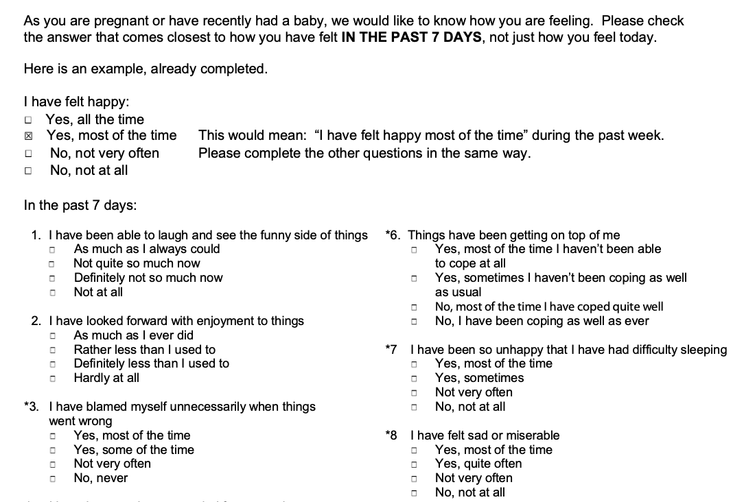
EPDS
Max score of 30
Risk of depression and/or anxiety
  ≥ 10 at risk
  ≥ 13 high risk
Score of > 0 on #10 indicates risk of harm to self or others

Slide 36
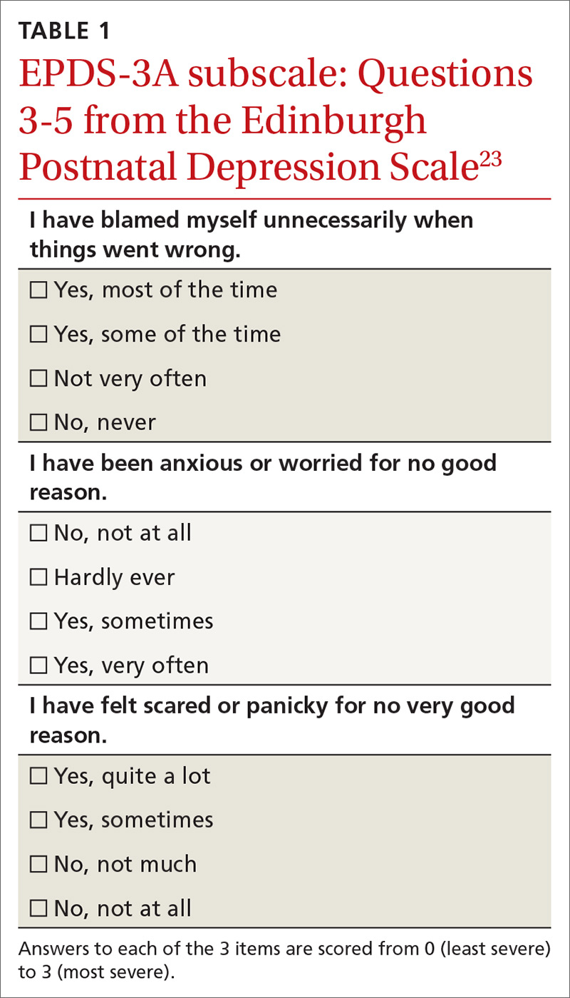
Edinburgh Postnatal Depression Anxiety Subscale (EPDS-3A)
Used to calculate a specific anxiety score
Items 3, 4, and 5 of the EPDS are totaled
Cut off of ≥ 6 warrants further evaluation for anxiety
Notes:
Although the Edinburgh has anxiety components it doesn't give an anxiety score.
Perinatal mood and anxiety disorders are multidimensional and there is some evidence that when using the Edinburgh women with anxiety may not have a high enough overall score to be flagged for referral.
Items 3, 4, and 5 from the EPDS can be totaled to obtain a specific anxiety score.
A score of >/= 6 warrants further evaluation for anxiety.

Slide 37
Patient Health Questionnaire 9 (PHQ-9)
9-question self-administered scale
  Does not screen for anxiety
Takes less than 5 minutes to complete
Used in screening for adult depression
  Not specific to pregnancy or postpartum
Available in EMR and multiple languages

Slide 38
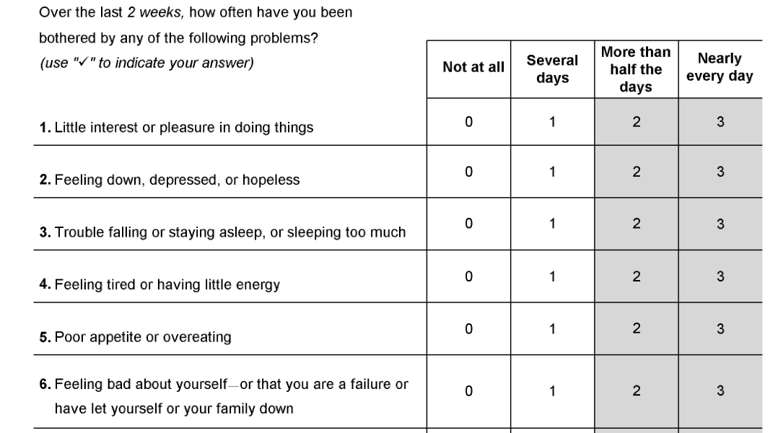
PHQ-9
Max score of 27
Depression scores:
  5-9 mild
  10-14 moderate
  15-19 moderate/ severe
  20-27 severe
Score of >0 on #9 indicates risk of harm to self or others

Slide 39
General Anxiety Disorder (GAD-7)
Should be utilized with the PHQ-9 to screen for possible anxiety
7-question self-administered scale
Takes 3 minutes or less to complete
Used in screening for adult anxiety
  Not specific to pregnancy or postpartum
Available in multiple languages

Slide 40
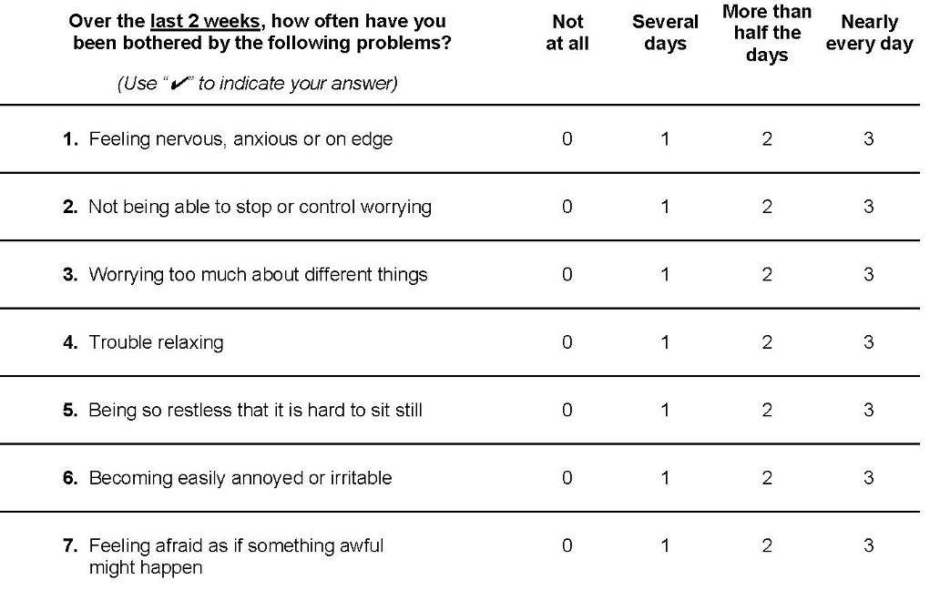
GAD-7
Max score of 21
Anxiety cutoffs:
  5 mild
  10 moderate
  15 severe

Slide 41

Getting Started

Slide 42


AIM: Perinatal Family Mental Health Initiative
Launched Fall 2020
Three-year statewide depression screening project
Funded by the Pritzker Foundation through a sub-award from First Five Nebraska
By July of 2023, parents from all areas of Nebraska will consistently be screened and subsequently treated for perinatal depression.
Goals:
  Establish perinatal depression screening as the standard of care in all clinics, hospitals, and NICU’s caring for obstetric and pediatric patients.
  Identify state-wide treatment referral systems
Notes:
In 2020, the NPQIC received funding from the Pritzker Children’s Initiative and First Five Nebraska for a 3 year statewide depression screening and referral project.
The AIM of our initiative is that by the end of the grant period, parents from all areas of NE will consistently be screened and subsequently treated for perinatal depression. ​
Funding ended in June 2023. Will continue to work on perinatal mental health.
Our goals are to:​
Establish perinatal depression screening as the standard of care for all clinics, hospitals and NICU’s caring for obstetric and pediatric patients ​
And to identify state-wide treatment referral systems. ​
​
We are also monitoring the availability and saturation of resources especially those that provide care regardless of insurance status and ability. ​

Slide 43
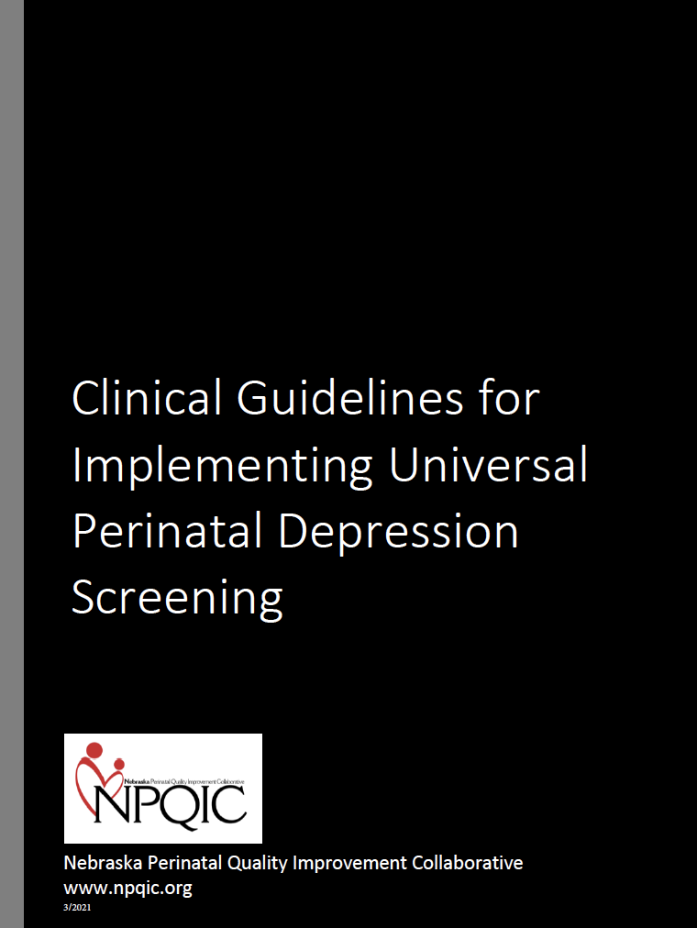
Toolkit
Why Screen for Perinatal Depression
Who and When to Screen
Which Screening Tool to Use
  Edinburgh Postnatal Depression Scale (EPDS)
  Patient Health Questionnaire-9 (PHQ-9)
  Generalized Anxiety Disorder Screener (GAD-7)
Sample Screening Algorithm for EPDS and PHQ-9
Sample Action Crisis Plan
Key Clinical Considerations
Perinatal Mental Health Resources
Medication Therapy and Lactation
Lactation Resources
Resources for Families
Patient Handouts and Education
Appendix A-G:
  Summary of Mood and Anxiety Disorders
  EPDS, PHQ-9, and GAD-7 Tools (English/Spanish) and Scoring Instructions
  Sample Scripts for Screening and Referral
  Local Resources Template
  Behavioral Health System of Care Regions
Notes:
Based on a review of the current literature and recommendations from the steering committee a toolkit was created to guide implementation of PDS.
Included in the toolkit are recommendations for who and when to screen, which tool to use with links, a sample action crisis plan, key clinical considerations, a list of perinatal mental health resources, resources for families including patient handouts and education.
The next couple of slides highlight some of the items included in the toolkit… some of which were adapted or used in permission from several other entities including the DC Collaborative for Mental Health in Pediatric Care, MN Dept of Health, Kansas MCH Program, and MA Child Psychiatric Access Program for Moms. ​

Slide 44
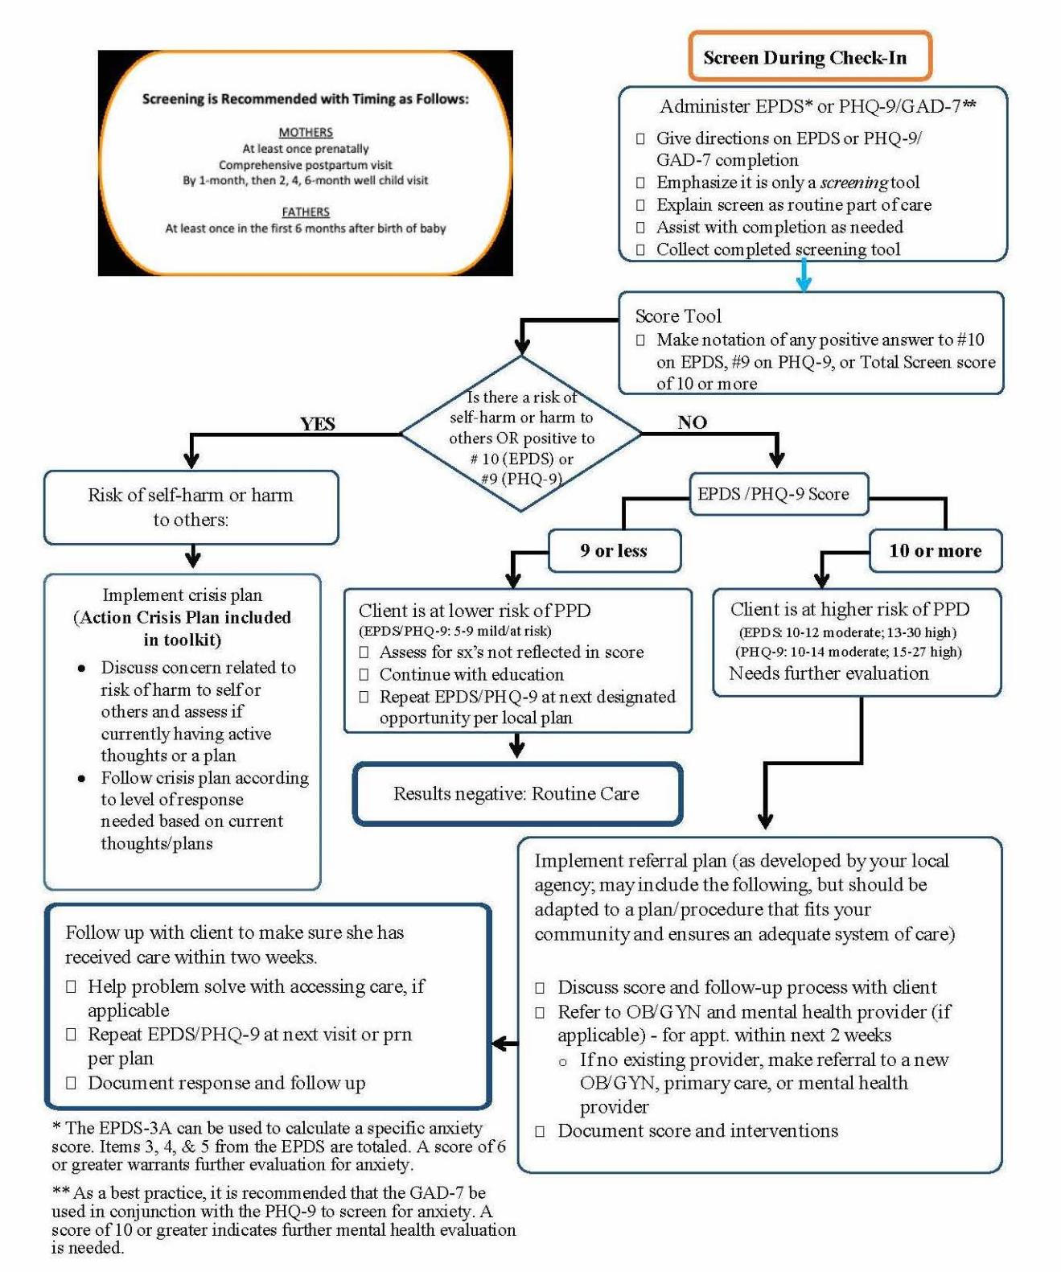
Sample Workflow
Notes:
Sample workflow with minimum screening timeline and algorithm from check-in to follow-up.

Slide 45
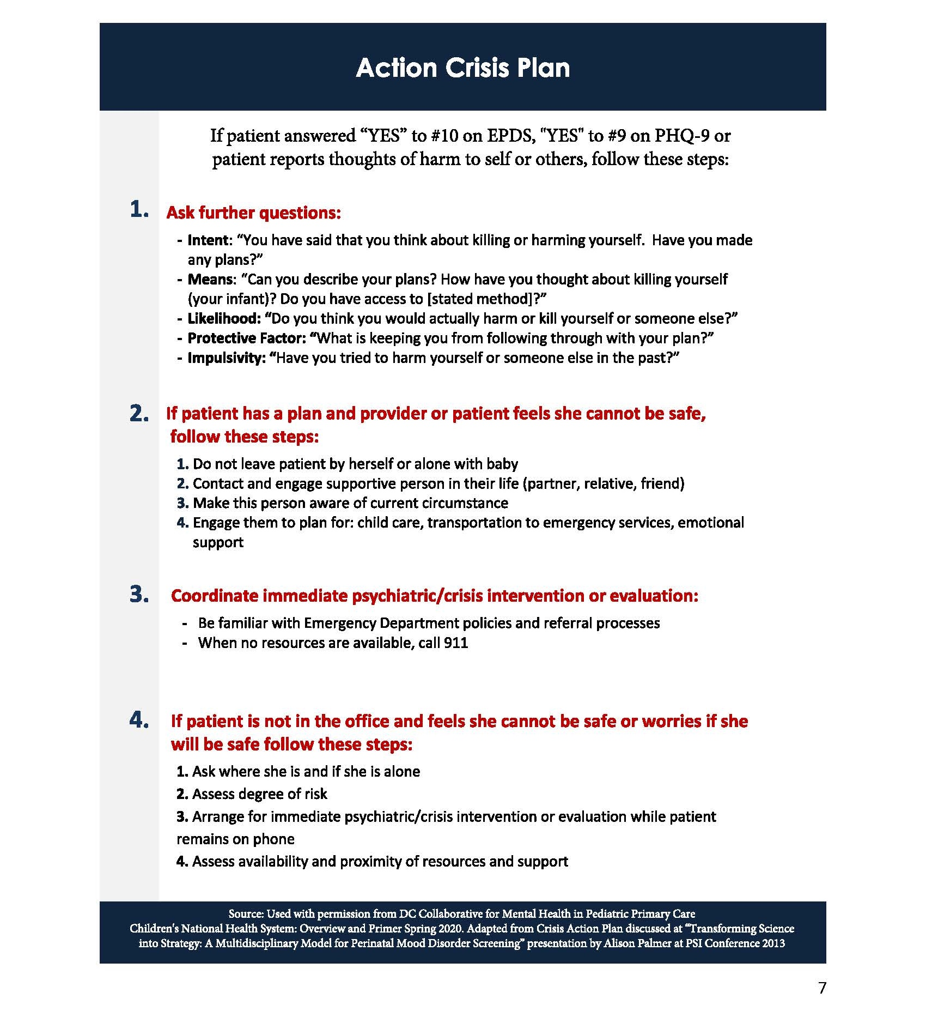
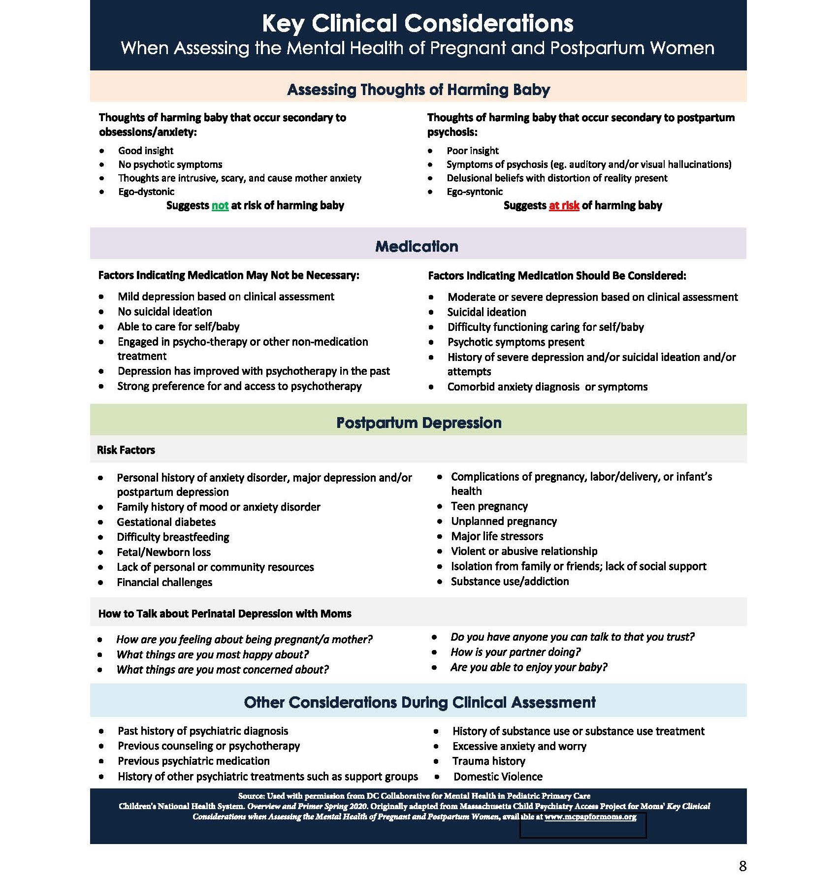
Notes:
Used with permission of DC Collaborative for Mental Health in Pediatric Primary Care

Slide 46

Introducing the Screen to Patients
  “We ask all patients these questions because mood changes, anxiety, and worry are very common during pregnancy or after giving birth. They can affect your health and the health of the baby.”
  Provide education on perinatal mental health
Notes:
Training may be helpful for all of the staff involved in administering the postpartum depression screen and needed follow up. The next few slides provide some scripting that can be used as a guide by staff and providers to discuss postpartum depression.

Slide 47
Introducing the Screen to Patients
Prenatally Visit
  “I’d like to check in to understand how you feel since you’ve become pregnant.”
Postpartum
  "Now that you have had your baby. I would like to know how you are feeling and how you have been coping lately.”
NICU Parents
  “Having a baby, especially one in the NICU, is a big adjustment and can be stressful for moms and dads. I would like to know how you are feeling and how you have been coping lately.”
Well Child Visit
  “As your child’s provider, I’m concerned about your child's wellbeing, and so I’m also concerned about the wellbeing of the people who care for your child. I’d like to know how you are feeling and how you have been coping.”

Slide 48
Response to Screening
  Negative Screenings
    Highlight behaviors and strategies for maintaining wellness.
  Suggested Script for Discussing Positive Screenings
    “Thank you for filling out this screening. It seems like you’ve been experiencing low mood and stress and may be depressed. Depression and anxiety during pregnancy are common. You and your baby deserve to be well. There are many effective support options available. Would it be ok if we discussed those?”

Slide 49

Management of Perinatal Depression
Demystification
Self-Care
  Proper rest, good nutrition, regular exercise, assistance with baby and other children, relaxation/mindfulness, or time with partner
Family and community support resources
Psychotherapy or counseling with mental health provider
Treatment of symptoms with medications
(ACOG, 2018b; Earls, 2019; PSI, 2021; Walsh et al.,2020;)
Notes:
When screening reveals a concern, next steps include communication and demystification, support, identification of community and family resources, and referrals as indicated.
Treatment plans for perinatal depression will vary for each individual… one of the most important steps is demystification.
Perinatal depression is common, the mother is not at fault or a bad mother, perinatal depression is treatable!
Healthy mother is critical to health of the baby!
Management typically starts with self- care...
Psychotherapy is first line for mild-mod PPD
Meds more severe or not respond to psychotherapy

Slide 50

Barriers to Seeking Mental Health Care
Stigma surrounding mental illness
Accepting depression diagnosis is viewed as being an “unfit mother”
  Fear of getting “locked up” or having their child taken from them
  Shame and embarrassment, resulting in suffering with their emotions silently
Unaware that their emotional response is beyond the typical baby blues
Limited access to health care services
Fear and distrust of healthcare providers
  Low socioeconomic demographics and minority populations
(Baines et al., 2013; Kim & Dee, 2017)
Notes:
Unfortunately, barriers to seeking Mental HC do exist.
Despite increased awareness of mental illness and efforts to reduce the shame and isolation associated with the diagnosis of various mental health conditions within the United States, the stigma continues.
Many women are reluctant to seek professional help due to fear, shame and embarrassment or may be may be completely unaware that their emotional response to the postpartum experience is beyond the scope of ‘typical’ baby blues.
Additional barriers included:
Limited access to care in general including screening and access to licensed mental health providers.
Fear and distrust of health care providers particularly among low socioeconomic demographics and minority populations
“You are not alone. You are not to blame. With help, you will get better”

Slide 51

Antidepressants
SSRIs (serotonin selective reuptake inhibitors) recommended first line for medications
  Common: Zoloft, Lexapro, Celexa, Prozac, Paxil
If a woman has already been on a medication that has worked well, that is the best medication to use
Can take 4‐6 weeks to be effective
Changes in doses are common
Using medication is a mutual decision‐making process
  All risk and benefits of continuing or initiating medication therapy should be discussed with the mother, including the risk of withholding treatment.
(Doyle, 2020)
Notes:
There are times when symptoms of depression require treatment with medications…
More severe forms or symptoms don’t respond to psychotherapy.
Balanced perspective treated vs untreated illness and associated risk and benefits.
New therapies
FDA-approved treatment specifically for postpartum depression before zuranolone was brexanolone .While effective, brexanolone consists of a 60-hour in-hospital intravenous infusion and may not be readily accessible. The FDA approval of zuranolone provides another treatment option for severe postpartum depression that had onset within the third trimester of pregnancy or within 4 weeks postpartum, that is orally administered for 14 days. Safety in breastfeeding needs to be available… cost and insurance coverage also an issue to access.

Slide 52
Medication Therapy and Lactation
Anti-depressants are found in very low amounts in breastmilk.
  Benefit of treatment often outweighs the small risk of transmission in the breastmilk.
In general, most anti-depressants are considered safe due to low or undetectable levels in infants’ serum.
What is the mother’s breastfeeding goal? Are her symptoms interfering with achieving that goal?
  Women who have PPD and anxiety are more likely to stop breastfeeding because of their symptoms.
  The goal is to find a solution that benefits the mother-baby dyad while posing the least amount of risk to each.
(Hammer, 2021; Sachs, 2013)
Notes:
Many mothers are inappropriately advised not to breastfeed or to avoid taking essential medications due to fears of adverse effects on their infants. This advice is often not evidence-based and unnecessary in many cases (AAP, 2013). the AAP recommends exclusive breastfeeding for the first 6 months of life.
Benefits: Improved immunity, promotion of maternal-child bonding, and improved neurodevelopmental outcomes.
Use appropriate references for information on medication compatibility with pregnancy and lactation.
Sharon Hammer- 2021 personal communication

Slide 53

Lactation Resources
LactMed Database
  https://www.ncbi.nlm.nih.gov/books/NBK501922/
MotherToBaby
  https://mothertobaby.org/
Infant Risk Center (Texas Tech University Health Sciences Center)
  https://www.infantrisk.com/forum/
Books
  Medications and Mothers’ Milk
  Briggs Drugs in Pregnancy and Lactation
Notes:
Use appropriate references for information on medication compatibility with pregnancy and lactation.
MTB: Provides evidence-based information on the safety of medications and other exposures during pregnancy and while breastfeeding.
Fact-sheets available to print and distribute.
IRC: No-cost information service is available to mothers and health professionals via chat, test, phone and email.

Slide 54

What Resources Are Available?

Slide 55

Emergency Resources
Emergency Services
  9-1-1
National Suicide Prevention Lifeline
  Dial 988
  suicidepreventionlifeline.org
National Crisis Text Hotline (24/7)
  Text HOME to 741741
Domestic Violence Hotline
  800-799-7233
  Text START to 88788
Notes:
Free confidential hotline available 24/7 in English and Spanish. Offer over 60 language interpreters.

Slide 56
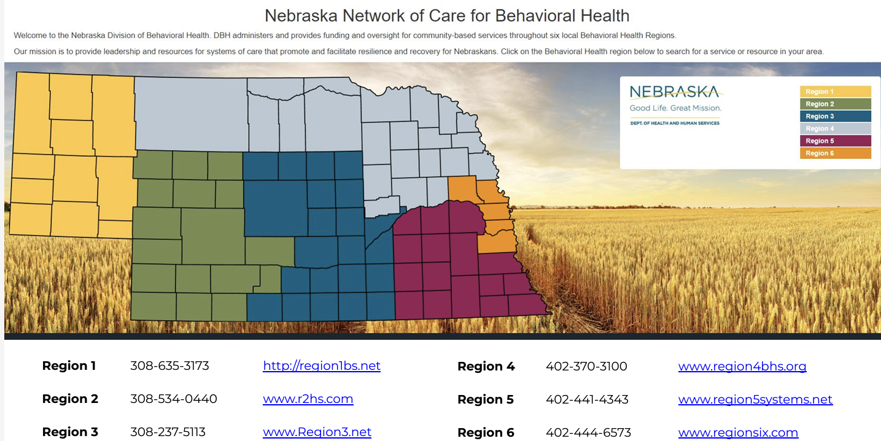
Nebraska Network of Care
Nebraska Behavioral Health Network of Care
Notes:
Providers and clinics have been encouraged to develop a referral plan that fits their community.
Starting points…
Google search for private therapists…
Providers and clinics are encouraged to develop a referral plan that fits their community. The following resources provide a starting point for locating local services for treating mothers and fathers who may be experiencing perinatal depression.
NE Network of Care: Interactive website for finding licensed mental health providers in the six behavioral health regions of Nebraska

Slide 57

Resources for Providers
Blue Valley Behavioral Health
  https://bvbh.net/
Local Health Department
Nebraska Family Helpline: 888-866-8660
United Way 2-1-1
The Nebraska Rural Response Hotline: Counseling, Outreach, and Mental Health Therapy Program (COMHT): 1-800-464-0258
Notes:
BVBH: Twelve offices that serve 16 rural counties in Southeast Nebraska. Private non-profit organization, provides professional outpatient behavioral and mental health services
UW: Comprehensive information and referral system for Nebraskans to DHHS, community, and government programs
COMHT: Provides vouchers for free, confidential mental health crisis counseling to farm, ranch, and rural families

Slide 58
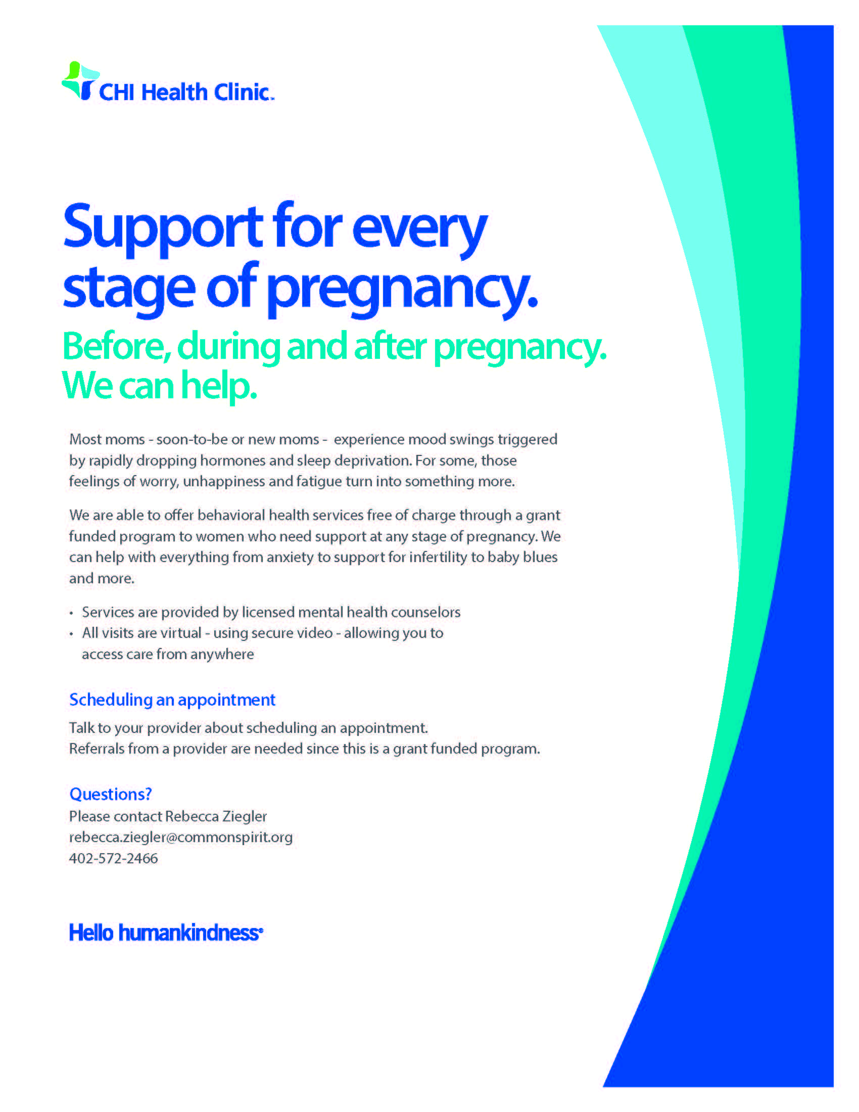
Resources for Providers
UNMC Reproductive Psychiatry
  800-922-0000
CHI Health Behavioral Care
  24/7 Information and Referral Line
  Call 402-717-HOPE, in the Kearney area, call 1 (800) 930-0031
CHI Free Perinatal Behavioral Health Services
  Grant-funded program, free telehealth visits with licensed mental health providers trained in perinatal mental health
  Patients must reside in Nebraska and live outside of Lincoln or Omaha
  Providers can refer patients by contacting Rebecca Ziegler at Rebecca.ziegler@commonspirit.org or 402-570-2466
Notes:
Free confidential hotline available 24/7 in English and Spanish. Offer over 60 language interpreters.

Slide 59
Resources for Providers
Postpartum Support International (PSI) Perinatal Psychiatric Consultation Line
  For medical professionals only
  Call 877-499-4773 or request an appointment online https://www.postpartum.net/professionals/perinatal-psychiatric-consult-line/
  Guaranteed response in 24 hours (typically 3 hours)
UMass Chan, Lifeline for Moms
  Lifeline4Moms App
    Provider-facing app to provide decision-support to obstetric providers as they address the maternal mental health needs of their perinatal patients.
  Massachusetts Child Psychiatry Access Program (MCPAP) for Moms
    Obstetric Provider Toolkit for screening, treating, and preventing perinatal mental health and substance use concerns
ACOG: Assessment and Treatment of Perinatal Mental Health Conditions
Notes:
Who are prescribers and have questions about the mental health care related to pregnant and postpartum patients and pre-conception planning.

Slide 60

Resources for Families
Postpartum Support International (PSI)
  www.postpartum.net
  Find Local Help: Coordinators connect families to local resources and providers
  Provider Directory: Search for trained perinatal mental health providers (www.psidirectory.com)
  Online Support Groups
  Peer Mentor Program
  Chat Groups and Patient Forums
  App available
Postpartum Progress
  www.postpartumprogress.com
Connected Forever
  www.connected4ever.org
Notes:
English and Spanish- 8a-11p EST.

Slide 61

Resources for Families
24/7, call or text
Free, confidential
60+ languages
Staffed by professional counselors
Connect to local support groups and organizations
Refer to healthcare professionals
National Maternal Mental Health Hotline
Notes:
Free confidential hotline available 24/7 in English and Spanish. Offer over 60 language interpreters.

Slide 62

Resources for Fathers
Postpartum Support International (PSI) Help for Dads
  Chats for Dads: First Monday of each Month
Postpartum Men
The Center for Men’s Excellence
Padre Cadre

Slide 63

Our Progress

Slide 64
Screening in Clinics
Notes:
Recruitment for pilot sites began in Spring of 2021—3 rural family medicine clinics
Metrics- Number of hospitals, clinics, and NICU’s screening- interval
Referal times

Slide 65
Notes:
CHI Health/Methodist Women’s will be implementing screening at 43 family medicine clinics which will impact future rates.

Slide 66
Screening at Hospital Discharge
31 out of 47
Notes:
Increase of ~40 %, 31/47
12/52

Slide 67
Screening in NICU
11 out of 14
8 out of 14
Notes:
Baseline
14 NICU’s in Nebraska
9 screening mothers
2 screening fathers
Current
11 screening mothers
7 screening fathers
Not screening NP, GI Reg, Reg West
Not screening Dads NP, GI Reg, Reg West, Bryan, Children’s, Mary Lanning, Meth Women’s

Slide 68
Perinatal Mental Health Referrals
Average wait time 7-28 days ​
Increase in social work and behavioral health referrals as a result of increased screening practices.​
Notes:
In many rural areas, family practice physicians are having to manage care until patients can be seen.​

Slide 69

Closing the Gap: Your Next Steps
Evaluate current screening practices
  Review current workflow and timing
  Assess staff comfort with screening and scripting
  Identify gaps and opportunities for improvement
  Create an action plan for standardization
Build Resource Network
  Compile a repository of local and crisis resources
  Create a quick reference guide for positive screens
  Connect with mental health providers in your area
  Establish clear referral pathways
Strengthen Follow-up Systems
  Set EMR screening alerts
  Track positive screens and referrals
  Monitor connections to resources
Notes:
Perinatal Depression is a significant public health concern. ​
Treatment does not happen if the parent is not screened and identified as depressed. ​
As women’s health and neonatal providers we have the power to make a positive impact…but it will take all of us working together to improve outcomes for new mothers, babies and families in our state. ​
We need you! ​

Slide 70

www.npqic.org

Slide 71


Notes:
Great quote from Atul Gawande…Better is possible…
This really sums up NPQIC and our teams… This is hard work, and it takes hard work to continue moving improvements forward. But we see progress, we know that better is possible. We commend all of you for being here today, because you are willing to try and willing to try together which makes a huge difference

Slide 72


Questions?

Slide 73
Thank You!

Slide 74
References
American College of Obstetrics and Gynecologists. (2018a). ACOG committee opinion no. 736 Optimizing postpartum care. Obstetrics & Gynecology, 131(5), e140-e150. https://www.acog.org/-/media/project/acog/acogorg/clinical/files/committee-opinion/articles/2018/05/optimizing-postpartum-care.pdf
American College of Obstetrics and Gynecologists. (2018b). ACOG committee opinion no. 757 Summary: Screening for perinatal depression. Obstetrics & Gynecology, 132(5), 1314-1316. https://doi.org/10.1097/aog.0000000000002928
American College of Obstetrics and Gynecologists. (2023). ACOG clinical practice guideline no. 4 Screening and Diagnosis of Mental Health Conditions During Pregnancy and Postpartum. Obstetrics & Gynecology, 132(5), 1314-1316. https://doi.org/10.1097/aog.0000000000002928
Baines, T., Wittkowski, A., & Wieck, A. (2013). Illness perceptions in mothers with postpartum depression. Midwifery, 29(7), 779–786. https://doi.org/10.1016/j.midw.2012.06.020
Centers for Disease Control and Prevention. (2024, August 22). Prevalence of Selected Maternal and Child Health Indicators for Nebraska, Pregnancy Risk Assessment Monitoring System (PRAMS), 2016–2022. https://www.cdc.gov/prams/php/data-research/mch-indicators-by-site.html
Centers for Disease Control and Prevention. (2024, May). Pregnancy Mortality Surveillance System. https://www.cdc.gov/maternal-mortality/php/pregnancy-mortality-surveillance/?CDC_AAref_Val=https://www.cdc.gov/reproductivehealth/maternal-mortality/pregnancy-mortality-surveillance-system.htm#cdc_survey_profile_surveys_used-pregnancy-related-deaths-by-race-ethnicity
Cox, J. L., Holden, J. M., & Sagovsky, R. (1987). Detection of postnatal depression. Development of the 10-item Edinburgh Postnatal Depression Scale. The British journal of psychiatry : the journal of mental science, 150, 782–786. https://doi.org/10.1192/bjp.150.6.782
Davis, N. L., Smoots, A. N., & Goodman, D. A. (2019). Pregnancy-related deaths: Data from 14 U.S. Maternal Mortality Review Committees, 2008-2017. Centers for Disease Control and Prevention, U.S. Department of Health and Human Services. https://www.cdc.gov/reproductivehealth/maternal-mortality/erase-mm/MMR-Data-Brief_2019-h.pdf
DC Collaborative for Mental Health in Pediatric Primary Care Children's National Hospital. (2020). Perinatal Mental Health Toolkit for Pediatric Primary Care: Overview and Primer. https://www.dchealthcheck.net/resources/healthcheck/mental-health-tools.html
Earls, M. F., Yogman, M. W., Mattson, G., & Rafferty, J. (2019). Incorporating Recognition and Management of Perinatal Depression Into Pediatric Practice. Pediatrics, 143(1). https://doi.org/10.1542/peds.2018-3259
Gunja, M. Z., Gumbas, E.D., Masitha, R., & Zephyrin, L. (2024, June 4). Insights into the U.S. Maternal Mortality Crisis: An International Comparison. Commonwealth Fund. https://doi.org/10.26099/cthn-st75
Hoyert, D. L. (2023, February). Maternal mortality rates in the United States, 2021. National Center for Health, Health E-Stats. https://dx.doi.org/10.15620/cdc:124678
Hoyert, D. L. (2024, May). Maternal mortality rates in the United States, 2022. National Center for Health, Health E-Stats. https://dx.doi.org/10.15620/cdc/152992
Hynan, M. T., Mounts, K. O., & Vanderbilt, D. L. (2013). Screening parents of high-risk infants for emotional distress: Rationale and recommendations. Journal of Perinatology, 33(10), 748–753. https://doi.org/10.1038/jp.2013.72
Kim, Y., & Dee, V. (2016). Self-Care for health in Rural Hispanic women at risk for postpartum depression. Maternal and Child Health Journal, 21(1), 77–84. https://doi.org/10.1007/s10995-016-2096-8
Luca, D. L., Margiotta, C., Staatz, C., Garlow, E., Christensen, A., & Zivin, K. (2020). Financial toll of untreated Perinatal mood and anxiety disorders AMONG 2017 births in the United States. American Journal of Public Health, 110(6), 888–896. https://doi.org/10.2105/ajph.2020.305619
Maternal Mental Health Fact Sheet. Maternal Mental Health Leadership Alliance. (2021, August 9). https://www.mmhla.org/wp-content/uploads/2020/07/MMHLA-Main-Fact-Sheet.pdf

Slide 75
References
MCPAP for Moms Obstetric Provider Toolkit. MCPAP for Moms. (2019, December 9). https://www.mcpapformoms.org/Toolkits/Toolkit.aspx#Mood
MCPAP for Moms Toolkit- Pediatric Provider. MCPAP for Moms. (2018, March 14). https://www.mcpapformoms.org/Toolkits/PediatricProvider.aspx
Murthy, S., Haeusslein, L., Bent, S., Fitelson, E., Franck, L. S., & Mangurian, C. (2021). Feasibility of universal screening for postpartum mood and anxiety disorders among caregivers of infants hospitalized in nicus: A systematic review. Journal of Perinatology, 41(8), 1811–1824. https://doi.org/10.1038/s41372-021-01005-w
Mustafa, A. B., Zahra, R., & Rana, M. H. (2016). Postpartum depression in Pakistan: Suffering in silence. Journal of Pakistan Psychiatric Society, 13(2), 6–7. http://www.jpps.com.pk/article/14735343296041-Editorial-Postpartum%20Depression%20in%20Pakistan-Suffering%20in%20Silence.pdf.
Nebraska Department of Health and Human Services. (2024). PRAMS 2017-2022 statewide data [Unpublished raw data].
Petersen, E. E., Davis, N. L., Goodman, D., Cox, S., Mayes, N., Johnston, E., Syverson, C., Seed, K, Shapiro-Mendoza, C. K., Callaghan, W. M., & Barfield, W. (2019). Vital Signs: Pregnancy-related deaths, United States, 2011–2015, and strategies for prevention, 13 states, 2013–2017. Morbidity Mortality Weekly Report, 68(18), 423–429. http://dx.doi.org/10.15585/mmwr.mm6818e1
Policy Center for Maternal Mental Health. (n.d.-b). 2023 U.S. Maternal Mental Health State Report Cards. Policy Center for Maternal Mental Health 2024 State Report Cards. https://policycentermmh.org/state-report-cards/
Postpartum Support International - PSI. (2021, August 17). https://www.postpartum.net/
Sachs, H. C. (2013). The transfer of drugs and therapeutics into human breast milk: An update on selected topics. Pediatrics, 132(3), e796–e809. https://doi.org/10.1542/peds.2013-1985
Siu, A. L., Bibbins-Domingo, K., Grossman, D. C., Baumann, L. C., Davidson, K. W., Ebell, M., … Pignone, M. P. (2016). Screening for Depression in Adults. JAMA, 315(4), 380-387. https://doi.org/10.1001/jama.2015.18392
Stark, A. R., Pursley, D. M., Papile, L.-A., Eichenwald, E. C., Hankins, C. T., Buck, R. K., Wallace, T. J., Bondurant, P. G., & Faster, N. E. (2023). Standards for levels of neonatal care: II, III, and IV. Pediatrics, 151(6). https://doi.org/10.1542/peds.2023-061957
Trost SL, Busacker A, Leonard M, et al. (2024). Pregnancy-related deaths: Data from Maternal Mortality Review Committees in 38 U.S. states, 2020. Centers for Disease Control and Prevention, U.S. Department of Health and Human Services. https://www.cdc.gov/maternal-mortality/php/data-research/index.html
Van Niel, M. S., & Payne, J. L. (2020). Perinatal depression: A review. Cleveland Clinic Journal of Medicine, 87(5), 273–277. https://doi.org/10.3949/ccjm.87a.19054
Walsh, T. B., Davis, R. N., & Garfield, C. (2020). A Call to Action: Screening Fathers for Perinatal Depression. Pediatrics, 145(1). https://doi.org/10.1542/peds.2019-1193
Wisner, K. L., Sit, D. K., McShea, M. C., Rizzo, D. M., Zoretich, R. A., Hughes, C. L., … Hanusa, B. H. (2013). Onset Timing, Thoughts of Self-harm, and Diagnoses in Postpartum Women with Screen-Positive Depression Findings. JAMA Psychiatry, 70(5), 490. https://doi.org/10.1001/jamapsychiatry.2013.87

