Slide 1
Nebraska DHHS HAI/AR Program
Lacey Pavlovsky, RN, MSN, CIC, LTC-CIP, FAPIC
HAI/AR Infection Preventionist and
NHSN Coordination Lead,
Nebraska DHHS

Slide 2
PROGRAM OVERVIEW

Slide 3
HAI Burden in the United States
CDC estimates that on any given day, 1 in 31 hospital patients has at least one healthcare associated infection
Cost billions of dollars in added expenses to the health-care system
Can have devastating effects on physical, mental/emotional, and financial health
Super germ (antibiotic resistant germs) is a big concern. A growing number of HAIs are caused by pathogens (germs) that our outsmarting the antimicrobial drugs typically used to fight them

Slide 4
About the HAI/AR Program
CDC
NCEZID
HAI/AR
National Center for Emerging and Zoonotic Infectious Diseases (NCEZID)
The Division of Healthcare Quality Promotion (DHQP)
Healthcare-Associated Infections (HAIs) and Antimicrobial Resistance

Slide 5
Programs are Organized around Five Key Program Areas
HAI/AR Response and Prevention Network
Antibiotic Resistance Laboratory Network (AR Lab Network)
Antibiotic Stewardship
National Healthcare Safety Network (NHSN)
Project Firstline
HAI/AR PROGRAM AREAS

Slide 6
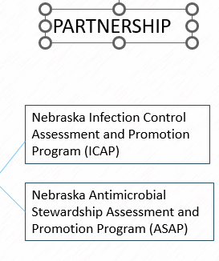
Nebraska DHHS HAI/AR Program
State
Academia
Monitors HAI rates and AR data and keep facilities informed regarding progress and opportunities
Initial outbreak response/consultations
Assist facilities with data reporting and validations
Partners with stakeholders to drive changes focused on decreasing HAIs and AR
Partners with facilities to assess & advance their IC and AS programs on voluntary basis
Assist with IC assessment during outbreaks
Connect all facilities in the state with IC and AS subject matter experts
Develop educational resources and guidance

Slide 7
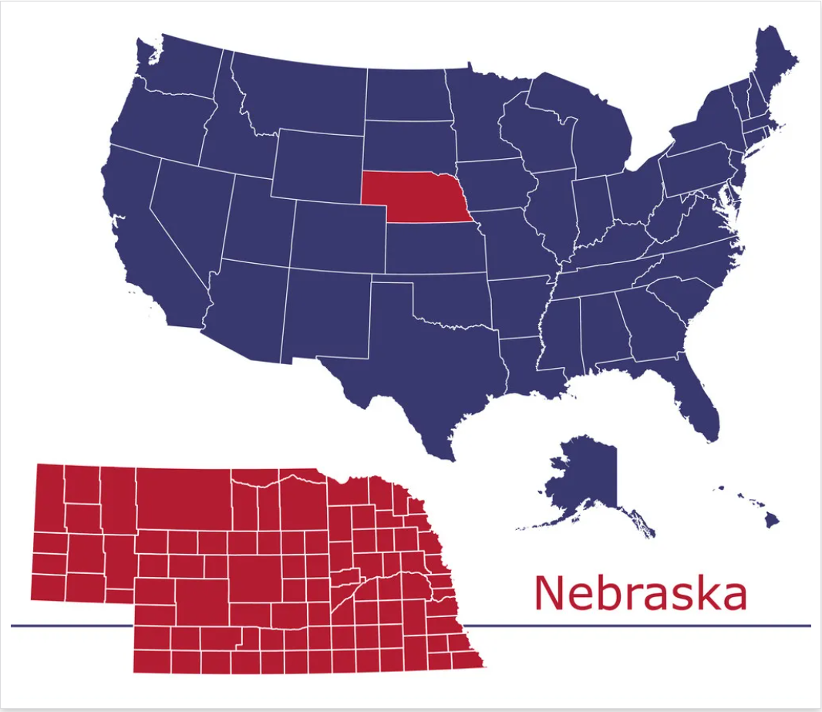
Reporting to the State

Slide 8
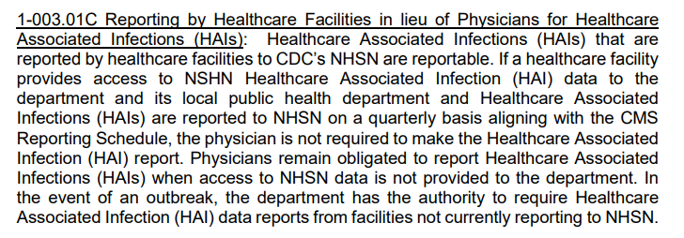
HAIs are Reportable in Nebraska – Title 173
https://www.nebraska.gov/rules-and-regs/regsearch/Rules/Health_and_Human_Services_System/Title-173/Chapter-01.pdf

Slide 9
How to IMMEDIATELY report to the State
Preferred Method (in addition to electronic laboratory reporting or ELR)
Notify the state HAI team by creating an alert for the NEDHHS HAI team:
https://epi-dhhs.ne.gov/redcap/surveys/?s=7XWYTPPFHAAP3ALX
Website: https://dhhs.ne.gov/pages/Healthcare-Associated-Infections.aspx
Or Call: 531-207-4053 (Ishrat) or 402-219-3115 (Storm)
Other:
General Epidemiologic Unit phone number: 402-471-2937 (8 am to 5 pm, M through F)
Poison Control (Last Resort): 1-800-222-1222 (After hours and weekends)
https://www.nebraska.gov/rules-and-regs/regsearch/Rules/Health_and_Human_Services_System/Title-173/Chapter-01.pdf

Slide 10
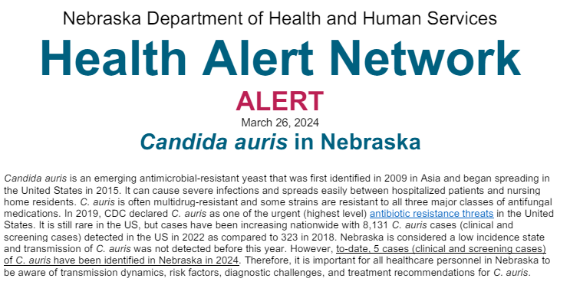
Transmission of Candida auris in Nebraska
https://dhhs.ne.gov/han%20Documents/ALERT03262024.pdf

Slide 11
Nebraska HAI/AR Data

Slide 12
What is NHSN?
National Healthcare Safety Network (NHSN). (cdc.gov)
Notes:
CDC’s National Healthcare Safety Network is the nation’s most widely used healthcare-associated infection (HAI) tracking system. NHSN provides facilities, health departments, tracking system, states, regions, and the nation with data needed to identify problem areas, measure progress of prevention efforts, and ultimately eliminate healthcare-associated infections.
In addition, NHSN allows healthcare facilities to track blood safety errors and important healthcare process measures such as healthcare personnel influenza vaccine status and infection control adherence rates. NHSN provides medical facilities, states, regions, and the nation with data collection and reporting capabilities needed to:
identify infection prevention problems by facility, state, or specific quality improvement project
benchmark progress of infection prevention efforts
comply with state and federal public reporting mandates, and ultimately,
drive national progress toward elimination of HAIs.

Slide 13
What is NHSN? (continued)
National Healthcare Safety Network (NHSN). (cdc.gov)

Slide 14
Benefits for NHSN Reporting
For Medical Facilities:
While ensuring data security, integrity, and confidentiality, NHSN gives healthcare facilities the ability to see their data in real-time and share that information with clinicians and facility leadership, as well as with other facilities (e.g., a multihospital system) and partners such as health departments or quality improvement organizations.
CDC provides the standard national measures for HAIs as well as analytic tools that enable each facility to assess its progress and identify where additional efforts are needed.
In addition, NHSN is the conduit for facilities to comply with Centers for Medicare and Medicaid Services (CMS) infection reporting requirements.
About | NHSN | CDC

Slide 15
Benefits for NHSN Reporting
For Patients:
In addition to benefiting from increased attention to HAI prevention, patients can use NHSN data posted publicly on the Department of Health and Human Services’ Hospital Compare website. Patients are encouraged to visit the website to see how their local facilities are doing and discuss concerns with their healthcare providers.
For States and for the Nation:
NHSN data are analyzed by CDC and others to direct actions for HAI prevention. Local, state, and national HAI trends are used to identify emerging problems and areas of concern that need intervention, and to measure progress in HAI reduction against national, state, and local prevention goals.
About | NHSN | CDC

Slide 16
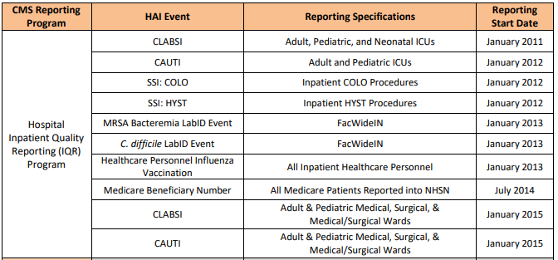
Healthcare Facility HAI Reporting Requirements to CMS via NHSN-- Current or Proposed Requirements
https://www.cdc.gov/nhsn/pdfs/cms/cms-reporting-requirements.pdf

Slide 17
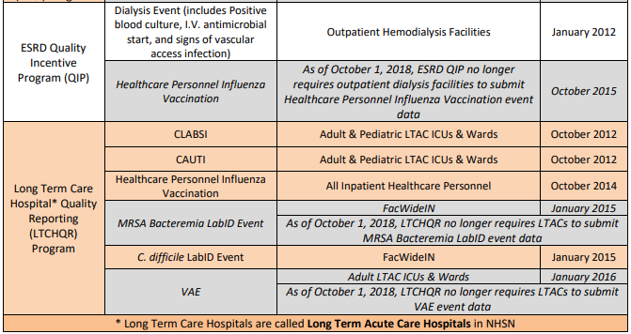
Healthcare Facility HAI Reporting Requirements to CMS via NHSN-- Current or Proposed Requirements
https://www.cdc.gov/nhsn/pdfs/cms/cms-reporting-requirements.pdf

Slide 18
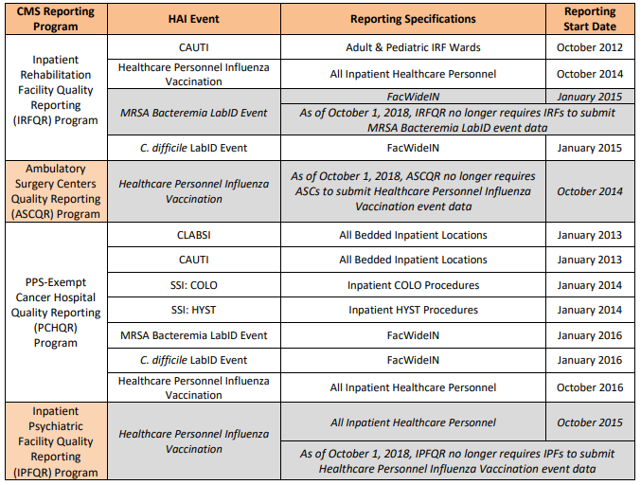
Healthcare Facility HAI Reporting Requirements to CMS via NHSN-- Current or Proposed Requirements
https://www.cdc.gov/nhsn/pdfs/cms/cms-reporting-requirements.pdf

Slide 19
1 %
HAI | % Change Nationally
CLABSI | 9% decrease
CAUTI | 12% decrease
VAE | 19% decrease
Colon | No significant change
Hysterectomy | No significant change
Hospital onset MRSA bacteremia | 16% decrease
Hospital onset CDI | 3% decrease
Standardized Infection Ratio (SIR)
18 %
29 %
27 %
*
0%
39 %
*
8 %
* Statistically significant change
https://www.cdc.gov/nhsn/datastat/progress-report.html#anchor_1700850695274
https://arpsp.cdc.gov/profile/geography/nebraska

Slide 20
https://arpsp.cdc.gov/profile/geography/nebraska?year-select-common-hais=haiYear2022

Slide 21
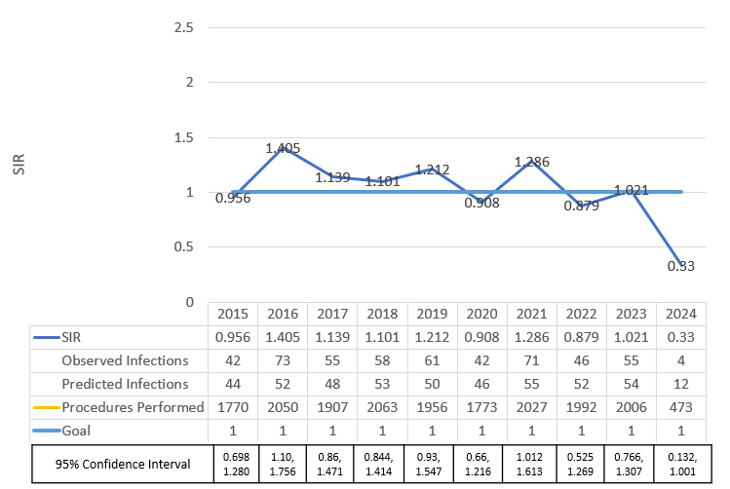
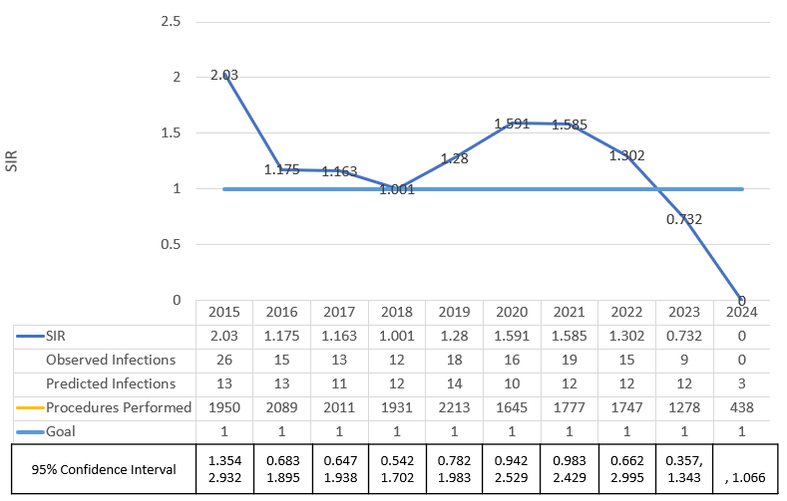
SSI [Abdominal Hysterectomy]
SSI [Colon]
2015-2023 Data Source: NHSN – Include acute care hospitals conferring rights to DHHS
2024 Data Source- NHSN DUA Group
Notes:
Updated 5/17/2024 by LP

Slide 22
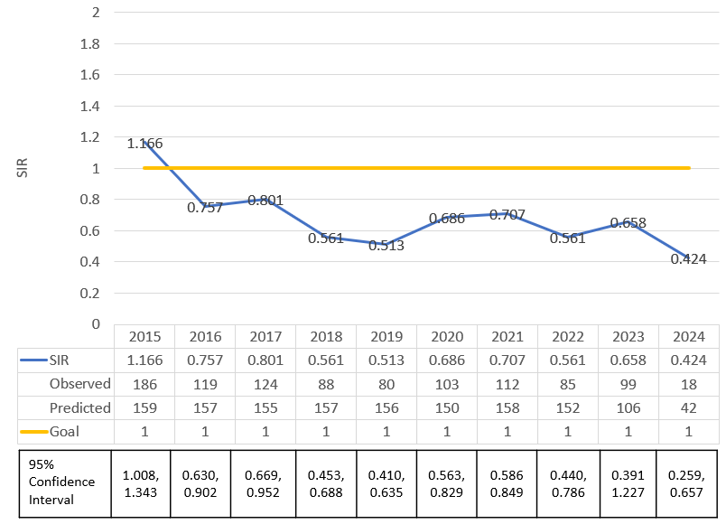
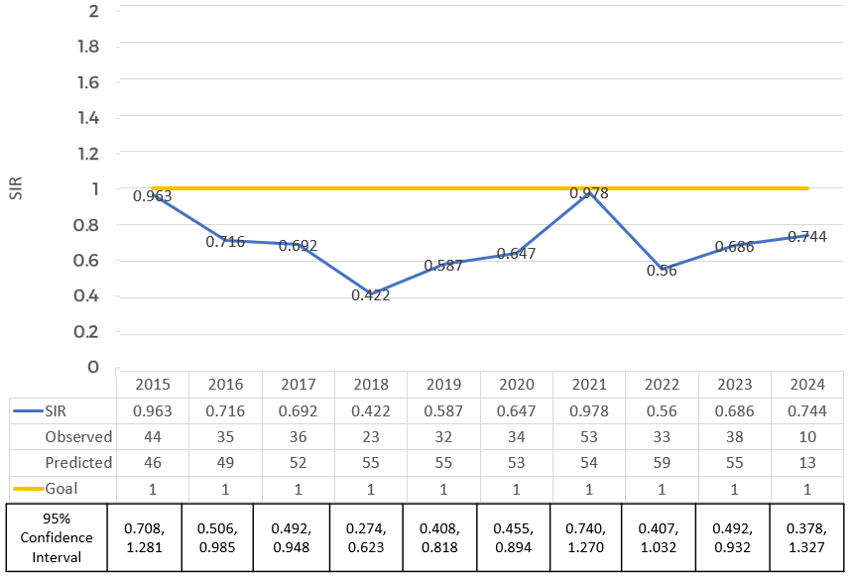
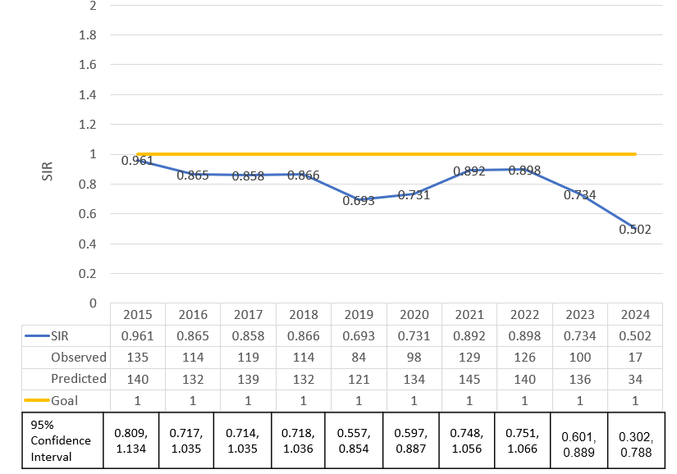
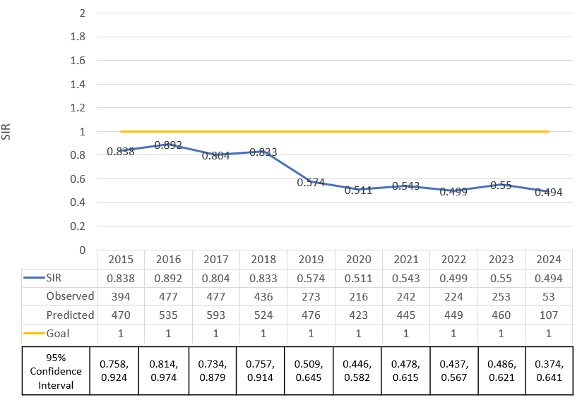
CLABSI [ACH All Locations]
MRSA Bacteremia [ACH]
*2024 Data is for January 2024-March 2024
CAUTI [ACH All Locations]
CDI [ACH]
2015-2023 Data Source: NHSN – Include acute care hospitals conferring rights to DHHS
2024 Data Source- NHSN DUA Group
Notes:
Updated 5/17/2024 by LP
Acute Care hospitals (ACH). Does not include CAH

Slide 23
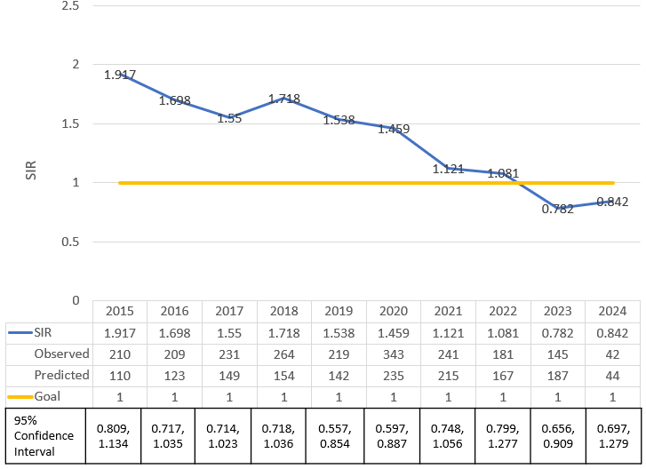
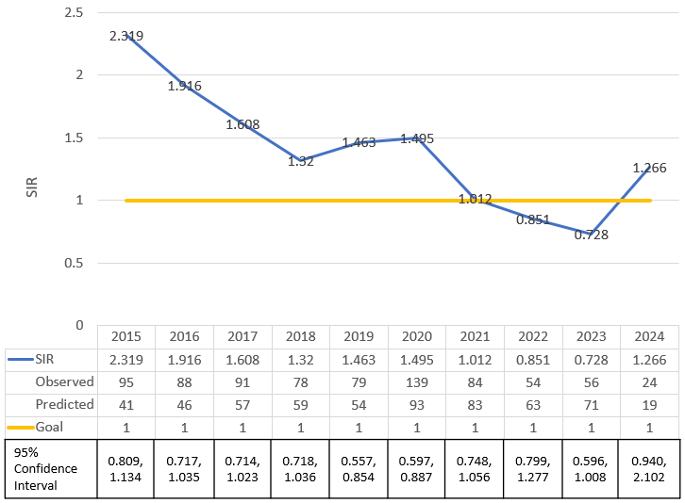
Ventilator-Associated Event ACH (Total VAE)
Includes Ventilator-Associated Conditions (VAC),Infection Related Ventilator Associated Complications (IVAC) and Possible Ventilator Associated Pneumonia (PVAP)
At least 2 days of stability followed by increased in PEEP or FiO2 will be needed for condition to be considered as VAE
HAI/AR team plans to start discussion with the HAI/AR Advisory Council on strategies to decrease VAEs in Nebraska
Ventilator-Associated Event ACH (IVAC Plus)
Includes Infection Related Ventilator Associated Complications (IVAC) and Possible Ventilator Associated Pneumonia (PVAP)
In addition to minimum criteria mentioned for VAE, there needs to be a new antibiotic started along with change in WBC or Temperature
2015-2023 Data Source: NHSN – Include acute care hospitals conferring rights to DHHS.
2024 Data Source- NHSN DUA Group
Notes:
Updated 5/23/2024 by LP
2024 18 facilities reported
2023 19 facilities reported

Slide 24
Data Source: Electronic Lab Reports Submitted to NEDSS
Notes: Preliminary data (subject to change after further updates); Currently denominator for ceftriaxone and carbapenem resistant isolates include those isolates with missing susceptibility results

Slide 25
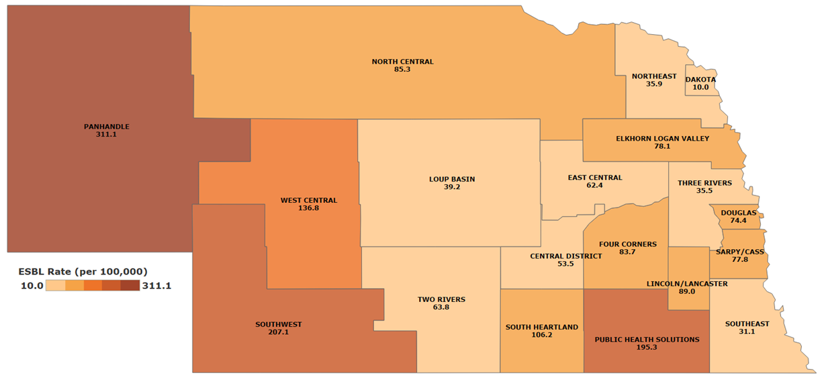
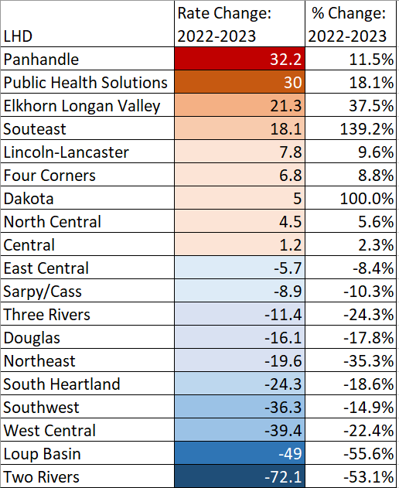
Ceftriaxone-Resistant Enterobacterales per 100,000 person by LHD
Change in Rate for Ceftriaxone-Resistant Enterobacterales from 2022 to 2023 by LHD
Southeast
Data Source: Electronic Lab Reports Submitted to NEDSS
Notes: Preliminary data (subject to change after further updates); Currently denominator for ceftriaxone and carbapenem resistant isolates include those isolates with missing susceptibility results

Slide 26
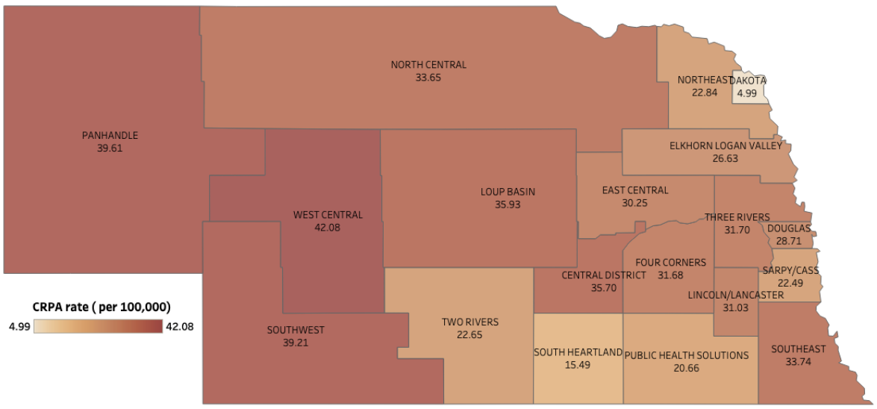
CRPA isolates per 100,000 person in 2023 by LHD
Data Source: Electronic Lab Reports Submitted to NEDSS

Slide 27
2023- Carbapenemase producing Pseudomonas aeruginosa and Acinetobacter Baumannii has also been reported
2024- Carbapenemase producing Pseudomonas aeruginosa has been reported
Year | KPC | NDM | OXA-48 | OXA-181 | VIM | IMP | Total
2019 | 18 | 9 | 0 | 3 | 0 | 0 | 30
2020 | 8 | 0 | 1 | 0 | 0 | 0 | 9
2021 | 3 | 0 | 1 | 0 | 0 | 0 | 4
2022 | 8 | 3 | 1 | 0 | 1 | 0 | 13
2023 | 7 | 6 | 4 | 2 | 0 | 0 | 19
2024 to date | 6 | 4 | 3 | 0 | 0 | 1 | 14
Notes:
Updated 5/17/2024 by LP

Slide 28
NPHL SPECIMEN SUBMISSION CRITERIA
2023 Nebraska CRE isolates eligible for Carbapenemase testing
Enterobacterales
Ertapenem MIC > 1 µg/mL, or meropenem MIC > 2 µg/mL, or imipenem MIC > 2 µg/mL, or non-susceptible by disk diffusion method
Exceptions: Proteus species, Providencia species, or Morgenella morganii non-susceptible only to imipenem but susceptible to meropenem and ertapenem
Pseudomonas aeruginosa
Meropenem or imipenem MIC > 4 µg/mL or non-susceptible by disc diffusion method PLUS non-susceptible to both cefepime and cefazidime at MIC > 16 µg/mL
Exceptions: Pseudomonas aeruginosa that are mucoid or from cystic fibrosis patients
Acinetobacter baumanii
Doripenem, Meropenem or imipenem MIC > 4 µg/mL or non-susceptible by disc diffusion method
https://www.nphl.org/index.cfm/testing-results/?testlink=78

Slide 29
Multidrug-Resistant Organisms (MDRO) Tiers for Nebraska
Tier | Definition of Included Organisms and Mechanisms | Examples (not all inclusive) of organisms/mechanisms for Nebraska | Transmission-Based Precautions Recommendations
Tier 1 | Never (or very rarely) been identified in the United States and for which experience is extremely limited | Novel Carbapenemases | Contact precautions until otherwise recommended by HAI/AR team
Tier 2 | Primarily associated with healthcare settings and are not commonly identified in the region (i.e., not been previously identified in the region or have been limited to sporadic cases or small outbreaks), corresponding to “not detected” or “limited to moderate spread” epidemiologic stages. No current treatment options exist (pan not-susceptible) and potential to spread more widely. | Pan-resistant organisms* Candida auris Carbapenemase (e.g., KPC, NDM, OXA-48, VIM, IMP) producing organisms (CPO) Enterobacterales Pseudomonas aeruginosa Acinetobacter Baumannii | Contact Precautions Long-term Care Facilities (LTCF): Enhanced barrier precautions (EBP) recommended for colonized resident(s)**
Tier 3 | Include MDROs targeted by the facility or region for epidemiologic importance that have been identified frequently across a region, indicating advanced spread, but are not considered endemic | Extended spectrum beta-lactamase (ESBL) producing organisms Carbapenem-resistant Enterobacterales (CRE) Carbapenem-Resistant Pseudomonas aeruginosa (CRPA) | Contact Precautions Long-term Care Facilities (LTCF): Enhanced barrier precautions (EBP) considered for colonized resident(s)**
Tier 4 | Endemic in a region and have been targeted by public health for their clinical significance and potential to spread rapidly | Methicillin-resistant Staphylococcus aureus (MRSA) Vancomycin-Resistant Enterococci (VRE) | Contact precautions per facility risk assessment Long-term Care Facilities (LTCF): Enhanced barrier precautions (EBP) considered for colonized resident(s)**
* Contact tracing and colonization screening may not be indicated for these organisms
**Contact precautions for acute/active infections or uncontained drainage/secretions
Updated 5.26.2024
https://dhhs.ne.gov/HAI%20Documents/Nebraska%20MDRO%20Tiers.pdf

Slide 30
Carbapenem-Resistant Enterobacterales in Nebraska

Slide 31
Nebraska Antimicrobial Stewardship Assessment and Promotion (NE ASAP) Program
Juan Teran Plasencia, MD
Medical Director of Nebraska ICAP

Slide 32
Antimicrobial Stewardship
Implement an antimicrobial stewardship program.
Appropriate antimicrobial use includes avoiding antimicrobial exposure if the patient does not have a condition for which antimicrobials are indicated and deescalating antibiotic therapy when feasible.
Implement CDC’s Core Elements of Hospital Antibiotic Stewardship Programs.
Image by rawpixel.com
Core Elements of Hospital Antibiotic Stewardship Programs
NE ASAP

Slide 33
ASP Core Elements
The Core Elements of Hospital Antibiotic Stewardship Programs (cdc.gov)

Slide 34
Core Elements are not unlike the performance improvement model
Tracking
Reporting
Planning
Education
Action
Notes:
Dr. VanSchooneveld, our ASAP medical director, guided me that the core elements should really be considered as process elements that work together, very much like a continuous improvement model. When looking at programs, these elements should really correlate in order to be effective.
For example: if we agree that treatment of asymptomatic bacteriuria is the problem and we enact a diagnostic algorithm or UTI SBAR (or both) as our action. We need to educated the providers and nurses that what we are doing and why- they should know their role. Tracking and monitoring with related to the tools we put in place (like use of the SBAR), the number of UTI treatment courses, and the number of courses that meet our treatment criteria. Reporting the use of the tools and the number of infections helps the team understand our progress. So the rest of the slides speak to each step, but the congruence of those things is something that we should be evaluating when we look at the ASP elements in place.

Slide 35
Nebraska ASAP Structure and Goals
Supported through Nebraska Department of Health and Human Services (DHHS) through a CDC grant
Team consists of ID pharmacists, ID physicians, infection preventionists, database analysts, and administrative assistants
The goal of ASAP is to promote the effective use of antimicrobials and improve patient outcomes throughout the state of Nebraska by collaborating with local clinicians, pharmacists, infection preventionists and other health care workers to establish effective antimicrobial stewardship programs.

Slide 36
Examples of ASAP Activities
Assist with antimicrobial stewardship program (ASP) development/alignment with CDC Core Elements (important CMS surveys)
Answer any ASP questions/troubleshoot issues/provide 1:1 guidance
Assist with tracking and interpretation of antimicrobial use data
Nebraska ASAP website with numerous helpful resources for acute care, outpatient, and long-term care facilities (https://asap.nebraskamed.com/)
YouTube account with informational videos on antimicrobial stewardship (https://www.youtube.com/channel/UCbRttgPKWu2z53Fj3OlKMxw)
Host annual Nebraska Antimicrobial Stewardship Summit
Services offered at no cost to facilities thanks to CDC grant funding

Slide 37
Core Element Assessment Surveys
Links/QR codes below lead to a stewardship self-assessment survey (~15-30 minutes to complete)
Once complete, ASAP will review results and reach out to schedule a meeting with your ASP team and our ID pharmacists and physicians
Discuss your ASP, provide targeted feedback, answer any questions you have, and provide written report
These assessments are not regulatory in any way and are a free resource for you to improve your antimicrobial stewardship program.
https://redcap.nebraskamed.com/surveys/?s=3HKX3R9AAH

Slide 38
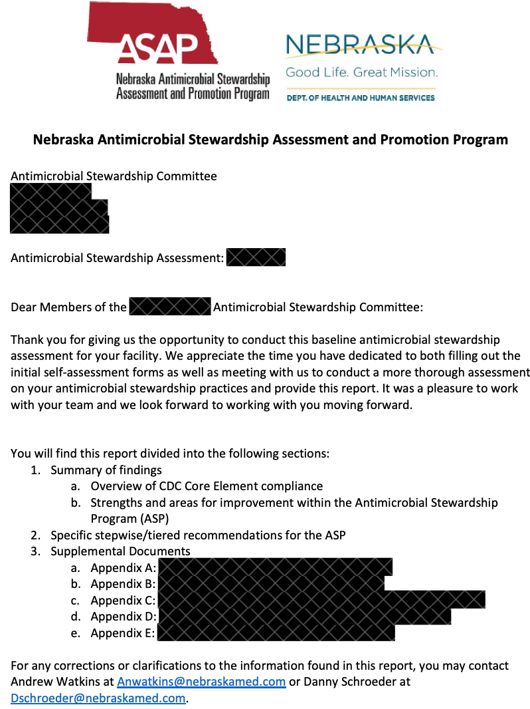
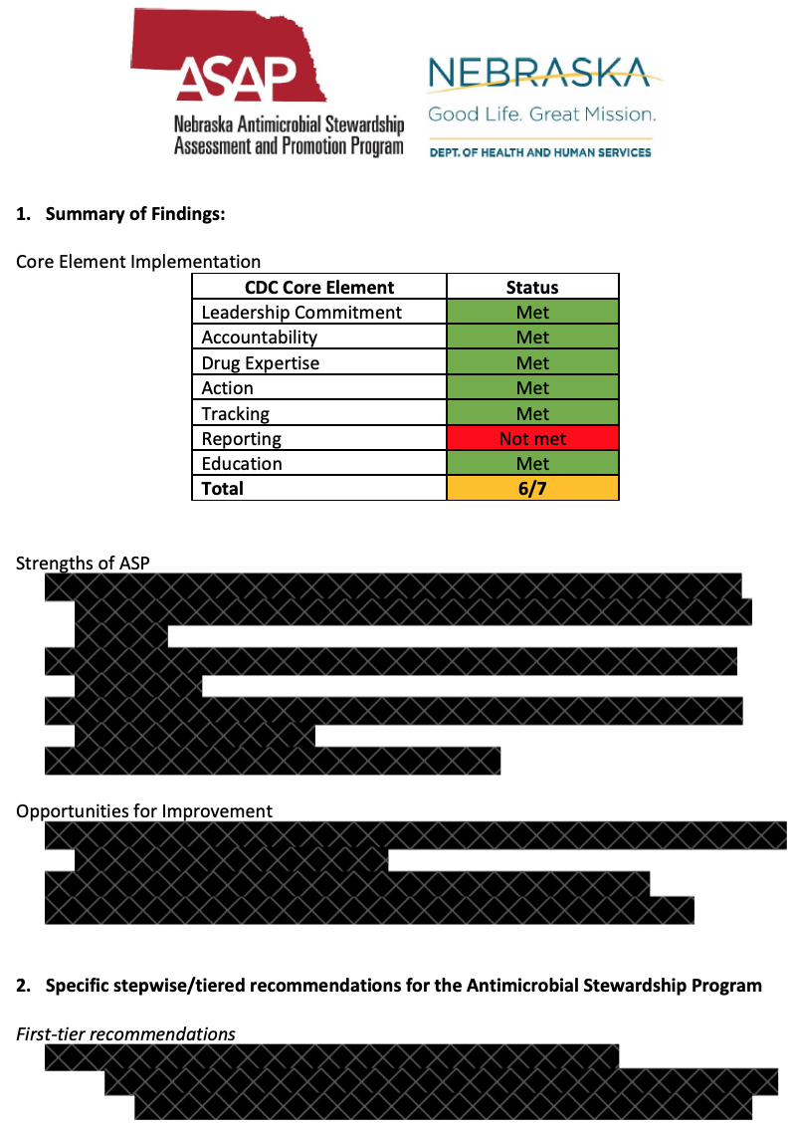
Example of ASAP Core Element Assessment Report

Slide 39
NSHN AUR Reporting
2022
1 CAH Reporting
AU and AR Data
September 2024
31 CAHs Reporting
AU Data
September 2024
22 CAHs Reporting
AR Data

Slide 40
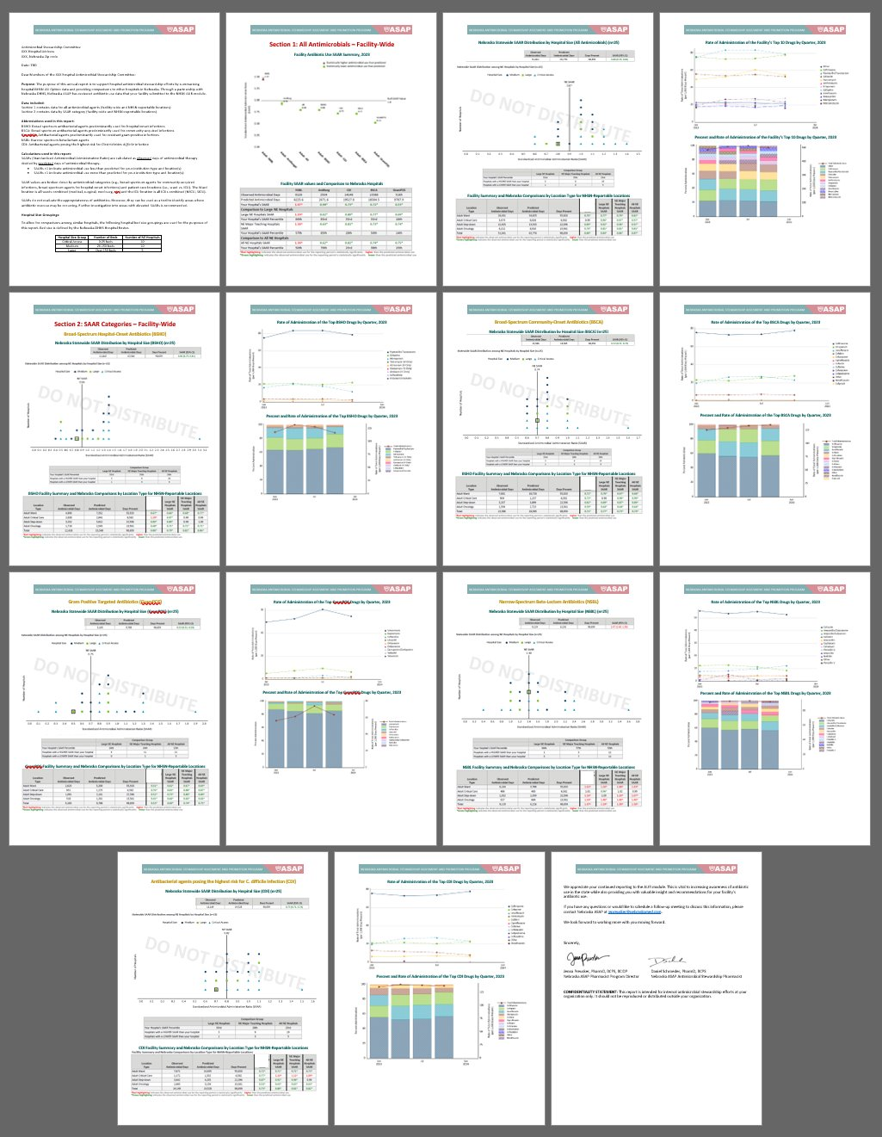
Nebraska ASAP Annual Facility Report

Slide 41
Nebraska Infection Control Assessment and Promotion (NE ICAP) Program
Juan Teran Plasencia, MD
Medical Director of Nebraska ICAP
Rebecca Martinez, BSN, BA, RN, CIC
Infection Preventionist, NE ICAP

Slide 42
How did we get here?
2009
American Recovery and Reinvestment Act
HAI Programs -> CDC Epidemiology and Laboratory Capacity (ELC)
2014
Ebola Preparedness and Response Activities
2015
Domestic Ebola supplement -> Healthcare Infection Control Assessment and Response (ICAR)
ICAP is funded to provide technical support to state and local health departments
HAI surveillance -> CDC Emerging Infection Program (EIP)

Slide 43
Nebraska ICAP Program
Our team includes experienced infection preventionists, infectious disease trained medical directors, and professional educators.
ICAP represents an academic and public partnership to combine resources and expertise to meet the needs of healthcare facilities.
NE ICAP offers no cost, peer-to-peer infection control assessments and recommendations.
Other services include being available for consultations to answer IPC questions and provide education, sharing information on our website, a monthly webinar for acute care and outpatient settings, a monthly webinar for long-term care settings, listings of helpful infection prevention and control (IPC) resources, and development of tools and other publications.
https://icap.nebraskamed.com/

Slide 44
Additional ICAP initiatives for All Healthcare Settings
Infection preventionist mentoring program
Individualized IPC training sessions for healthcare facilities staff through Project Firstline
IPC office hours
Social media outreach for infection control education of frontline healthcare workers
Facebook, LinkedIn, Instagram
Mouthy IP podcast
Dirty Drink podcast
Dental IPC bites (Newsletter)
Nebraska ASAP YouTube Channel

Slide 45
ICAP Support by Setting Type
Acute Care
Dental
Dialysis
Long-term care
Outpatient
School

Slide 46
Nebraska ICAP Outbreak Assessments

Slide 47
CDC’s Core IPC Practices for Safe Healthcare
CDC’s Core Infection Prevention and Control Practices for Safe Healthcare Delivery in All Settings represent fundamental standards of care that are not expected to change based on emerging evidence or to be regularly altered by changes in technology or practices and are applicable across the continuum of healthcare settings.
There are 8 core practice categories:
Leadership Support
Education and Training of Healthcare Personnel on Infection Prevention
Patient, Family and Caregiver Education
Performance Monitoring and Feedback
Standard Precautions
Includes hand hygiene, environmental cleaning and disinfection, injection and medication safety, risk assessment with use of personal protective equipment (PPE), minimizing potential exposures, and reprocessing of reusable medical equipment.
Transmission-Based Precautions
Temporary Invasive Medical Devices for Clinical Management
Occupational Health
CDC's Core IPC Practices for Safe Healthcare Delivery in All Settings
Image by rawpixel.com
Notes:
Rebecca takes over from Dr. Teran. Thank you so much.. Again, I am Rebecca Martinez, an infection preventionist for NE ICAP and I focus primarily are assisting IPs at critical access hospitals and other hospitals but also assist in other settings as well. I wanted to start this with slide about CDC’s Core Infection Prevention and Control Practices for Safe Healthcare Delivery in All Settings because it as foundational for any IPC program. The first core practice is leadership support which include not just your executive leadership but the support from the quality. That is why I am so happy to be able to speak to you today because a key partnership between quality and infection prevention and control in my view is critical to any successful IPC program. Other core practice categories are Education and Training of Healthcare Personnel on Infection Prevention and Control (IPC) – note that education is different than training – staff need to be set for success by being given education to retain that knowledge and be able to demonstrate skills to perform their job duties. Patient, Family and Care giver education is another core practice. You are directly involved in the performance monitoring and feedback. I now that Jessica talked about infection prevention prior so to review standard precautions are a fundamental standard of care and include hand hygiene, environmental cleaning and disinfection, injection and medication safety, using PPE appropriate for the task, minimizing potential exposures and this include respiratory hygiene and cough etiquette, and the reprocessing of reusable medical equipment. Transmission-based precautions when needed such as airborne, contact droplet precautions. Also avoiding the use of medical devices unless necessary and maintaining them when used with prompt removal when no longer necessary is key. And finally, a foundational core practices is a robust occupational health or employee health program as your employees are valuable and you most important asset and quality and safety involves both the patient and healthcare care personnel.

Slide 48
CMS Memo QSO-22-20-HOSPITALS
CMS QSO-22-20-Hospitals
Updates to the interpretive guidance for hospital requirements, State Operations Manual, Appendix A – Survey Protocol, Regulations and Interpretative Guidelines for Hospitals - 42 CFR §482.42 Conditions of Participation (CoP): Infection prevention and control and antibiotic stewardship programs.
CMS - Appendix A - Hospitals
Similar State Operations Manual, Appendix W – Survey Protocol, Regulations and Interpretative Guidelines for Critical Access Hospitals (CAHs) and Swing-Beds in CAHs - 42 CFR §485.640 Conditions of Participation (CoP): Infection prevention and control and antibiotic stewardship programs.
CMS - Appendix W - CAHs
Notes:
Unfortunately, not every IPC program is well supported. I always knew that our quality department which is often one person in a critical assess department, you in this room may be the only “friend’ that the infection preventionist or IP can rely for support because you understand and care about quality but also because you have a responsibility to address IPC concerns brought to you formally. That is why I am bring up this slide which Jessica touched on earlier. This CMS State Operations Manual, Appendix W for Critical Access Hospitals outlines the conditions of participation, the requirements for the IPC program and the antibiotic stewardship program.

Slide 49
CMS CoP – IPC & QAPI Program Support
CMS - Appendix W - CAHs
Notes:
I included this key excerpt because the hospital is required to have an active facility wide program for the surveillance, prevention, and control of healthcare associated infections and other infectious disease and also for the optimization of antimicrobial use through stewardship. The program must adherence to nationally recognized guidelines and best practices to reduce the development and transmission of HAIs and antibiotic-resistant organisms. The issues identified in the IPC and AMS programs must be address in coordination with the facility-wide quality assessment and performance improvement (QAPI) program. This is also reinforced under leadership responsibilities.

Slide 50
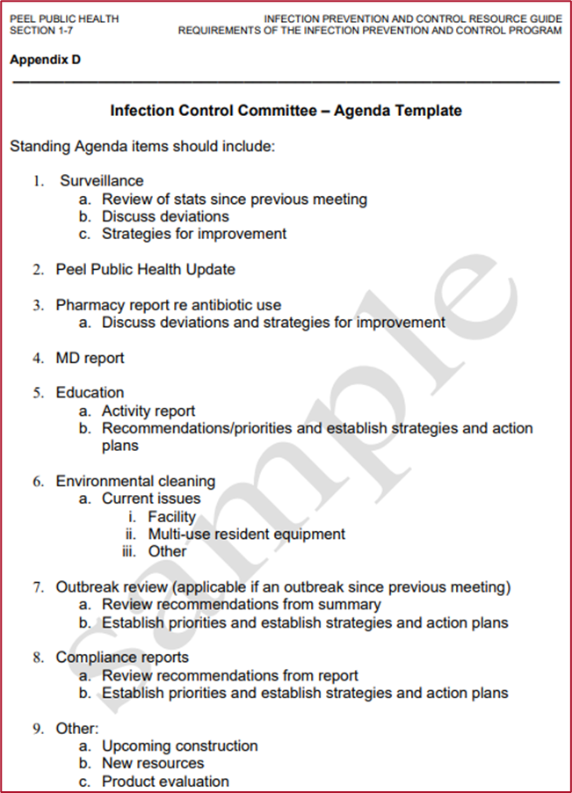
Sample IPC Committee Agendas
Attendance and approval of prior IPC committee meeting minutes
Healthcare Associated Infections (outcome surveillance)
Outbreaks
Reportable Diseases per Nebraska DHHS per 173 NAC 1 – Reporting and Control of Communicable Diseases and Poisonings
Process Surveillance
Hand Hygiene audits
PPE – Standard and Transmission-Based Precaution audits
Safe Injection Practices and Blood Glucose Monitoring audits
Employee Health Report
Environmental Cleaning and Disinfection
Antibiotic Stewardship Program Update
Dialysis
Water reports ensure received
Water management program (WMP)
IPC policies or procedures, review and approve, as needed
If applicable, update on any QAPI initiatives
Other business and open discussion
SAMPLE Infection Control Committee Agenda Template
Notes:
Some facilities have a joint IPC and QAPI committee, some are separate or IPC might be a sub-committee of the QAPI committee. Regardless, I am including a sample IPC committee agenda that might be helpful to ensure the IPC program is engaging and informing other key stakeholders and continually evaluating the program. Overall all, attendance is taken, prior meeting minutes that were sent out after the meeting for review are approved, surveillance and outbreaks are discussed including anything that was required to be reported which often electronic lab reporting automatically does this in most cases, then progress surveillance is discussed such as audit findings including environmental cleaning and disinfection. Not every topic will be an agenda item for each meeting but should be represented at some point. For example, April Showers bring May Flowers, you might want to have a water management program update each April annually and then whenever there are concerns or updates that would be reported and addressed at the time as well. It can be a great time to ensure data from stakeholders is being submitted along with having a rotational system to review IPC policies and procedures getting feedback and approving. This is a key point where concerns to the QAPI committee to help address are documented and placed on agenda for updates.

Slide 51
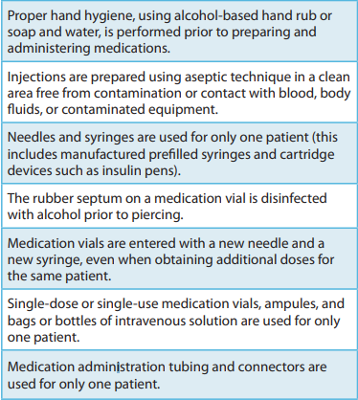
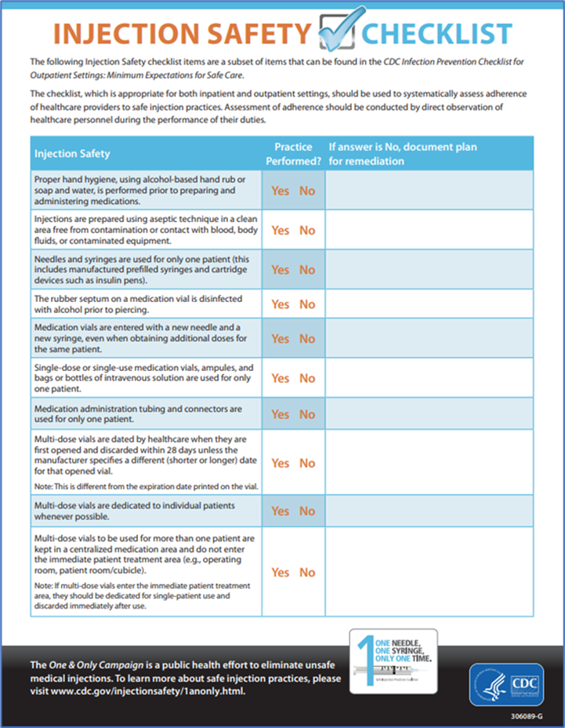
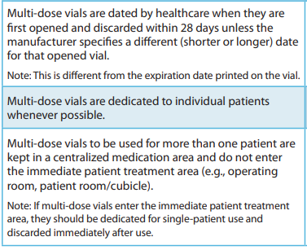
Injection & Medication Safety – Use Injection Safety Checklist
Other Tips:
Avoid multi-dose vials whenever possible
Store vaccine at temperatures indicated by the manufacturer and discard when expired or indicated
Only purchase safety needles for administration
Wear a facemask when placing a catheter or injecting material into the epidural or subdural space (e.g., during myelogram, epidural or spinal anesthesia)
CDC's Core IPC Practices for Safe Healthcare Delivery in All Settings
CDC - Injection Safety Checklist
CDC - Safe Injection Practices and Your Health - One and Only Campaign
OSHA Fact Sheet - Protecting Yourself When Handling Contaminated Sharps
Notes:
Now, I know that Jessica talked about the importance of injection safety and that really can’t be understated as it remains a key gap or area of opportunity across the years in critical access hospitals and other settings. I find this very concerning especially the increasing number of injections being provided when delivering medications including vaccines. It is very concerning because it a very high volume and high risk task where many hospitals are not doing any form of auditing and may not be validating competency of safe injection practices. IPs should be rounding regularly (along with managers of departments). A scenario the we encounter that an IP would encounter would be rounding and noting the medications are within the splash zone of sink or other water source within 36 inches and/or they notice that staff are not swabbing the top of the medication vials each and every time as those dust caps are just that to protect from dust and the septum still needs to be disinfected. So when the IP identifies gaps, this is a prime opportunity for the IP and the QAPI program to work together within their scopes to not duplicate work but have a synergistic effect. You can work together to make this a performance improvement goal, identify injection safety champions, and engage people on the front-line to meeting everyone’s needs. Auditing can be performed and delegated along with the QAPI department helping to monitor performance improvement. There is a wealth of resources on this slide to help get your started and provide a foundation for competency-based training upon hire, annually, and when gaps or new processes are identified.

Slide 52
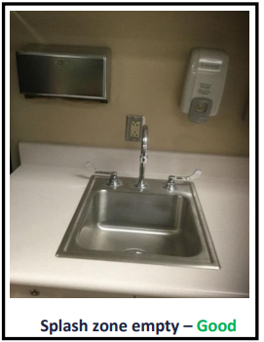
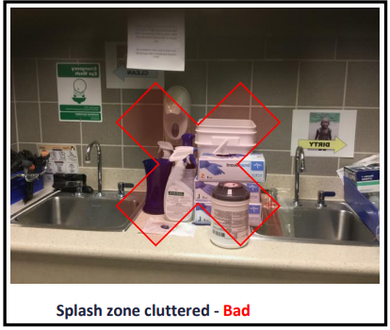
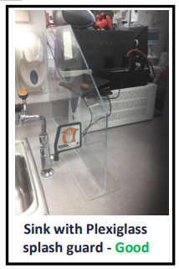
Splash Zones
Outbreaks of infection have been associated with medications contaminated with tap water.
Do not prepare medications near areas of splashing water (e.g., within 3 feet of a sink).
Make sure sink splash zones do not contain any items which could become contaminated from hand washing/water splash.
Mount a splash guard when workspace is limited.
NE ICAP - The Splash Zone
Notes:
This is a photo of splash zones and why they are important to mitigate. Outbreaks of infection have been associated with medications contaminated with tap water.
Do not prepare medications near areas of splashing water (e.g., within 3 feet of a sink).
Make sure sink splash zones do not contain any items which could become contaminated from hand washing/water splash.
Mount a splash guard when workspace is limited.

Slide 53
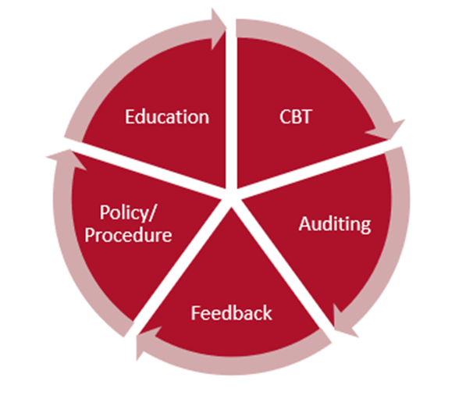
Education and Training of HCP on IPC
Training should be adapted to reflect the diversity of the workforce, facility type, and tailored to meet the needs of each category of HCP being trained.
Provide job-specific, infection prevention education and training to all healthcare personnel for all tasks.
Require training before individuals are allowed to perform their duties and at least annually.
Provide additional training in response to recognized lapses in adherence and to address new equipment or protocols.
Develop processes to ensure that all HCP understand and are competent to adhere to IPC requirements as they perform their roles and responsibilities.
Provide written IPC policies and procedures that are available, current, and based on evidence-based guidelines (e.g., CDC/ HICPAC, etc.).
Competency-Based Training (CBT):
The provision of job-specific education, training, and assessment to ensure that healthcare personnel possess the proven ability to apply essential knowledge, skills, and abilities to prevent the transmission of pathogens during the provision of care.
CDC's Core IPC Practices for Safe Healthcare Delivery in All Settings
CMS - QSO-22-20-Hospitals
Notes:
Again, HPC need to have education and training on IPC. Competency-Based Training (CBT):
The provision of job-specific education, training, and assessment to ensure that healthcare personnel possess the proven ability to apply essential knowledge, skills, and abilities to prevent the transmission of pathogens during the provision of care. You in the quality department can advocate to ensure HCP have protected time to be adequately trained and that the IP has protected time to perform their job duties as well. Policies and procedures should be current and available and based on evidence-based guidelines, they provide great education but the CBT is key. Auditing is the monitoring and documenting to validate practices and feedback is critical to give to front-line staff so they know and also to share trends within the committee and organization for improvement and prioritization of activities.

Slide 54
Performance Monitoring and Feedback
Performance measures should be tailored to the care activities and the population served.
Identify and monitor adherence to infection prevention practices and infection control requirements.
Auditing is monitoring and documenting.
Provide prompt, regular feedback on adherence and related outcomes to HCP and facility leadership.
Train performance monitoring personnel and use standardized tools and definitions.
Monitor the incidence of infections that may be related to care provided at the facility and act on the data and use information collected through surveillance to detect transmission of infectious agents in the facility.
Image by rawpixel.com
CDC's Core IPC Practices for Safe Healthcare Delivery in All Settings
CDC - STRIVE - CBT Audits and Feedback
Notes:
In addition to using auditing data to help monitor performance, the IP should work with the QAPI department to delegate tasks to be performed using standardized tools and definitions to monitor the incidence of infections that may be related to care provided at the facility and act on the data and use information collected through surveillance to detect transmission of infectious agents in the facility. I have been to CAHs where quality reports to NHSN but isn’t sharing their data with IP or others, work together.

Slide 55
ICAR (infection Control Assessment and Response) Site Visits with ICAP
Visits are scheduled for both prevention and outbreak-related visits for all healthcare setting
The ICAP team evaluates infection prevention practices in a peer-to-peer, non-regulatory format.
ICAR evaluations are friendly, confidential, and free.
A visit generally takes 6 hours, but we are happy to customize the evaluation to any time frame that works best for the facility’s schedule and can consider remote options.
Most facilities find the informal dialogue during the visit to be most helpful.
On the day of the ICAR, we initially start out by sitting down and discussing current procedures related to infection control.
Following, a portion of the visit will include touring the building and observing areas such as supply storage, laundry processing, hand hygiene, donning/doffing of PPE, point of care blood glucose testing and medication preparation areas .
Any facility leadership are welcome participate during the visit.
https://icap.nebraskamed.com/icar-assessments/
Notes:
Finally, NE ICAP is here for you as Dr. Teran noted and we can provide education and are available for consulting. Just contact us. A key activity are infection control assessment and response visits. The ICAP team evaluates IPC practices in a peer-to-peer, non-regulatory format. ICAR evaluations are friendly, confidential, and free. We do some interview and discussion questions then perform observations across your facility. The ICAR visits can be more general of focused.

Slide 56
Focused ICAR Visits Are Available
Nebraska ICAP is available for on-site infection control assessment and response (ICAR) non-regulatory voluntary visits. Based on your request, we can provide a more focused assessment including some, or all of the below domains. An example would be an SSI focused ICAR looking at surgical suite practices including device reprocessing.
Surgical Site Infection (SSI) Prevention
Device Reprocessing including sterilization and high-level disinfection
Infection Control Program and Infrastructure
Hand Hygiene
Personal Protective Equipment (PPE)
Catheter-associated Urinary Tract Infection (CAUTI) Prevention
Central Line associated Bloodstream Infection (CLABSI) Prevention
Ventilator-associated Event (VAE) Prevention
Injection Safety
Clostridioides difficile infection (CDI) Prevention
Environmental Cleaning & Disinfection (ATP testing offered during visit)
Systems to Detect, Prevent, and Respond to HAIs and MDROs
Healthcare Personnel Safety
Water Management
COVID-19 Prevention and Response
Antimicrobial Stewardship
The NE ASAP program provides comprehensive assessments
Please let us know if interested nebraskaicap@nebraskamed.com
(402) 552-2881
Notes:
For example, a general ICAR will be lengthy but a focused on certain domains to meet your facility needs.

Slide 57
What is Assessed During an SSI- Focused ICAR Visit?
The visit would focus on the areas related to SSI prevention, including:
Policies & Procedures related to Infection Prevention Control (IPC) and SSI Prevention
Infection Control Training, Competency, and Audits
Perioperative Environment
Sterile Processing and Device Reprocessing
Hand Hygiene
Personal Protective Equipment
Environmental Cleaning & Disinfection
Notes:
And SSI focused ICAR would include touching on your overall IPC program, hand hygiene, PPE, and environmental cleaning along with observing in the operating and observing sterilization practices. Not that we do not approve policies, but review to make sure all areas that need to be addressed are addressed in written policies.

Slide 58
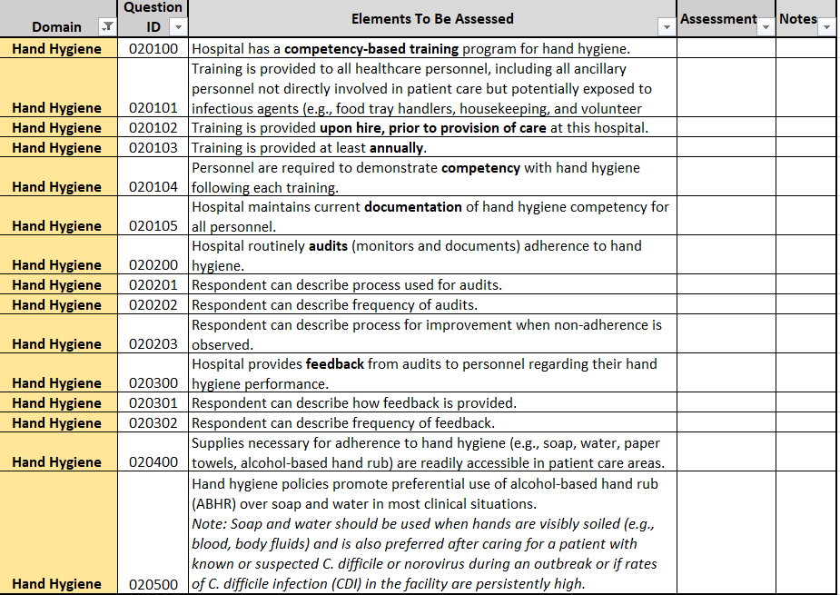
Assessment Tool – Hand Hygiene Example
Notes:
This is an excerpt of interview questions we go over. For an SSI focused-ICAR we would review the results of an SSI survey you may have already completed to compare to overall Nebraska results.

Slide 59
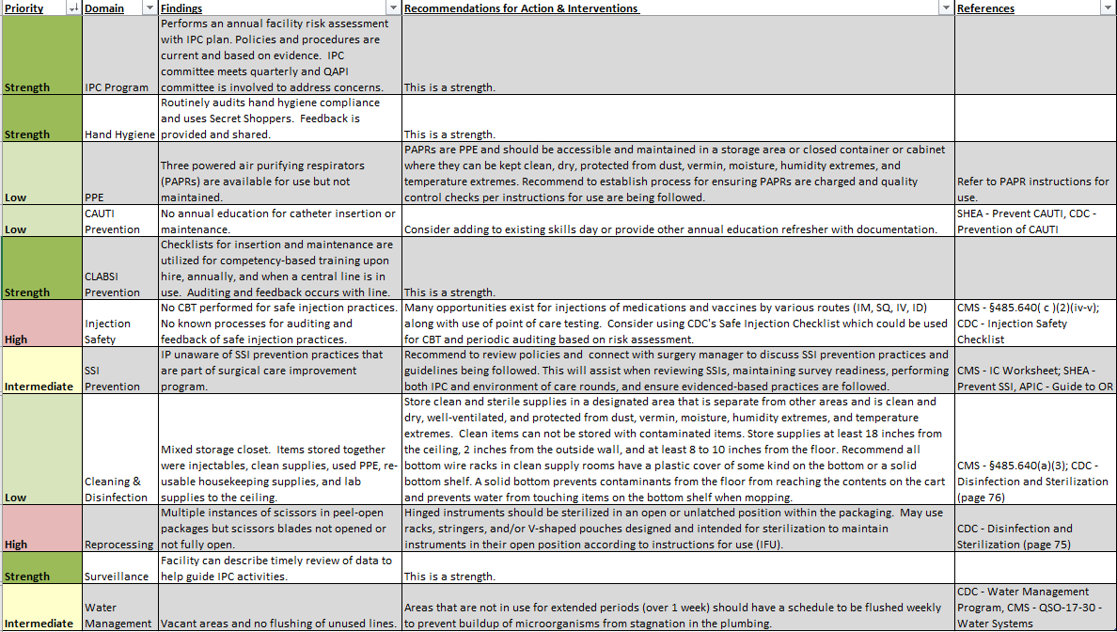
ICAR Response Report
Notes:
This is an example of a response document that is sent via a secure package that includes strengths and what we may prioritize as opportunities. It includes findings and specific recommendations including references to back-up those recommendations. The facilities do not have to complete the recommendations; however we encourage facilities to address at least the higher level recommendations and for ease, we even include the response document in a spreadsheet that could be used as a performance improvement tool. Thank you.

Slide 60
Closing Thoughts

Slide 61
Social Media
Follow us on Facebook at https://www.facebook.com/nebraska.icap.asap
Follow us on LinkedIn at https://www.linkedin.com/company/nebraska-icap-asap
Now on Instagram! Follow us at https://www.instagram.com/nebraska_icap_asap/
Subscribe to our YouTube at: https://www.youtube.com/@nebraska_icap_asap

Slide 62
ICAP Contact Info
Main Number Call 402-552-2881
Office Hours are Monday – Friday
8:00 AM - 4:00 PM Central Time
Weekends and Holidays 8:00-4:00
On-call hours are available for emergencies only
Scan the QR Code to be taken to our NE ICAP Contact Form.
You can request to be connected to an
Infection Preventionist that specializes in your area,
get added to our setting specific communication list
for webinar and training invites,
sign up for newsletters and reminders,
or request an ICAR review for your facility.

Slide 63
Infection prevention and control is a team effort. Thank you!
Please feel free to contact us for any questions now or in the future.
Juan Teran Plasencia, MD jteranplasencia@unmc.edu
Lacey Pavlovsky, RN, MSN, CIC, LTC-CIP, FAPIC lacey.pavlovsky@nebraska.gov
Rebecca Martinez, BSN, BA, RN, CIC remartinez@nebraskamed.com

