Slide 1


Slide 2
Nebraska EMS System Redesign
Transforming Emergency Medical Services Statewide

Slide 3
Background
Sustainability of the current program
EMS as a vital member of the healthcare delivery model
  Access to healthcare in a large rural state

Slide 4
Vision for the Redesigned EMS System
Responsive: Quick, reliable response across Nebraska.
Integrated: Seamless connections to broader healthcare.
Equitable: Addressing disparities in underserved areas.
Sustainable: Long-term workforce and resource development.

Slide 5
Regional EMS Systems
Breaking down silos through regional systems.
Centralizing resources and oversight.
Enhancing collaboration and training.
Improving response with predictive analytics.

Slide 6
Coordinate Resources:
Combine personnel, equipment, and infrastructure within designated regions to reduce duplication and improve coverage.
Establish regional EMS oversight committees to oversee operations and ensure balanced distribution of resources.
  Including EMS providers, local government officials, healthcare representatives, and community leaders, ensuring diverse perspectives and comprehensive oversight.
Share costs for medication and supply ordering across the region. By placing larger, consolidated orders, the regional systems can achieve significant cost savings while ensuring a consistent supply of essential materials.

Slide 7
Regionalized EMS Training
Centralizing EMS training at regional hubs offers significant advantages over individual agency-based training. Regionalized training ensures standardized protocols and curricula across multiple agencies, fostering uniformity in care and operational procedures.
By pooling resources, regional training reduces redundancy and enhances cost-effectiveness, enabling the acquisition of advanced training tools and access to highly qualified instructors.
This approach promotes collaboration and networking among EMS providers within the region, creating a cohesive workforce better equipped to respond to large-scale emergencies.
Provide regional training hubs to support ongoing education and professional growth for EMS personnel.

Slide 8
Establish Regional Medical Direction:
Appoint regional medical directors to provide oversight, guidance, and support to local medical directors.
Ensure consistency in clinical practices and facilitate region-wide adherence to evidence-based protocols.
Coordinate closely with the Nebraska Department of Health and Human Services (DHHS) and the State EMS Medical Director to align regional practices with statewide healthcare objectives.

Slide 9

Consolidation with Emergency Management Offices:
Explore the idea of consolidating EMS operations under pre-existing emergency management offices. This integration would adopt an all-hazards approach, allowing for comprehensive coordination that includes medical response.
Aligning EMS with emergency management can enhance resource utilization during disasters and routine emergencies alike, ensuring seamless communication and a unified strategy.

Slide 10

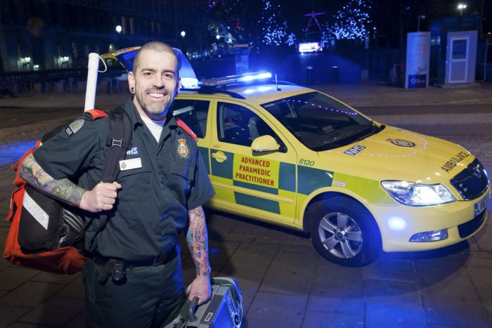


Paramedic Practitioner Program
A cornerstone of the redesign is the introduction of an advanced educational pathway for EMS professionals that will create Paramedic Practitioners.
This was a key initiative highlighted in NEMSAC’s recent recommendations to NHTSA

Slide 11

Meeting Rural and Underserved Needs
The Paramedic Practitioner role is especially well-suited for rural and medically underserved areas.
These practitioners will help bridge the gap in healthcare for regions lacking hospitals and other medical resources, ensuring access to essential services for populations that might otherwise go without.

Slide 12
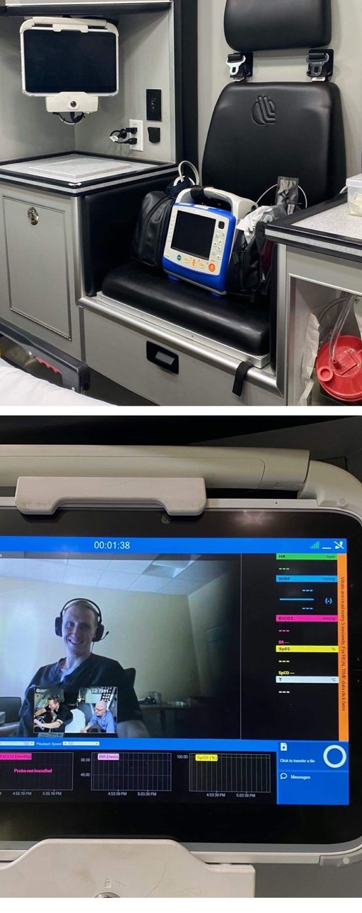
Infrastructure & Technology
Modernizing Nebraska’s EMS system requires significant investment in infrastructure and technology. Core initiatives include:
  Centralized Data Integration:
    Continue utilizing a statewide EMS database to monitor performance, optimize resource deployment, and analyze healthcare trends.
  Telemedicine Integration:
    Continue the use of telemedicine as explored in ongoing pilot programs and foster relationships with healthcare systems to further integrate telemedicine and the Paramedic Practitioner role into those systems.
    Highlight telemedicine’s potential to be integrated into the dispatch process to assist in triaging resources for lower-acuity 911 calls, optimizing EMS deployments and reducing unnecessary hospital transports.
    Expand telemedicine access to rural regions, bridging gaps in specialist care.
    Evaluate the current telecommunication network and infrastructure to ensure it can adequately support telemedicine in rural areas.

Slide 13

Infrastructure & Technology
Predictive Resource Allocation:
  Leverage examples from large urban centers regarding system status management and apply these principles in rural settings to better anticipate EMS usage and optimize the placement of resources.
  Use data analytics to deploy EMS resources strategically, reducing response times and enhancing efficiency.
Artificial Intelligence in Prehospital Care:
  Leverage AI technologies to assist EMS providers with documentation, ensuring accuracy and reducing the administrative burden on crews.
  Provide real-time protocol references and adherence checks, ensuring high-quality and consistent patient care.
  Use AI for medical decision-making assistance, offering evidence-based recommendations and enhancing the provider's capacity to handle complex medical cases.

Slide 14

Expanding the EMS Workforce
Statewide EMR training for firefighters.
  Encourage every firefighter in the state to receive training at the Emergency Medical Responder (EMR) level.
    This initiative would provide a baseline medical capability across fire departments, enhancing the availability of first responders in emergencies.
  Partner with fire academies and training institutions to integrate EMR certification into firefighter training programs.
  Offer incentives such as tuition reimbursement or stipends to support firefighters pursuing EMR certification.
  Offer or expand pre-existing incentives such as tax write-offs for those who obtain the EMR certification.
  Pathway to other careers in EMS

Slide 15
Expanding the EMS Workforce
Scholarship and grant programs for rural areas.
Establish financial assistance programs to attract new entrants into the EMS field, particularly in rural and underserved areas.
Leadership training and mentorship for retention.
Implement career advancement pathways, including mentorship programs and leadership training, to retain skilled EMS personnel.
Public awareness campaigns to highlight EMS careers.
Launch campaigns to raise awareness about EMS careers, focusing on the vital role of EMS providers in the healthcare system and their opportunities for professional growth.

Slide 16
Community Engagement
Engaging the community is critical for the success of the redesigned EMS system. Proposed initiatives include:
Public Education:
  Launch statewide campaigns to educate the public on the role of EMS and basic life-saving techniques, such as CPR and AED use.
Health Equity Programs:
  Collaborate with community organizations to tailor EMS services to the needs of diverse populations, particularly in underserved areas.
Bystander Training:
  Implement programs to increase bystander participation in emergency response, improving outcomes in critical situations.

Slide 17
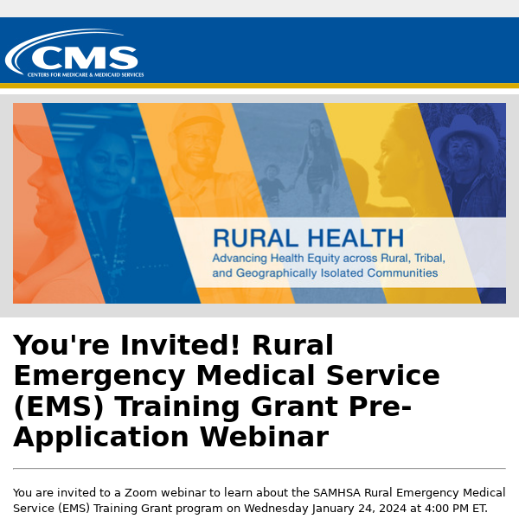


Financial Strategy
Initial Funding:
  Seek federal and state grants, including those from the Health Resources and Services Administration (HRSA), the Federal Emergency Management Agency (FEMA), and the U.S. Department of Health and Human Services (HHS).
  Leverage state funding programs aimed at healthcare infrastructure and rural health initiatives.
  Apply for grants such as the Rural Emergency Medical Services Training Grant and other targeted EMS funding opportunities.
  Explore private investments and philanthropic contributions to supplement government funding.
    E.g. Helmsley Foundation Funding.

Slide 18
Financial Strategy
Sustainability Measures:
Implement cost-sharing agreements with local governments.
Utilize reimbursement models for telemedicine and other advanced EMS services.
Investment in Technology:
Prioritize spending on technologies that enhance efficiency and reduce long-term costs.

Slide 19
Implementation Plan
Phase 1
Planning and Partnership Development
Establish partnerships with academic institutions capable of providing prehospital and advanced practice education.
Form an advisory board including EMS leaders, healthcare professionals, and community stakeholders.
Phase 2
Pilot Programs
Introduce pilot programs for the Paramedic Practitioner role and telemedicine integration.
Test predictive analytics for resource allocation in selected regions.
Phase 3
Statewide Expansion
Roll out successful pilot programs across the state.
Standardize operational protocols and expand training initiatives statewide.
Phase 4
Continuous Evaluation and Improvement
Use performance metrics and community feedback to refine services.
Stay adaptable to emerging healthcare trends and technological advancements.

Slide 20
Anticipated Outcomes
The redesigned Nebraska EMS system aims to achieve:
  Reduced Response Times: Through predictive deployment and technology integration.
  Higher Quality of Care: Via advanced training and telemedicine capabilities.
  Improved Accessibility: Ensuring equitable access to emergency services for all Nebraskans.
  Sustainable Growth: Building a resilient EMS workforce and resource model to meet future demands.

Slide 21
Conclusion
The Nebraska EMS System redesign represents a bold step toward delivering cutting-edge, equitable emergency medical care. By aligning resources, technology, and education with community needs, the state will create a model EMS system that serves as an example for others nationwide.

