Slide 1
C.U.T. the fluff out of Infection Control and Emergency Preparedness

Slide 2
Contact info
Valerie Hangman BSN, RN, CPHQ
Director of Quality Assurance and Performance Improvement
Providence Medical Center
1200 Providence Road
Wayne, NE 68787
(402)-375-3800

Slide 3
Objectives
Review 4 steps to get started on any topic when you feel lost
Template to C.U.T. the fluff out of infection control or emergency preparedness
Identify options to get people on the team

Slide 4
Incident Action Plans

Slide 5
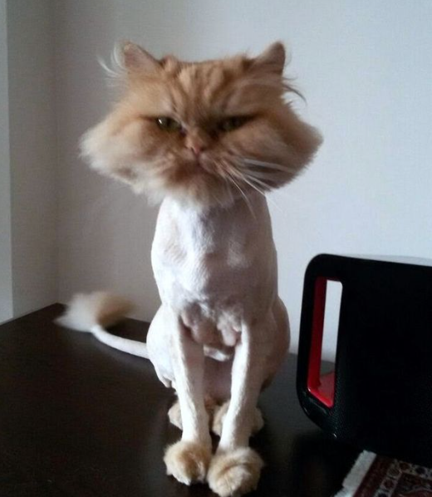
C.U.T.
Concise
A lot of info made clear with few words
User-friendly
Easy to understand and use, standardized
Thorough
Complete; important parts included

Slide 6
Four steps to get started on any topic
What do you have?
What is required?
What are the options?
Make a choice/Develop a process

Slide 7
What do you have?
Policies, Procedures, Plans-that spell out your topic or relate to your topic.
Documents-paper, electronic health record.
Processes-how are they written, how are they done and are they something you use frequently.
Likes, dislikes, pain points and issues.

Slide 8
What is required?
Laws-state and federal
Regulations-OSHA, FDA, OIG
Conditions of participation
Nebraska Rules and Regulations Title 175 Chapter 9

Slide 9
What are the options?
Options for how you could do something
Strict and complex
Lax and minimal
Brainstorm, no idea is stupid
Questions about the topic
Suggestions to make it easier
Best Practice to follow and Resources to steal from

Slide 10
Make a choice
Update what you have or start over?
Interpretation of Laws, Regulations and Conditions of Participation.
Drills and actual events.
Weigh your options

Slide 11
Develop a Process
Who is the info for? Is that info user-friendly?
Do you have everything you need for the option you chose or the updates you are making? Is it thorough, but concise?
How will you educate?
How will you test the plan?
Is there a metric you should be monitoring?
Are you using PDSA and small tests of change?

Slide 12
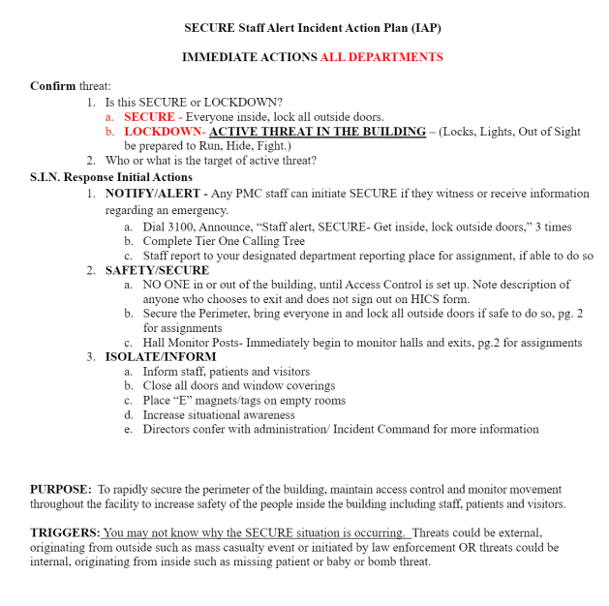
Template to C.U.T. the fluff-Secure
A mnemonic to remember the vital first steps.
S.I.N.
Safety, Isolate, Notify
Can be used in any order and may vary depending on the incident
3-5 bullet points under each.
Standardize plans to include S.I.N.

Slide 13
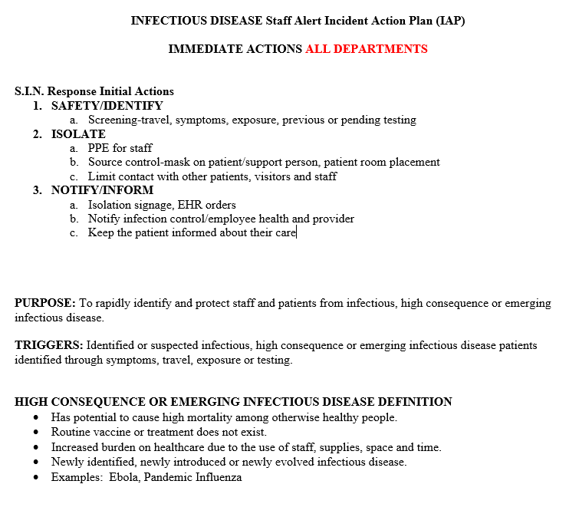
Template to C.U.T. the fluff-Infectious Disease
Use of Safety, Isolate, Notify with Identify, Isolate and Inform.
Group things together where you can.
Within groups list things by importance.

Slide 14
Process-The rest of the story?
S.I.N. vs. the Full Plan for Infectious Disease
What are you adding or removing from your full plan?
Removing
Anything that is in another plan, policy or procedure.
Outdated things.
Adding
List of policies that may need to be reviewed or used.
Links to resources.
Template for the scoop on each specific disease.

Slide 15
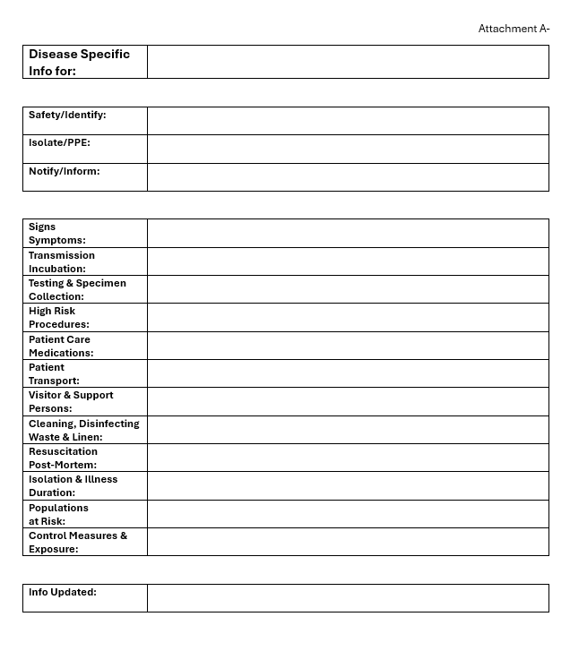
Template for Disease Specific Info
Standardize a template to give you concise, user-friendly, thorough information on each disease.
Templates will allow you to assure you have complete info on each specific disease while being easier to read and easier for your brain to comprehend.
Once you find a format you like for your attachments to a plan then use it as much as you can.

Slide 16
Get people on the Team!!
Literally, get people on the team! Bring in the frontline staff that will be doing the work to assist in the process.
Encourage directors/supervisors to give you the help of frontline staff so they don’t have to do the work.
For those involved in the immediate actions, like hallway monitoring or door access for a plan like secure, bring them to the table to assure the plan is doable before you put it out.
Offer options for education and ask staff how they might like to see info. Power point with voiceover video, something 15 minutes or less they can show at a meeting. Hit the high points.
If all else fails, ask a specific frontline staff member for help. “I’m not sure this plan is right. You had great ideas on X. Do you have a few minutes to look over the plan with me?” or “Bob you are new hear and a fresh set of eyes. Would you talk through the secure plan with me?”

Slide 17
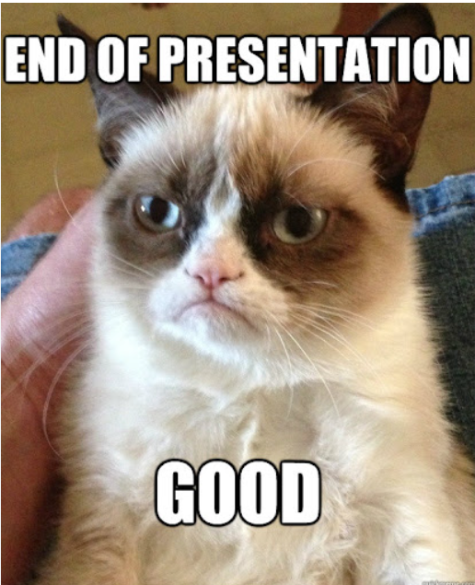
Questions?

Slide 18
Lessons Learned
Concise
Group things, 3-5 bullet points so people can skim.
Don’t be afraid to ask, “Do we really need that” and “What could happen if we don’t have that”.
Less is more.
User-friendly
Use what people know, pivot if you need to, change isn’t a bad thing.
Make it easy to understand or people are skipping it.
People read the first page, skim the second and assume the rest.
Thorough
Doesn’t have to be every, single thing you can dream up.
Template to help you remember.
Standardize and organize things.
Team
Pick people for your team that aren’t like you.
Give credit where it is due.
Communicate in writing for timeliness and transparency
Manage expectations, does it need to be perfect or will good enough work.

