Slide 1
True or False?!??
Top Myths of Diagnosis and Management of Infectious Diseases for Best Practices in Antibiotic Stewardship
Jenna Preusker, PharmD, BCPS, BCIDP
Nebraska ASAP Pharmacy Coordinator
Nebraska Hospital Association Quality Conference
November 14, 2025

Slide 2
Disclosures
I have no relevant financial conflicts of interest to report related to this presentation.

Slide 3
Objectives
02
01
Identify common misconceptions in the diagnosis and treatment of infectious diseases that contribute to antibiotic overuse.
Explore why myths commonly exist in diagnosis and treatment of infectious diseases.
03
Recognize opportunities to improve antibiotic therapy related to common infectious disease myths through quality improvement strategies.

Slide 4

Why do myths exist in antibiotic prescribing?
Resistance to Change
History of Antibiotic Prescribing
Dogmas reinforced
Inertia
Early History
Dogmas reinforced by past experience and clinical guidelines = “standard of practice”
Barrier to change as new & higher quality evidence becomes available
Dogma > evidence
Many ID practices based on case series from 1940s and 1950s, predating randomized controlled trials
Practices often maintained due to lack of new data & historical inertia - “How we’ve always done it…”
Wald-Dickler N, et al. Am J Med. 2022 Mar;135(3):369-379.e1

Slide 5


The First Penicillin Treated Patient…
5 Days
Photo Credit: BBC
Notes:
The modern antibiotic era began with the introduction of penicillin in 1940, and with it, the dilemma of determining the appropriate duration of therapy for infectious diseases. Albert Alexander, a British constable, was the first human to receive penicillin therapy for extensive streptococcal and staphylococcal facial abscesses following an injury sustained in a bombing raid (3). Constable Alexander received five days of penicillin therapy with an excellent short-term response; however, despite attempt to re-purify penicillin from his urine, the supply of purified penicillin was exhausted and therapy was discontinued as a result. Sadly, within several weeks, his infection returned and he eventually succumbed to his disease. While this first use of penicillin demonstrated the power of antibiotics to treat bacterial infections, it also presaged the current challenge of determining antibiotic therapy duration, highlighting both the question of “how much is enough”, and the legitimate fear that inadequate therapy may result in relapse or poorer outcomes.

Slide 6
Impact of Myths on Quality and Safety
Antibiotic overuse leads to resistance, C. diff infections, adverse drug events
Diagnostic overuse can lead to false positives and overtreatment
Financial and workflow impact
Notes:
Talk about historical prescribing habits, things have changed
Some historical habits are no longer safe and are contributing to a larger antibiotic usage problem

Slide 7

Myth #1: Longer durations of therapy are safer for our patients

Slide 8
Misconceptions about Antibiotic Durations
01
02
03
Concerns over
infection relapse
Longer durations ↓ antibiotic resistance
Longer courses are more effective
Prompted by an early pneumonia case series = disproven
Opposite is true! Longer durations lead to more resistance
Clinical trials demonstrate equivalent outcomes with short-course regimens
Rice LB. The Maxwell Finland Lecture: for the duration-rational antibiotic administration in an era of antimicrobial resistance and Clostridium difficile. Clin Infect Dis 2008;46(4):491–6
Chastre J, Wolff M, Fagon J-Y, et al. Comparison of 8 vs 15 days of antibiotic therapy for ventilator-associated pneumonia in adults: a randomized trial. JAMA 2003;290(19):2588–98
Notes:
Antibiotic duration of 7, 14, 21 days are commonly ordered by prescribers despite evidence that many common infections can be treated with shorter courses.
There are several misconceptions that may lead to this prescribing:
Concerns over infection relapse - The relapse myth was prompted by an early pneumonia case series indicating that penicillin durations for pneumonia should continue past symptom resolution due to increased relapses in patients who received short-course therapies. However, a re-evaluation of the data disproved this theory when it determined that patients had new infections with different bacterial serotypes, rather than relapses
Belief that antibiotic resistance can be prevented by treating beyond symptom resolution - Despite studies in pneumonia demonstrating that longer antibiotic courses lead to the emergence of resistance,15,16 patients have long been instructed to finish antibiotic courses to prevent resistance, even if they feel better sooner.
Belief that longer antibiotic courses are more effective - Clinical trials have shown that short-course therapies for a variety of infections are equivalent to longer durations

Slide 9
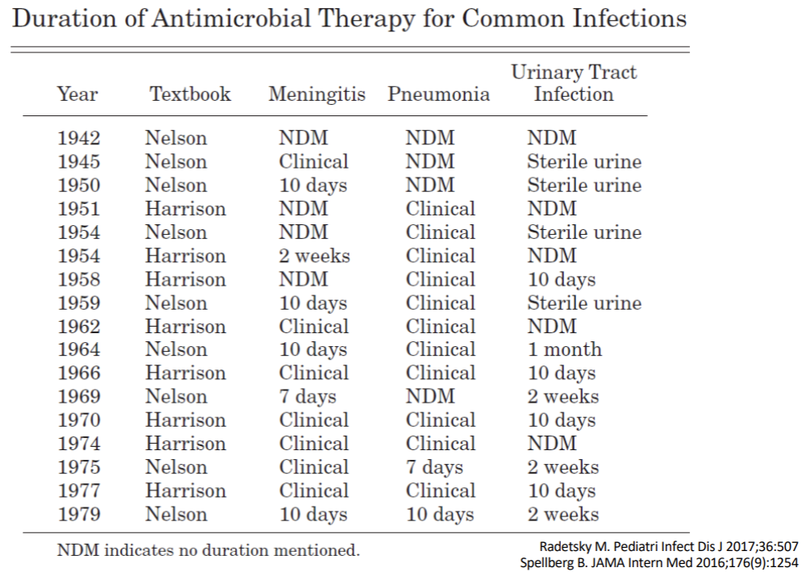


Slide 10

Patients receive antibiotics
If antibiotics are continued…
How Antibiotic Resistance Happens
Infections start when pathogenic bacteria outcompete the normal flora, or good bacteria
Both pathogenic and good bacteria decrease in numbers
Symptoms resolve
Good bacteria continue to decrease in numbers
Pathogenic bacteria mutate and become resistant to survive
As antibiotics continue even longer…
When antibiotic durations are prolonged…
Good bacteria are severely reduced
Resistant bacteria continue to multiply and may spread to other people or cause recurrent infection
Resistant bacteria begin to multiply and share mutations with other bacteria

Slide 11
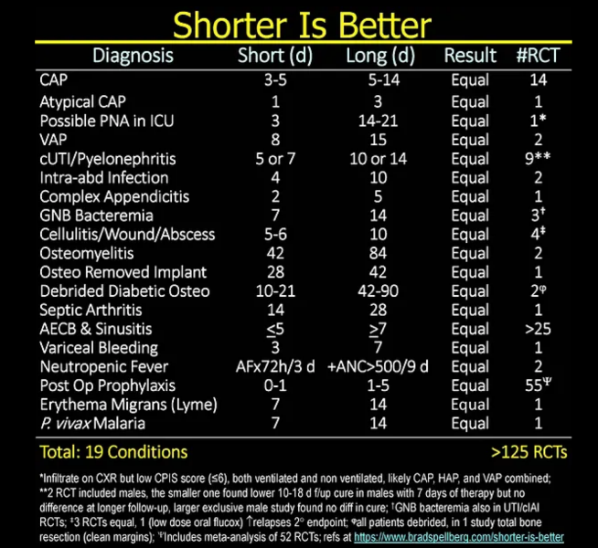
Shorter is Better!
Default treatment durations for uncomplicated infections should infrequently (never) exceed 7 days
Caveats
No deep-seated or uncontrolled source of infection
  Endocarditis, osteomyelitis, undrained abscess, retained foreign body, etc.
Immunocompetent host
Spellberg B. JAMA Intern Med 2016;176(9):1254 www.bradspellberg.com/shorter-is-better
Notes:
Early stopping of treatment in the conditions below can increase the risk of relapse and poor outcomes
Deep seated infections (endocarditis, osteomyelitis)
Infections with certain invasive organisms – e.g. S. aureus
Complex, difficult to treat infections – mycobacterial, fungal, etc.
Critical illness with complex etiology
Infections with insufficient source control

Slide 12
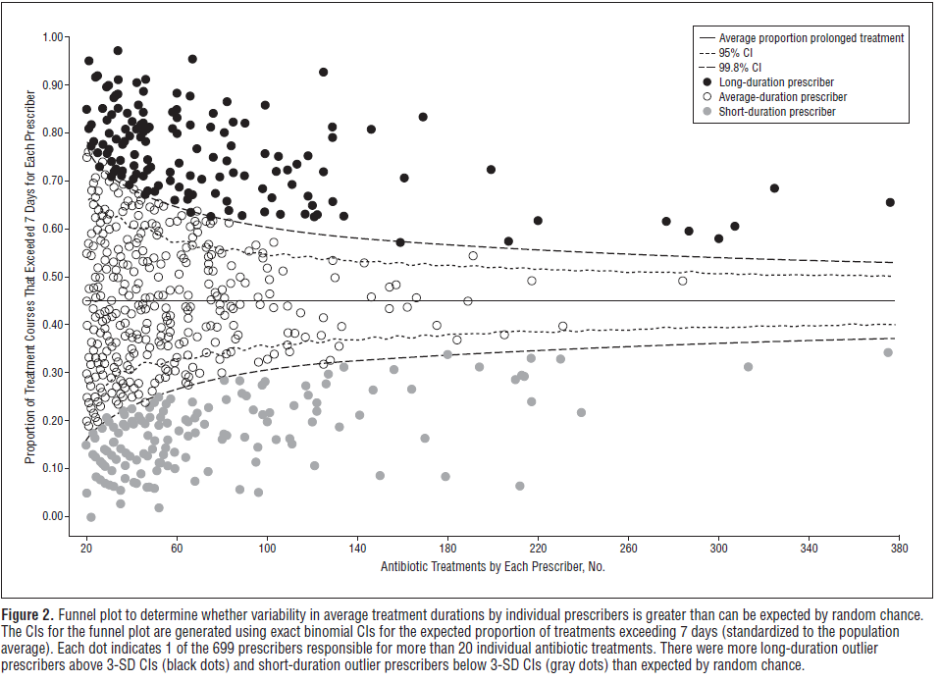
Long Duration of Treatment Influenced by
PROVIDER PREFERENCE > Patient Characteristics
Many prescribers chose durations over 7 days more than 50% of the time for uncomplicated infections
Daneman N et al. JAMA Intern Med. 2013 Apr 22;173(8):673-82

Slide 13
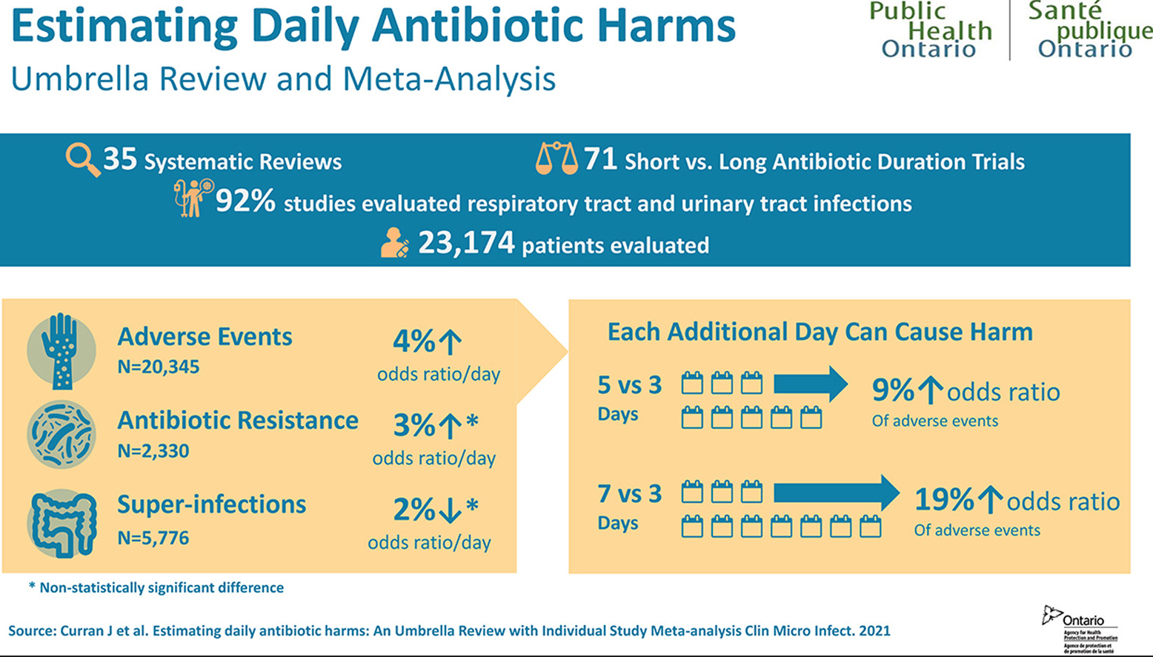
Curran J. Clin Microbiol Infect. 2022;28(4)

Slide 14
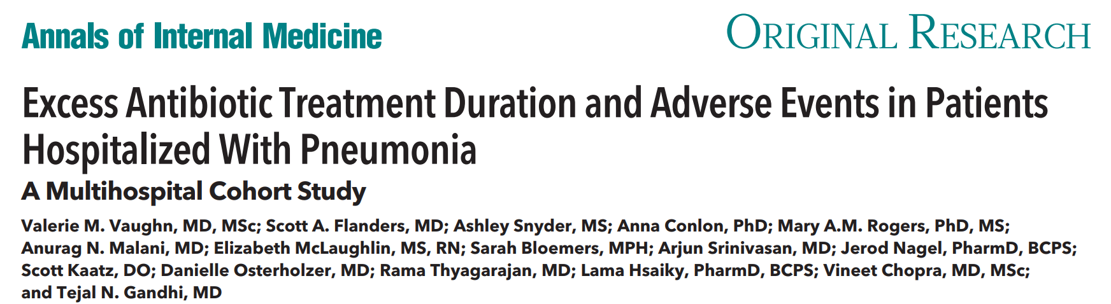
6481 patients, 43 hospitals
Two-thirds of patients received excess antibiotic therapy
93% of excess antibiotic duration occurs at discharge
Vaughn, V et.al. Annals of Internal Medicine. 2019

Slide 15
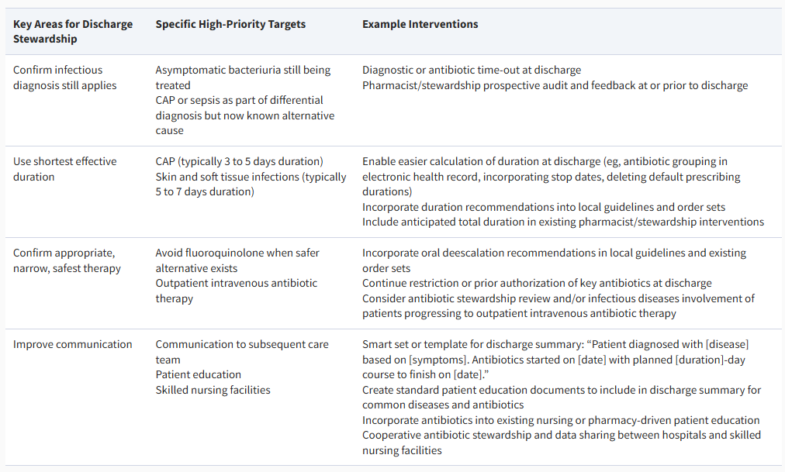
Summary of Targets & Interventions for Discharge Stewardship
Table Link| Clinical Infectious Diseases
Notes:
Based on what is known, there are at least 4 main targets to improving antibiotic prescribing at discharge. First, and perhaps most critical, is stopping unnecessary antibiotics in patients who initially were considered to have a possible infection (eg, pulmonary infiltrates, tachycardia) but were later determined to have a nonbacterial etiology (eg, heart failure, viral pneumonia). If not done at 48–72 hours during a “time-out,” discharge is an ideal time to consolidate the medication list and finalize discharge diagnoses, including removing infectious diagnoses that have been ruled out. Second, for patients who have a confirmed or likely infection, the most common type of antibiotic overuse at discharge is excess duration. As noted by the CDC’s Core Elements for ASPs, discharge is a critical time for improving total duration of therapy given that the vast majority of excess duration occurs after hospitalization. For stewardship programs seeking “low hanging fruit” to begin their discharge assessment, community-acquired pneumonia and skin and soft tissue infections are prime targets. Third, reducing fluoroquinolone use at discharge remains a critical target. Despite reductions in fluoroquinolone prescribing during hospitalization, fluoroquinolone use at discharge has only minimally decreased. Primary avoidable causes of fluoroquinolone use at discharge include pneumonia, intraabdominal infections, and perioperative therapy. Finally, patients discharged on OPAT can often be optimized by switching to oral therapy, reducing duration, optimizing dose and agent, or stopping antibiotics altogether. Additional opportunities exist for special populations, most critically improving communication, monitoring, and antibiotic use at discharge to SNFs.

Slide 16
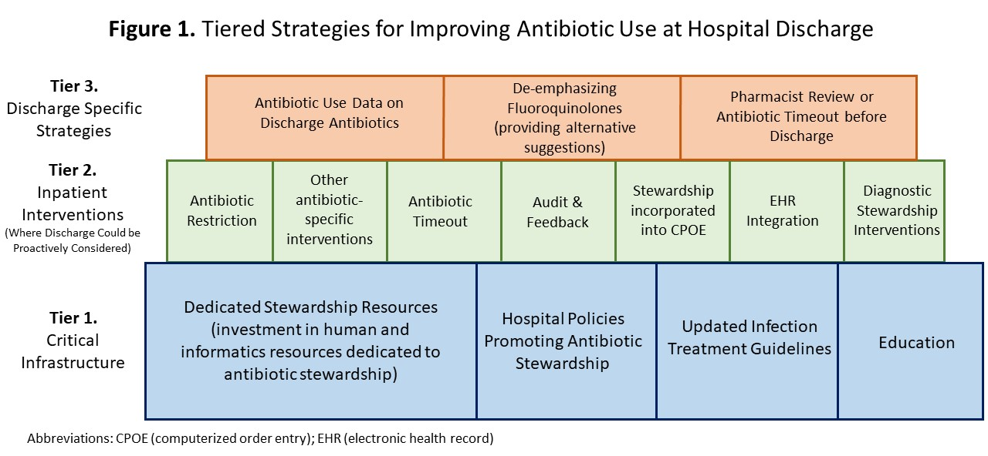
Discharge Antibiotic Stewardship:
The ROAD Home Framework
Listen Here! 2024 Nebraska Antimicrobial Stewardship Summit Session Recording
The Reducing Overuse of Antibiotics at Discharge Home Framework | Clinical Infectious Diseases
Notes:
The ROAD Home Framework includes 3 tiers modeled after successful frameworks to improve healthcare-associated infection. Tier 1 strategies provide critical infrastructure required for stewardship in general. Tier 2 strategies (classified as “action” elements in the CDC’s Core Elements of ASPs) are those that target inpatient prescribing but, based on published studies, can have carryover effects to discharge when thoughtfully designed with care transitions in mind. Finally, tier 3 strategies are discharge-specific strategies. For hospitals seeking to improve antibiotic prescribing at discharge, the ROAD Home Framework can be helpful to identify critical elements that are missing (ie, tier 1 strategies), existing inpatient stewardship interventions that could be designed more thoughtfully with discharge in mind (ie, tier 2 strategies), and to plan specific, stand-alone interventions to improve prescribing at discharge (ie, tier 3 strategies).

Slide 17
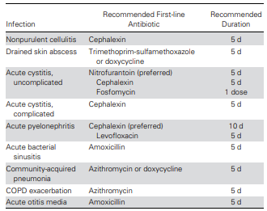
Outpatient Opportunities: Take 5 Campaign
Article Link: Take 5 Campaign
Jenkins, Open Forum Infectious Diseases, September 2025
Notes:
For most outpatient infections where antibiotics may be warranted, evidence suggests that antibiotic durations of ≤5 days are effective. However, in clinical practice, prescribed durations are much longer. For example, in recent large-scale studies, 10-day prescriptions for conditions such as acute sinusitis and acute otitis media were the norm rather than the exception. As such, there is substantial opportunity to reduce antibiotic exposure across ambulatory care settings through prescribing the shortest effective duration of therapy when an antibiotic is indicated. In two urgent cares, a quality improvement intervention to promote use of institutional guideline–recommended 5-day antibiotic durations for common infections—the Take 5 campaign. The objectives of this study were to evaluate the effects of this intervention on prescribed durations of therapy and overall antibiotic exposure.

Slide 18
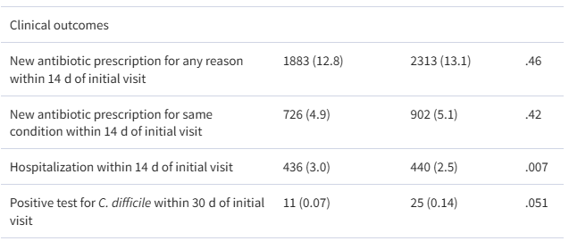
Outpatient Opportunities: Take 5 Campaign
(P < .001)
57%
83%
≤5 days Pre-intervention
≤5 days Post-intervention
Pre-intervention
Post-intervention
Annual Antibiotic-days decreased
Fewer days of therapy
21
6,000
percent
Jenkins, Open Forum Infectious Diseases, September 2025

Slide 19

Myth #1: Longer durations of therapy are safer for our patients
Truth: Shorter durations of therapy are safer. They reduce resistance, adverse drug events, and costs without compromising patient outcomes
Notes:
Antibiotic duration of 7, 14, 21 days are commonly ordered by prescribers despite evidence that many common infections can be treated with shorter courses.
There are several misconceptions that may lead to this prescribing:
Concerns over infection relapse - The relapse myth was prompted by an early pneumonia case series indicating that penicillin durations for pneumonia should continue past symptom resolution due to increased relapses in patients who received short-course therapies. However, a re-evaluation of the data disproved this theory when it determined that patients had new infections with different bacterial serotypes, rather than relapses
Belief that antibiotic resistance can be prevented by treating beyond symptom resolution - Despite studies in pneumonia demonstrating that longer antibiotic courses lead to the emergence of resistance,15,16 patients have long been instructed to finish antibiotic courses to prevent resistance, even if they feel better sooner.
Belief that longer antibiotic courses are more effective - Clinical trials have shown that short-course therapies for a variety of infections are equivalent to longer durations

Slide 20
Myth #2: If a patient has a penicillin allergy, we must avoid all beta-lactam antibiotics

Slide 21
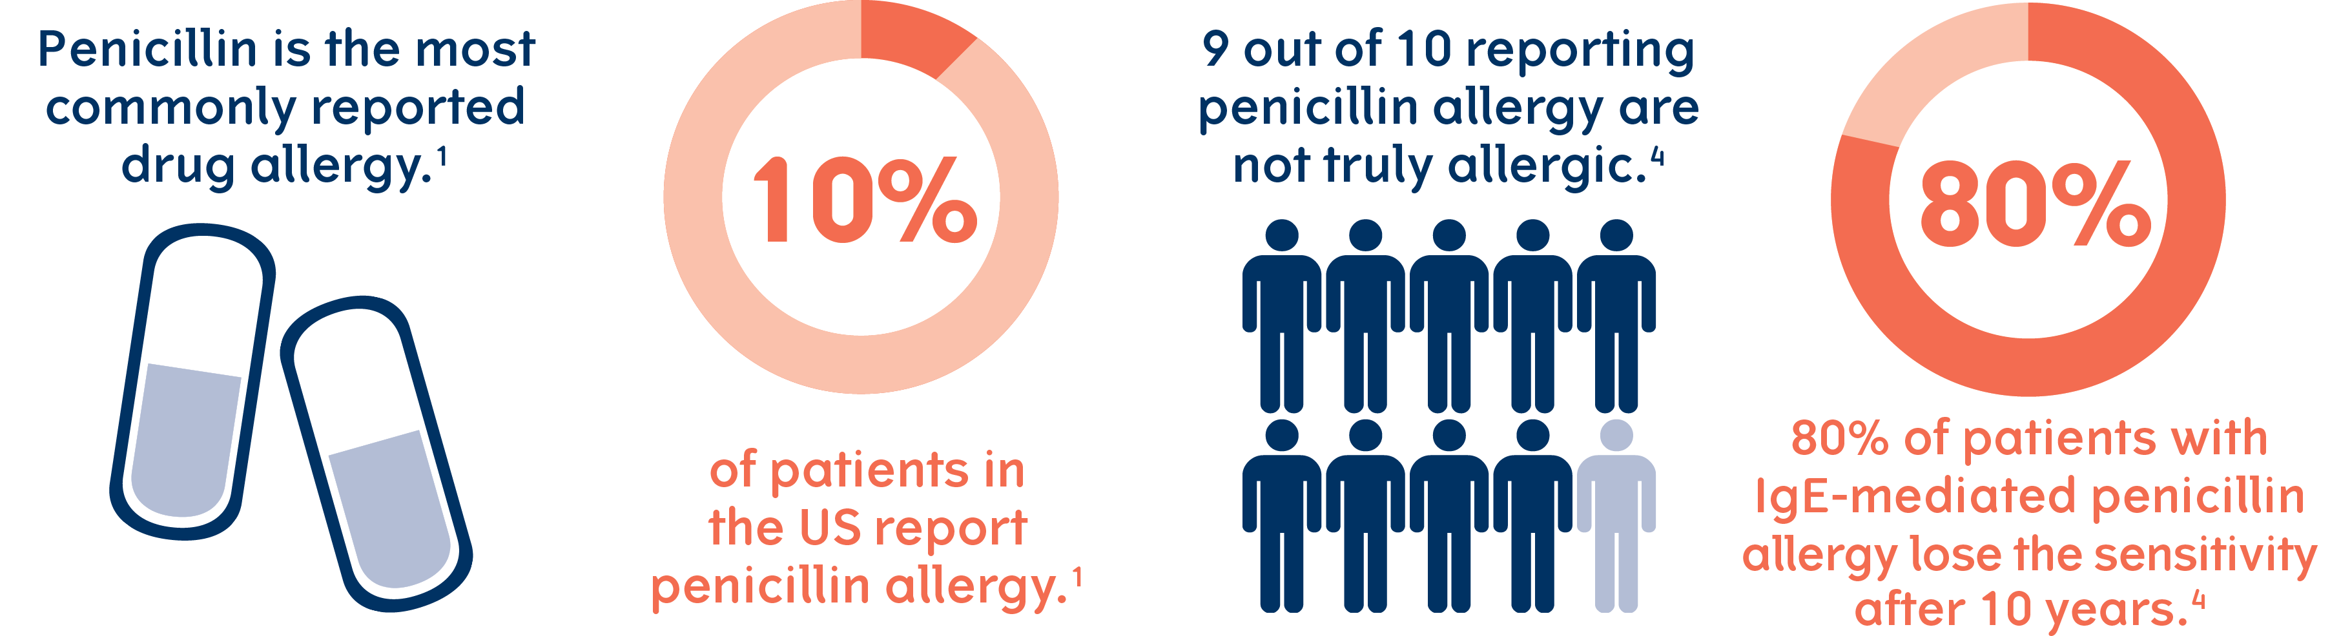
Shenoy, ES, Evaluation and Management of Penicillin Allergy. JAMA, 2019
Joint Task Force on Practice Parameters representing the American Academy of Allergy, Asthma and Immunology; American College of Allergy, Asthma and Immunology; Joint Council of Allergy, Asthma and Immunology. Drug allergy: an updated practice parameter. Ann Allergy Asthma Immunol 2022
Notes:
Penicillin allergy is the most common drug allergy, reported by 10% of hospitalized patients.43 Unfortunately, patients with a history of penicillin allergy, regardless of the reaction type, often receive broader-spectrum antibiotics that may be more toxic and costly.44 Several myths surrounding penicillin allergy exist and warrant discussion. First, the widely quoted cross-reactivity risk of 10% between penicillin and other beta-lactams is a fallacy. These estimates originated from early studies that were conducted when cephalosporins were often contaminated with penicillin through manufacturing processes that have since been optimized. In patients with confirmed immunoglobulin E mediated penicillin allergies, the risk of cross-reaction with cephalosporins and carbapenems is actually quite low. Secondly, 9 out of 10 patients with a history of penicillin allergy are not, in fact, allergic at all.48

Slide 22
Consequences of
Penicillin Allergy Labels
Treatment failure
Adverse Drug Events
2nd line agents have inferior coverage
Clostridioides difficile infection
Increased drug-drug interactions
Medication side effects
Increased all-cause
mortality
Antibiotic Resistance
Surgical Site Infections
More common when alternative antibiotics are chosen
Increased development of Methicillin-Resistant Staphylococcus aureus and Vancomycin-Resistant Enterococcus
Samarakoon U et al. Ann Allergy Asthma Immunol. 2022 Dec 20;S1081- 1206(22)02006-3

Slide 23
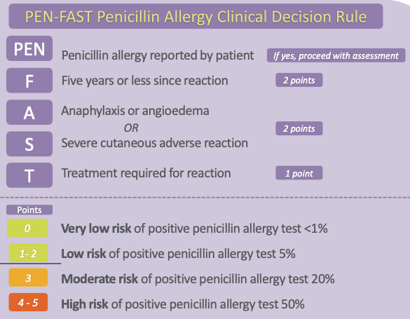
PEN-FAST Tool to Identify Low-Risk Penicillin Allergies
Negative Predictive Value of Score <3: 96.3%
https://www.mdcalc.com/calc/10422/penicillin-allergy-decision-rule-pen-fast
Trubiano JA, Vogrin S, Chua KYL et al. Development and Validation of a Penicillin Allergy Clinical Decision Rule. JAMA Internal Med. JAMA Intern Med 2020;180[5]:745-752
Notes:
Many hospitals have developed and implemented penicillin-allergy de-labeling protocols incorporating allergy history assessment, penicillin skin testing, or direct oral amoxicillin challenges with the safe administration of beta-lactams to patients with a previous penicillin allergy label.49,50 Importantly, patients with a history of delayed reactions (symptoms >2 hours after drug administration) with organ dysfunction (ie, hemolytic anemia, renal/hepatic failure), delayed reactions with severe cutaneous manifestations, or serum sickness are not candidates for de-labeling or re-challenge (Figure 1).51

Slide 24
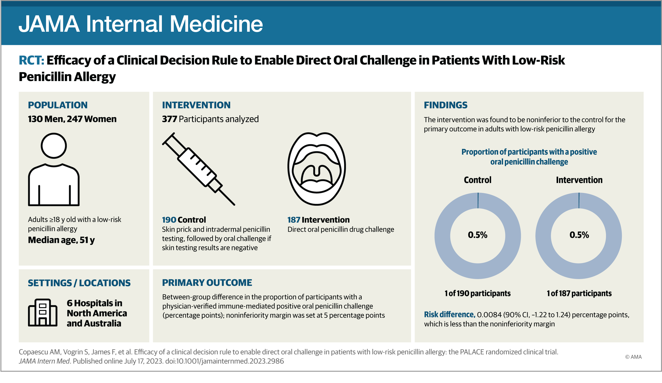
Low risk patients (PEN-FAST <3) can be administered oral penicillin challenge safely
Removes need for specialized allergist assessment

Slide 25
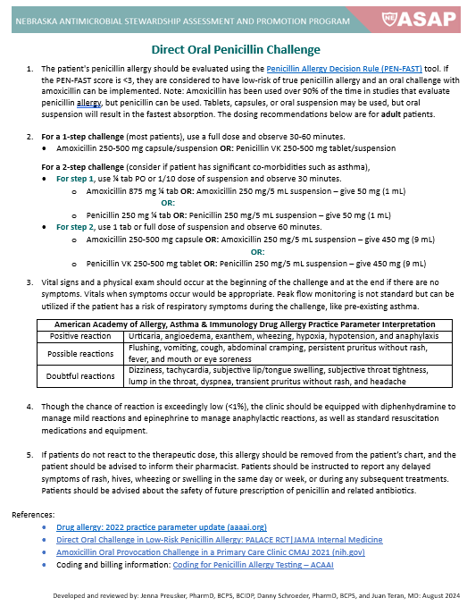
Direct Oral Penicillin Allergy Challenge Protocol – Inpatient & Outpatient

Slide 26

Patients who receive alternative antibiotics for surgical prophylaxis have more surgical site infections
Alternative Agents
n = 348,885 adult surgical patients across 175 hospitals
Compared β-lactam vs non–β-lactam surgical prophylaxis
  Ciprofloxacin: aOR 1.57
  Vancomycin: aOR 1.38
  Clindamycin: aOR 2.12
Key Results
β-lactam: 342,936 patients (98%) → SSI 2.8%
Non–β-lactam: 5,949 patients (2%) → SSI 6.1% (P < .001)
Adjusted OR for SSI: 1.78
  (95% CI, 1.59–1.99)
  Non–β-lactam surgical prophylaxis was linked to nearly 2-fold higher odds of SSI.
β-Lactam vs Non–β-Lactam Antimicrobial Prophylaxis and Surgical Site Infection | JAMA

Slide 27
Patients who receive alternative antibiotics for surgical prophylaxis have more surgical site infections
  8,385 patients undergoing 9,004 procedures (hip/knee arthroplasty, hysterectomy, colon surgery, CABG)
  Compared those with vs. without reported PCN allergy
  Primary outcome: SSI (CDC/NHSN definition)
  Antibiotic use with vs. without reported PCN allergy :
Cefazolin: 12% vs 92%
Second-line antibiotics used: Clindamycin, Vancomycin, Gentamicin
Key Results
Reported PCN allergy → 50% ↑ SSI risk which was fully explained by suboptimal perioperative prophylaxis
Preoperative allergy clarification/testing can improve outcomes and reduce SSIs
11% reported PCN allergy
SSI occurred in 2.7% overall
Adjusted odds of SSI: 1.51 (95% CI 1.02–2.22) with reported PCN allergy
NNT: 112–124 allergy evals to prevent 1 SSI
The Impact of a Reported Penicillin Allergy on Surgical Site Infection Risk - PubMed

Slide 28
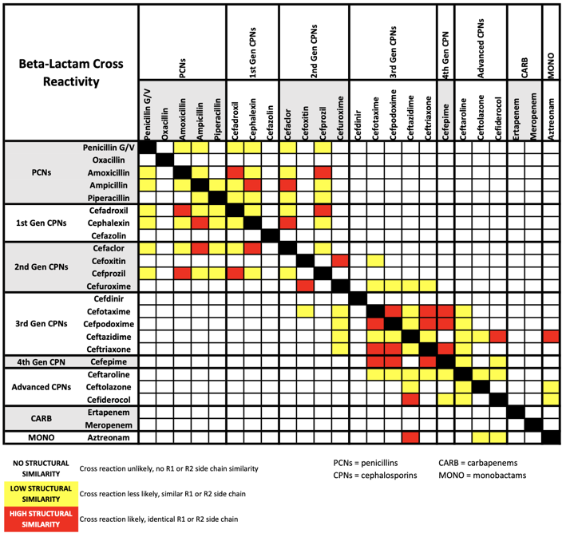
Beta-Lactam Cross Reactivity
Link to chart: UNMC betalactam_crossreactivity

Slide 29
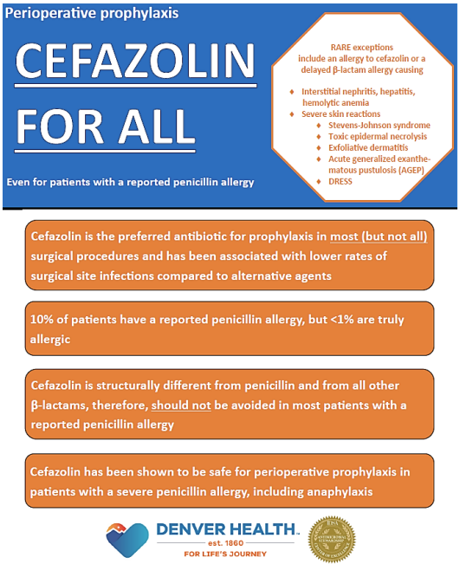
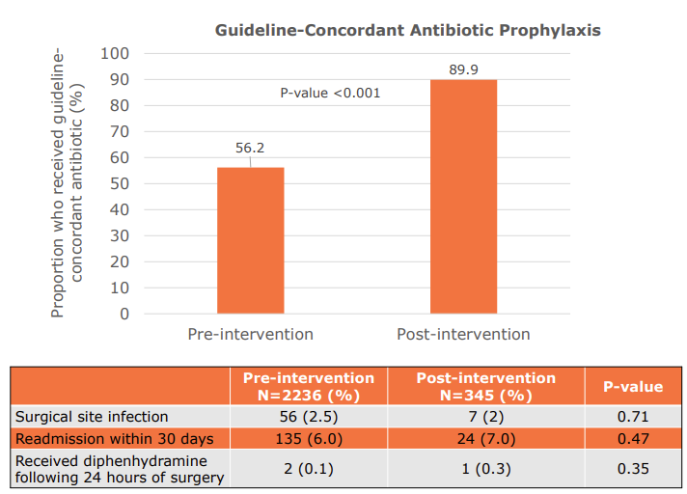
Cefazolin for all Campaigns
Data presented as abstract at ID Week 2025
Shihadeh, K. et al.

Slide 30
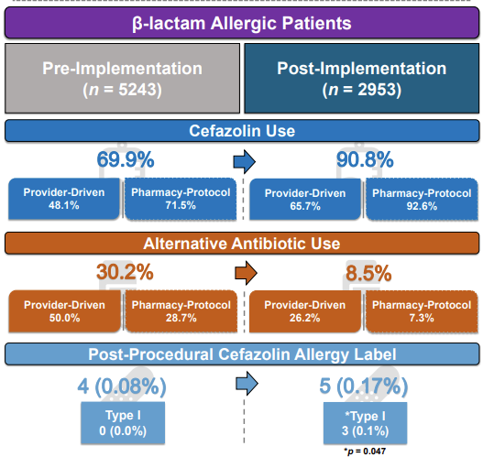
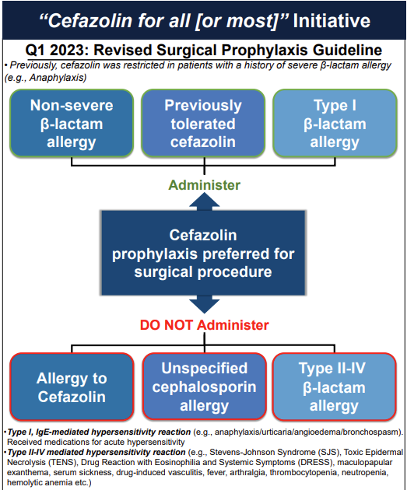
Cefazolin for all Campaigns
Data presented as abstract at ID Week 2025
Orlikowski, C. et al.

Slide 31
Opportunities for Quality Improvement
Increasing Pre-Operative Cefazolin Use
Audit your baseline
  Review past 6 months of surgeries
  Determine % receiving cefazolin vs. alternatives
  Note which had a “penicillin allergy” label
Clarify allergy history pre-op
  Use PEN-FAST at pre-operative assessment appointment
Update order sets
  Evaluate EHR allergy alerts
  Consider a pharmacy-driven protocol
Measure & feedback
  Track % of surgical cases receiving cefazolin
  Share data with OR, anesthesia, and infection prevention teams quarterly
  Set goal: Increase cefazolin use by 10% in 6 months
Celebrate success
  Highlight improved SSI outcomes and reduced clindamycin and vancomycin use

Slide 32
Myth #2: If a patient has a penicillin allergy, we must avoid all beta-lactam antibiotics
Truth: Clarifying and de-labeling penicillin allergies provide better patient outcomes

Slide 33
Myth #3: More tests mean better treatment

Slide 34
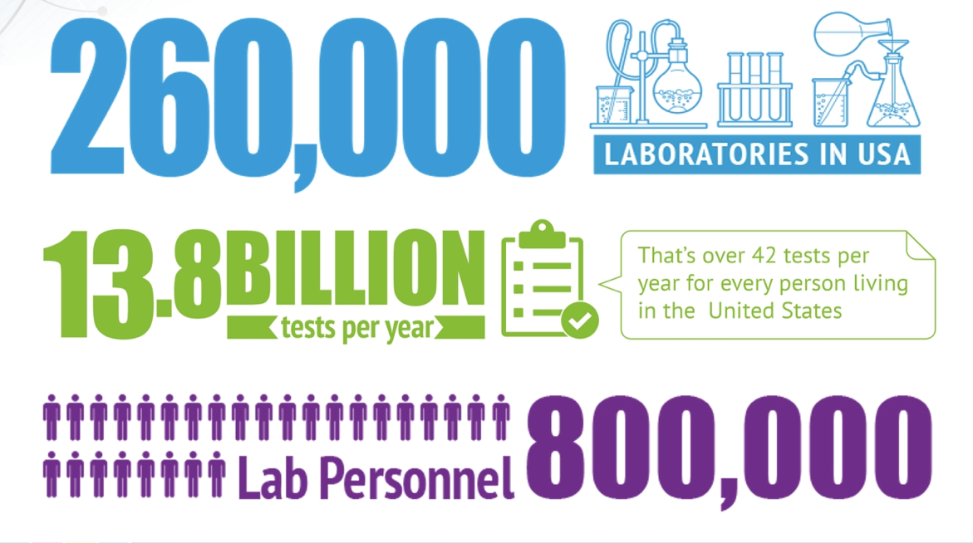
Areas of focus:
ESR
CRP
PCT
Blood & Urine cultures
Cornish, CDC
ECCMID 2019

Slide 35
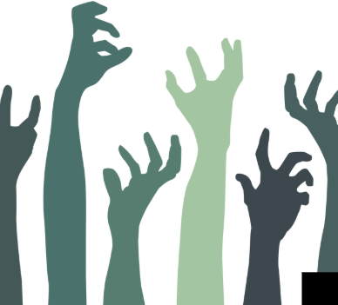
ESR
CRP
CRP (C-reactive protein) is a protein made by the liver in response to inflammation
Reflects systemic inflammation and tissue injury
Has a short half life, so rises and falls quickly
ESR and CRP
ESR (Erythrocyte sedimentation rate) measures how quickly red blood cells settle in a test tube over a specified period
During inflammation, the liver produces more fibrinogen, CRP, and immunoglobulins
These coat red blood cells and allow them to aggregate and settle more rapidly, producing a higher ESR value
The rise represents systemic inflammation
Despite their limited utility in guiding diagnosis or treatment decisions, they continue to be ordered frequently — refusing to "die"
ESR and CRP: Zombie Tests?
Notes:
ESR (Erythrocyte sedimentation rate) measures how quickly red blood cells settle in a test tube over a specified period
During inflammation, the liver produces more fibrinogen, CRP, and immunoglobulins
These coat red blood cells and allow them to aggregate and settle more rapidly, producing a higher ESR value
The rise represents systemic inflammation
CRP (C-reactive protein) is a protein made by the liver in response to inflammation
Reflects systemic inflammation and tissue injury
Has a short half life, so rises and falls quickly
ESR and CRP are sometimes called "zombie tests" in infectious disease management because, despite their limited utility in guiding diagnosis or treatment decisions, they continue to be ordered frequently — refusing to "die"

Slide 36
ESR and CRP – PRO vs CON
Generally inexpensive | Non-specific – elevated in a wide range of conditions
Test results available quickly | Delayed response
Reassuring when concordant with clinical impression | Remain high long after infections resolve
Can be used to trend inflammation over time | Individual patient variability – age, underlying health conditions, medications
Can prompt further diagnostic evaluation outside of bacterial infection | Excess cost, diagnostic errors, lab personnel time
Spellberg B et al., Revisiting diagnostics: erythrocyte sedimentation rate and C-reactive protein: it is time to stop the zombie tests, Clinical Microbiology and Infection
Notes:
PRO
The ubiquity of ESR and CRP testing reflects the simple fact that the tests are generally inexpensive, easy to order, and result fairly quickly, combined with the psychological fear of diagnostic uncertainty.
When confronted by a confusing therapeutic dilemma, a simple test result that is concordant with our clinical impression is reassuring and helps us feel as though the world makes sense. Thus, the simplicity of the ESR and CRP may create a false perception among clinicians that ordering these tests does little harm.
CON
Non-Specificity: ESR and CRP levels can be elevated in a wide range of conditions, not exclusively due to bacterial infections. Conditions such as viral infections, autoimmune diseases, and even trauma
Delayed Response: In some infections, particularly those caused by fastidious organisms or in immunocompromised patients, ESR and CRP may not rise promptly or significantly, potentially delaying appropriate antibiotic treatment and impacting patient outcomes.
Remain high long after an infection has resolved, leading to confusion, unnecessary follow-up testing, and/or prolonged antibiotic use.
Individual Variability: Patient factors such as age, underlying health conditions, and medications can affect ESR and CRP levels, complicating their interpretation in clinical settings.
Truthfully, clinicians underestimate the collective harm in terms of excess cost, diagnostic errors, laboratory personnel time, and inappropriate antibiotic use that result from millions of unnecessary and unhelpful tests.
With such poor test accuracy, lack of a unified definition of a cut-off, redundancy with other clinical information, lack of a reference standard, and failure to demonstrate clinical impact, these tests are presently of no benefit when diagnosing or managing infections in most situations.

Slide 37
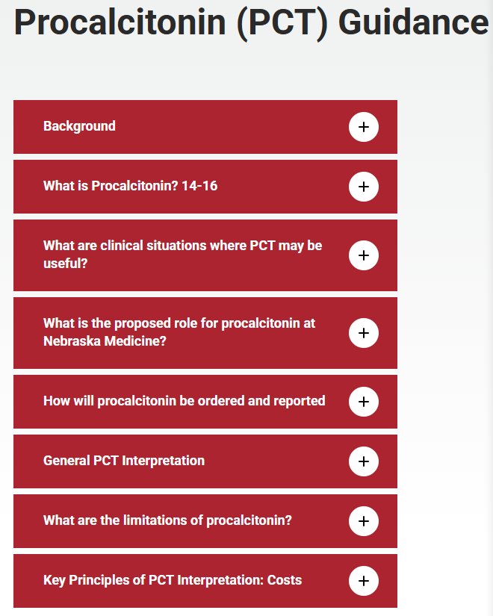
Procalcitonin
PCT: blood biomarker that rises rapidly in bacterial infections
  More sensitive and specific than CRP or lactate for distinguishing bacterial from non-bacterial causes of inflammation
PCT levels guide antibiotic therapy, primarily helping clinicians assess when to stop antibiotics, especially for respiratory and sepsis syndromes
Procalcitonin (PCT) Guidance | Department of Internal Medicine | University of Nebraska Medical Center
Notes:
PCT levels may not rise with localized infections (osteomyelitis, localized abscess, etc.) and a negative PCT should not be considered to rule out a localized infection.
Its biomarker profile—rapid rise in bacterial infections with fast decline as infection resolves—enables targeted de-escalation or discontinuation of antibiotics, with strong negative predictive value

Slide 38
Procalcitonin – PROS vs CONS
Very good negative predictive value for bacterial co-infection in viral respiratory infections (98% for PCT ≤0.1 ng/mL) | Use of PCT must be combined with clinical judgment, not as a sole decision-maker. Delayed elevation in early infection may miss or underdiagnose sepsis, especially if antibiotics are needed urgently​
Algorithms recommend discontinuing antibiotics when PCT falls below 0.5 ng/mL or by >80% from peak | Procalcitonin is not recommended for all septic or complex medical patients; utility is largely limited to respiratory infections, with unclear benefit outside these groups
Procalcitonin result is associated with use of 25% fewer antibiotics and an overall mortality benefit | False positives can occur due to non-bacterial causes (e.g., major surgery, trauma, burns, systemic inflammation), risking unnecessary changes in management
Savings from reduced antibiotic use complications can outweigh cost | Testing is too expensive if results are not used!
Empiric Antibacterial Therapy and Community-onset Bacterial Coinfection in Patients Hospitalized With Coronavirus Disease 2019 (COVID-19)| Clinical Infectious Diseases
Procalcitonin do's and don'ts | ACP Hospitalist
Notes:
PROS
Very good negative predictive value for bacterial co-infection in viral respiratory infections (98% for PCT ≤0.1 ng/mL)
Algorithms recommend discontinuing antibiotics when PCT falls below 0.5 ng/mL or by >80% from peak
Procalcitonin result is associated with use of 25% fewer antibiotics and an overall mortality benefit
CONS
Use of PCT must be combined with clinical judgment, not as a sole decision-maker.
Delayed elevation in early infection may miss or underdiagnose sepsis, especially if antibiotics are needed urgently.​
Procalcitonin is not recommended for all septic or complex medical patients; utility is largely limited to respiratory infections, with unclear benefit outside these groups.​
False positives can occur due to non-bacterial causes (e.g., major surgery, trauma, burns, systemic inflammation), risking unnecessary changes in management.​
Testing is expensive—direct costs double that of CRP
Overuse without clear impact on clinical decision-making leads to wasted resources; reimbursement from payers may not fully cover costs.​
May not impact overall outcomes (mortality, readmission) if used indiscriminately or for patient groups not covered by evidence-based guidelines.​

Slide 39
Blood Culture Stewardship
Judicious BCx use is important due to the unintended consequences of contaminated BCx:
Unnecessary antibiotic use (e.g., primarily vancomycin with associated acute kidney injury and drug allergy)
Further unneeded testing (more BCx, echocardiography, therapeutic drug monitoring, further cultures or susceptibility testing) with associated costs
Unwarranted central venous catheter removal
Cancellation of surgical procedures
Unnecessary consultations (e.g., infectious diseases)
Increased hospital length of stay
Iatrogenic anemia and increased need for blood products
Diagnostic delays due to anchoring bias on blood culture contaminants as cause of symptoms
National Healthcare Safety Network-defined central line associated bloodstream infection (CLABSI), despite not being a true bloodstream infection
Link: UNMC asp_blood_culture_utilization_guidance_final.pdf

Slide 40
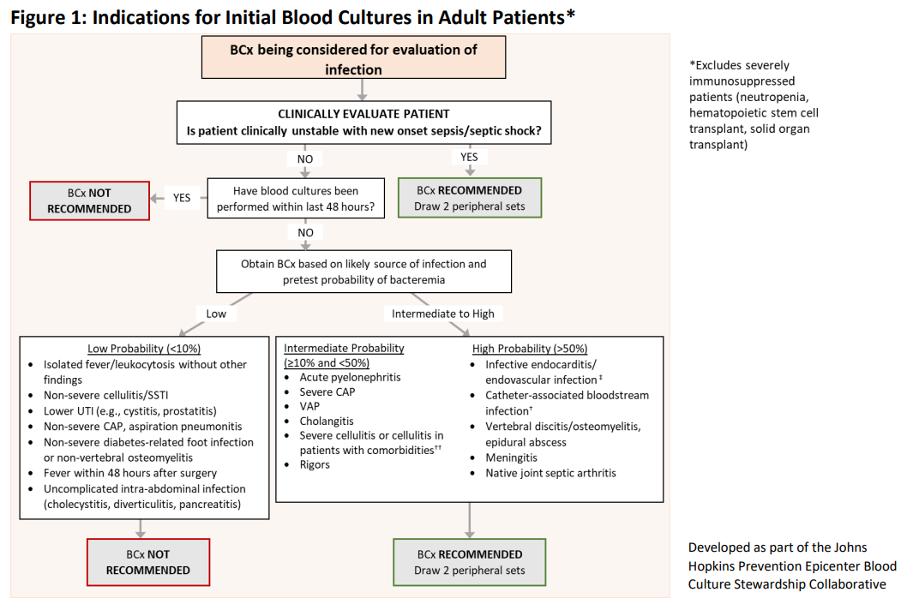
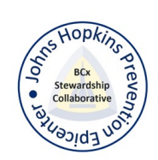
Notes:
Certain situations have a very likelihood of positive blood cultures (<10%), though blood cultures are routinely ordered

Slide 41
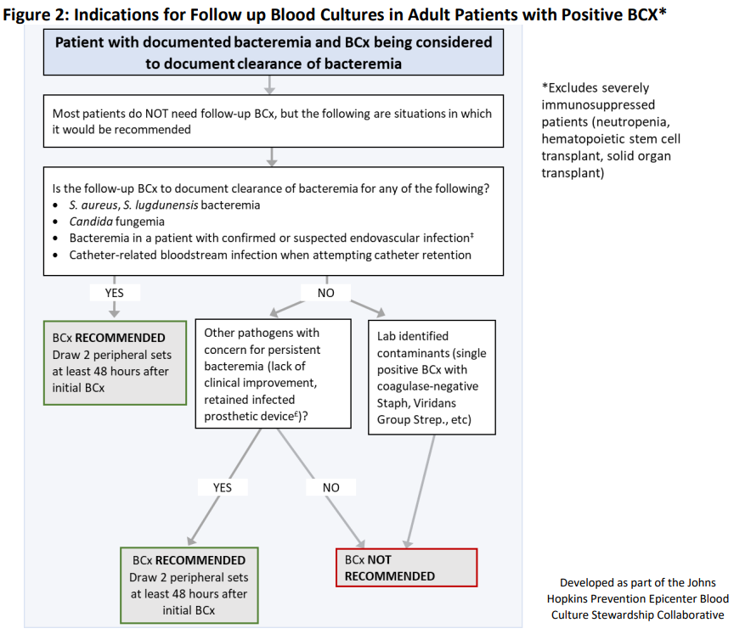

Slide 42
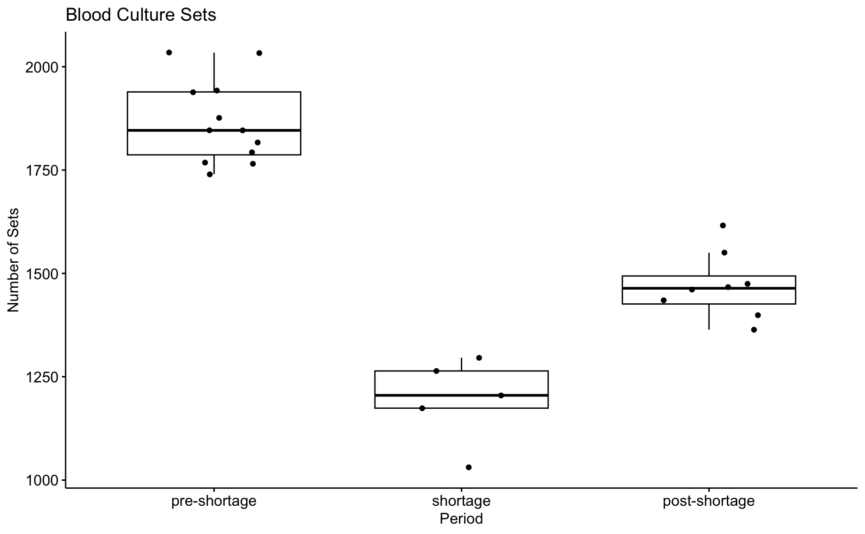

Nebraska Medicine Study – Blood culture bottle shortage
p=0.0006
p=0.0044
p=0.0096
Timeline
SBAR sent to provider notifying of shortage
EMR interruptive alert
EMR soft stop on repeat BCx within 48 hours
EMR alert removed once shortage over
1846
1464
1205
Pre-shortage 7/2023-6/2024
Shortage 7/2024-11/2024
Post-shortage 12/2024-7/2025
Kusnik, N., et al. Results presented at IDWeek 2025
Notes:
Total blood culture draws decreased significantly during the shortage period, from 1846 pre-shortage to 1205 during the shortage, then rebounding to 1464 post-shortage. All comparisons were statistically significant.

Slide 43
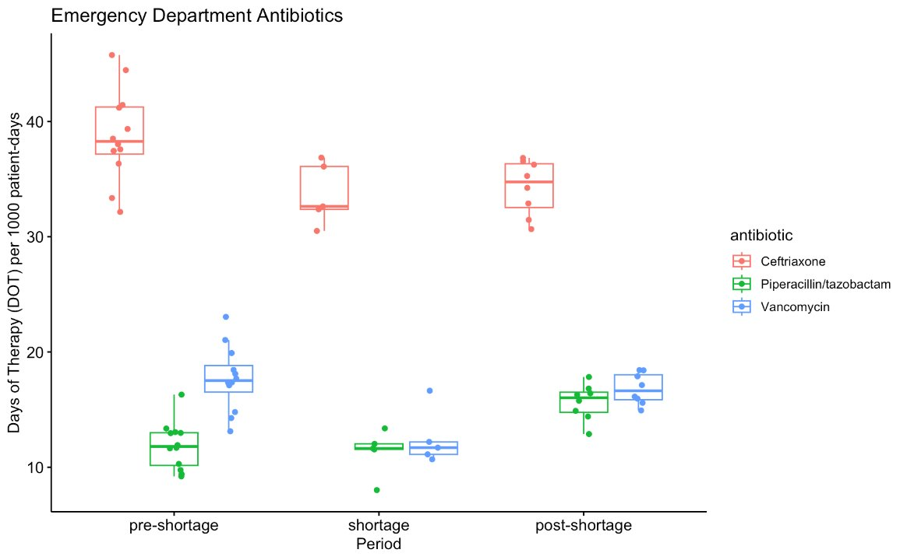
Results
Group | Pre-shortage (12 months) | Shortage (5 months) | Post-shortage (8 months) | P-value
SEP-1 failure rate, median % | 0.54 | 0.44 | 0.56 | 0.3201
Mean Length of Stay, days, median | 7.01 | 6.71 | 6.96 | 0.0206
Mortality rate, median % | 3.50 | 3.75 | 3.71 | 0.8573
Contamination Rates, % | 1.96 | 1.66 | 1.69 | 0.0791
ED Vancomycin usage also decreased!
p=0.0122
p=0.0502
Kusnik, N., et al. Results presented at IDWeek 2025
Notes:
SEP-1 failure rates remained stable across all periods. Mean length of stay decreased slightly during the shortage (7.01 to 6.71 days), with a modest increase post-shortage (6.96), and this was statistically significant (p=0.0206). Mortality rates remained unchanged.

Slide 44
Urine Culture Stewardship -
Asymptomatic Bacteriuria
Reasons for treatment
Overcautiousness/Risk Perceptions Overworked
Institutional culture/Social norms
Survey of 551 primary care clinicians in 2022: 71% would prescribe antibiotics without a clear symptom indication if cultures grew bacteria
Survey of 95 Hospital resident physicians - Only 33% could differentiate ASB from true infection - After correct identification, 50% still prescribed antibiotics
Clinical inertia – if started in the ED, continued for at least 3 days
Longer hospitalization
Development of CDI
Trautner BW, Petersen NJ, Hysong SJ, Horwitz D, Kelly PA, Naik AD. Overtreatment of asymptomatic bacteriuria: identifying provider barriers to evidence-based care. Am J Infect Control. 2014;42(6):653–658.
Baghdadi JD, Korenstein D, Pineles L, et al. Exploration of primary care clinician attitudes and cognitive characteristics associated with prescribing antibiotics for asymptomatic bacteriuria. JAMA Netw Open. 2022;5(5):e2214268.
Lee MJ, Kim M, Kim NH, et al. Why is asymptomatic bacteriuria overtreated?: a tertiary care institutional survey of resident physicians. BMC Infect Dis. 2015;15:289.
Eyer MM, Läng M, Aujesky D, Marschall J. Overtreatment of asymptomatic bacteriuria: a qualitative study. J Hosp Infect. 2016;93(3):297–303.
Notes:
Additional surveys have highlighted overcautiousness or risk perceptions, institutional culture and social norms, and being overworked as associated with overtreatment. Amongst primary care clinicians, 71% indicated that they would prescribe antimicrobial therapy in the setting of ASB without a clear indication. Additionally, a survey of hospital resident physicians found that only 33% were able to differentiate ASB from true infection and, importantly, after correct identification of ASB, approximately 50% reported still prescribing antimicrobial therapy despite no clear indication Clinical inertia often leads to continuation of antimicrobial therapy in the setting of ASB. In one study, once antimicrobials were started, they often continued into patients’ hospital stay for at least 3 days; this was associated with longer hospitalization and development of CDI. Thus, time and time again it has been shown that inappropriate antimicrobial prescribing frequently stems from inappropriate urine culturing.

Slide 45
Urine Culture Ordering
Recognize and Document Signs and Symptoms
Remove urinalysis from standardized order sets
Cancel repeat urine culture orders
Engage bedside nursing staff

Slide 46
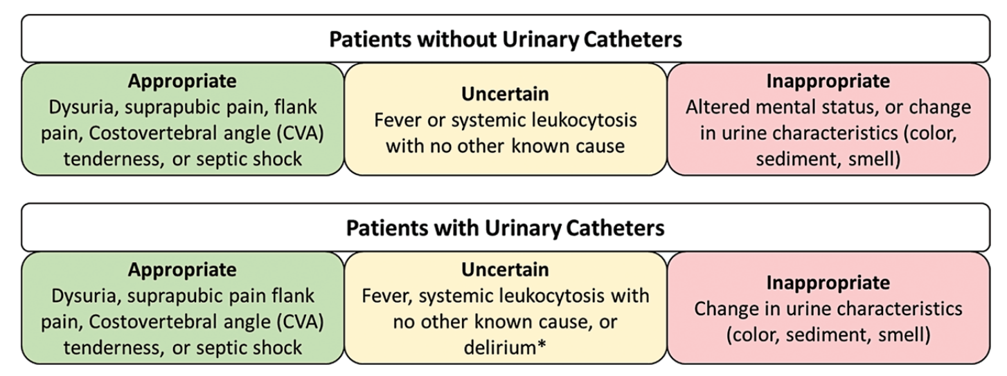
Recognize and DOCUMENT urinary tract infection signs and symptoms
*Delirium as defined by validated tool such as the Confusion Assessment Method. Urinary catheter broadly defined to include both internal and external catheter use.
Claeys KC, Trautner BW, Leekha S, et al. Optimal urine culture diagnostic stewardship practice- results from an expert modified-Delphi procedure. Clin Infect Dis 2021; 75(3):382–389. doi:10.1093/cid/ciab987
Notes:
Appropriate practice for ordering a urine culture starts with recognition and documentation of signs and symptoms of a urinary traction infection.

Slide 47
Remove UA/Urine Culture Orders From Standard Clinical Order Sets
Emergency department evaluation
Hospital admission
Inpatient pre-op
Assessment of altered mental status
Assessment of falls in long-term care
Claeys KC, Trautner BW, Leekha S, et al. Optimal urine culture diagnostic stewardship practice- results from an expert modified-Delphi procedure. Clin Infect Dis 2021; 75(3):382–389.

Slide 48
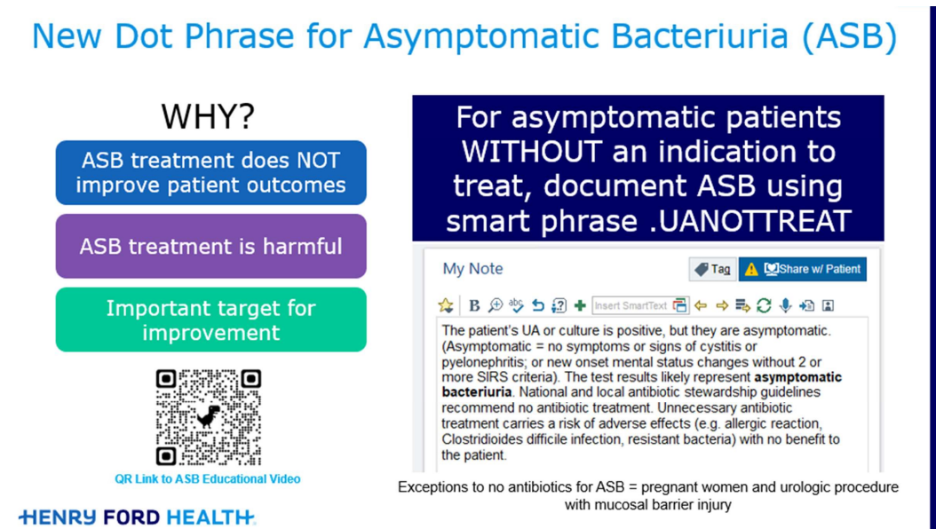
Provider Documentation of ASB
Slide presented at SHEA Spring Conference, 2023

Slide 49
Myth #3: More tests mean better treatment
Truth: Appropriate diagnostic testing ensures timely, accurate care while minimizing unnecessary costs, treatments, and patient harm

Slide 50
Cross-Cutting Quality Improvement Strategies for Smarter Antibiotic Use
Take Home Points
Build Stewardship into Daily Workflow
Strengthen Diagnostic Stewardship – Test with Purpose
Audit, Measure, & Feedback
Engage & Educate the Team
Create a Culture of “Pause and Reflect”
Quality improvement and stewardship share the same goal —
the right antibiotic, for the right patient, for the right duration, every time.
Notes:
Build stewardship – Daily review of antibiotic therapy by the team
Use EHR prompts & local antibiogram links
Create short-course, narrow-spectrum order sets
Strengthen Diagnostics - Combine lab results + clinical picture
Monitor unnecessary testing trends
Audit, Measure, Feedback - Track DOT, broad-spectrum use, IV-to-PO conversions
Share performance dashboards by unit/clinic
Recognize improvement teams regularly
Engage and Educate: Deliver myth-busting education with local cases
Empower nurses & pharmacists to question orders
Review cases together for learning, not blame
Pause and Reflect - Ask: “Does this patient truly need an antibiotic today?”
Normalize diagnostic uncertainty discussions
Frame stewardship as patient safety, not restriction

Slide 51
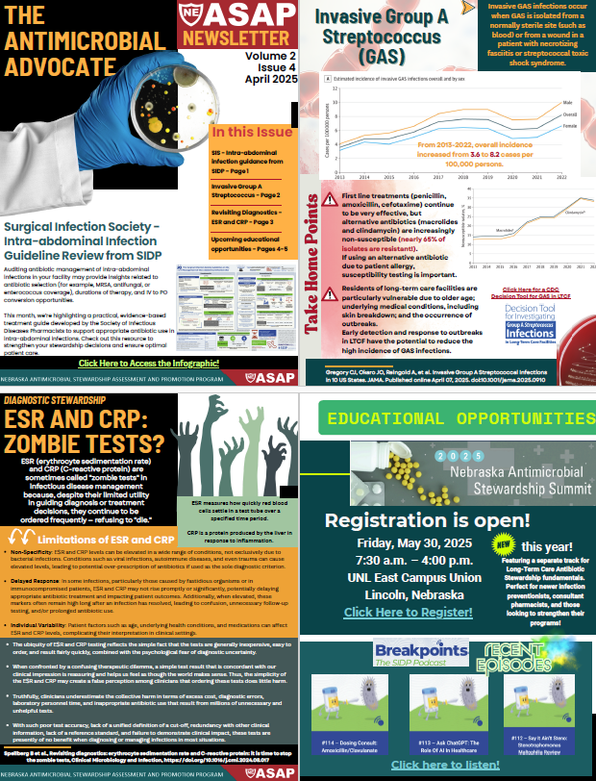


Nebraska ASAP Newsletter:
The Antimicrobial Advocate
Click Here to Subscribe!

Slide 52
Thank you!
jepreusker@nebraskamed.com

