Slide 1

Achieving High Community HPV Vaccination Rates
CAH/RHC Quality Conference
November 13, 2025
Bob Rauner, MD, MPH

Slide 2

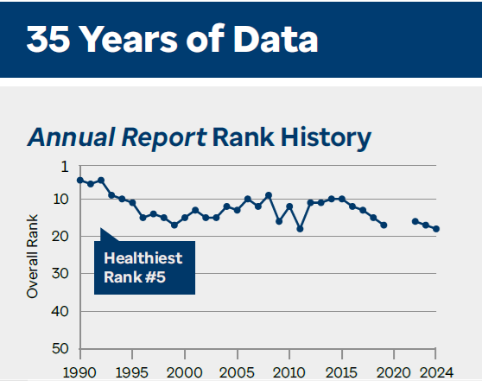
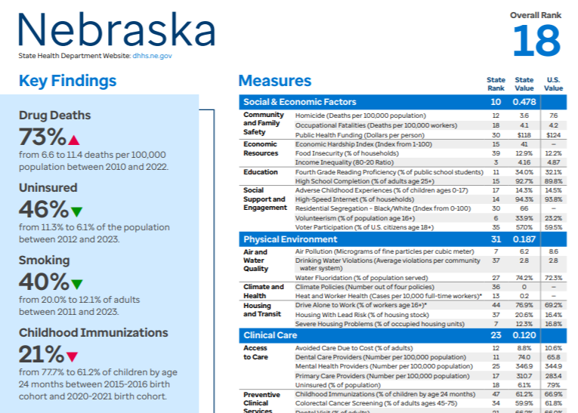
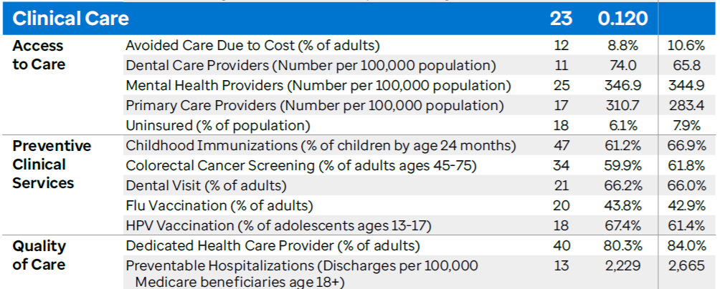

Slide 3
https://healthynebraska.org/what-we-do/align-nebraska-project.html

Slide 5
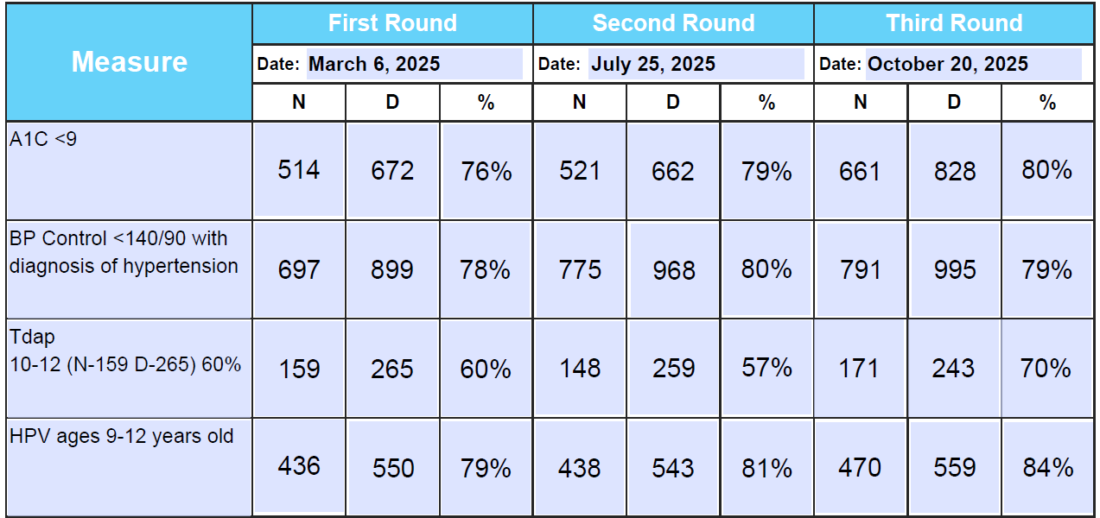

Slide 6
40% by Age 12, Better Than 90th Percentile US Average

Slide 7
WHY?

Slide 8
5 Whys
It’s the Best Care for Our Patients
Doing It Together Improves the Health of Our Community
You Get Style Points If You’re the Best!
You Can Get Paid Better on ACO Contracts (and Reduce Risk)
30 Hours CME/Part IV MOC
Notes:
Why participate in this project?

Slide 9
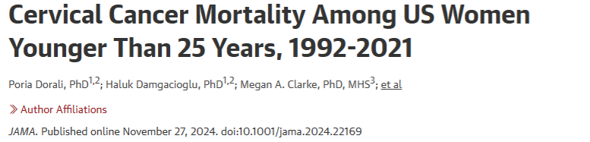
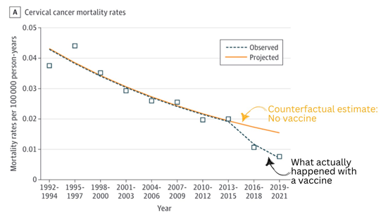
https://jamanetwork.com/journals/jama/article-abstract/2827212?utm_source=substack&utm_medium=email

Slide 10
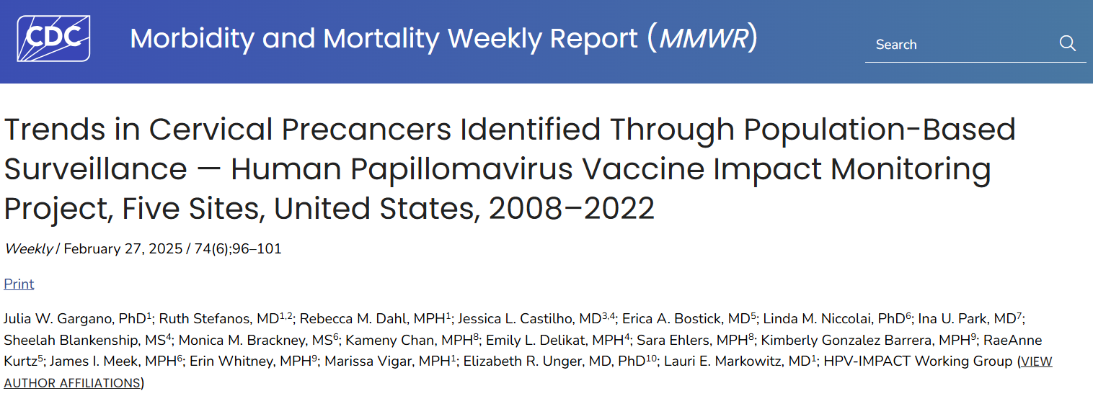
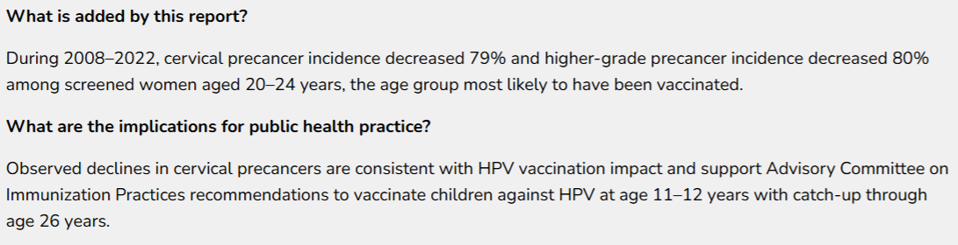

Slide 11
Lessons Learned From the Clinics & ACOs Who Do It Best

Slide 13
6 Habits of Highly Effective Clinics
Physician engagement drives patient and practice team engagement.
Co-located (rather than centrally housed) care management greatly improved practices’ ability to share information and coordinate team-based care.
Offloading routine tasks (e.g., medication refills, gap closures) from the primary care physician workstream frees them to focus on patient needs and championing team-based care.
- Physicians lead, staff does.

Slide 14
6 Habits of Highly Effective Clinics
Availability and responsiveness to patient needs as well as patient awareness of the availability mattered more than extended hours.
Integrating performance reporting into regular team huddles or communication drives accountability for performance. Sharing provider-level performance regularly also motivated improvement among individual providers.
High-performing practices had a method for identifying patients who would benefit from interventions.

Slide 15
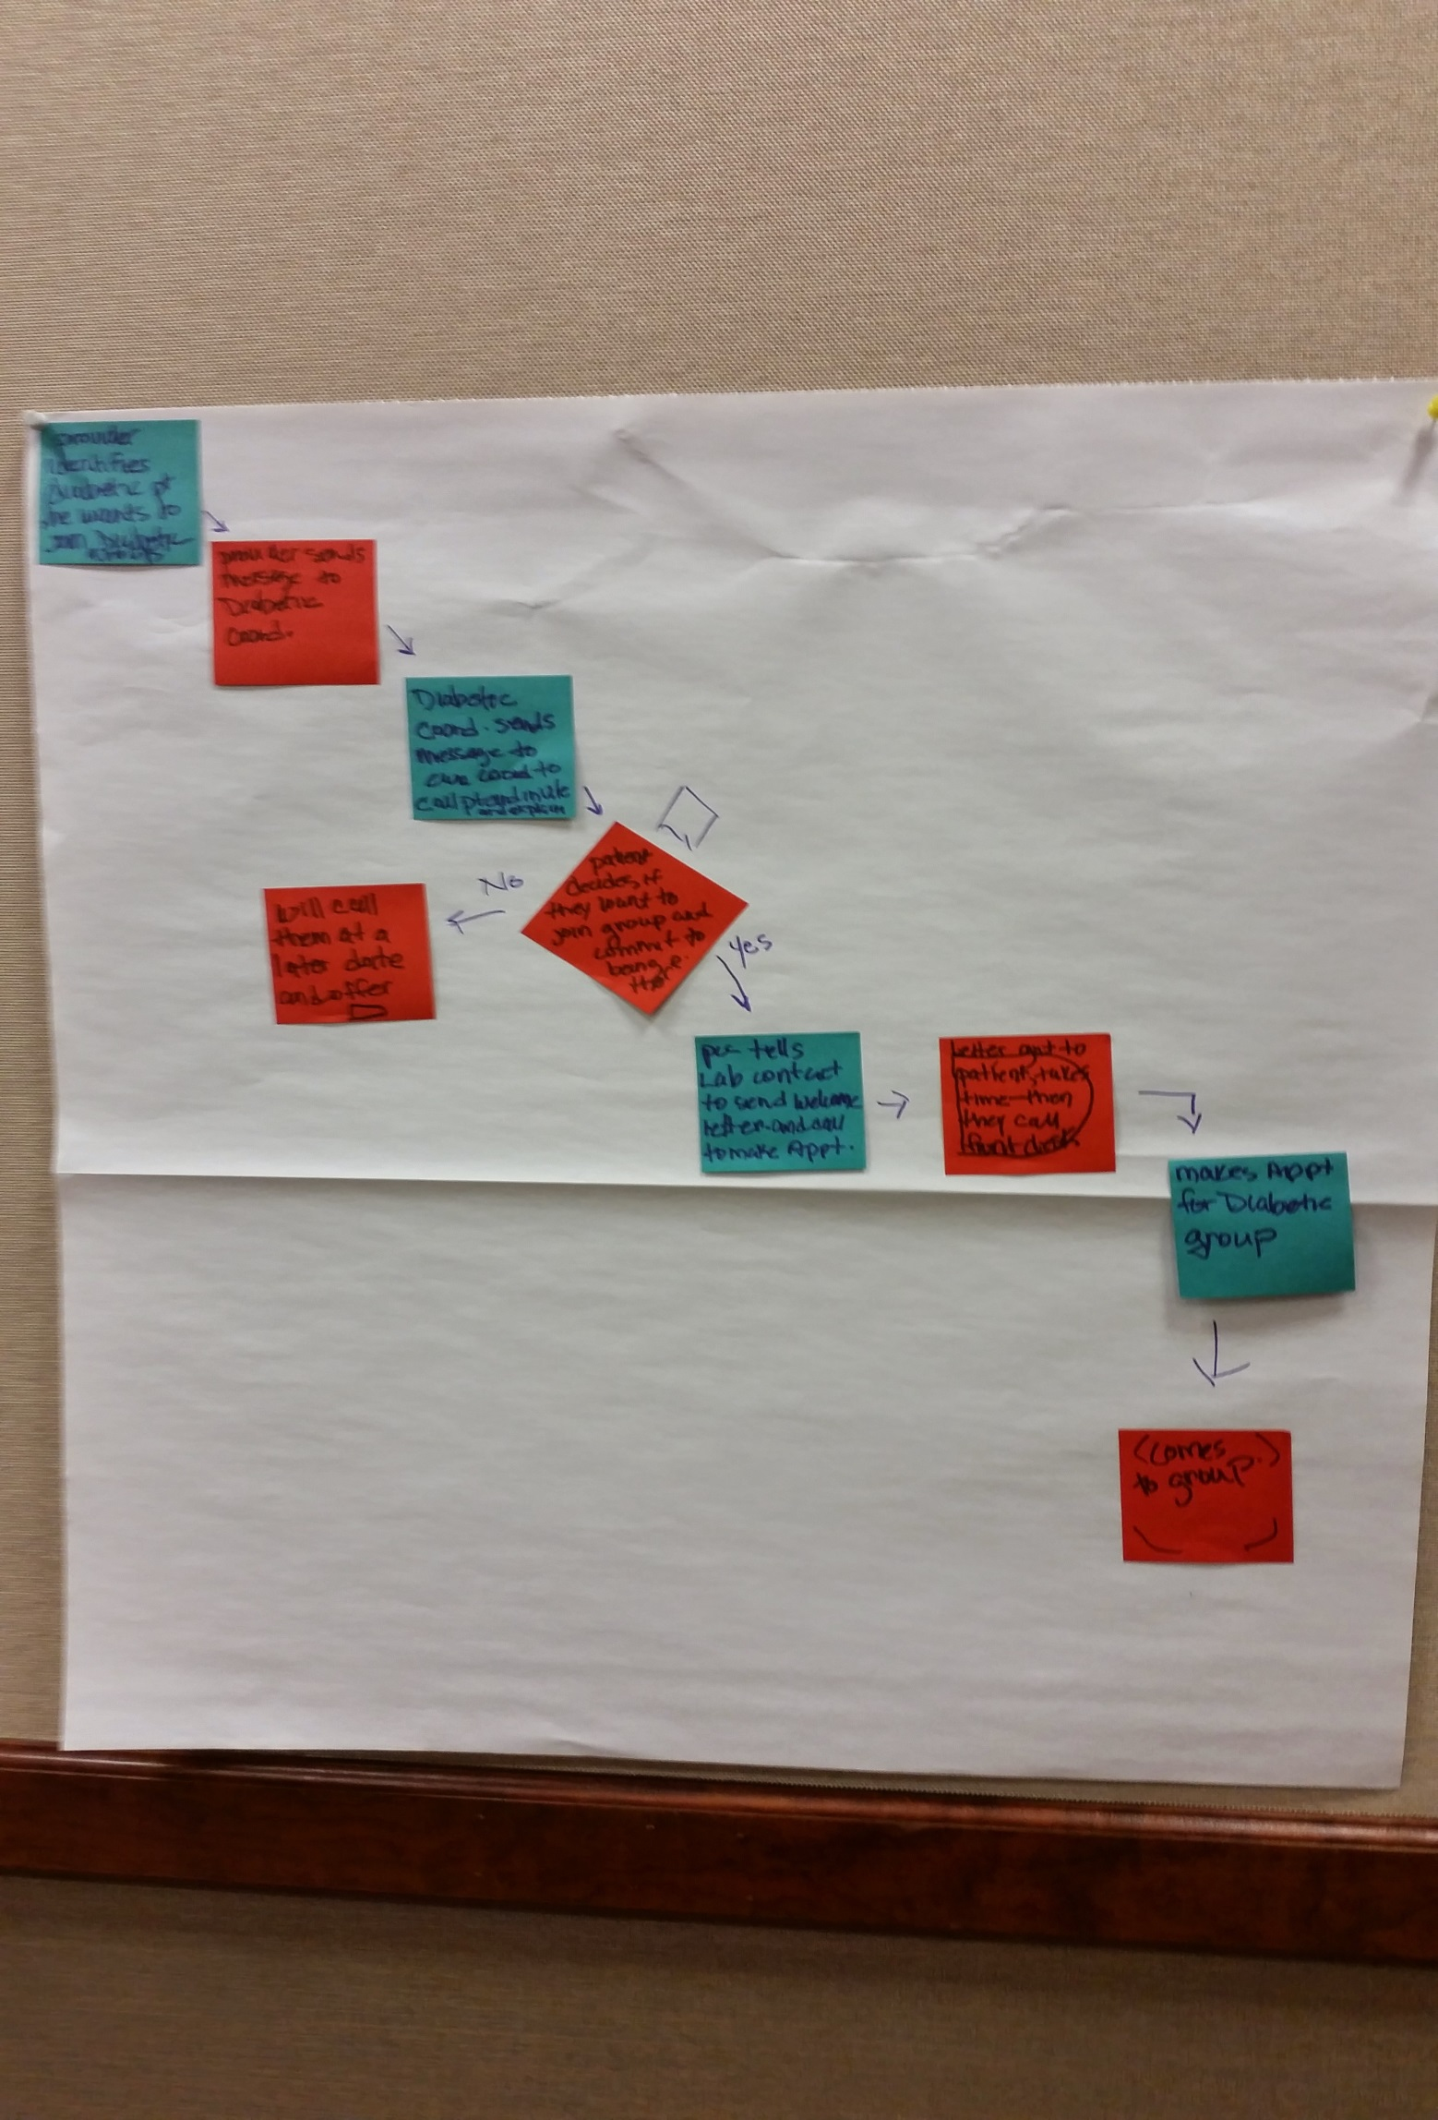

Slide 16
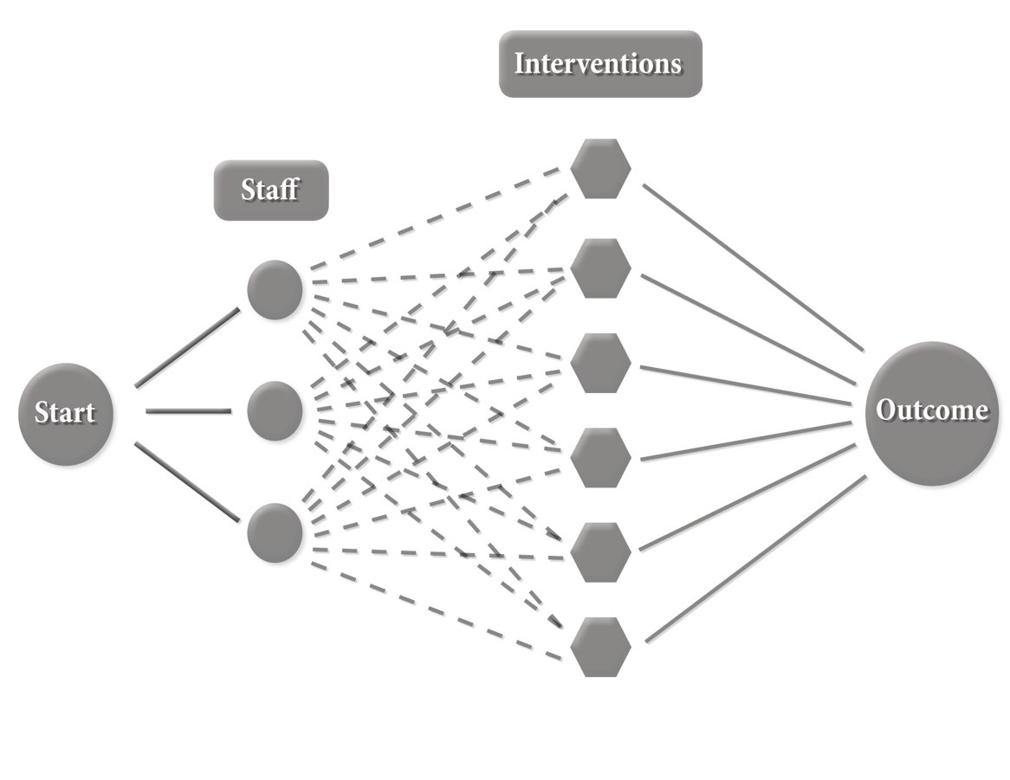

Slide 17
Possible Interventions
Reminder systems (EHR alerts, patient reminders).
Recall lists of overdue patients, who follows up on the “gaps in care”? (Work flow?)
Training MA/LPN/RN staff to correctly measure blood pressure and train patients on home blood pressure monitoring.

Slide 18
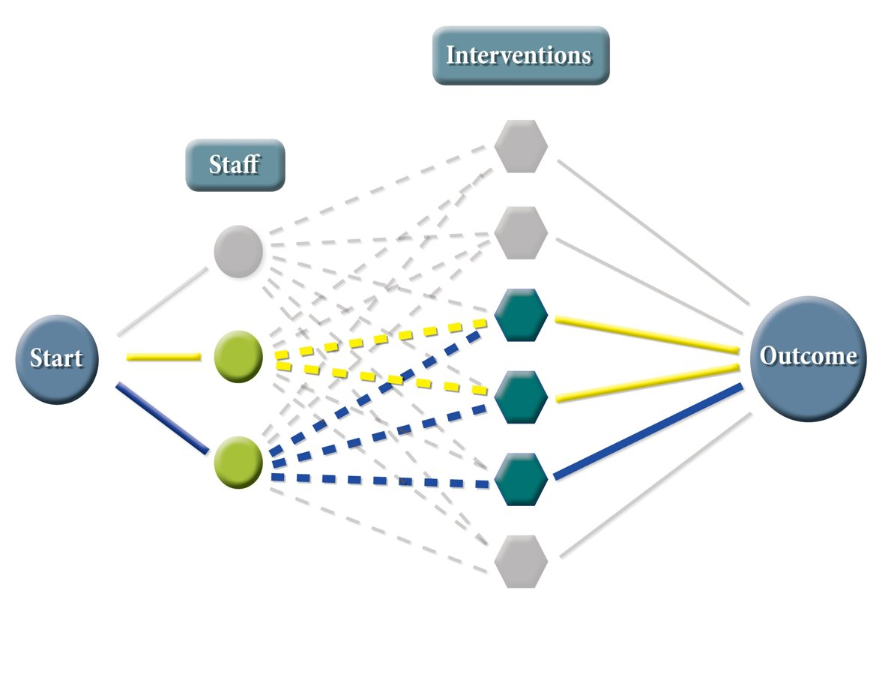

Slide 19
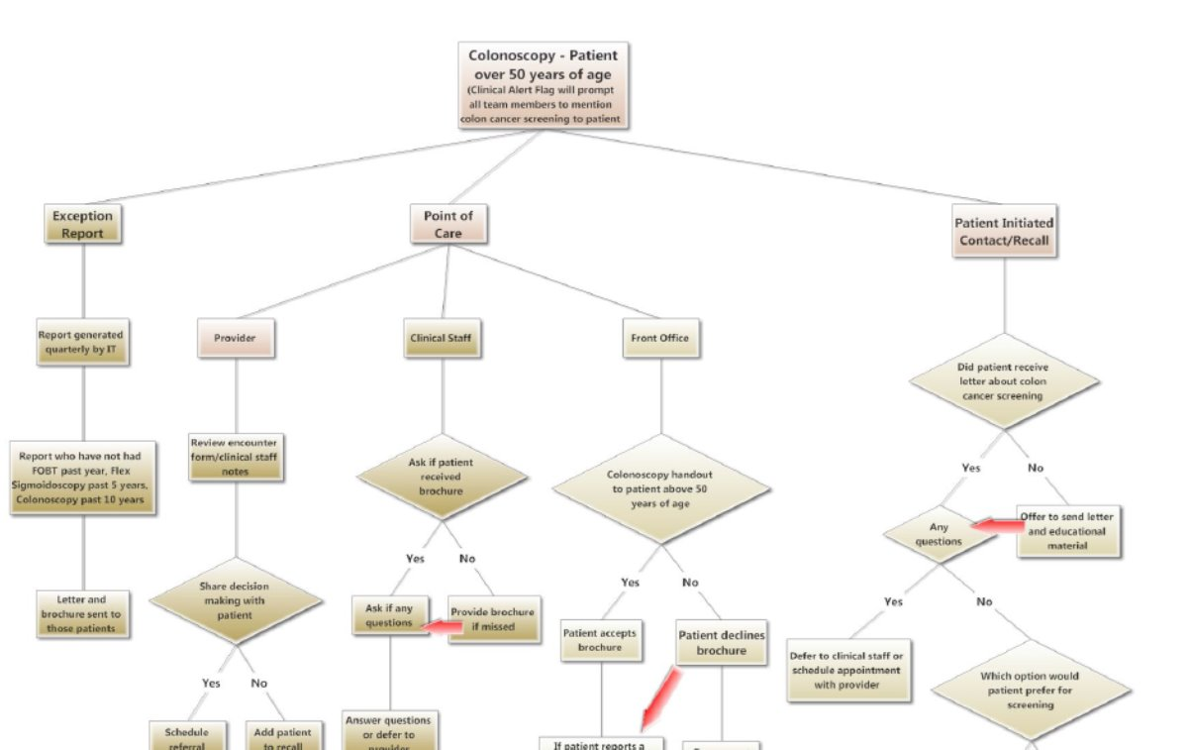

Slide 20
Communication
DO: Positive competition (highlight & share)
DON’T DO: “Rank and spank”
DO: Work As a Team
Everyone in the clinic should know the role they play in improving quality!

Slide 21
“If you want to build an organization that is fearful, angry, cynical, and full of resistance to change, dump in data without explanation and start ranking and spanking.” Thom Walsh, Ph.D.

Slide 23
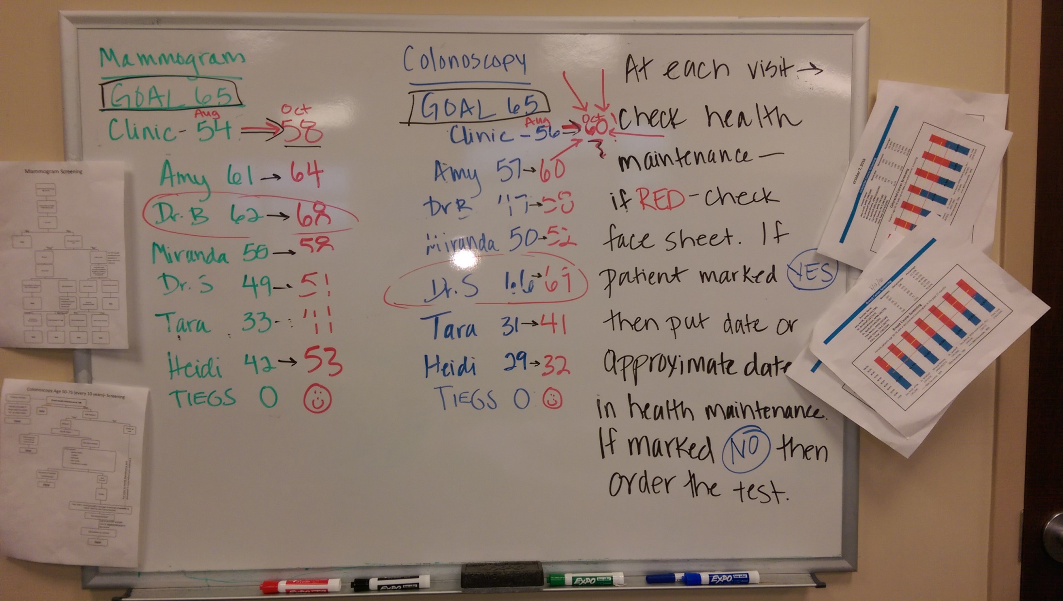

Slide 24
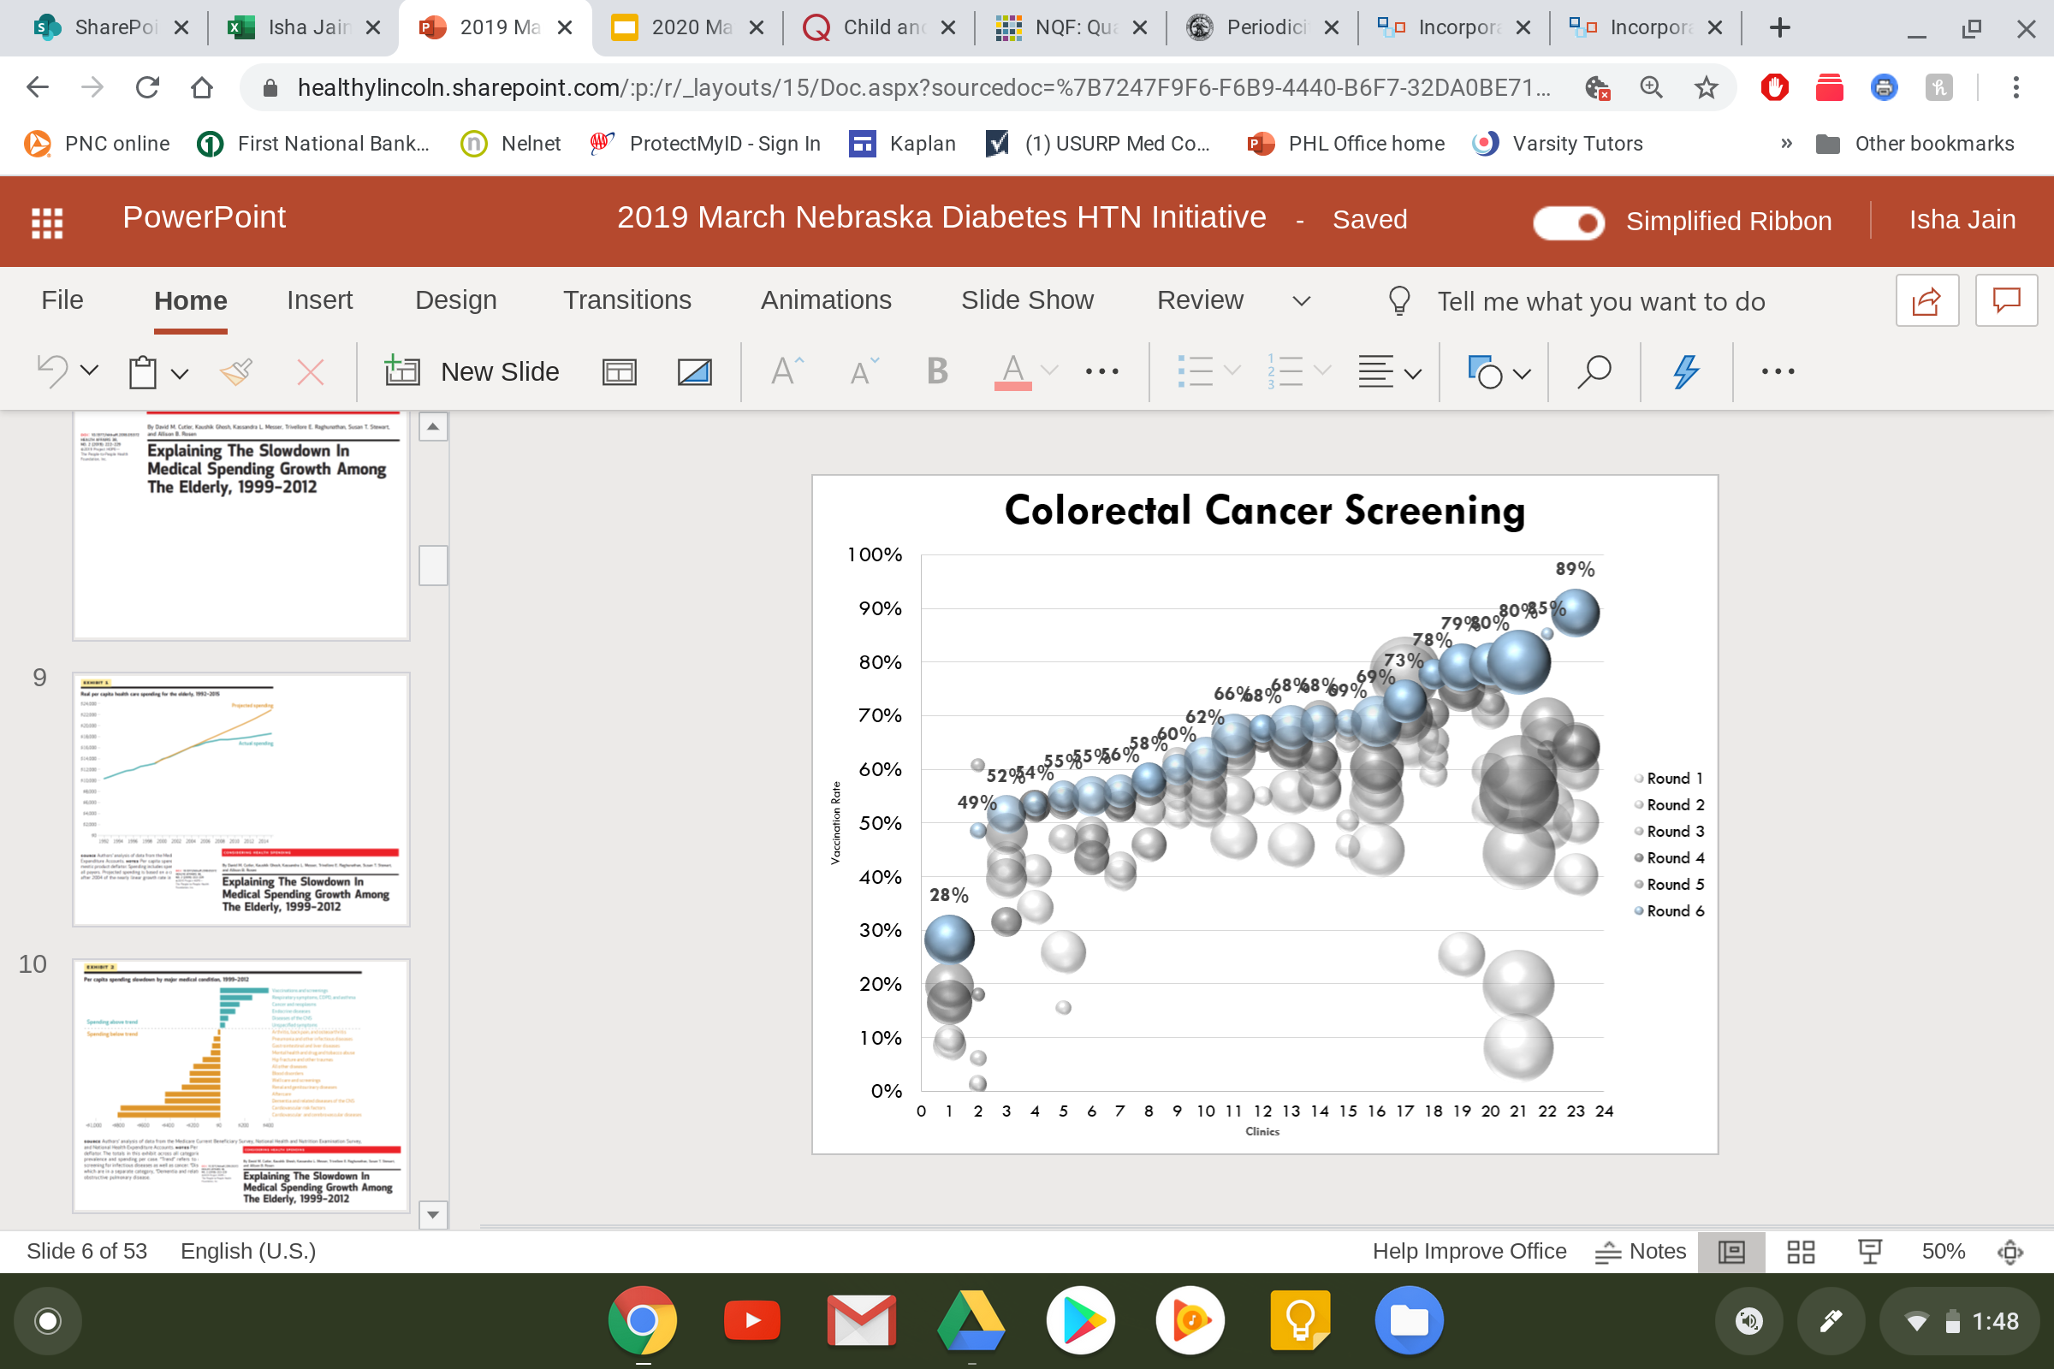

Slide 25
Clinics Who Did It Best for HPV
Started at 9 & 10 Year Old WCC
Said It the Right Way
Had a Recall System

Slide 26
Clinics Who Did It Best for HPV
Do Say:
“These are the 3 vaccines we recommend for your child.”

Slide 27


Slide 28
Questions?
Bob Rauner, MD, MPH
brauner@healthylincoln.org

