Slide 1

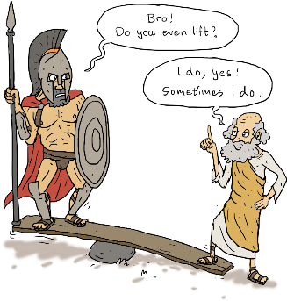
Nebraska Hospital Association
Leading in Times of Crisis
Leadership is Worthless…But Leading is Priceless
Thom Mayer, MD, FACEP
Medical Director
NFL Players Association
EVP, Leading, LogixHealth
Senior Lecturing Fellow
Duke University
Clinical Professor of EM
George Washington University

Slide 2
The Most Important Slide?
thommayermd@gmail.com
703-403-4147

Slide 3


Slide 4
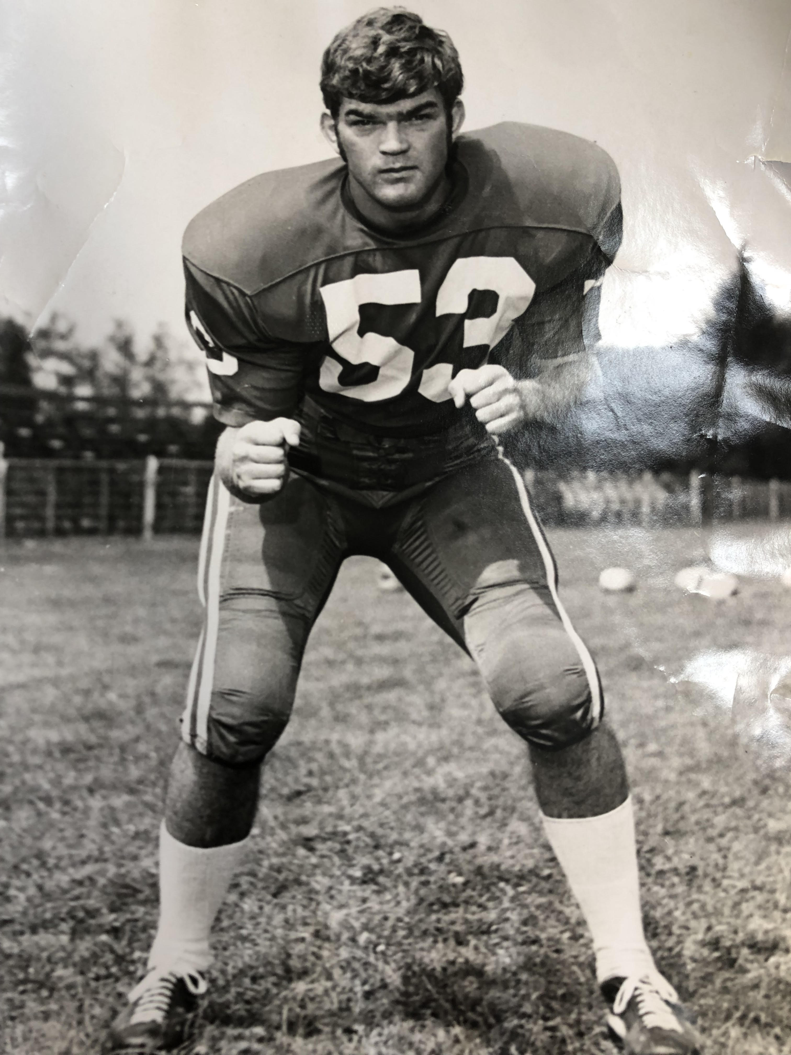

Slide 5

If You Haven’t Been There…You Don’t Know!
Notes:
You are the Tip of the Sword
Held accountable for a system over which you have little or not control!

Slide 6

Leading in Times of Crisis
Don’t Aspire to Lead…You already are Leading
Embrace the fact of leading and delight in it!
Inspire each and every member of the team to Lead
Notes:
All of this is nothing without action
Must act
I know you…
I’ve seen you in action…
I am one of you…
Innovation at the speed of trust! No trust, no innovation, no evolution
Ask for forgiveness…but not permission
Confidence to fail

Slide 7
Leading in Times of Crisis
Think about Leadership and Leading in a Radically Different Way..
Act on those Thoughts Within the Week
Innovate You and Your Team to Evolve the System…and Yourselves!
Notes:
All of this is nothing without action
Must act
I know you…
I’ve seen you in action…
I am one of you…
Innovation at the speed of trust! No trust, no innovation, no evolution
Ask for forgiveness…but not permission
Confidence to fail

Slide 8
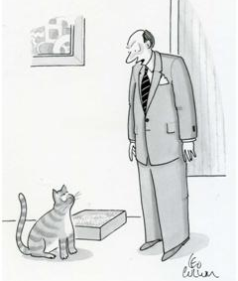
Innovation is NOT For Everyone
“Never, ever, think outside the box.”
Notes:
The Boss vs. The Leader

Slide 9


The Leader You Are Looking for… Is You!

Slide 10


Don’t EVER Call Someone a “Future Leader!” Demeaning, Demoralizing, Disfiguring, Demonic, Satanic…

Slide 11
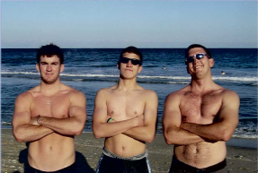
Deep Joy, Deep Need…

Slide 12
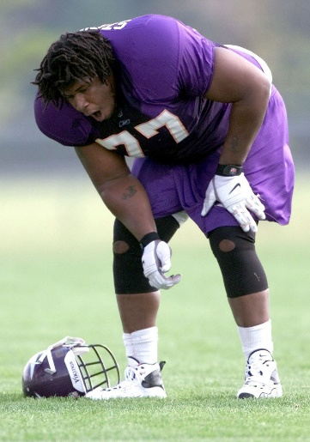
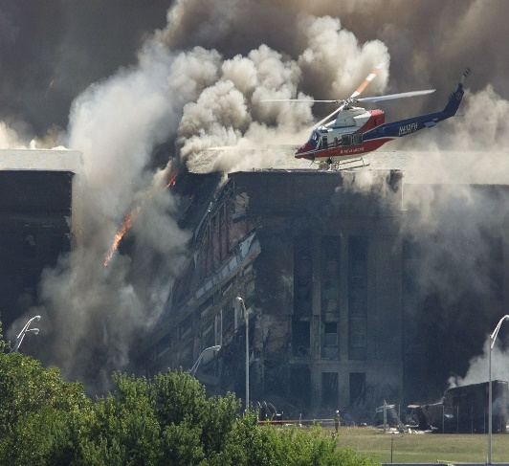
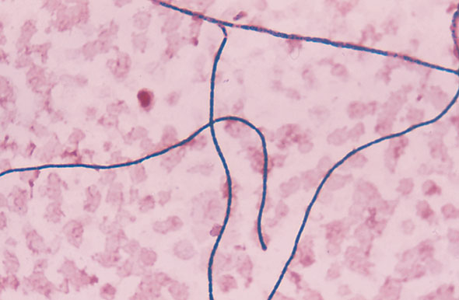
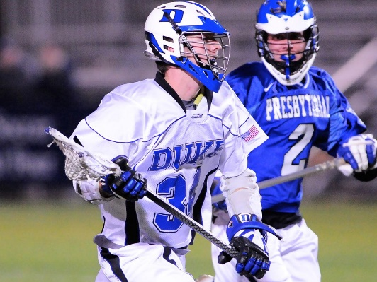
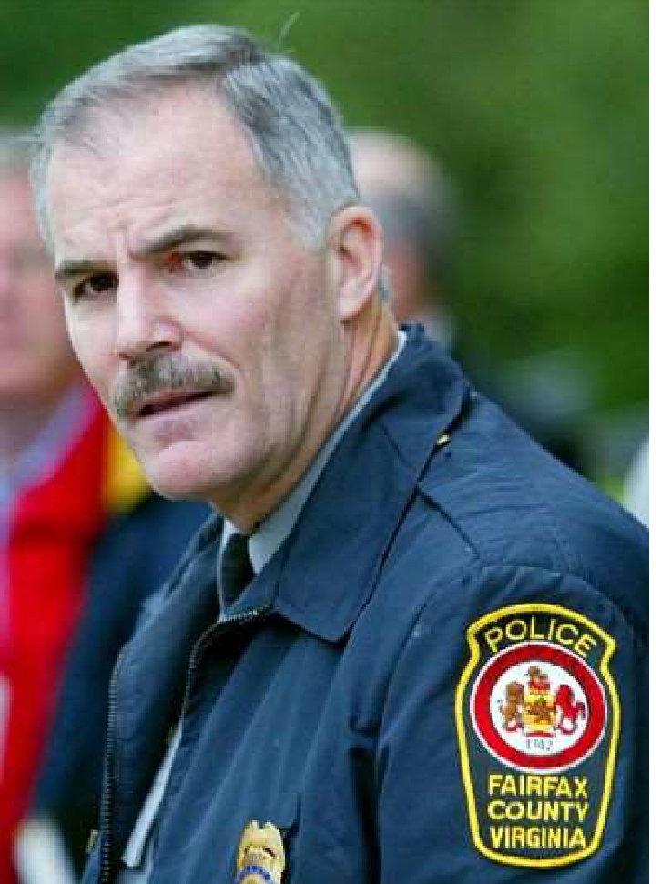


Leading in Times of Crisis
Notes:
Lou Holtz-”Doc, all these crises-has it ever occurred to you, you might be Bad Luck?”
People will forgive us for the wrong action, but not inaction
People often share the urgency-but not the solution!

Slide 13


Slide 14


Slide 15


Slide 16
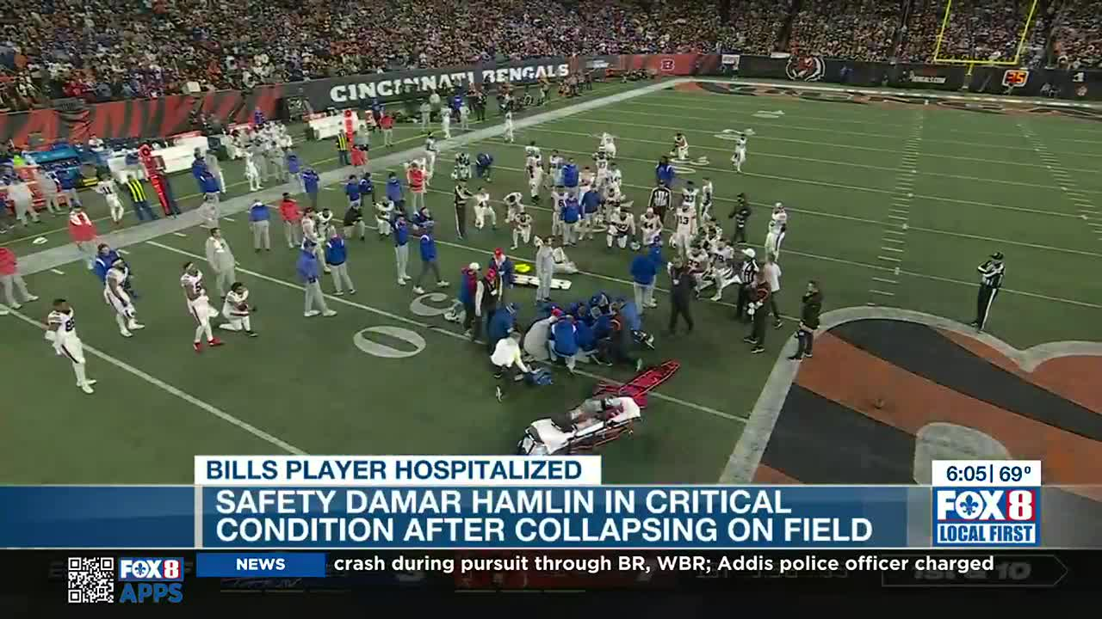

Slide 17

Notes:
Reverse the Jump
Unleash/ Liberate this Potential in Your Teams!

Slide 18


Slide 19
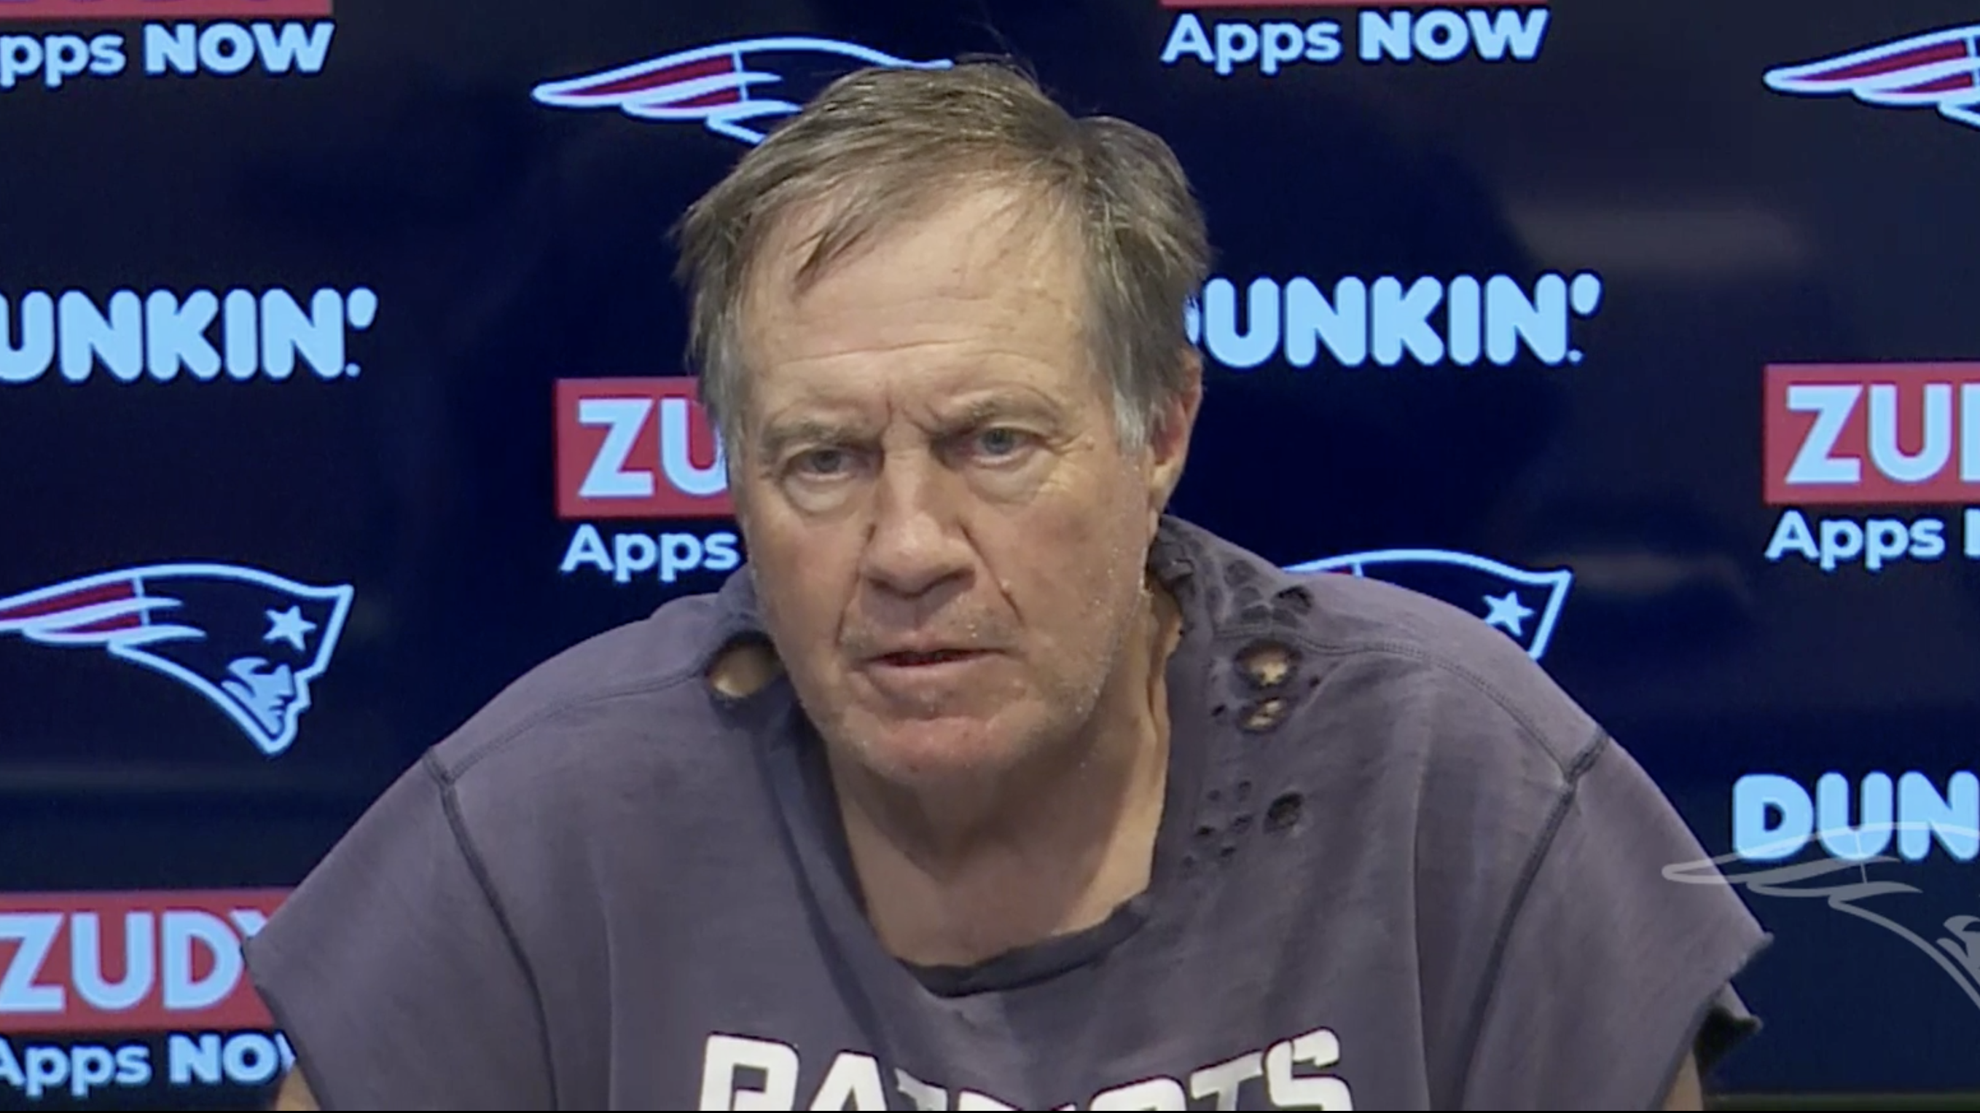
Hire Right!-The War for Talent
Talent sets the floor of a team…
But character sets the ceiling.

Slide 20
Leading and…The War for Talent!
Hire Right!
…Or Repent for a Very Long Time!
The team you assemble is the most expensive decision you will ever make
Don’t hire (exclusively) smart people-hire motivated people and educate them
Servant Leadershi[p
Are they born for… the Deep Joy of Your M/V/V?
How does this person make other people feel?
“What’s the nurses facial expression when they see your name on the schedule?
What’s the worst thing we’re going to hear about you and who will we hear it from?

Slide 21


The Way We’re Working…Isn’t Working!

Slide 22

Battling Burnout and Restoring Resiliency Burnout = Inability to Experience Your Deep Joy
Job Stressors
Burnout Adaptive Capacity/Resiliency
Cardinal Symptoms
Emotional Exhaustion
Cynicism
Loss of Meaning at Work
Notes:
Definitions Drive Solutions
Succinct, easily remembered, actionable
Agile, Mobile, Hostile…and Adaptile!
This is precisely what you mean by “adapt as they work at the forefront of that change”

Slide 23
3 Fundamental Insights Drive it All
Every member of the team is a leader…
Lead Yourself
Lead Your Team
Every team member is a performance athlete…
Invest in Yourself
Invest in Your Team
The Work Begins Within!
But it turns towards…teamwork
Notes:
This is the book in 33 words!
But that would have been a one page book-which might have been an improvement- yet I wrote 300!
Case Studies, Philosphical/theological insights. History
Healthy People = Healthy Care!

Slide 24

The Paradox of Team Work?
We can confidently assure our patients that they will be cared for by a team of experts…
But can we assure them they will be taken care of by an expert team?
Notes:
These are all smart people
But are they smart in the ways they work together

Slide 25

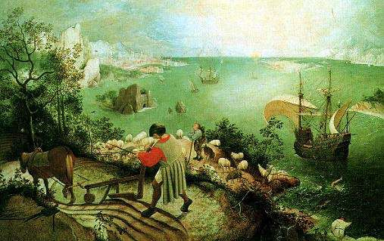
“What was Leading at the Pentagon/Concussion/Covid/Ukraine Like?”
The Path to the Head is Through the Heart- Become the Chief Story Teller
“About suffering, they were never wrong, the Old Masters. How well they understood its human position.”
-WH Auden, Musee de Beauxs Arts
“In the middle of the road of my Life
I awoke in a Dark Wood
Where the True Way was wholly lost
Death could scarce be more bitter
But if I would show the good that came from it
I must talk about things other than the good.”
-Dante Alighieri

Slide 26





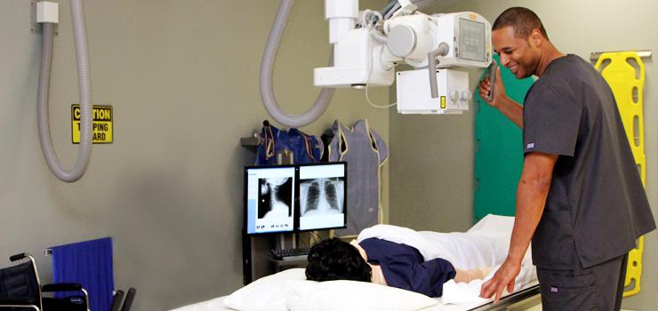
Making the Patient a Part of the Team Leading is a Team Sport-Say Team vs. Play Team

Slide 27
Making the Patient Part of the Team
“We have a great team-but you are the most important member of the team!”
“What’s the most important thing
We can do to make this an
Excellent healthcare experience?”

Slide 28
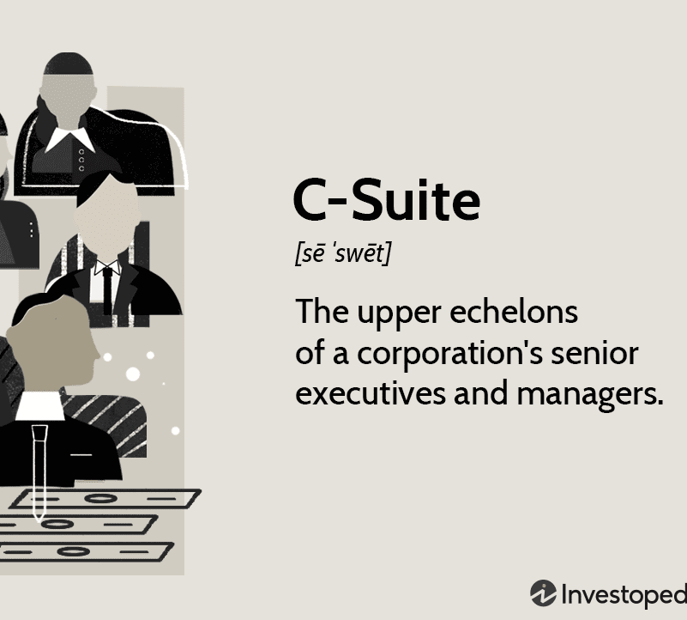

From the “C-Suite” to the “WE-Suite” “Words on the Walls” vs. “Happenings in the Halls”

Slide 29
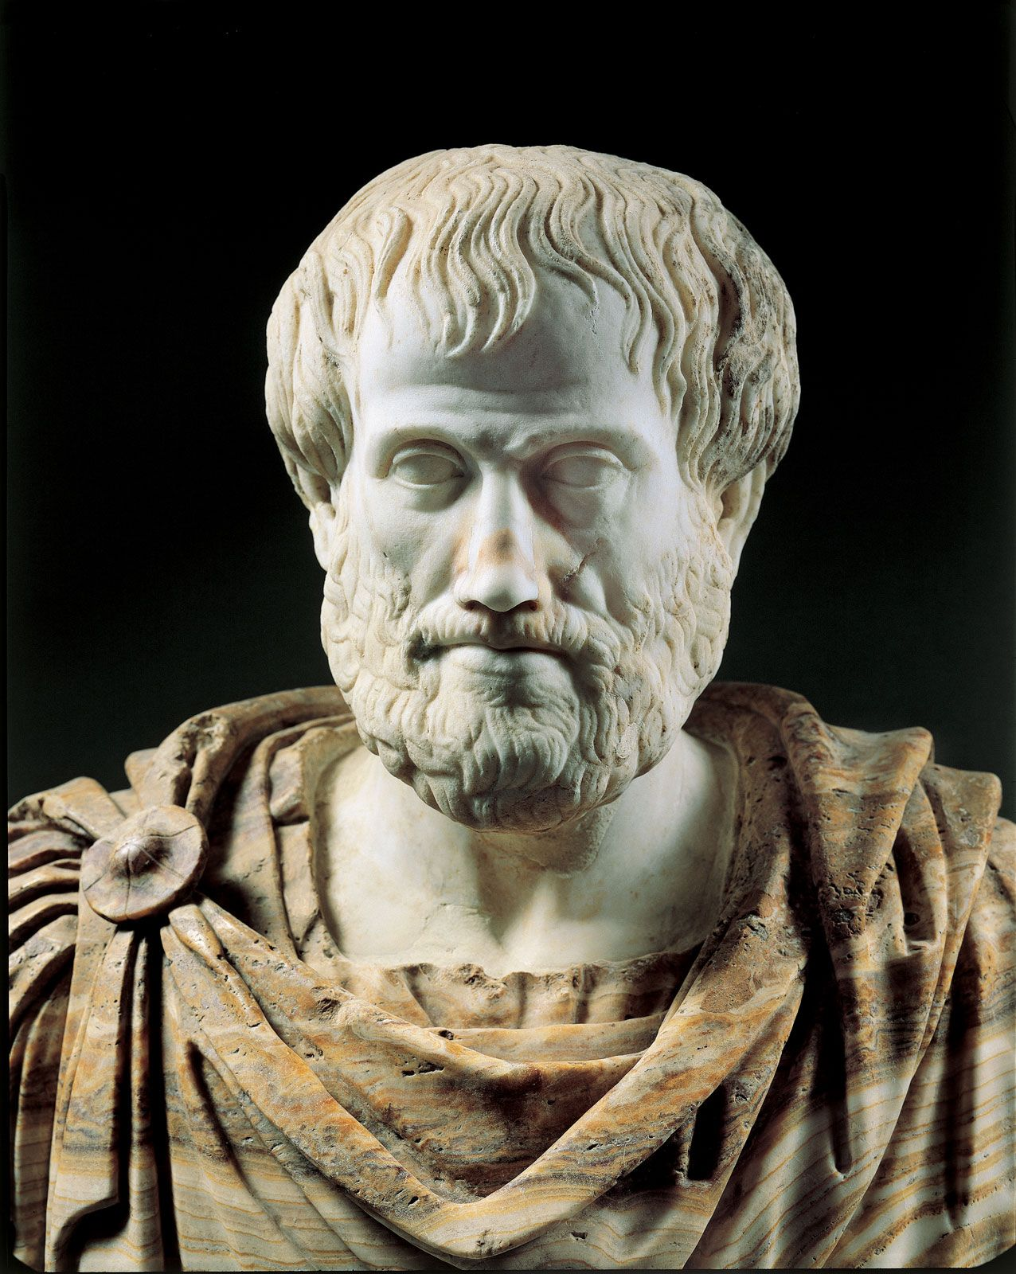
Culture of Personal Passion and Resilience Great Culture ≠ 50% Burnout Rates!
Definitions drive solutions
Don’t make this complicated
“We are what we repeatedly do. Excellence is not a virtue but a habit.”
Culture = Actions = Leading
We constantly, daily, iteratively redefine our culture
Leave a legacy

Slide 30
Limits Begin Where Vision Ends
What’s the significance of this date?
May 6, 1954
Until that date, no one in the history of mankind had done it …

Slide 31
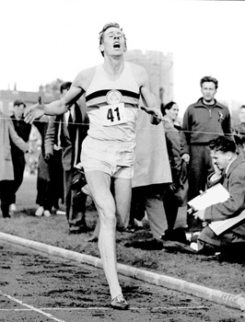
Limits Begin Where Vision Ends
What’s the significance of this date?
May 6, 1954
Until that date, no one in the history of mankind had done it …
3:59.4
How long until 10 people had done it?

Slide 32
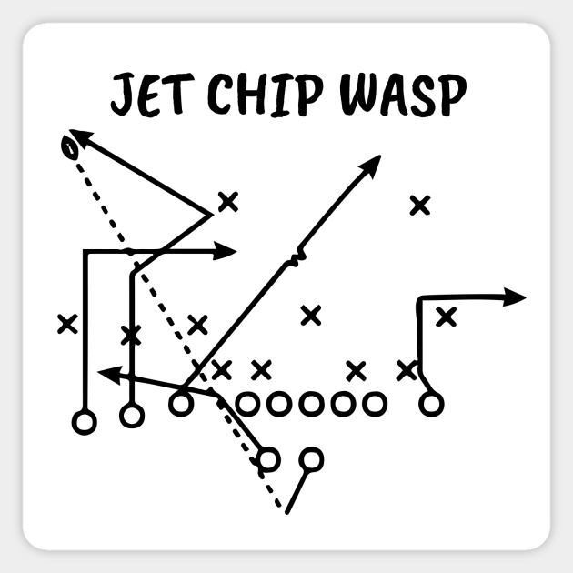
The Sting of the Wasp
Super Bowl 54, February 2, 2020, Hard Rock Stadium
4th quarter, 7 minutes, 13 seconds remaining
Chiefs trail 20-10, “Mahomes Magic”
Patrick “Do we have time to run Wasp?”
Gun, Trey Right, 2-3 Jet Chip Wasp, Y funnel
49ers in Cover 3
7 step drop, 14 yards deep, DeForest Buckner
Chiefs score on the next 3 possessions
Chiefs 31, 49ers 20

Slide 33
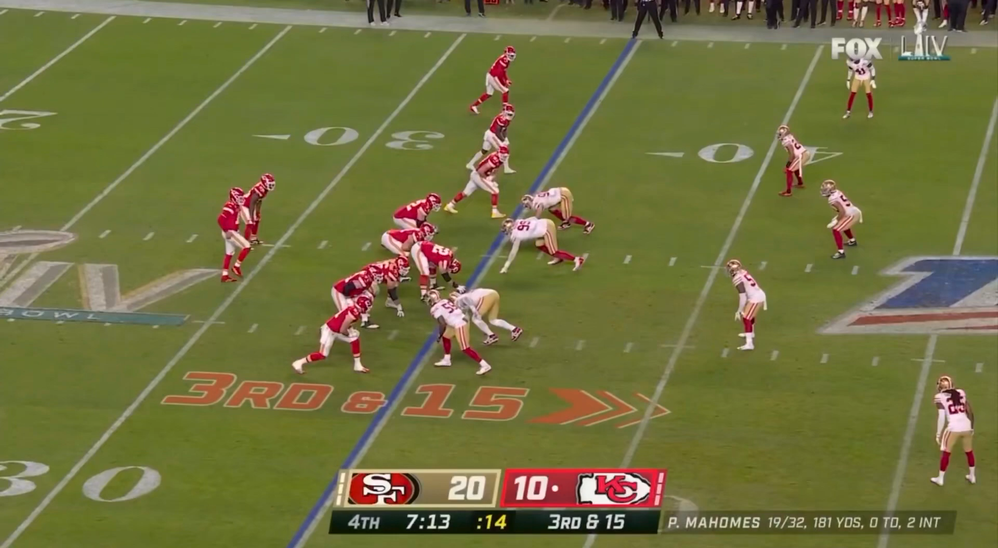

Slide 34
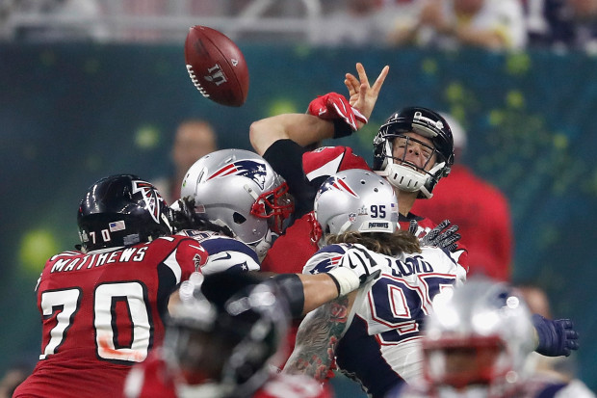

Smart People ≠ Smart Teams
Notes:
Don’t talk about sex, money, religion…or football
Dominic Scarnecchia or Dom Scar Thumbs up…fingers out vs. Thumbs in, fingers up

Slide 35
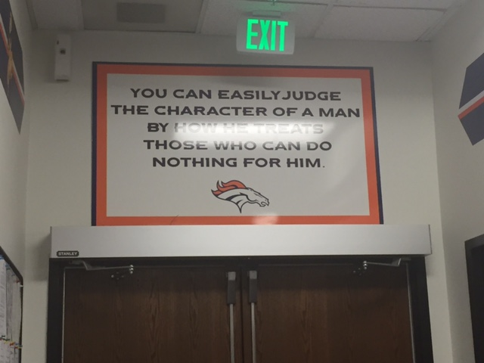
Say “Thank You!” 50 Times Per Day

Slide 36
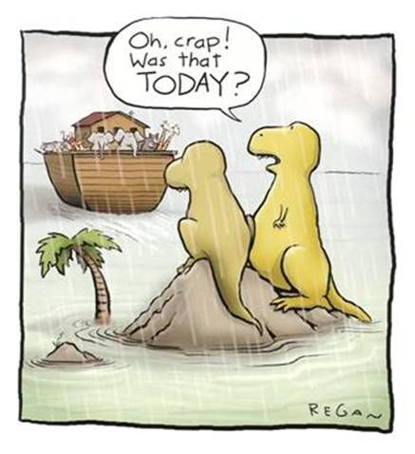
Timing is Everything…
Notes:
ACT !!!!!!!

Slide 37
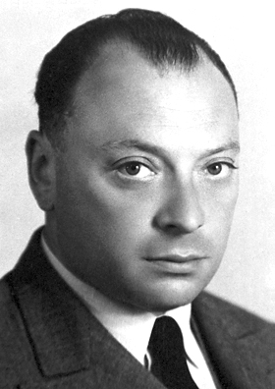
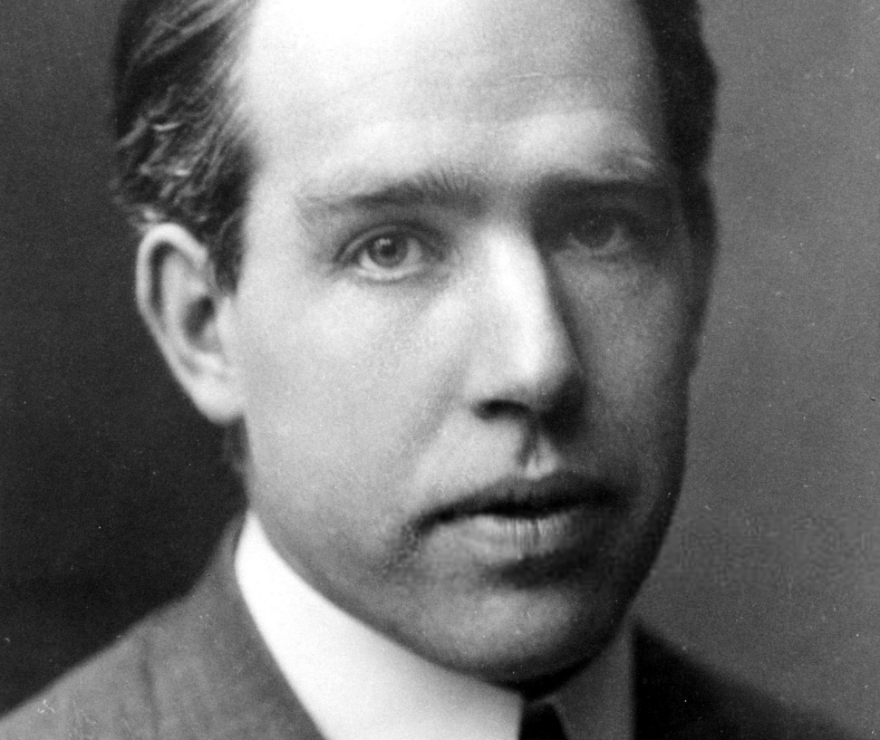
From Courage to Crazy

Slide 39

The Star Thrower

Slide 40
Thank you
Thom Mayer, MD, FACEP, FAAP, FACHE
Executive Vice President, Leadership, LogixHealth
Medical Director, NFL Players Association
Founder-Best Practices, Inc.
Senior Lecturing Fellow, Duke University
tmayer@logixhealth.com

