Slide 1



State Directed payment program – a comprehensive look
October 23, 2025

Slide 2








State directed payment program – a comprehensive look
Timothy Johnson, MBA
Chief Financial Officer
Nebraska Hospital Association
Michael Feagler, FHFMA, MBA
Vice President, Medicaid Administration
Nebraska Hospital Association
nebraskahospitals.org
Christine Widman, MHA
Vice President, Program Operations
Nebraska Hospital Association

Slide 3
Medicare prior authorizations
The wiser model

Slide 4



NEW Medicare Prior Authorizations – WISeR Model
The WISeR Model | Changing The World As We Know It
On January 1, 2026, CMS is expected to roll out the new prior authorization process for traditional Medicare patients – The WISeR Model.
The Wasteful and Inappropriate Service Reduction (WISeR) Model is initially designed to "implement and streamline the prior authorization process for select items and services that may be fraudulent, and wasteful, or of low-value to beneficiaries in original Medicare".
The Wiser Model will bake in discrete clinical requirements that are conditions of payment from existing NCDs, LCDs and other related sub-regulatory sources into the prior authorization process.
The WISeR Model is voluntary for participating hospitals and will begin on January 1, 2026, and run for two three-year agreement periods, until December 31, 2031. The initial demonstration will include 6 states - New Jersey, Ohio, Oklahoma, Texas, Arizona and Washington.

Slide 5
NEW Medicare Prior Authorizations – WISeR Model
NHA Advisory Services | Targeted WISeR Model Preparation Audits
A critical first step in the process will be for each provider to perform independent and targeted WISeR Model preparation audits.
Targeted WISeR Model audits should incorporate all CMS sub-regulatory requirements on each CMS focus areas, including medical necessity, documentation and other billing/coding payment criteria (i.e., NCDs, WPS LCDs, CMS Manuals, CPT/HCPCS, ICD-10, AHA Coding Clinic, etc.).
NHA Advisory Services staff is working closely with national Medicare compliance experts to leverage a history of proven success with 10,000+ Medicare appeals and bring vital resources to completing targeted WISeR Model audits for our Nebraska hospitals.
Please join our CFO call on November 10 for an in-depth and detailed discussion of the WISeR Model introduction, its initial focus areas and the expected impact on Nebraska hospitals.

Slide 6
State Directed payment program – a comprehensive look

Slide 7

State directed payment program – a comprehensive look
NHA SDP Operational Team – Key Contacts
Tim Johnson – NHA Chief Financial Officer
Mike Feagler – Vice President of Medicaid Administration
Christine Widman – Vice President of Program Operations
Amber Kavan – Senior Director, Clinical Quality & Workforce
Shana Anthens – Programming & Office Manager
Ryan Anderson – Director of Data & Analytics

Slide 8

Medicaid Sdp – historical timeline
SDP Program History & Milestones
Q2 2023 – NHA Board & Advocacy team lead statewide efforts to bring Medicaid State Directed Payments to Nebraska hospitals
Q1 2024 – Legislature passes LB 1087 & Governor Pillen signs it into law
Q2 2024 – NHA establishes LB 1087 Advisory Committee
Q2 2024 – DHHS submits Tax Waiver and initial program Preprint
Q4 2024 – All 93 hospitals sign TPA agreement with NHA
Q4 2024 – DHHS completes 8+ rounds of paid claims scrubbing with MCOs
Q4 2024 – DHHS submits CY 2025 Preprint to CMS for approval
Q2 2025 – On Friday, June 27, CMS approves 2024 SDP Tax Waiver & Preprint
Q3 2025 – On Tuesday, July 1, DHHS sends out SDP Notice of Assessment
Q3 2025 – On Friday, August 29, NHA completes effectuation of the initial round of SDP payments to all Nebraska hospitals for Q3 2024

Slide 9
Medicaid Sdp – historical timeline
Other Vital Contributions & Operational Support
2024/2025 - Nebraska's congressional delegations and hospital leaders work tirelessly to support approval of Nebraska's SDP program
2024/2025 - NHA's Advocacy team works 24/7 to ensure SDP program approval
2024/2025 - NHA's Quality & Community Benefits staff work with all 93 hospitals to successfully report related program outcomes
2024/2025 - DHHS/NHA collaborate with HMA and legal counsel to respond to wide ranging questions and address multiple potential challenges from CMS
2024/2025 - DHHS/NHA staff at all levels work closely to effectuate the SDP program in support of Nebraska's 93 participating hospitals

Slide 10

Medicaid Sdp – quarterly/annual program funding
Interim SDP Quarterly Payments & Final Reconciliation
Total quarterly statewide SDP provider taxes are approx. $118M. Tax assessments are allocated based each hospital's net patient service revenue reported during SFY '22 multiplied by its applicable SDP provider classification tax rates for inpatient & outpatient services. Each provider's quarterly tax assessment amount will remain the same until rebased.
Total quarterly statewide SDP payments are approx. $352M. SDP payments are allocated using each hospital's proportion of MCO paid claims for inpatient and outpatient services. The quarterly payments are considered "interim" and are based on retroactive claim experience from rolling fiscal quarters. Individual hospital SDP payments will vary quarter-to-quarter.
All interim quarterly SDP payments are reconciled on an annual basis. While SDP interim payments are based on retroactive paid claims experience, the final reconciliation is based on actual MCO paid claims experience with DOS in the applicable calendar year period.

Slide 11

Ne medicaid state directed payments
SDP – Summary Program Update
The second SDP interim quarterly payment will be for the Q4 2024 period. The second payment is in-process and tentatively scheduled to be validated & disbursed by the NHA to all hospitals on or before October 31.
The CY 2025 Preprint has been submitted but is still pending CMS approval. Based on recent communications from CMS to Nebraska DHHS staff, CMS appears to be "in process" of reviewing the CY 2025 approval.
We have received indications that select CMS staff have been furloughed in conjunction with the current federal shutdown. However, we have also received information that – upon CMS' return to work – older SDP Preprints (such as Nebraska's) are intended to be prioritized for approval & completion.
DHHS and HMA are working to update the actuarial and supporting quantitative analyses, detailed paid claims experience and SDP payments allocation methodology for the CY 2026 Preprint submission. This work is in progress and there is no set, defined timeframe for the CY 2026 submission to CMS.

Slide 12



Medicaid sdp - preliminary cash flow timeline
nebraskahospitals.org
Note: DHHS and NHA have worked to establish a preliminary, 60-day payment cadence designed to “catch up” on 4 quarterly retroactive payments (7/1/24 –6/30/25) | All dates above are estimates | Actual timeframes may vary significantly and are subject to a wide range of potentially known & unknown issues.
If CMS approval of the CY 2025 SDP preprint is delayed beyond October 30, the preliminary 60-day cadence will require modification and updating. Preliminary discussions with DHHS regarding to prospect of effectuating multiple, concurrent, quarterly payments is underway.
Preliminary Cash Flow Timeline dependent on CMS approval of CY 2025/2026/2027 Preprints, funding availability and ongoing program effectuation
of the SDP program by all NE hospitals | SDP funding is not guaranteed

Slide 13
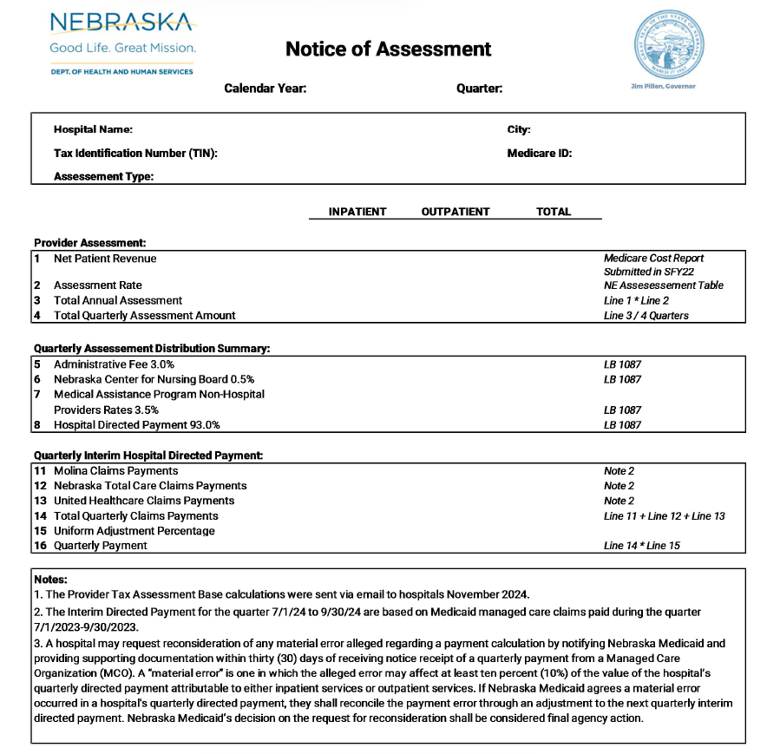
SDP OPERATIONS WORKFLOW
Interim Payment Cycle:
NHA claims validation – established hospital workgroup
Program point of contacts (POCs) will receive NOA from DHHS
Hospitals have 30 days to pay Provider Assessment to DHHS
Hospitals have 30 days to report reconsideration issues
NHA receives funds from MCOs – will disperse monies to hospital accounts
Post-payment Notices of Net Deposit will be sent to designated POCs via email.

Slide 14



Updating point of contacts
Hospital SDP Program Contacts:
  NOA from DHHS
  Notice of Net Deposit from NHA
  Updates regarding the program
Hospital Banking Contacts:
  2 per hospital
  Custodial account access
Hospital local bank account updates
Updates - CONTACT: Christine Widman, cwidman@nebraskahospitals.org

Slide 15
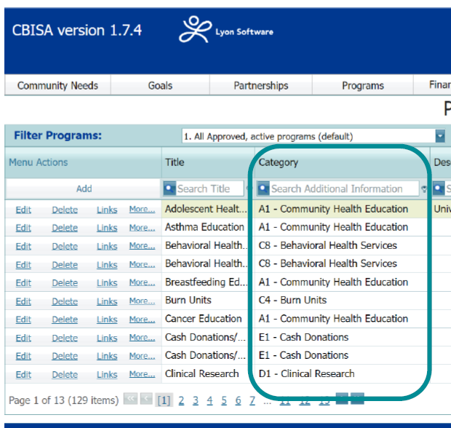
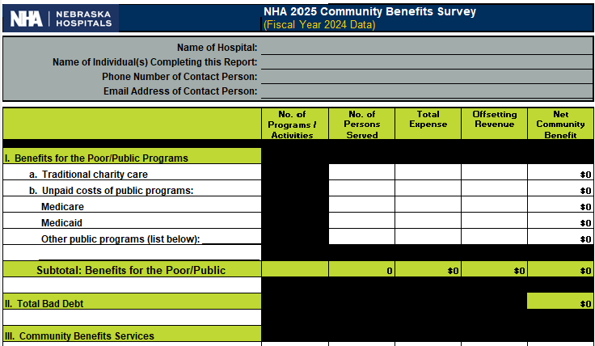


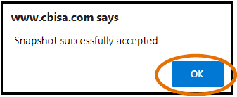
Community benefits & Impacts reporting
Bolster tracking & reporting of traditional community impacts
# of Programs, # Nebraskans impacted, Narratives!
Impacts made in:
  Senior Care
  Maternal Care
  Behavioral Health
  *Workforce Development
Reporting: NHA survey form OR via CBISA reporting platform
Official notice to all hospitals going out November 3
Collecting FY24 data, due January 16

Slide 16
Medicaid Quality Overview & update
3 Key Required Metrics:
  SDOH Screening
  Post-Partum Depression Screen for Delivering Hospitals
  CAUTI
Supplemental Metrics:
  Increase unique Age-Friendly organizations
  Explore use of ED for primary diagnoses related to behavioral health
Quarterly scorecards distributed
UPDATE:
  Beginning Q4 2025, Medicaid-only data will be required to report

Slide 17

Medicaid Quality Overview & update
Quality Performance Reporting Compliance:
    Q3 2024 = 100%
    Q4 2024 = 100%
    Q1 2025 = 100%
    Q2 2025 = 100%
Upcoming Data Due Dates:
 | Q3 2025 (July-Sept) | Q4 2025 (Oct-Dec) | Q1 2026 (Jan-Mar) | Q2 2026 (Apr-June) | Q3 2026 (July-Sept) | Q4 2026 (Oct-Dec)
Data Due Dates | November 30, 2025 | February 28, 2026 | May 31, 2026 | August 31, 2026 | November 30, 2026 | February 28, 2027

Slide 18

Claims Payment Validation
The NHA utilizes a work group of 17 hospitals to review the paid claims that will be used for the interim State Directed Payment.
The work group includes systems, urban and rural PPS hospitals, and critical access hospitals.
The State provides the NHA the paid claims data that is distributed to the work group for review.
Any data issues found during this process are shared with the State and they review.

Slide 19

Reconciliation process
CMS requires that any interim Hospital Directed Payments be “trued up” or reconciled to actual experience from the Directed Payment Preprint year.
DHHS will aggregate the total interim payments paid to each hospital by inpatient and outpatient services for the periods.
DHHS will work with their actuary to aggregate the total volume of inpatient and outpatient service payments by hospital based on the date of service.
DHHS will then reconcile the interim payments with the actual experience to determine the variance/reconciliation amount.
DHHS will include the variance/reconciliation amount by hospital by inpatient and outpatient service line in the next interim directed payment calculation and distribution.

Slide 20

Reconciliation process
DHHS has stated that the cost settlements for your cost reporting period will not be included in the reconciliation process.
Their stance is due to three issues:
  The lag time in the calculation of the cost settlements would materially increase the amount of time it would take to complete the reconciliation process.
  CAH rates are routinely rebased, including the ancillary cost component, which has a material impact on the reduction of cost settlements, and shifts those dollars into the rates passed through into the interim and reconciliation data experience.
  The varied hospital FYE dates would impact the ability to do reconciliations timely.

Slide 21
Questions?
CONTACT INFO:
Tim Johnson
(303) 589-9350
tjohnson@nebraskahospitals.org
Mike Feagler
(402) 937-3154
mfeagler@nebraskahospitals.org
Christine Widman
(402) 356-5519
cwidman@nebraskahospitals.org
nebraskahospitals.org

