Slide 1
CATCH RURAL Falls: A Program to Support Rural Health Clinics with Fall Risk Management for Older Adults
Dawn Venema, PT, PhD​
Associate Professor, Department of Health and Rehabilitation Sciences, College of Allied Health Professions
Victoria Kennel, PhD​
Associate Professor, Department of Allied Health Professions Education, Research, and Practice, College of Allied Health Professions

Slide 2


Introductions and Contact Information
Dawn Venema, PT, PhD
dvenema@unmc.edu
Physical therapist, with experience primarily in geriatric practice
Expertise in fall risk management and mobility
Victoria (Vicki) Kennel, PhD
victoria.kennel@unmc.edu
Industrial organizational psychologist
Expertise in quality improvement, teamwork, and organizational science

Slide 3
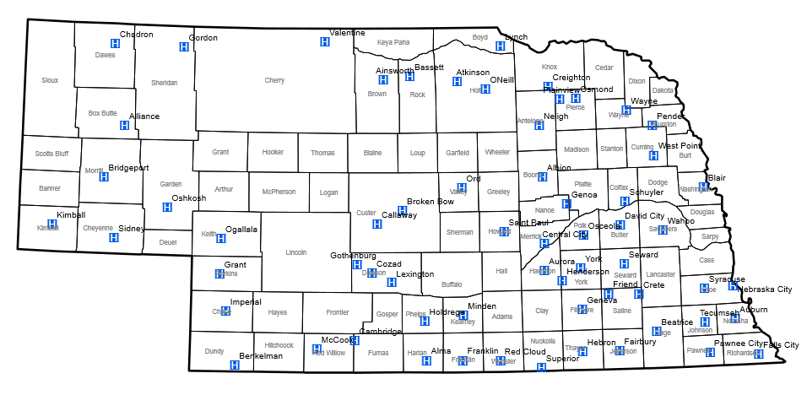
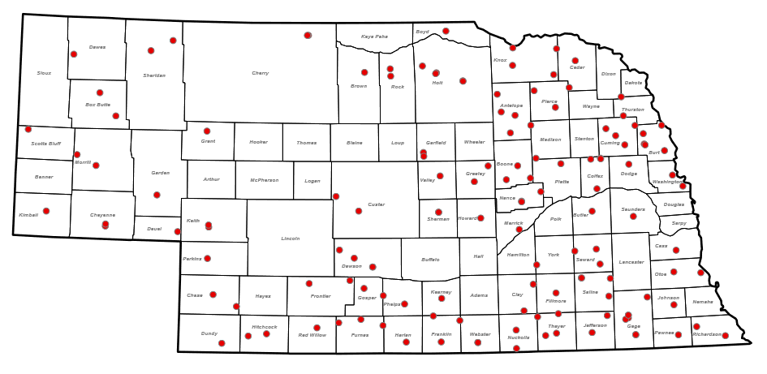
Funding Acknowledgements
This work is supported by the
Nebraska Department of Health and Human Services Office of Rural Health via the Medicare Rural Hospital Flexibility Program
Image Credit: https://dhhs.ne.gov
The content is solely the responsibility of the presenters
and does not necessarily represent the views of any funding source

Slide 4


The CAPTURE Falls Program and the CATCH RURAL Falls Program
Collaboration And Proactive Teamwork Used to REduce (CAPTURE) Falls
10+ years of support to over 30 Nebraska Critical Access Hospitals for quality improvement of inpatient fall risk reduction
Address patient fall risk during a hospital stay
Coordinated Action Toward Community Health: RedUce Risk And Limit (CATCH RURAL) Falls
Logical extension of our work with hospitals to Rural Health Clinics
Proactive approach to try to reduce fall risk among older adults in the community

Slide 5



Session Objectives
Identify recommended fall risk management strategies for older adults for use in primary care settings
Describe the use of fall risk management strategies in a sample of Nebraska RHCs
Discuss the purpose of and resources available to Nebraska RHCs in the CATCH RURAL Falls Program

Slide 6

Centers for Disease Control (CDC) STEADI Toolkit
Created for healthcare providers to support implementation of a coordinated approach to manage falls
Algorithm for Decision-Making
Patient Education Materials
Provider Education Materials
Implementation Strategies
Screening and Assessment Tools
CDC STEADI: Stopping Elderly Accidents, Deaths & Injuries

Slide 7
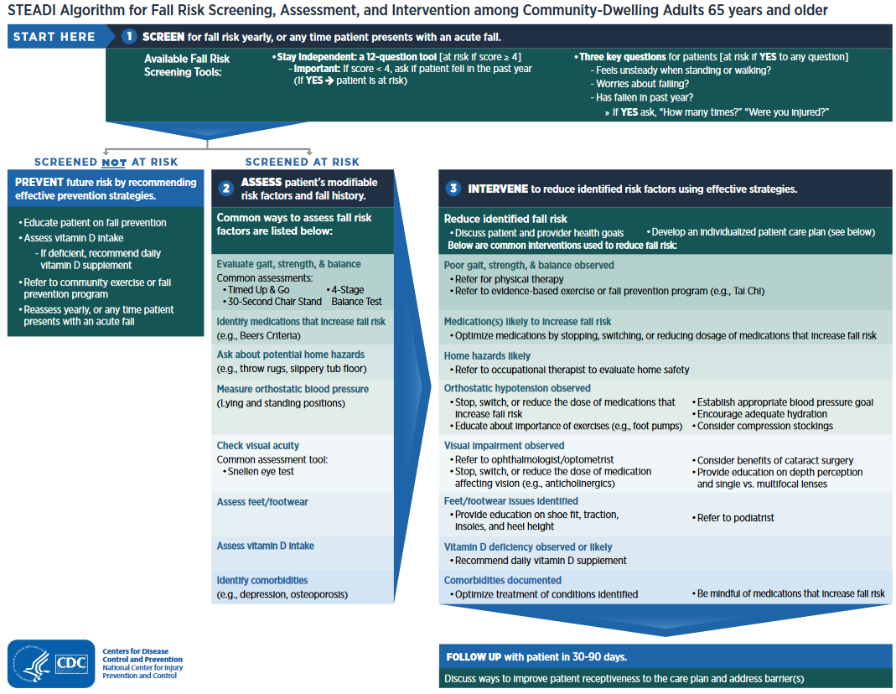
CDC STEADI Algorithm for Fall Risk Screening, Assessment, and Intervention

Slide 8
Factors that Influence Implementation of Fall Risk Management in Primary Care
Provider Beliefs and Practice
Enhance awareness of importance of falls
Address fragmented services and challenges with care coordination
Knowledge
Information about how to manage fall risk
Time Constraints
High volume of patients
Patient Engagement
Financial Factors
Inadequate reimbursement given the time required
Direct and indirect costs of interventions
Increase awareness of clinical guidelines
Too much to address within a single appointment
Stigma of falls
Lack of awareness falls are a medical issue
McConville & Hooven (2020)

Slide 9
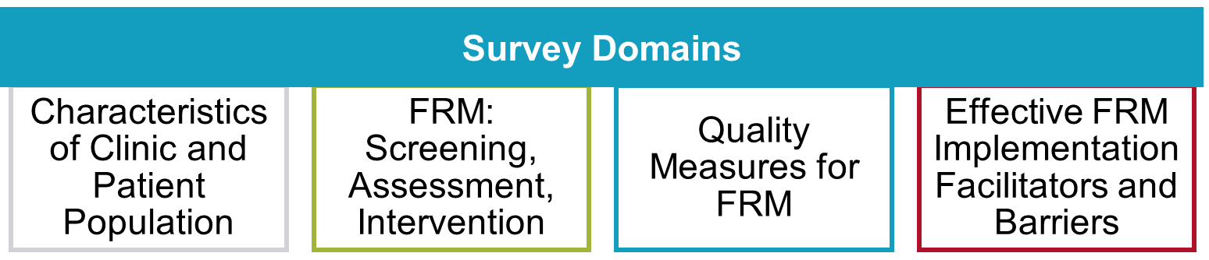
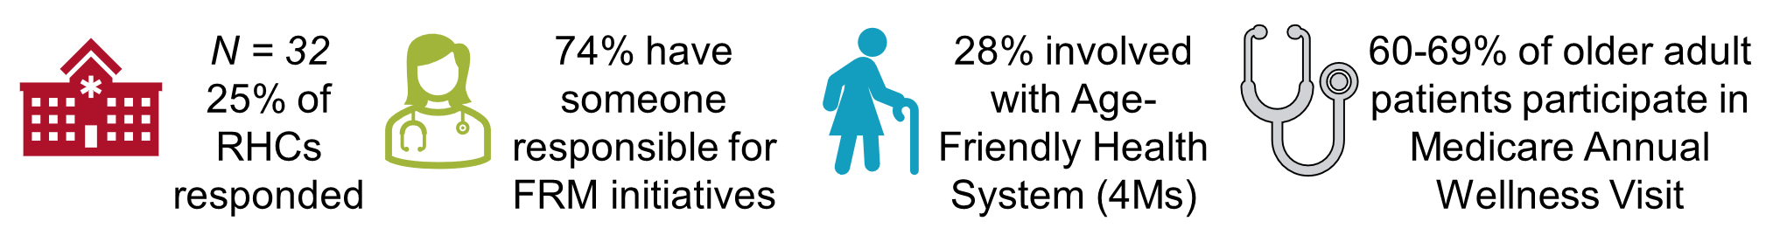
2024 Statewide Survey of Fall Risk Management (FRM) Practices in Nebraska RHCs
RHC Sample Characteristics
Kennel, Yao, & Venema (2024)

Slide 10
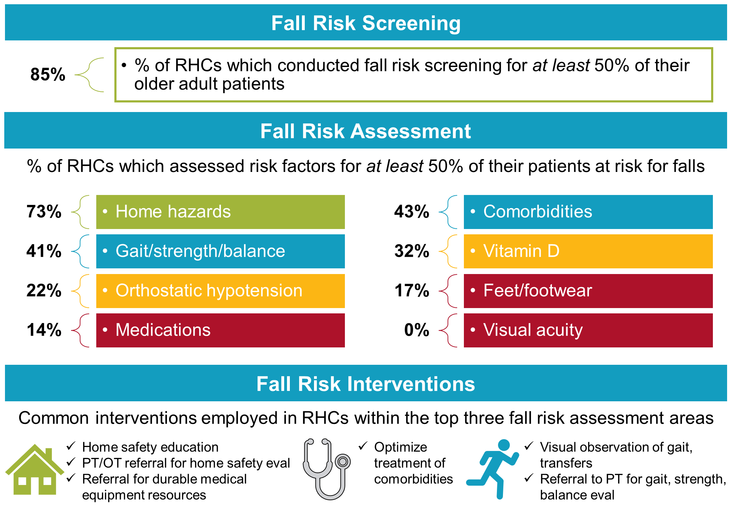
Current State of Fall Risk Management Practices
Kennel, Yao, & Venema (2024)

Slide 11
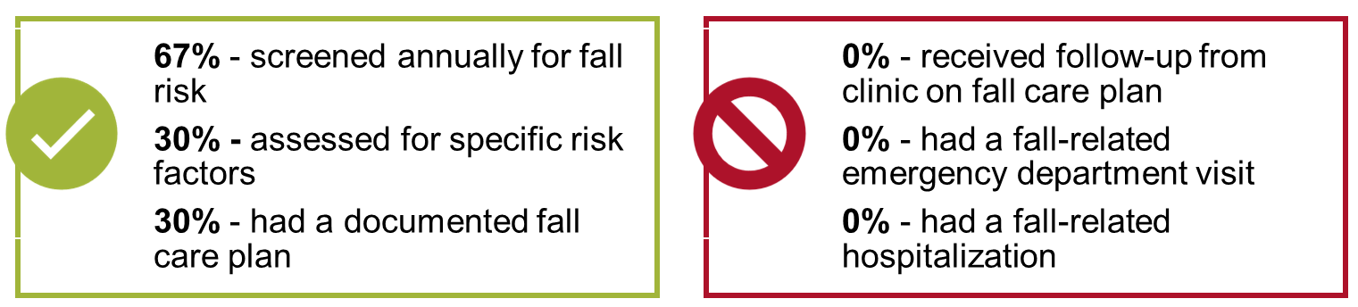
Fall Risk Management Quality Indicators
% of RHCs required to track and externally report the number
or percent of older adult patients who:
Kennel, Yao, & Venema (2024)

Slide 12
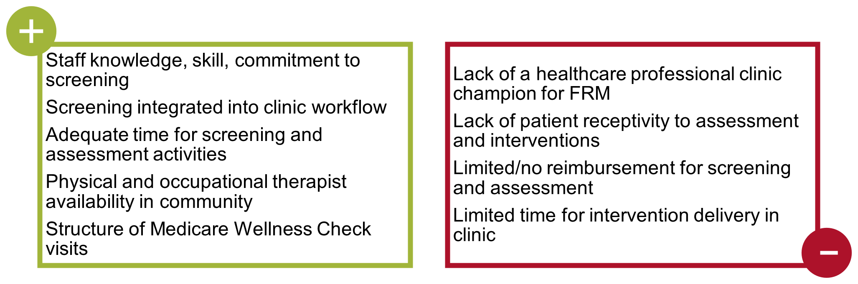
Top Reported Facilitators and Barriers to Effective Implementation of Fall Risk Management
Facilitators
Barriers
Kennel, Yao, & Venema (2024)

Slide 13

CATCH RURAL Falls Program
Coordinated Action Toward Community Health:
RedUce Risk And Limit Falls
Provide education, resources, and improvement support
for Nebraska Rural Health Clinics
to improve care for older adults in your community
by adopting and implementing
an evidence-based fall risk management program

Slide 14
CATCH RURAL Falls Program Components
On-demand education
regarding fall risk management activities and implementation strategies
Monthly touch-points
via virtual cohort and 1:1 consultations to discuss implementation strategies and support practice change
Monthly data collection and reporting
to evaluate outputs and changes in fall risk management practices
Improvement tools
to establish clinic specific goals, identify measures, run tests of change, and support implementation into practice

Slide 15

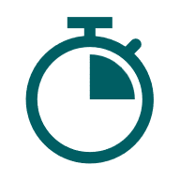
On-Demand Education
On-demand education
regarding fall risk management activities and implementation strategies
Clinical practice considerations for fall risk screening, assessment, and intervention
Quality improvement considerations for fall risk screening, assessment, and intervention
Pre-recorded and posted online for on-demand access and availability
Coordinated Action Toward Community Health: RedUce Risk And Limit (CATCH RURAL) Falls

Slide 16

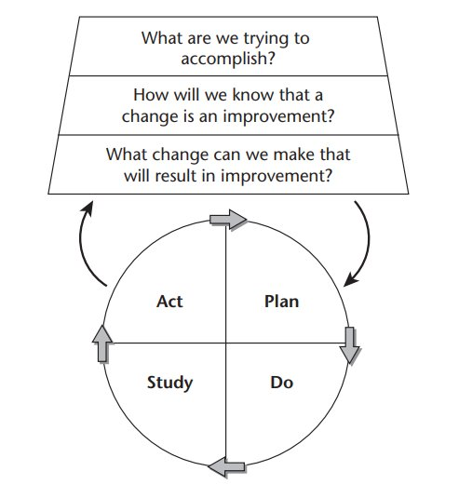


Quality Improvement Tools
Improvement tools
to establish clinic specific goals, identify measures, run tests of change, and support implementation into practice
Establish an aim statement to guide your efforts
Determine feasible strategies for data collection to demonstrate measurable progress
Select ideas to test to improve fall risk management practices
Coordinated Action Toward Community Health: RedUce Risk And Limit (CATCH RURAL) Falls

Slide 17



Monthly Touch-Points
Monthly touch-points
via virtual cohort and 1:1 consultations to discuss implementation strategies and support practice change
1:1 clinic consultation(s) for clinic specific support
Monthly cohort collaborative calls to discuss what is working well, what isn’t, and how we can help
Idea sharing and collaborative discussion among cohort participants

Slide 18



Monthly Data Collection and Reporting
Monthly data collection and reporting
to evaluate outputs and changes in fall risk management practices
Data use agreement for program participation signed by your clinic and UNMC
REDCap survey to track monthly short-term outcomes
Percent of eligible pts screened (required)
Percent of eligible pts who receive specific fall risk assessment/intervention (optional)
Data visualization to track progress over time

Slide 19
CATCH RURAL Falls Program Target Outputs and Outcomes
Outputs
Form fall risk management team
Select screening and assessment tools/strategies
Short-Term Outcomes
% of older adult patients screened for fall risk
% of older adult patients at risk for falls with appropriate assessments completed
Intermediate Outcomes
Patients and family aware of fall risk status
Patients participate in recommended interventions
% of older adult patients with fall risk and appropriate interventions documented in care plan
% of older adult patients with appropriate intervention referrals
Develop/enhance referral and community resource lists
Develop/enhance patient and family education materials
Train providers and staff
Integrate tools into workflow/EHR
Identify billing codes
Create and update improvement and program monitoring plans
Long-Term Outcomes
Patients gait, strength, balance improves
Fewer patients fall in their community dwelling setting
Fewer patients fall with injury in their community dwelling setting
Fewer patient fall-related visits to ED
Fewer patient fall-related hospitalizations
Bergen & Shakya (2019)

Slide 20
References and Resources
Bergen G, Shakya I. CDC STEADI: Evaluation Guide for Older Adult Clinical Fall Prevention Programs. Atlanta, GA: National Center for Injury Prevention and Control, Centers for Disease Control and Prevention, 2019. https://www.cdc.gov/steadi/pdf/Steadi-Evaluation-Guide_Final_4_30_19.pdf
Center for Disease Control (CDC) Stopping Elderly Accidents, Deaths, and Injuries (STEADI) – Older Adult Fall Prevention Home Page. Accessed October 30, 2025. https://www.cdc.gov/steadi/index.html
CDC Resource Algorithm for Fall Risk Screening, Assessment, and Intervention. Accessed October 30, 2025. https://www.cdc.gov/steadi/media/pdfs/STEADI-Algorithm-508.pdf
Collaboration and Proactive Teamwork Used to REduce (CAPTURE) Falls. Accessed October 30, 2025. https://www.unmc.edu/patient-safety/capturefalls/
Coordinated Action Toward Community Health: RedUce Risk And Limit (CATCH RURAL) Falls. Accessed October 30, 2025. https://www.unmc.edu/patient-safety/catch-rural-falls/index.html
Eckstrom E, Parker EM, Shakya I, Lee R. Coordinated Care Plan to Prevent Older Adult Falls. Edition 1.1. Atlanta, GA: National Center for Injury Prevention and Control, Centers for Disease Control and Prevention, 2021. https://www.cdc.gov/steadi/pdf/Steadi-Coordinated-Care-Plan.pdf
Kennel V, Yao Y, Venema D. Coordinated Action Toward Community Health: RedUce Risk And Limit (CATCH RURAL) Falls: A Quality Improvement Initiative for Rural Health Clinics. Poster presentation at the Health Administration Best Practices and Research Symposium, 97th Annual Nebraska Hospital Association Convention, La Vista, NE, October 16, 2024. Poster available here.
McConville A, Hooven K. Factors influencing the implementation of falls prevention practice in primary care. J Am Assoc Nurse Pract. 2020;33(2):108-116. Published 2020 Apr 1. doi:10.1097/JXX.0000000000000360
Langley GL, Moen R, Nolan KM, Nolan TW, Norman CL, Provost LP. The Improvement Guide: A Practical Approach to Enhancing Organizational Performance (2nd edition). San Francisco: Jossey-Bass Publishers; 2009. Model for Improvement Figure 1.1. Permission obtained from John Wiley and Sons on 1.13.2025 to use this figure in this presentation.

Slide 21
Closing Slide [do not remove]

