Slide 1
Flipping the Script: Transitioning from Academics to Workforce.

Slide 2
OBJECTIVES: Identify strategies to successfully transition from academics to the workforce. Review tools and resources to support becoming a confident and enthusiastic nurse in your organization. Review tools to assist with managing your time and priorities while developing your professional identity.

Slide 3
Benner's Stages of Clinical Competence
Will I ever be an expert?
How will I ever get there?

Slide 4
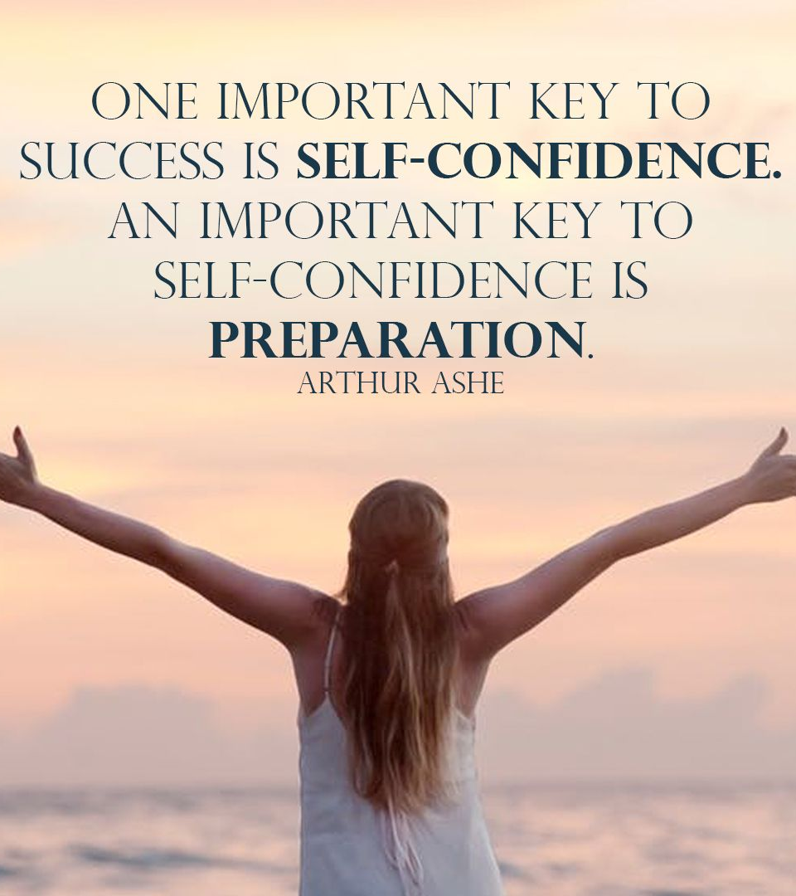
Confidence Building
Understanding Confidence
Building Confidence-not a sprint, but rather a journey.
Positive self-talk, focus on the positive, not the pitfalls
Goal setting **SMART**
Facing fears

Slide 5
PROFESSIONAL IDENTITY
Continuous Learning-workshops, seminars, certifications.
Join professional organizations-start networking with peers
Seek mentorship, align yourself with some whom you trust and respect
Reflect on your practice
What went well today, what could I have done better, who should I thank today, what do I need to be successful?
WHY...ask yourself why...

Slide 6
Work/Life Balance
Identify your Burnout Ques...
Define/importance to you at any given moment-it will change
Setting boundaries
Scheduling downtime-Vacations are essential for success and refresh.
Finding hobbies-outside of work!

Slide 7
Being an Engaged Preceptee
Role of a preceptee...ask the questions, don't pretend to know it all.
Maximizing the Experience...be proactive
Feedback Importance...learn from feedback, don't shy away from it. Round with your one up at least monthly.
Seek feedback
Reflect on performance
Explore new techniques
Set personal goals
Iterate and adapt, improve

Slide 8
Prioritization
TOOLS Eisenhower matrix, abc method, covey’s quadrants

Slide 9
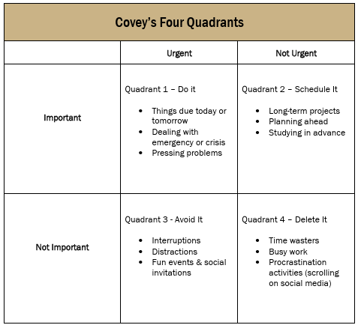
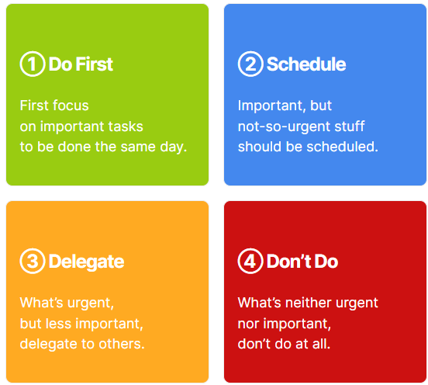
Covey & Eisenhower Quadrants to organize

Slide 10
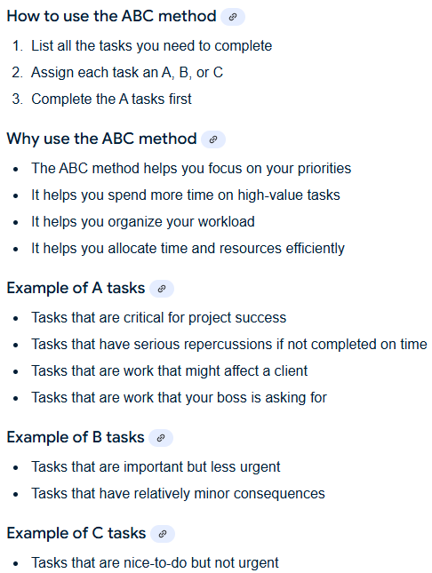
ABC's Method...lists

Slide 11
Time management
Key Principals
Delegation-Covey or Eisenhower?
Calendars
To-Do Lists (ABC-method?)
Time Blocking
Kardex-Task manager in the EMR

Slide 12
Key principles of time management
Set clear goals for the shift
Adapt to changing goals throughout the day
Plan & Prioritize
Set a routine-stick with it
Be a team player, but learn to say no
Refer to plan and prioritize
No vs. Not right now
Eliminate time wasters
You know who they are, keep on walking
Delegate
Hardest skill to learn. Trust your team. Set expectations.

Slide 13
Let's practice

Slide 14
Adaptation to cross training
Definition of cross training
Learning new skills and responsibilities of another practice area.
Adapting to new roles
Constantly learning new tasks and responsibilities enhances career development.
Success stories

Slide 15
Conclusion
Recap
Q & A
Closing remarks…

Slide 16
Thank you
Donna Armknecht MSN, RN
402-269-7652
darmknecht@syracuseareahealth.com

