Slide 1
Cervical Cancer Screening
Angie Barber, MHA, BSN, RN-BC, CPHQ
Kayleigh Allen, CSW
Notes:
Both introduce ourselves

Slide 2
Objectives
To provide structure to improve Cervical Cancer Screening utilizing Lean Six Sigma DMAIC process
Improve workflows between providers internal and external clinics
Improve inter-departmental workflows
Standardize outreach to patients

Slide 3
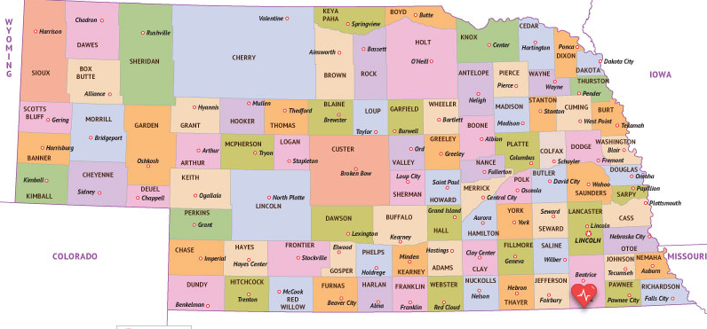
About Us
Beatrice population-12,272
25 bed Critical Access Hospital and Rural Health Clinics in Southeast Nebraska
Serve Gage, Jefferson, Saline, Johnson, and Pawnee counties
Quality
Notes:
Angie

Slide 4
Our Mission
We are dedicated to be the healthcare resource for the communities we serve by providing quality services and compassionate care.
Our Vision
Caring People, Committed to Caring for People
Our Values Excellence * Compassion * Ethics
Notes:
Angie

Slide 5
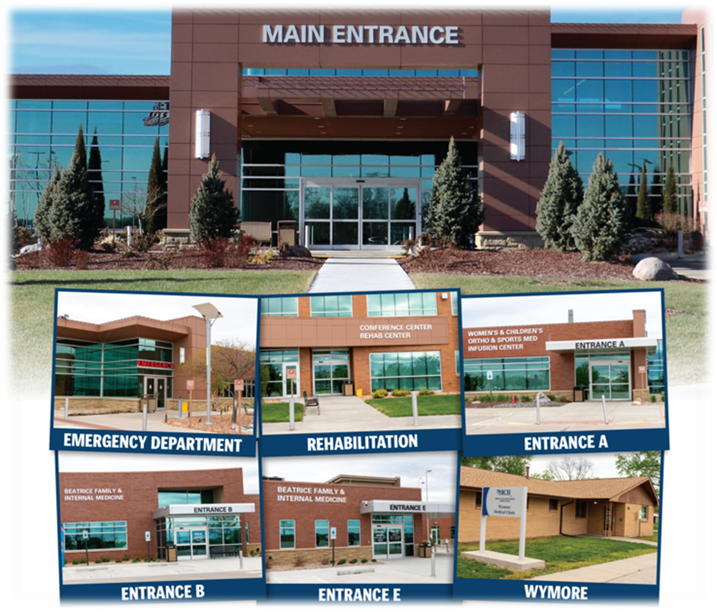
Notes:
Angie-2023 statistics that includes Acute care admissions, number of babies delivered, our outpatient department statistics, number of employees and employed providers

Slide 6
Why Focus on Cervical Cancer Screening
Best Practice for Cervical Cancer Prevention
Focus on all payers with the ACO
Organizational goal
Goal-80% or greater
Actual 46%
Notes:
Angie
Evidence based best practice for CCS
We decided to focus on all payers so that we would meet our ACO requirements and hit all our patients regardless of payer source
It rose to the top as one of our organizational quality goals
Original goal was 80% with a minimum of 77%, our actual starting % was 46%

Slide 7
Quality Initiative/Rapid Cycle Improvement (PDSA)
June 2022-ACO steering committee decided to make this a focus for PDSA starting in July
July 2022-Sherlock ticket for issue with Pap/HPV and Pap categories
August 2022-HPV co-test and discontinued Cervical Cancer screenings not satisfying dashboard
September 2022-HPV co-test issue fixed
October 2022-Discontinued CCS for hysterectomy still not satisfying dashboard
November 2022-Kayleigh started review of all patients on the dashboard
December 2022-Kayleigh started quick abstracting to satisfy CCS where it is incorrect
January 2023-Hysterectomy issue fixed
February 2023-Old lab code not satisfying dashboard effecting 2018 & 2019 results, re-abstracting to fix dashboard
March 2023-Dashboard cleanup complete. Education PowerPoint sent out to providers
April-May-monitoring with no movement in % of 59% since February
Notes:
Angie through October…
In the beginning we really felt that a PDSA would be sufficient to make improvement on CCS. However, month by month we realized we were just fixing the dashboard with workflow and EHR issues.
Kayleigh November to the end…
Reviewed the dashboard patient by patient who qualified for this metric
Abstracted records that were not meeting the metric, found that hysterectomy were not falling off and excluding, fixed the old lab code so it was not longer an option in EPIC
Went to the Provider meeting and educated providers on this change
In May discussed with internal ACO steering committee to move this to a PI project to standardize workflows and potentially additional improvements.

Slide 8
Cervical Cancer Screening Performance Improvement Project
Notes:
Angie-Officially was assigned as a PI project in June 2023

Slide 9
Lean Six Sigma Methodology
Notes:
Angie
Lean Six Sigma Methodology includes Define, Measure, Analyze, Improve and Control. Difference from the PDSA in the fact that you go through this once and not cyclic. The PDSA actually lives in the Improve phase if you were to do several tests of change. Typically, we have a project be a Lean Six Sigma if we do not know the problems, there needs to be more research and discovery, and the project will be longer than 1-3 months.

Slide 10
Define

Slide 11
Healthcare Effectiveness Data and Information Set (HEDIS) Measure
Assesses women who were screened for cervical cancer using any of the following criteria:
Women 21–64 years of age who had cervical cytology performed within the last 3 years.
Women 30–64 years of age who had cervical high-risk human papillomavirus (hrHPV) testing performed within the last 5 years.
Women 30–64 years of age who had cervical cytology/high-risk human papillomavirus (hrHPV) cotesting within the last 5 years.
Notes:
Kayleigh
(Review HEDIS metrics qualifications)

Slide 12
Team members
Name | Role
Kayleigh Allen-Social Worker/Quality Population Health Manager | Core Team Member
Angie Barber-Director of Quality | PI Project co-leader
Lisa Cerveny-Executive Assistant of Nursing Services | PI Project co-leader
Jessica Cullison-Director of Clinic Practice | Process Owner
Dr. Dayton, DO-Family Internal Medicine | Provider Champion
Erin Dorn, PA-Family Internal Medicine | Provider Champion
Makayla Koch-Women’s and Children’s Clinic Nurse Supervisor | Core Team Member
Britney Kotas-Family Internal Medicine Case Manager | Core Team Member
Kelsey Rengstorf-Family Internal Medicine Supervisor | Core Team Member
Lindsey Zimmerman-Women’s and Children’s Case Manager | Core Team Member
Eric Trusty Senior Executive of Clinics | Executive Sponsor
Notes:
Kayleigh
(Point out the positions and role of people chosen)

Slide 13
Measure
Notes:
Kayleigh

Slide 14
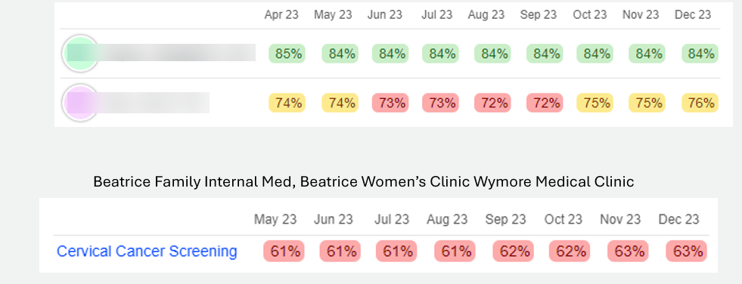
Provider Champions
Goal 77%
Notes:
Kayleigh
Providers chosen due to their success to help with final workflows as shown by their numbers what they are doing is working

Slide 15
Analyze
Notes:
Angie
Both measure and analyze went faster than normal because of all the work with the PDSA

Slide 16
Prioritized Actions
Higher Priority
Provider education including Health Maintenance and proper diagnosis coding
Nurse and HIM abstraction education
HIM completing outreach for external GYN visits
Updating Care Teams (Clinic names instead of providers) at visits annually with ambulatory profile
Standard workflows for all Family and Internal Medicine clinics
Additional CCS outreach via portal and physically mailing outreach letters with a detailed CCS insert
Providers willing to help with Pap screens
Lower priority
Annual Women’s Health Fair/Incentives for scheduling appointment
Focus on 20–30-year-olds or possibly 20–40-year-olds to get them scheduled for their pap
Notes:
Angie
We had a lot of things we wanted to tackle but prioritized those that we felt had a higher impact and those that could wait.
Education to the providers to use proper diagnosis codes, especially with Hysterectomy was needed. Total Hysterectomy with removal of cervix was not always used
Getting Pap results from an external source was a big problem so we did education on this workflow as well as proper abstraction so that it counted on Health Maintenance
Providers and nurses like the Clinic name instead of the provider of external GYN clinics for easier retrieval of notes/pap results
Need for Standard workflows to be developed
Need for stronger outreach workflows
Need for more providers to help with pap screens for those that do not perform them in the clinic
Decided a Women’s health fair was a good idea but a project in an of itself to be done 20–40-year-old
We knew we wanted to focus on 20–40-year-olds first, but ended up outreaching to all who were due

Slide 17
Improve
Notes:
Kayleigh

Slide 18
Defined Workflows
Notes:
Kayleigh

Slide 19
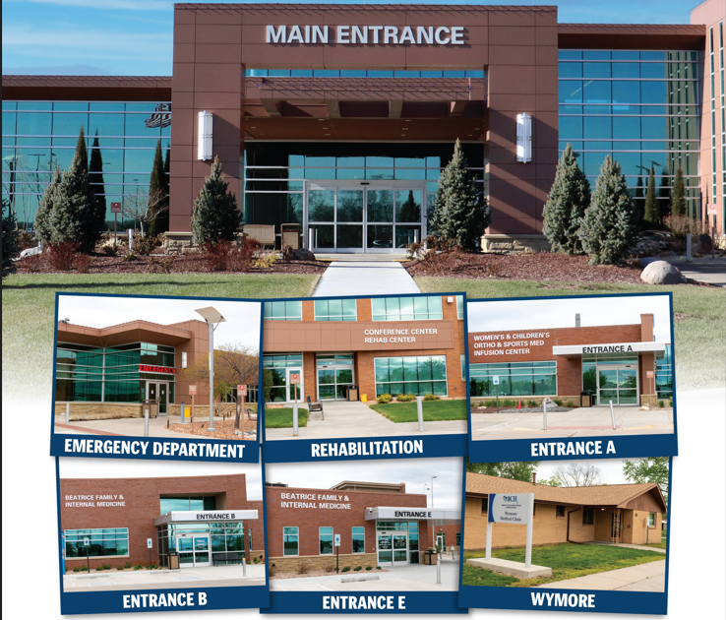
Beatrice Structure
3 Clinics that provide CCS Services
2-Family and Internal Medicine
Beatrice-17 providers
Wymore-2 providers
Women’s Clinic
Beatrice-5 providers
Notes:
Kayleigh
Have 3 clinics that can provide CCS services
2 Family Internal Medicine- Beatrice 17 providers and Wymore has 2 providers
We also have a Womens OBGYN Clinic which has 5 providers
12 of the 19 providers are willing to help with CCS. Consolidated in the last year

Slide 20
Notes:
Angie
Best practice was that the receptionist would get the patient scheduled for the proper visit if due, but relying on the patient to tell them. Second level is for the nurse to catch with chart prep that it is the proper visit. Best practice that pap is completed during this visit, but can be scheduled at a later date if does not meet the converted reasons. The rest is completion workflow.

Slide 21
Notes:
Angie
Workflow starts out the same as previously, but adds the second provider if possible. Best workflow is to coordinate the two provider’s schedule to complete together. At the time we encouraged the providers to team up with another provider but now all of our physicians are paired with a PA or APRN that completes pap exams.
2-Providers, if going to 2nd provider for Pap only, we use Q0091 PR OBTAINING SCREEN PAP SMEAR, but we do not bill to insurance as they will not pay, but it gives provider credit for RVUs for performing the Pap separate service. Same day or different day.
Patient here for Pap only. Swabbed and sent off for testing. Nothing else performed. This would be the Q0091

Slide 22
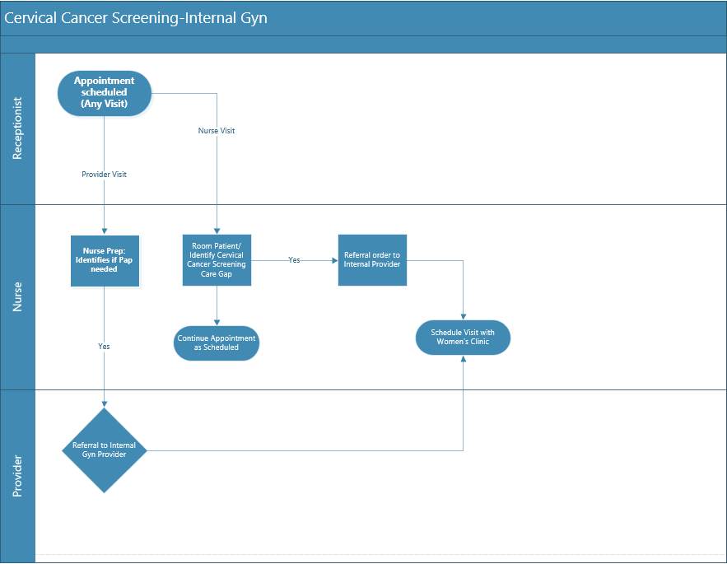
Notes:
Kayleigh
Visit with the patient PCP and then send a referral/schedule with Womens clinic
Visit with PCP will be billed with E&M and visit dx. GYN visit can be billed if identified a problem, but in no problem and routine will be the Q0091 code above and written off.

Slide 23
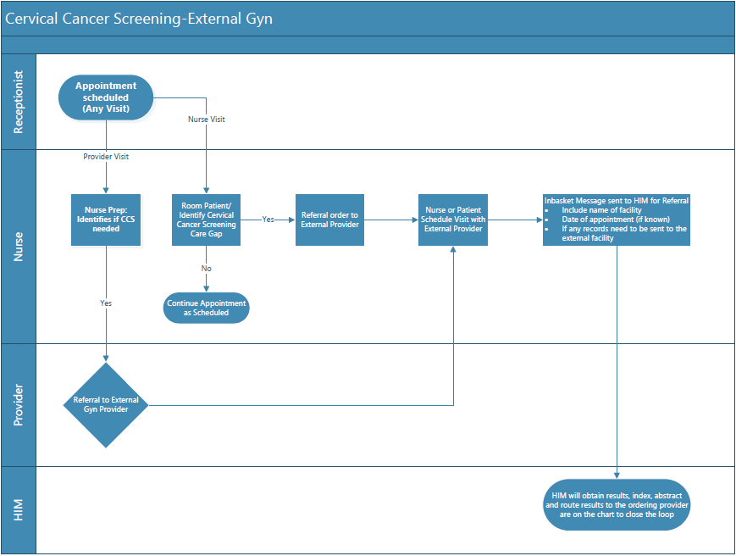
Notes:
Kayleigh
Visit with patient and then send referral for external CCS at GYN clinic in say Lincoln. We did add to this with HIM and the LPN routes this chart to HIM and we have an employee to monitor and send request for records

Slide 24
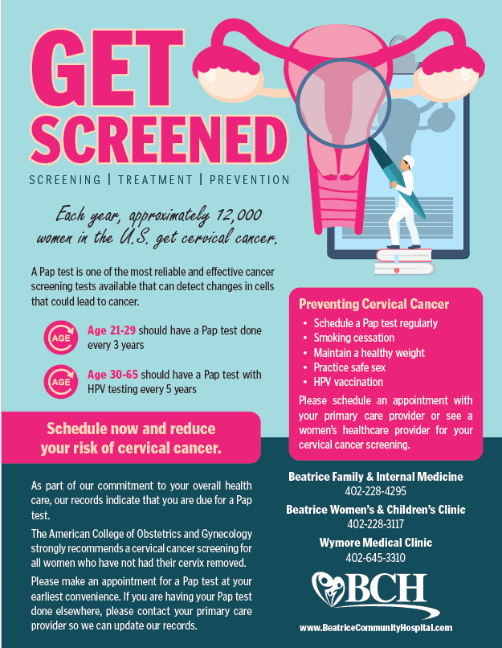
Patient Outreach
*3 providers planning to retire/reduce hours
*Redistributing patients
Patients that hadn’t been seen in over 3 years called to schedule
Bottom 3 performers called patients to schedule
Mass outreach to all patients overdue for CCS
Notes:
Kayleigh
Within EPIC we are able to send out Mass communication where we developed a dot phrase with this flyer in so the letter will be in the patient EHR
Had multiple patients reach out and state they had the Cervical Cancer Screening done elsewhere and we worked with HIM to obtain the record from the other entity and were able to abstract and scan it in to close the loop.
Had patients reaching out via telephone/portal to schedule appointment for Cervical Cancer Screening to be done
Portal/Mailing 1,426
We also did patient outreach on providers who are retiring to redistribute patients and get them seen by a new provider and to address care gaps.
We did specific targeted outreach on the lower performers by calling them to schedule Cervical Cancer Screening

Slide 25
Control
Notes:
Angie
The transition to the control phase is very important for continued success of a project in the long-term
Formal hand-off to the accountable person that will ensure the project continues
Formal expectations of monitoring
Best to have it as an agenda item at the appropriate meeting-For us it is our ACO steering committee

Slide 26
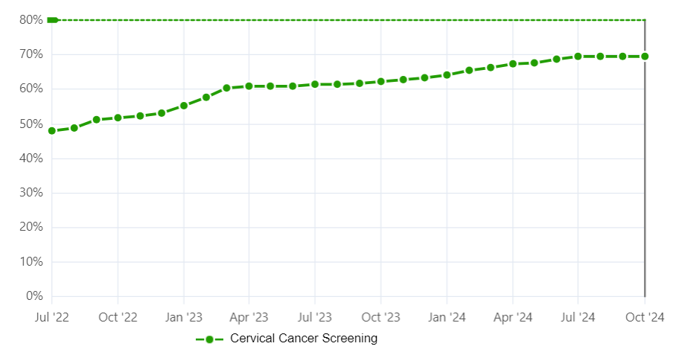
Notes:
Angie
We have had a steady trend upwards throughout the entire project. Starting in July is remained steady at 70%. We attribute this to 3 providers retiring and the efforts to redistribute those patients to new providers. We will continue to watch this and follow our formal control plan as written if the % drops.

Slide 27
Lessons Learned
Involve providers early with data validation
Validate your report/dashboard
Don’t try to tackle too much at once
Be patient
Notes:
Angie
When doing the PDSA, we discovered more by the providers looking at their patients in the dashboard more closely. Many of them gave us lists of patients that should have counted as completed. Make sure you pick provider champions that are willing to step up and fully support the changes with all providers.
We did validate our dashboard early, but found that providers did not trust the data because it was not counting for various reasons as mentioned earlier
Try not to boil the ocean even though it is tempting. This is a measure that will show a steady improvement if the proper workflows/outreach stay in place.
Give it time to show the results of your hard work

Slide 28
Questions
Notes:
Both

Slide 29
Contact Information
Angie Barber, MHA, BSN, RN-BC, CPHQ
Kayleigh Allen, CSW
Director of Quality
abarber@bchhc.org
Quality Population Health Manager
kdallen@bchhc.org

