Slide 1
CREATING A RESILIENT HEALTH CARE SYSTEM THROUGH CULTURE AND STRATEGY
Jim Ulrich, CEO York General
April 8, 2025

Slide 2
OBJECTIVES
11:00am – 11:40am
Describe what makes up an organizations culture and how to keep it vibrant.
Describe the process of strategic planning and the importance of a strong strategic plan for organizational success
Understand how nursing leadership helps to shape the culture of an organization and the role that they should play in the development of a strategic plan
Relate finances, clinical practice, and high-quality care to the organizations strategic plan.

Slide 3
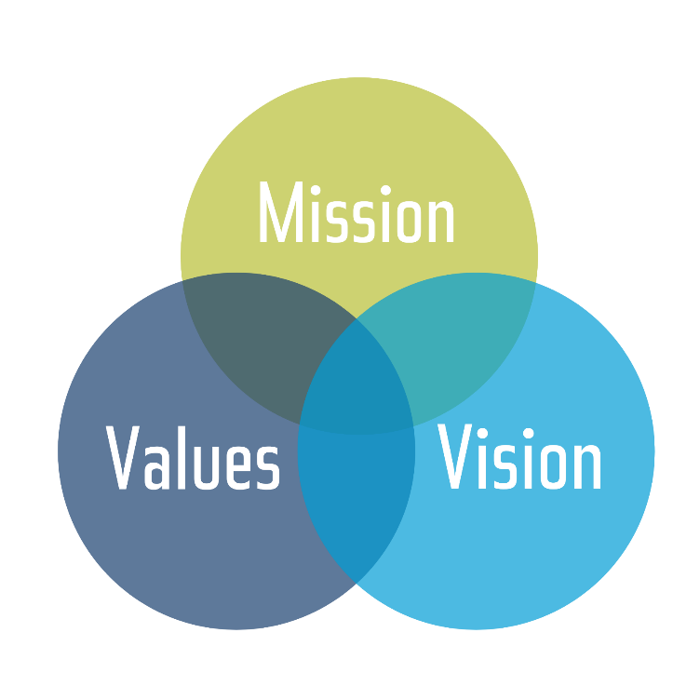
MISSION, VISION & VALUES
York General Mission Statement – Organization’s purpose.
Regional excellence through enhancing health and providing accessible care.
York General Vision Statement – Organizations overall long-term goal/aspiration.
To be our region’s trusted choice for the improvement of health and delivery of quality care throughout life.
York General Values – I CARE – How we act.
I – Innovation
C- Compassion
A - Attentiveness
R – Respect
E – Excellence
Culture

Slide 4
CULTURE
“Defined expectations of behavior, words, symbols, habits, values, and beliefs that directly impact an organization’s work environment, vision & mission, ethical practices, objectives, and performance standards.”
Culture is the “secret sauce” that enables a company to succeed. It is based on the belief system of its founders, which includes:
What they value,
How they reward staff,
What they do for fun, and
The structure (or lack of structure) they create.
Even how they communicate

Slide 5
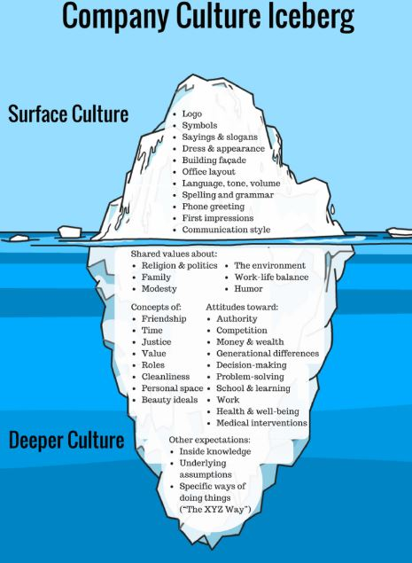

Slide 6
KEEPING THE CULTURE VIBRANT
Reward/Celebrate
Communicate consistently and transparently (be trusting of your team)
Ensure that all team members know their “purpose”
Profess and keep the Mission, Vision, and Values in front of your team
Keep your Culture tools alive and well in your organization. Revitalize this effort if necessary (i.e. Behavior Standards, ERC, KWKT, AIDET, 10/5 rule, Forums/Service Excellence training, CEO Chats, Rounding-Check-ins, etc.)
Strive to increase the level of engagement in your team members. Measure this in your Employee Engagement Surveys.

Slide 7
Hospital_2
Categories of Engagement
Fully Engaged: Employees answered “Strongly Agree” to all four engagement statements listed to the left.
Engaged: Employee response to all four statements averaged “Agree.”
Unengaged: Employee response to all four statements averaged at best “Neutral.”
Employee Engagement
Engagement assesses employees’ emotional and intellectual commitment to York General, based on their agreement to the following statements:
I care about the success of York General.
I am committed to investing my thoughts and ideas into York General.
My work at York General is rewarding.
I feel a sense of ownership in York General.

Slide 8
Employees' Perceptions of York General as a Place to Work

Slide 9
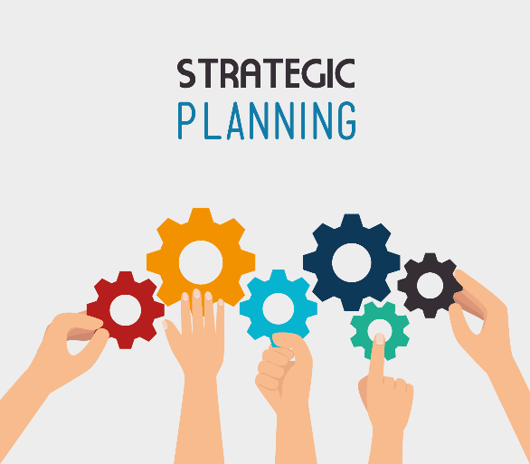
STRATEGIC PLANNING PROCESS
Strategic planning is an organization's process of defining its strategy or direction, and making decisions on allocating its resources to attain strategic goals. It involves identifying goals, necessary strategies, and systems for monitoring progress.

Slide 10
STRATEGIC PLANNING PROCESS
Typical steps in the process of developing and implementing a Strategic Plan
Assess your current organizational strategies and environment (SWOT Analysis, Include Board, Medical Staff, Department Directors, others).
Identify your organization’s goals and objectives. (From the first step, what do you desire to accomplish to uphold your mission and achieve your vision? Address items identified in your SWOT).
Develop your strategic plan and performance metrics to track your progress (Develop tools like a Balanced Scorecard).
Implement and share your plan (Communicate the plan to all stakeholders).
Update stakeholders on the progress of achieving goals and objectives, and revise if necessary (Healthcare is constantly changing).

Slide 11
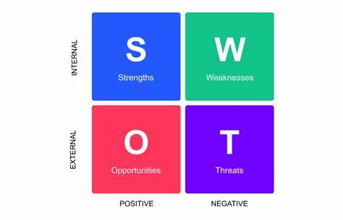
STRATEGIC PLANNING PROCESS
Think of the SWOT analysis as a tool to help open your eyes, in order to see the Strengths, Weaknesses, Opportunities, and Threats of and to your organization. We don’t want to develop “blind spots”. This analysis can be done through a survey given to all of your stakeholders. What great input and perceptions being shared from multiple points of view.

Slide 12
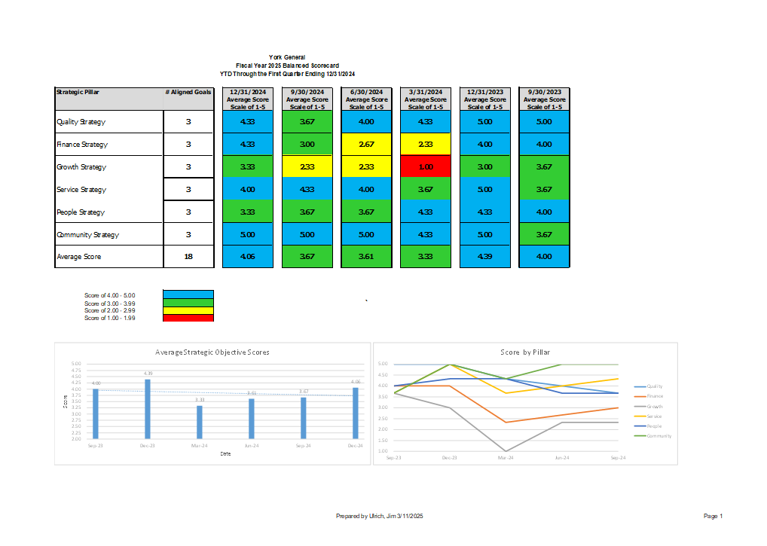
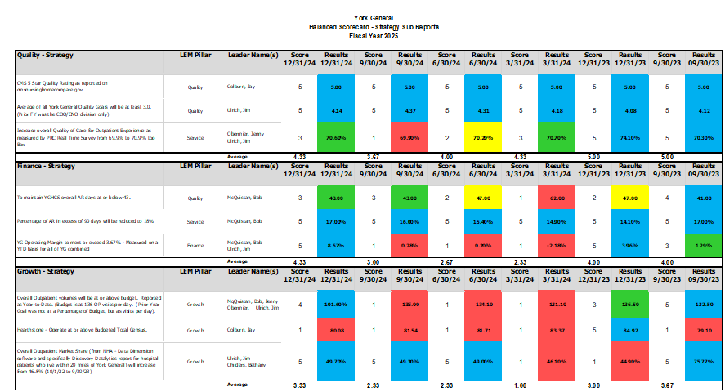
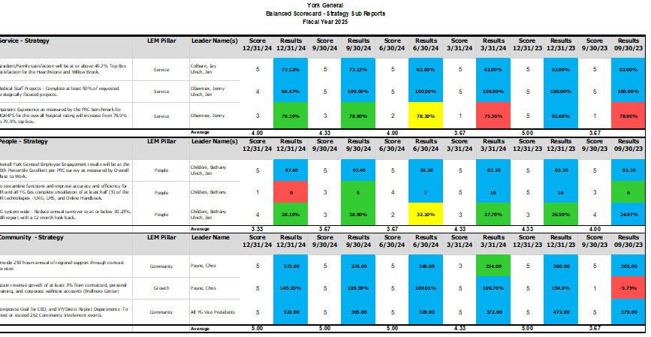
STRATEGIC PLANNING PROCESS
The Balanced Scorecard is a great way to track the progress on your Strategic Plan goals and initiatives through operational key performance indicators or measurements. Below is a snapshot of York General’s Balanced Scorecard.

Slide 13
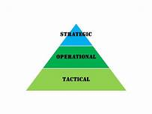
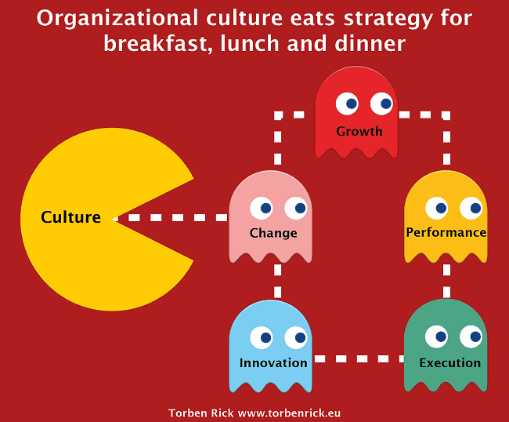
NURSING LEADERSHIP’S ROLE
Leaders – live the Mission, strive for the Vision, and live by the Values and Standards. Get involved in the plan development process by giving input, completing the SWOT, etc. Be owners and advocates for your organization and its strategies. Be role models. Communicate, give purpose, work to engage your teams. Be transparent. Remember that operational and tactical goal achievement are instrumental in moving strategic goals forward toward their achievement. This is where goal alignment is so key. Live the culture. Culture eats strategy...

Slide 14
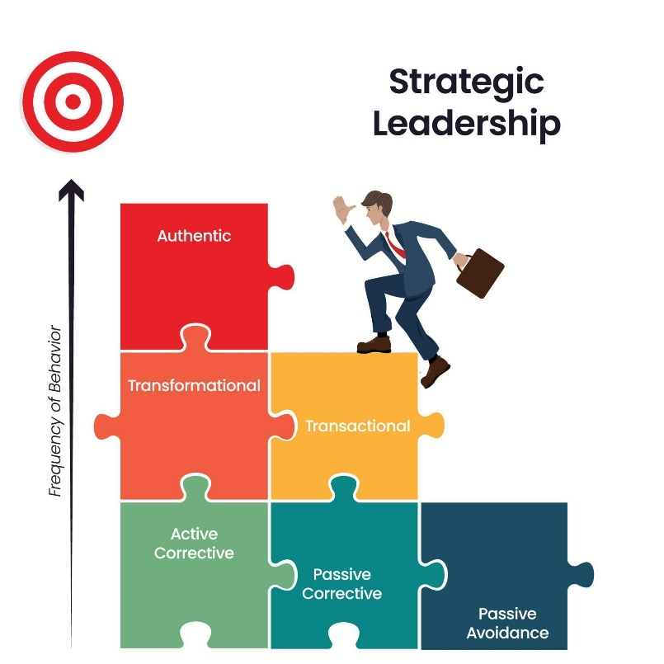
NURSING LEADERSHIP’S ROLE
Strategic leadership involves thinking about the future, creating a vision for the organization, anticipating changes, making strategies, and coordinating resources and people toward a common goal. To become a strategic leader, one should visualize goals, practice strengths-based leadership, model servant leadership, and spend time learning and thinking.

Slide 15
QUESTIONS?

