Slide 1

Quality Residency capstone project
Sara Kubik rn bsn
October 4th, 2024
Brown county hospital

Slide 2
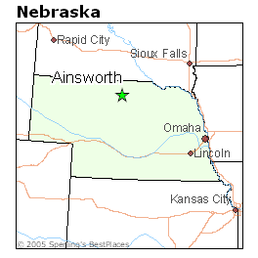
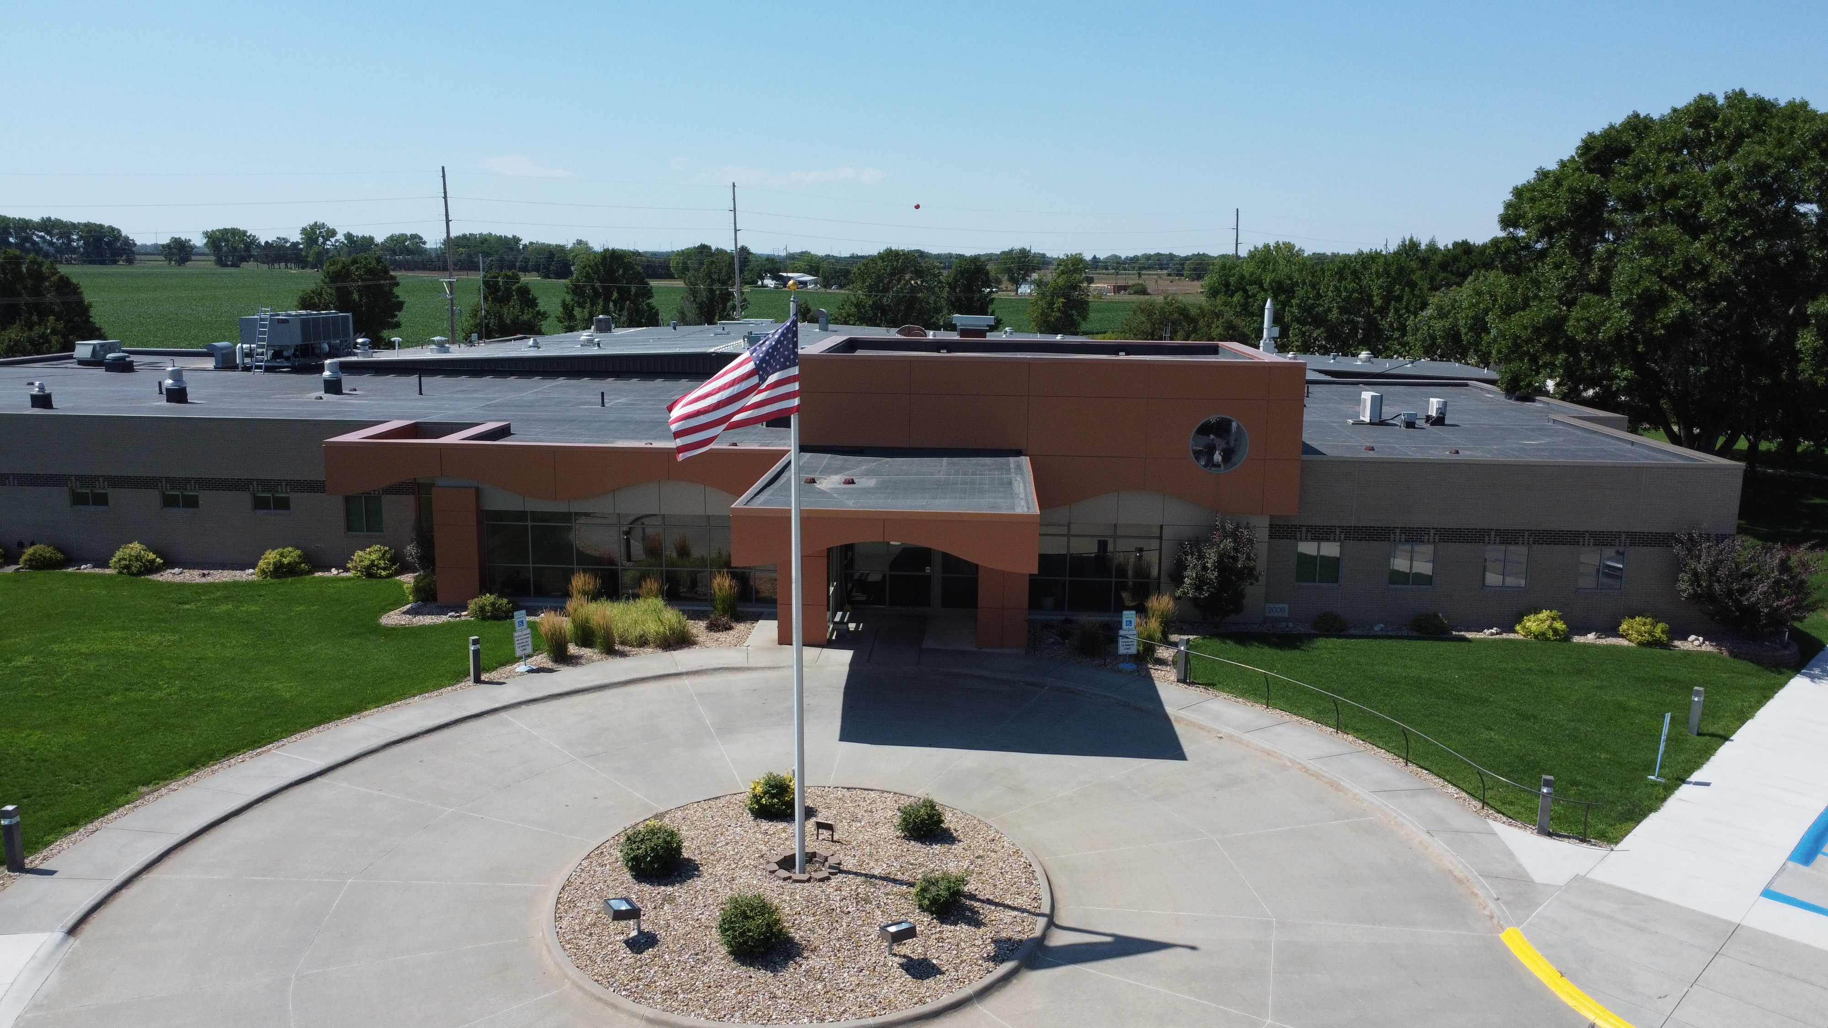
Brown County Hospital
Ainsworth ne
Urine contamination rates
Team members included: Quality (Sara), Infection prevention (deb), Director of nursing (Brandy), Chief Financial Officer (Tad), Nursing staff including rns, lpns and cnas, med techs. And lab team.

Slide 3



The aim of this project is to decrease urine contamination rates from 25% to less than 15% of all collected urinalysis.

Slide 4

Measuring success
The team will see success as contamination rates decrease.
Infection prevention reviews all urine cultures and tracks contamination rates, organisms identified, appropriate antibiotic usage and timely collection.
The quality coordinator and ip work together to track trends. Ip is lab by background and quality is nurse by background.

Slide 5

PDSA the team tracked and trended all contaminated urinalysis on a quarterly basis.
Proper education was provided to nursing staff, techs and cnas about collection.
Education was provided to the ordering providers about using a straight cath technique instead of clean catch on patients because of age, size, cognitive function, trauma diagnosis, or have restricted movement.

Slide 6
Plan-do-study-act
Plan
Ip and quality identified the need for intervention with high rates of urine contamination
Plan was formed to track rates to see what baseline data showed
Do
Data was observed for 3 months
Education was provided to nurses, aides, and providers about project and proper urine collection
Education was provided to clinic and lab staff about how to educate patients on self collection
Study
We learned that basic collection was not being done correctly, patients were not properly cleaned, voiding in hats and commodes and then transferring to ua cup
More education was completed to all staff with special emphasis to the cna’s
Act
It was seen that there was room for improvement
A chart review was conducted on each patient and some where “thrown out” due to colonization.
Special education was completed for patients with urostomy.

Slide 7
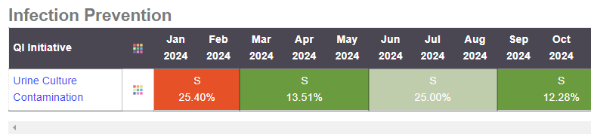

Slide 8
Return on investment
Costs to Consider:
Education time to staff ~ $1000
Recollection/ culture/change abx/Staff time ~$1130
Went from 25% recollection rate ($38,740) to 12% (13,560) for a savings of $25,180
Costs to consider but not easily measured
  Gas to come back for recollection
  Staff time if patient was in a facility (nursing home, ALF)
  Lab staff calling patients back
  Centralized scheduling time to schedule and manage patients
  Time and cost to patient

Slide 10
Maintaining
We plan to continue to watch trends and do annual education along with as needed education and with all new hires within the nursing department

Slide 11
THANK YOU!
Questions
Sara Kubik RN bsn
Quality coordinator, trauma nurse coordinator, nurse educator
Brown county hospital
Ainsworth ne

