Slide 1
NHA Healthcare Quality Update
nebraskahospitals.org
November 15, 2024
Nebraska CAH / RHC Conference on Quality

Slide 2
Key Quality Programs:
MBQIP
eCQM / Interoperability – AUR/ARR reporting
Medicaid Directed Payment – LB 1087
CMS Quality 13th SOW
TOC – 2 year look back
GIS Mapping
Health Equity

Slide 3
Medicare Beneficiary Quality Improvement Project - MBQIP
nebraskahospitals.org

Slide 4
MBQIP Implementation Timeline
2024:
Hospitals prepare for new MBQIP core measures
Hospitals may choose to report the new MBQIP core measures at this time
Hospitals will continue to report current existing MBQIP core measures
2025:
Begin reporting new MBQIP core measures
Global Measures
Patient Safety
Emergency Department
Patient Experience
Care Coordination
Moving from 4 domains to 5 domains
Align with existing quality reporting programs
Final “launch” date: September 1, 2025

Slide 5
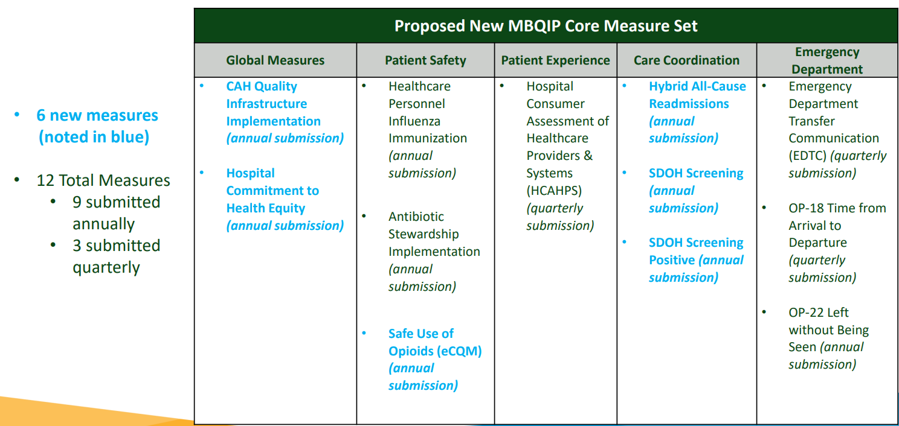
MBQIP:

Slide 6
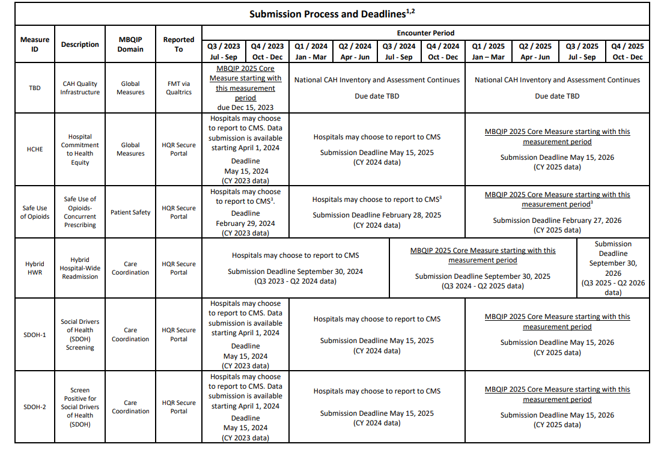
Due November 22, 2024

Slide 7
Promoting Interoperability / eCQMs
(once known as meaningful use)
nebraskahospitals.org

Slide 8
Promoting Interoperability / eCQMs:

Slide 9
Promoting Interoperability / eCQMs:
eCQM Requirements for CY2024
Must report on:
3 self-selected eCQMs;
The Safe Use of Opioids – Concurrent Prescribing eCQM; AND
Severe Obstetric Complications eCQM and Cesarean Birth eCQM

Slide 10
AUR / ARR Reporting in NHSN
nebraskahospitals.org

Slide 12
CMS Updates
2023 Hardship Exception Application Deadline for CAHs is November 30, 2024
Medicare Promoting Interoperability Program
Key Details:
May 1, 2024: Opened Hardship Exception application period for CAHs and eligible hospitals for CY 2023 reporting period.
CAHs must submit their Hardship Exception application by November 30, 2024, to be considered for an exemption from a downward payment adjustment.
How to Submit Your Hardship Exception Application:
Submit application: https://cmsqualitysupport.servicenowservices.com/cms_hh
About the Hardship Exception:
For the CY 2023 reporting period refer to 2015 Edition Cures Update certified electronic health record technology (CEHRT) to meet the Medicare Promoting Interoperability Program requirements.
A downward payment adjustment will apply to CAHs that were not meaningful users of CEHRT, did not meet the minimum score of 60 points, or failed to report electronic clinical quality measure (eCQM) data as required.
CAHs may apply for a Hardship Exception if compliance would result in significant hardship. Please note that simply lacking CEHRT does not qualify for an exception.
If granted, the Hardship Exception applies only for the payment adjustment year, and CAHs must reapply annually. No more than five exceptions may be granted to any one CAH.
Hardship Exception Categories Include:
Infrastructure — CAHs must demonstrate that they are in an area without sufficient internet access or face insurmountable barriers to obtaining necessary infrastructure (e.g., lack of broadband).
Unforeseen Circumstances — This may include events like natural disasters or other unforeseeable barriers that prevent compliance.
EHR Vendor Issues — This applies if a CAH’s EHR vendor was unable to obtain certification or the CAH experienced delays in EHR implementation due to certification issues.
Additional Resources:
For more information on the Hardship Exception process, view the Hardship Exception Fact Sheet.

Slide 13
Nebraska Medicaid Directed Payment Program – LB 1087
nebraskahospitals.org

Slide 14
NHA Updates
LB 1087: Nebraska Directed Payment Program
Soft start -- July 1, 2024
Quarterly progress reports will be submitted to the NHA
First data deadline: November 30, 2024
Annual performance reports will be submitted to CMS
Webpage Dedicated to Directed Payment Program Resources and Information
https://www.nebraskahospitals.org/

Slide 15
Medicaid Directed Payment Program: Quality Initiatives
Key Performance Metrics – Year 1 (July 2024-December 2025)
Social Determinants of Health Screening Compliance
Maternal Postpartum Depression Screening Compliance
CAUTI Infection Rate
Supplemental Measures Related to Governor’s Focused Programming
ED Use for Behavioral Health Primary Diagnosis
Expansion of Age-Friendly Health Systems

Slide 16
Approved Initial Measures
Measure | Numerator | Denominator | Data Source
Complete a screening for Social Determinants of Health (SDOH). | Number of adult patients (>=18 y/o) admitted inpatient to the hospital that receive a SDOH screening that includes each of the five health related social needs (food insecurity, housing instability, transportation needs, utility difficulties, interpersonal safety) during each hospital stay. Only fully complete screenings will be considered applicable. | Total number of inpatient admissions. | Self-Reported – EHR Report
Maternal Post-partum depression screening. | Number of delivering mothers that receive a depression screen after delivery before discharge. | Total number of delivering moms. | Self-Reported – EHR Report
CAUTI | Number of CAUTI infections | Number of catheter days | NHSN or Self-Reported
https://www.nhaqualitydata.org

Slide 17
Potential Goals and Benchmarking
Measure | Current Benchmark | Potential Goal
Complete a screening for Social Determinants of Health (SDOH) | NA | 35% by the end of 2025. 55% by the end of 2026. 80% by the end of 2027.
Maternal post-partum depression screening | 66% November 2023 per NPQIC data | 71% by the end of 2025. 75% by the end of 2026. 80% by the end of 2027.
CAUTI | 0.743 SIR for All Locations 1.152 SIR for Acute Hospitals (non-ICU) | 0.7 by end of 2025

Slide 18
Behavioral Health – ED Data

Slide 19
Hospital Reporting Cadence - initial year (18-month lookback)– July 1, 2024 through December 2025:
Reporting Period | July 1, 2024 -- September 30, 2024 | October 1, 2024 – December 31, 2024 | January 1, 2025 – March 31, 2025 | April 1, 2025 – June 30, 2025 | July 1, 2025 – September 31, 2025 | October 1, 2025 – December 31, 2025 | January 1, 2025-December 31, 2025
Data Submission Date | November 30, 2024 | February 28, 2025 | May 31, 2025 | August 31, 2025 | November 30, 2025 | February 28, 2026 | February 28, 2026
Only for SDOH Screening Measure
CMS Statewide Report will be submitted by the Nebraska Hospital Association on June 30, 2026.

Slide 20
CMS 13th SOW
nebraskahospitals.org

Slide 21
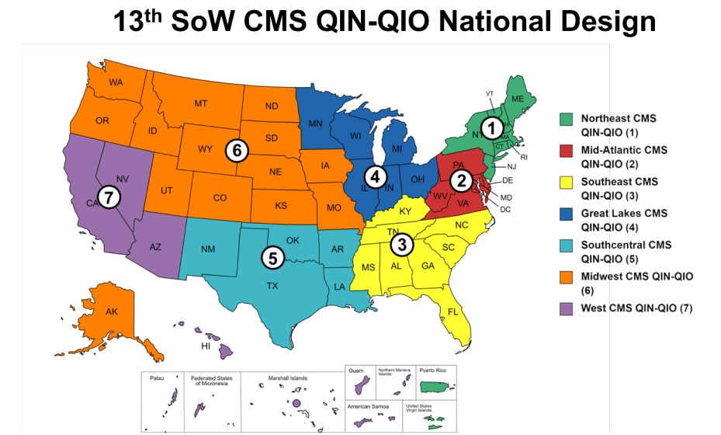
13th SOW

Slide 22
Transitions of Care and LB227
nebraskahospitals.org

Slide 23
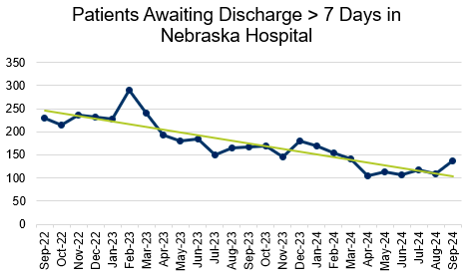

Slide 24
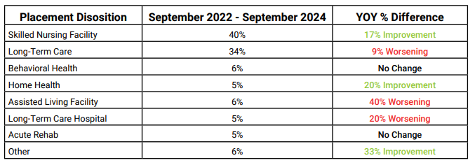
2-Year Transitions of Care Report
Breaking the Pattern: Driving Initiatives to Safely Transition Patients Across the Care Continuum
41% improvement rate in patient discharge delays since 2022
71% of patients awaiting placement need skilled nursing or long-term care

Slide 25
2-Year Transitions of Care Report
Most Common Reasons for Delay in Placement
Dialysis Needs
Peg Tube Needs
Tracheostomy Care Needs
Geriatric Psych
Dementia Care Needs
Bariatric Needs
Alcohol and Substance Use Disorder
Adult Behavioral Health Needs
Adolescent Behavioral Health Needs
Other Reasons
Workforce Shortages
Hemodialysis
Transportation
Post-Acute Facility Closures
Prior Authorization Delays
Medicaid Pending
Patient Factors

Slide 26
2-Year Transitions of Care Report
Solutions that are Driving Effective Change
Transitions of Care Council
Nebraska Advocacy
LB227 – Change provisions relating to public health and welfare
LB434 – Require DHHS to enroll LTACHs as providers under the medical assistance program and submission of a SPA of waiver
LB157 – Provide appointment of temporary guardians
LB517 – Require DHHS to pay discharge incentives to post-acute placement facilities

Slide 27
2-Year Transitions of Care Report
Solutions that are Driving Effective Change
Regional Case Management Collaborative Calls
Reverse Transfers
Medicaid Workgroup
Improving Guardianship Efforts
Additional Needs
Increase Access to LTC and BH Services
Enhance Transportation Access
Improve Processes to Expedite the Medicaid Application Process

Slide 28
2-Year Transitions of Care Report
2 Years in Review
41% improvement in patients awaiting post-acute placement | 20% of patients needing LTC placement are waiting >6 months
40% improvement in patients awaiting a skilled nursing facility | 37% of patients needing skilled nursing placement are waiting >30 days
29% improvement in patients awaiting a long-term care facility
73% improvement in patients boarded in Emergency Departments | 70% of patients needing long-term care placement are waiting >30 days

Slide 29
GIS Mapping
nebraskahospitals.org

Slide 30
Top 10 Reasons for Inpatient Hospitalization
ICD-10 Diagnoses | Total Discharges in 2023
Septicemia | 12,888
Heart Failure | 5,044
Depressive Disorders | 4,781
Cardiac Dysrhythmias | 3,637
Pneumonia | 3,301
Hypertensive Complications During Pregnancy | 3,227
Diabetes Complications | 3,095
Acute Myocardial Infarction | 2,713
Respiratory Failure | 2,766
Renal Failure | 2,613

Slide 31
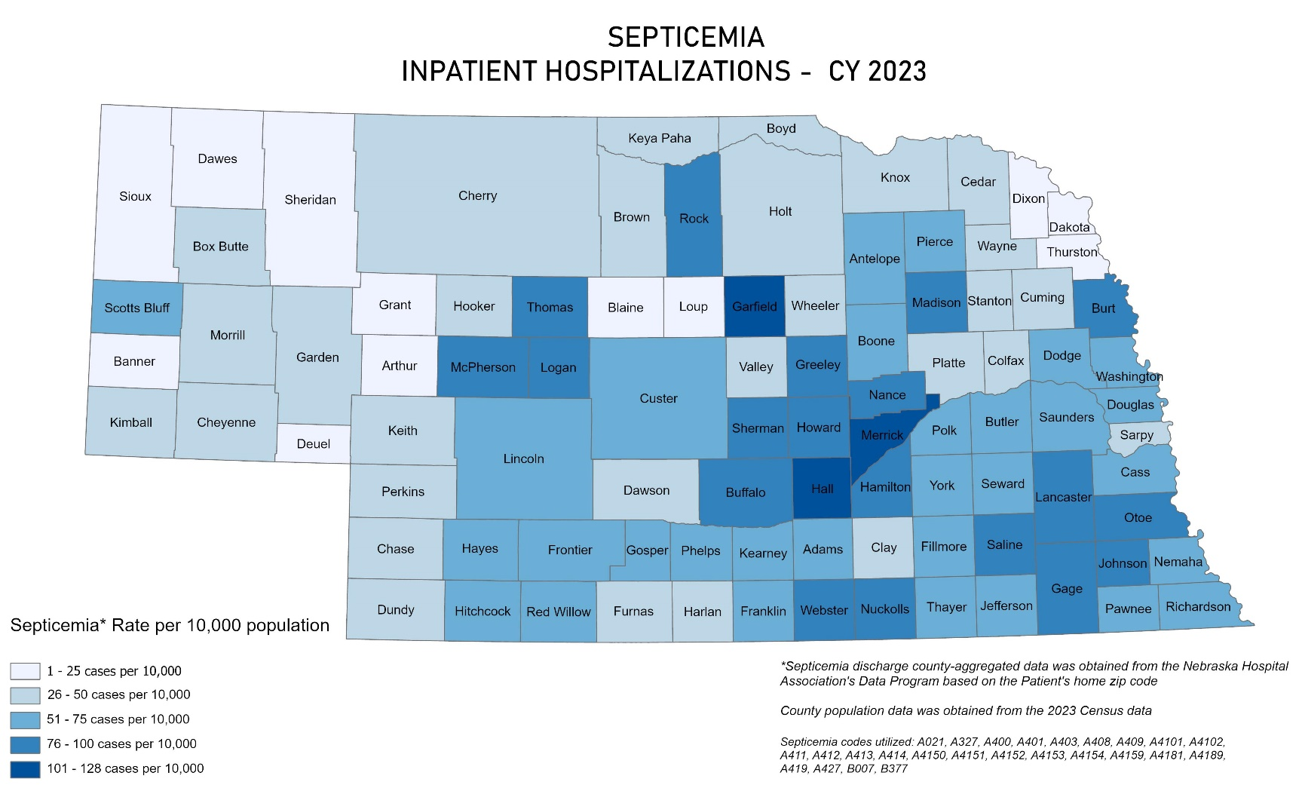
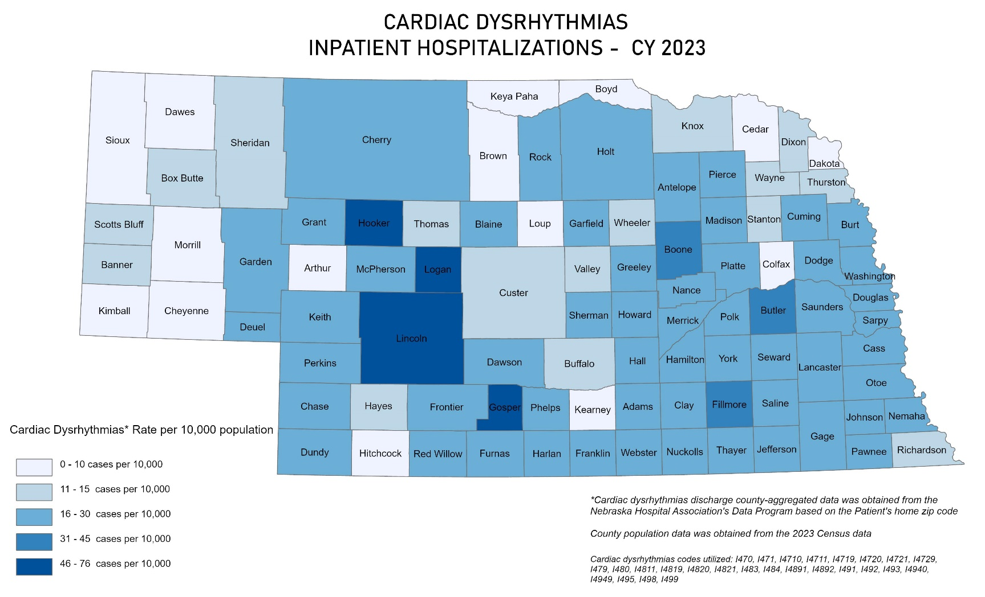
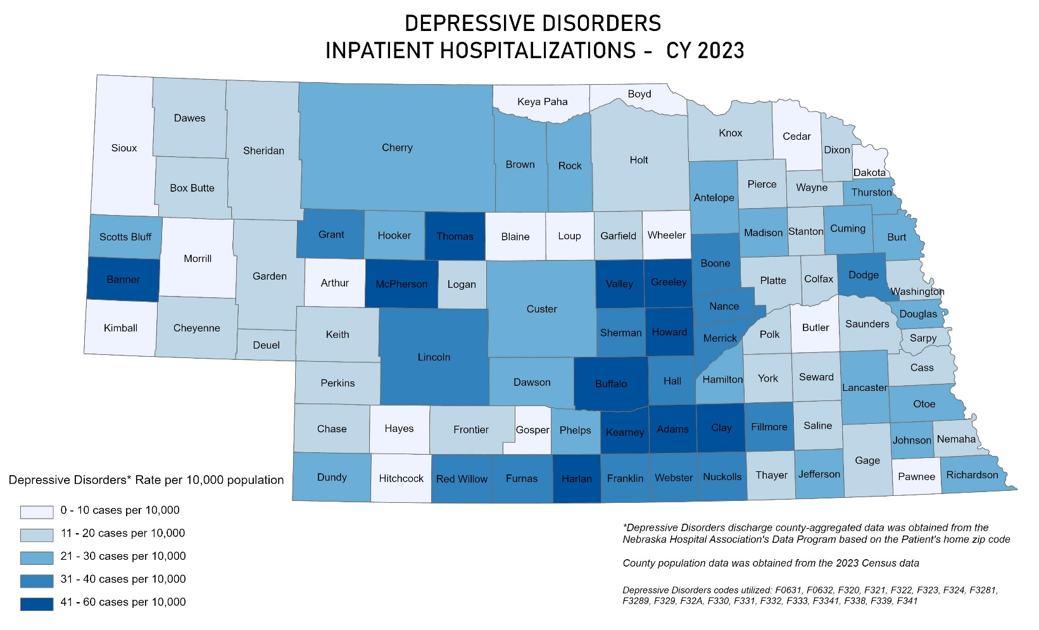
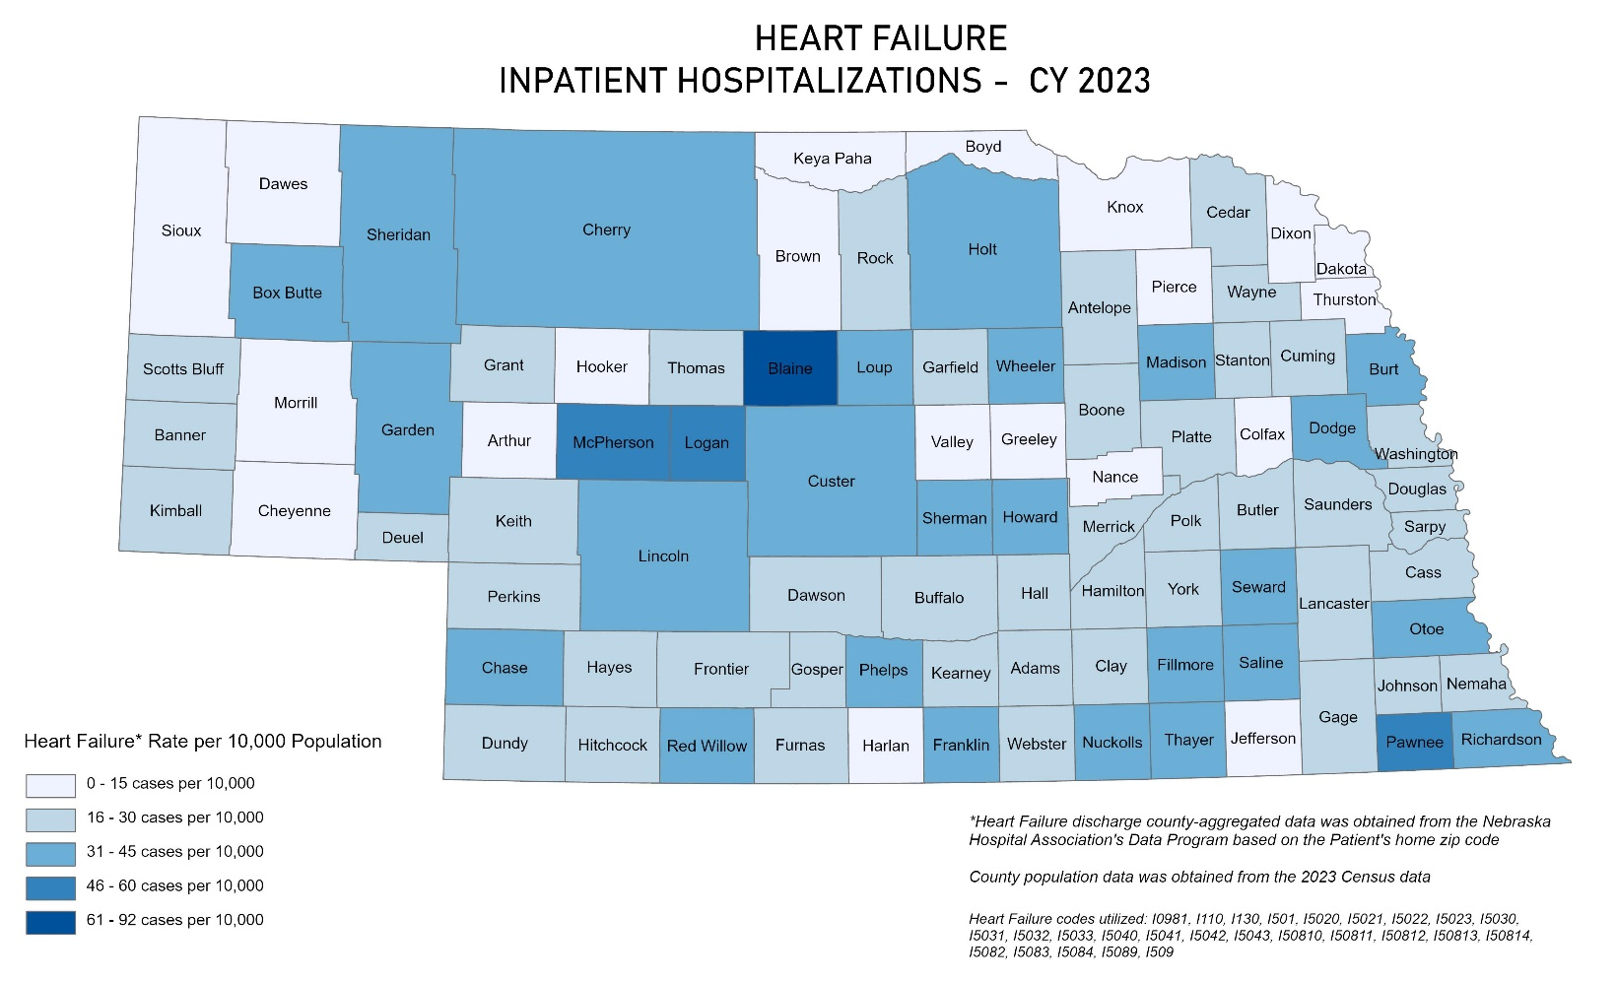

Slide 32
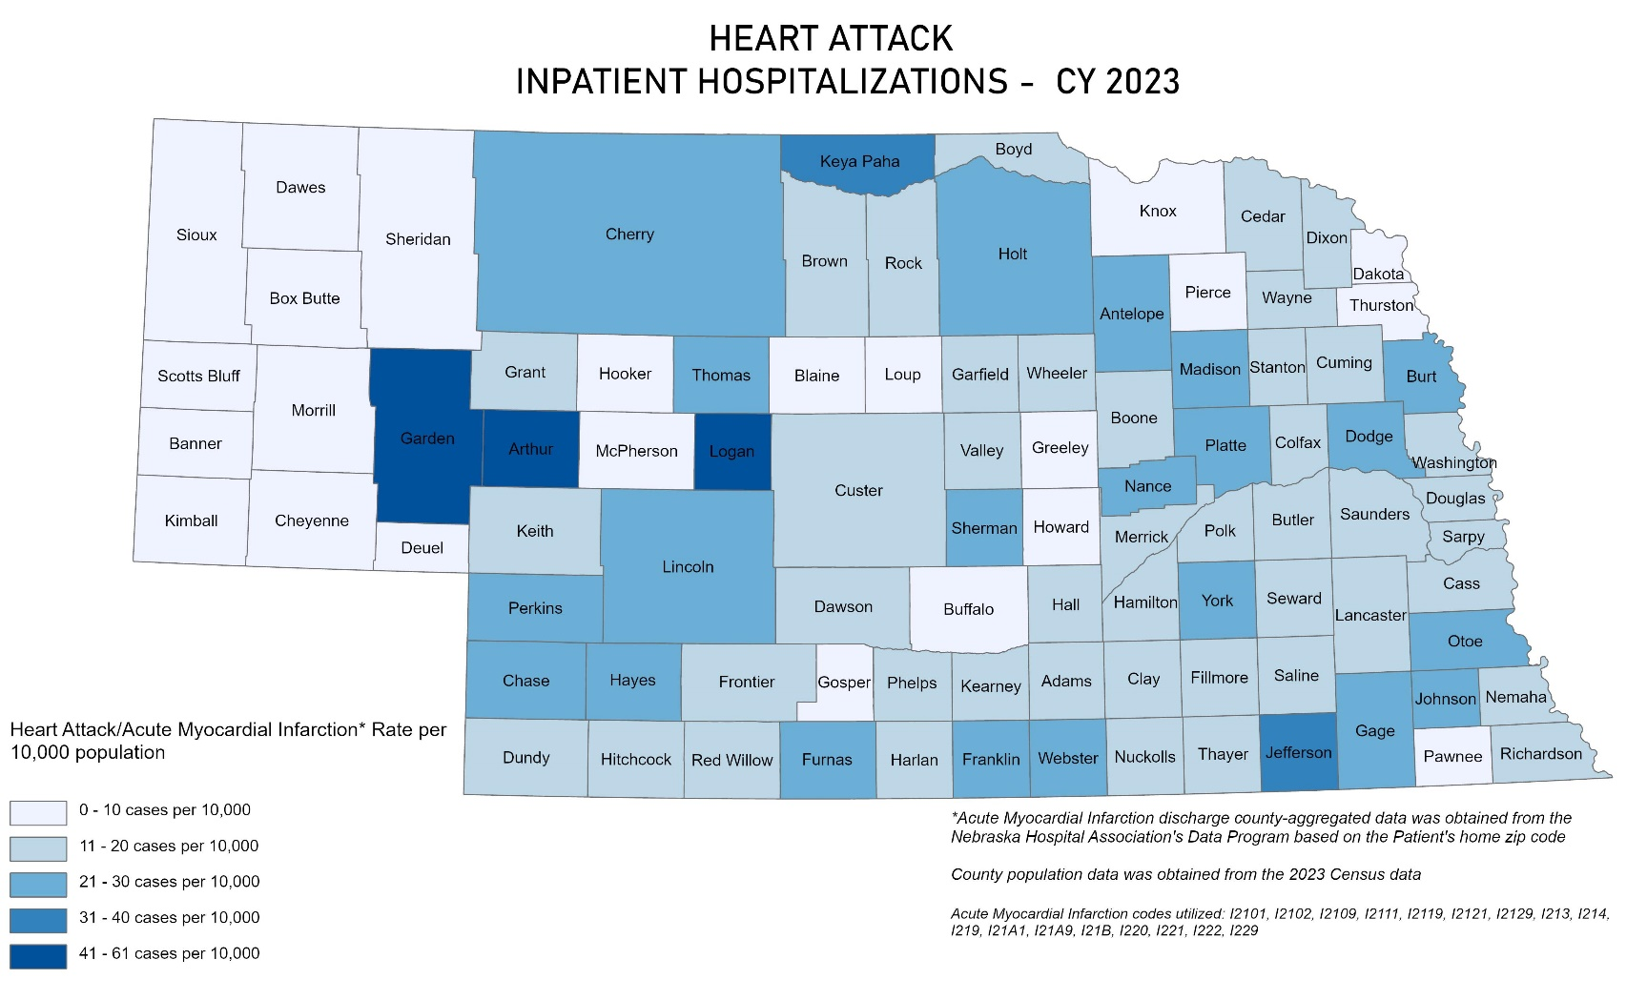
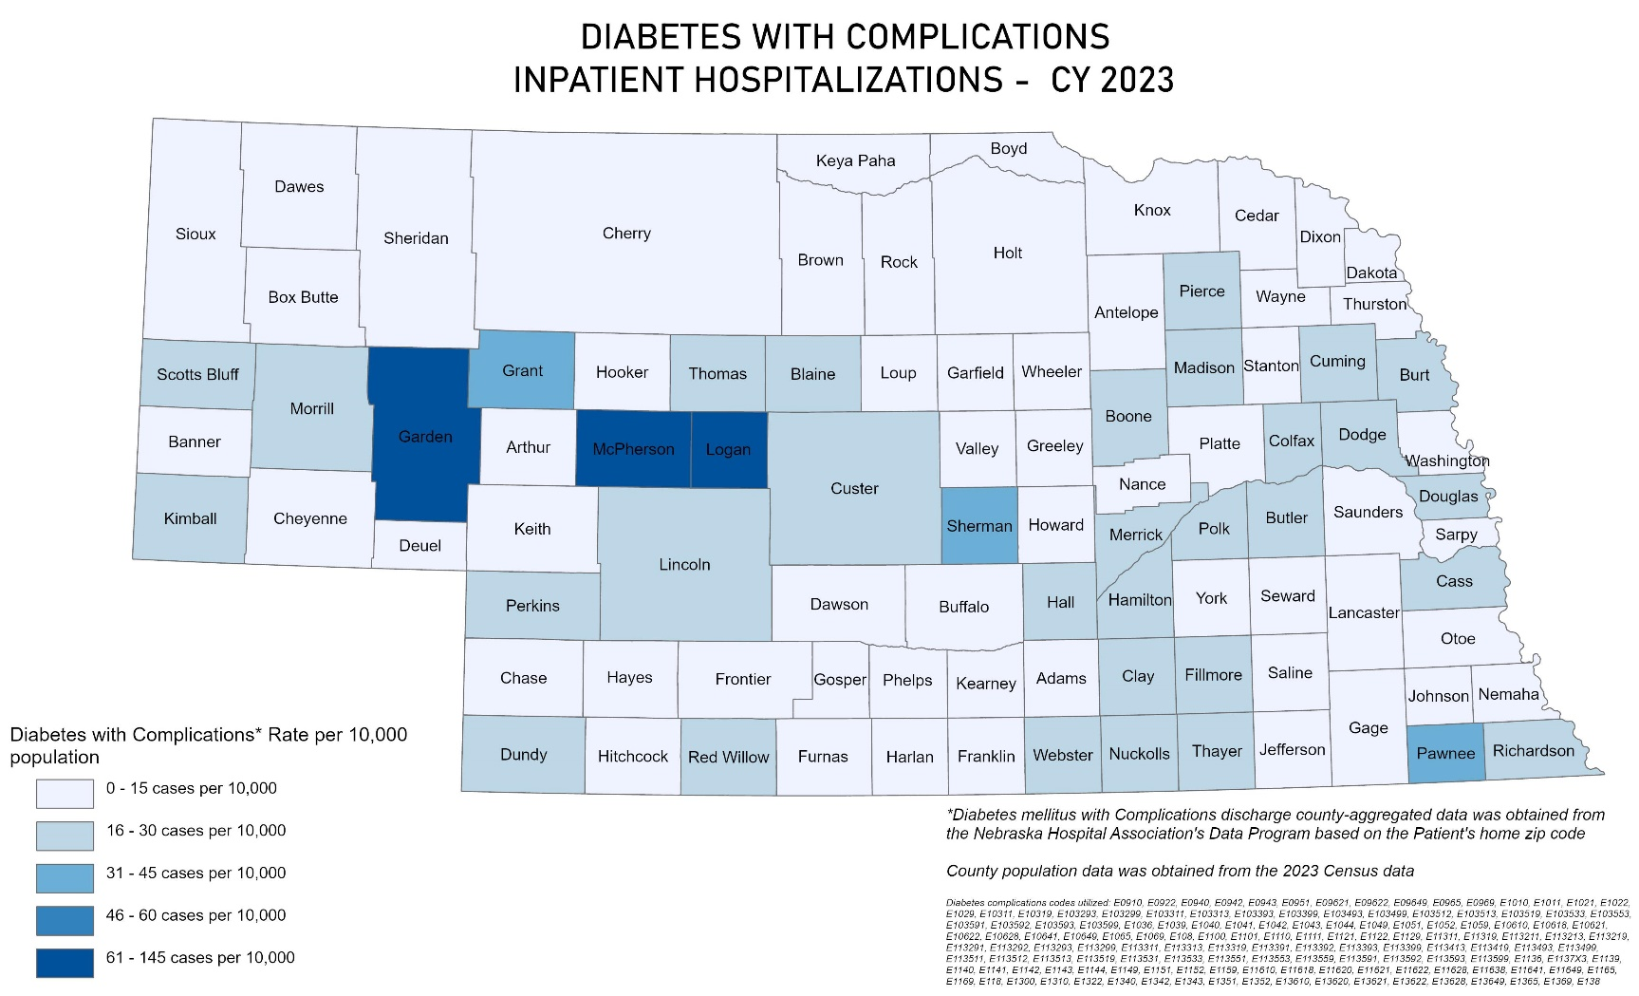
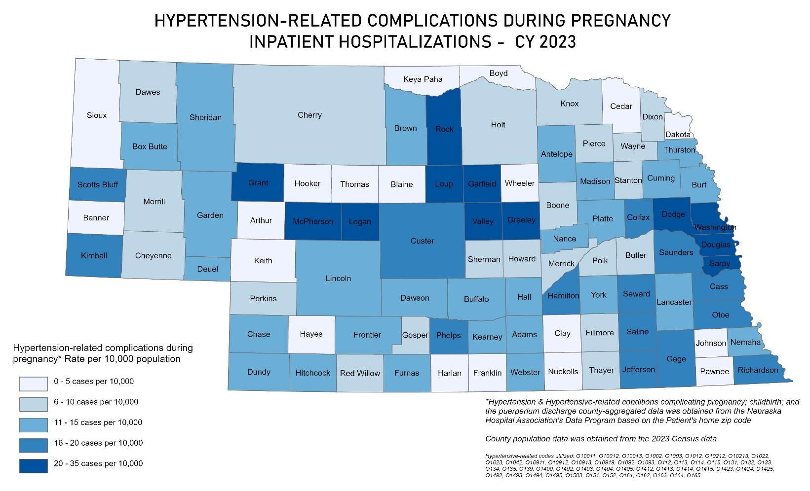
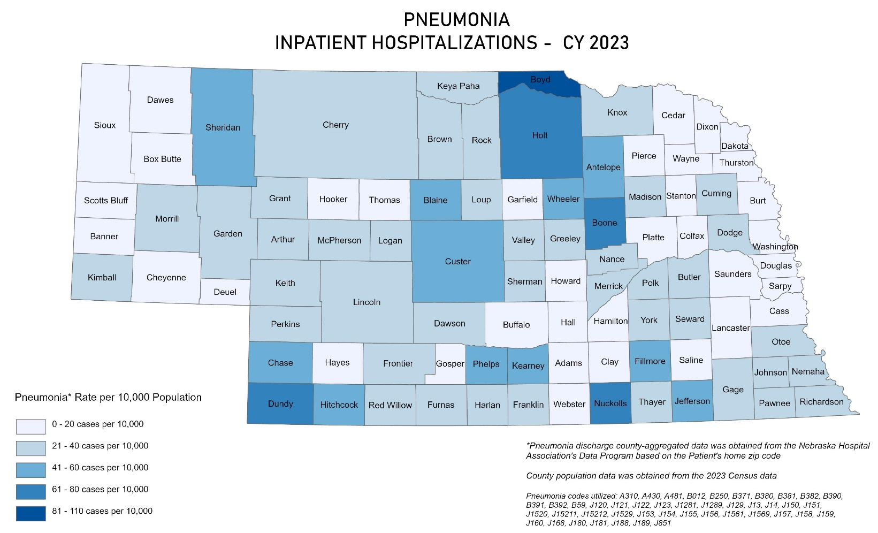

Slide 33
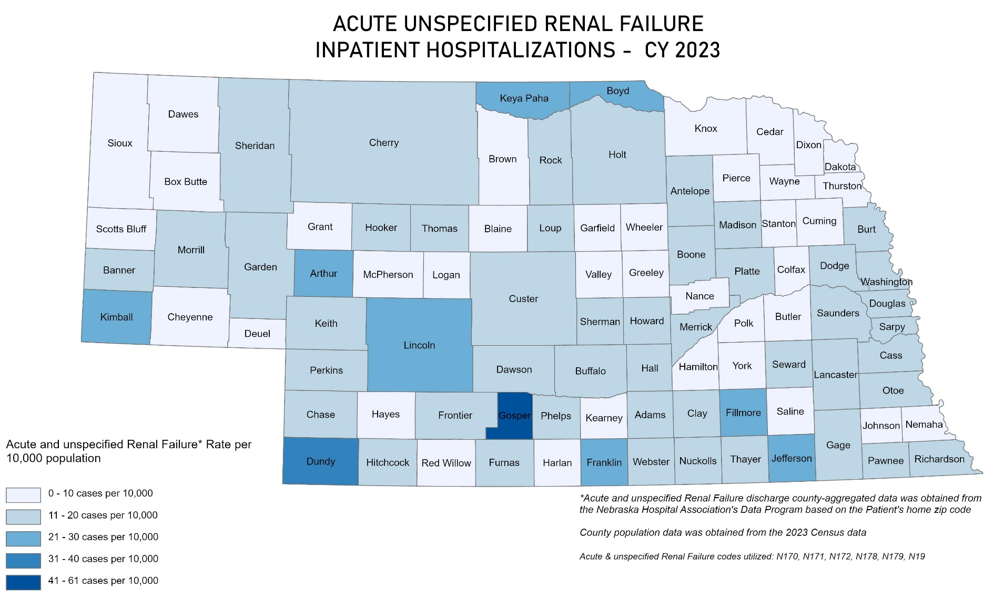
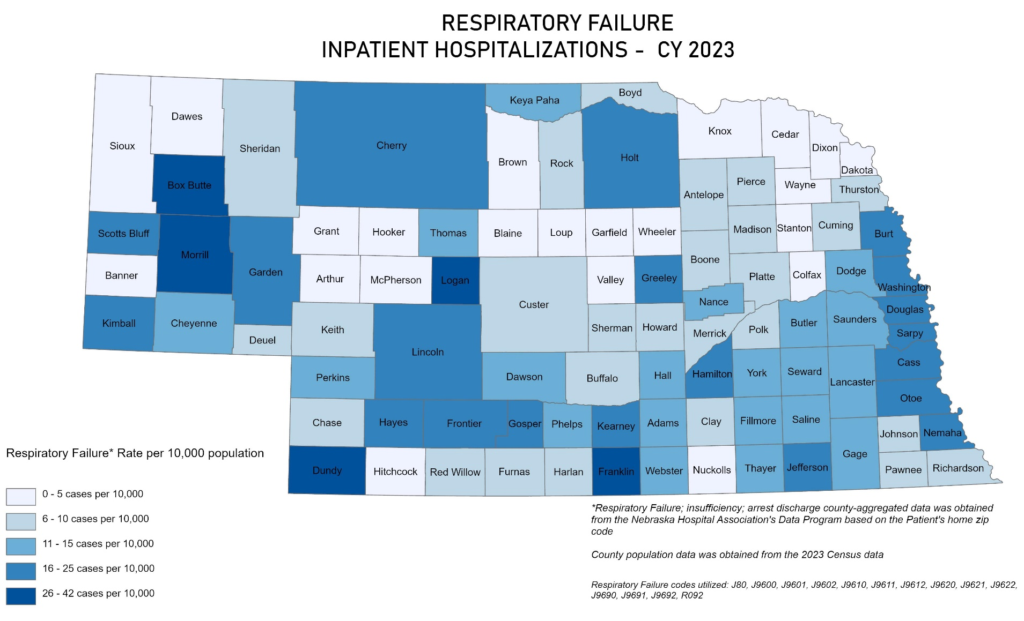

Slide 34
What’s in the Booklet?
Counties with highest rates
How to use the data
Resources
How to pull your own data
What’s Next?
Pull individual data
Identify opportunities for improvement
Build QI projects related to the needs of your organization and community

Slide 35
Health Equity Toolkit
nebraskahospitals.org

Slide 36
What’s New?
REaL/Age Data
Gap analysis to assess SDOH and REaL/Age data collection
Sample Scripting
Conversation starters
“I’m going to ask you some questions about your background. We ask these questions so we can provide the best care to every patient.”
Language
“In what language would you prefer to communicate with the medical team.”
Race
“Is there a racial group you identify with?”
Ethnicity
“What ethnic background do you identify with?”
“Where is your family from?”
Hispanic
“Do you identify as Hispanic or Latino?”

Slide 37
What’s New?
SDOH Sample Scripting
• “Many times, our patients come to us with needs beyond just medical, for example, housing, food, and transportation. While we don’t help with those directly, we do have partners in the community who can help, and we would like to link you with them. Would you mind if I ask you a few questions to see if there are resources I can share?”
“At [insert name], we believe that basic needs influence a patient‘s overall health. We would like to begin to screen patients for different types of basic needs so that we can help connect them with resources to assist them with these needs. For some needs, we may not be able to connect patients with resources to assist them, but we would like to identify community needs that we need to create resources for as well.”
“As part of your visit today we’d like to help with other resources to help you/your family maintain your health. Some examples of these include food, housing, utility assistance, and transportation. Could we ask you a few questions to see if you have any needs in these areas?”

Slide 38
What’s New?
Putting it all together
Creating a team
Identify priority areas
Use PDSA model to create and implement PI plans
Resources
SDOH and Z-Codes
MCO Connections and Resources
Molina Healthcare
Nebraska Total Care
United Healthcare

Slide 39
2025 Scholarship Opportunity
Get reimbursed for:
Early bird conference registration fee
Hotel accommodations for nights beginning on the first day through the last full day of the conference
Cost of economy air travel up to $800 round-trip
Eligibility:
Employee of NHA member hospital
Hospital must be in good standing with Nebraska’s required data reporting
Have not received a scholarship in the previous consecutive year
Attest to sharing knowledge gained at conference through a presentation, webinar, tool development, etc.
Deadline to Apply: December 10, 2024
National Conferences
AHA Rural Healthcare Leadership | February
APIC National Conference | June
AHA Leadership Summit | July
IHI National Conference | December
Nebraska Conferences
NICN Primary Infection Prevention Course
Nursing Leadership
NHA Convention
NPQIC Conference
Antimicrobial Stewardship Summit

Slide 40
Mark your Calendars for 2025
Advocacy Day | Lincoln
March 12, 2025
Nursing Leadership Conference | Kearney
April 8-9, 2025
Nebraska Rural Health Conference | Kearney
June 9-11, 2025
Annual Convention | Omaha
October 22-24, 2025
CAH/RHC Conference on Quality | Kearney
November 13-14, 2025

Slide 41
What to Expect after the Conference
10-day e-mail series following keynote speaker
Review scholarship opportunity
Plan to apply for QFE in 2025
Save the date for 2025 events

