Slide 1
Quality Residency
Capstone Project
nebraskahospitals.org
Jordan Siegel BSN,RN , October4,2024, Annie Jeffrey Memorial County Health Center

Slide 2
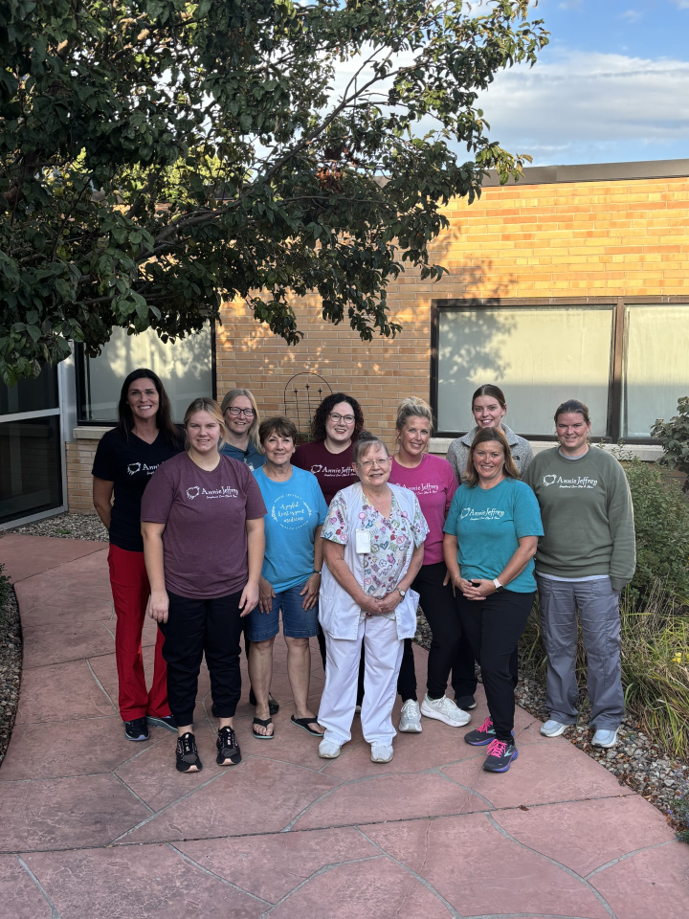
Introduction to the Organization, Project, Team
16 bed Critical Access Hospital
Only hospital in Polk County- nearest hospitals are 30 minutes away
Services include:
Emergency Department- Level IV Trauma Center
Outpatient Services
Inpatients/ Swing Beds
Obstetrics
Surgery
Sepsis Committee
Jordan Siegel BSN, RN
Kim Yungdahl BSN, RN , DON
Kamrie Peterson MSN,MBA, RN
Katie Steager BSN, RN
Jordan Eller PA-C
Megan Sutton RN
Jamie Johnson Pharm-D
Maryssa Schleis MLS
Nataly Sanley- Chief Operating Officer
Chris Gabel RN, Clinical IT
Heather Roberts BSN, RN
Notes:
Overview of Project: I chose to look at our Sepsis order set and how we care for our Sepsis patients. Research reported that we were not screening appropriately in the ED or starting our ATBS in a timely manner. I started with educating nurses to screen all patients 18 and older in the ED for Sepsis and to report positive screens to the providers. After a few months of auditing our positive screen charts, I noticed a trend in our door to antibiotic times. We were way over the goal of 60 minutes. Our average for Quarter 2 was about 104.5 minutes.

Slide 3
AIM Statement
The aim of this project is to decrease the door to antibiotic administration time in suspected sepsis patients in the Emergency Room from 116.22 minutes to 60 minutes in 75% of ED patients 18 and older by January 1, 2025.

Slide 4
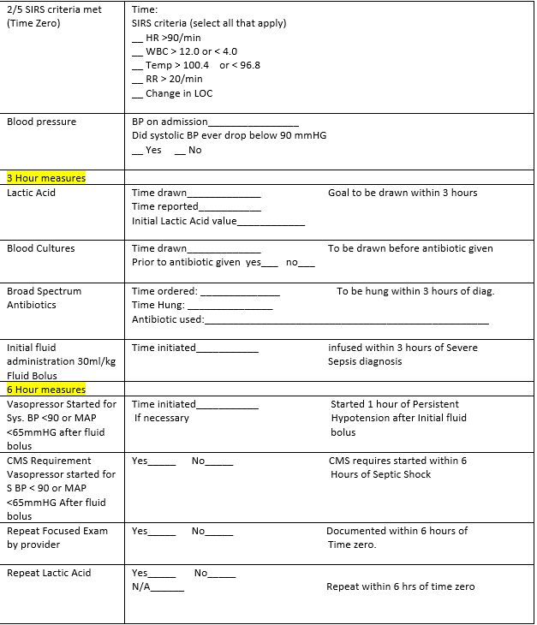
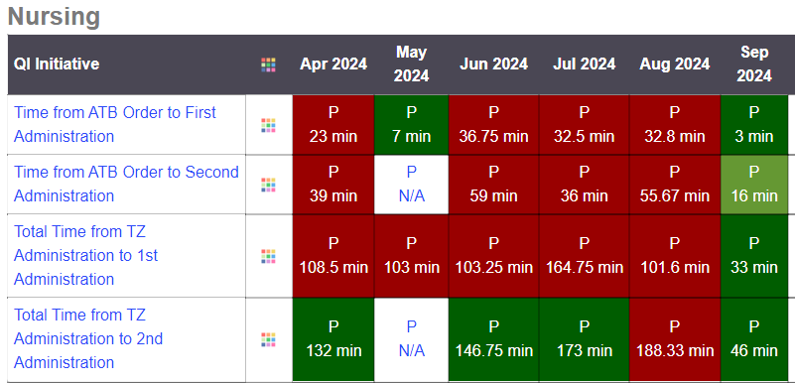
Measuring Success
Monthly Audit of all ED charts 18 and older for Sepsis Screening
Review all positive sepsis screening charts and using a data collection worksheet marked the times antibiotics were given and administered
Time zero to antibiotic administration time was calculated in minutes and compared to the goal of 60 minutes .
Notes:
So finding the data in our EHR was a bit of a challenge, I had to go into every ER chart over 18 and older and look through the charting for the sepsis screen . I couldn’t pull a good report. Then if it was positive I had to search through the labs and EMAR for times. Thank you Carmen for the data collection tool!

Slide 5
Selecting Changes
Reviewed current practice with staff and what was available in the EHR
Began screening all patients 18 and over for Sepsis in the ED- this screening was already in nursing documentation.
Created a Sepsis Committee- consisting of pharmacy, quality assurance , clinical IT, 2 floor nurses ( one from each shift), a provider, DON, lab , COO, and the sepsis coordinator.
Met with providers and talked about bundle measures and their processes
Identified that we were over the goal of 60 minutes for our first antibiotic administration times
Reviewed workflow
Notes:
The Sepsis Committee performed a GAP analysis to see where we sat as a facility. We then discussed what we could do to improve.

Slide 6
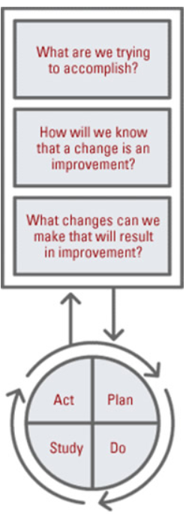
Plan ~ Do ~ Study ~ Act
Screen all patients 18 and older for sepsis in the ED
My hope was to improve early identifications and initiate bundles quicker to improve patient outcome
Observe current Sepsis practices
Educate nursing on how to properly screen for Sepsis , charting properly and notifying Providers
Staff was unaware of where Sepsis screen was in the ED. Found that Sepsis Screen is not in the Trauma Documentation they have to open a different flow sheet
Observed we were not screening appropriately and therefore not treating appropriately.
Room for improvement in our antibiotic administration times
Sepsis screening to be completed in ED on all 18 and older patients

Slide 7
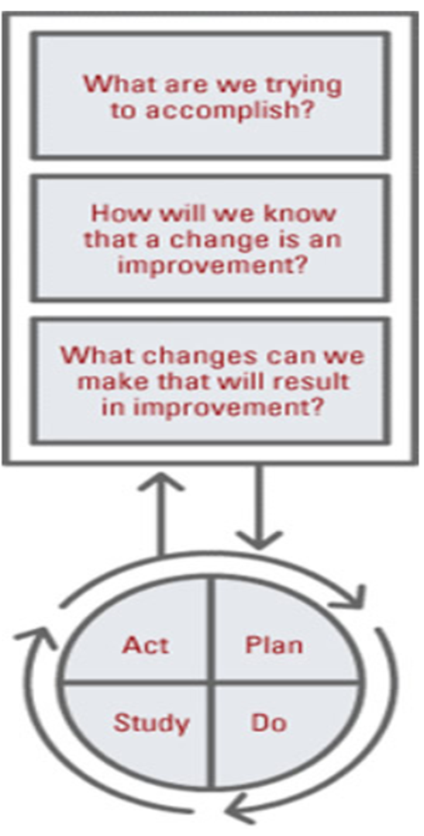
Plan ~ Do ~ Study ~ Act
Plan: Decrease the door to antibiotic administration time in suspected sepsis patients 18 and over in the ED.
Goal: Decrease Antibiotic time from 160 minutes to 60 minutes
Plan
Observe current antibiotic usage and administration times
Identified that TruBridge did not alert when nursing screened positive. Created a workflow
for providers and nursing to communicate
Educate nurses and providers on early identification and sepsis bundle standards
Do
There was a large time period between time zero and the first antibiotic being administered
Measurement goal was not met- but improving from 160 minutes in July to 84 minutes in August
Study
Changes I think will be sustained , its integrated as part of the ED workflow.
Continuing to educate providers and nursing on Sepsis and Sepsis Bundles
Act

Slide 8
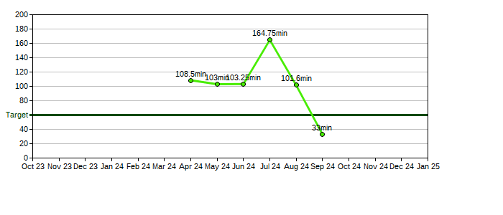
Data and Trends
Monthly audit of all ED patients 18 and older starting in April
Shared with Nursing and Providers
Noticed in July are times were really delayed, provided education to the Midlevel's.

Slide 9
Return on Investment (ROI)
Explore the financial implications of the project:
Will costs/expenses be incurred to make noted changes?
No Additional staff needed
Personnel time- lab coming back for repeat draws
Variable costs ( diagnostics, therapeutics, supplies)- a positive screen costs around $2000
No IT expense – Sepsis screening built into EHR prior
Sepsis re-admit costs the facility around $7,000-8,000 a day
What savings/revenue will be noted?
Early recognition and standardized management of sepsis, including early administration of appropriate antimicrobials, have improved sepsis mortality
Increased billable codes
Patients with sepsis who receive timely care have shorter hospital stays and lower costs than patients who receive delayed care
The financial implications on Sepsis are astounding. According to NHA Sepsis Toolkit average annual margin loss of sepsis care in small hospitals with less than 200 beds is about $9.9 million
Notes:
Some direct costs would be length of stay, variables costs for increased equipment, indirect costs would be surveillance, reporting, QI initiatives, delayed treatment / delayed diagnosis or mis diagnosis overall cost of sepsis care per day – and early intervention = shorter LOS which equates to fewer nursing hours and supplies

Slide 10
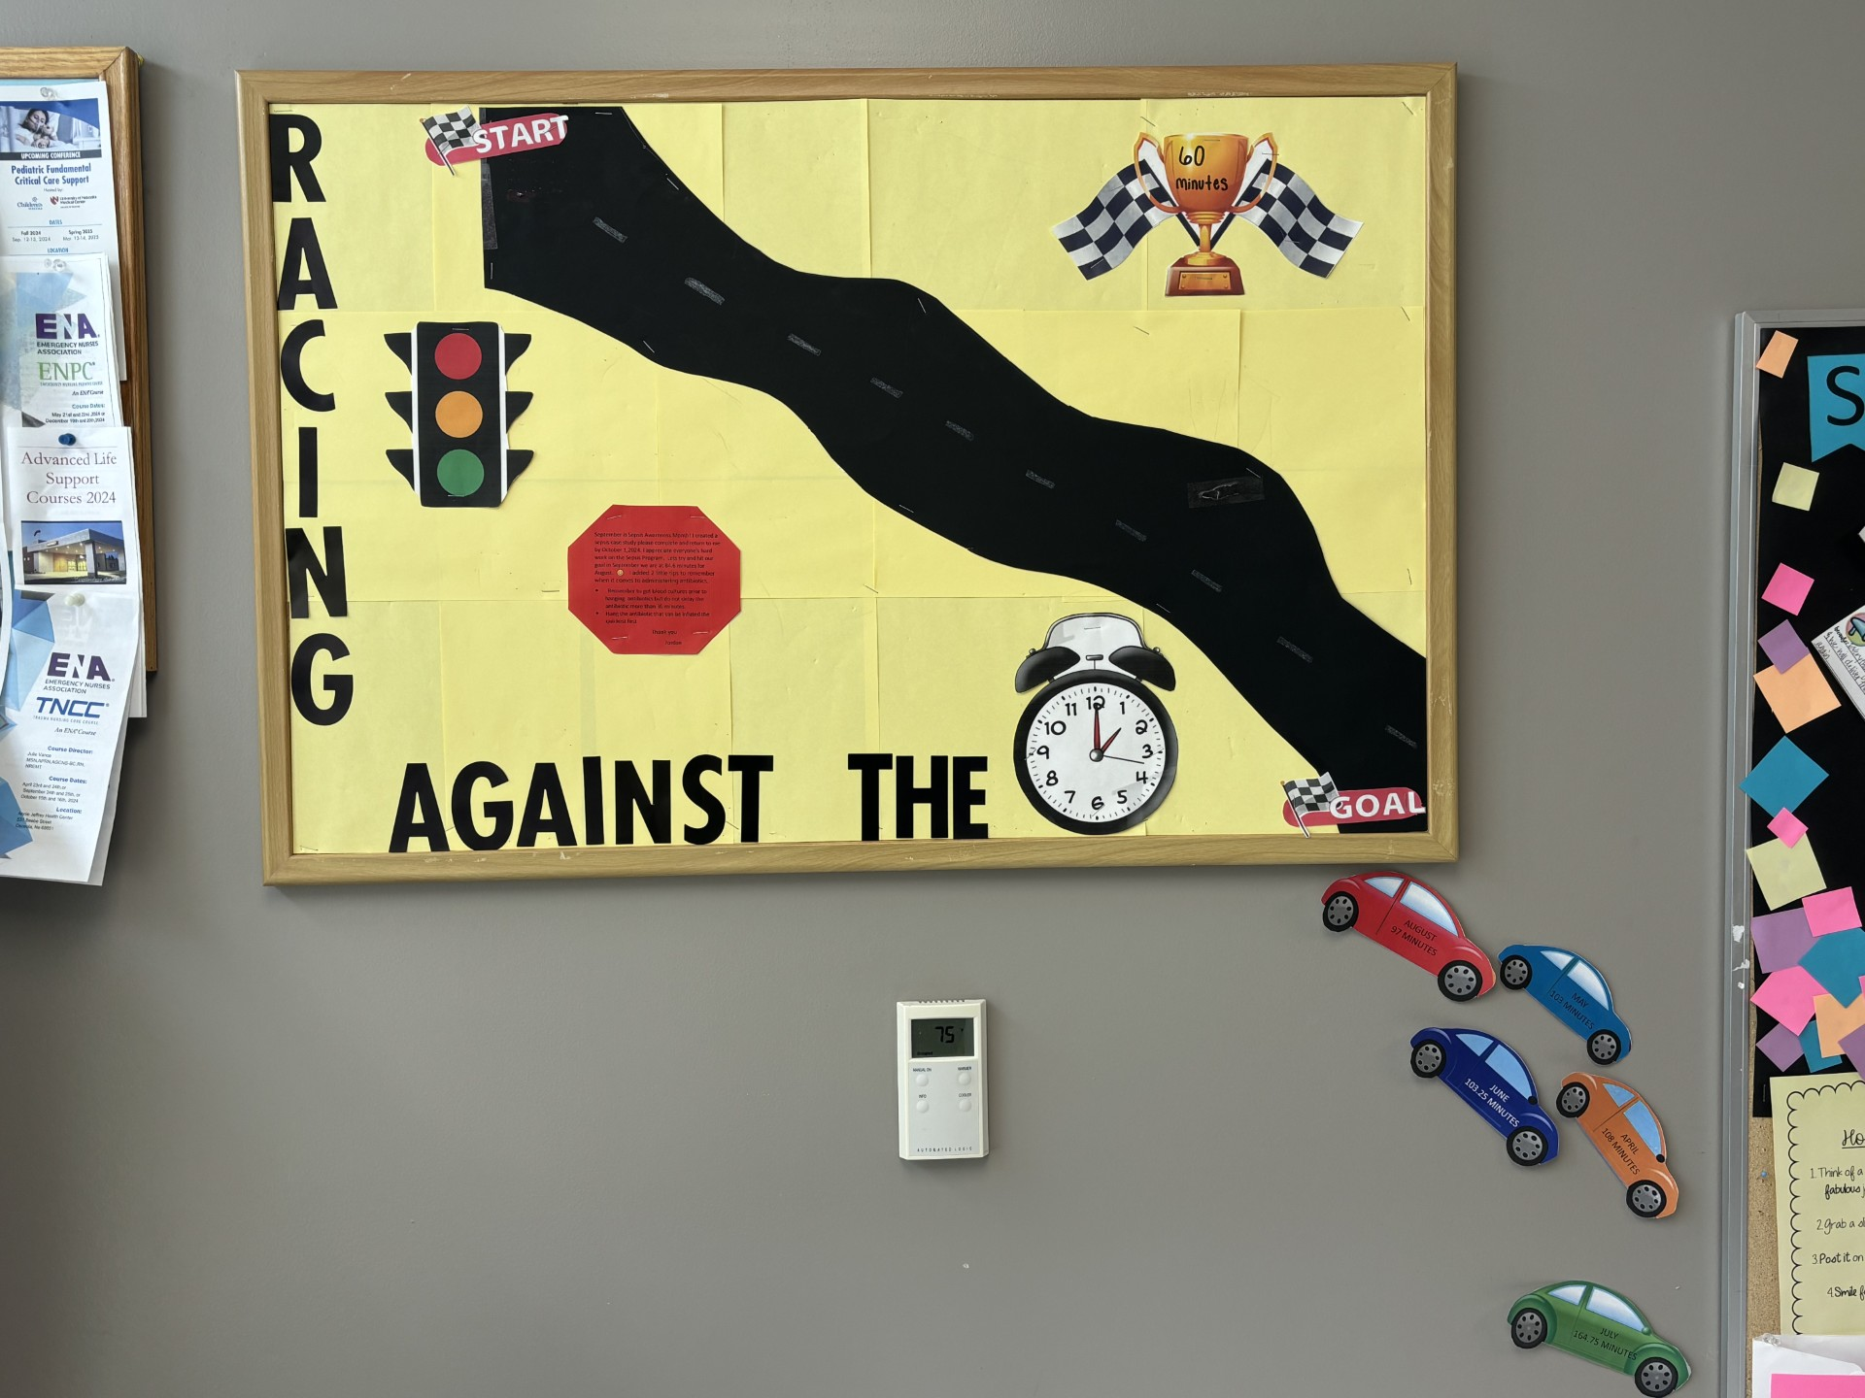
Spreading / Sustaining / Maintaining / Replicating
Monthly chart audits will continue
Provider and staff scorecards issued Quarterly
Posted progress in the nursing breakroom
Continuing education on Sepsis with staff
Unintended Win
This quality improvement project was not meant to be replicated in other areas of the hospital. However, it did generate thoughts and conversations about other nursing processes that could use some improvement.

Slide 11
THANK YOU/Questions
Jordan Siegel- jordan.siegel@ajmchc.org
nebraskahospitals.org

