Slide 1

NHA Advocacy & Quality Update
November, 2025

Slide 2
Objectives
Summarize recent NHA initiatives focused on quality improvement and workforce
Identify opportunities for member hospitals to engage in statewide quality and policy initiatives
Outline strategic priorities and planned initiatives for 2026 to advance quality across Nebraska

Slide 3
State & Federal Policy Update
David Slattery,
Senior Director, State & Rural Policy

Slide 4
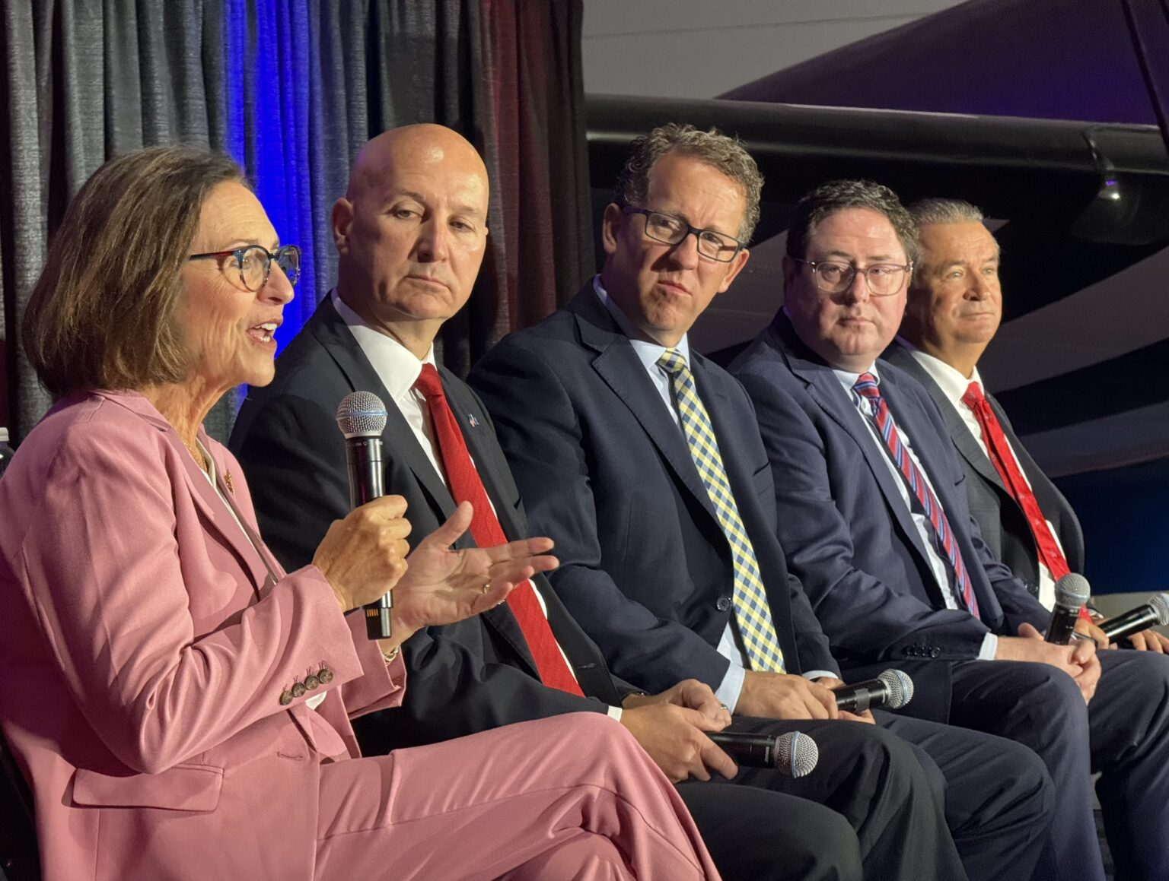
Federal Advocacy
Nebraska Federal Delegation
U.S. Senate
Senator Deb Fischer (reelection 2030)
Senator Pete Ricketts (reelection 2026)
U.S. House of Representatives
1st District - Representative Mike Flood
2nd District - Representative Don Bacon (not seeking reelection 2026)
3rd District - Representative Adrian Smith

Slide 5

Government Shutdown
Government shutdown as of Oct. 1 – November 9ish
Failed votes to pass a clean CR
Key health care programs part of that debate
Enhanced Premium Tax Credits extender
Expire end of 2025
Telehealth and hospital-at-home extender
Expired Sept. 30
Following flurry of activity on CMS website issuing guidance on Medicare payments amid shutdown
Notes:
Telehealth:
CMS guidance reaffirmed that pandemic-era expanded telehealth flexibilities have ended for Medicare beneficiaries
CMS has issued MACs to implement a temporary claims hold for 10 business days on telehealth claims
Guidance says providers who continue performing telehealth services may consider sending Advance Beneficiary Notice of Noncoverage
Flurry of activity last week between CMS announced Wednesday night that it would pause fee-for-service Medicare payments to physicians, community health centsre, and ground ambulance providers indefinitely. Then Thursday morning, CMS stated that most payments to physicians will be paid 'in a timely manner' as govt shutdown continues.

Slide 6
Medicaid Policy Changes - OBBBA
Policy Change | CBO Savings/10 yrs | Coverage Loss | Effective Date
Community Engagement (Work Requirements) | $326B | 4.8M | 12/2026 (*12/2028)
Increase Eligibility Redeterminations | $63B | 2.2M | 1/2027
Limit Retroactive Coverage | $6B |  | 1/2027
Reduce FMAP for Emergency Medicaid to certain individuals | $28B |  | 10/2026
Increase Co-Pays for Beneficiaries in Expansion States | $7B |  | 10/2028
Reduced FMAP for Medicaid expansion states | $14B |  | 1/2026
Moratorium on Enrollment & Eligibility Rules | $139B | 600,000 | On Enactment
Moratorium on Nursing Home Staffing Rule | $23B |  | On Enactment
Limit Use of Provider Taxes | $191B | 400,000 | 1/2028
Limit State Directed Payments | $149B |  | 1/2028
Managed Care Tax Changes | $35B |  | 1/2028
CBO Estimate: More than $1T / 10 years

Slide 7
Rural Health Transformation Program
$50B/5 yrs to states to carry out the activities specified in the legislation
$25B - $5B per yr or $100M per state/yr.
Other $25B half based on proportions of rural resident & rural facilities.
By 11/5/2025, states must apply for Program funds in the form and manner specified by the Administrator with plan to accomplish:
Improve access to hospitals to rural residents;
Improve health care outcomes of rural residents;
Emerging technologies that emphasize prevention and chronic disease management;
Strengthen strategic partnerships between rural hospitals and other health care providers for quality improvement, financial stability, economies of scale, and share best practices;
Enhanced clinician recruitment and training; and
Data and technology driven solutions.

Slide 8
Rural Health Transformation Program
Directs the Administrator to specify the terms and conditions to which a state must adhere with regard to Program funds:
Evidence-based interventions to improve prevention and chronic disease management.
Payments to providers for the provision of health care items or services, as specified by the Administrator.
Promoting consumer-facing, technology-driven solutions for chronic disease management.
Training and technical assistance for the adoption of technology-enabled solutions that improve care delivery in rural hospitals, including RPM, AI, and others
Recruiting and retaining clinical workforce talent in rural areas.
Significant IT adoption to improve efficiency, enhance cybersecurity, and improve patient health outcomes.
Assisting rural communities to right size their health care delivery systems.
Access to opioid and other substance use treatment services and mental health services.
Support innovative models of care that include value-based care arrangements and alternative payment models.
Additional uses designed to promote sustainable access to high quality rural health care services, as determined by the Administrator.

Slide 9


Rural Health Transformation
NHA Process
OBBBA Signed on July 4th
All-Member Survey on July 14th
PDC Survey Refinement
5 District meetings
More PDC Refinement
One-on-one Member Calls
77/92 members involved along the way
Meetings with DHHS
Meetings with NMA, FQHCs, NABHO, NHCA and more
DHHS submitted November 4th, not making publicly available

Slide 10
2025-2026 Federal issues
Nebraska's State Directed Payment Program & Preprint Approvals
OBBBA and the Rural Health Transformation Program
Extend the Enhanced Premium Tax Credits
Expire at the end of 2025
Extend Telehealth and Hospital-at-Home Waivers
Expired Sept. 30, 2025
Reject Site-neutral Payments
Protect the 340B Drug Pricing Program
Outpatient Prospective Payment System Proposed Rule included proposals to accelerate the timeline for clawing back funds resulting from the agency's unlawful policy between calendar years 2018-2022
Also includes call for agency to conduct drug acquisition survey
HHS announced new 340B rebate model pilot program
Senate HELP hearing on 10/23: The 340B Program: Examining its Growth & Impact on Patients
Drug Pricing/PBM Reform
Insolvency of Medicare Trust Fund
Notes:
ADVOCACY PRIORITIES
Extend the Enhanced Premium Tax Credits. The Enhanced Premium Tax Credits help individuals and families purchase insurance on the Health Insurance Marketplaces. Policies enabling these credits will expire at the end of 2025. Urge your members of Congress to extend the enhanced premium tax credits that enable millions of people to have health care coverage.
Reject Site-neutral Payments. Site-neutral payments would compensate hospital outpatient departments the same as independent physician offices and other ambulatory sites of care, ignoring the very different level of care provided by hospitals and the needs of the patients and communities cared for in that setting. Ask your members of Congress to reject efforts to enact additional site-neutral payments proposals.
Protect the 340B Drug Pricing Program. Hospitals depend on the 340B program to manage rising prescription drug costs and expand access to care for patients. Ask your members of Congress to oppose any harmful changes to the 340B program.
Extend Telehealth and Hospital-at-home Programs. These programs enable providers to care for patients at home, without having to make long drives to a facility. These programs are set to expire Sept. 30. Urge your lawmakers to extend these programs so providers can ensure continuity of care.
Prevent Medicaid Disproportionate Share Hospital Cuts. The Medicaid DSH program provides essential financial assistance to hospitals that care for our nation’s most vulnerable populations, including children and those who are disabled and elderly. The Medicaid DSH cut for fiscal year 2026 is $8 billion and will go into effect on Oct. 1 unless Congress acts. Urge your lawmakers to provide relief from the Medicaid DSH cuts given the vital need for the program.
Extend the Low-volume Adjustment and Medicare-dependent Hospital Programs. The enhanced low-volume adjustment and Medicare-dependent hospital programs provide rural, geographically isolated and low-volume hospitals additional financial support to ensure rural residents have access to care. Without action from Congress, the enhanced LVA and MDH programs will expire Sept. 30. Urge your lawmakers to extend these vital programs.

Slide 11
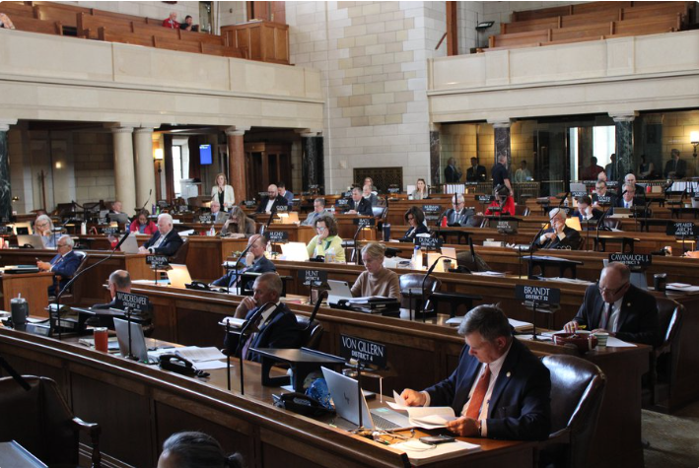
State Advocacy
2025 Session Review
Looking Ahead
- 2026 Session
- Interim studies
- Legislative Candidates
How to Be Involved

Slide 12
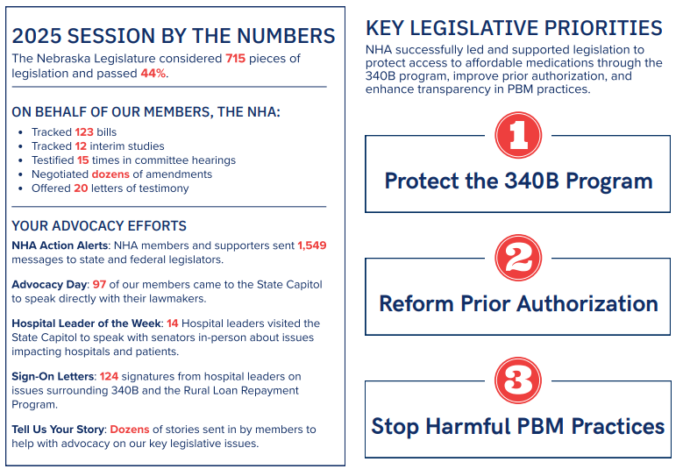
State Legislative Wrap Up

Slide 13
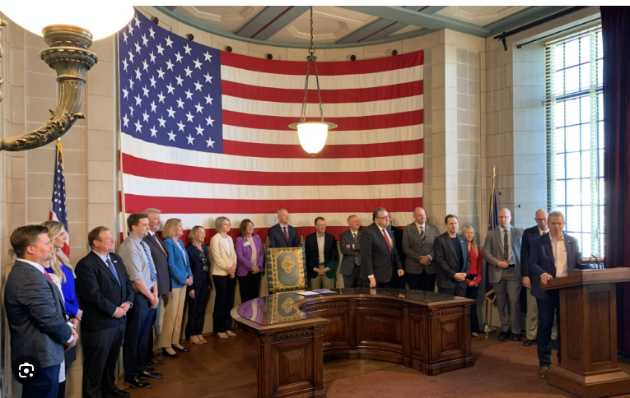
State legislation – 340B Legislation
LB168 – Protect the 340B Community Benefits Program
Governor Signing Ceremony
Law effective as of April 10, 2025
AbbVie v. Nebraska lawsuit
NHA signed onto AHA amicus brief
AG Hilgers filed motion to dismiss
Plaintiffs- drug manufacturers who participate in the federal 340B discount drug program - obviously feel aggrieved by perceived abuses and alleged noncompliance with that program's regulatory safeguards. But this lawsuit, in which Plaintiffs take aim at Nebraska statute and Nebraska law enforcement (rather than the federal program itself, the federal entities that could mitigate the alleged harms, or the wrongful actors themselves) is a clear case of misdirected anger. This Court should not indulge the Plaintiffs' temper tantrum.

Slide 14
State legislation – Prior Authorization Reform
Increase Transparency
Require insurance to make PA requirements publicly available on their website
Requires 60 days' notice to providers before implementing new PA requirements
Streamline Processes & Accountability
Create standard form for all health insurers
Adverse decisions on PA requests must be made by a physician
Requires a peer-to-peer consult when requested
Requires appeals to be reviewed by a physician of the same or similar specialty
Prohibits use of AI as sole basis of a decision to deny, delay, or modify services
Must pay providers for services that received prior auth approval
Require Response Times
72 hours urgent and 7 days non-urgent. Beginning 2028, urgent request timeframe reduced to 48 hours.
If insurance fails to meet deadlines, PA request deemed approved.
Protect Patient's Continuity of Care
A PA is valid for 1 year in most cases
Approved prior auth can follow a patient for 60 days if they switch plans
Provides clarity/accountability for inpatient care to eliminate uncompensated care
No retrospective denials after a PA is approved
Prohibit Prior Authorizations Requirements for:
Emergency services
Emergency ground transportation
Preventative services
Notes:
NDOI forms available
Reg guidance document
On or before November 1, 2025, the Department of Insurance will approve a single uniform prior authorization request form for prescription drugs, devices, and DME and a single uniform form for all other health care services. It must not exceed two printed pages.
Beginning January 1, 2026, all health care providers must use only the approved forms. This does not prohibit a URA from using a prior authorization process using an Internet webpage, portal, or similar web-based system if it is consistent with the department’s forms. A URA may request from the department an exemption if they implement an API or other electronic prior authorization methodology that automates and standardizes the process. A URA must provide at least 90 days’ notice to providers if they are using an API. Beginning January 1, 2026, a URA must meet the following timelines for determinations: Urgent health care services: within 72 hours or
Non-urgent health care services: within 7 days Beginning January 1, 2028, a URA must meet the following timelines for determinations: Urgent health care services: 48 hours or Non-urgent health care services: within 7 days Nothing prohibits a provider and carrier from contracting for shorter timeframes. Health care services are deemed authorized if a URA fails to meet these timeframes. The URA must provide the duration of approval when they provide notice of the same.

Slide 15
State legislation – PBM Reform
LB 198 – Change provisions of the PBM Licensure and Regulation Act
Introduced by Sen. Sorrentino
BCI Committee priority bill
Committee Amendment included provisions of NHA's LB109:
Prohibits patient steering by a PBM
Allows a pharmacy/pharmacist to decline to provide a drug if paid less than acquisition cost
Prohibits spread pricing on certain dates
White bagging parameters
Appeals process
Refill requests
Delivery/signature requirements
Must authorize/reimburse for drug if substantially similar
Prohibits brown bagging
Prohibits a PBM from restricting a retail pharmacy's ability to ship, mail, or otherwise deliver prescriptions to patients
Allows nationally accredited specialty pharmacies in NE to participate in PBM networks by preventing PBMs from imposing unreasonable terms beyond the requirements for national accreditation

Slide 16
State legislation
LB 322 – Prohibit assault on a pharmacy and health care professionals (LB26)
Sen. Clouse priority bill
8 hour filibuster
Advanced to Select File 37-8
Ballard amendment filed on Select to address DD concerns
Will carry forward into the 2026 legislative session
Rural Loan Forgiveness Program – Budget Bill
LB261 Committee Amendment included the $1.5M that the original bill had proposed to cut
Governor did not veto that line-item, so the Program remains funded

Slide 17
2026 State Legislative Issues
Nebraska State Budget
General Fund pressures – Nebraska projected deficit of about $451 million after tax revenues for the year came in below forecasts
Coupled with Gov. Pillen's call to cut General Fund spending by 10% (~$500 million)
Protecting State Directed Payment program dollars
State Implementation of the OBBBA
Work requirements
Eligibility reviews
Rural Health Transformation Program
Policy factors that garner additional points
Continued push for LB322 advancement for workplace violence protections
Strengthen Rural EMS

Slide 18
Interim Studies
LR232 - Interim study to examine regulatory restrictions and opportunities in medical education in order to strengthen the medical workforce in rural and other underserved areas of Nebraska (October 16)
LR188 - Interim study to examine the significance of the state financial partnership with the federal government in delivering health services to Nebraskans through the Medicaid program (November 7)
LR124 - Interim study to examine the role of a pharmacy benefit manager within the Nebraska health insurance industry and the impact on prescription drug prices (November 19-21)

Slide 19

2026 Elections
Primary: May 12 General: November 3
• U.S. Senator Pete Ricketts re-election
• Governor Pillen and Executive Slate up for re-election
• 24 out of 49 state legislative seats are up for election
• There will be a minimum of 12 new senators elected 24% of legislature
• 12 current senators face re-election

Slide 20
2026 Legislative Elections
Interesting Races
• District 28 – Lincoln
- Former Senator Patty Pansing Brooks seeking another term
• As of October 15, 2026
- 10/12 senators seeking re-election do not have an announced opponent
- District 22 (Columbus area) and District 17 (Blair/West Point area)
- 0 announced candidates

Slide 21
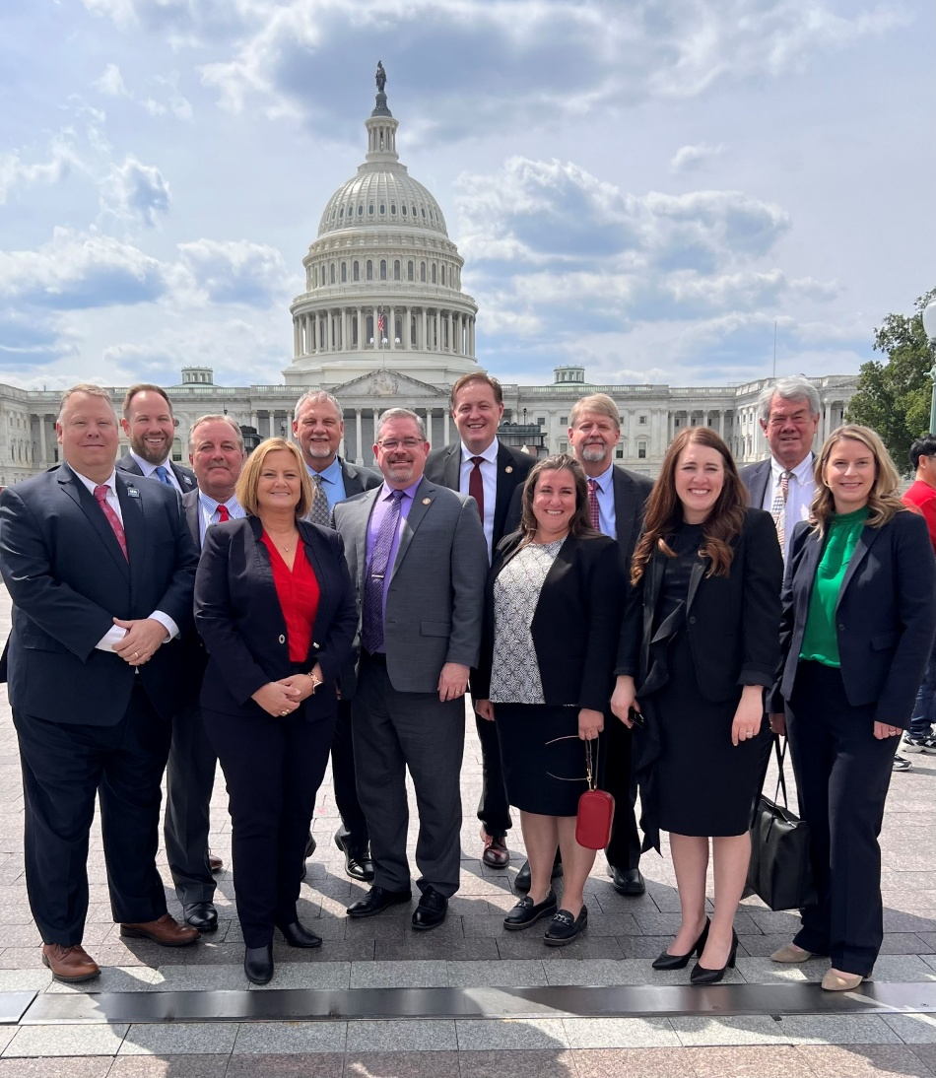
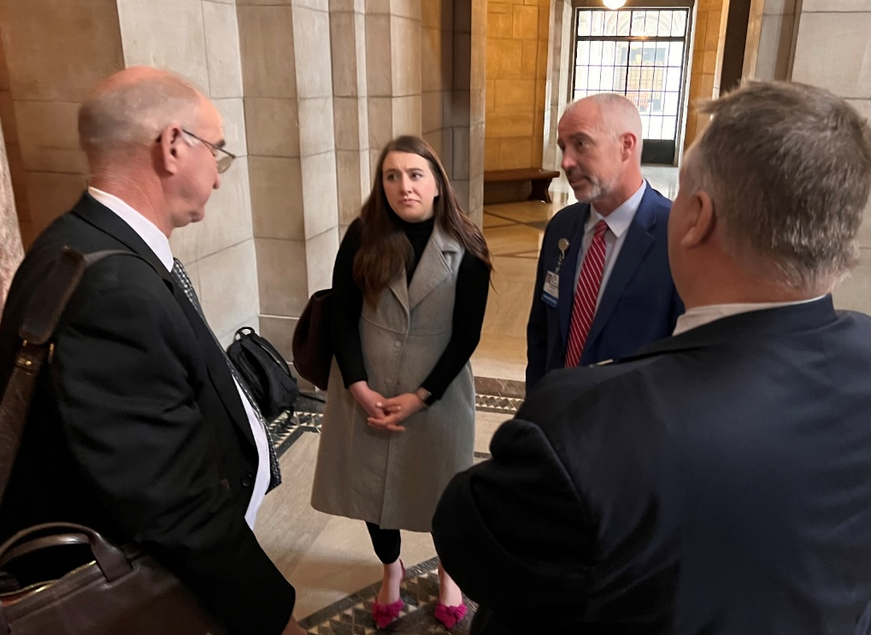
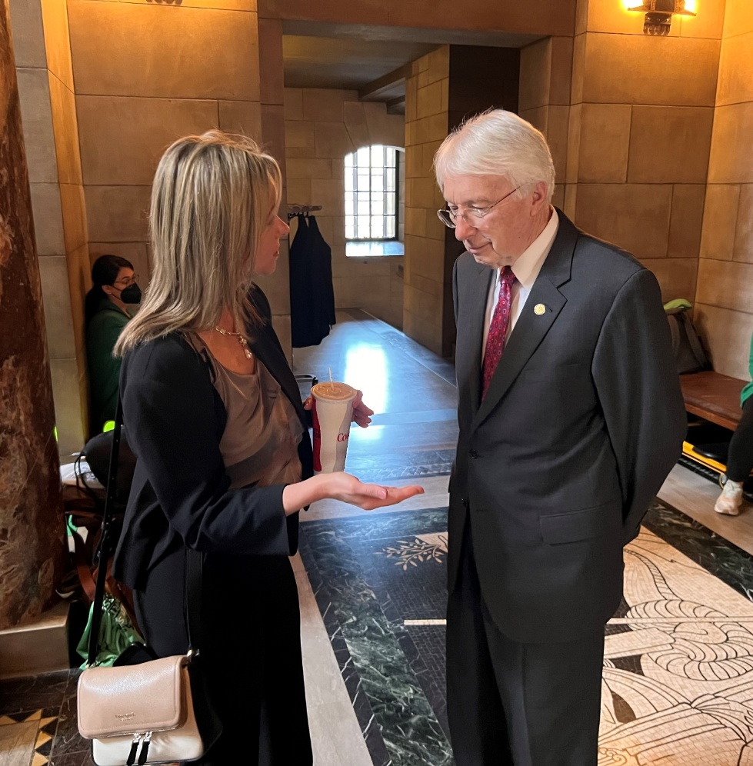
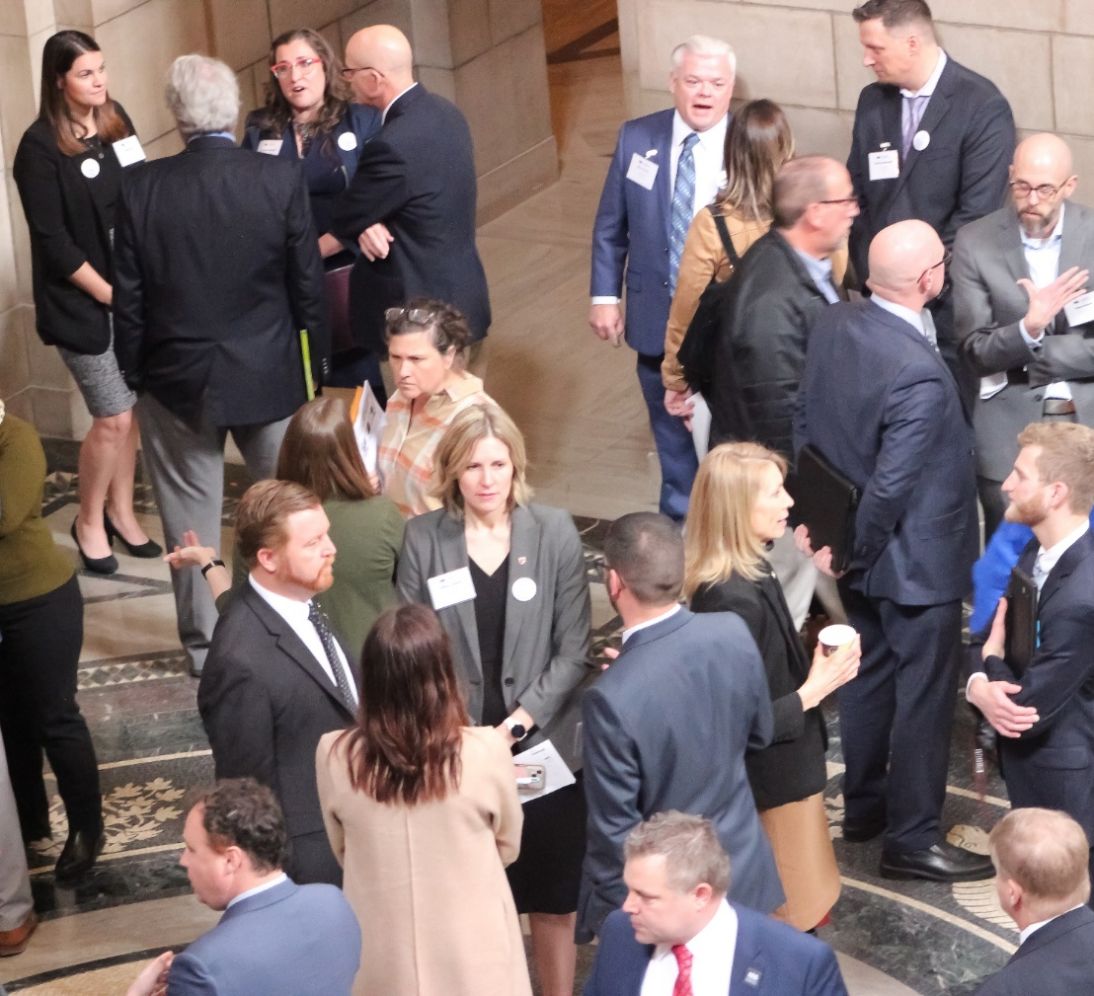
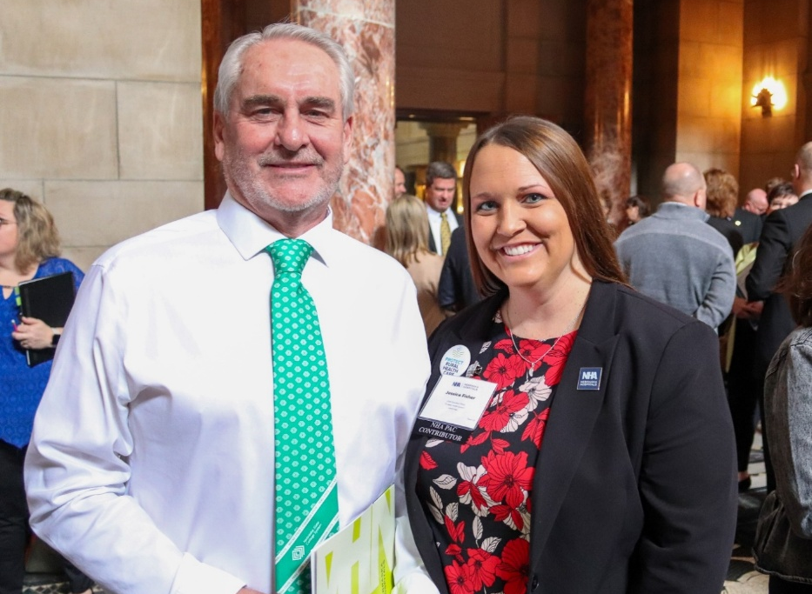
Advocacy is a team sport.
WE NEED YOU!

Slide 22
Why Advocacy Matters
Term limits have created a new dynamic in our ability to effectuate change in Nebraska’s political climate today.
• 2022 15 new senators
• 2024 16 new senators
• 2026 minimum of 12 new senators
This past session, two thirds of the Legislature had 2 years or less of experience in policy making.
The NHA is continuously engaging with and educating lawmakers and their staff.
Notes:
We're constantly educating them about the top issues that are impacting your facilities today:
Workforce Crisis
Historic Inflation
Post-Acute Placement Bottlenecks
Growing Commercial Insurance Burdens
Services are closing or at-risk
Protect Medicare & medicaid

Slide 23

How to Advocate
• NHA Guide to Hospital Advocacy
• Understand the Life on a Senator
• Personal Visits and Meetings
• Phone Calls, Letters, In-person, and Emails
- Including Thank You notes for key legislation or votes
• Submit a letter of support or opposition on a bill to a senator or committee
• Testify at a hearing on a bill
• Write an op-ed in a local newspaper on a relevant issue
• Invite Senators to Hospital and Community Tours
• Social Media
-engage with elected officials on their social accounts, like posts
• Start an Advocacy Team at your hospital

Slide 24
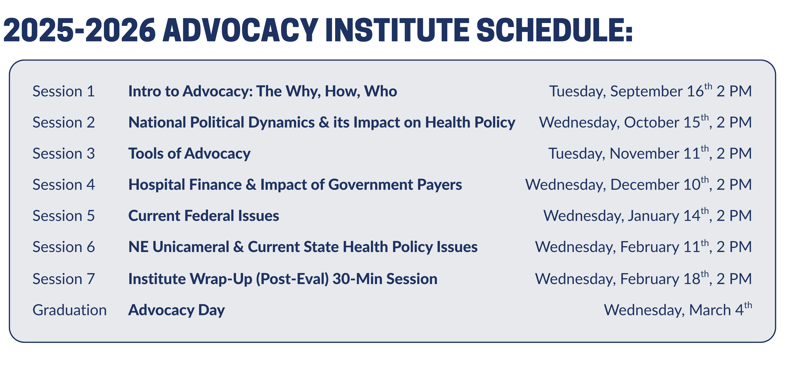
Become Involved with the NHA
www.nebraskahospitals.org
• Attend Advocacy Day (March 4, 2026, Lincoln)
• Attend NHA Annual Conference (October 22-24, LaVista)
• Attend Rural Health Conference (June 9-10, Kearney)
• Subscribe to Newslink (Weekly Newsletter)
• Attend monthly NHA Member Calls (1st Thursday of the Month, Zoom)
• Join NHA Peer to Peer Groups (Quarterly Zooms)
• Use NHA Action Center (to contact state and federal delegations on important bills)
• Submit a Story to NHA Story Bank
• Register for NHA Advocacy Institute
• Contribute to the NHA Political Action Committee (NHAPAC)

Slide 25
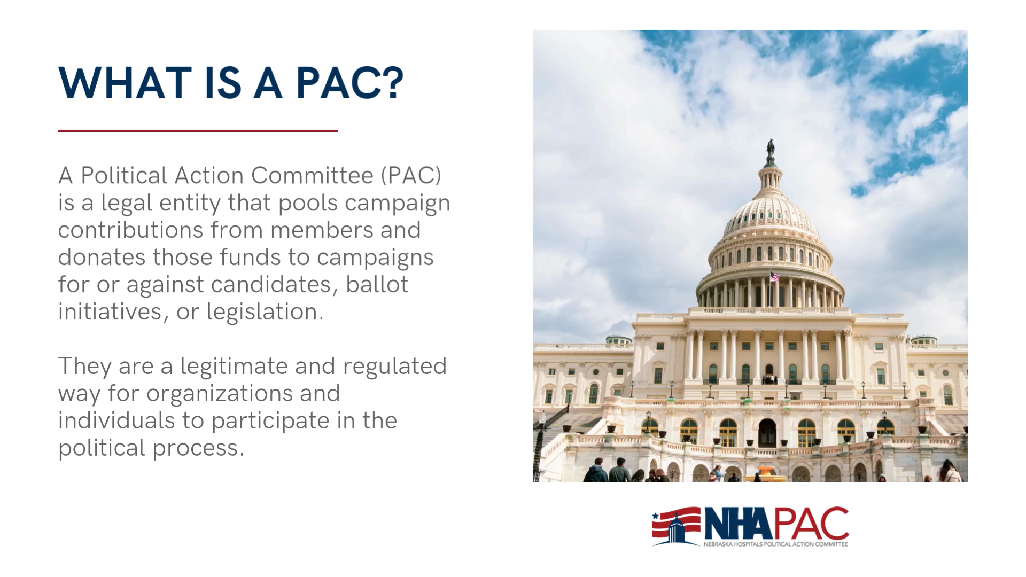

Slide 26

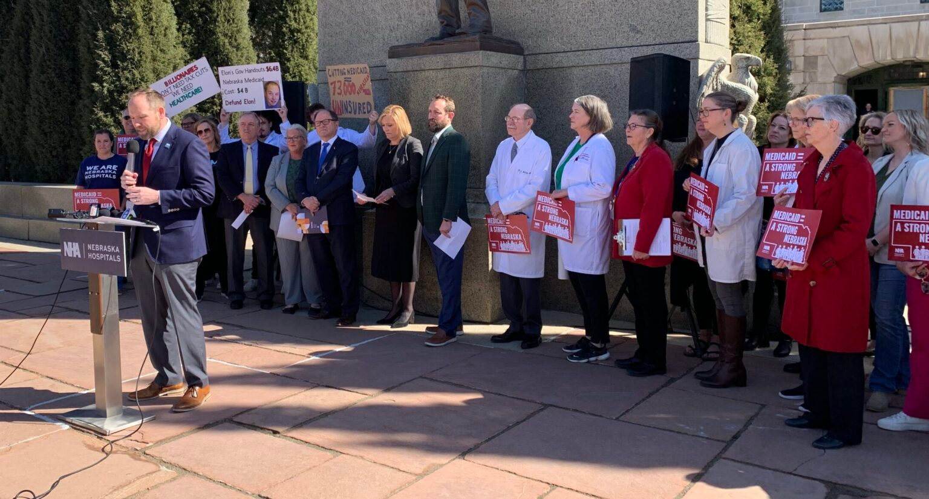

WHY WE ENGAGE
KEY ISSUES ON THE CAMPAIGN TRAIL
PROTECTING MEDICARE & MEDICAID
These programs are the financial backbone for many Nebraska hospitals, serving our most vulnerable populations. We advocate for sustainable reimbursement rates, expanded access, and policies that ensure the long-term viability of these programs.
Standing Up to Big Insurance & BIG PHARMA
We actively counter policies that favor large insurance companies and pharmaceutical corporations at the expense of hospitals and patients. This includes advocating for fair practices, increased transparency, and combating anti-competitive behaviors.
SUPPORTING INVESTMENTS IN HEALTH CARE WORKFORCE
NEBRASKA FACES CRITICAL HEALTH CARE WORKFORCE SHORTAGES. WE CHAMPION INITIATIVES THAT SUPPORT EDUCATION, TRAINING, RECRUITMENT, AND RETENTION OF NURSES, PHYSICIANS, AND HEALTH PROFESSIONALS TO ENSURE ACCESS TO CARE.

Slide 27


WHO CAN GIVE WHAT?
NON-PROFIT HOSPITALS
LIMITED BY LAW
FOR-PROFIT GIANTS = DIRECT CONTRIBUTIONS
As 501(c)(3) non-profit organizations, Nebraska hospitals are legally prohibited from making direct contributions to political candidates.
For-profit companies like UnitedHealthCare and Abbvie operate under different rules.
They can and do make direct financial contributions to Nebraska candidates at the state level.
This gives them a direct line of influence that non-profit hospitals do not have independently.

Slide 28
YOUR CONTRIBUTION TO THE NHA PAC IS AN INVESTMENT IN THE FUTURE OF HEALTH IN NEBRASKA.
IT EMPOWERS US TO:
SUPPORT CANDIDATES WHO CHAMPION HEALTH CARE CAUSES
Identifying, vetting, and financially supporting candidates who are true allies of hospitals and patients.
EDUCATE POLICYMAKERS ON COMPLEX CHALLENGES
Providing lawmakers with accurate, timely information on the operational, financial, and patient care realities facing Nebraska hospitals.
MOBILIZE GRASSROOTS EFFORTS
Activating hospital staff, community members, and advocates to contact their legislators on critical issues, creating a powerful collective voice.

Slide 29
2025 PAC Goal $95,000 Contribute Online pac.nebraskahospitals.org Username: nhapac Password: nhapac1

Slide 30
Contact
Meghan chaffee, jd
Chief advocacy & legal officer
mchaffee@nebraskahospitals.org
402-742-8191
David Slattery
Senior director, State & Rural Policy
dslattery@nebraskahospitals.org
402-742-8153

Slide 31
Questions?

Slide 32
Nebraska Medicaid Directed Payment Program – LB 1087

Slide 33
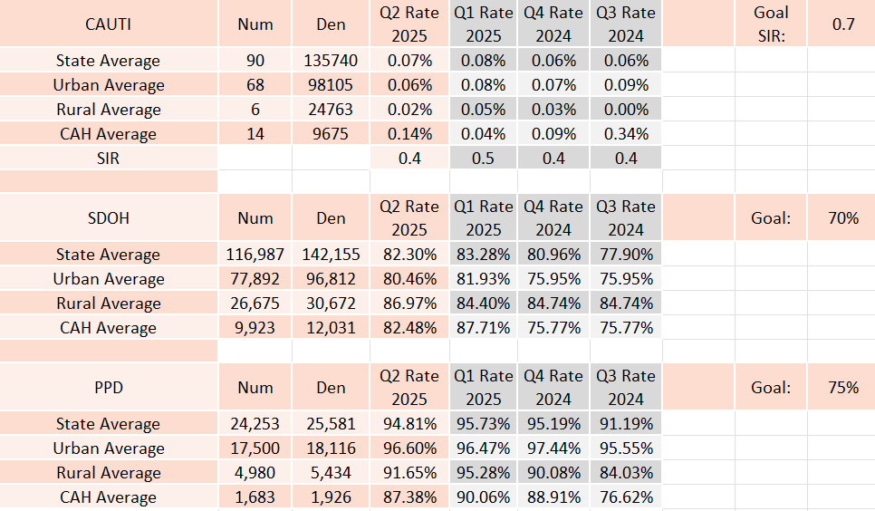
Medicaid Quality Overview & Update
Quality Performance:
Reporting Compliance:
Q3 2024 = 100%
Q4 2024 = 100%
Q1 2025 = 100%
Q2 2025 = 100%

Slide 34
Directed Payment Quality Data Trends

Slide 35
Directed Payment Quality Data Trends

Slide 36
Directed Payment Quality Data Trends

Slide 37
Medicaid Quality Overview & Update
Age-Friendly: Goal by EOY 2025 = 39 unique organizations, 3 AF communities
58 unique organizations engaged
105 total sites at Level 1 and 2
4 current communities engaged
Emergency Department Behavioral Health Usage Data:
Report distributed annually with calendar year data
Data from NHA Data Dimensions claims-based data

Slide 38
2025 Data: Medicaid SDOH
 | Num | Den | Rates | Total Number Reporting
State Average | 751 | 896 | Q1 83.82% | 57/96 = 59%
 | 732 | 795 | Q2 92.08% | 56/96 = 28.3%
2025 Data: Medicaid PPD
 | Num | Den | Rates | Total Number Reporting
State Average | 726 | 758 | Q1 95.78% | 24/44 = 62%
 | 381 | 400 | Q2 95.25% | 24/44 = 62%
Medicaid only data required 4Q2025

Slide 39
2026 Dates:
 | Q4 2025 (Oct-Dec) | Q1 2026 (Jan-Mar) | Q2 2026 (Apr-June) | Q3 2026 (July-Sept) | Q4 2026 (Oct-Dec)
Data Due Dates | February 28, 2026 | May 31, 2026 | August 31, 2026 | November 30, 2026 | February 28, 2027
Q3 Data due November 30, 2025
Annual SDOH Screening due February 28, 2026
Includes separate annual submission for January 1, 2025 – December 31, 2025

Slide 40
Introducing the Statewide Quality Collaborative

Slide 41
Overview
Purpose:
Designed to bring hospitals together around a shared mission: Improving patient safety and reducing preventable harm
Vision:
Make Nebraska the safest place to receive hospital care through collaboration, data transparency, and shared learning.
Scope:
Voluntary program to share key quality and patient safety data that will guide statewide improvement
Measures:
Healthcare-associated infections
Hospital 30-day readmissions
Patient falls (assisted and unassisted)
Sepsis 3-hour bundle compliance
Sepsis mortality

Slide 42
Diving into the Measures
Measure Name | Catheter-Associated Urinary Tract Infection (CAUTI)
Numerator | Total number of observed healthcare-associated CAUTI among patients in bedded inpatient care locations
Denominator | Total number of indwelling urinary catheter days for each location under surveillance for CAUTI during the data period
Rate Calculation | (Numerator / Denominator) x 100
Exclusions | The following are not considered indwelling catheters by NHSN definitions: 1. Suprapubic catheters 2. Condom catheters 3. “In and out” catheterizations 4. Nephrostomy tubes
Data Source(s) | NHSN or self-report

Slide 43
Diving into the Measures
Measure Name | Central Line-Associated Bloodstream Infection (CLABSI)
Numerator | Total number of observed healthcare-associated CLABSIs among patients in bedded inpatient care locations
Denominator | Total number of central line days for each location under surveillance for CLABSI during the data period
Rate Calculation | (Numerator / Denominator) x 100
Exclusions | The following are excluded as central lines: 1. Non-lumen pacemaker wires and other non-lumened devices inserted intro central blood vessels or heart
 | - Arterial catheters - Arteriovenous fistula - Arteriovenous graft - Exracorporeal membrane oxygenation (ECMO) - Hemodialysis reliable outflow (HERO) dialysis catheters | - Intra-aortic balloon pump (IABP) devices - Atrial catheters (also known as transthoracic intracardiac catheters, those catheters inserted directly into the right or left atrium via heart wall) - Peripheral IV or midlines - Ventricular Assist Device (VAD)
Data Source(s) | NHSN or self-report

Slide 44
Diving into the Measures
Measure Name | Methicillin-resistant Staphylococcus aureus (MRSA)
Numerator | Total number of observed hospital-onset unique blood source MRSA LabID events among all inpatients in the facility
Denominator | Total patient days
Rate Calculation | (Numerator / Denominator) x 100
Exclusions | Data from patients who are not assigned to an inpatient bed in an applicable location are excluded from the denominator counts. Denominator counts exclude data from inpatient rehabilitation units and inpatient psychiatric units.
Data Source(s) | NHSN or self-report

Slide 45
Diving into the Measures
Measure Name | Clostridium difficile Infection (CDI)
Numerator | Total number of observed hospital-onset CDI LabID events among all inpatients in the facility
Denominator | Total patient days
Rate Calculation | (Numerator / Denominator) x 100
Exclusions | Data from patients who are not assigned to an inpatient bed are excluded from the denominator counts, including outpatient clinics, 24-hour observation units, and emergency department visits. Inpatient rehab locations and inpatient psychiatric locations are excluded. Additionally, data from well-baby nurseries and NICUs are excluded from the denominator count.
Data Source(s) | NHSN or self-report

Slide 46
Diving into the Measures
Measure Name | All Cause 30-Day Hospital Readmissions
Numerator | Inpatients >18 years old returning as an acute care inpatient within 30 days of date of an inpatient discharge to same facility
Denominator | All acute inpatients >18 years old discharged from the hospital (excluding discharges due to death
Rate Calculation | (Numerator / Denominator) x 100
Inclusions | Acute, Swing, Observation patients Obstetric All Payers
Exclusions | Outpatients Planned readmission for scheduled procedure Readmissions on the same day for the same principal dx Index discharge was against medical advice Readmission for palliative care or end-of-life care
Data Source(s) | Self-Report

Slide 47
Diving into the Measures
Measure Name | Assisted Fall Rate
Numerator | Total number of assisted falls with or without injury, among bedded patients >18 years old
Denominator | Number of patient days
Rate Calculation | (Numerator / Denominator) x 100
Inclusions | Acute, Swing, Observation patients Obstetric All Payers
Exclusions | Behavioral health units ED, pediatric patients
Data Source(s) | Self-Report

Slide 48
Diving into the Measures
Measure Name | Unassisted Fall Rate
Numerator | Total number of unassisted falls with or without injury, among bedded patients >18 years old
Denominator | Number of patient days
Rate Calculation | (Numerator / Denominator) x 100
Inclusions | Acute, Swing, Observation patients Obstetric All Payers
Exclusions | Behavioral health units ED, pediatric patients
Data Source(s) | Self-Report

Slide 49
Diving into the Measures
Measure Name | Sepsis 3-Hour Bundle
Numerator | Patients >18 years old admitted to the hospital for inpatient acute care with a principal dx for Sepsis and a completed 3-hour sepsis bundle | 3-hour sepsis bundle 1. Measure serum lactate 2. Obtain blood cultures before antibiotics 3. Administer broad-spectrum antibiotics 4. Give 30 ml/kg crystalloid fluid bolus for hypotension or elevated lactate
Denominator | Total number of patients >18 years old with a principal dx for Sepsis
Rate Calculation | (Numerator / Denominator) x 100
Inclusions | Acute, Swing, Observation patients Obstetric All Payers
Exclusions | Patients who do not have severe sepsis or septic shock Those transferred from another acute care facility - Those already receiving intravenous antibiotics for more than 24 hours before presentation
Data Source(s) | Self-Report

Slide 50
Diving into the Measures
Measure Name | Sepsis Mortality
Numerator | Total number of in-hospital deaths with a dx of sepsis
Denominator | Total number of patients with a sepsis dx
Rate Calculation | (Numerator / Denominator) x 100
Inclusions | Acute, Swing, Observation patients Obstetric All Payers
Exclusions | Behavioral health units ED patients not admitted to the hospital
Data Source(s) | Claims

Slide 51
Additional metrics may be added…
SSI’s
Adverse Drug Events
Pressure Injury
Patient Safety Index-90
These may be collected via self-report, claims or NHSN and will be determined by hospitals.

Slide 52
Benefits to Participating Hospitals
Access to meaningful, Nebraska-specific benchmarking data
Quarterly scorecards to allow peer-to-peer comparisons
Opportunities to engage in peer learning and improvement initiatives
Support from statewide quality experts and partners
Recognition as a leader in advancing patient safety and quality outcomes

Slide 53
Workforce updates

Slide 54

Shared Clinical Model
Purpose: to grow Nebraska’s nursing and health care workforce by removing bottlenecks in clinical education and improving training infrastructure statewide
Benefits
Allows the RN to serve as nurse educator to AND, PN, RN, or BSN students
Fast track to becoming certified Clinical Practice Instructor (CPI)
Direct mentorship from academic center MSN-prepared RN
Complete student care planning and evaluation
Stipends to the CPIs for courses and books
Stipends to the hospital facility for RN hourly wages in serving as CPI
Stipends to the academic institution for providing mentorship
Incentive fees to the hospital and academic institution for participating in the model
Student nurse mileage and housing assistance available
Bolsters students in rural practice settings

Slide 55
Shared Clinical Model
Hospital CPI Responsibilities
RNs with at least 2-years of experience
Must be recommended by hospital leadership
3 required instructor courses over 2 years
Receive 50 hours mentorship from MSN-prepared RN at academic center
Provide evaluation reporting to NHA at conclusion of each clinical rotation
Academic Institution Responsibilities
Partner with hospital clinical site to host a clinical group (up to 8 students/rotation)
Appoint an MSN-prepared faculty member to provide 50 hours mentoring to CPI
Provide evaluation reporting to NHA at conclusion of each term

Slide 56
Shared Clinical Model
Reimbursements and Stipends
Hospital Facility:
Hospital stipend: $60/hour for CPI time spent
Hospital incentive participation fee: 8% of hourly rate
CPI Courses:
$1,000/course for each of the 3 courses
$650/course for books and materials
Student Travel and Housing Assistance:
Mileage reimbursement >15 miles from rural hospital site
Housing reimbursement up to 2 nights/week
*Mileage and housing reimbursement rates as per established IRS rate

Slide 57
Nurse internships
Purpose: Innovative approach to grow and retain the nursing student pipeline.
Responsibilities and Benefits
Interns receive hands-on clinical experience while attending a Nebraska hospital approved nursing school
Licensed RN will act as supervising nurse providing direct supervision
Hospitals must pay the Nurse Intern at least $18.50/hour
Reimbursement for half the hourly rate ($9.25) up to 10 hours/week, minimum of 8 weeks; up to 30 weeks total
Hospital Stipend: $1,000 for supervision of each Nurse Intern for each 8-week cycle
Provide evaluation reporting to NHA at conclusion of each 8-week experience
Student travel and housing assistance:
Mileage reimbursement >15 miles from rural hospital site
Housing reimbursement up to 2 nights/week
*Mileage and housing reimbursement rates as per established IRS rate

Slide 58
Simulation equipment
Purpose: Expand access to high-quality, hands-on training tools that strengthen clinical training capacity, workforce readiness and enhance patient care.
Simulation equipment infused into 15 simulation centers across Nebraska
Facilitating community hospital staff trainings
Free of charge to hospitals
Possible CEU opportunities, depending upon training center

Slide 59
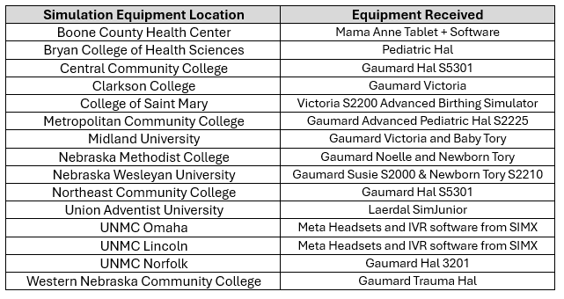
Simulation equipment
Simulation Equipment Locations and Models

Slide 60

Student pipeline
Health Care Heroes Program
Afterschool curriculum, grades 3-6
Partnership between NHA and Nebraska Health Care Foundation
Sponsored by Medica and Nebraska Medical Association
Hands-on learning for exposure to health care professions:
Emergency Medical Technician/Paramedic/Firefighter
Radiology Tech
Respiratory Therapist
Physical Therapist
Occupational Therapist
Recreational Therapist
Ophthalmology Tech
Nurse/Nurse Aide
Medical Assistant
Surgical Tech

Slide 61
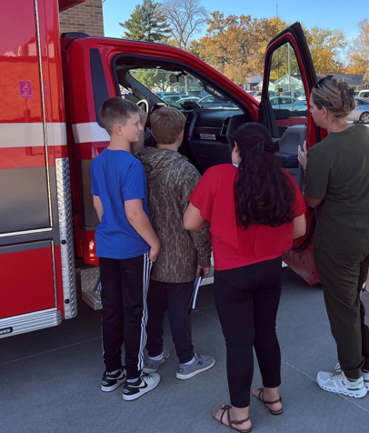

STUDENT PIPELINE
Community-focused learning
Retired teachers
School nurses
Student nurses
Other health care professionals
Community members
Weekly 1-hour lessons
Start anytime during the school year
Teaching materials provided free of charge each semester
Explores various care settings
Community hospitals often partner with school district
Volunteer instructor and kids complete evaluation data on the experience

Slide 62
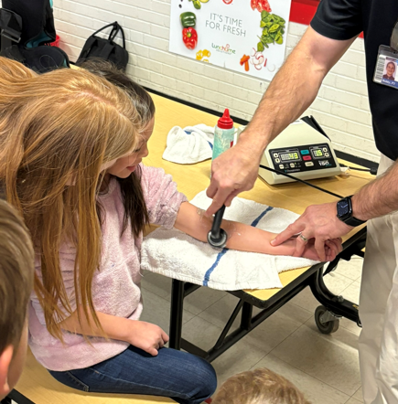
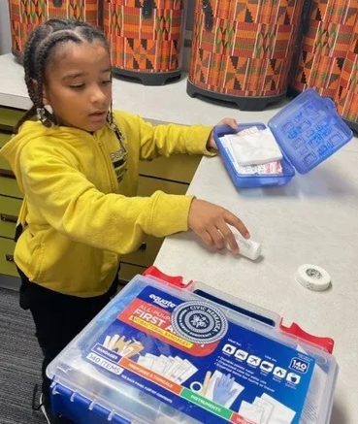

STUDENT PIPELINE

Slide 63
MBQIP Updates

Slide 64
MBQIP
Quality Inventory and Assessment Survey
Due November 21, 2025
Complete online via Qualtrics
Link to complete: https://umn.qualtrics.com/jfe/form/SV_4Iag7pu0kPaH6zc

Slide 65
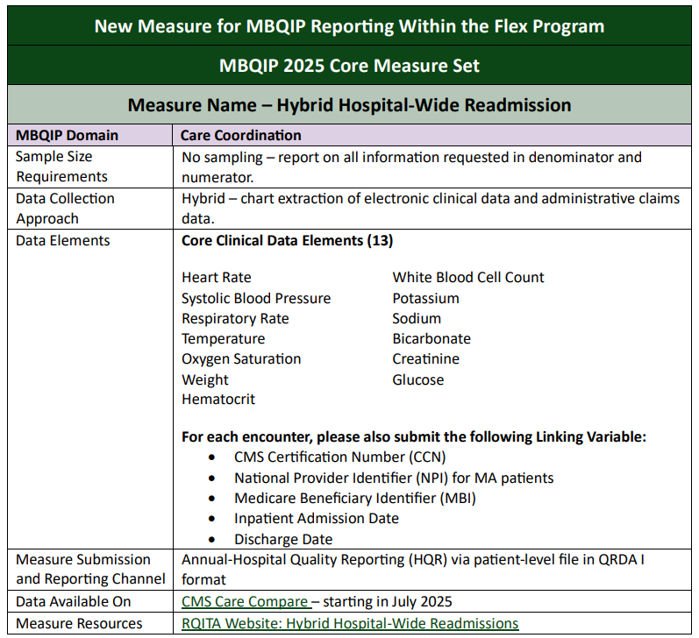
MBQIP
Hybrid Readmissions
Voluntary this year
Required next year
Be sure to work with your EHR vendor to ensure accurate reporting

Slide 66
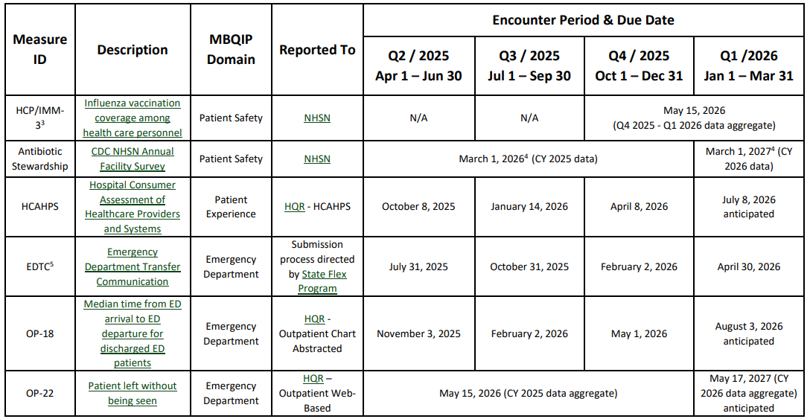
MBQIP Deadlines

Slide 67
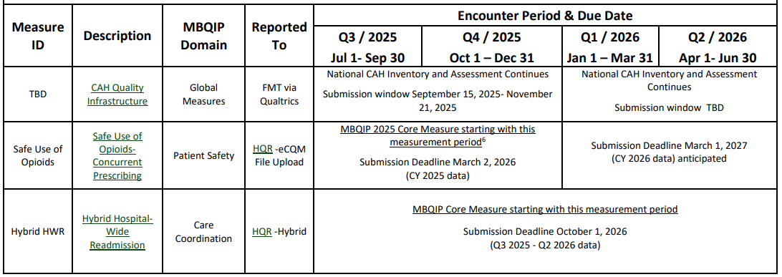
MBQIP Deadlines

Slide 68
Transitions of Care
in Nebraska

Slide 69
Making a Difference…
LB227
Passed in 2023 to address discharge barriers for complex patients
Funded a $1M pilot project
7 projects awarded to 6 post-acute organizations
Targeted patients with high-acuity needs
CHI Plainview Plainview | Cozad Community Health System Cozad | Douglas County Health Center Omaha | Emerald Nursing & Rehab Columbus | Florence Home Omaha | Ambassador Health Lincoln | Douglas County Health Center Omaha
Bariatric | Bariatric | Bariatric and Complex Wound | Bariatric and Complex Wound | Complex and End-of-Life | Hemodialysis | Hemodialysis
Notes:
434 July 1, 2024

Slide 70
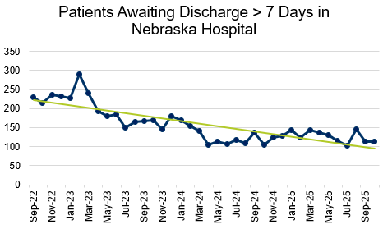
How it’s Going...
2Q2024
3Q2024
4Q2024
1Q2025
2Q2025
3Q2025
526 patients!

Slide 71
We still have work to do
Aging population is increasing
Shortage of behavioral and mental health professionals
Increased complexity of patients
Bariatric
Dialysis
Mental Health Disorders
Behavioral Health Disorders
Substance Abuse Disorders
Criminal History
Notes:
434 July 1, 2024

Slide 72
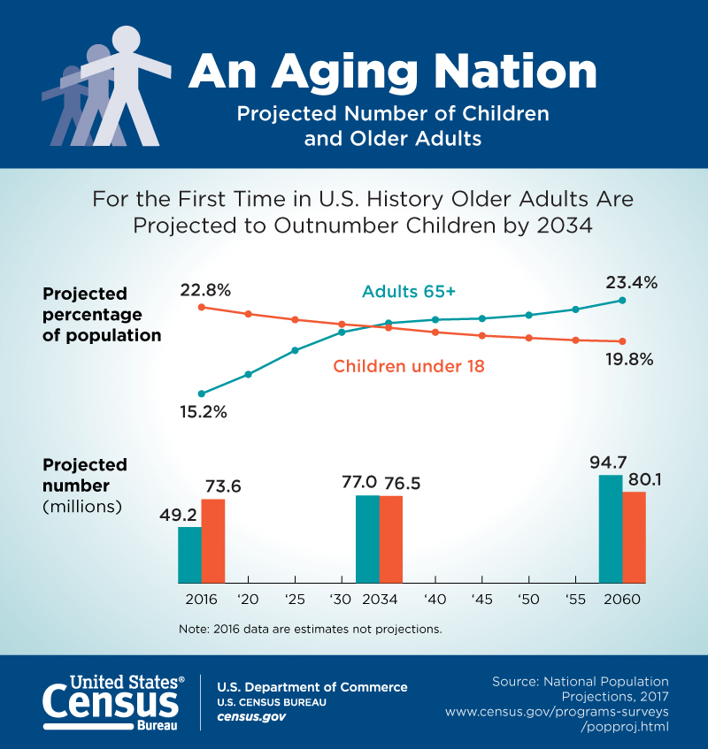
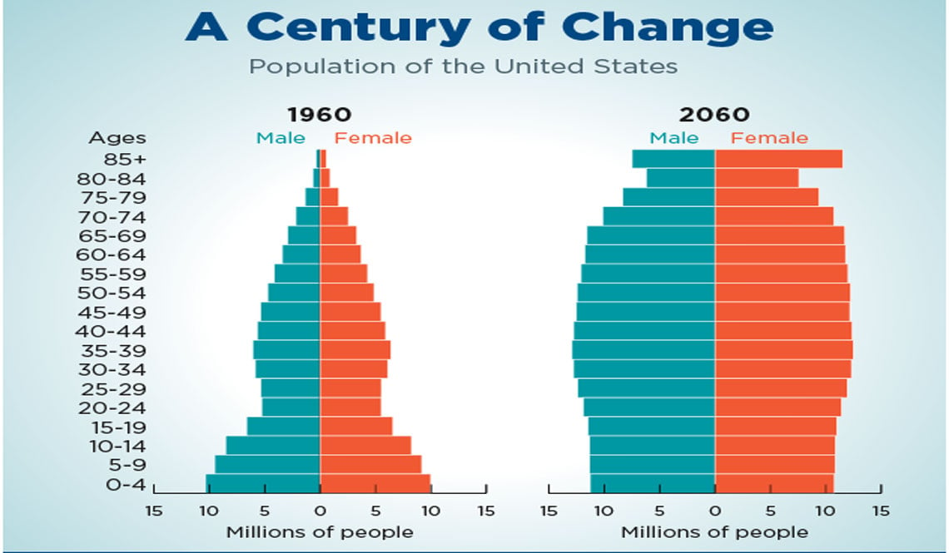
Why it’s Important…

Slide 73
Nebraska is Aging
Percent of Nebraska’s total population age 50 and older
5.6%
age
50 - 54
6.0%
age
55 - 59
6.2%
age
60 - 64
5.5%
age
65 - 69
4.4%
age
70 - 74
2.7%
age
75 - 79
1.8%
age
80 - 84
1.9%
age
85+
Making up 34.1% of the total population
43% live in non-metro counties
33% live in metro counties
https://dhhs.ne.gov/Reports/UNO%20State%20Aging%20Plan%20Report%20-%202022.pdf

Slide 74










Top 5 Concerns of Aging Nebraskans
85.2%
Health Care
72.1%
Financial Security
64.2%
Having enough
food to eat
59.7%
Affordable and accessible housing
56.4%
Programs to help persons with dementia and their families
https://dhhs.ne.gov/Reports/UNO%20State%20Aging%20Plan%20Report%20-%202022.pdf

Slide 75
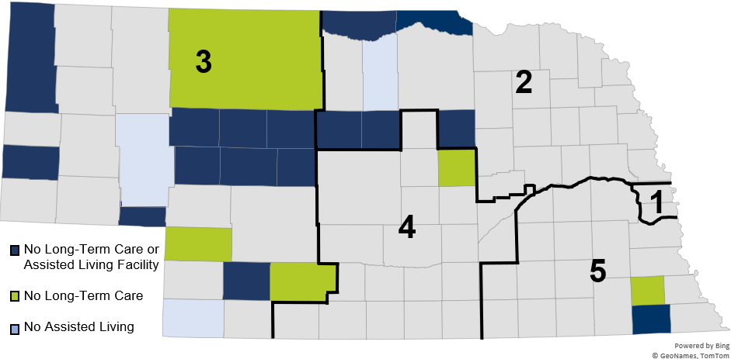
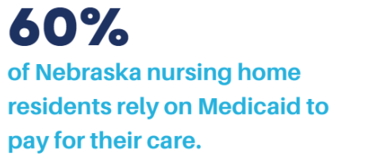
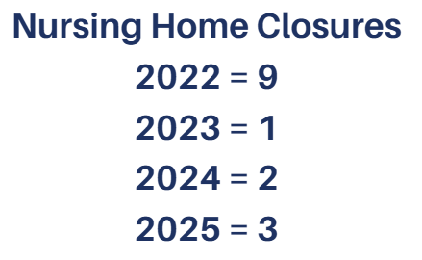
We are in Trouble…

Slide 76
We are in Trouble…
According to the 2023 Status of the Nebraska Healthcare Workforce Report…
47.8%
Physicians
50 +
22.4%
PAs
50 +
26.8%
APRNs
50 +
36.5%
RNs
50 +
11.6%
Physicians
65 +
2.4%
PAs
65 +
5.2%
APRNs
65 +
10.1%
RNs
65 +
https://www.unmc.edu/publichealth/_documents/healthcare-workforce-2024.pdf

Slide 77
Actionable Steps our Hospitals can Take
Join the Age-Friendly movement
Review the workforce initiatives to see if it’s feasible for your organization
Know and engage with your community – review your community benefits program
Gather data internally to identify opportunities for improvement
Integrate social determinants into your strategic and financial plans
Explore funding options to support your work
Establish measurement strategies and evaluation tools

Slide 78
FINAL NHA Updates

Slide 79
2026 Scholarship Opportunity
10 scholarships available for NAHQ Micro-Credentials
Deadline to submit December 10, 2025
Performance & Process Improvement
Health Data Analytics
Regulatory & Accreditation
Patient Safety
Quality Leadership & Integration
Professional Engagement
Quality Review & Accountability
Population Health & Care Transitions
Grab an application on your way out!

Slide 80
Mark your Calendars for 2026
Advocacy Day | Lincoln
March 4, 2026
Nursing Leadership Conference
TBD
Nebraska Rural Health Conference | Kearney
June 8-10, 2026
Annual Convention | Omaha
October 21-23, 2026
CAH/RHC Conference on Quality | Kearney
November 12-13, 2026

Slide 81
What to Expect after the Conference
CEU e-mail and evaluations will be sent early next week
Review scholarship opportunity
Plan to apply for QFE in 2026
Save the date for 2026 events

Slide 82
THANK YOU!
Safe Travels home!

