Slide 1
How to Stay Positive as a Quality Leader
And Why It is Important

Slide 2
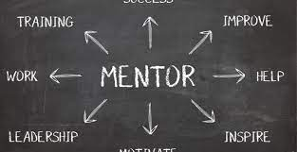
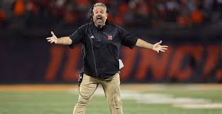
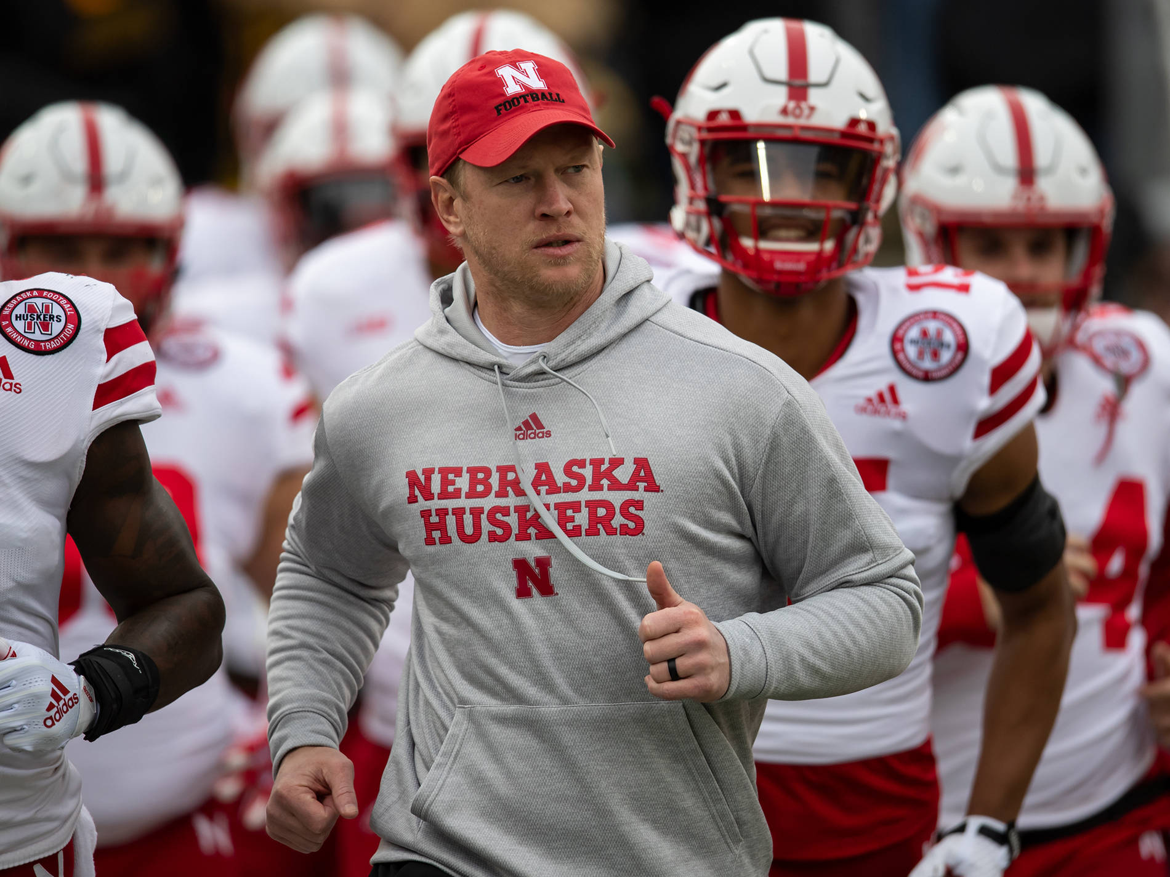
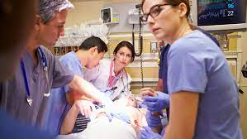
Notes:
Let’s talk about a day in the life of Quality- how many different roles do you have some days? Detective, Mentor, Coach, Cheerleader, Teacher, Data Analyst, Counselor, Front Line Nurse… we just never know what may come up for us!
And let’s not forget that we are Lifesavers: whenever we improve patient quality of care and patient safety, we are potentially saving a life!

Slide 3
Why is it easy to “get negative”?
It’s human nature!! Our brains are wired to be constantly scanning for threats, this is a survival tool.
Our brains are also wired to remember the threats (negative events and information) while quickly dismissing the positive.
Negative information= Brain like Velcro- it sticks!!
Positive information = Brain like Telflon- it slides off!
In our jobs, we spend a lot of time looking for and studying problems: process problems, workflow problems, communication problems: the list goes on…
Notes:
So- it’s easy to see how easy it is to “get negative” if we aren’t aware and intentional about our attitudes! Our “lizard brain” is a champion at watching for anything dangerous to our survival- constantly scanning for threats. We are wired to remember that negative information to keep use safe. So when the caveman falls into the fire, his brain remembers “fire hot- ouch- don’t fall in”!
When you are focused on problems most of the time, it is easy to let your brain be overloaded with the negative. SO- HOW DO WE COMBAT THIS??

Slide 4
BEGIN WITH THE END IN SIGHT!
What is YOUR vision as a Quality Leader??
Notes:
What is YOUR vision as a Quality Leader?

Slide 5
What does positive leadership look like? Take it from Frank P. Saladis, an expert in project management and leadership:
“Positive leadership is about establishing relationships, understanding other points of view, not always having the answer (or pretending to have the right answer), and creating an environment of creativity and innovation. The truly effective and positive leader is an observer, a mentor, a change agent, and someone who enables others to succeed” (2015).
Notes:
I like definitions- and I love this definition of Positive Leadership! Isn’t that a great vision to have as a Quality Leader: to be an observer, a mentor, a change agent, and someone who enables others to succeed?

Slide 6
Debbie Downer?
OR
Susie Sunshine?
Who would you rather work with??
If you think you are leading, but no one is following- you are just going for a walk
- Kevin Eikenberry
Notes:
Starting with the basics: be a Leader others want to follow!

Slide 7
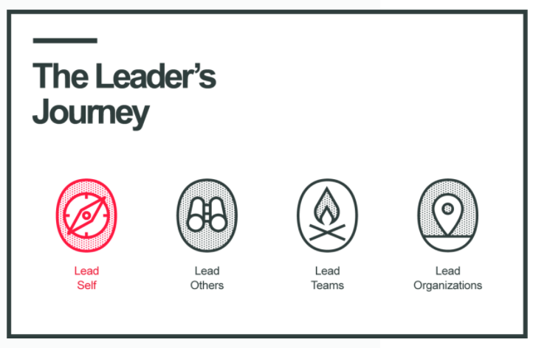
So- Why Is It Important to Stay Positive?
As a Quality Professional, you will be called on to lead groups of your staff through the process of improving: finding problems (opportunities!) and solutions.
Key Point: Before you can lead others, you must first lead yourself.
If you want your team to be positive, YOU need to be positive!
Notes:
I’ve seen many times where someone thinks they can just jump right in to “lead the organization”. But becoming a leader is a journey, not a destination- and it must begin with learning to lead yourself!

Slide 8
Your Attitude Is Contagious!
Positive teams are productive teams
Confident and supportive cultures are more COLLABORATIVE and CREATIVE and ultimately attract hard-working, talented people.
This kind of culture doesn’t just happen- it must be modeled and demonstrated.
COMMIT to a consistent positive attitude! It’s better for YOU and will have a marked influence on your team!
Notes:
Let’s talk about the Advantages of Positive Leadership. First and foremost, attitudes are CONTAGIOUS. I’m sure we all want to have teams that are collaborative, creative, hardworking and talented!

Slide 9
Enthusiasm Is Motivational
It’s true- you CAN drive people through fear and intimidation.
But why would you choose this route? People will only work hard enough to “stay off your radar”!
When you lead with a positive attitude in a supportive climate, people will go above and beyond what you ask. People who feel appreciated become more confident and productive.
POSITIVE ENTHUSIASM IS MOTIVATIONAL-there is no downside!
Notes:
Another advantage is that Enthusiasm is a great motivator. Raise your hand if you ever worked with someone who managed through fear and intimidation? How did that work for you and your organization? More effective to “catch them doing something right- and praise them”. Fear and intimidation is “extrinsic motivation”- it is only effective when the motivator is present. Leading by enthusiasm leads to intrinsic motivation- people perform because they WANT to! I always say “more carrot, less stick!”

Slide 10
Attitude Directs Our Relationships
Leaders lead people! So by definition, no leader is successful on their own. Achievements depend on relationships.
You can have all the leadership skills in the world, but if you are demanding and abrasive, you will have to work twice as hard to get half as far. You will have to use so much more of your energy just convincing people to follow you.
Positive people are like magnets. Good natured, confident leaders are not struggling to attract others to their vision. Others are happy to be on their team because they inspire trust and confidence. When you are positive, it is easier to build a network of advocates and champions.
Notes:
I think we can all agree that relationships are vital in many areas of our lives and leadership is no exception.
GROUP DISCUSSION: THINK ABOUT YOUR FAVORITE LEADERS AND COWORKERS OVER THE YEARS- WHY ARE THEY YOUR FAVORITE???
Think about your favorite leaders or coworkers over the years- what did they have in common? How did they make you feel? BE A MAGNET!! Creating a network of advocates and champions for quality- how awesome would that be!

Slide 11
Positivity Creates Resilience
The road to success in any endeavor is full of difficulties, obstacles, and challenges.
When you have an optimistic perspective, you are more likely to view these things as minor setbacks and not overwhelming morale killers.
The better your attitude, the quicker you rebound after a setback.
When your teams see your resilience, they feel braver and hardier themselves!
Notes:
How important is this right now? The pandemic has been a real test of our resilience; I can tell you that having a positive team that supports each other has been essential as we work day by day to provide great care at our hospital! As Izaak Walton said: “Good company in a journey makes the way seem shorter.”
BONUS: The NHA website has a whole page of resources on resilience; check it out!

Slide 12
Optimism Improves Problem Solving
When you run into an obstacle, how do you respond? The answer to that question has a lot to do with your outlook!
Negative people tend to brood and ruminate more, and this draws out the process of dealing with the hurdles.
Positive people tend to roll up their sleeves and start solving the problem!
OPTIMISM ALLOWS YOU TO SEE BEYOND THE PROBLEM AND RECOGNIZE POTENTIAL SOLUTIONS. Hopeful people are less likely to wallow in frustration and discouragement. They want to tackle challenges head-on, regain lost momentum, and move forward!
Notes:
Example: When a staff member calls in at the last minute and you can’t find a replacement- you are “working short”. Is your time better spent complaining about the person who called in, how hard you are going to have to work, etc, etc,- OR saying “if we were great today, what would great look like?- and putting a plan together?
Role play:
Staff Member 1: You know who called in again today!
Staff Member 2: COMMISERATES
Staff Member 1: You know who called in again today!
Staff Member/Courageous Leader: Wow, let’s figure this out! If we were great today, what would great look like???
Staff Member 1: Well, we could….

Slide 13
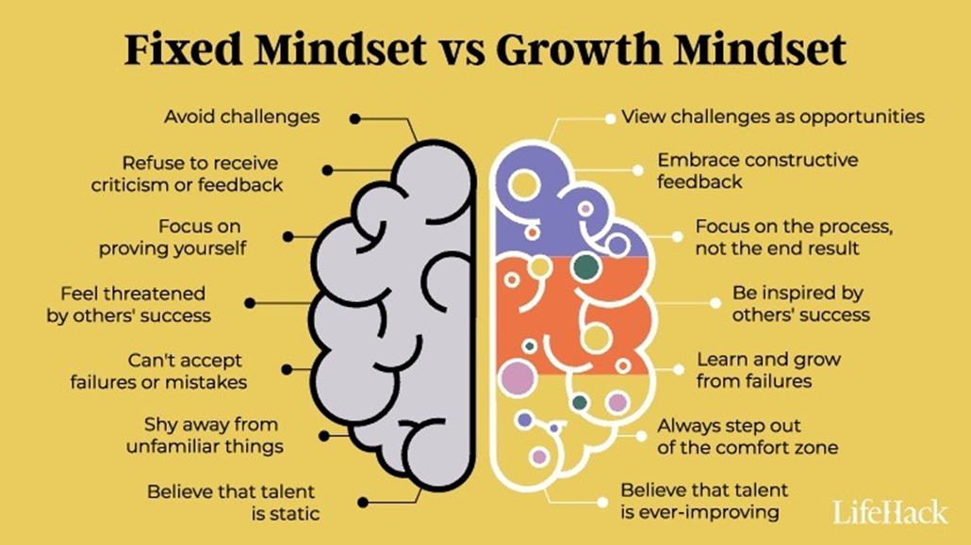

Slide 15
Does being positive mean ignoring problems?
Absolutely not!!
So, what DOES it mean?
Being Positive about yourself and your team
Being Positive about the finding potential solutions
Being Positive about finding the lesson in every problem
Notes:
Here’s a comment I have heard from time to time: Don’t you have to ignore or downplay problems in order to stay positive? Really people? Do you think that I am positive about patient falls, or pressure ulcers, or medication errors?- of course not!!
Positive Quality Leaders are NOT positive about problems- but they are positive about being able to find solutions!
I always say “ we hate it when bad things happen, so let’s never waste an opportunity to learn from them.” That’s the only way we can keep them from happening again.

Slide 16
YOUR ATTITUDE IS YOUR SUPERPOWER!!
Some people might have a natural disposition toward positivity, but even if you do not, you can still CHOOSE to become more positive.
SO- make a conscious choice to be a positive leader and reinforce your decision with inspiration to keep you motivated. You will be amazed how this can impact the progress you make in any project your team decides to take on!
Notes:
No all of us were born to be positive, some of us really have to work at it! Your second Superpower is networking with your peers! Sometimes just talking to others who are doing the same work and brainstorming on ideas is all it takes to bring your attitude up!

Slide 17
Strategies for Keeping a Positive Outlook:
Be Aware- of your self-talk and of your thoughts. Are they serving you?
Make a Choice- decide in advance that you will keep your outlook positive.
Take Care of Yourself- so basic and yet so often neglected! Stay hydrated, get enough
rest, eat a nutritious diet, move your body. It’s hard to have a positive outlook when
you don’t feel great!
Focus on the things you CAN control: this includes your thoughts and how your respond
to stress.
Develop a practice of gratitude.
Learn to ask GREAT questions and realize that you don’t have all the answers!
Assume positive intent.
Start every day- and every meeting- on a positive note. CELEBRATE EVERY WIN- EVEN THE SMALL ONES!
Avoid the “energy vampires”! If you must interact with them, don’t “absorb” their vibes!
Notes:
So, we’ve talked about how valuable a positive attitude can be. Now- how do you get and keep a positive attitude? CURIOSITY NOT JUDGEMENT! Positive intent- it seems like right now people are so quick to take offense and often there is no offense intended!! Example: someone bumps into you at Starbucks, they have a sour look on their face. What do you think? What you don’t realize is that it’s likely that what they did and how they looked had nothing to do with you- maybe they just got a phone call that their child is sick and they are rushing to get to the hospital? Give people GRACE whenever you can! It’s good for them, it’s good for you and it avoids unneeded drama!
Example of assuming positive intent?

Slide 18
10. Talk it out with a positive buddy.
Limit your diet of negativity from social media, TV shows, the news, etc.
Train yourself to find the lesson in every failure- and remember that failure is an
essential part of learning and change. If you are not failing, you are not trying!!
13. ALWAYS remember your “Big Why”- why you are doing this work and who is depending
on you to do it.
KEY POINT: It is one thing to KNOW the strategies, it is quite another to IMPLEMENT and USE them CONSISTENTLY!!
Notes:
Just being aware is the most important step. Find ways to bring yourself back up if we start to feel your lizard brain taking over. Keep a menu of ideas close by in case you need to review!
There are many other strategies that you could use, this list is just a start. What are your favorite ways to stay positive????

Slide 19
Do You Want to Learn How to Develop More Positivity??
Good Books to Read!!
1. Mindset- Carol Dweck
2. Learned Optimism- Martin Seligman
3. The Power of Positive Thinking- Dr. Norman Vincent Peale
4. Don’t Sweat the Small Stuff- Richard Carlson
5. The Happiness Advantage- Shawn Achor
6. Positivity- Barbara Erickson
7. Flourish- Martin Seligman
8. Emotional Agility- Susan David
Notes:
If you haven’t read any of these, definitely start with Mindset!
I included a couple of handouts for you- one is a little quiz to make you more aware of how you see the world. The other one is a fun little worksheet that goes along with a practice of gratitude, I think gratitude is one of the most powerful drivers of a positive attitude. I hope you enjoy them!
I also just received this awesome resource from one of our keynote speakers last week at the NHA Annual Conference. I have asked myself “which side of the card are you on” several times since then!

Slide 20
Shari Michl RN, CPHQ
Fillmore County Hospital Geneva, NE
smichl@myfch.org
402-759-3167
Notes:
On behalf of the NHA and all the patients served by Nebraska hospitals, thank you for doing this important work!! Call me anytime if you need some words of encouragement!

