Slide 1


Operating Margin Challenges and Opportunity Strategies

Slide 2
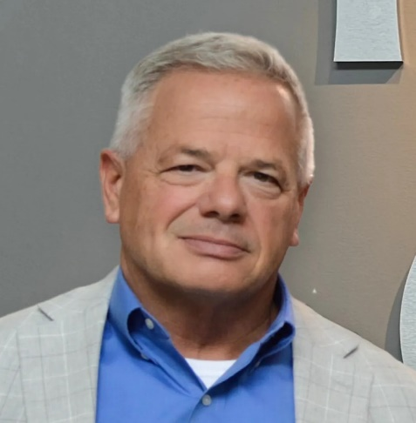
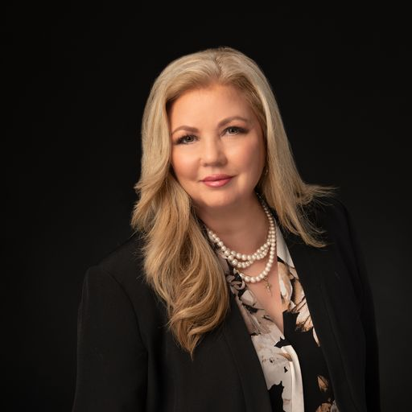
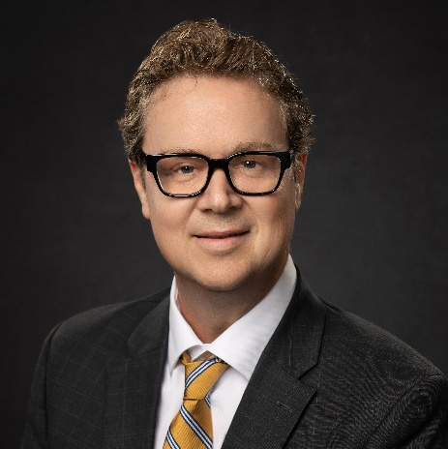
Your Speakers
Timothy Johnson
NHA Chief Financial Officer
Prior to his role with the NHA, Tim held senior advisory & management positions within industry-leading organizations such as Deloitte Consulting, Cerner, SCL Health and LifeLinc Anesthesia.
Val Howell, MBA, MSN, RN, NEA-BC
Michael Brown, CRCE, CHAM
National Clinical Operations Leader
National RCM Consulting Leader
Val provides Clinical Operations leadership with extensive experience in healthcare operational financial improvement. She has worked in the health care industry for over 25 years.
Michael Brown is the RSM National Revenue Cycle Consulting Leader, with extensive expertise in financial management and strategic initiatives within the health care industry.
Notes:
Michael to start

Slide 3



Health data & business intelligence
NHA Advisory services

Slide 4


Health Data & Business Intelligence Services
CEO Advisory Strategic Financial Planning
Board Summaries & Ops Dashboards CMS Organizational Transformations
CFO Advisory Targeted WISeR Model Audits
Chargemaster Coding Reviews & Updating
  Revenue Cycle Operations Support
  IT Implementations & AI Integration
  Service Line & Physician Performance
Patient Migration Studies
Utilization & Productivity Assessments
Monthly Financial Reporting
Annual Operating Budget Development
Quality / Nursing Board & Leadership Dashboards
Clinical Operational Assessments
Third-Party Outcomes Reporting
NE State & Federal Reporting
Marketing Internal/External Marketing & Assessments
Human Resources Productivity & Operational Assessments
Strategic Workforce Planning
$1,295 - $6,475 Annual Subscription Fees
Includes 8 to 40 Professional Fee Hours
Experienced & Unlimited Professional Resources
Value-Based % | Negotiated Fixed Fee | Time & Materials

Slide 5
Upcoming nha educational events

Slide 6







Upcoming NHA Revenue Cycle & Operations Events
Join Us For 3 Great Sessions!
The Medicare WISeR Model – Changing The World As We Know It
Monday, November 10th | 11:00a to 12:00p
Nebraska Rural Health Transformation Program Funding
Monday, November 17th | 11:00a to 12:00p
Upcoming NE Medicaid Changes – CAH Cost Report Impacts
Monday, December 8th | 11a to 12:00p
nebraskahospitals.org

Slide 7
Current State Challenges for Healthcare
Notes:
Michael to start

Slide 8







State of the Union 2026
Workforce Disruption and Financial Strategy: Staffing Smarter in Healthcare
  Increased use of scheduling predictive analytics and real time monitoring
  New labor shortage - anesthesiologists
  Agile staffing-Cross-training and cross-functioning is a must have
  Healthcare worker pipeline-not just for nurses
  Housing is an issue in rural communities
  Utilization of AI for efficiency for scheduling and staffing
  Employee wellness programs and focus
Shifting Payer Strategies and Consumer Behavior
  More than half of Americans state they will be cutting back on health care spending (Reuters,2025)
  Higher benefits and out-of-pocket costs for insured approximately 6-9% (Reuters,2025)
  Many payers opting out of Medicare Advantage plans in certain locations
  GLP1 impact to healthcare – increased pharmacy costs, decreased demand for bariatric surgery, dialysis, diabetes management
  Increased focus on chronic condition management and cancer care
Shift Toward Value & Efficiency, With Tech Accelerating Change
  More emphasis on value-based care models and procedures will be shifting towards outpatient settings where possible
  Digital health transformation is occurring including AI, remote monitoring, telehealth digital kiosk, rev cycle automation and clinical automation
  AI can be risky and costly
Workforce is suffering burnout and needs time off and guaranteed breaks. New regulations are appearing at the federal and state level
Increased out-of-pocket costs could lead to decreased low acuity volumes but increased higher acuity patients presenting to the ED and hospital
Technology can be leveraged to change the health care model to more virtual and hospital at home settings
RSM | 8

Slide 9



Operating margin improvement resource constraints experienced by many hospitals and health systems
Tools and resources to monitor progress (Tableau, Power BI)
Data Analysis
Skill set - organization, project management, knowledge of workstream
Bandwidth
Technical skills
Leadership accountability structures
RSM | 9

Slide 10
Traditional areas that provide opportunities for Operating Margin Improvement
Care Delivery Model
340 B Optimization
Numerous Services
Scheduling Efficiency
OR Block Utilization
Denials
Recruitment of staff
Market share for specialties
Provider Utilization
Supply cost
Write-offs
Clinical variation
Supply waste
High Cost Drugs
ACO Metrics
Medicare Wellness
Readmissions
Observation Analytics
Payment Variation
Cash Collections
Authorizations
Swing Bed Utilization
Preference card analysis
Pharmacy costs
Automation Opportunities
RSM | 10

Slide 11
Alignment of Services to Community Needs and Changing Demographics
Notes:
Michael to start

Slide 12
Community Needs Assessment
Every three years, CAHs (like other nonprofit hospitals) conduct CHNAs to identify local health priorities.
They gather input from residents, local agencies, and health departments, helping to align services with the actual needs (e.g., aging populations, chronic disease prevalence, mental health needs).
The findings often shape service expansion (like adding telehealth or wellness programs) or partnerships with other provider

Slide 13
Leveraging Technology and Data Tools
🌐 3. Leveraging Telehealth and Digital Tools
To overcome geographic barriers and meet consumer demand for convenience, CAHs:
Partner with larger systems to provide tele-specialty consults (e.g., cardiology, psychiatry).
Use remote patient monitoring for chronic diseases.
Offer virtual visits to maintain access while reducing travel burdens.

Slide 14

Aligning with Consumer Expectations
Modern healthcare consumers value accessibility, transparency, and personalization, so CAHs adapt by:
Offering online scheduling and patient portals.
Promoting preventive and wellness programs rather than just acute care.
Enhancing the patient experience (e.g., shorter wait times, better communication, community outreach).

Slide 15
Collaboration and Partnerships
Data-Driven Decision Making
Use of local health data, claims data, and electronic health record analytics helps identify service gaps and utilization trends.
For example, an increase in ER visits for behavioral health might lead to investment in crisis stabilization services.
Collaboration and Partnerships with local businesses, schools and community centers
CAHs often form alliances with regional hospitals, public health departments, and universities to share resources and specialists.
They may join accountable care organizations (ACOs) or clinically integrated networks to improve care coordination and financial sustainability.

Slide 16




Leverage Telemedicine and Virtual Care
Extend specialty coverage and convenience of appointments for patients
Alignment of Workforce and Resources
Share Resources
Share equipment, technology, purchasing coalitions and administrative functions across regional partners
Cross train/function staff
Staff can be cross trained to perform multiple roles or “helping hands” to account for fluctuations in volumes and acuity
Seek creative funding courses
Seek grants funding, 340 B pharmacy optimizations, foundation and state/federal support for critical service sustainability

Slide 17
The Clinical / Revenue Cycle Connection
Notes:
Michael to start

Slide 18

Clinical Revenue Cycle Integration
Charge Capture
Understand your charge triggers and any external system integration
Strategic Partnership
Empower your providers with information and feedback regarding their individual and department contribution to the financial health of the organization.
Documentation Accuracy
Invest in ongoing feedback and education to providers to support accuracy of severity capture.
Denial Avoidance
Leverage a multi-disciplinary team that includes clinical and revenue cycle representatives to stay on top of changes in payer behavior
Documentation Timeliness
Empower providers with technical solutions that reduce administrative burden and support timely completion

Slide 19
Market Analytics
Increase revenues by growing services
Increase revenues by better referral management
Notes:
Michael to start

Slide 20

Market Analytics
Should I buy an orthopedic surgery group?
Where should I invest?
What providers should I hire or collaborate with?
Should I build an ambulatory surgical center?
To answer these types of questions, we leverage claims data
For patients in my geography who go to other health systems, what specialists are they seeing? What procedures?
When my doctors refer to other providers, what specialists do they refer to?
How many orthopedic surgeries are performed in my area? What ancillary services are received?
RSM | 20

Slide 21
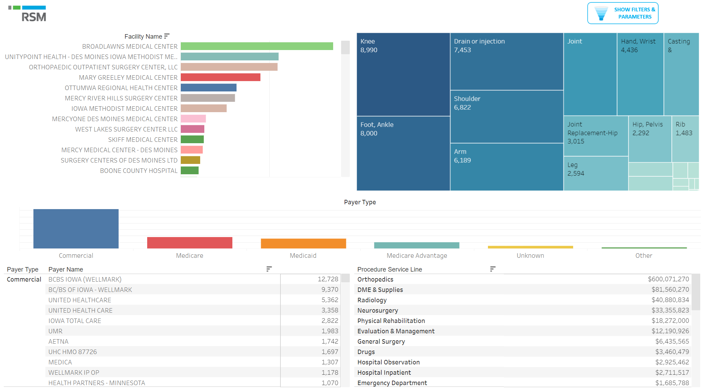
Market Analytics
RSM | 21

Slide 22
Execution and Implementation
Increase revenues by growing services
Increase revenues by better referral management
Notes:
Michael to start

Slide 23





C-Suite Operating Margin Opportunities –
Daily Practice
Data, data and more data-is it meaningful? RSM utilizes “guided data”
Weekly executive meetings to ensure transparency and accountability
Need to spend time on growth, not just putting out daily fires
Identification of opportunities needs to be a collaborative approach
Prioritize projects that are low effort/high impact “low hanging fruit” first
RSM | 23

Slide 24

How outside support can boost successful results in margin improvement and transformation projects
Unbiased approach and deep industry experience
Political roadblock navigation
High level project management and accountability structures
Data guided recommendations
Monitoring of results
Advanced technology capabilities
Automation recommendations
Provides bandwidth that organizations may not necessarily have
RSM | 24

Slide 25
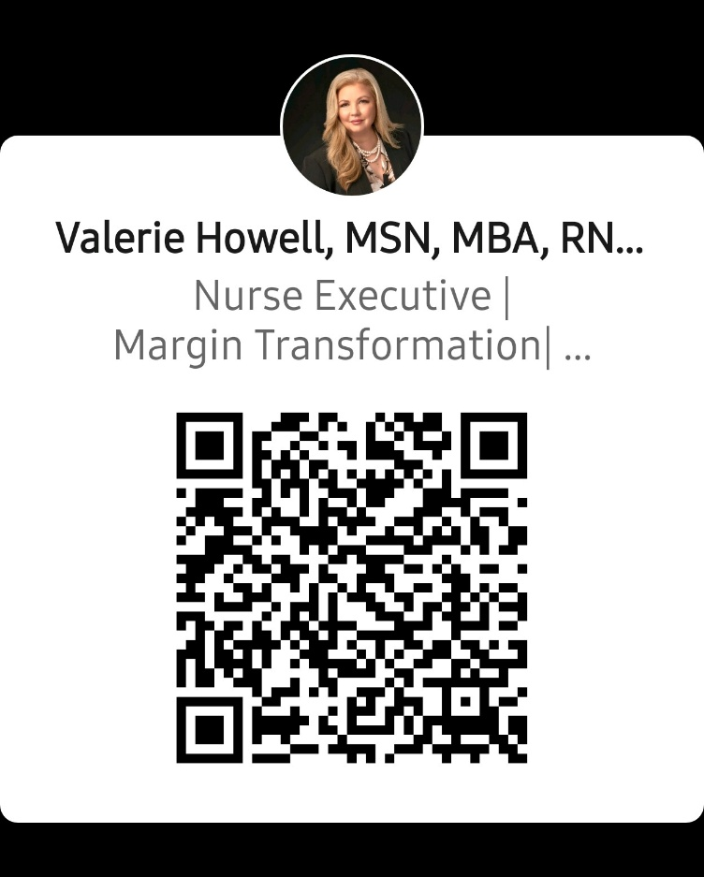
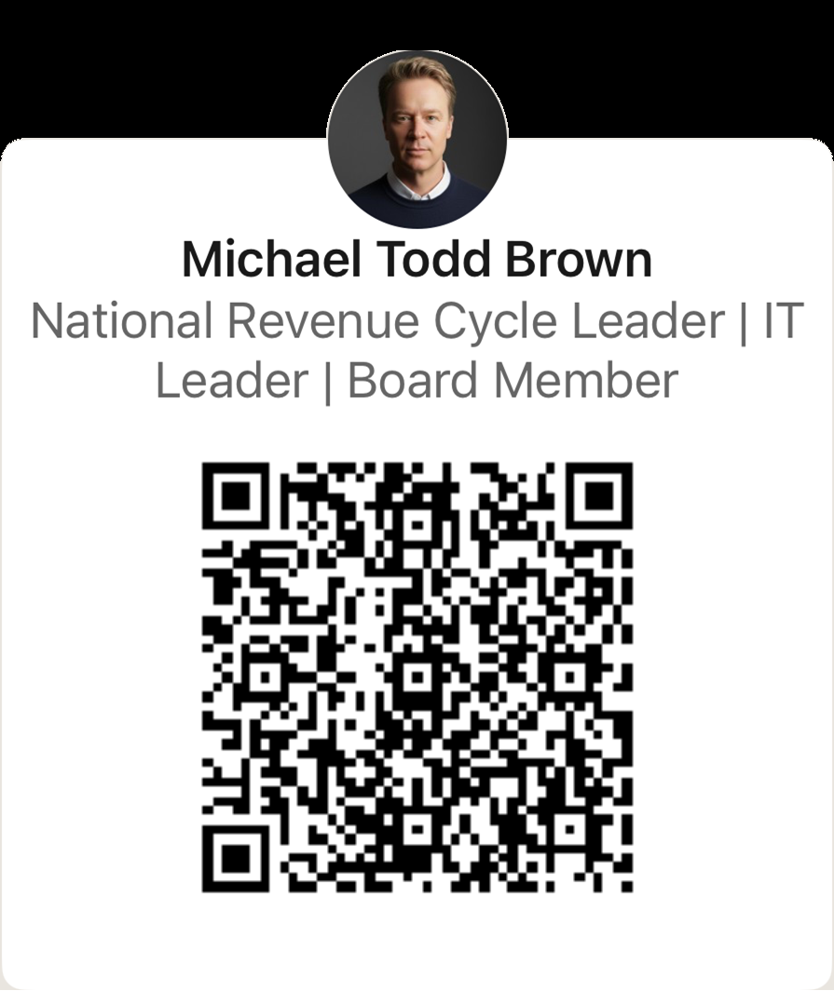
Contract Us on LinkedIn
Thank you for your most valuable asset
– YOUR TIME
Valerie Howell
Valerie.Howell@rsmus.com
Michael Brown
Michael.Brown@rsmus.com
Notes:
Michael to start

Slide 26

This document contains general information, may be based on authorities that are subject to change, and is not a substitute for professional advice or services. This document does not constitute assurance, tax, consulting, business, financial, investment, legal or other professional advice, and you should consult a qualified professional advisor before taking any action based on the information herein. RSM US LLP, its affiliates and related entities are not responsible for any loss resulting from or relating to reliance on this document by any person. Internal Revenue Service rules require us to inform you that this communication may be deemed a solicitation to provide tax services. This communication is being sent to individuals who have subscribed to receive it or who we believe would have an interest in the topics discussed.
RSM US LLP is a limited liability partnership and the U.S. member firm of RSM International, a global network of independent assurance, tax and consulting firms. The member firms of RSM International collaborate to provide services to global clients, but are separate and distinct legal entities that cannot obligate each other. Each member firm is responsible only for its own acts and omissions, and not those of any other party. Visit rsmus.com/aboutus for more information regarding RSM US LLP and RSM International.
RSM, the RSM logo and the power of being understood are registered trademarks of RSM International Association.
© 2023 RSM US LLP. All Rights Reserved.

